Slide 1

Overview of Project Management
Chapter 1
Prepared by/ Dr. Walaa Mohamed
Everyone’s Smart
University
PMG101
Foundations of Project Management

Slide 2

Why Studying Project Management Course?
A project management course equips you with strong planning abilities, including the capacity to set clear goals and realistic objectives, along with a schedule with specific stages to achieve the project goals. Budgeting, time frames, and resource estimates are typically covered by project management course. You’ll learn skills for not only setting goals for achievement within a realistic budget and time, but also for reviewing and vetting costs and resource estimates.

Slide 3

Learning Objectives
Defining project and its attributes.
Key constraints within which a project must be managed.
Difference between Routine work (regular operations) and Project.
Know different concepts of project management.
Why project management.
Know about Project Manager and his responsibilities .
Understand Selection of a Project Manager.
Know about Characteristics of Project Management Team.
Know about the phases of Project Management .
Understand Project Environment.
The 7S of Project Management .

Slide 4
What is a project?
A project is a group of unique, interrelated activities that are planned and executed in certain sequence to create a unique product or service, within a specific time frame, budget and the client’s specifications.
A project is a temporary endeavor undertaken to create a unique product, service or result.
Temporary means: A Project is a one-off event and not an ongoing operation It has a definite beginning and a definite end.
The end is reached when:
The project’s objectives have been achieved.
When it becomes clear that the project objectives will not or cannot be met.
The need for the project no longer exists and the project is terminated.

Slide 5
Attributes of a Project
A Project is a planned set of activities.
A Project has a specific scope.
A Project has time, cost, quality and resource constraints.
Has a well-defined objective.
Has a defined life span with a beginning and an end.
Involves doing something unique.
Has a customer.
Involves a degree of uncertainty.

Slide 6

Examples of Projects
Construction of a hospital.
Writing a book.
Designing and implementing a computer system.
Introducing a new product in the market.
Construction of a new bridge over a river.
Designing and producing a brochure.
A Politician contesting an election.
Building a dam.
Organizing a seminar.

Slide 7
Difference between project and routine work
Project
One time
Use of wide variety of skills
Use of special purpose equipment for short duration
No revenue during
Project stages
Routine work
Repetitive
Limited Skills
Equipments are in continuous use
Revenues are there

Slide 8
Comparison of Routine Work with Projects
Routine, Repetitive Work
Taking class notes.
Responding to a supply-chain request.
Day to day process of painting cars in an assembly plant.
Routine manufacture of an Apple iPod.
Projects
Writing a term paper.
Developing a supply-chain information system.
Installing robots to paint cars in an assembly plant.
Designing an iPod that is approximately 2 X 4 inches, interfaces with PC, and
stores 10,000 sound records.

Slide 9
Definitions of Project Management
Project management is the discipline of organizing and managing resources (money, people, time, space, etc.) in such a way that these resources deliver all the work required to complete a project within defined scope, time, and cost constraints.
It is the application of knowledge, skills, tools and techniques to a broad range of activities in order to meet the requirements of the particular project.
The planning, control and coordination of all aspects of a project, and the motivation of all those involved in it, in order to achieve the project objectives.

Slide 10
History of Project Management
As a discipline, Project Management developed from several different fields of application, including construction, mechanical engineering, military projects, etc. In the United States, the forefather of project management is Henry Gantt, called the father of planning and control techniques, who is famously known for his use of the “bar” chart as a project management tool, for being an associate of Frederick Winslow Taylor’s theories of scientific management, and for his study of the work and management of Navy ship building.

Slide 11
Why project management has existed?
Project Management has emerged because the characteristics of our turn-of-the-century society demand the development of the new methods of management. Of the many forces involved, three are paramount:
The exponential expansion of the human knowledge.
The growing demand for a broad range of complex, sophistical, customized goods and services.
3. The evolution of worldwide competitive markets for the production and consumption of goods and services.

Slide 12
Functions of Project Manager
Project manager should be an HRD (human resource development) expert to motivate the workforce and avoid any conflict between the management and the workforce.
The functions are as follows:
1. Developing a unique product or process and manage change.
2. Identification of the need for project.
3. Finding different alternatives of the project.
4. Developing a plan of action.
5. Training operators.
6. Establishment of quality assurance cell to control quality.

Slide 13
7. Incorporation of changes as and when needed while implementing project.
8. Selection of suitable equipment.
9. Finding suitable financial resources.
10. Assessment of alternatives and obtaining approval to proceed.
11. Measuring performance of the project.
12. Transfer of material, funds and settling all accounts after completion of project.
13. Monitoring progress and reporting to higher authorities.
14. Closing all records, submission of final report and transfer of responsibility after
completion of specified project.

Slide 14
Selection of a Project Manager
The Selection of Project Manager depends on following points:
Problem Solving Skills
Personal Leadership Style
Organizational Experience
Skills and Knowledge
Project Management Experience

Slide 15
Project Management Team Characteristics
They must be technically competent.
Senior members of the project team must be politically sensitive.
Members of the project team need a strong problem orientation.
Team members need a strong goal orientation.
Project workers need high self-esteem.

Slide 16
Figure 1.1: Project Management in Six Phases, with the Central Theme of Each Phase
Initiation phase: Idea
Definition phase: What?
Design phase: How?
Development phase: How to implement?
Implementation phase: Implementation
Follow-up phase: maintenance

Slide 17

1. Initiation Phase
The initiation phase is the beginning of the project. In this phase, the idea for the project is explored and elaborated. The goal of this phase is to examine the feasibility of the project. In addition, decisions are made concerning who is to carry out the project, which party (or parties) will be involved and whether the project has an adequate base of support among those who are involved.
2. Definition Phase
In this phase, the requirements that are associated with a project result are specified as clearly as possible. This involves identifying the expectations that all of the involved parties have regarding the project result.

Slide 18

3. Design Phase
The list of requirements that is developed in the definition phase can be used to make design choices. In the design phase, one or more designs are developed, with which the project result can apparently be achieved. The project supervisors use these designs to choose the definitive design that will be produced in the project. Once the design has been chosen, it cannot be changed in a later stage of the project.
4. Development Phase
During the development phase, everything that will be needed to implement the project is arranged. Potential suppliers or subcontractors are brought in, a schedule is made, materials and tools are ordered, and instructions are given to the personnel and so forth. The development phase is complete when implementation is ready to start. All matters must be clear for the parties that will carry out the implementation.

Slide 19
5. Implementation Phase
The project takes shape during the implementation phase. This phase involves the construction of the actual project result. Programmers are occupied with encoding, designers are involved in developing graphic material, contractors are building, and the actual reorganization takes place. It is during this phase; the project becomes visible to outsiders. The implementation phase is the doing phase.
6. Follow-up Phase
During this phase, everything is arranged that is necessary to bring the project to a successful completion. Examples of activities in the follow-up phase include writing handbooks, providing instruction and training for users, setting up a help desk, maintaining the result, evaluating the project report, holding a party to celebrate the result that has been achieved, transferring to the directors and dismantling the project team.

Slide 20
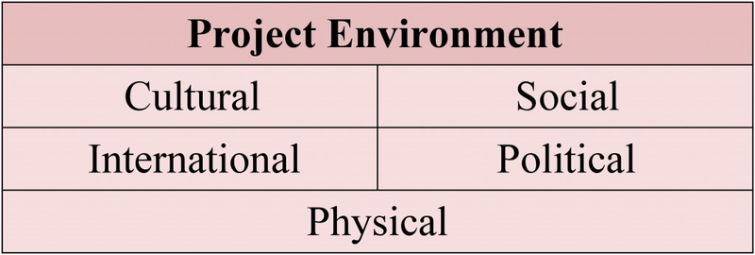
Project environment
The project environment is made up of internal and external factors that influence a project. When managing a project, the project manager must consider more than just the project itself. Proactively managing a project involves understanding the environment in which the project must function.

Slide 21
The McKinsey 7S Framework
This model is a tool for managerial analysis and action that provides a structure with which to consider the company as a whole, so that the organization’s problems may be diagnosed, and a strategy maybe developed and implemented.
Developed in the early1980s by Tom Peters and Robert Waterman, two consultants working at the McKinsey company which is global management consulting firm, the basic premise of the model is that there are seven internal aspects of an organization that need to be aligned if it is to be successful.
The 7S model can be used in a wide variety of situations where an alignment perspective is useful to:
1) Improve the performance of a company
2) Examine the likely effects of future changes within a company;
3) Align departments and processes during a merger or acquisition; or
4) Determine how best to implement a proposed strategy.

Slide 22
Where 7S model can be used?
To improve the performance of a company,
To examine the likely effects of future changes within a company,
To align departments and processes,
To determine what is the best way to implement a proposed strategy.

Slide 23
The Seven Elements
Hard elements | Soft elements
Strategy | Shared values
Structure | Skills
Systems | Style
 | Staff
"Hard" elements are easier to define or identify and management can directly influence them: These are strategy statements; organization charts and reporting lines; and formal processes and IT systems.
"Soft" elements, on the other hand, can be more difficult to describe, and are less tangible and more influenced by culture. They are harder to change directly and take longer time to change. However, these soft elements are as important as the hard elements if the organization is going to be successful.

Slide 24
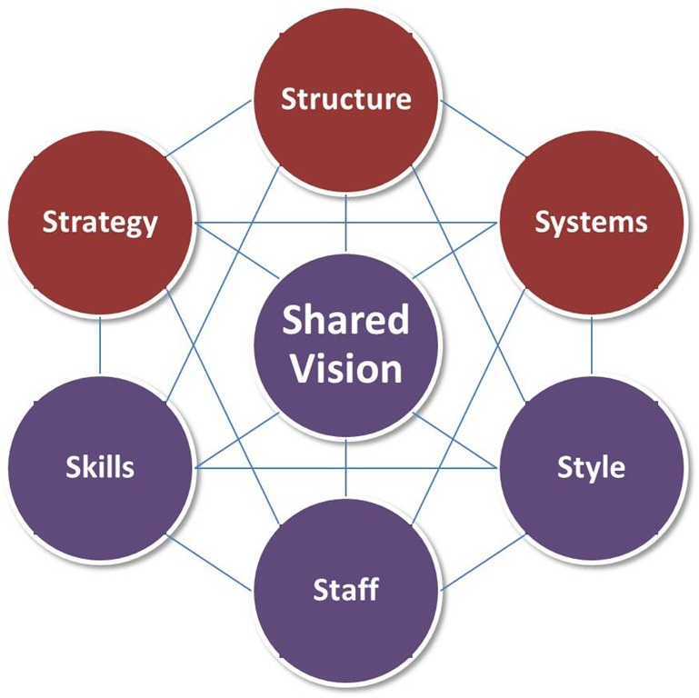
The key point of the model is that all the seven areas are interconnected and a change in one area requires change in the rest of them for it to function effectively.

Slide 25
Strategy: the plan devised to maintain and build competitive advantage over the competition.
Structure: structures describe the hierarchy of authority and accountability centralized, functional divisions (top-down); decentralized (the trend in larger organizations); matrix, network, holding, etc. These relationships are frequently diagrammed inorganization charts.
Systems: the daily activities and procedures that staff members engage in to get the job done.
Shared Values: these are the core values of the company that are evidenced in the corporate culture and the general work ethic.
Style: the style of leadership adopted.
Staff: the employees and their general capabilities.
Skills: the actual skills and competencies of the employees working for the company.

Slide 26

Apple Inc
Shared Values - business is aligned around the values of design and user experience.
Strategy - focus on a small number of products and to make them innovative and excellent – enabling the business to capture a huge market share relative to its size, and build a loyal customer following.

Slide 27

Staff - offers their employees huge benefits.
Skills - highly qualified and creative employees.
Systems - supply chain with built capacity for launching and supplying huge new market-dominating products.
Style - people are free to innovate – as long as they met Jobs’ high standards.
Structure- Apple Inc. has a hierarchical organizational structure, with notable divisional characteristics.

Slide 28
Choose the correct answer
1. The basic nature of a project is a _____ one.
(A) permanent
(B) temporary
(C) (A) or (B)
(D) Both (A) and (B)
2. Which from the following statement(s) is/are NOT true?
I. Projects have defined objectives
II. Members of the project team need a strong problem orientation.
III. Projects generate revenue during its management phases.
(A) I only
(B) II only
(C) III only
(D) II and III only

Slide 29
3. Assembling project team and assigning their responsibilities are done during which phase of a project management?
(A) Initiation
(B) Design
(C) Development
(D) Implementation

Slide 30

Thank you for your attention!

