Slide 1


Research Project –
Introductory Lecture
Prepared by
Associate Professor. Ahmed Rageh Ismail
ENT636
Research Project
Lecture 1

Slide 2


Chapter
Learning outcomes
01
By the end of this chapter you should:
be able to explain the nature of research;
be able to outline the features of business and management research;
be able to place your research project on a basic–applied research continuum according to its purpose and context;
understand the stages you will need to complete (and revisit) as part of your research process;

Slide 3
Chapter
The nature of research
01
When watching the television or reading the news it is difficult to avoid the term ‘research’. The results of ‘research’ are all around us.
Daily news report the research findings of academics’ and organisations. Documentary programmes tell us about ‘research findings’ and advertisers may highlight the ‘results of research’ to encourage you to buy a particular product or brand.
However, we believe that what these examples really emphasise is the wide range of meanings given to the term ‘research’ in everyday speech.

Slide 4
Chapter
The nature of research
01
Many of these everyday uses of the term ‘research’ are not research in the true meaning of the word. As part of this, he highlights ways in which the term is used wrongly:
just collecting facts or information with no clear purpose;
reassembling and reordering facts or information without interpretation;
as an activity with no or little relevance to everyday life;
as a term to get your product or idea noticed and respected.

Slide 5
Chapter
The nature of research
01
The first of these highlights the fact that, although research often involves the collection of information, it is more than just reading a few books or articles, talking to a few people or asking people questions.
While collecting data may be part of the research process, if it is not undertaken in a systematic way and without a clear purpose, it will not be seen as research.

Slide 6
Chapter
The nature of research
01
The second of these is commonplace in many reports. Data are collected, perhaps from a variety of different sources, and then assembled in a single document with the sources of these data listed without any explanation of what the data means.
In other words, there is no interpretation of the data collected. Again, while the assembly of data from a variety of sources may be part of the research process, without interpretation it is not research..

Slide 7
Chapter
The nature of research
01
The third emphasises, how despite research often appearing abstract, it influences our daily lives and creates our understanding of the world.
Finally, the term ‘research’ can be used to get an idea or product noticed by people and to suggest that people should have confidence in it. In such instances, when you ask for details of the research process, these are either unclear or not forthcoming.

Slide 8
Chapter
The nature of research
01
Based upon this brief discussion we can already see that research has a number of characteristics:
The purpose, to find out things, is stated clearly.
The data are collected systematically.
The data are interpreted systematically.
We can therefore define research as a process that is undertaken in a systematic way with a clear purpose, to find things out. Two phrases are important in this definition: ‘systematic way’ and ‘to find out things’. ‘Systematic way’ suggests that research is based on logical relationships and not just beliefs ( Ghauri and Grønhaug 2010 ).
As part of this, your research will involve an explanation of the method or methods used to collect the data, will argue why the results obtained are meaningful and will explain any limitations that are associated with them

Slide 9
Chapter
The nature of research
01
To find out things’ suggests there are a multiplicity of possible purposes for your research. It is therefore an activity that has to be finished at some time to be of use.
This will undoubtedly be true for your research project, which will have a specific deadline. Purposes are often stated as describing, explaining, understanding, criticizing and analyzing.
Crucially, it also emphasizes you have a clear purpose or set of ‘things’ that you want to find out, such as the answer to a question or number of questions.

Slide 10
Chapter
Business and management research
01
Using our earlier definition of research we can define business and management research as undertaking systematic research to find out things about business and management.
Two features, which have gained considerable support, are the transdisciplinary nature of such research and its relevance to or impact on business and management practice.
The former of these emphasize that management research also draws on knowledge from other disciplines such as sociology, psychology and economics which have differing underlying assumptions. In other words, using knowledge from a range of disciplines enables management research to gain new insights that cannot be obtained through using these disciplines separately.

Slide 11
Chapter
Business and management research
01
The second ‘relevance’ or ‘impact’ feature of management research highlighted in the debate is a belief that it should have the potential for some form of practical consequences.
In other words it should be relevant to and have the potential to impact upon business and management practice. Here it has been argued that such research should complete a virtuous circle of theory and practice through which research on managerial practice informs practically derived theory.
This in turn becomes a blueprint for managerial practice, thereby increasing the stock of relevant and practical management knowledge.

Slide 12
Chapter
Business and management research
01
A useful four-fold taxonomy for considering rigour and relevance in relation to managerial knowledge. Using the dimensions of theoretical and methodological rigour, and of practical relevance. They identify four quadrants.
Theoretical rigour refers to the clarity and thoroughness with which the research as reported is grounded in existing explanations of how things work.
Although part of the same dimension, methodological rigour refers to the strength and quality of the research method used in terms of the planning, data collection, data analysis, and subsequent reporting; and therefore the confidence that can be placed in the conclusions drawn

Slide 13
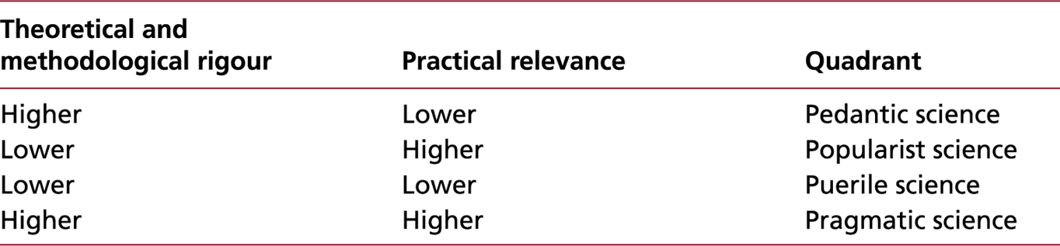
Chapter
A taxonomy for considering the 'relevance gap' in relation to managerial knowledge
01

Slide 14
Chapter
Business and management research
01
Pedantic science is characterised by a focus on increasing methodological rigour at the expense of results that are relevant. This can sometimes be found in refereed academic journals.
In contrast, popularist science is characterised by a focus on relevance and usefulness while neglecting theoretical and methodological rigour, examples being found in some books targeted at practising managers. Consequently, while findings might be useful to managers, the research upon which they are based is unlikely to be valid or reliable.
Puerile science both lacks methodological rigour and is of limited practical relevance and, although unlikely to be found in refereed academic journals, can be found in other media.
Finally, pragmatic science is both theoretically and methodologically rigorous and relevant.

Slide 15
Chapter
Business and management research
01
The separation of knowledge producers from knowledge users. This has introduced a schism, or what is called the ‘relevance gap’, which has been the subject of considerable debate for decades.
Ways of closing this prevailing ‘research–practice gap’ is the virtues of ‘evidence-based management’, which derives principles from research evidence and translates them into practices that solve organisational problems.
Research findings do not appear to have transferred well to the workplace. Instead of a scientific understanding of human behaviour and organisations, managers, including those with MBAs, continue to rely largely on personal experience, to the exclusion of more systematic knowledge.

Slide 16
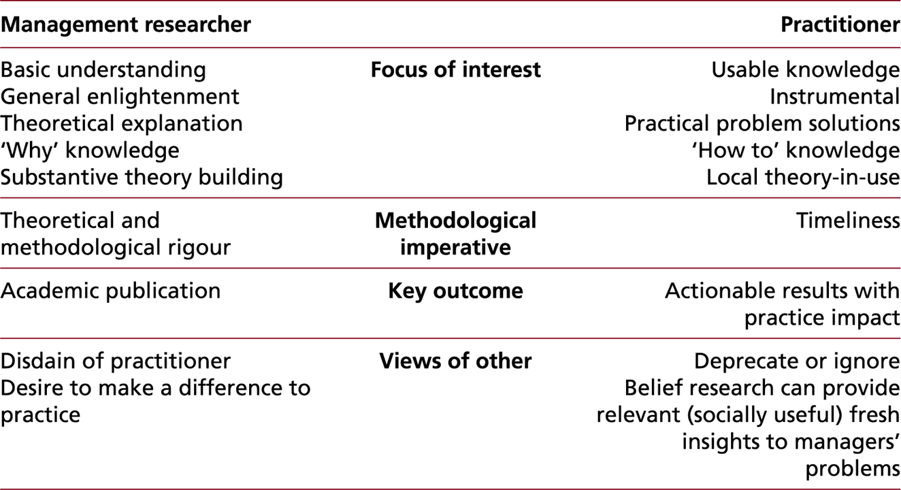
Chapter
Practitioners and management researcher orientations
01

Slide 17
Chapter
Business and management research
01
More recently, debate has focused on the impact of management research and, in particular, for whom, how and when this is created.
Researcher have argued that research’s impact is about the influence that it exerts on practice on both those engaged with academia (students, academics, practitioners) and those engaged in policy and practice communities such as professional bodies.
New knowledge from research will result in, for example, new theories, models and frameworks, research agendas, methodologies and new curricula. This is likely to act over time in one or more of four interrelated realms: changing ideas, influencing others, changing practice and changing self. The last of these highlights how you are likely to be shaped by your own research experiences.

Slide 18
Chapter
Business and management research
01
Consequently, although increasing knowledge in a systematic way, the purpose and
the context of research project can differ considerably. For some research projects
the purpose may be to understand and explain the impact of something, such as a particular
policy. Researcher may undertake this research within an individual organisation and
suggest appropriate action on the basis of your findings.
For other research projects researcher may wish to explore the ways in which various organisations do things differently. In such projects the purpose may be to discover and understand better the underlying processes in a wider context, thereby providing greater understanding for practitioners.

Slide 19
Chapter
Business and management research
01
Despite this variety, all business and management research projects can be placed on the continuum below according to their purpose and context

Slide 20
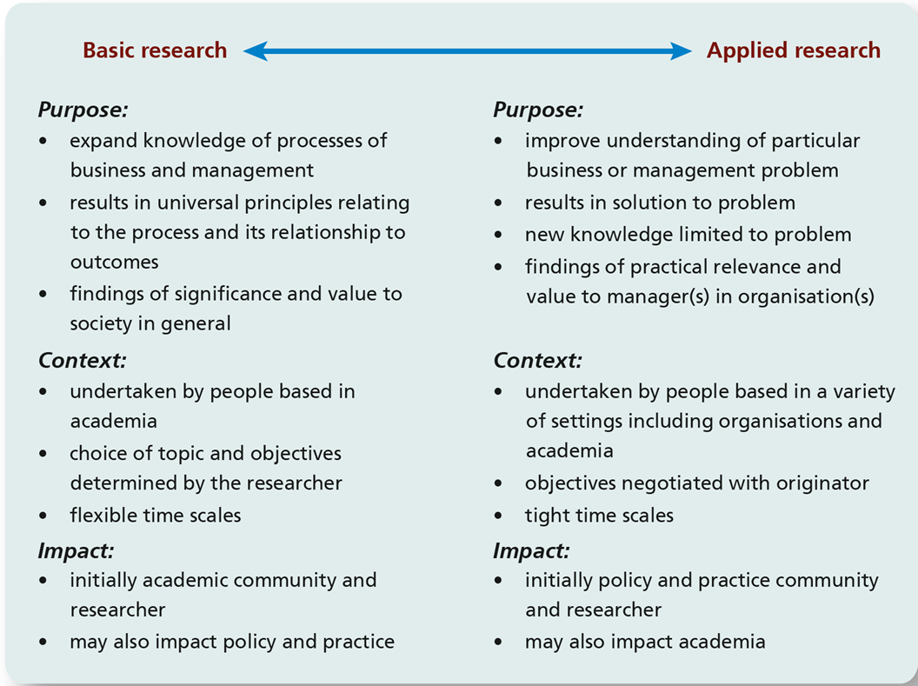

Slide 21
Chapter
Business and management research
01
At one extreme of the continuum is research that is undertaken purely to understand the processes of business and management and their outcomes.
Such research is undertaken largely in universities and largely as the result of an academic agenda. Its key impact is within the academic community, with relatively little attention being given to relevance to or impact on practice.
This is often termed basic, fundamental or pure research and, although the focus may not have been on practical or commercial value, the resultant model may be of considerable utility having impact in both academic and practitioner communities.

Slide 22
Chapter
Business and management research
01
Through considering the practical consequences, the research would start to move towards the other end of the continuum. At this end is research that is impactful for practitioner communities being of direct and immediate use to managers, addresses issues that they see as important, and is presented in ways that they understand and can act on.
This is termed applied research . It can be very similar to consultancy, particularly when the latter is conducted in a thorough manner.

Slide 23
Chapter
Example on the value of research
01
Barney’s (1991) article explaining the resource-based view of the firm published
in the Journal of Management. It is argued that Barney’s article provides an example of how
basic research can have considerable practical value.
It is noted how Barney’s article made the ideas of the resource-based view of the firm clear and usable to many management scholars; offering evidence of its utility in terms of the thousands of citations (the citation count according to Google Scholar was 97,066 at the time this chapter is written!

Slide 24
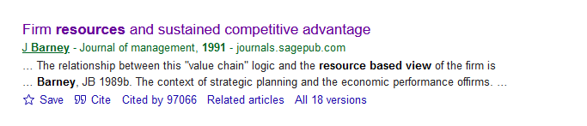

Slide 25
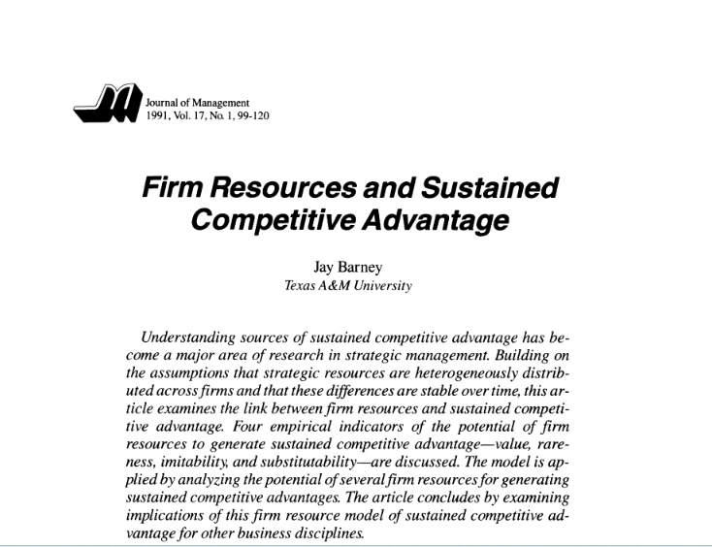

Slide 26
Chapter
The research process
01
Its wide use in textbooks, its wide use in applied research and publications as well as in the development and delivery of management development programmes.
Building upon this, it is argued that such basic research enhances the value of subsequent applied research and provides content for curricula.

Slide 27
Chapter
The research process
01
Most research textbooks represent research as a multi-stage process that you must follow in order to undertake and complete your research project.
The precise number of stages varies, but they usually include formulating and clarifying a topic, reviewing the literature, designing the research, collecting data, analysing data and writing up.
In the majority of these the research process, although presented with rationalised examples, is described as a series of stages through which you must pass.

Slide 28
Chapter
The research process
01
Articles you have read may also suggest that the research process is rational and straightforward.
Unfortunately this is very rarely true, and the reality is considerably messier, with what initially appear as great ideas sometimes having little or no relevance.
While research is often depicted as moving through each of the stages just outlined, one after the other, this is unlikely to be the case.

Slide 29
Chapter
The research process
01
In reality some stages will overlap and you will probably revisit each stage more than once.
Each time you revisit a stage you will need to reflect on the associated issues and refine your ideas.

Slide 30
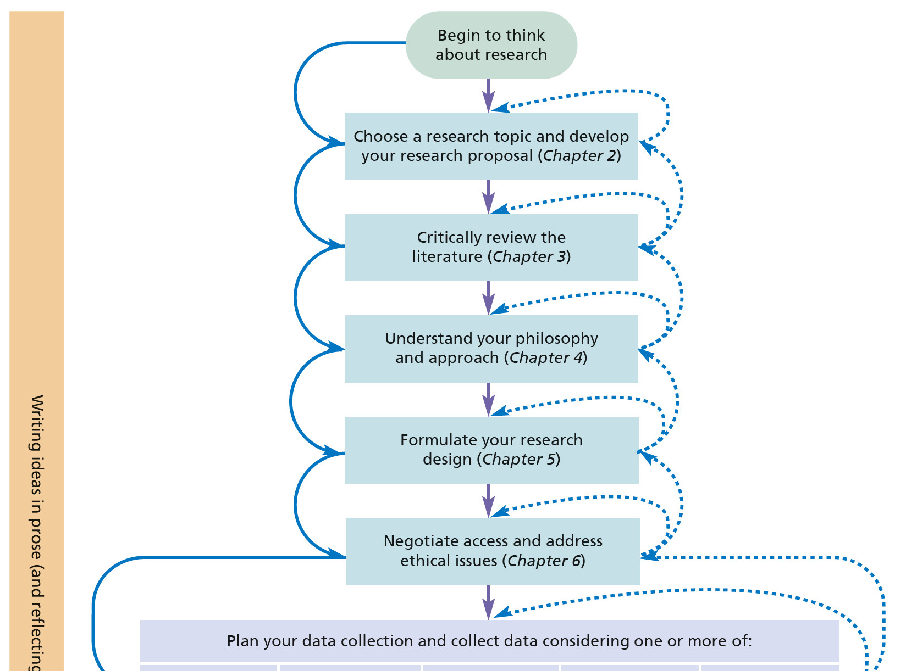
Chapter
The research process (1 of 2)
01

Slide 31
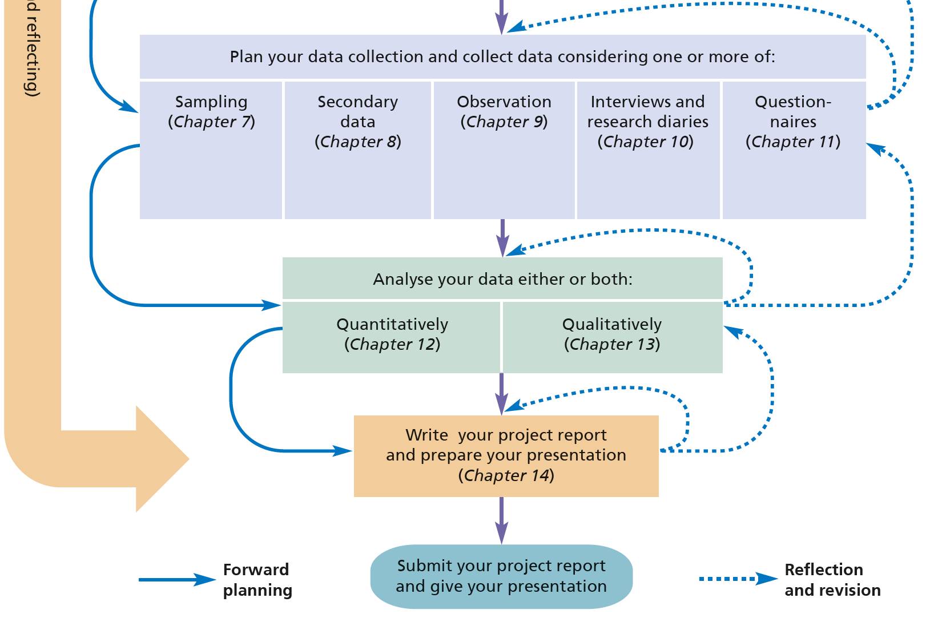
Chapter
The research process (2 of 2)
01

Slide 32
Chapter
The research process
01
In this course the research process is presented as a series of linked stages and gives the appearance of being organised in a linear manner. However, as depicted in the above figure you will recognise the concurrent and iterative nature of the research process
As part of this process it is believed that it is vital that you spend time formulating and clarifying your research topic.
This should be expressed as a research problem and one or more research questions that your research must answer, accompanied by a set of objectives that your research must address. However, it should also be stressed the need to reflect on your ideas continually and revise both these and the way in which you intend to progress your research.

Slide 33
Chapter
The role of theory in research
01
Some research is aimed at building theory, whereas other research is designed to test a theory or to describe what is going on, using an existing framework, instrument, or model.
Indeed, in one form or another, theory plays an important role in a research project.

Slide 34
Chapter
The role of theory in research
01
The term ‘theory’ can mean a lot of different things, for instance, for some people, a theory is any concept, instrument, model, or framework that helps them to think about or solve a problem, to describe a phenomenon, or to better understand a topic of interest, such as competitive advantage.
To a scientist, a theory explains a certain phenomenon, and the idea is that this explanation will hold in a wide range of settings. For instance, expectancy theory proposes that people will choose how to behave depending on the outcomes they expect as a result of their behavior. In other words, people decide what to do based on what they expect the outcome to be. At work, for example, it might be that people work longer hours because they expect an increase in pay

Slide 35
Chapter
The role of theory in research
01
Like this, a theory may generate testable – and sooner or later, tested – predictions. A theory (in the formal, scientific sense) may thus vary in the extent to which it has been conceptually developed and empirically tested.

Slide 36
Chapter
The research problem
01
A “problem” does not necessarily mean that something is seriously wrong with a current situation that needs to be rectified immediately.
A problem could also indicate an interest in an issue where finding the right answers might help to improve an existing situation. Thus, it is fruitful to define a problem as any situation where a gap exists between an actual and a desired ideal state.

Slide 37
Chapter
The research problem
01
Examples of problems that entrepreneur may encounter:
Factors Influencing Small Business Growth
Challenges Faced by Women Entrepreneurs
Impact of Entrepreneurial Education on Venture Success
Significance of Entrepreneurial Networks on Business Performance
Importance of Market Research in Startup Development
Government Policies Fostering Entrepreneurship
Benefits and Challenges of Family-Owned Businesses
Rise of Social Entrepreneurship and Its Implications

Slide 38
Chapter
The research problem
01
Impact of Artificial Intelligence on Traditional Business Models
Opportunities and Challenges of the Sharing Economy for Entrepreneurs
Role of Sustainability in Entrepreneurship
Cultural Factors and Their Influence on Entrepreneurial Behavior
Entrepreneurial Ecosystems and Their Impact on Innovation and Growth
Emotional Intelligence in Entrepreneurial Leadership
Relationship Between Entrepreneurial Mindset and Business Success

Slide 39
Chapter
The research problem
01
Problems versus symptoms of problems:
It is very important that symptoms of problems are not defined as the real problem. For instance, a manager might have tried to decrease employee turnover (the best people are leaving the organization) by increasing wages, but with little success.
Here the real problem may be something else such as the low motivation of employees who feel they do not have enough control over their work.
The high turnover rate may merely be a symptom of the deep‐rooted motivational problem. Under these conditions, in the long run, a higher salary will not affect employees ’ intentions to leave.

Slide 40
Chapter
The research problem
01
Thus, finding the “right” answer to the “wrong” problem definition will not help. Hence, it should be recognized that correct problem identification is extremely critical for finding solutions to vexing issues.
Frequently, managers tend to describe the problem in terms of symptoms. Rather than accepting it as such, the researcher needs to identify the problem more accurately.
One way of determining that the problem, rather than the symptom, is being addressed is a technique called “5 Whys” or “5 Times Why”.

Slide 41
Chapter
The research problem
01
5 Whys is a fairly straightforward approach that will help researchers to get to the root cause (the most basic cause) of a problem (via preliminary research). Developed by the Japanese industrialist Sakichi Toyada, the idea is to keep asking “Why?” until the most basic cause is arrived at.

Slide 42
Chapter
The research problem
01
Let’s go back to our example to illustrate this approach.
My best employees are leaving the organization.
Why? Because they are not satisfied with their jobs.
Why? Because they do not find a challenge in their jobs.
Why? Because they do not have control over their work.
Why? Because they do not have a lot of influence over planning, executing, and evaluating the work they do.
Why? Because we have been reluctant to delegate.

Slide 43
Chapter
The research problem
01
Note that the number five is a general guideline for the number of whys needed to get to the root cause level, but asking “Why?” five times versus three, four, or six times is not a strict requirement.
What matters is that we investigate recurring problems by addressing true causes and not symptoms of these causes.

Slide 44
Chapter
The research problem
01
There is a need to narrow down a broad research problem into a feasible topic for research. Preliminary research will help to make the necessary transformations.
Three initial stages of the research process and illustrates how we get from a broad research problem to a feasible topic for research. Note that this process is not linear; in the beginning of our project we will have to move back and forth between preliminary research and (re)defining the problem.

Slide 45
Chapter
The research problem
01
1- Identification of the broad problem
2- Preliminary research
3- Definition of the research problem

Slide 46
Chapter
The research problem
01
Once we have identified the broad problem area preliminary research should help the researcher to gain a better understanding of the problem and to narrow the problem down to a researchable topic for study.
Preliminary research should help the researcher to find answers to questions such as:
“What is the problem?”;
“Why does the problem exist?”;
“Is the problem important?”;
and “What are the benefits of solving the problem?”

Slide 47
Chapter
The research problem
01
Although the exact nature of the information needed for this purpose depends on the type of problem one is addressing, it may be broadly classified under two headings:
Information on the organization and its environment – that is, the contextual factors.
2. Information on the topic of interest.

Slide 48



Thank You

