Slide 1

Digital Media and Identity
Prepared by Dr. Shereen Kedwany
Lecture 6
DGM 711
Introduction to Digital Media

Slide 2

Chapter
06
Reminder
Digital media foster new forms of interaction and enrich the social life of individuals.
Therefore, social relationships seem to always be mediated.
Yet the social relations these technologies mediate are not neutral, but rather depend on uneven power dynamics, as well as on cultural and identity factors.
Social media are “coding relationships between people, things and ideas into algorithms.”
This means that it analyzes past interactions in order to predict future behavior .
These companies have developed business models that allow them to extract profits from the information they manage.
The information collected by social media platforms can be sold to third parties.

Slide 3

Chapter
06
Outline
I. Digital Identity .
II. Digital Cultures .
III. Algorithmic Identity .
VI. Critiques of Digital Sociality .
V. Conclusion.

Slide 4
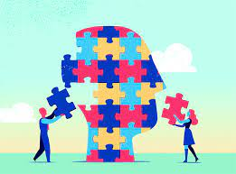
Chapter
06
I. Digital Identity :
Digital media, and social media platforms in particular, are important instruments through which individuals implement active strategies of identity building.

Slide 5
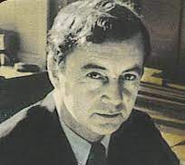
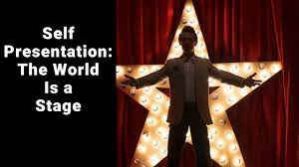
Chapter
06
I. Digital Identity :
In the mid‐twentieth century the sociologist Erving Goffman studied the rituals of self‐presentation through which people present themselves in public and construct their identity through communicative practices (1959).
This idea has been recalibrated to adapt to digital media and the possibilities offered by social media platforms.
Goffman used the theater as a metaphor to describe the way in which people “perform” their identity in public.
Following this metaphor, we can argue that social media are one of the “stages” from which individuals represent their own identity through a continuous work of construction.

Slide 6
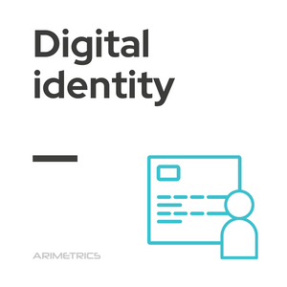
Chapter
06
I. Digital Identity :
Social media provide individuals with a high control over these processes, therefore allowing for a particularly flexible construction of identity.
Opening an account of a particular social media, choosing the photo that characterizes your profile, choosing your friends, joining a particular discussion group, posting politically connoted images or links to music videos are all examples of the ways in which we represent in public some features that we want to be perceived as part of our identity.
By revealing something about themselves, for example the way they dress, their hobbies, musical preferences, or political views, individuals perform the continuous work of identity construction discussed by Goffman.

Slide 7

Chapter
06
I. Digital Identity :
The type of information that we make public may vary within different contexts, i.e., on platforms that are meant to have specific purposes or audiences.
For example, professional identity construction is explicit on LinkedIn, while on Facebook the boundary between professional identity and other forms of identity can fade or be difficult to maintain .
Furthermore, social media are based on the ability to activate and make visible social ties.
Therefore, the content of the information posted by a user may be less important than the context in which the communication takes place.

Slide 8
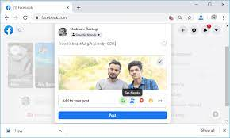
Chapter
06
I. Digital Identity :
The photo of a beautiful sunset on a beach posted on the Facebook wall of a friend can be important not only for what it depicts, but especially because it highlights a relationship.
In this case it may indicate that the individual who published it was on a vacation with that person.
However, social media do not completely determine the identity of a person, but rather contribute to framing it.

Slide 9

Chapter
06
I. Digital Identity :
Many mediated behaviors that have to do with identity performance mirror those that take place offline.
For example, researchers have found the prevalence of phenomena of conformism among adolescents who used MySpace in the mid‐2000s and strove to be accepted by peers (Boyd 2008).

Slide 10

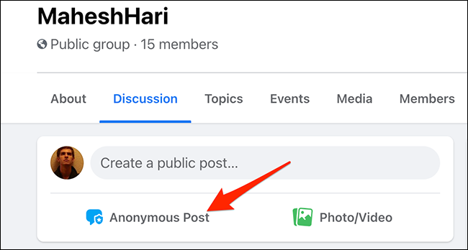
Chapter
06
I. Digital Identity :
On today’s social media, most individuals use their real name.
Platform policies had an impact on this change: for example, Facebook prohibits the use of pseudonyms.
In other cases, social media do provide a space in which individuals can anonymously express sides of their identity that are deemed socially unacceptable.

Slide 11
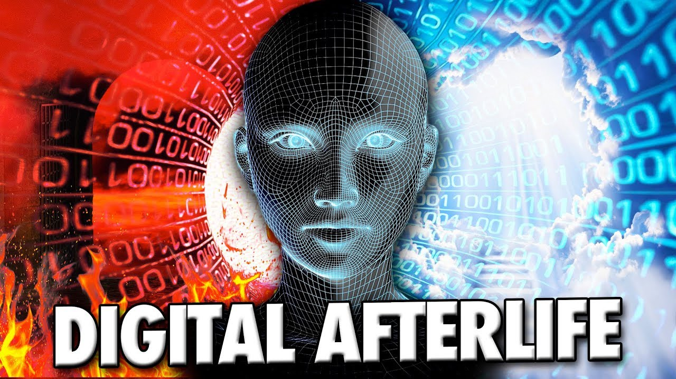
Chapter
06
I. Digital Identity :
The importance of social media for people’s identity is also highlighted by phenomena such as the so‐called “digital afterlife”: it has become common to use a dead person’s social media profile, especially on Facebook, to announce their passing and collect messages and memories from friends and relatives.
This process can create a kind of “immortality” in which the digital identity of the deceased survives his death .
These examples do not mean that there is discontinuity between offline and online identities.
Efforts to distinguish them can indeed sound unrealistic.

Slide 12
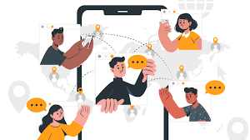
Chapter
06
I. Digital Identity :
Most relationships mediated by social media are rooted in face‐to‐face ones.
On platforms such as Facebook, people tend to become friends mainly with people with whom they have interactions offline.
However, social media are also used to form new relationships, or to enable so‐called “latent ties” .
An example is friends of friends on Facebook: even if two individuals do not know each other in person, they may realize that they are already part of the same circles and therefore create a connection via the social network.

Slide 13

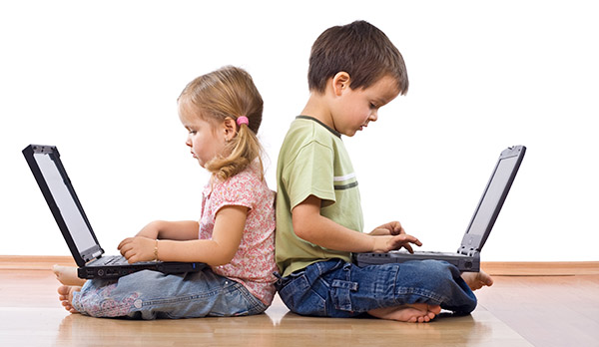
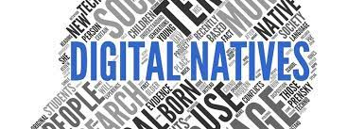
Chapter
06
I. Digital Identity :
Of course, the use of digital media as social spaces is not neutral, but rather influenced by social factors such as age, gender, ethnicity, or class.
In response to the spread of connectivity and the integration between the internet and mobile technologies in the 2000s, media scholars even discussed the rise of a new generational subject.
The definition “digital natives” (Prensky 2001) was meant to describe young people born in close contact with computers and the internet through mobile phones, tablets, and video games consoles.

Slide 14
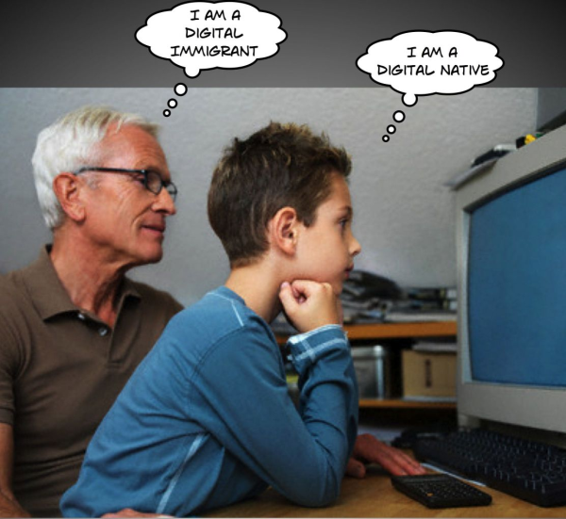
Chapter
06
I. Digital Identity :
The formula was used to distinguish them from “digital immigrants,” that is from people who were born before the advent of the internet and came of age in a world dominated by print and television.
Furthermore, the natives would also be bearers of new forms of sociability and identity strongly marked by the characteristics of these technologies.

Slide 15
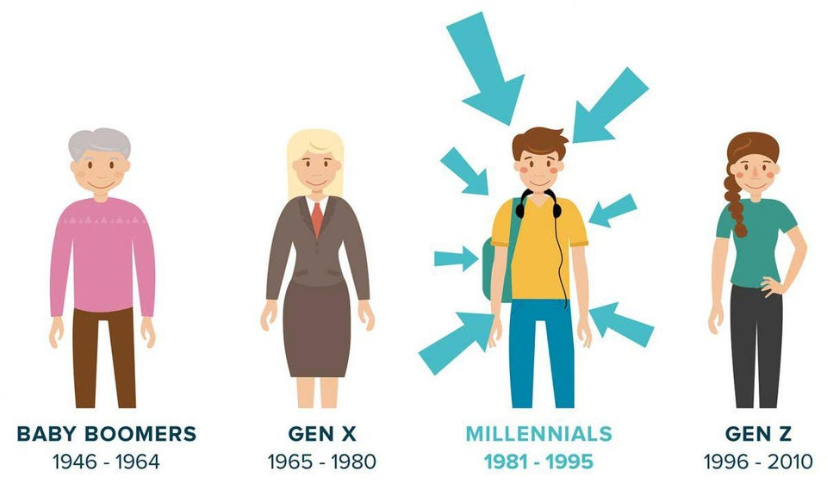
Chapter
06
I. Digital Identity :
The concept resonates with common sense ideas of how so‐called “millennials” interact with digital media.
However, the concept of “digital natives” has been largely abandoned, since it tends to hide the differences in how people use the internet and social media, even among those who are born into a world dominated by these technologies.
Furthermore, it focuses narrowly on generational differences while ignoring those based on social class, gender, and ethnicity.

Slide 16

Chapter
06
I. Digital Identity :
Indeed, digital technologies are far from being “blind” to gender or race, and can reproduce gender‐ or race‐based rather than generational divisions.
First, different services can be populated by different demographics or respond to specific gender‐based logics.
For example, 4chan, a famous anonymous forum where many memes that subsequently spread on social media are created, has a strong male component.

Slide 17

Chapter
06
II. Digital Cultures :
Furthermore, research on internet cultures has indeed shown how digital media tend to represent both gender and race according to stereotypes, thus contributing to reinforcing them.
Recent feminist scholarship has highlighted several facets of such phenomena and how they intersect with the functioning of social media platforms.
For example, a platform such as YouTube relies on human moderators, often working in developing countries, to filter and remove violent, racist content after it has been flagged by users.

Slide 18
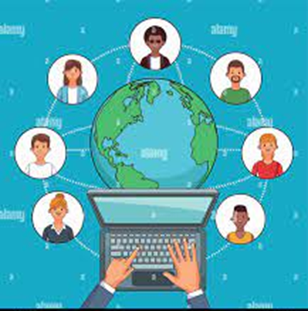
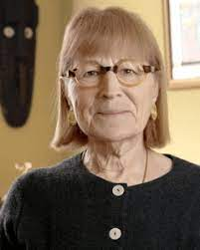
Chapter
06
II. Digital Cultures :
The representation of identities is not the only lens through which to look at gender and race in digital media and intersects with other dynamics.
Feminist theorists of technology have long argued that studying design is key to understanding gender relations in contemporary societies (Wajcman 2000).
Following this call, scholarship on digital media has started focusing on how cultural and political values are not simply represented, but rather inscribed in or reproduced by “the machine.”

Slide 19
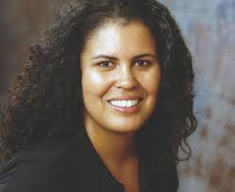
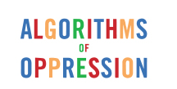
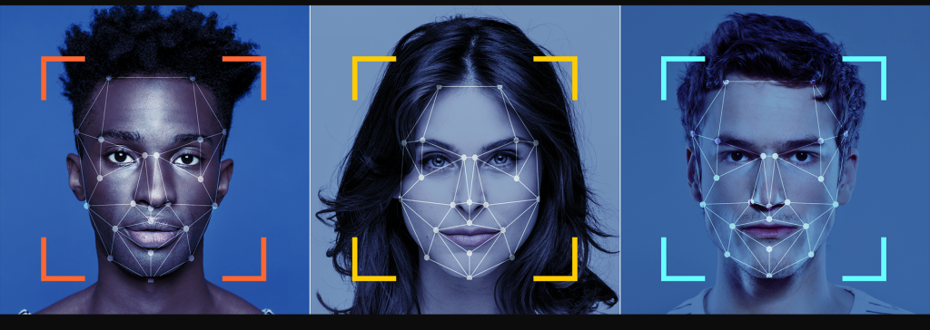
Chapter
06
II. Digital Cultures :
Black feminists such as Safiya Noble have called for a politically infused analysis of the “algorithms of oppression” that reinforce inequalities while presenting themselves as neutral.
There are many other instances of algorithms that reinforce inequalities.
For example, companies producing face recognition software have been criticized for producing technologies which work better with light skin.

Slide 20
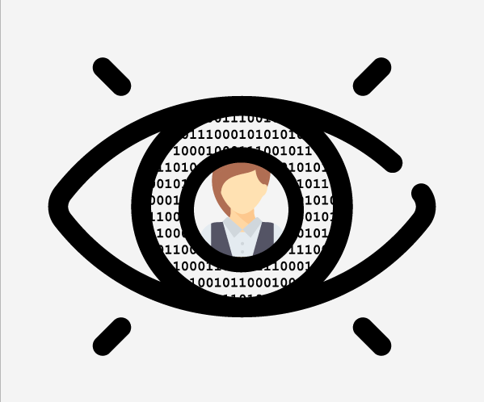
Chapter
06
III. Algorithmic Identity:
The algorithms that underpin the functioning of digital media produce what scholars have called “algorithmic identity” not directly related to our racial or gender identity but rather inferred based on algorithmic evaluations of our online behavior.
This has to do with economic rationales.
Indeed, algorithms used to profile users “calculate” gender and race, so to speak, by producing statistical models used for marketing or other purposes.
In these processes, gender and race become marketing categories rather than negotiations about gender roles or socially constructed racial groups.

Slide 21
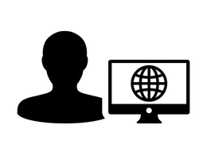
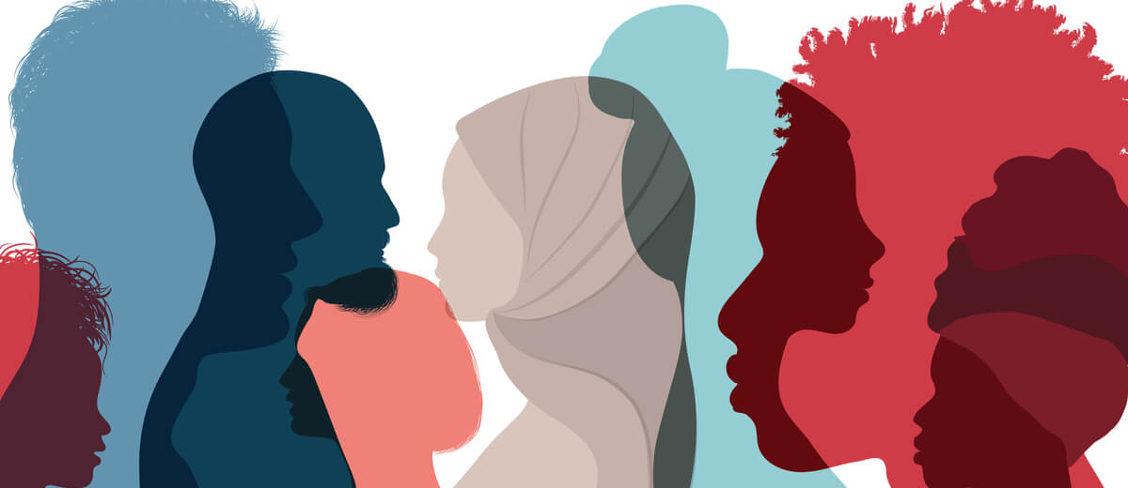
Chapter
06
III. Algorithmic Identity:
Therefore, a user who visits a website that is classified as “manly” would be considered by marketing algorithms as more likely to be male.
Facebook does not ask users their race but, depending on what they do on the platform, it may assign them something it calls “ethnic affinity.”

Slide 22
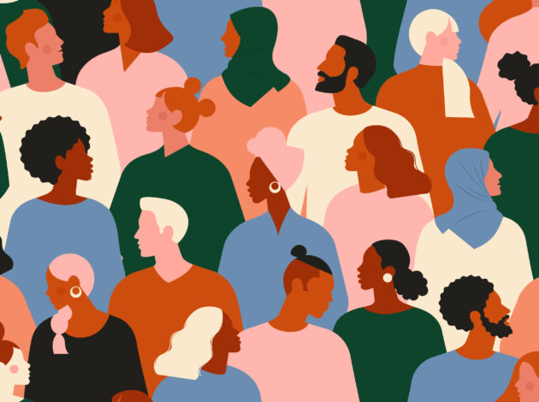
Chapter
06
III. Algorithmic Identity:
If you live in Texas and occasionally write messages in Spanish, it might assign you to the “Hispanic” category.
Interestingly, Facebook has “ethnic affinity” categories for African Americans, Asian Americans, and Hispanics among others, but none for Caucasians.
Regardless of behavior, social relations, and geographical location, Facebook won’t put them in the “white” category, because that category does not exist.

Slide 23
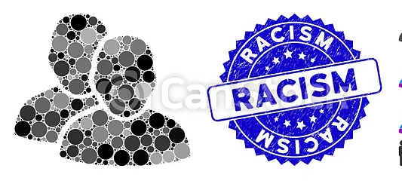
Chapter
06
III. Algorithmic Identity:
Scholars studying such phenomena have come up with definitions such as “platformed racism” to describe how seemingly technical decisions amplify racist discourses and reproduce social inequalities .
Indeed, these calculations have material effects, as the identities assigned by algorithms are used to predict consumer behavior and select which content will be shown to a certain user.
Facebook’s choices reinforce the idea that white is “normal” and shapes its ads accordingly.
On some job‐seeking platforms, users who are considered women are less likely than men to be shown job ads for managerial positions.

Slide 24
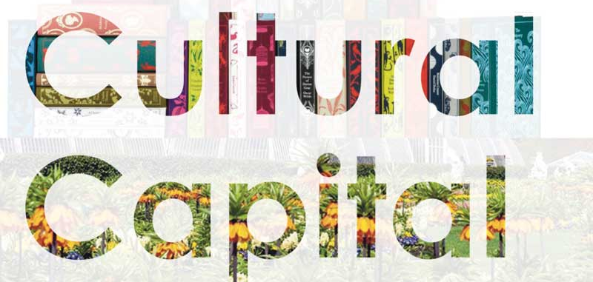
Chapter
06
III. Algorithmic Identity:
Finally, some of the most important differences in the use of digital media result from different levels of access to what sociologists call “cultural capital.”
Individuals with a high level of education who are used to searching and using information in a thoughtful and creative way tend to exhibit these characteristics in all spheres of life, including those mediated by digital technologies.

Slide 25
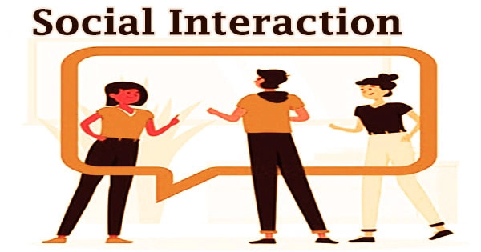
Chapter
06
III. Algorithmic Identity:
On the contrary, people who are accustomed to a more passive use of information tend to be less critical and less reflective in the use of digital media too.
People who have a life full of activities and social relations, perhaps because they are members of associations, volunteer for a non‐profit, or are politically active, tend to make a richer and more varied use of digital media compared to those characterized by a lower richness of social relations.

Slide 26
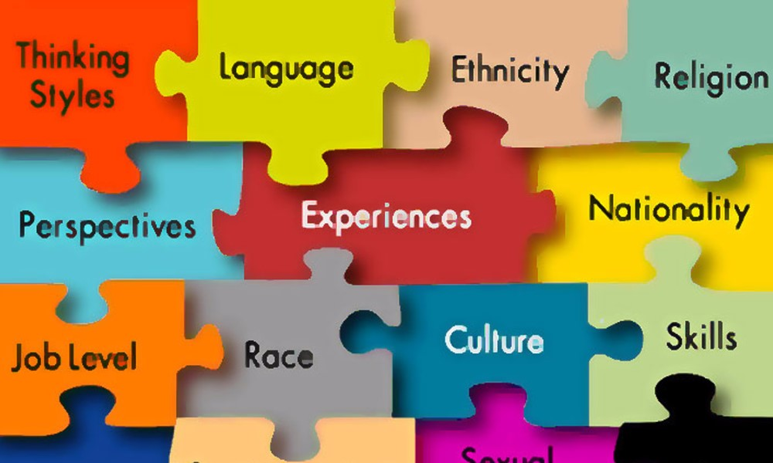
Chapter
06
III. Algorithmic Identity:
Facebook, in sum, differences in social class, gender, cultural traditions, or geographical area may be more important than age in influencing the different ways in which people use digital media (Van Dijck and Hacker 2011).
For example, online services used by diasporic communities that are united by the experience of migration are used to maintain and strengthen ties based on ethnicity and nationality.

Slide 27
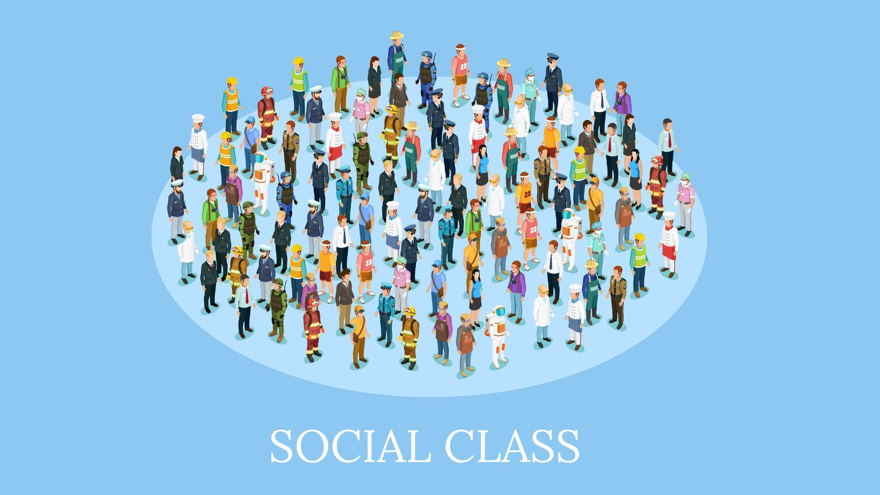
Chapter
06
III. Algorithmic Identity:
At the same time, individuals belonging to different social classes can use digital services and technologies in completely different ways even within the same territory.
In order to capture the flexible nature of online identities, media studies have focused on how they are organized as publics of media content.

Slide 28
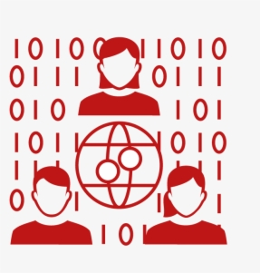
Chapter
06
VI. Critiques of Digital Sociality :
Forms of sociality mediated by digital technologies have been faced with many critiques.
Among the most common points of contention is the claim that networked relationships tend to be colder and less engaging than face‐to‐face interactions.

Slide 29
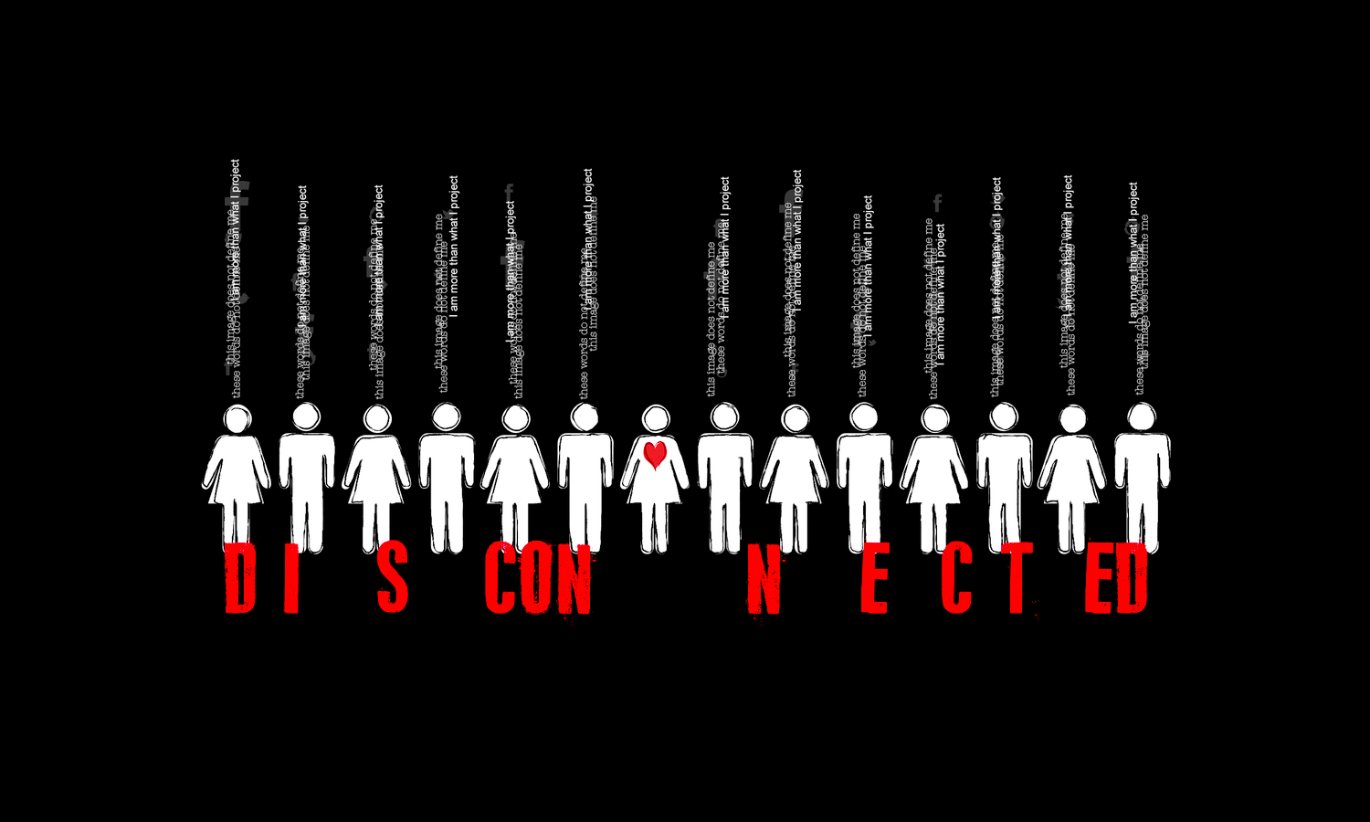
Chapter
06
VI. Critiques of Digital Sociality :
For some, the result of an increasingly mediated world would be a set of individuals who are emotionally disconnected from each other, and thus united by weak bonds and superficial forms of solidarity that are likely to fall apart when facing challenges.
This criticism is partly founded.
Compared with traditional communities, the ties that characterize contemporary online publics are less strong and generate less stringent forms of solidarity.

Slide 30
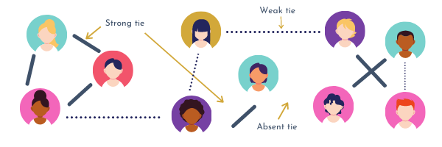
Chapter
06
VI. Critiques of Digital Sociality :
However, not having strong social ties with the people with whom one shares some interests or discussions does not prevent them from satisfying their need for affectivity in different spaces or with different people.
Moreover, the weight of different forms of sociality depends on individuals, who may choose to be more or less bound to a certain public.

Slide 31
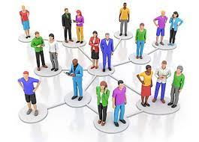

Chapter
06
VI. Critiques of Digital Sociality :
Other critics of digital sociality argue that the immersive experience provided by digital media tends to absorb people into a parallel world, and therefore isolate them.
This idea was already present in science fiction written at the dawn of digital networks.
In the cyberpunk world described in the 1980s by US novelist William Gibson, people immersed themselves in a virtual world, a cyberspace directly connected to their cerebral cortex in which they lived a parallel life without having to interact with other human beings.

Slide 32

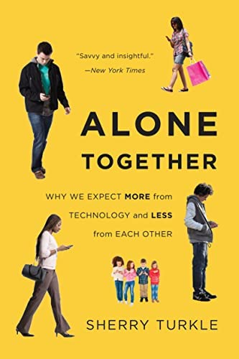
Chapter
06
VI. Critiques of Digital Sociality :
According to Turkle (2011), the spread of the internet, and particularly of ubiquitous social media accessible via mobile technologies, creates a situation in which individuals no longer interact with their neighbors but are rather absorbed in a parallel world made of Snapchat messages and Instagram posts.
According to this view, social media would project us in a world in which we are “alone together.”

Slide 33

Chapter
06
VI. Critiques of Digital Sociality :
Turkle includes in this framework many technologies, such as robots used to foster social interactions in patients suffering from senile dementia.
Human interactions would become scarce and replaced by interactions with machines that try to simulate, with varying degrees of success, the warmth and authenticity of human affectivity.

Slide 34
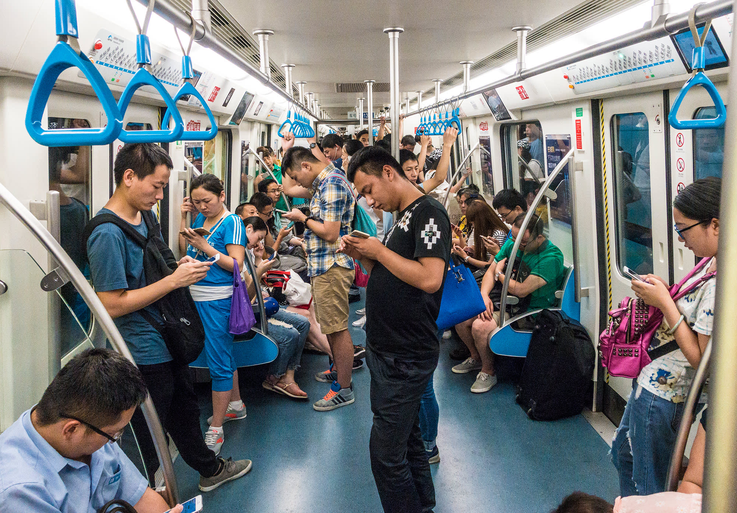
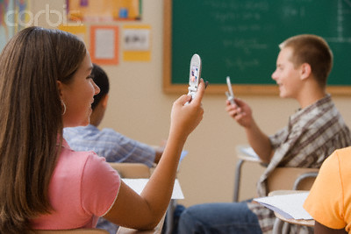
Chapter
06
VI. Critiques of Digital Sociality :
The picture painted by Turkle is recognizable in situations like a subway car in which individuals sitting side by side are immersed in their smartphones, or a classroom where students interact on Facebook or Instagram instead of listening to the lecture.
They are physically present together, but mentally absorbed in their private worlds.
Alone together, indeed.

Slide 35
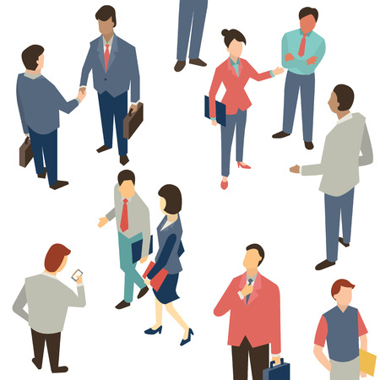
Chapter
06
VI. Critiques of Digital Sociality :
This and other similar views are part of a long narrative about the loss of sense of community and “warm” social relations that, since the late nineteenth century, accompanies modernization processes and the emergence of new communication technologies.

Slide 36
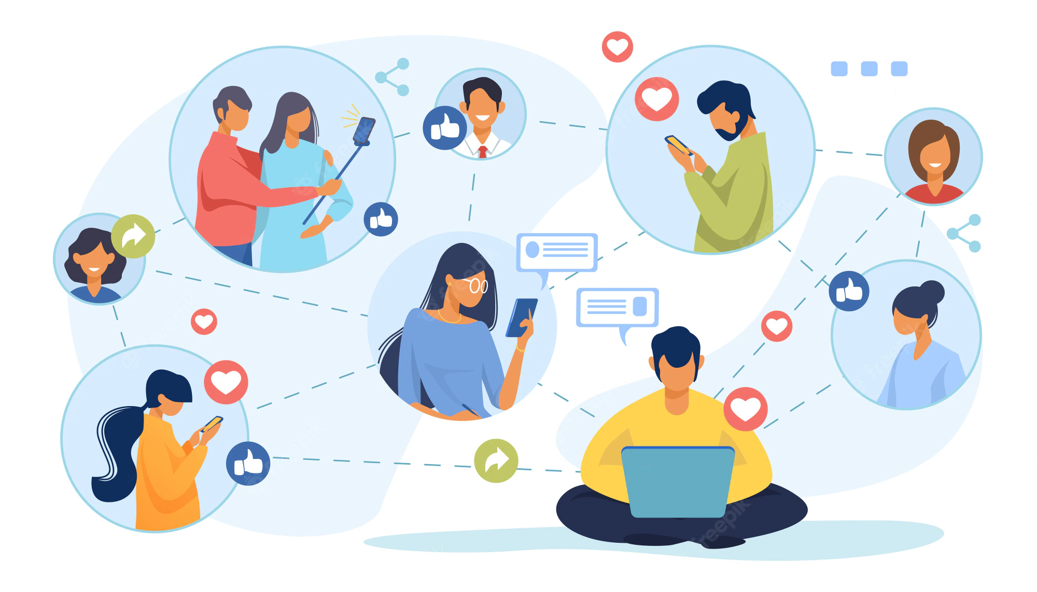
Chapter
06
VI. Critiques of Digital Sociality :
However, empirical studies carried out since the 1990s seem to provide a very different picture.
Users of digital media tend to have larger and more diverse social networks than those who do not use them.
Internet users are not inherently less prone to visit their neighbors and tend to have a richer community life than people who do not use digital media.

Slide 37
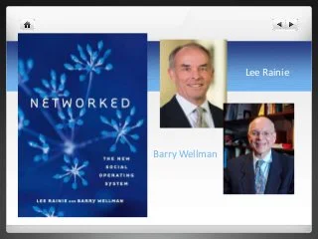
Chapter
06
VI. Critiques of Digital Sociality :
Digital media do not keep people away from the public space, but rather can be considered a factor that nurtures their rich social life (Rainie and Wellman 2012).
Social media are an integral part of our social life and are not a means to leave it.
They do not impoverish social relationships.
Rather, the way in which people interact with each other can change with the use of these technologies.

Slide 38


Chapter
06
VI. Critiques of Digital Sociality :
When analyzing such critiques, we should keep in mind that new communication technologies always tend to generate waves of criticism and even moral panic .
These forms of so‐called techno‐pessimism are nothing new:
Fears linked to the social role of digital technologies are part of a much longer history of mistrust toward new media.
In eighteenth‐century Europe the novel was accused of diverting young women from their social roles and immersing them in an unreal world of dreams.

Slide 39
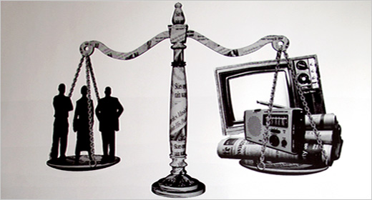
Chapter
06
VI. Critiques of Digital Sociality :
In the 1930s some argued that movie, theaters and jazz music diffused via radio would destroy the moral fiber of younger generations.
In the 1960s television was accused of destroying communities and traditional cultures;
in the 1980s videotapes were blamed for generating violence in youth; this accusation was then turned against video games in the 1990s.

Slide 40

Chapter
06
VI. Critiques of Digital Sociality :
Privacy is another area of emerging concern.
Indeed, the proliferation and extension of the mediated environments that organize our social and individual lives has important effects on privacy.
Social media platforms have undermined old concepts of privacy as based on the ability to live a private life not visible in public.
In a sense this idea of privacy had already been undermined with the advent of television and the subsequent exposure of the private lives of celebrities and politicians.

Slide 41
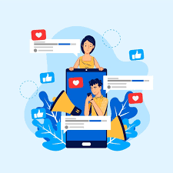
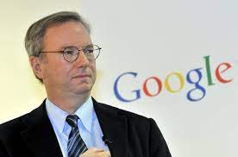
Chapter
06
VI. Critiques of Digital Sociality :
Yet social media push all individuals to share, in public, personal details of their private lives, from holiday photos on Instagram to the results of medical tests on patient forums.
Google’s CEO, Eric Schmidt, once argued that “if you have something that you don’t want anyone to know, maybe you shouldn’t be doing it in the first place”, reiterating that individuals are to be considered responsible for their own privacy.
Yet it would be difficult to ignore the need for stringent rules that protect privacy or for technologies that allow the removal of unwanted information from the public view.

Slide 42
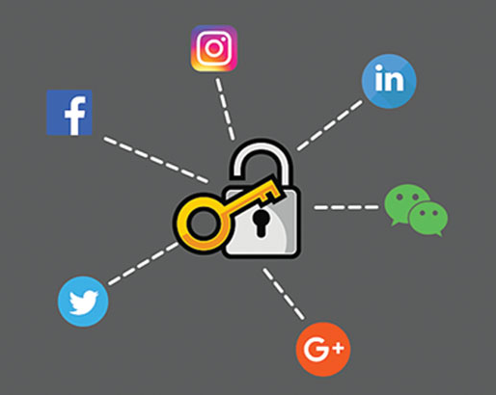
Chapter
06
VI. Critiques of Digital Sociality :
Furthermore, issues around individual privacy intersect with the pervasive forms of surveillance and social control that both governments and corporations put in place through digital media .
Clashes regarding access to information held by internet services by, for example, the police, or the use of personal social media data for marketing purposes emerge cyclically.
And yet several studies show that the explosive growth of social media goes hand in hand with a change in the perception of these problems.

Slide 43
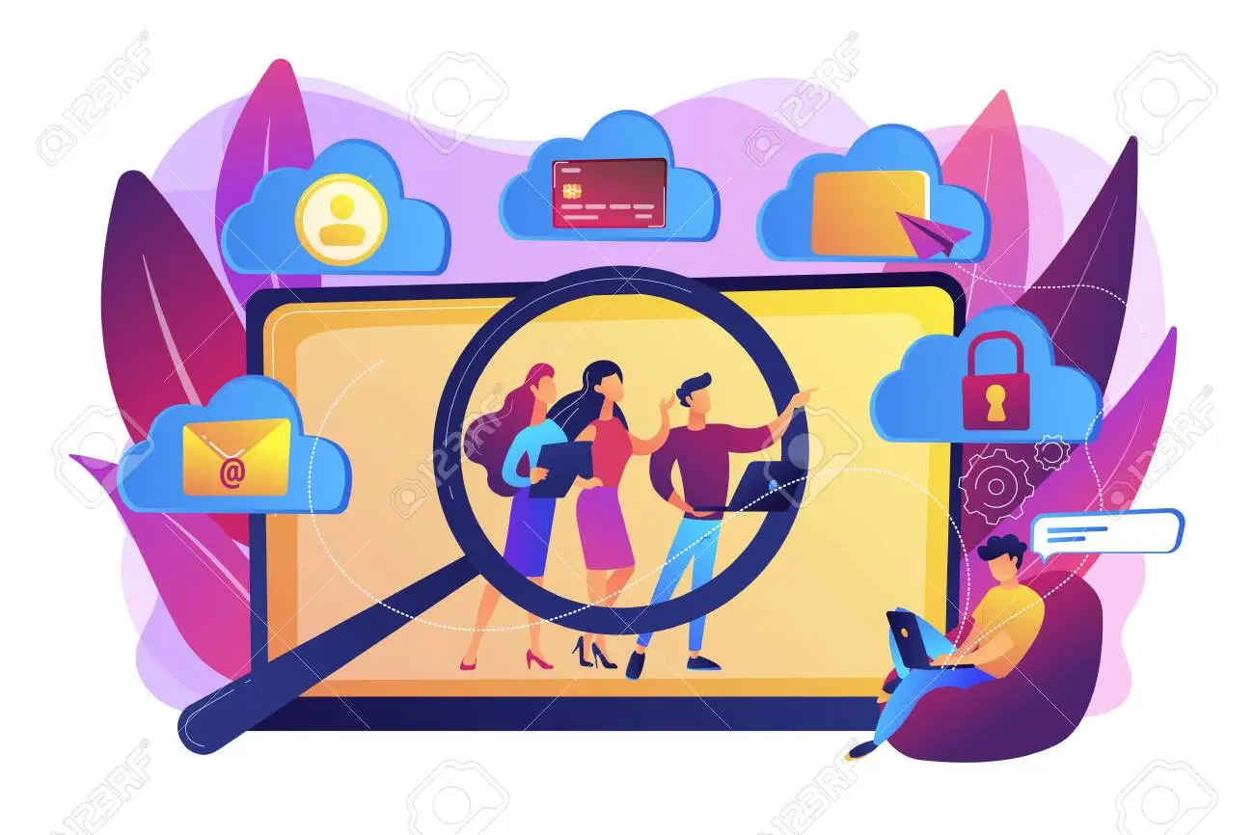
Chapter
06
VI. Critiques of Digital Sociality :
The idea of having two completely separate spheres, i.e. a public and a private life, cannot be considered an accurate description of digitally mediated sociality.
On the one hand, individuals have partially given up a conception of privacy as a right to a non‐accessible private sphere.
Indeed, such an arrangement would undermine one’s chances to fully participate in digital sociality.

Slide 44
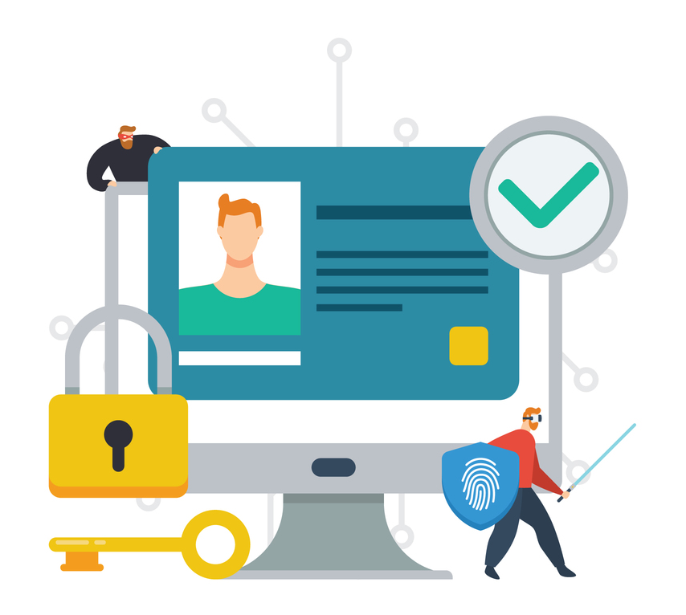
Chapter
06
VI. Critiques of Digital Sociality :
On the other hand, people tend to actively negotiate privacy by controlling available information about them or the social interactions they have in different mediated spaces.
Individuals are able to choose what kinds of communication relating to their private life they carry on through which media.
Also, they know the cultural and informal communication codes that characterize different platforms and contexts.

Slide 45
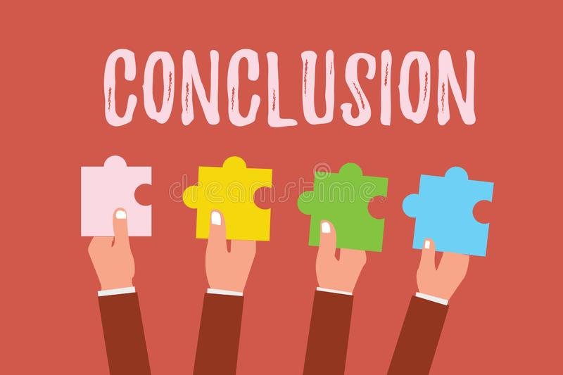
Chapter
06
V. Conclusion
Digital media, and social media platforms in particular, are important instruments through which individuals implement active strategies of identity building.
social media are one of the “stages” from which individuals represent their own identity. individuals perform the continuous work of identity construction
The so‐called “digital afterlife can create a kind of “immortality” in which the digital identity of the deceased survives his death .
The use of digital media as social spaces is not neutral, but rather influenced by social factors such as age, gender, ethnicity, or class, Like “digital natives” and “digital immigrants”.
Algorithms reinforce inequalities.
The “algorithmic identity based on algorithmic evaluations of our online behavior.
Forms of sociality mediated by digital technologies have been faced with many critiques.

Slide 46
Thank you for listening
DGM 711
Introduction to Digital Media

