Slide 1

PMG 506
Advanced Project Management
LECTURE 7
Everyone’s Smart
University
Starting the project plan: The WBS

Slide 2

PMG506 Advanced Project Management (APM)
Introduction:
Lecture 1 Introduction to APM and Initial Project Strategy
Lecture 2 Project Quality Management
Project planning
Lecture 6 Initial project coordination and the project Charter
Lecture 7 Starting the project plan: The WBS
Lecture 8 Project risk management
Lecture 9 Budgeting, Estimating costs and risks
Project Initiation:
Lecture 3 Project Communication and team Management
Lecture 4 Managing conflicts and the art of communication
Lecture 5 Strategic Management and project selection
Project Execution
Lecture 10 Monitoring and information systems
Lecture 11 Project Control
Lecture 12 Project Auditing
Lecture 13 Project termination

Slide 3



Learning Outcomes
By the end of this lecture, you will be able to:
Know what is a work breakdown structure ( WBS).
Explain the key components of the WBS.
Describe the importance, use and design approaches of a Work Breakdown Structure (WBS).
Assign the WBS identification codes.
Explain the “Responsibility Matrices”.

Slide 4

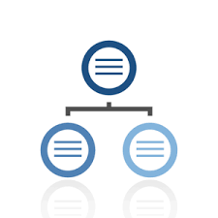


Hierarchical planning process
Level 1
Level 2
Level 3
Notes:
Hierarchical Planning A planning approach that breaks the planning task down into the activities that must be done at each managerial level. Typically, the upper level sets the objectives for the next lower level.

Slide 5
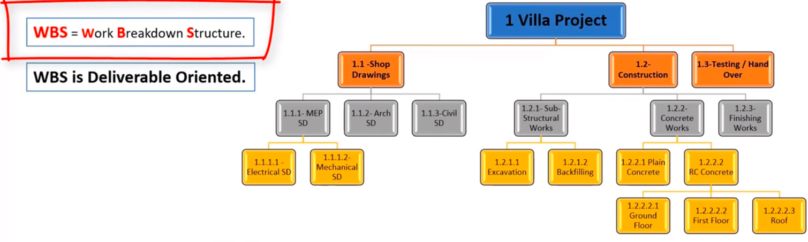
Introduction
Once the scope and deliverables have been identified, the work of the project can be successively subdivided into smaller and smaller work elements. The outcome of this hierarchical process is called the work breakdown structure (WBS). Use of a WBS helps to assure project managers that all products and work elements are identified, to integrate the project with the current organization, and to establish a basis for control. Basically, the WBS is an outline of the project with different levels of detail.

Slide 6
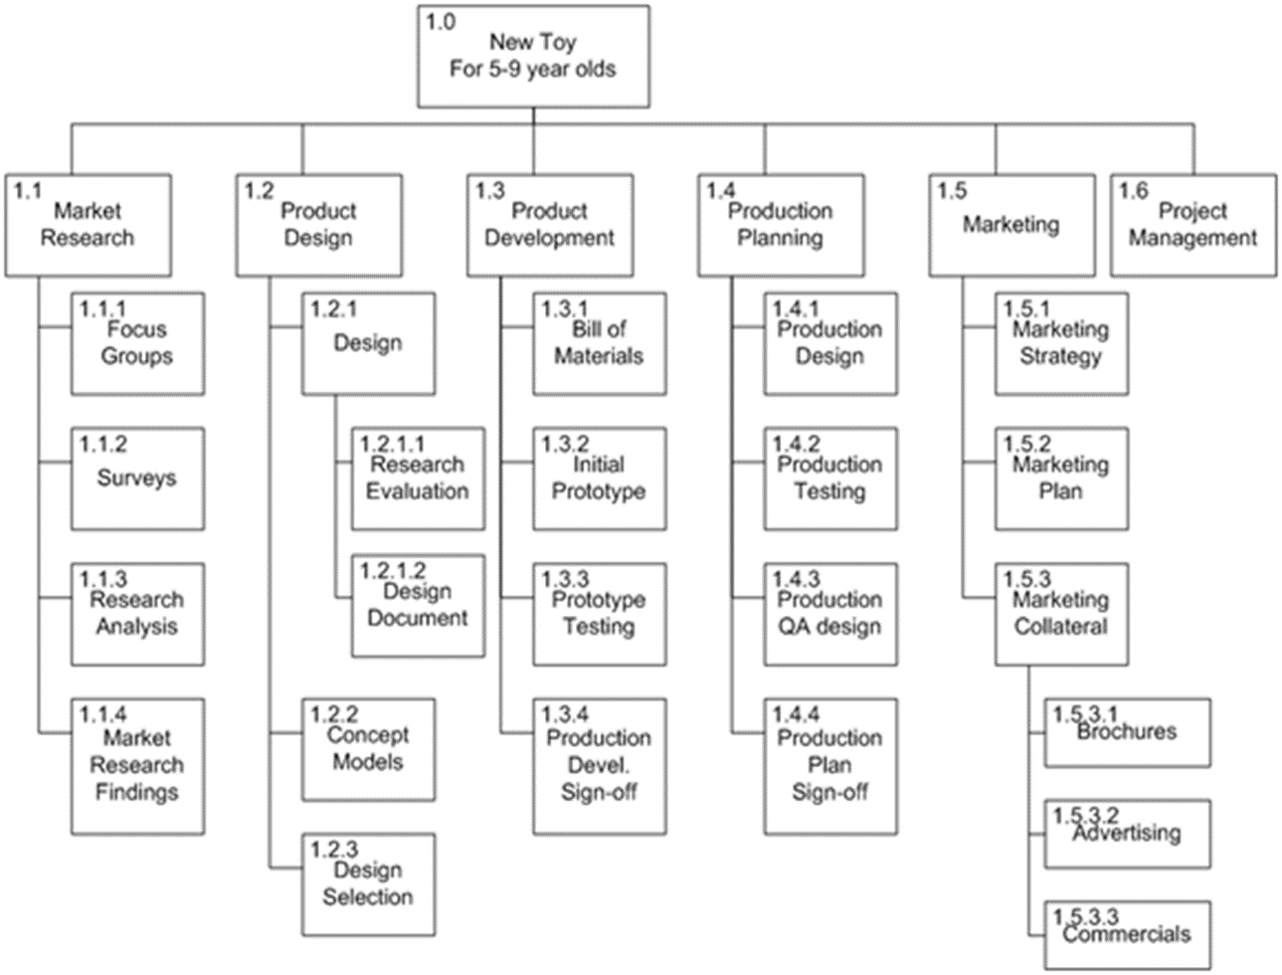
What is a WBS ?
A work breakdown structure ( WBS ) is a chart or document used to organize project work into a list of work packages ( activities and tasks ) so that all work stays on track to meet project goals.
A work breakdown is a project management tool that lays out everything a project must accomplish, organizes those tasks into multiple levels, and displays these elements graphically. It’s a deliverable-based approach, meaning you’ll end up with a detailed project plan of the deliverables you must create to finish the job.

Slide 7

Major Groupings Found in a WBS
The WBS begins with the project as the final deliverable. Major project work deliverables/systems are identified first; then the sub deliverables necessary to accomplish the larger deliverables are defined. The process is repeated until the sub deliverable detail is small enough to be manageable and where one person can be responsible. This sub deliverable is further divided into work packages. Because the lowest sub deliverable usually includes several work packages, the work packages are grouped by type of work—for example, design and testing. These groupings within a sub deliverable are called cost accounts. This grouping facilitates a system for monitoring project progress by work, cost, and responsibility.

Slide 8
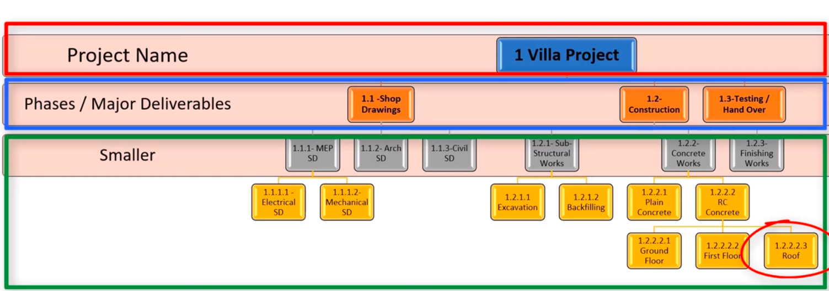
Example:
Work package:
Planned work is contained within the lowest level of WBS components.
A work package can be used to group the activities where work is scheduled and estimated, monitored and controlled.
How many work packages can you see ?

Slide 9
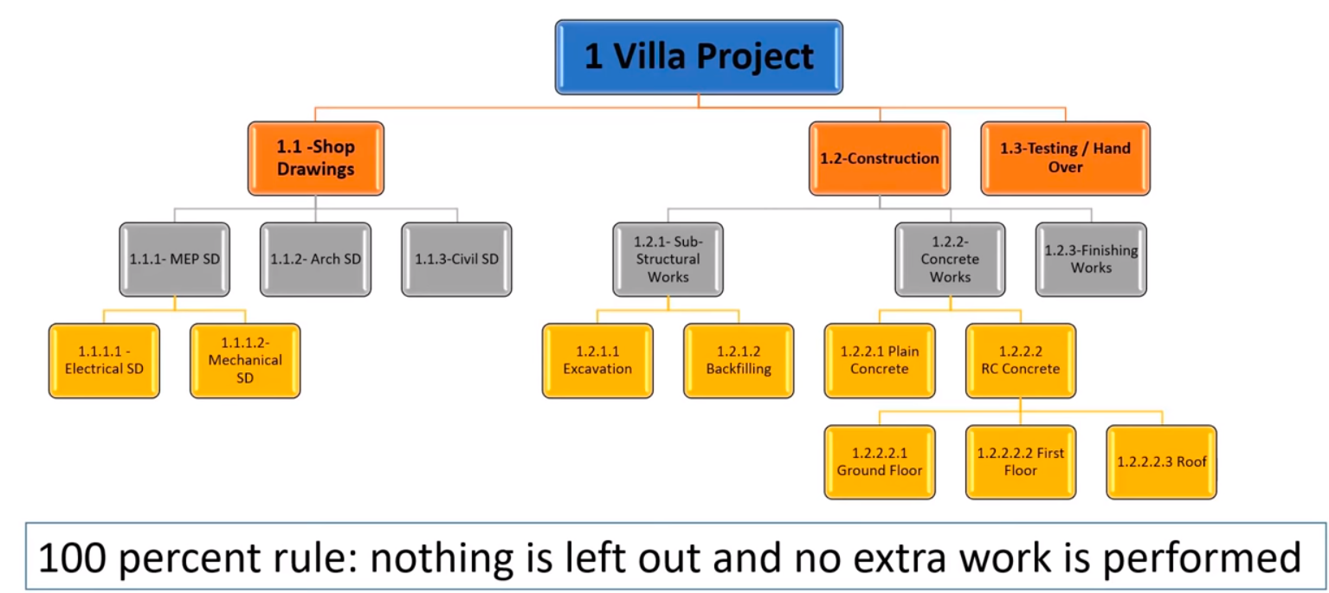
100 percent rule

Slide 10
Example: WBS Chart

Slide 11
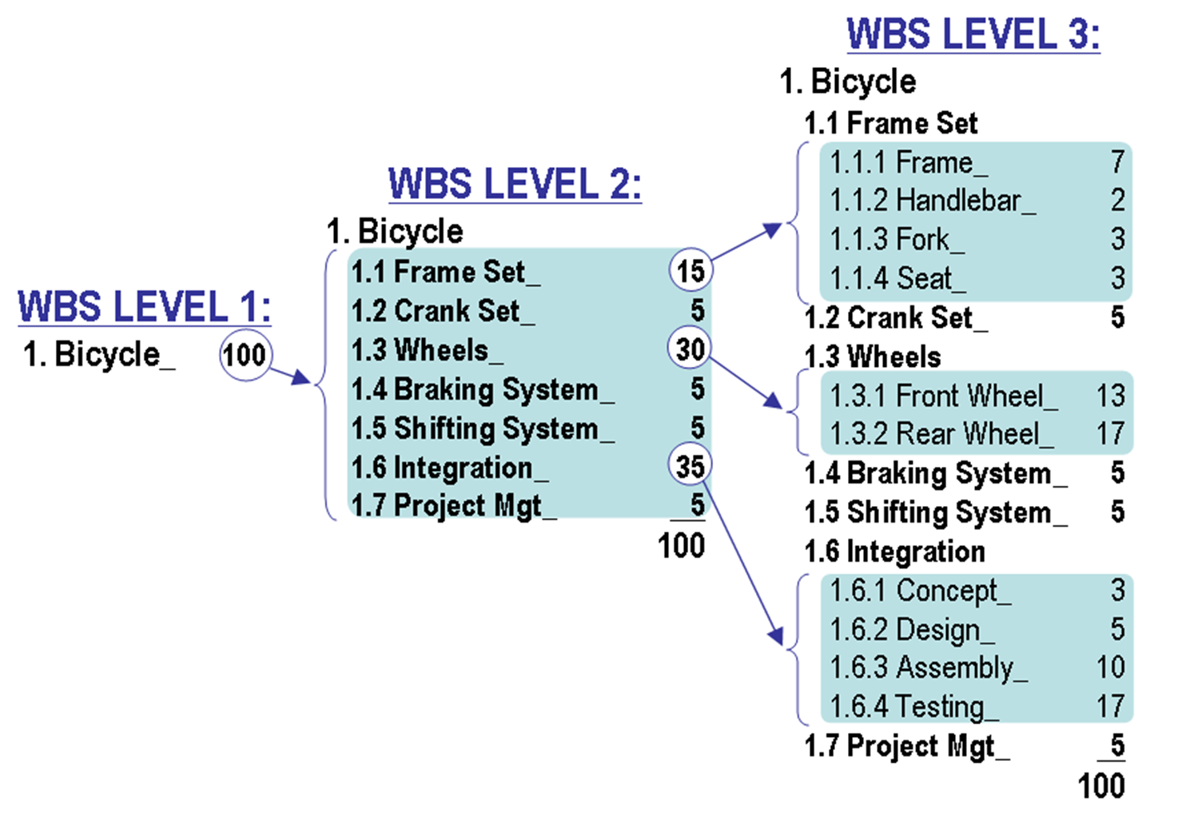
Example: WBS Chart

Slide 12
Example: WBS Table

Slide 13
Example: WBS Memo

Slide 14
How WBS Helps the Project Manager?
The WBS defines all the elements of the project in a hierarchical framework and establishes their relationships to the project end item(s).
Think of the project as a large work package that is successively broken down into smaller work packages; the total project is the summation of all the smaller work packages.
This hierarchical structure facilitates evaluation of cost, time, and technical performance at all levels in the organization over the life of the project.
The WBS also provides management with information appropriate to each level. For example, top management deals primarily with major deliverables, while first-line supervisors deal with smaller sub deliverables and work packages.

Slide 15

Each item in the WBS needs a time and cost estimate. With this information it is possible to plan, schedule, and budget your project. The WBS also serves as a framework for tracking cost and work performance.
As the WBS is developed, organizational units and individuals are assigned responsibility for executing work packages. This integrates the work and the organization. In practice, this process is sometimes called the organization breakdown structure (OBS).
Use of the WBS provides the opportunity to “roll up” (sum) the budget and actual costs of the smaller work packages into larger work elements so that performance can be measured by organizational units and work accomplishment.
The WBS can also be used to define communication channels and assist in understanding and coordinating many parts of the project. The structure shows the work and organizational units responsible and suggests where written communication should be directed. Problems can be quickly addressed and coordinated because the structure integrates work and responsibility.

Slide 16
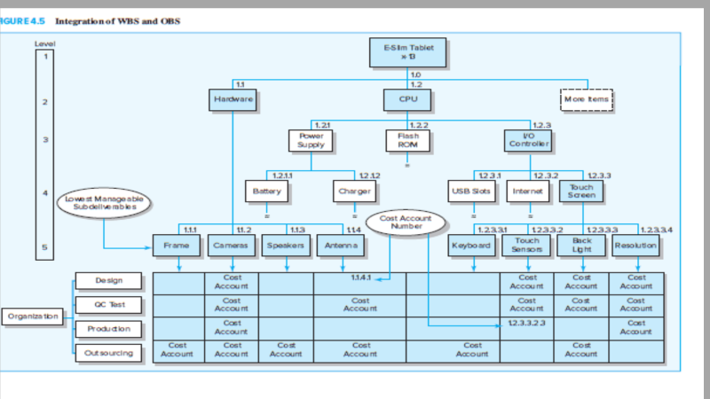
WBS Development
This figure shows a simplified WBS to develop a new prototype tablet computer.
At the top of the chart (level 1) is the project end item—the E-Slim Tablet x-13 Prototype. The sub deliverables levels (2–5) below level 1 represent further decomposition of work. The levels of the structure can also represent information for different levels of management. For example, level 1 information represents the total project objective and is useful to top management; levels 2, 3, and 4 are suitable for middle management; and level 5 is for first-line managers.

Slide 17
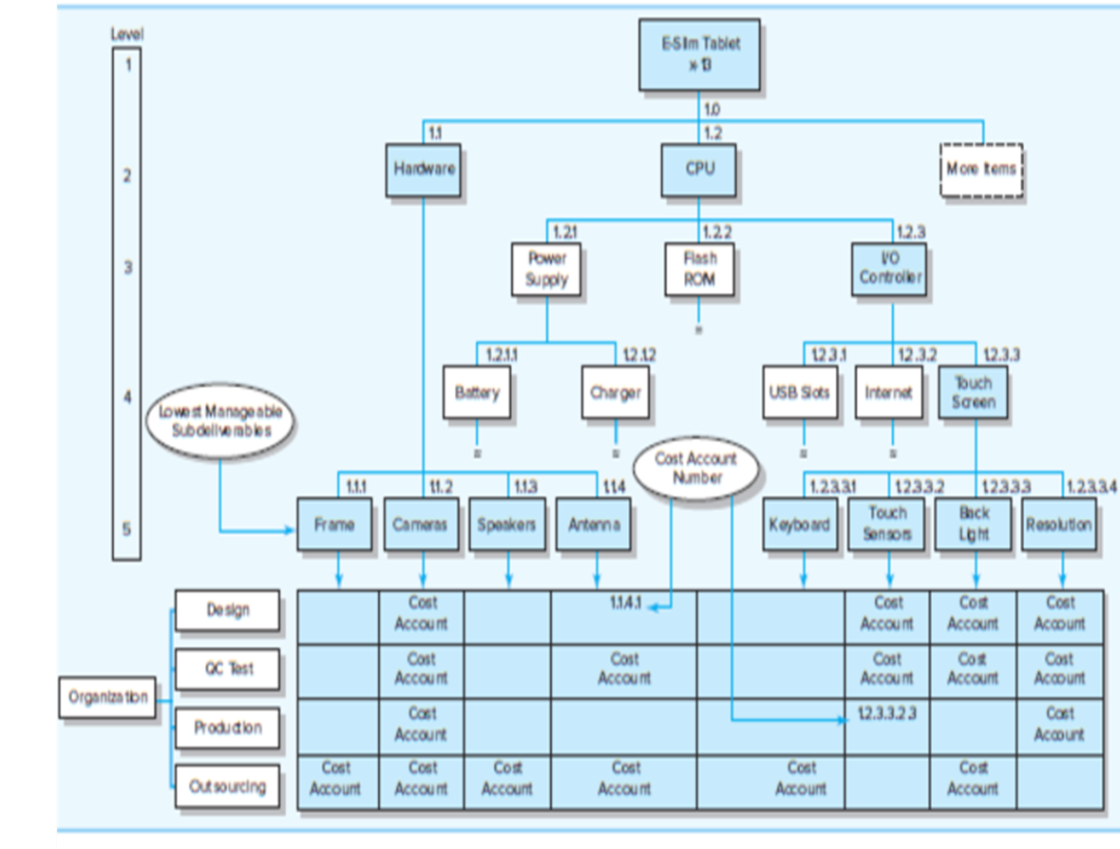
level 2 indicates there are two major deliverables—Hardware and CPU, or central processing unit. At level 3, the CPU is connected to three deliverables—Power Supply, Flash ROM, and I/O Controller. The I/O Controller has three sub deliverables at level 4—USB Slots, Internet, and Touch Screen. The many sub deliverables for USB Slots and Internet have not been decomposed. The Touch Screen (shaded) has been decomposed down to level 5 and to the work package level.

Slide 18
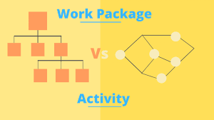
The lowest level of the WBS is called a work package. Work packages are short duration tasks that have a definite start and stop point, consume resources, and represent cost. Each work package is a control point. A work package manager is responsible for seeing that the package is completed on time, within budget, and according to technical specifications. Practice suggests a work package should not exceed 10 workdays or one reporting period. If a work package has a duration exceeding 10 days, check or monitoring points should be established within the duration, say, every three to five days, so progress and problems can be identified before too much time has passed. Each work package of the WBS should be as independent of other packages of the project as possible. No work package is described in more than one sub deliverable of the WBS.

Slide 19
Work package, Planning package and Control account
Work package: is a group of related tasks within a project. Because they look like projects themselves, they are often thought of as sub-projects within a larger project. Work packages are the smallest unit of work that a project can be broken down to when creating your Work Breakdown Structure (WBS)
Planning Package is a work breakdown structure component below the control account with known work content but without detailed schedule. A planning package may be converted to a work package when the lowest-level details of the work are defined, budgeted, and scheduled. a planning package stores future work until the work can be broken down into specific tasks and assigned to actual resources, when it becomes part of the Work Breakdown Structure (WBS) in the form of work breakdown packages.
Control Account is a management control point where scope, cost, and schedule are integrated and compared to the earned value for performance measurement. Control Accounts are placed at selected management points in the WBS. Each Control Account is defined with a unique code or an accounting number which can be used to link to the performing account system.

Slide 20
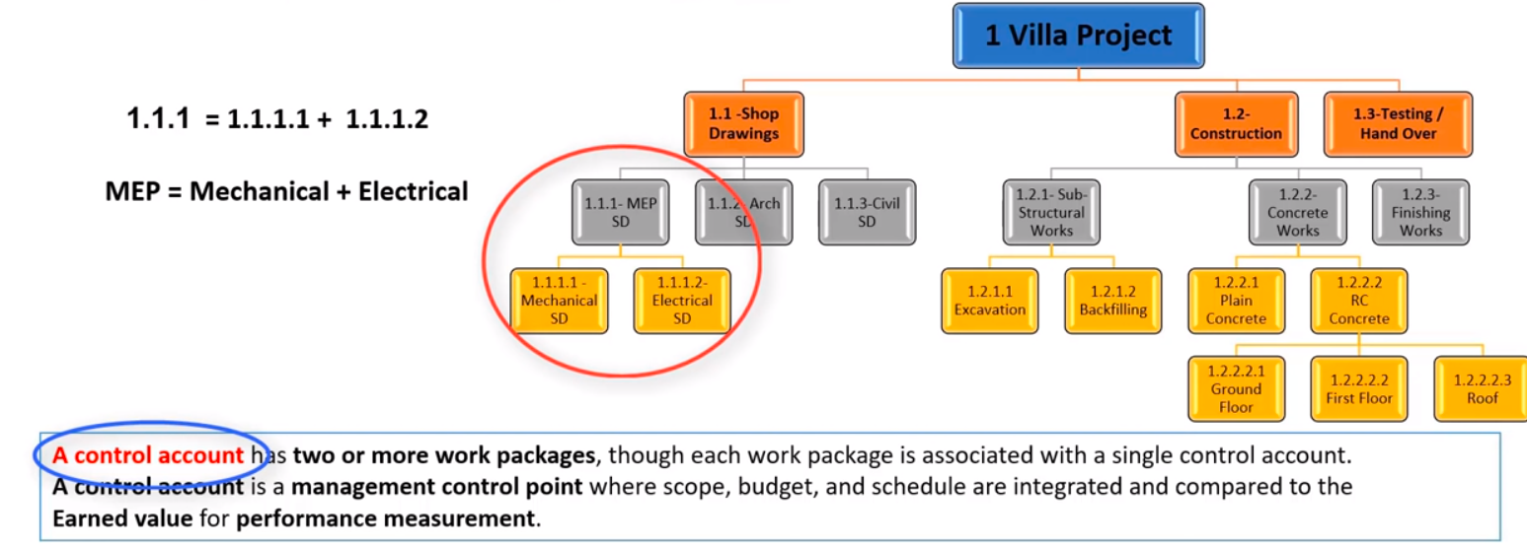
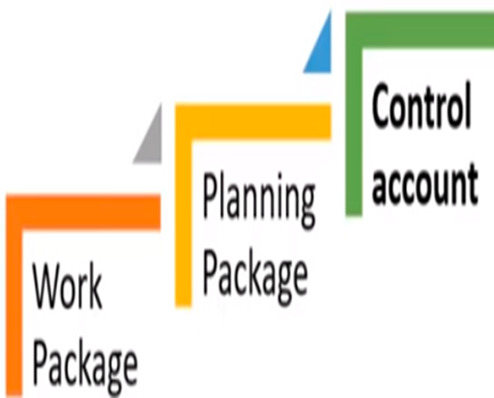

Slide 21
To review, each work package in the WBS
1. Defines work (what).
2. Identifies time to complete a work package (how long).
3. Identifies a time-phased budget to complete a work package (cost).
4. Identifies resources needed to complete a work package (how much).
5. Identifies a single person responsible for units of work (who).
6. Identifies monitoring points for measuring progress (how well).

Slide 22

Remember!
Project managers should take advantage of relevant examples from previous projects to begin the process.
WBSs are products of group efforts. If the project is small, the entire project team may be involved breaking down the project into its components. For large, complex projects, the people responsible for the major deliverables are likely to meet to establish the first two levels of deliverables. In turn, further detail would be delegated to the people responsible for the specific work. Collectively this information would be gathered and integrated into a formal WBS by a project support person.
The final version would be reviewed by the inner echelon of the project team. Relevant stakeholders (most notably customers) would be consulted to confirm agreement and revise when appropriate.

Slide 23

Remember!
Project teams developing their first WBS frequently forget that the structure should be end-item, output oriented.
First attempts often result in a WBS that follows the organization structure—design, marketing, production, finance. If a WBS follows the organization structure, the focus will be on the organization function and processes rather than the project output or deliverables.
A WBS with a process focus will become an accounting tool that records costs by function rather than a tool for “output” management.
Every effort should be made to develop a WBS that is output oriented in order to concentrate on concrete deliverables.

Slide 24

Learning Summary and Evaluation 1
The main idea I have learnt?
A new word I have learnt today is? It means……
How could I apply these ideas towards my course studies and career aspiration?

Slide 25

1. What is a WBS?
A work breakdown structure ( WBS ) is a chart or document used to organize project work into a list of work packages ( activities and tasks ) so that all work stays on track to meet project goals.

Slide 26
Learning Check
Can you work out where you would put the following elements?
Planning package
Work package
Control account
1. The lowest level of the WBS is called _______________.
2. ______________ is a work breakdown structure component with known work content but without detailed schedule.
3. _____________ is a management control point where scope, cost, and schedule are integrated and compared to the earned value for performance measurement.
How many did you get right?

Slide 27
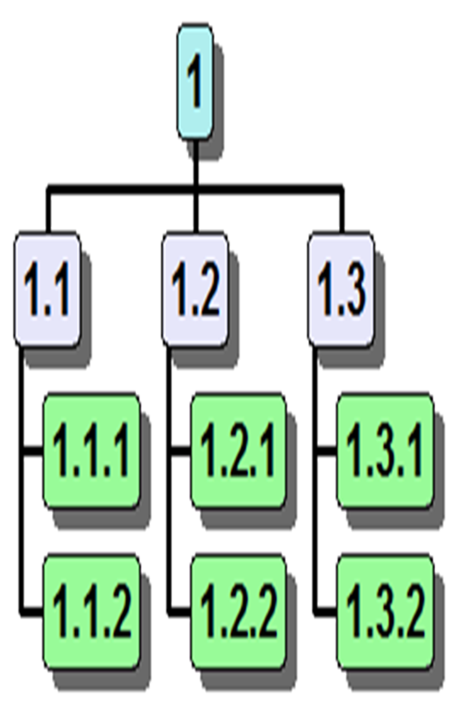
Coding the WBS
Gaining the maximum usefulness of a breakdown structure depends on a coding system.
The codes are used to define levels and elements in the WBS, organization elements, work packages, and budget and cost information.
The codes allow reports to be consolidated at any level in the structure. The most used scheme in practice is numeric indention. Note the project identification is 1.0. Each successive indention represents a lower element or work package. Ultimately the numeric scheme reaches down to the work package level, and all tasks and elements in the structure have an identification code. The “cost account” is the focal point because all budgets, work assignments, time, cost, and technical performance come together at this point.

Slide 28
This coding system can be extended to cover large projects. Additional schemes can
be added for special reports. For example, adding a “23” after the code could indicate
a site location, an elevation, or a special account such as labor. Some letters can be used as special identifiers such as “M” for materials or “E” for engineers. You are not limited to only 10 subdivisions (0–9); you can extend each subdivision to large numbers—for example, .1−.99 or .1−.9999. If the project is small, you can use whole numbers

Slide 31

Responsibility Matrices
One tool that is widely used by project managers is the responsibility matrix (RM). The RM (sometimes called a linear responsibility chart) summarizes the tasks to be accomplished and who is responsible for what on a project. In its simplest form an RM consists of a chart listing all the project activities and the participants responsible for each activity.

Slide 32
Why responsibility Matrices?
Responsibility matrices provide a means for all participants in a project to view their responsibilities and agree on their assignments.
They also help clarify the extent or type of authority exercised by each participant in performing an activity in which two or more parties have overlapping involvement.
By using an RM and by defining authority, responsibility, and communications within its framework, the relationship between different organizational units and the work content of the project is made clear

Slide 33
Example 1
This figure illustrates a RM for a market research study.
In this matrix the R is used to identify the committee member who is responsible for coordinating the efforts of other team members assigned to the task and making sure that the task is completed.
The S is used to identify members of the five-person team who will support and/or assist the individual responsible.
Simple RMs like this one are useful not only for organizing and assigning responsibilities for small projects but also for subprojects of large, more complex projects.

Slide 34
More complex RMs not only identify individual responsibilities but also clarify critical interfaces between units and individuals that require coordination.
For example, This is an RM for a larger, more complex project to develop a new piece of automated equipment. Notice that within each cell a numeric coding scheme is used to define the nature of involvement on that specific task. Such an RM extends the WBS/OBS and provides a clear and concise method for depicting responsibility, authority, and communication channels.
Example 2

Slide 37
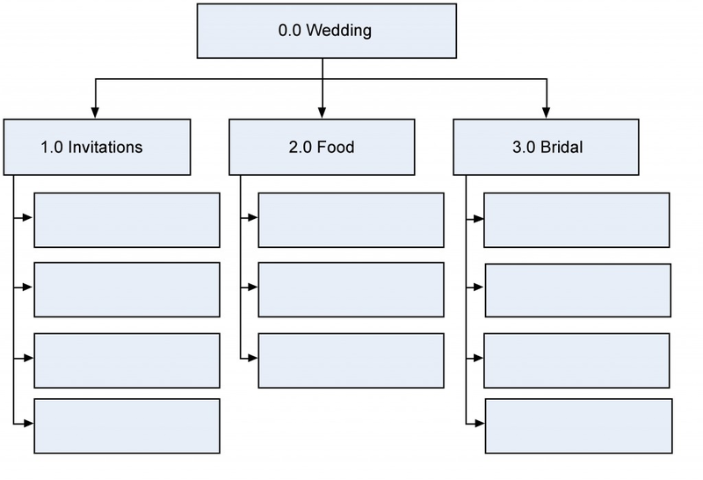
Case Study: Wedding Deliverables
Remember!
WBS follows 100% rule

Slide 38
Deliverables Decompose into Work Packages
Shop for shoes
Create guest list
Have the tailoring and fitting done
Shop for dress
Find caterer
Cater the wedding
Wait for RSVPs
Mail the invitations
Finalize the menu
Print the invitations
Choose the bouquet

Slide 39
Summary
The scope definition provides focus and emphasis on the end item(s) of the project. Establishing project priorities allows managers to make appropriate trade-off decisions. The WBS structure helps ensure all tasks of the project are identified and provides two views of the project—one on deliverables and one on organization responsibility
The WBS avoids having the project driven by organization function or by a finance system. The structure forces attention to realistic requirements of personnel, hardware, and budgets.
Use of the structure provides a powerful framework for project control that identifies deviations from plan, identifies responsibility, and spots areas for improved performance.

Slide 40
The greatest benefit of developing a work breakdown structure is providing a common understanding of all the work required to deliver the product or service.
The hierarchical approach (level planning process) to project planning is most appropriate and can be aided by a tree diagram of project subsets, called a Gozinto chart, and a Work Breakdown Structure (WBS).
The WBS relates the details of each subtask to its task and provides the final basis for the project budget, schedule, personnel, and control.
A linear responsibility chart is often helpful to illustrate the relationship of personnel to project tasks and to identify where coordination is necessary.

Slide 41
What is next?
In the next lecture, we will we cover the knowledge area and discuss “Budgeting, Estimating costs and Project risk management”, the process of identifying, analyzing, and responding to project risk.

Slide 42

Glossary
Hierarchical Planning A planning approach that breaks the planning task down into the activities that must be done at each managerial level. Typically, the upper level sets the objectives for the next lower level.
Milestones Natural subproject ending points where payments may occur, evaluations may be made, or progress may be reassessed.
Deliverables The physical items to be delivered from a project. This typically includes reports and plans as well as physical objects.
RACI matrix: A table showing for each project task, who is responsible, accountable, who can be consulted, and who needs to be informed.( Also known as responsibility or assignment chart)

Slide 43
Discussion Questions
Assignment Discussion.
In what ways may the WBS be used as a key document to monitor and control a project?
Describe the process of subdivision of activities and events that composes the Work Breakdown Structure. Why is the input of responsible managers and workers so important an aspect of this process?

Slide 44
Resources

Slide 45


