Slide 1


Cybersecurity
Concepts
Prepared by Dr. Diaa Salama
FNT625
Network Basics
Lecture 1

Slide 2




Cybersecurity
Concepts
Lecture 1
FNT625
Network Basics
Prepared by
Dr. Diaa Salama
www.midocean.ae

Slide 3
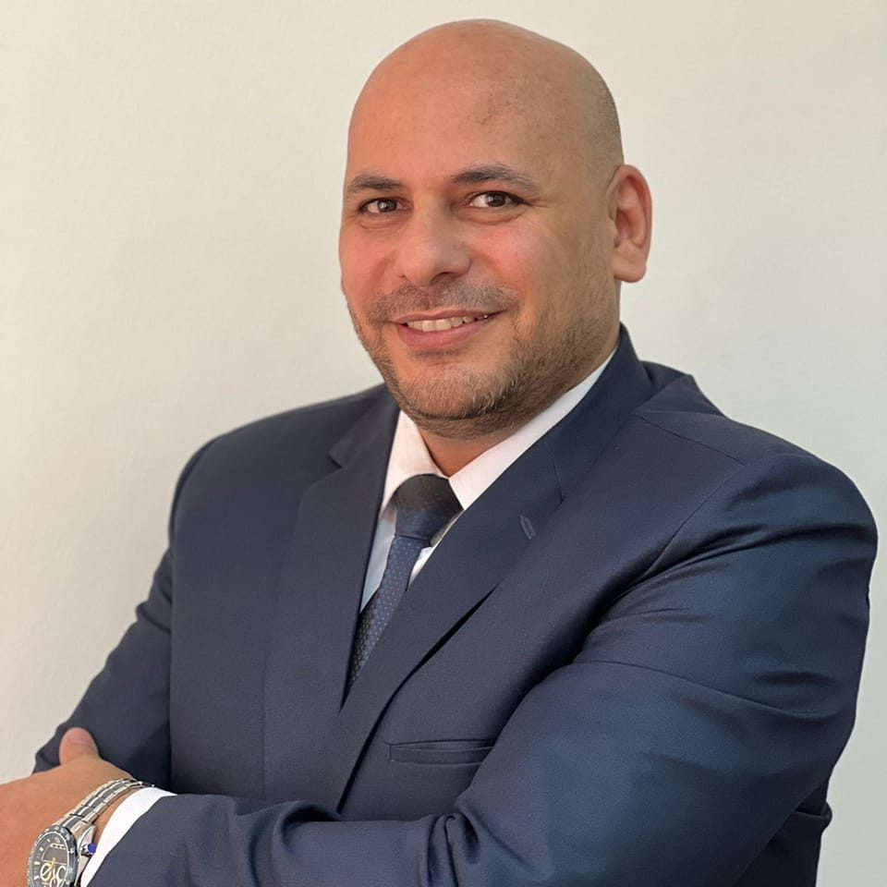
www.midocean.ae
Associate Professor, Data Science Department, Faculty of Computers Science , Misr International University, On Leave from Faculty of Computers & Artificial Intelligence, Banha University, Banha, Egypt.
Member, National Committee of Communications and Information Technology, Academy of Scientific Research & Technology, CAIRO, Egypt.
Member, International Telecommunication Union (ITU), United Nations (UN)
Member, International Federation for Information Processing - IFIP
Winner of the Arab Republic of Egypt Encouragement Award for Advanced Science and Technology in the Field of Engineering Sciences 2021
Winner of the Benha University Encouragement Award for Advanced Science and Technology in the Field of Engineering Sciences 2019
Winner of the DELL EMC AWARD for the academic year 2015/2016, 2016/2017, and 2017/2018
Dr.Diaa Salama Ph.D
One of the top 2% Scientists worldwide 2023 by Stanford university ranking.

Slide 4
Lecture
Course Info
01
Instructor: | Associate Professor : Diaa Salama
Subject Name: | Cybersecurity Concepts
Subject Code: | FNT625
Program name: | Master of Financial Technology
University Name: | Midocean
Faculty | Faculty of Humanities
Department | Financial Technology
Academic Year | 2024
Teaching Language | English
Date of establishment of the curriculum plan/Date of review of the curriculum plan. | 2024
www.midocean.ae

Slide 5

Lecture
Lets Start our Course
01
Basics Terminology
www.midocean.ae

Slide 6
Lecture
What is Cyber Security (Network Security) !
01
A network is simply two or more computers linked together to share data, information or resources.
Security : prevention of system Crash
www.midocean.ae

Slide 7
Lecture
Basic Terminologies
01
Computer Security - generic name for the collection of tools designed to protect data
Network Security - measures to protect data during their transmission
Internet Security - measures to protect data during their transmission over a collection of interconnected networks
www.midocean.ae

Slide 8
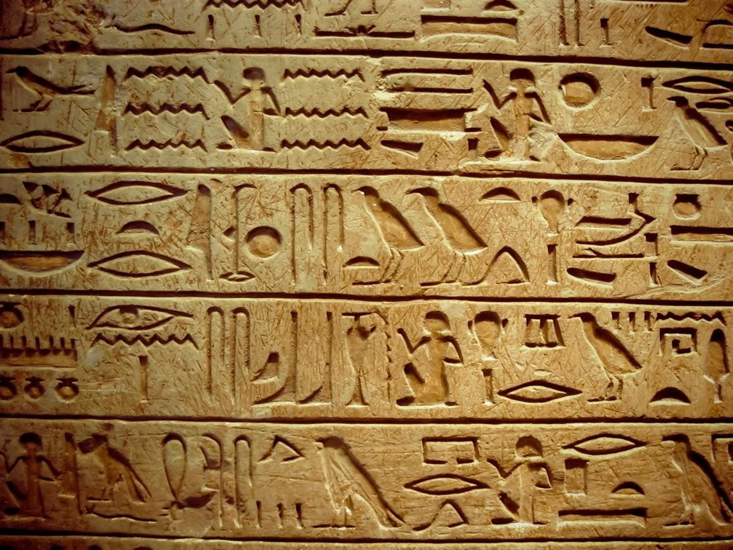
Lecture
Cryptography
01
Cryptography: is the science of secret writing and is an ancient art; the first documented use of cryptography in writing dates back to 1900 B.C. when an Egyptian scribe used non- standard hieroglyphs in an inscription (handwriting).
www.midocean.ae

Slide 9

Lecture
Basic Terminologies
01
The protection afforded to an automated information system in order to attain the applicable objectives of preserving the integrity, and confidentiality of information system resources includes hardware, software, firmware, information/data, and telecommunications)
Availability
Integrity
Confidentiality
CIA triad

Slide 10

Lecture
confidentiality
01
Ensuring that no one can read the message except the intended receiver.
Preserving authorized restrictions on information access and disclosure (detection), including means for protecting personal privacy and proprietary information. A loss of confidentiality is the unauthorized disclosure of information.
I O D Q N H D V W
D W W D F N D W G D Z Q
www.midocean.ae

Slide 11
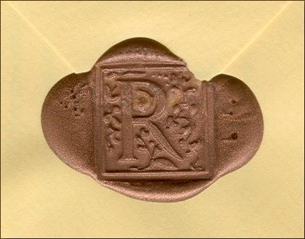
Lecture
integrity
01
Assuring the receiver that the received message has not been altered in any way from the original.
Guarding against improper information modification or destruction, including ensuring information nonrepudiation and authenticity. A loss of integrity is the unauthorized modification or destruction of information.
www.midocean.ae

Slide 12
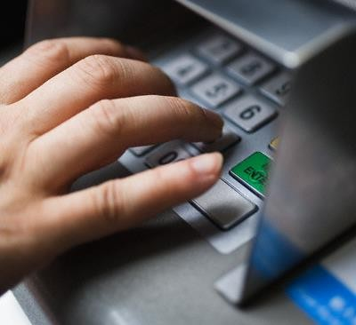
Lecture
availability
01
Ensuring timely and reliable access to and use of information.
A loss of availability is the disruption (confusion) of access to or use of information or an information system.
www.midocean.ae

Slide 13
Lecture
Network Basics
01
1
CISCO Company
2
Introduction to CCNA
3
Introduction to Computer Networks
4
How to Setup a LAN
www.midocean.ae

Slide 14
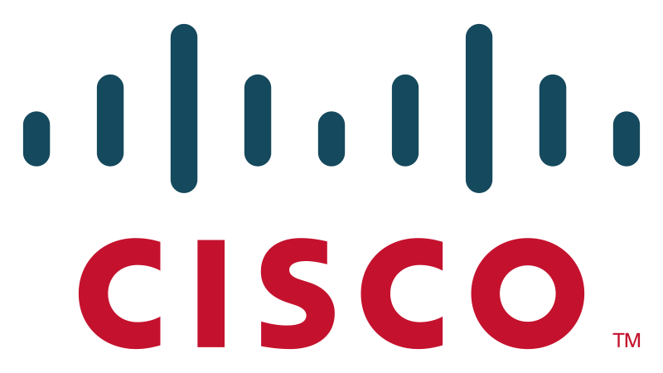
Company
www.midocean.ae

Slide 15
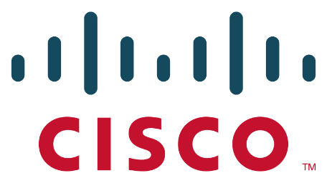
Lecture
CISCO Company
01
It is an American multi-national corporation technology company headquartered in San Jose, California.
The company designs, manufactures and sells networking equipment worldwide (such as switches, routers,….).
It is the largest networking company in the world.
Cisco Systems was founded in December 1984 by Leonard Bosack.
www.midocean.ae

Slide 16
Lecture
CISCO Company
01
Leonard Bosack was in charge of the Stanford University computer science department's computers.
His wife Sandy Lerner, who managed the Graduate School of Business' computers.
The name "cisco" was derived from the city name, San Francisco, which is why the company's engineers insisted on using the lower case "cisco" in its early years.
The logo is intended to depict the two towers of the Golden Gate Bridge.
www.midocean.ae

Slide 17

CISCO Company
www.midocean.ae
The two towers of the Golden Gate Bridge.

Slide 18
Introduction to CCNA
www.midocean.ae

Slide 19
Cisco Courses
Cisco Courses
Voice
Telephone over IP & Communication Lines
Security
Hardware/Software
How to secure network infrastructure
R&S
Routing and Switching
www.midocean.ae

Slide 20

Cisco Courses
Cisco Courses
Voice
Telephone over IP & Communication Lines
Security
Hardware/Software
How to secure network infrastructure
R&S
Routing and Switching
www.midocean.ae

Slide 21
List of Acronyms
CCNA Cisco Certified Network Associate
CCNP
Cisco Certified Network Professional
CCIE Cisco Certified Internetwork Expert
www.midocean.ae

Slide 22
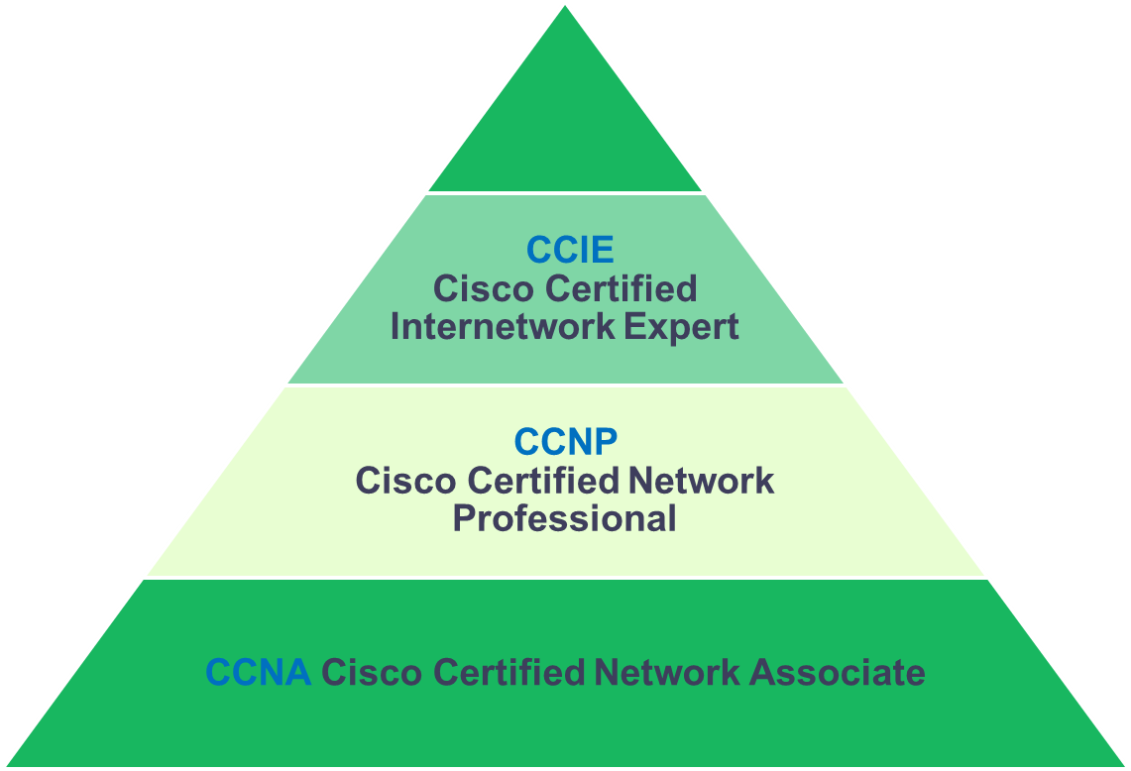
Cisco Certificates
Cisco Voice Certificates Levels:
  CCNA Voice.
  CCNP Voice.
  CCIE Voice.
Cisco R&S Certificates Levels:
  CCNA R&S.
  CCNP R&S.
  CCIE R&S.
Cisco Security Certificates Levels:
  CCNA Security.
  CCNP Security.
  CCIE Security.
www.midocean.ae

Slide 23
Cisco Certificates
Cisco Voice Certificates Levels:
  CCNA Voice.
  CCNP Voice.
  CCIE Voice.
Cisco R&S Certificates Levels:
  CCNA R&S.
  CCNP R&S.
  CCIE R&S.
Cisco Security Certificates Levels:
  CCNA Security.
  CCNP Security.
  CCIE Security.
www.midocean.ae

Slide 24
Cisco CCNA R&S Certificates
CCNA (200-125)
ICND 1
(100-105)
ICND 2
(200-105)
www.midocean.ae

Slide 25
Introduction to Computer Networks
www.midocean.ae

Slide 26
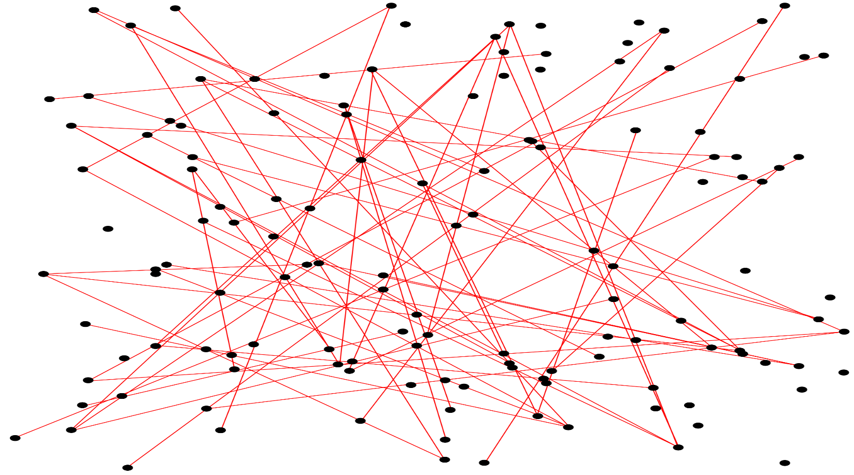

Introduction to Computer Networks
How to communicate each point to another point or points.
www.midocean.ae

Slide 27
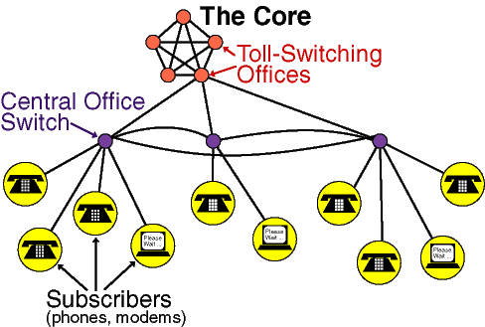
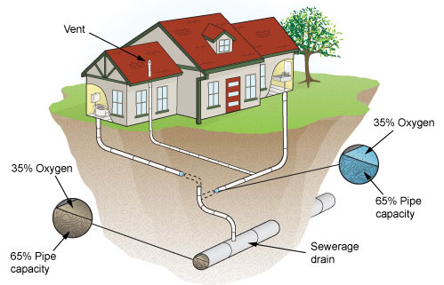
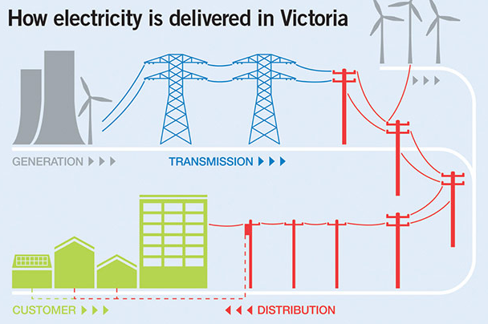

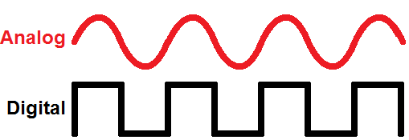
Introduction to Computer Networks
Networks
Drainage networks
Telephone networks
Electricity networks
Difficult for data transmission
www.midocean.ae

Slide 28
Types of Computer Networks
www.midocean.ae

Slide 29
Types of Computer Networks
Network Types
LAN
Local Area Network
WAN
Wide Area Network
MAN
External network
not Large network
Internal network
not small network
Hardware:
Cables
Switch
Pc with NIC [network
interface card]
Hardware:
Cables
Switch
Pc with NIC [network
interface card]
Router
www.midocean.ae

Slide 30
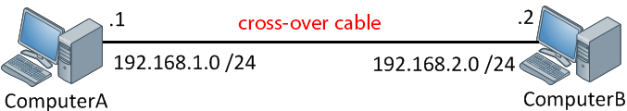
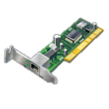

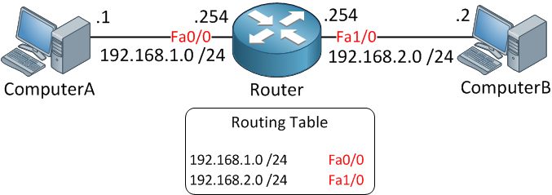
Introduction to Computer Networks
Connecting two Computers on the same location (e.g. in Lab).
Connecting two Computers on different and distant locations.
www.midocean.ae

Slide 31
How to Setup a LAN
www.midocean.ae

Slide 32
How to Setup a LAN
LAN
Component
Hardware
Software
Hardware:
Cables
Switch
Pc with
NIC [network
interface card]
www.midocean.ae

Slide 33
1- Cables
www.midocean.ae

Slide 34
Cables
Cables
Type | Scientific Name | Speed/distance Data transfer | Comments
Coaxial Cable | Thin 10 base 2 (20 milli) (Megabit/s) Thick 10 base 5 (50 milli) (Megabit/s) Thick 100 base 5 (Megabit/s) Thick 1000 base 5 (1000 Megabit/s) | 100 m (long distance need repeater). 500 m | Cable is not elastic so it is not practical for long distance. It uses BNC connector for terminals so it needs a converter to connect to a switch or router device . It is expensive
UTP unshielded twisted pair | 10 base T (Twisted Pair). In market it is famous with Cat 5 (max speed 10 Megabit/s) Cat 5 e (enhanced max) max speed 100 Megabit/s Cat 6 (max speed 1000 Megabit/s ) | 100 m Connector RJ45 | It is not expensive It is connected directly to switch or router.
Thickness
Max
Speed
If cable speed is 10 means 10 Mega bits/second
Network speed is measured by bit.
While storing data is measured by byte.
www.midocean.ae

Slide 35
Cables
Type | Scientific Name | Speed/distance (Data transfer) | Comments
STP shielded twisted pair | 10 base T (Twisted Pair). In market it is famous with Cat 5 (max speed 10 Megabit/s) Cat 5 e (enhanced max) max speed 100 Megabit/s Cat 6 (max speed 1000 Megabit/s) | 100 m Connector RJ45 | It is expensive It is connected directly to switch or router.
Fiber Optics | 10 base F | 300 km/s
www.midocean.ae

Slide 36
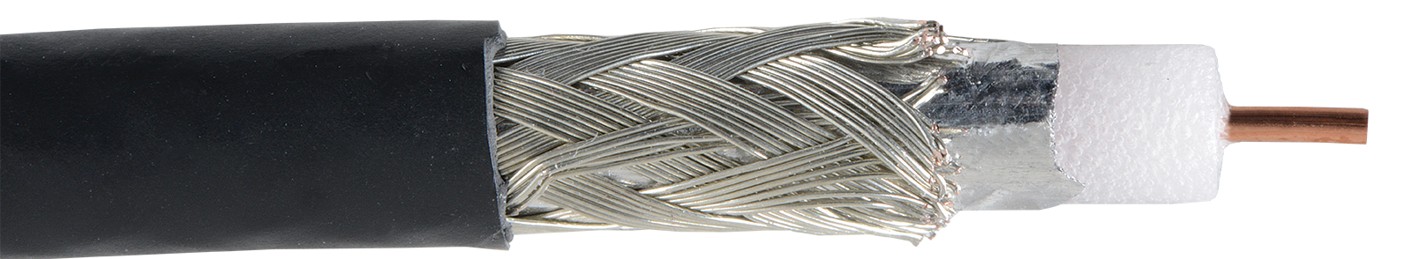
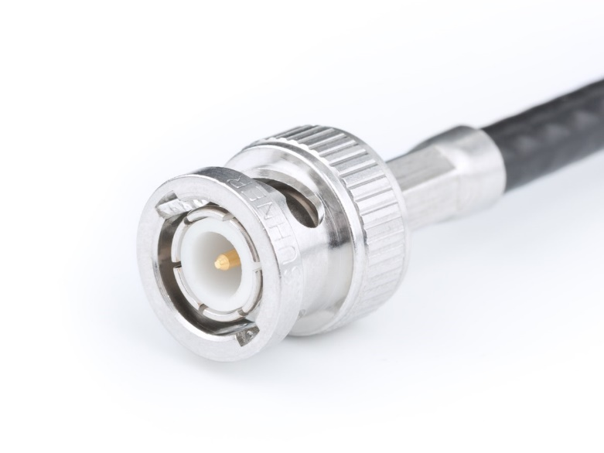
Coaxial Cable
www.midocean.ae

Slide 37
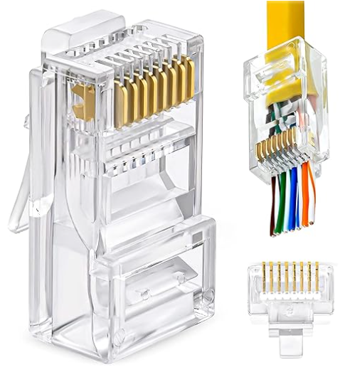
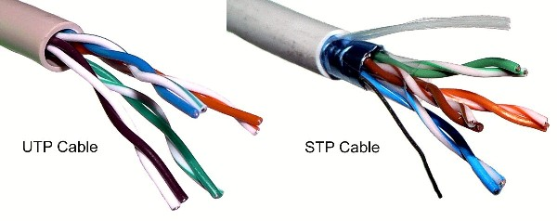
Unshielded Twisted Pair (UTP) VS (STP)
www.midocean.ae

Slide 38
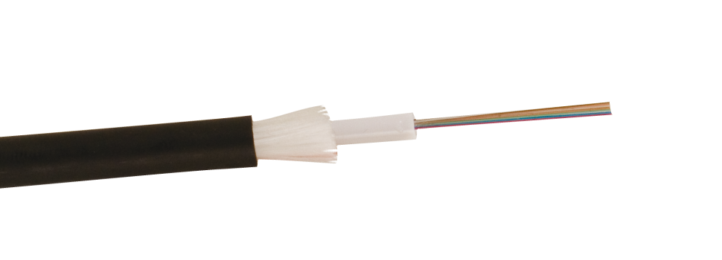
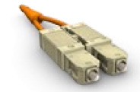
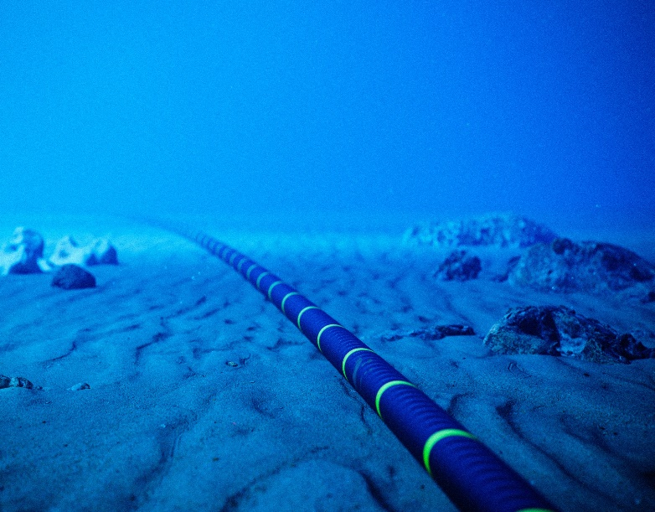
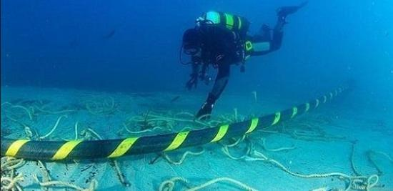
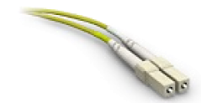
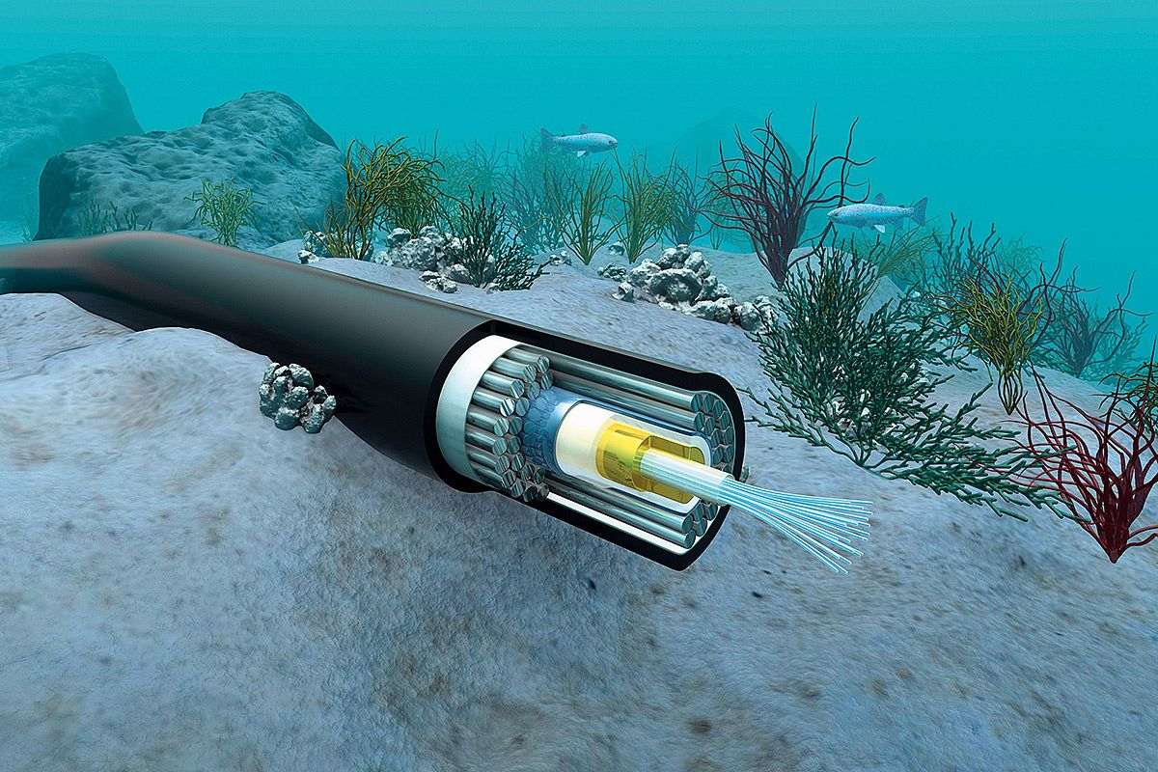
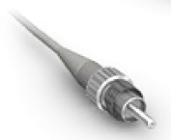
Fiber Optics
Standard Connector
Lucent Connector
Straight Tip Connector
www.midocean.ae

Slide 39
Fiber optics Cables
Two types of optical cables: single-mode and multimode
Single-mode | Multimode
Carries single beam of light | Can carry multiple beams of light simultaneously
Distance up to 10km | Used for short distance (Modal dispersion weakens signal strength after certain distance )
Single-mode Fiber
Multimode Fiber

Slide 40
Fiber Optics
Standard Connector
Lucent Connector
Straight Tip Connector
www.midocean.ae

Slide 41



Thank You

