Slide 1


Change Management
Prepared by Dr. Ranya Mahfouz
MGM323
Lecture 7

Slide 2


Change Management
Lecture 7
Cultural change
MGM323
Prepared by
Dr. Ranya Mahfouz

Slide 3
Agenda The Part Two - The applications
Introduction
Culture change definition
The trigger for a culture change
The importance of measuring culture change
The techniques of measuring culture change

Slide 4

Change Management
This subject is about learning how to manage change. The world around us is changing very quickly. Almost every day, there is a new discovery or innovation, especially in science. Globalization also has a big effect on how we think about politics and business. At the same time, the problems that come with globalization are growing just as fast, which is also a big concern.

Slide 5

Content
1 Individual change
Learning and the process of change
2 Team change
What is a group and when is it a team?
3 Organizational change
How organizations really work
4 Leading change
Roles that leaders play
5 The change agent
Models of change agency

Slide 6
Content
6 Mergers and acquisitions
The purpose of merger and acquisition activity
7 Cultural change
Guidelines for achieving successful cultural change
8 IT-based process change
The role of IT management
9 Complex change
When is change complex?
10 Leading change in uncertain times
The impact of uncertainty on our working lives

Slide 7
Agenda The Part Two - The applications
Introduction
Culture change definition
The trigger for a culture change
The importance of measuring culture change
The techniques of measuring culture change

Slide 8

Chapter
07
Culture change definition
Culture change, also referred to as cultural transformation, is a set of activities an organization undertakes to change the behaviors and mindsets of employees to achieve strategic goals. A culture change is usually a gradual process that can be observed over a medium to a long period of time.

Slide 9
Agenda The Part Two - The applications
Introduction
Culture change definition
The trigger for a culture change
The importance of measuring culture change
The techniques of measuring culture change

Slide 10
Chapter
07
The trigger for a culture change
The trigger for a culture change is when the current culture of the business doesn’t align with its vision, mission, core values, and strategic objectives. This misalignment indicates to the leadership that the culture has become a barrier to achieving the organization’s goals.

Slide 11
Agenda The Part Two - The applications
Introduction
Culture change definition
The trigger for a culture change
The importance of measuring culture change
The techniques of measuring culture change

Slide 12
Chapter
07
The importance of measuring culture change
Culture change is a big undertaking, which requires a lot of effort and big investments in terms of resources. It requires a focused effort of leadership, management, and employees over a long period. If done correctly, it can have a monumental outcome for your employee experience and the business results.

Slide 13
Chapter
07
The importance of measuring culture change
For this reason, measuring culture change is necessary to know how the business is progressing and what impact the transformation has on the business.
Measuring culture change requires a mixture of quantitative metrics and qualitative techniques. By measuring culture change, it's able to the following:

Slide 14

Chapter
The importance of measuring culture change
07
1- Evaluating the success of the initiatives
It could assess if the culture change initiative has the desired impact. As you’re investing a lot of resources and effort into creating culture change, you need to understand if it’s bringing you the results you expected, and if not, why not.

Slide 15
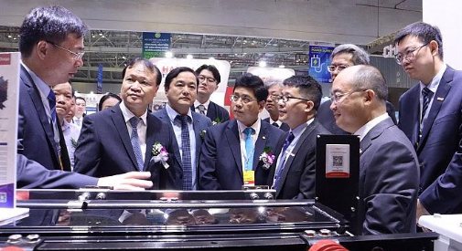
Chapter
The importance of measuring culture change
07
2- Showcasing the results
It could show the impact the culture change has on your business in a measurable way, which helps you speak the business leadership language. Cultural change requires a time and money investment, so showing the outcome and results is essential.

Slide 16
Chapter
The importance of measuring culture change
07
2- Showcasing the results
Alongside organizational structural changes, Microsoft’s CEO Satya Nadella had the goal to transform the culture to ensure they reach their goals. A new Microsoft vision was developed, which was “to empower every person and every organization on the planet to achieve more.”
Prior to the restructure, employees lacked a sense of purpose, and engagement scores were quite low. Through various culture initiatives and realignment of their purpose, Microsoft was able to get back on track. One of the outcomes was notable stock price growth:

Slide 17
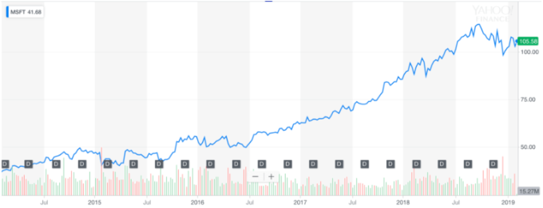
Chapter
The importance of measuring culture change
07
2- Showcasing the results

Slide 18
Chapter
07
The importance of measuring culture change
2- Showcasing the results
Microsoft’s Financial Highlights in 2025 —
Microsoft experienced substantial financial growth throughout 2025, driven by strong performance in cloud computing and artificial intelligence. The key financial metrics for the year were as follows:
Annual Revenue: $245.12 billion
Annual Net Income: $88.14 billion
Earnings Per Share (EPS) for the 12-month period: $13.00 USD
Highest Share Price through July 2025: $506.78 USD
Total Employees: 228,000 (representing a 3.1% year-over-year increase)

Slide 19
Chapter
The importance of measuring culture change
07
3- Uncovering points of improvement
If the desired results aren’t there, you can use data to look into what I could improve and how to cement the culture change further. By understanding how your transformation is progressing, it can uncover obstacles in the internal and external environment.

Slide 20
Agenda The Part Two - The applications
Introduction
Culture change definition
The trigger for a culture change
The importance of measuring culture change
The techniques of measuring culture change

Slide 21
Chapter
07
The techniques of measuring culture change
Measuring company culture, as well as measuring culture change, is not easy. It has to identify how to translate the culture into measurable elements, and if there is a need to measure the outcomes of the change. Here are some ways to measure culture change:

Slide 22

Chapter
The techniques of measuring culture change
07
1. Identify KPIs relevant to your culture change goals
Rome was not built in a day, and so too changing corporate culture is not a quick fix. A KPI (key performance indicator) provides a quantifiable measure of your culture change over a period of time. It indicates the milestones along the way to let you know you’re on track and acts as a benchmark to provide insights to make better decisions in the future.

Slide 23
Chapter
The techniques of measuring culture change
07
2. Use the Organizational Culture Assessment Instrument (OCAI)
The Organizational Culture Assessment Instrument helps you identify what your company culture is like and how it differs from your desired organizational culture. You can also use the assessment to measure culture change over time by comparing the before and after results.

Slide 24
Chapter
The techniques of measuring culture change
07
2. Use the Organizational Culture Assessment Instrument (OCAI)
Developed by Kim Cameron and Robert Quinn, the tool identifies four types of company culture. The company culture exists “along with a competing values framework,” which are:
Flexibility & Discretion vs. Stability & Control
Internal Focus & Integration vs. External Focus & Differentiation

Slide 25
Chapter
The techniques of measuring culture change
07
3. Use the Organizational Culture Inventory
The Organizational Culture Inventory (OCI) is another diagnostic tool that enables you to measure culture change. It uses over 35 years of research and measures the attributes of company culture relayed to the behavior and performance of employees. After completing a survey, it reveals the collective beliefs in the organization, behavioral norms, and thus the foundations for culture change.

Slide 26
Chapter
The techniques of measuring culture change
07
4. Keep track of your Glassdoor ratings
It could see how the Culture & Values rating is developing on Glassdoor throughout a specific period of time. This indicates how the employees’ perception of the company’s culture is changing.
The company ratings on Glassdoor are based on recent employee feedback, which is calculated through a proprietary rating algorithm. The more recent the review, the heavier its weight on your company’s rating. So, it’s a good measure to understand if any recent culture initiatives have shifted your ranking.
A Glassdoor ranking looks something like this:

Slide 27
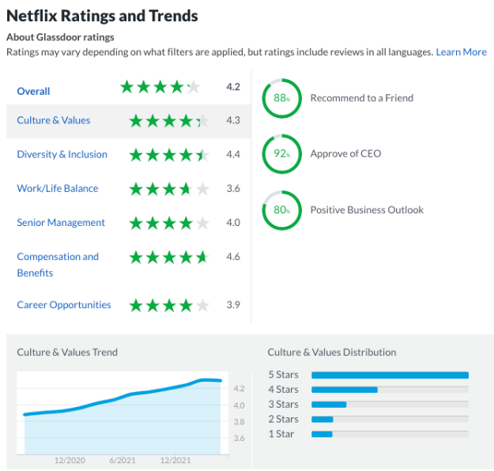
Chapter
The techniques of measuring culture change
07
4. Keep track of your Glassdoor ratings

Slide 28
Chapter
The techniques of measuring culture change
07
5. Conduct a sentiment analysis
Sentiment analysis is increasingly used in HR to understand what employees are thinking. A variety of text-based data like onboarding and offboarding feedback, performance reviews, etc., is analyzed through dedicated software. It can help you see how employees perceive your organization’s culture.
For example, suppose the goal of your culture change is to promote the feeling of belonging with the ultimate goal of retaining a diverse workforce. In that case, you can analyze the sentiment around this (next to your retention data).

Slide 29
Chapter
The techniques of measuring culture change
07
5. Conduct a sentiment analysis
Sentiment analysis software analyses a variety of qualitative sources:
Diary notes / comments
Performance feedback check-ins
Offboarding data
Compliance policies
Policy updates
Client feedback
Any textual records
Employee survey feedback

Slide 30
Chapter
The techniques of measuring culture change
07
5. Conduct a sentiment analysis
Through the use of Natural Language Processing (NLP), the combinations of phrases and words from the above sources are classified into positive, negative, or neutral and scored on a scale from -1.0 to +1.0. Here is an example from intelliHR:

Slide 31
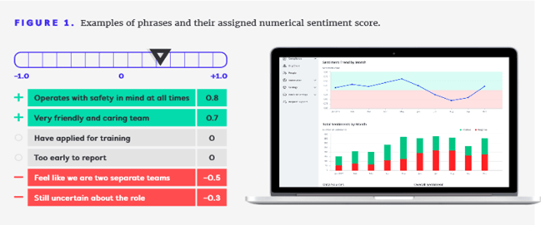
Chapter
The techniques of measuring culture change
07
5. Conduct a sentiment analysis
www.midocean.ae

Slide 32
Chapter
The techniques of measuring culture change
07
6. Organize a focus group
An employee focus group is an effective way to have a moderated discussion to gather specific feedback on your company culture. To measure whether there has been any culture change through your focus group, conduct them periodically and note any changes. You would be able to notice the changes through the analysis of your focus group’s results (identify key trends; analyze actual quotes from the focus group; develop a formal report). Some examples you might ask include:

Slide 33
Chapter
The techniques of measuring culture change
07
6. Organize a focus group
What company culture shifts have you noticed in the past quarter?
How would you describe internal communication in this company? (If your goal has been to improve internal communication)
How does the company help you with your professional development? (If your goal is to improve the learning culture)

Slide 34
Chapter
The techniques of measuring culture change
07
6. Organize a focus group
How would you define the leadership in the company?
How do you believe the company defines success?
Do you feel the company is committed to diversity and inclusion?
You should formulate the questions based on the culture change you want to observe. And the same questions should be asked again after a defined period of time so that you can compare results and measure culture change.

Slide 35
Chapter
The techniques of measuring culture change
07
7. Measure your eNPS
Employee net promoter score (eNPS) is frequently used to measure employee engagement in a survey. Employees answer the question “On a scale from 1-10, how likely are you to recommend this organization as a place to work?” or “Based on your experience, how likely are you to recommend our organization to a friend or colleague?”
Improvements in your eNPS might be a good indicator of the success of your culture change efforts.

Slide 36
Chapter
The techniques of measuring culture change
07
8. Employ a dedicated culture measurement tool
Dedicate culture measurement tools are also useful when measuring culture change at your organization. Some of them include:
CultureAmp is a powerful platform that uses continuous listening, feedback, and various development tools to improve employee engagement and performance over time. The various metrics provided by CultureAmp can measure the success of your culture efforts over time.

Slide 37
Chapter
The techniques of measuring culture change
07
8. Employ a dedicated culture measurement tool
Perceptyx uses employee surveys, social listening, and people analytics to gather insights within the organization. It is a useful tool to turn your culture data into insights and measure change over time.

Slide 38
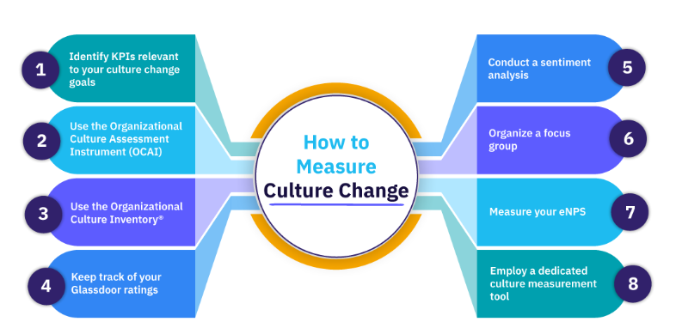
Chapter
The techniques of measuring culture change
07

Slide 39
Chapter
The techniques of measuring culture change
07
The ways you choose to measure culture change will depend on the goals you’ve set for the transformation. Combining several methods of measuring culture change will give you an excellent insight into the impact your change initiatives have had.

Slide 40


Textbook
Thank You

