Slide 1



Influence and Negotiation Skills
Negotiation Strategies
Lecture 8
College of Entrepreneurship and Innovation
Code ENT623
Prepared by
Dr. Bothaina Mahmoud Fouad

Slide 2

Lec. 8 Overview
The main points:
The negotiation Strategies
Difference of each strategy through asking ourselves ( how and when we can use these strategies ).
Case studies

Slide 3
Difference between Tactics and Strategies
While strategy is the action plan that takes you where you want to go, the tactics are the individual steps and actions that will get you there. In a business context, this means the specific actions teams take to implement the initiatives outlined in the strategy

Slide 4
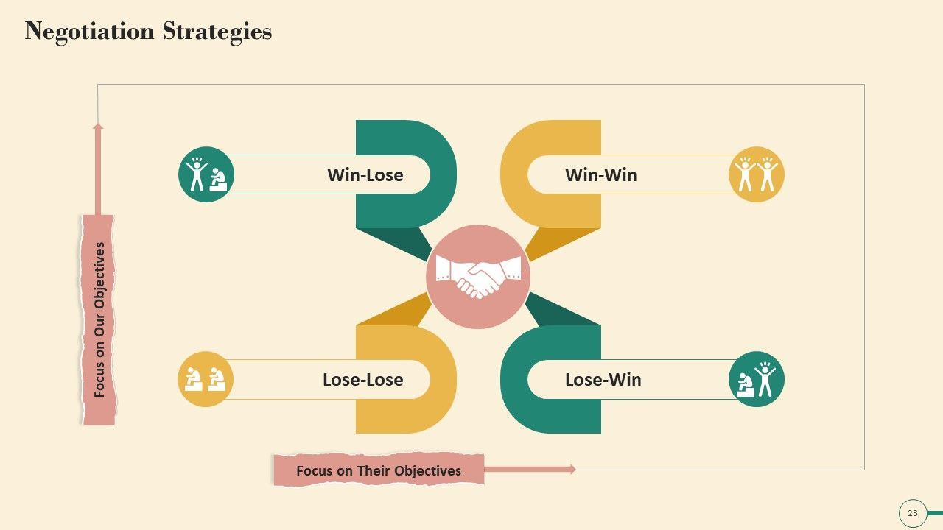

Slide 5
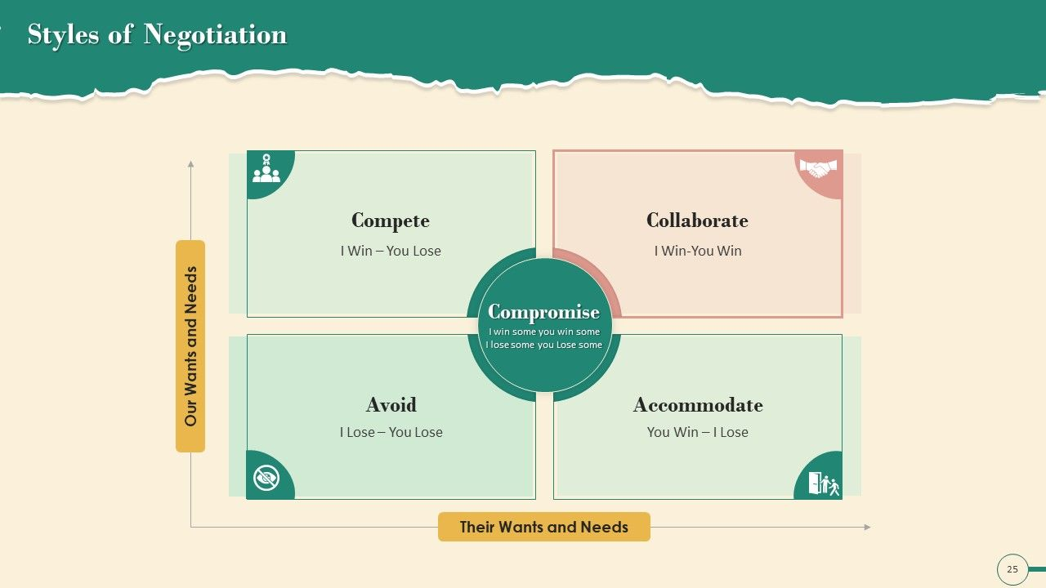
Looking at the Strategy Matrix, you will notice the varying negotiation styles.

Slide 6
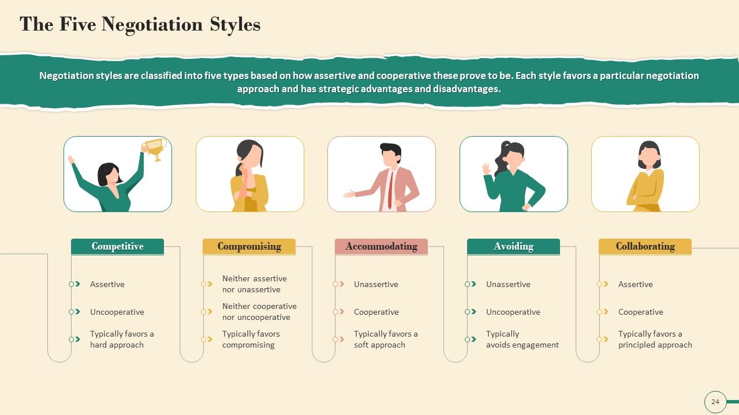
Looking at the Strategy Matrix, you will notice the varying negotiation styles.

Slide 7
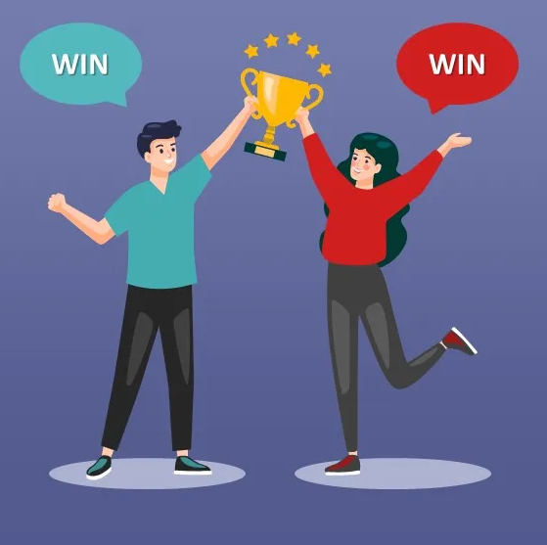
1
definition
A situation where both parties gain from a transaction or a deal, or where all possible outcomes are favorable
I Win- You Win Strategy

Slide 8
Win – Win Strategy
The situation by which a cooperation, compromise or group participation leads to all participants benefiting
the result of a mutual-gains approach to negotiation in which parties work together to meet interests and maximize value creation.
when both sides are satisfied with their agreement.

Slide 9
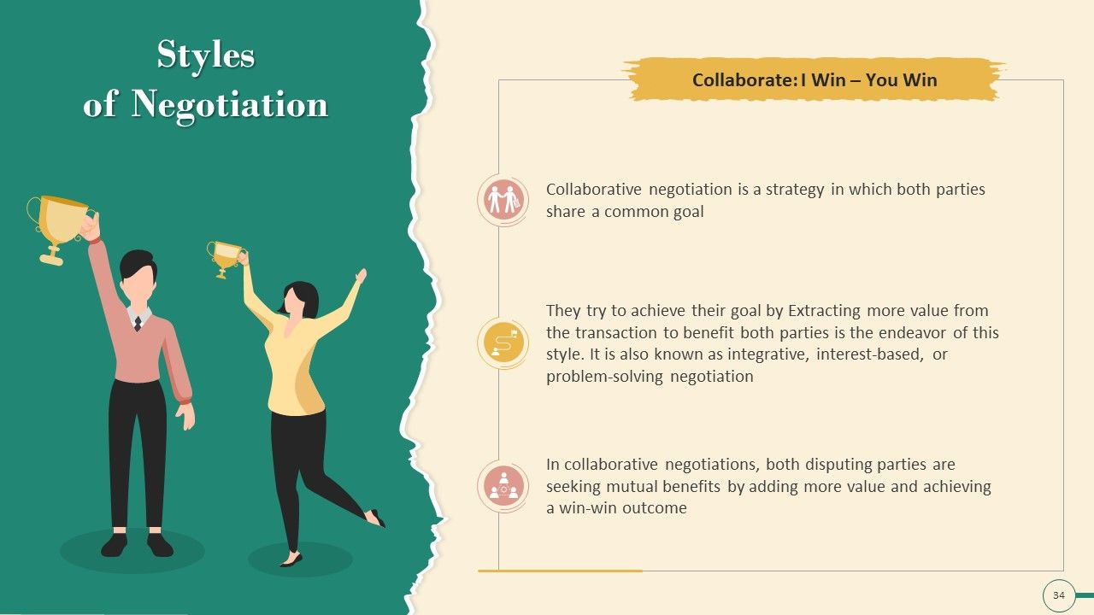
I Win- You Win Strategy

Slide 10
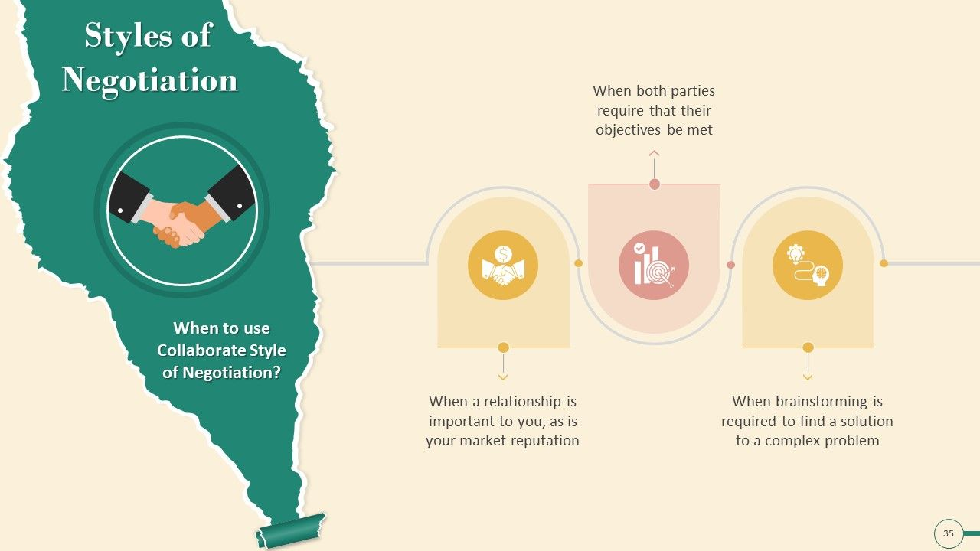
I Win- You Win Strategy

Slide 11
How to negotiate a win-win situation
1. Remember the other person's goals
When negotiating with someone, it's helpful to remember what the other person might want out of this situation.
Ex: If negotiating a pay raise, you might keep in mind your employer's need to stay within a certain budget, which might be outside of their control.
Ex: When negotiating with a contractor, remember that both their time and resources have value reflected in the payment they receive.

Slide 12
How to negotiate a win-win situation
2. Evaluate your expectations
Since a win-win resolution means that both sides think the outcome is beneficial, it's important to make sure that what you expect from the other party is fair to them.
Ex: If an employee wishes to negotiate a pay raise, it's helpful to remember the work expected of them and evaluate whether the pay reflects the value of that work to you. In the contractor example, consider whether you expect something beyond their original estimate and make adjustments

Slide 13
How to negotiate a win-win situation
3. Create mutually beneficial opportunities
If the negotiations don't seem to include a way of reaching a win-win situation, it's sometimes possible to create a new situation that does. In a business negotiation, this can mean creating a path to promotion for a hard-working employee who desires more pay that can't currently fit into the company budget. This can help you protect the budget in the short-term while providing an opportunity to improve business by giving an excellent employee more responsibility for more pay later on.

Slide 14
How to negotiate a win-win situation
4. Remain objective
During negotiations, it's best to keep a focus on the objective facts of that specific situation instead of the potential outcome. These facts might include things such as:
The actual work completed and its success
The established pay rate
Work completed beyond an employee's job description
Any previous estimates or unwritten agreements
Consider whether the resolution isn't just fair to the parties involved but that it's fair when accounting for the objective facts.

Slide 15
How to negotiate a win-win situation
5. Determine your best alternative
Instead of focusing on your most desirable outcome, it's helpful to determine which alternative outcome might have benefits for you. During the negotiation process, consider creating a list of alternative outcomes that still work well for you. Deciding which of these you feel is a positive resolution can give you something to negotiate toward if it's clear your most desirable resolution isn't likely to happen. By determining this beforehand, you can still feel you have something to win once the optimal outcome is no longer a factor

Slide 16
How to negotiate a win-win situation
6. Work together toward a common goal
It's sometimes helpful to work together with the other party to determine which outcomes you both want. By doing this, the negotiations can involve figuring out what it takes to meet both goals. When working together this way, it's helpful to keep consistent communication about what works, what doesn't and why. Through this communication, you can determine together what specific tactics work best to bring about a mutually beneficial solution.

Slide 17
How to negotiate a win-win situation
7. Be honest about any potential issues
In negotiations like these, it's helpful to remain honest about the things that conflict with your desired goal. This lets both parties either work around those potential conflicts or resolve the issues themselves. Consider doing the same for the other party's conflicts. If these issues can get resolved, it might help your negotiations reach win-win solution more easily.

Slide 18
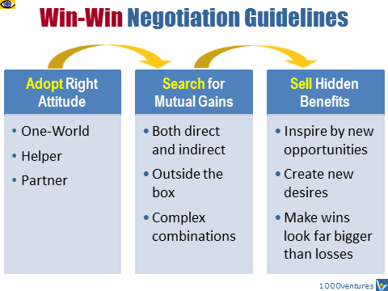

Slide 19
Tips for reaching a win-win situation
Start with defining a shared vision of a desired future you want to achieve.
Focus on long-term mutual gain and be ready to make short-term tactical changes in your plan if they help to achieve strategic success.
Think holistically, keep the big picture of the desired future in mind and always remember that there are not just one, but many ways to draw it.
See yourselves not as bargainers, but as creators and strategic design thinkers who design a better future jointly.
Be strategically flexible. Keep your mind open to emerging strategic opportunities when you face a major road block in negotiations. Be ready to adapt your strategies accordingly to achieve a Win-Win solution
Stay calm, it's helpful to stay calm and make sure your actions work toward a win for both sides. And to take a moment to breathe and collect your thoughts before responding to a proposed solution you find less than desirable.
Remain positive, Though it's not always certain that you can get everything you want, remaining positive can remind you that there's often still a resolution that can benefit the both of you. A positive attitude can also prime the atmosphere for the negotiations, helping the entire process take on a more positive tone.
Be respectful, Try to keep in mind that the other side of a negotiation is trying to get what they think is fair. Be respectful of other people's time, opinions and requests to help negotiations run smoothly.

Slide 20
Win – Win case study
Company A is a large manufacturer of electronics products, and Company B is a small retailer specializing in selling these products to consumers. Both companies recognize the potential for collaboration to increase their profits and market reach.
Objective:The objective of this collaboration is to create a win-win situation where both Company A and Company B can achieve their business goals through mutual cooperation.

Slide 21
Win – Win case study
Actions
Identifying Complementary Strengths: Both companies identified their respective strengths and weaknesses. Company A excelled in manufacturing and had a vast production capacity, while Company B had a strong local market presence and knowledge of consumer preferences.
Resource Sharing: To create a win-win situation, both companies agreed to share resources. Company A offered a discount on bulk purchases to Company B, enabling the retailer to access products at a lower cost. In return, Company B agreed to provide valuable market insights and feedback on product performance.

Slide 22
Win – Win case study
Actions
3. Marketing Collaboration: Company A and Company B collaborated in marketing efforts. Company B utilized its local market knowledge and customer relationships to promote Company A's products effectively. This resulted in increased sales for Company A and a boost to Company B's revenue through increased customer traffic.
4. Customer Support Collaboration: Company B provided pre and post-sales customer support on behalf of Company A. This arrangement helped both companies significantly. Company B expanded its service offerings, attracting more customers, and Company A reduced its operational costs by outsourcing customer support.

Slide 23
Win – Win case study
Results
Increased Sales and Profits: The collaboration resulted in increased sales for both companies. Company A's products gained wider visibility through the retailer's marketing efforts, leading to a surge in demand. Company B saw an increase in revenue due to access to discounted products and increased foot traffic.
Market Expansion: Through collaboration, Company A was able to penetrate new markets, leveraging Company B's established distribution channels. This resulted in increased product exposure and improved accessibility for customers.
Improved Efficiency: The collaboration allowed Company A to focus on its core competency of manufacturing, while Company B handled customer support and marketing. This specialization improved operational efficiency for both companies, ultimately leading to cost savings and improved overall performance.

Slide 24
Win – Win case study
Conclusion
This case study demonstrates how a win-win situation can be achieved through collaboration and resource sharing. By identifying complementary strengths and aligning their objectives, Company A and Company B were able to benefit from each other's capabilities, resulting in increased sales, market expansion, and improved efficiency. Such win-win partnerships build sustainable relationships and contribute to the long-term growth and success of businesses involved.

Slide 25
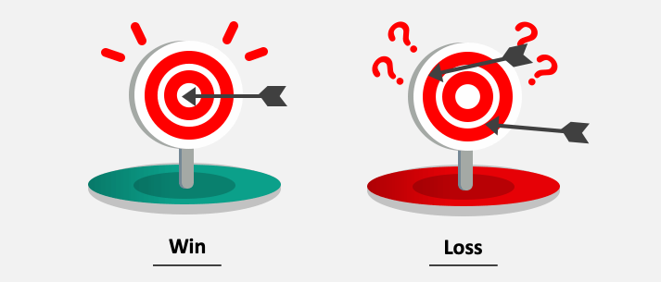
2
Definition
refers to a distributive negotiation where one negotiator’s gain the other negotiator’s loss. Both negotiators are typically competing to take away or claim the most value from their negotiation.
I Win- You Lose Strategy

Slide 26
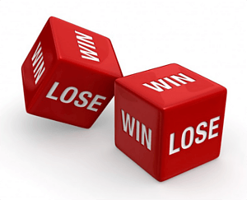
2
This term refers to a distributive negotiation whereby one party’s gain is another party’s loss.
Both parties are competing to get the most value from the negotiation
Also called the ‘fixed-pie’ scenario.
I Win- You Lose Strategy

Slide 27
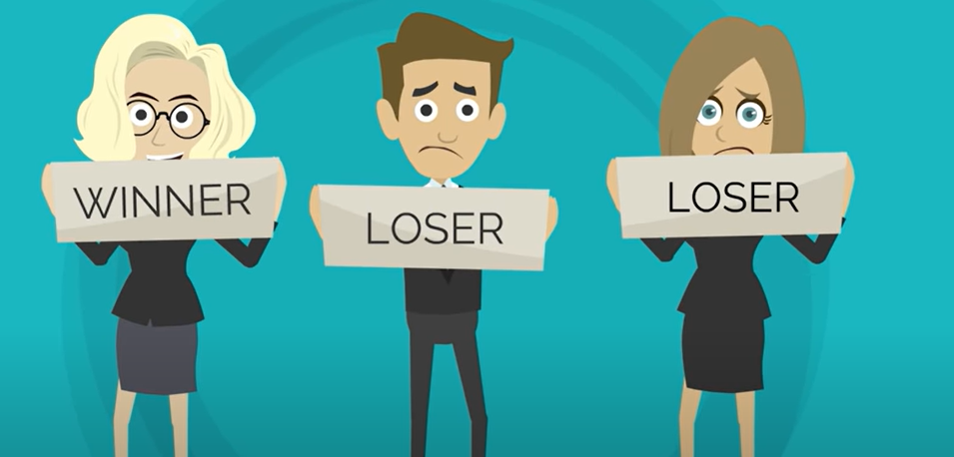
2
with Win-Lose, you are looking to claim as much of the existing value as possible.
I Win- You Lose Strategy

Slide 28
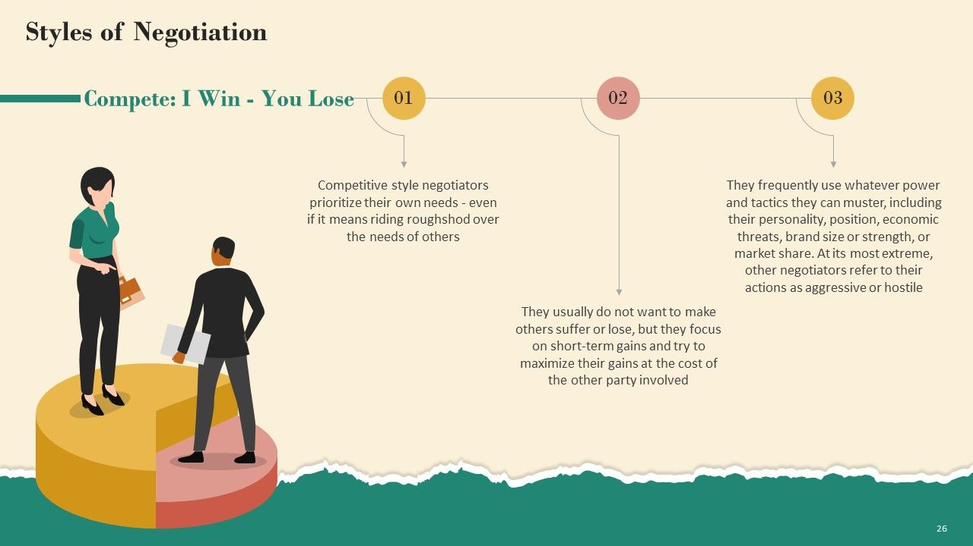
I Win- You Lose Strategy

Slide 29
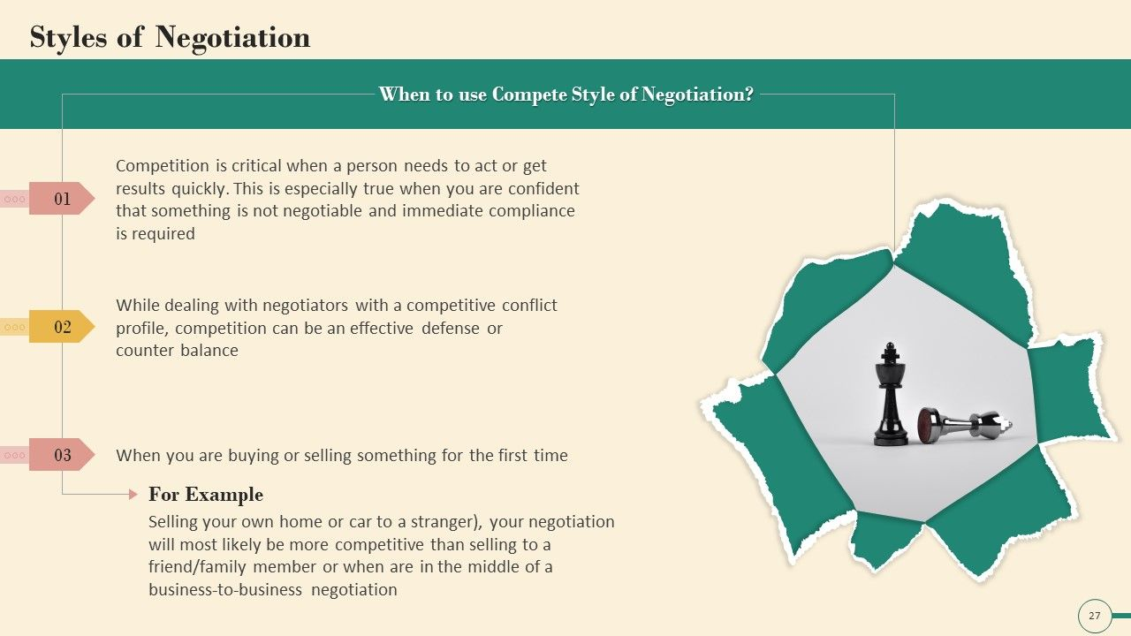
I Win- You Lose Strategy

Slide 30
Win – Lose case study
the negotiation between a company and its labor union during contract renewal.
Let's say Company X, a manufacturing firm, is negotiating a new contract with its labor union representing the workers.
The workers are demanding higher wages and improved working conditions, while the company wants to keep labor costs low to remain competitive in the market.

Slide 31
Win – Lose case study
In this situation, if the labor union is successful in negotiating higher wages and better working conditions, the workers will be considered the winners. They will enjoy improved pay and working conditions, potentially leading to higher job satisfaction and productivity.
However, if the company is unable to meet the union's demands, they will be considered the losers. They may have to cut costs in other areas, reduce labor force, or face strikes and disruptions in operations. This could negatively impact the profitability and competitiveness of the company.

Slide 32
Win – Lose case study
Conclusion
Ultimately, this negotiation illustrates a win-lose situation as the outcome favors one side (the workers or the company) at the expense of the other.

Slide 33
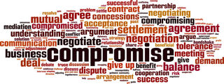
3
Definition
Is a basic negotiation process in which both parties give up something that they want in order to get something else they want more.
Compromise Strategy

Slide 34
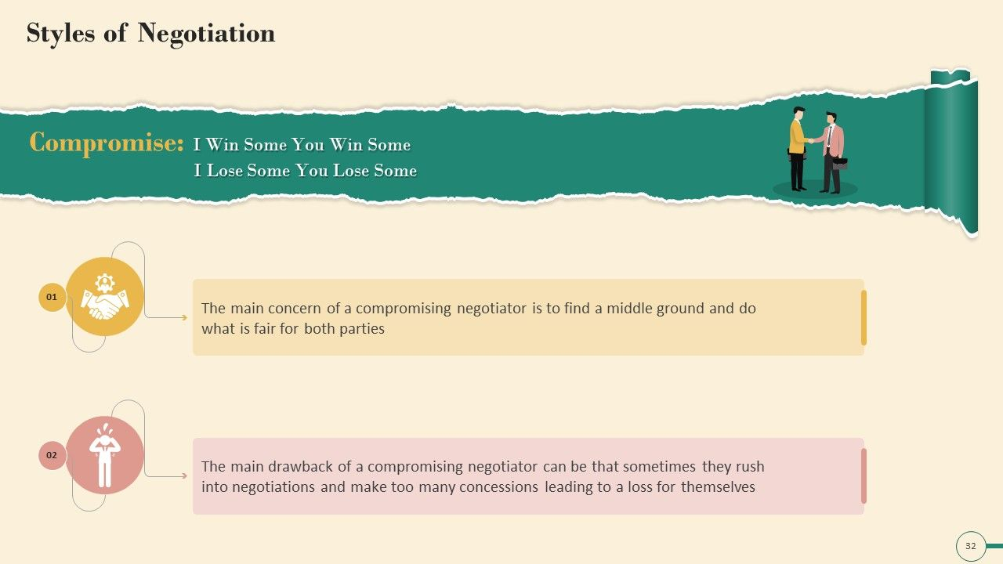
Compromise Strategy

Slide 35
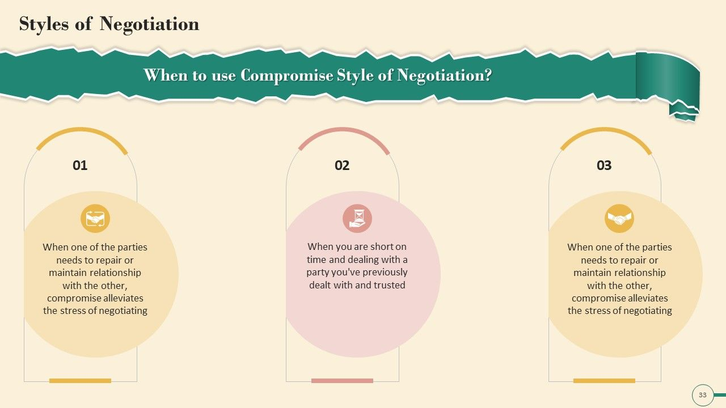
Compromise Strategy

Slide 36
Compromise case study
Joy and Antony want to buy a house that is on the market for 200000$.
However, they don’t want to pay that much, so they make an offer of 160000$.
Bob the seller doesn't want to go that low, but does want to sell the house soon, so he offers to sell for 180000$.
Joy and Antony accept the deal and the house is sold.
In this case, Joy and Antony paid 20000$ more than they wanted to and Bob sold for 20000$ less, but the house was exchanged, which was the main goal of both parties

Slide 37
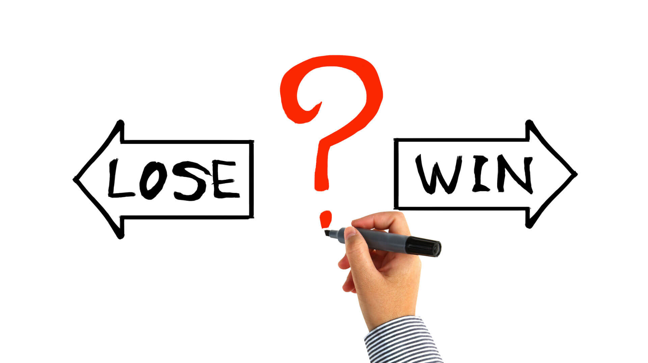
4
Definition
is a strategy where one party gives in to the wishes or demands of another. They're being cooperative but not assertive. This may appear to be a gracious way to give in when one figures out s/he has been wrong about an argument.
I Lose – You Win Situation

Slide 38
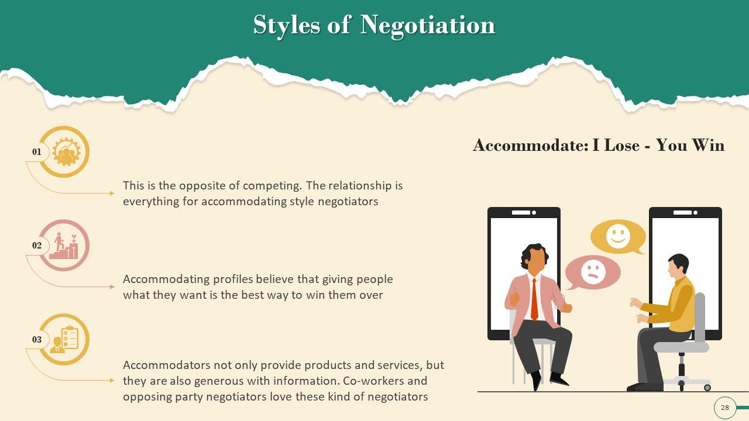
I lose – you win Strategy

Slide 39
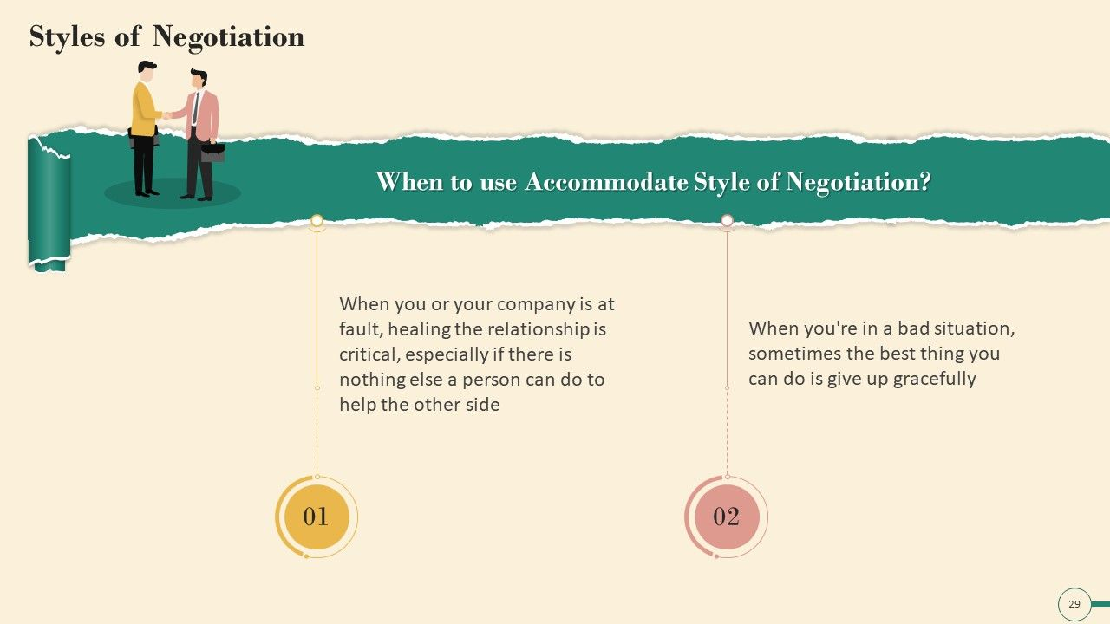
I lose – you win Strategy

Slide 40
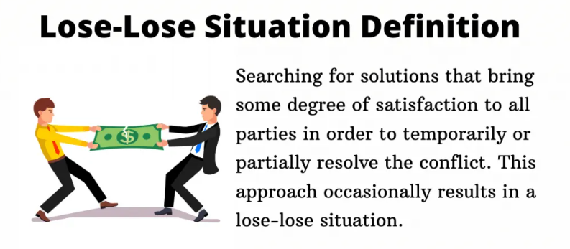
5
Definition
Is called too no win situation, is one where a person has choices, but no choice leads to a net gain
I Lose – You Lose Strategy

Slide 41
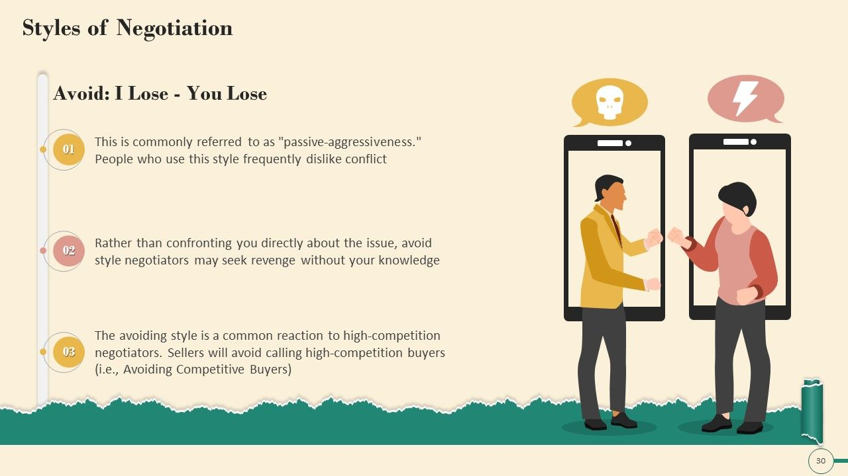
I Lose – You Lose Strategy

Slide 42
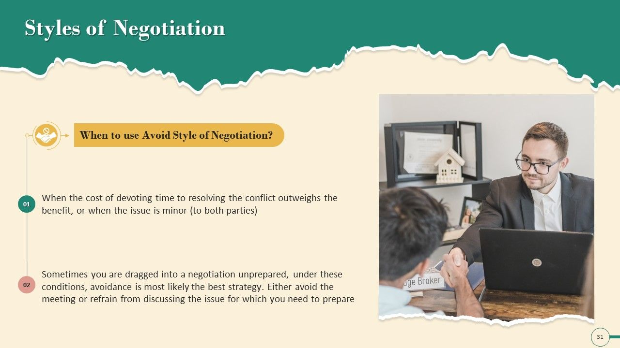
I Lose – You Lose Strategy

Slide 43
Lose Lose case study
For example, if a company finds a dangerous fault in one of its products, they can either issue a product recall and take some reputational damage, or allow the product to harm people: the company is in a no-win situation.

Slide 44
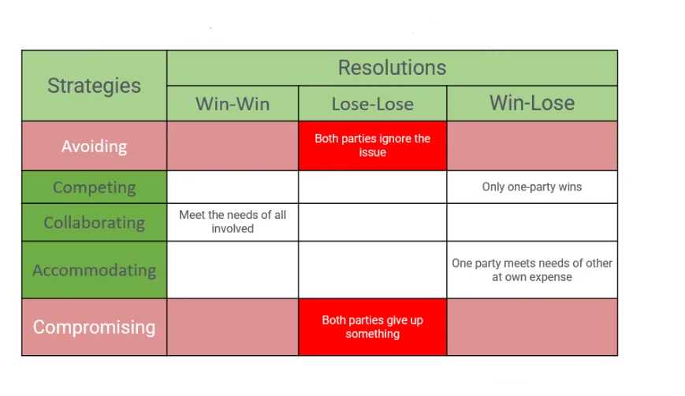
Lecture Conclusion

Slide 45



Thank You

