Slide 1


Change Management
Prepared by Dr. Amira Elfekky
PMG323
Lecture 1

Slide 2


Change Management
Lecture 1
PMG323
Prepared by
Dr. Amira Elfekky
www.midocean.ae

Slide 3
Agenda Individual change
Introduction
Learning and the process of change
The behavioral approach to change
The cognitive approach to change
The psychodynamic approach to change
The humanistic psychology approach to change

Slide 4
Agenda Individual change
Introduction
Learning and the process of change
The behavioural approach to change
The cognitive approach to change
The psychodynamic approach to change
The humanistic psychology approach to change

Slide 5


Change Management
This subject is about making sense of change management. The world we live in continues to change at an intense rate. Not a day goes by, it seems, without another important discovery or boundary-pushing invention in the scientific fields. The economics of globalization seems to dominate much of our political and corporate thinking, while the shadow side of globalization– develops at an equally alarming pace.
www.midocean.ae

Slide 6

Content
1 Individual change
Learning and the process of change
2 Team change
What is a group and when is it a team?
3 Organizational change
How organizations really work
4 Leading change
Roles that leaders play
5 The change agent
Models of change agency

Slide 7
Content
6 Mergers and acquisitions
The purpose of merger and acquisition activity
7 Cultural change
Guidelines for achieving successful cultural change
8 IT-based process change
The role of IT management
9 Complex change
When is change complex?
10 Leading change in uncertain times
The impact of uncertainty on our working lives

Slide 8
Agenda Individual change
Introduction
Learning and the process of change
The behavioural approach to change
The cognitive approach to change
The psychodynamic approach to change
The humanistic psychology approach to change

Slide 9
Chapter
LEARNING AND THE PROCESS OF CHANGE
01
Buchanan and Huczynski (1985) define learning as ‘the process of acquiring knowledge through experience which leads to a change in behavior’. Learning is not just an acquisition of knowledge, but the application of it through doing something different in the world.
www.midocean.ae

Slide 10
Chapter
LEARNING AND THE PROCESS OF CHANGE
01
Many of the change scenarios that you find yourself in require you to learn something new, or to adjust to a new way of operating: your new boss likes and dislikes, for example.
www.midocean.ae

Slide 11
Chapter
LEARNING AND THE PROCESS OF CHANGE
01
There is another example of driving your new car for the first time. For many people, the joy of a new car is tempered by the nervousness of driving it for the first time.
www.midocean.ae

Slide 12
Chapter
LEARNING AND THE PROCESS OF CHANGE
01
Getting into the driving seat of your old car is an automatic response, as is doing the normal checks, turning the key and driving off. However, with a new car, all the buttons and control panels might be in different positions. there are things might occur that will require an instantaneous response: sounding the horn, flashing your lights, putting the hazard lights on or activating the windscreen wipers.
www.midocean.ae

Slide 13

Chapter
LEARNING AND THE PROCESS OF CHANGE
01
All these things you would have done automatically but now you need to think about them. Thinking not only requires time, it also requires a ‘psychological space’ which it is not easy to create when driving along at your normal speed
www.midocean.ae

Slide 14

Chapter
Conscious and unconscious competence and incompetence
01
www.midocean.ae

Slide 15

Chapter
Conscious and unconscious competence and incompetence
01
Psychologists suggest that people have a worldview that entails some things being in the foreground and others being in the background of their consciousness.
www.midocean.ae

Slide 16

Chapter
Conscious and unconscious competence and incompetence
01
in the example of driving a new car for the first time, something else is happening. Assuming that I am an experienced driver, many of the aspects of driving, for me, are unconscious. All of these aspects I hopefully carry out competently.
www.midocean.ae

Slide 17
Chapter
01
Kolb’s learning cycle
www.midocean.ae

Slide 18

Chapter
Kolb’s learning cycle
01
David Kolb (1984) developed a model of experiential learning, which unpacked how learning occurs, and what stages a typical individual goes through in order to learn. It shows that we learn through a process of doing and thinking. The labels of activist, reflector, theorist and pragmatist.
www.midocean.ae

Slide 19
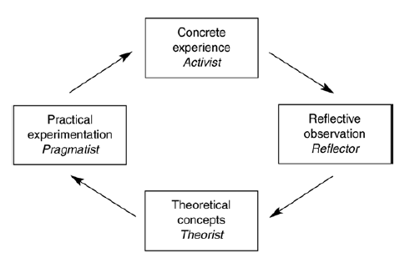
Chapter
Kolb’s learning cycle
01
www.midocean.ae

Slide 20

Chapter
Kolb’s learning cycle
01
A new piece of software arrives in the office or in your home. How do you go about learning about it?
• Do you install it and start trying it out? (Activist)
• Do you watch as others show you how to use it? (Reflector)
• Do you learn about the background to it and the similarities
with other programmes? (Theorist)
• Do you not bother experimenting until you find a clear purpose for it? (Pragmatist)
www.midocean.ae

Slide 21
Chapter
01
Approaches to change
www.midocean.ae

Slide 22
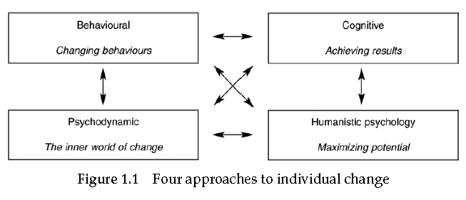

Slide 23
Agenda Individual change
Introduction
Learning and the process of change
The behavioural approach to change
The cognitive approach to change
The psychodynamic approach to change
The humanistic psychology approach to change

Slide 24

Chapter
THE BEHAVIOURAL APPROACH TO CHANGE
01
The behavioral approach to change, as the name implies, very much focuses on how one individual can change another individual’s behavior using reward and punishment, to achieve intended results.
www.midocean.ae

Slide 25
Chapter
THE BEHAVIOURAL APPROACH TO CHANGE
01
If the intended results are not being achieved, an analysis of the individual’s behavior will lead to an understanding of what is contributing to success and what is contributing to non-achievement.
www.midocean.ae

Slide 26
Chapter
THE BEHAVIOURAL APPROACH TO CHANGE
01
For example, an organization is undergoing a planned programme of culture change, moving from being an inwardly focused organization to a more responsive customer-oriented organization.
www.midocean.ae

Slide 27
Chapter
THE BEHAVIOURAL APPROACH TO CHANGE
01
will all need to change the way they behave towards customers and towards each other to achieve this change. The objective will be behaviour change, and there will not necessarily be any attention given to improving processes.
www.midocean.ae

Slide 28

Chapter
THE BEHAVIOURAL APPROACH TO CHANGE
01
What rewards and punishments operate in your organization?
How effective are they in bringing about change?
So in what ways may behaviorism help us with individuals going through change?
www.midocean.ae

Slide 29
Chapter
THE BEHAVIOURAL APPROACH TO CHANGE
01
In any project of planned behavior change a number of steps will be required:
• Step 1: The identification of the behaviors that impact performance.
• Step 2: The measurement of those behaviors. How much are these behaviors currently in use?
• Step 3: A functional analysis of the behaviors – that is, the identification of the component parts that make up each behavior.
www.midocean.ae

Slide 30

Chapter
THE BEHAVIOURAL APPROACH TO CHANGE
01
Reinforcement strategies
When generating reward strategies, the following possibilities should be borne in mind.
www.midocean.ae

Slide 31
Chapter
THE BEHAVIOURAL APPROACH TO CHANGE
01
Reinforcement strategies
1- Financial reinforcement
Traditionally financial reinforcement is the most explicit of the reinforcement mechanisms used, The use of bonus payments, prizes and other tangible rewards is common. To be effective the financial reinforcement needs to be clearly, closely and visibly linked to the behaviours and performance that the organization requires.e, the following possibilities should be borne in mind.
www.midocean.ae

Slide 32

Chapter
THE BEHAVIOURAL APPROACH TO CHANGE
01
Reinforcement strategies
2- Non-financial reinforcement - Feedback
Non-financial reinforcement tends to take the form of feedback given to an individual about performance on specific tasks.
This feedback can take both positive and negative forms. This feedback perhaps could take the form of a coaching conversation, where specific effective behaviors are encouraged, specific ineffective behaviors are discouraged and alternatives generated.
www.midocean.ae

Slide 33
Chapter
THE BEHAVIOURAL APPROACH TO CHANGE
01
Reinforcement strategies
2- Non-financial reinforcement - Social reinforcement
Social reinforcement takes the form of interpersonal actions: that is, communications of either a positive or negative nature. Praise, compliments, general recognition, and perhaps greater (or lesser) attention can all act as a positive reinforcement for particular behaviours and outcomes.
www.midocean.ae

Slide 34
Chapter
THE BEHAVIOURAL APPROACH TO CHANGE
01
Reinforcement strategies
2- Non-financial reinforcement - Social reinforcement
Similarly, social reinforcement could also take the form of ‘naming and shaming’ for ineffective performance.
www.midocean.ae

Slide 35
Agenda Individual change
Introduction
Learning and the process of change
The behavioural approach to change
The cognitive approach to change
The psychodynamic approach to change
The humanistic psychology approach to change

Slide 36

Chapter
THE COGNITIVE APPROACH TO CHANGE
01
The cognitive approach builds on the behaviorist approach by putting behavior into the context of beliefs and focusing more firmly on outcomes. Many cognitive techniques are used in the field of management today, particularly in the coaching arena.
www.midocean.ae

Slide 37
Chapter
THE COGNITIVE APPROACH TO CHANGE
01
People control their own destinies by believing in and acting on the values and beliefs that they hold.
R Quackenbush, Central Michigan University
www.midocean.ae

Slide 38

Chapter
THE COGNITIVE APPROACH TO CHANGE
01
www.midocean.ae

Slide 39

Chapter
THE COGNITIVE APPROACH TO CHANGE
01
Techniques for change
The cognitive approach has generated numerous techniques for changing the beliefs of people and thereby improving their performance. These include the following.
www.midocean.ae

Slide 40
Chapter
THE COGNITIVE APPROACH TO CHANGE
01
1- Positive listings
Simply list all the positive qualities you have, such as good feelings, good experiences, good results, areas of skills, knowledge and expertise. By accepting that these are all part of you, the individual, you can reinforce all these positive thoughts, feelings and perceptions, which then lead to enhanced beliefs.
www.midocean.ae

Slide 41
Chapter
THE COGNITIVE APPROACH TO CHANGE
01
2- Affirmations
An affirmation is a positive statement describing the way that you want to be. It is important that the statement is:
• Personal/ Present tense : ‘I am always enthusiastic when it comes to work!’ It is you who this is about, and it is as specific as you can make it.
Try writing your own affirmation. Put it on a card and read it out 10 times a day.
www.midocean.ae

Slide 42

Chapter
THE COGNITIVE APPROACH TO CHANGE
01
3 – Visualizations
Visualizations are very similar to affirmations but focus on a positive, present mental image. Effective visualizations require you to enter a relaxed state where you imagine a specific example of the way you want to be. You need to practise this on a regular basis.
www.midocean.ae

Slide 43

Chapter
THE COGNITIVE APPROACH TO CHANGE
01
4- Pattern breaking
Pattern breaking is a technique of physically or symbolically taking attention away from a negative state and focusing it on a positive. When you find you have slipped into being a bit nervous, catch yourself. Put your hand in the shape of a fist to your mouth and give a deep cough, you can say to yourself, ‘That wasn’t me. This is me right now.’
www.midocean.ae

Slide 44
Chapter
THE COGNITIVE APPROACH TO CHANGE
01
5- Rational analysis
Rational analysis is a cognitive technique par excellence. It is based on the notion that our beliefs are not necessarily rational: ‘I could never do that’ or, ‘I’m always going to be like that’. You need to be specific and not generalize (for example, ‘I’m always doing that’ – always?). You need to set measurable criteria, objectively based, and you need to use your powers of logic.
www.midocean.ae

Slide 45
Agenda Individual change
Introduction
Learning and the process of change
The behavioural approach to change
The cognitive approach to change
The psychodynamic approach to change
The humanistic psychology approach to change

Slide 46

Chapter
THE PSYCHODYNAMIC APPROACH TO CHANGE
01
The idea that humans go through a psychological process during change became evident due to research published by Elizabeth Kubler-Ross (1969).
The process of change and adjustment
Denial __ Anger _ Bargaining _ Depression _ Acceptance
www.midocean.ae

Slide 47
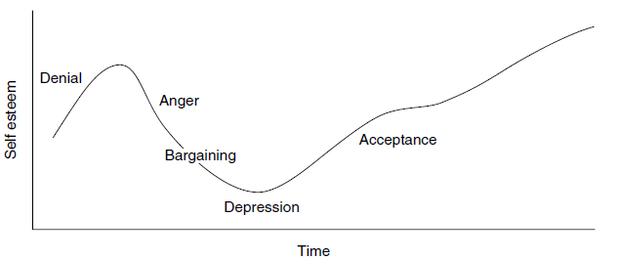
Chapter
THE PSYCHODYNAMIC APPROACH TO CHANGE
01
The process of change and adjustment
Denial __ Anger _ Bargaining _ Depression _ Acceptance
www.midocean.ae

Slide 48
Agenda Individual change
Introduction
Learning and the process of change
The behavioural approach to change
The cognitive approach to change
The psychodynamic approach to change
The humanistic psychology approach to change

Slide 49
Chapter
THE HUMANISTIC PSYCHOLOGY APPROACH TO CHANGE
01
Maslow and the hierarchy of needs
Maslow developed the hierarchy of needs, he believed that human beings have an inbuilt desire to grow and develop and move towards something he called self-actualization.
www.midocean.ae

Slide 50
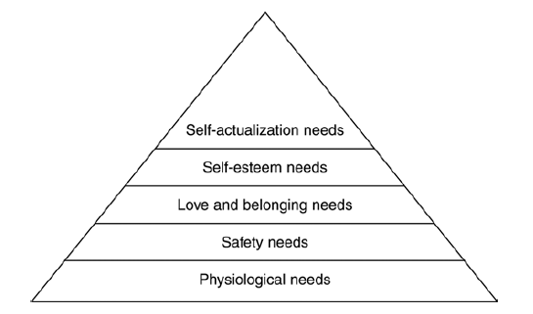
Chapter
THE HUMANISTIC PSYCHOLOGY APPROACH TO CHANGE
01
Maslow’s hierarchy of needs Source: Maslow (1970)
www.midocean.ae

Slide 51

www.midocean.ae

Slide 52


Thank You

