Slide 1

Introduction to Information Systems
Prepared by ENG. Eman Hamdy
Python Programming Language

Slide 2

Python
What is Programming?
Just like we humans can understand a few languages (Arabic, English, etc.), so is the case with computers.
Computers understand instructions that are written in a specific syntactical form called a programming language.
Simply, programming is a way to tell computers to do a specific task.
Some of the popular Programming languages are Python, C, C++, Java, etc

Slide 3
Python
What is Python?
Python is a popular programming language. It was created by Guido van Rossum, and released in 1991.
It is used for:
  web development (server-side),
  software development,
  system scripting.

Slide 4
Python
Why Python?
Python works on different platforms (Windows, Mac, Linux, Raspberry Pi, etc).
Python has a simple syntax similar to the English language.
Python has syntax that allows developers to write programs with fewer lines than some other programming languages.

Slide 5
Python
Python Syntax compared to other programming languages
Python was designed for readability and has some similarities to the English language with influence from mathematics.
Python uses new lines to complete a command, as opposed to other programming languages which often use semicolons or parentheses.
Python relies on indentation, using whitespace, to define scope; such as the scope of loops, functions and classes. Other programming languages often use curly-brackets for this purpose.

Slide 6
Python
Download Python Program Software
Go to Download Python page on the official site https://www.python.org/downloads/
and click Download Python 3.
• When the download is completed, double-click the file and follow the instructions to install it.
• When Python is installed, a program called IDLE is also installed along with it. It provides graphical user interface to work with Python.

Slide 7


Python
Variables
Creating Variables
Variables are containers for storing data values.
Unlike other programming languages, Python has no command for declaring a variable.
A variable is created the moment you first assign a value to it.

Slide 8


Python
Variables
Variables do not need to be declared with any particular type and can even change type after they have been set.
String variables can be declared either by using single or double quotes:

Slide 9
Python
Variables
#Legal variable names:
myvar = "John"
my_var = "John"
_my_var = "John"
myVar = "John"
MYVAR = "John"
myvar2 = "John"
#Illegal variable names:
2myvar = "John"
my-var = "John"
my var = "John"

Slide 10
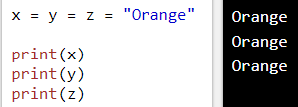
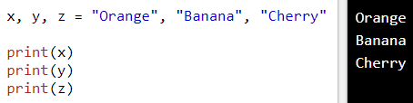
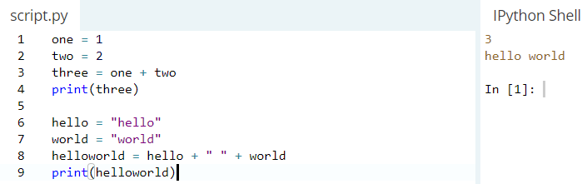
Python
Variables
Assign Value to Multiple Variables

Slide 11


Python
Output Variables
The Python print statement is often used to output variables.
To combine both text and a variable, Python uses the + character:

Slide 12
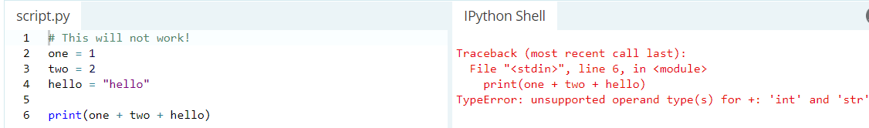
Python
Output Variables
If you try to combine a string and a number, Python will give you an error:

Slide 13
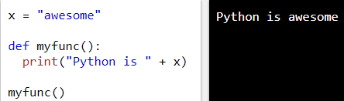
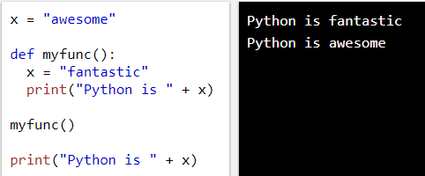
Python
Output Variables
Create a variable outside of a function, and use it inside the function
Create a variable inside a function, with the same name as the global variable

Slide 14
Python
Variables
Variables do not need to be declared with any particular type and can even change type after they have been set.
String variables can be declared either by using single or double quotes:

Slide 15
Python
Comments
Python has commenting capability for the purpose of in-code documentation.
Comments start with a #, and Python will render the rest of the line as a comment.
you can add a multiline string (triple quotes) in your code, and place your comment inside it:
  To add a multiline comment you could insert a # for each line

Slide 16
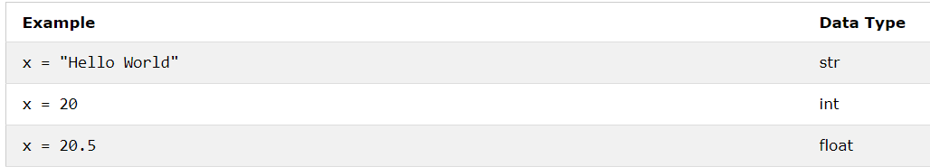
Python
Python Data Types
In Python, the data type is set when you assign a value to a variable:

Slide 17
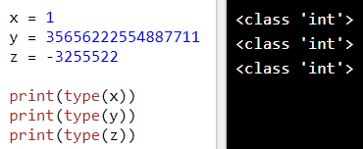
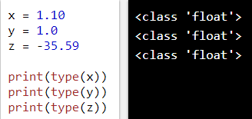
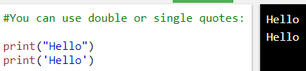
Python
Python Data Types
There are three numeric types in Python:
int
Float
String
String literals in python are surrounded by either single quotation marks, or double quotation marks.
'hello' is the same as "hello".

Slide 18

Python
Python Data Types
In programming you often need to know if an expression is True or False.

Slide 19
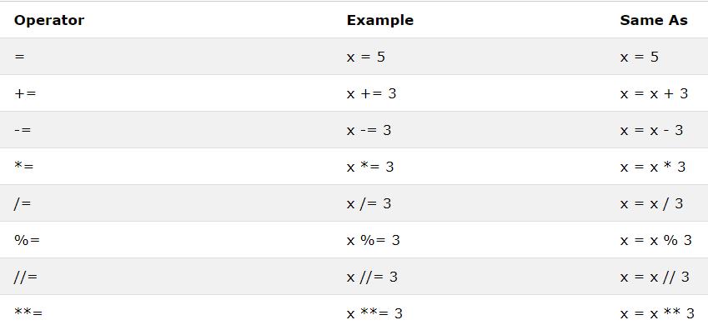
Python
Python Assignment Operators
Assignment operators are used to assign values to variables

Slide 20
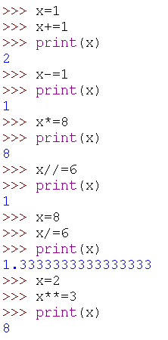
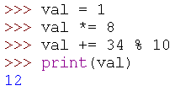
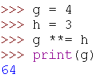
Python
Python Assignment Operators
Shortcut Operators
Operator | Equivalent to
X += Y | X = X + Y
X - = Y | X = X - Y
X * = Y | X = X * Y
X / = Y | X = X / Y
X //= Y | X = X // Y
X **= Y | X = X ** Y
X % = Y | X = X % Y

Slide 21
Python
User Enter Number
  X=input(" Enter a number : ")
user enter integer number
  X=int(input(" Enter a number : "))

Slide 22
Python
Enter more than one number
X,Y,Z,A= eval(input("Enter a number: ")) print("X= ",X)
print("Y= ",Y)
print("Z= ",Z)
print("A= ",A)

Slide 23
Python
Import Math (Library)
import math x=math.pow(2,3) print("x=",x) ->x=8.0
import math x=math.sqrt(9) print("x=",x) ->x=3.0

Slide 24
Python
Enter more than one number
Y= 𝑥 + 1 ∗ import math x=10
Y = 𝒙^{𝟑} + 𝟑𝒙^{𝟐} + 𝟑𝒙 + 𝟏
import math x=10
y=math.pow(x,3)+ 3*x**2+ 3*x+1 print("y=",y) ->y=1331.0
𝑥 + 2 ∗ 𝑥 + 3
y=math.sqrt(x+1)* math.sqrt(x+2)* math.sqrt(x+3)
print("y=",y) ->y=41.424

Slide 25
Thank you

