Slide 1



Communication skills
Prepared by Dr. Merna Emad
Orientation Lecture
www.midocean.ae

Slide 2

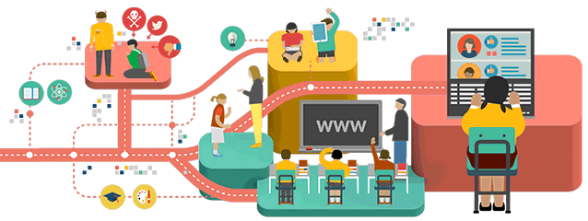
Communication skills

Slide 3
Communication skills
Developing communication skills can help many aspects of your life, from your professional career, to social gatherings, to your family life. In today's hectic world, we rely heavily on sharing information, resulting in greater emphasis being placed on having good communication skills. Good verbal and written communication skills are essential in order to deliver and understand information quickly and accurately. Being able to communicate effectively is a vital life skill and should not be overlooked.
In contrast, poor communication skills can have a negative impact - a poorly delivered message may result in misunderstanding, frustration and in some cases disaster.

Slide 4
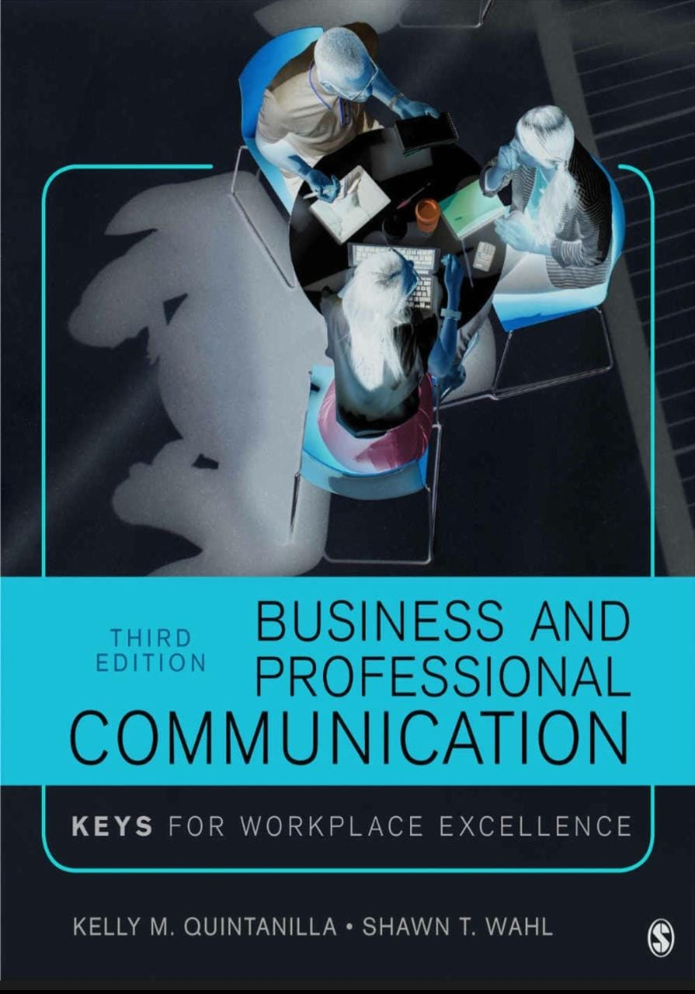

Slide 5
The book aims to:
Provide Business and Professional Communication students with the knowledge and skills they need to move from interview candidate, to team member, to leader.
Accessible coverage of new communication technology and social media prepares students to communicate effectively in real world settings.

Slide 6
The book aims to:
With an emphasis on building skills for business writing and professional presentations, this text empowers students to successfully handle important work-related activities, including job interviewing, working in team, strategically utilizing visual aids, and providing feedback to supervisors.

Slide 7

After completing this course you will be able to:
Recognize cultural differences that impact members of an organization and enact appropriate communication strategies to help attain cultural diversity
Understand the communication process and recall how networks and channels influence the communication process in organizations
Send and interpret verbal and nonverbal messages with accuracy and effectiveness

Slide 8
After completing this course you will be able to:
Evaluate listening habits and practice effective listening skills
Build positive interpersonal relationships in the workplace
Learn about all the interviewing stages.
Plan and conduct an interview in both interviewee and interviewer roles.

Slide 9
After completing this course you will be able to:
Distinguish groups and teams and recall communication factors that influence the effective development of teams
Identify and overcome common obstacles in group meetings
Demonstrate competence in making a decision as a leader.
Create and deliver a business presentation, reports and meetings.

Slide 10
Outline of the Book
The book is organized into five distinct parts.
Overview of key concepts
Developing the skills in the workplace
Developing strategies of communications
Enhancing interpersonal competency
Leadership and balancing between work and life through communication

Slide 11

Communication skills
Chapter 1
What Communication is?
History of communication
Principles of communication
Communication process and elements

Slide 12
Communication skills
Chapter 2
Communication models
Communication barriers
Communication ethics
KEYS for Excellence in the Workplace

Slide 13




The KEYS organizing theme
Know Yourself
Your Communication Interaction
Step Back and Reflect
Evaluate the Professional Context

Slide 14
Communication skills
Chapter 3
Verbal communications
Non-verbal communications
Forming relationships with Verbal and nonverbal communications.
Verbal and Nonverbal
Communication and Their Impact on Professions.

Slide 15
Communication skills
Chapter 4
Hearing and Listening
Listening barriers and styles
Improving Your Listening
KEYS for Listening Excellence

Slide 16
Communication skills
Chapter 5
Exploring
Researching
Applying Résumés

Slide 17
Communication skills
Chapter 6
Interviewing
Following up
Negotiating

Slide 18
Communication skills
Chapter 7
Learning Your Workplace Culture
Diversity in Your Workplace: Some Important Concepts
Examples of Diversity in Professional Contexts

Slide 19
Communication skills
Chapter 8
Interpersonal Communication at Work
Exploring Relationship Types at Work
The Line between Professional and Personal

Slide 20
Communication skills
Chapter 9
Groups vs teams
Conducting meetings
Conflict in Team Meetings
Handling Conflict

Slide 21
Communication skills
Chapter 10
Written Communication Types
Written communication excellence strategies & Skills
KEYS to enhance written communication

Slide 22

What I expect from you?

Slide 23

What I expect from you?

Slide 24



What I expect from you?

Slide 25

What I expect from you?

Slide 26




Thank You

