Slide 1

Iteration Statements and Strings
Prepared by Dr. Hamada I. AbdulWakel
Lecture 4
CYB550
Programming Foundations In Python

Slide 2

Lecture 4
MODULE OBJECTIVES
Conditional iterations.
Different forms of iteration statements.
Deal with strings.

Slide 3
Lecture 4
CONDITIONAL ITERATION
An iteration statement, or loop, repeatedly executes a statement, known as the loop body, until the controlling expression is False.
The control expression must have a scalar type.
The while statement evaluates the control expression before executing the loop body.
The for statement is used to repeat the execution of a set of statements for every element of a sequence.

Slide 4
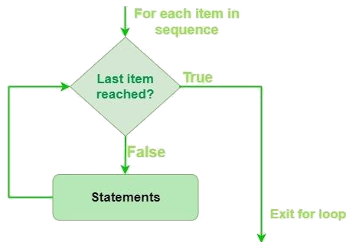
Lecture 4
CONDITIONAL ITERATION
Cont'd
For loop.
  Syntax
  for <variable> in <sequence> :
  <statement 1> ….....

Slide 5
Lecture 4
CONDITIONAL ITERATION
Cont'd
Write a program that reads the number of students in a class then reads their marks and finds and displays the average.
  Help:
    Get "stdCount" variable from the user.
    Define "sum" variable for the total of the marks.
    Inside a loop, get each "mark" from the user.
    Add "mark" to the "sum".
    After loop finished, divide the "sum" by the "stdCount".

Slide 6
Lecture 4
CONDITIONAL ITERATION
Cont'd
Write a program that reads the number of students in a class then reads their marks and finds and displays the average.
  Code:
  stdCount = int(input("Enter number of students in a class"))
  sum = 0.0
  for i in range(stdCount):
  mark = float(input("Enter mark: "))
  sum += mark
  print("The marks average = ", sum / stdCount)

Slide 7
Lecture 4
CONDITIONAL ITERATION
Cont'd
Write a program that calculates the total of the following series of numbers:
1/30 + 2/29 + 3/28 + ….....+ 30/1
  Help:
    From the formula, identify the number of iterations.
    Define the "sum" variable for the summation.

Slide 8
Lecture 4
CONDITIONAL ITERATION
Cont'd
Write a program that calculates the total of the following series of numbers:
1/30 + 2/29 + 3/28 + ….....+ 30/1
  Code:
  min = 1; max = 4; sum = 0.0
  for i in range(min, max+1):
  sum += min / max; min += 1; max -= 1
  print(sum)

Slide 9
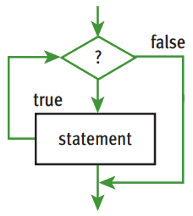
Lecture 4
CONDITIONAL ITERATION
While (entry-control) loop.
  Syntax
  while <condition>:
  <statement 1> …....

Slide 10
Lecture 4
CONDITIONAL ITERATION
Cont'd
Write a program that calculates the average of a set of temperature. Data is terminated by the value 999.
  Help:
    Define the "sum" variable.
    Define the "count" variable.
    Get the "temperature" values from the user.
    Inside a loop, sum the temperatures and count how many temperature values are entered.
    After the loop finished, divide the sum by the count.

Slide 11
Lecture 4
CONDITIONAL ITERATION
Cont'd
Write a program that calculates the average of a set of temperature. Data is terminated by the value 999.
  Code:
  sum = 0.0; count = 0
  temp = float(input("enter a temperature "))
  while temp != 999:
  count += 1; sum += temp
  temp = float(input("enter another temp"))
  print("temperature average = ", sum/count)

Slide 12
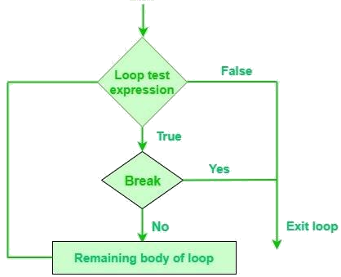
Lecture 4
CONDITIONAL ITERATION
Break statement.
  Syntax
  while <condition>:
  <statement 1> …....
  if <condition>:
  break

Slide 13
Lecture 4
CONDITIONAL ITERATION
Cont'd
Write a program to print numbers from 1 to 10. The program may stop in when 5 is reached.
  Code:
  count= 0
  while count < 10:
  if count == 5:
  break
  print(count)
  count += 1

Slide 14
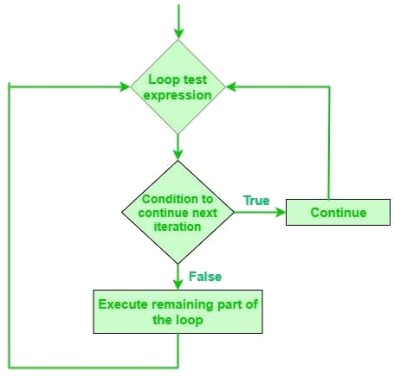
Lecture 4
CONDITIONAL ITERATION
Continue statement.
  Syntax
  while <condition>:
  <statement 1> …....
  if <condition>:
  continue

Slide 15
Lecture 4
CONDITIONAL ITERATION
Cont'd
Write a program to print numbers from 1 to 10 except 5.
  Code:
  count= 0
  while count < 10:
  if count == 5:
  continue
  print(count)
  count += 1

Slide 16
Lecture 4
CONDITIONAL ITERATION: TASK
Write a program that calculates the occupancy rate for a hotel. The program should start by asking the user how many floors the hotel has. A loop should then iterate once for each floor. In each iteration, the loop should ask the user for the number of rooms on the floor and how many of them are occupied. After all the iterations, the program should display how many rooms the hotel has, how many of them are occupied, how many of them are unoccupied. The percentage may be calculated by dividing the number of rooms occupied by the number of rooms.

Slide 17
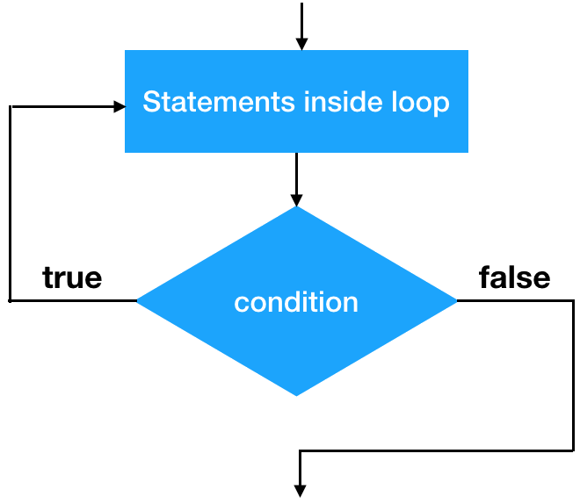
Lecture 4
CONDITIONAL ITERATION
Cont'd
Do-While loop not in python but can emulate.
  Syntax
  while True :
  <statement 1> ….....
  if <condition>:
  break

Slide 18
Lecture 4
STRUCTURE OF STRINGS
A string is an immutable data structure.
  Immutable: we can't change its content in the same location.
  Data structure: consists of smaller pieces of data.
  String’s length: number of characters it contains.
  Subscript operator is useful when you want to use the positions as well as the characters in a string.

Slide 19
Lecture 4
STRUCTURE OF STRINGS
Cont'd
A string declaration.
  Using " "
  Using ' '
  Using str() function
When the string itself contains "
  "He said that "I am from Egypt"" #syntax error
    Scape character \
    Using ''' '''

Slide 20
Lecture 4
STRUCTURE OF STRINGS
Cont'd
Immutable description.
  Ex: s1 = "Hello"
  s1[2] = 'x' #get run-time error
  print(id(s1))
  s1 += " world"
  print(id(s1)) # get a new memory location

Slide 21
Lecture 4
STRUCTURE OF STRINGS
Cont'd
Function | Description
Use + | to concatenate strings.
Use * | to repeat a string.
chr(number) | to get the character corresponds to the given number.
ord(single character) | to get the ASCII code for the given character.
len(string) | to get the string length.
max(string) | to get the maximum letter that has max ASCII code in the given string.
strip() | to remove the start and end whitespaces in the string.

Slide 22
Lecture 4
STRUCTURE OF STRINGS
Cont'd
Code:
s1 = "Hello"
print(len(s1))
print(max(s1))
s1 += " world"
print(len(s1))

Slide 23
Lecture 4
STRUCTURE OF STRINGS
Cont'd
Function | Description
isalnum() | to check if the string contains alphabetic and number.
isalpha() | to check if the string contains only alphabetic.
isdigit() | to check if the string contains only numbers.
islower() | to check if the string is written in lower case.
isupper() | to check if the string is written in upper case.
isspace() | to check if the string contains whitespaces.
startwith(substring) | to check if the string begins with the given substring.
endswith(substring) | to check if the string ends with the given substring.

Slide 24
Lecture 4
STRUCTURE OF STRINGS
Cont'd
Code:
s1 = "Hello"
print(s1.isalnum())
print(s1.isalpha())
print(s1.isupper())
print(s1.startwith("He"))
print(s1.endswith("z"))

Slide 25
Lecture 4
STRUCTURE OF STRINGS
Cont'd
Function | Description
replace(old, new) | to replace each old substring by new substring.
split(delimiter) | to split the string according to the delimiter.
count(substring) | to count the number of occurrence of the given substring.
find(substring) | to find the index of the substring in the string.
rfind(substring) | to find the last index of the substring in the string.
capitalize() | to capitalize the first letter of a string.
lower() | to convert the string to lower case.
upper() | to convert the string to upper case.

Slide 26
Lecture 4
STRUCTURE OF STRINGS
Cont'd
Code:
s1 = "Hello World"
print(s1.replace("e", "E"))
print(s1.split(' '))
print(s1.count('l'))
print(s1.find("l"))
print(s1.rfind("l"))

Slide 27
Lecture 4
SLICING FOR SUBSTRINGS
Python’s subscript operator can be used to obtain a substring through a process called slicing.
  S[1]
  S[-1]
  S[0 : 3] # from 0 to 3-1

Slide 28
Lecture 4
CONDITIONAL ITERATION
Cont'd
Write a program that print each character of a given string from the end.
  Code for help:
  s = "Hello"
  i= len(s)
  while i > 0:
  print(s[i-1])
  i -= 1

Slide 29
Lecture 4
TESTING FOR SUBSTRINGS
When using in operator, it returns True if target string is somewhere in search string, or False otherwise.
  Ex: s1 = "I love Python"
  print("I" in s1)
  print(" " in s1)
  print("x" in s1)

Slide 30
Lecture 4
CASE STUDY FOR STRINGS
It is easy to observe data crossing a network.
Data encryption can be used to protect information transmitted on networks.
One or more keys are used to encrypt messages to produce cipher text, and to decrypt cipher text back to its original plain text form.
  Examples: Caesar cipher, Block cipher.

Slide 31
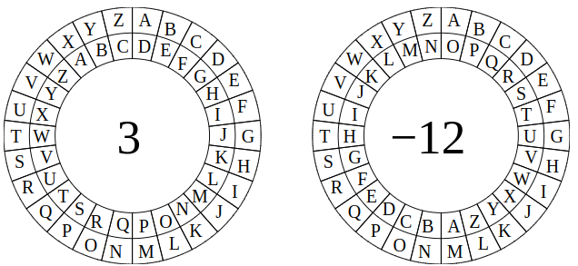
Lecture 4
CASE STUDY FOR STRINGS
Cont'd
Caesar cipher replaces each character in plain text with a character at a given distance away.

Slide 32
Lecture 4
CASE STUDY FOR STRINGS
Cont'd
Encrypt code:
  text = "pythoz"; k = 5; result = ""
  for i in range(len(text)):
  char = text[i]; oldValue = ord(char); cipherValue = oldValue + k
  if cipherValue > ord('z'):
  cipherValue %= 122
  cipherValue += 96
  code = chr(cipherValue)
  result += code
  print(result)

Slide 33
Lecture 4
CASE STUDY FOR STRINGS
Cont'd
Decrypt code:
  text = "udymte"; k = 5; result = ""
  for i in range(len(text)):
  char = text[i]; oldValue = ord(char); cipherValue = oldValue - k
  if cipherValue < ord('a'):
  cipherValue -= 96
  cipherValue += 122
  code = chr(cipherValue)
  result += code
  print(result)

Slide 34
THANK YOU

