Slide 1


Principles of
Accounting
Prepared by
Dr. Hoda Metwally
MGM 227
Lecture 4

Slide 2

Financial Statements Analysis and its interpretation
(Part two)
Ratio Analysis

Slide 3

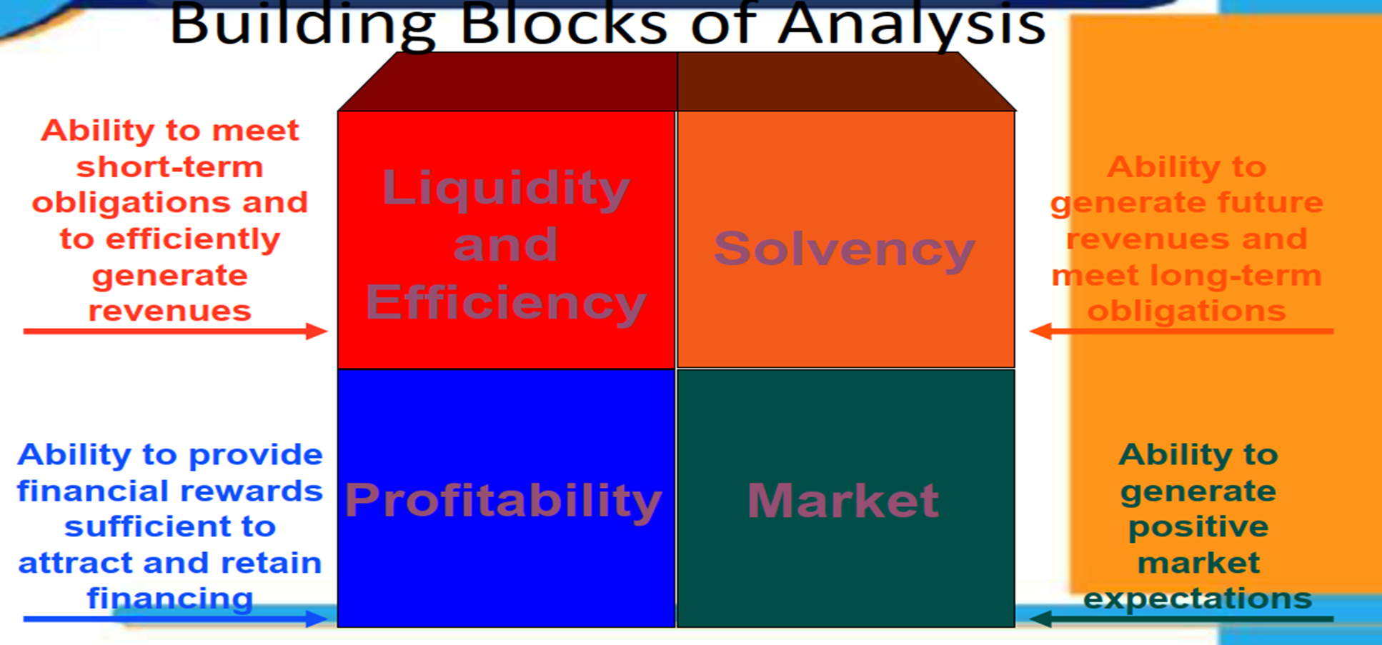

Slide 4
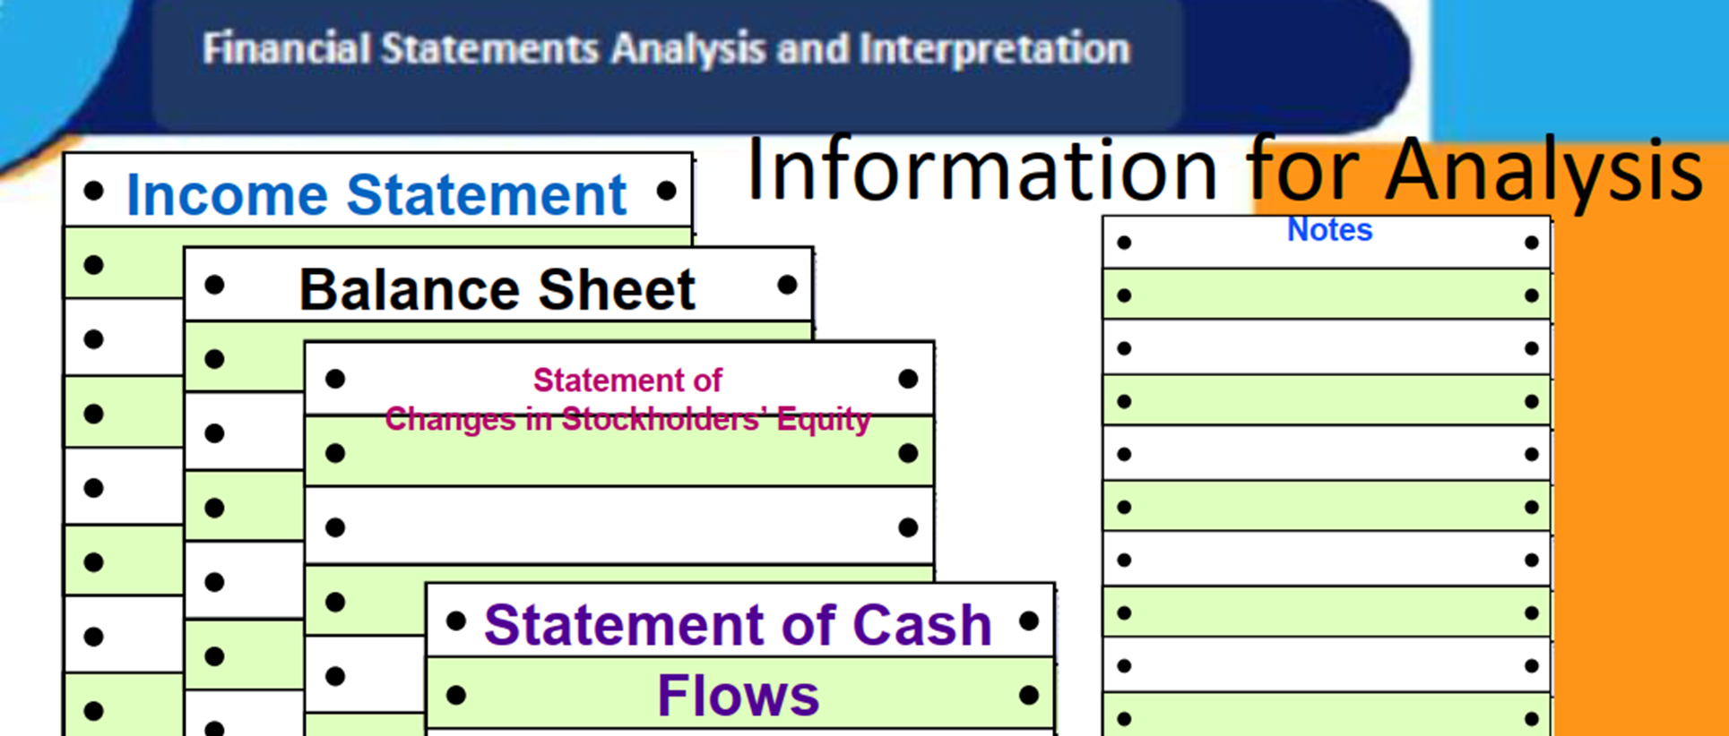

Slide 5
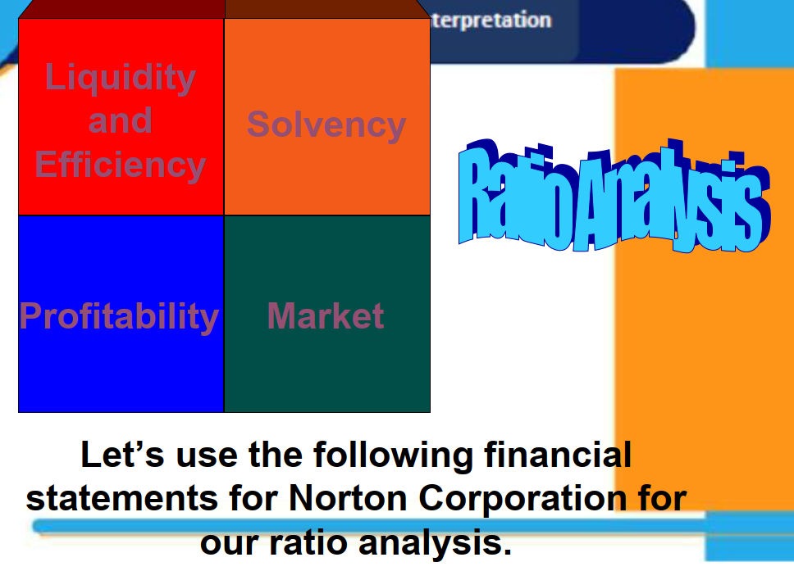

Slide 6


Slide 7
Liquidity and efficiency
Ratios
Analyze the ability to meet short-term obligations and to efficiently generate revenues

Slide 8
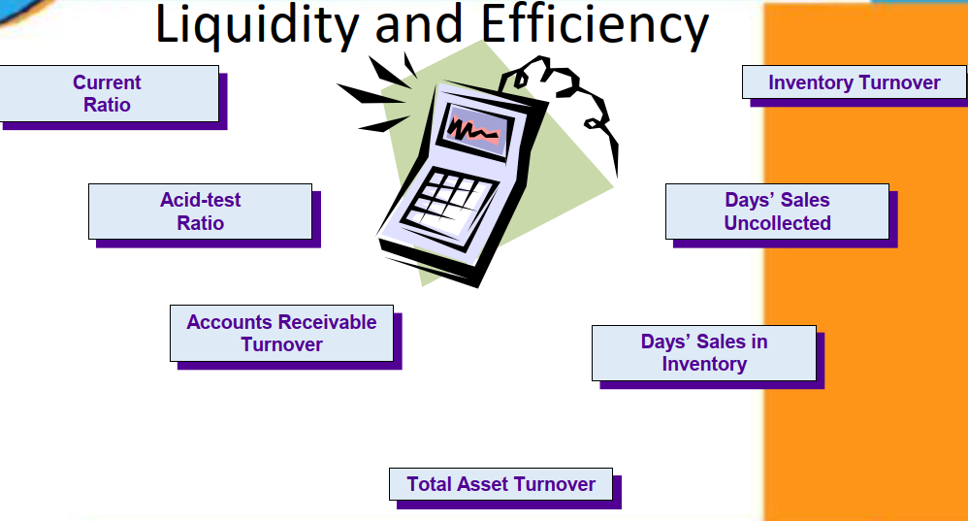

Slide 9
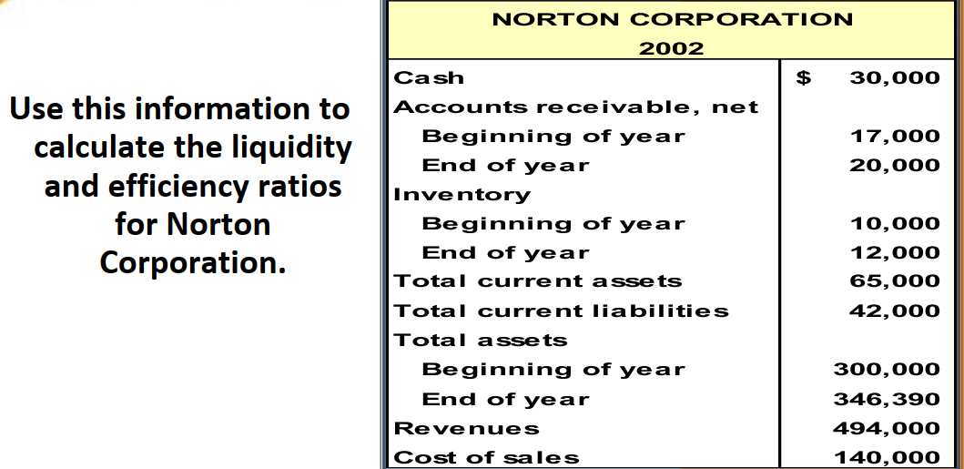

Slide 10
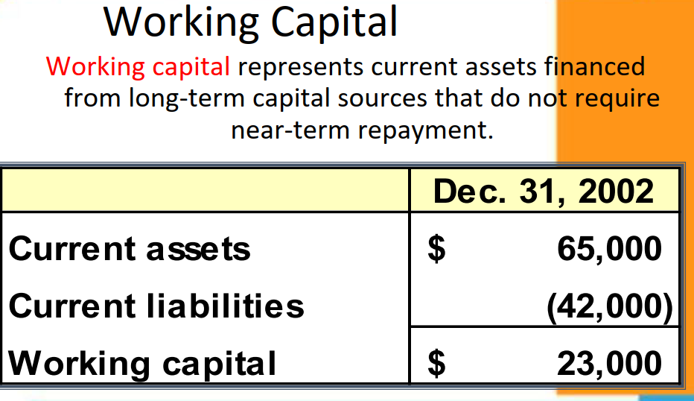

Slide 11
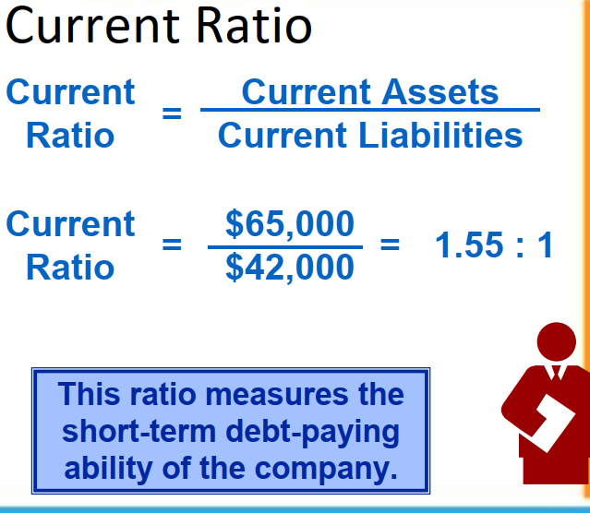

Slide 12

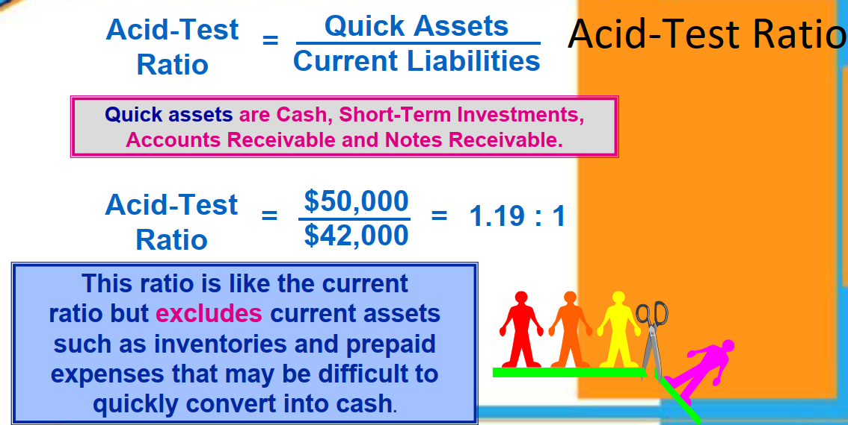
www.midocean.ae

Slide 13
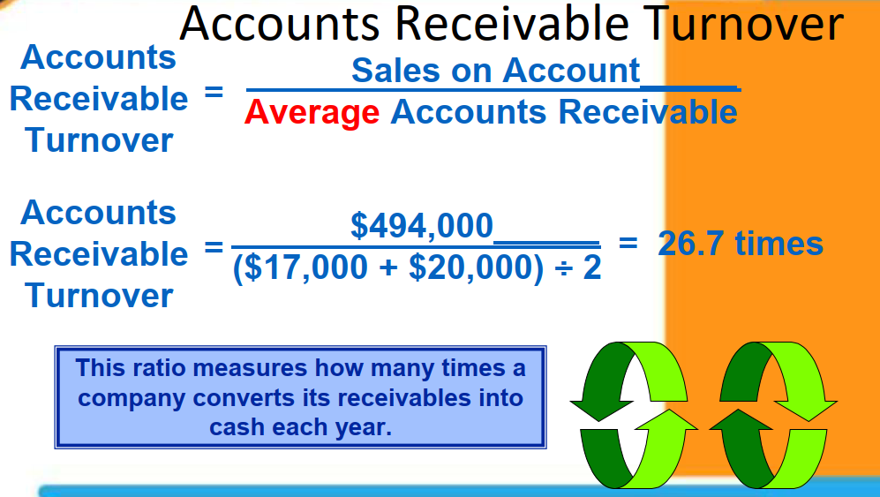

Slide 14
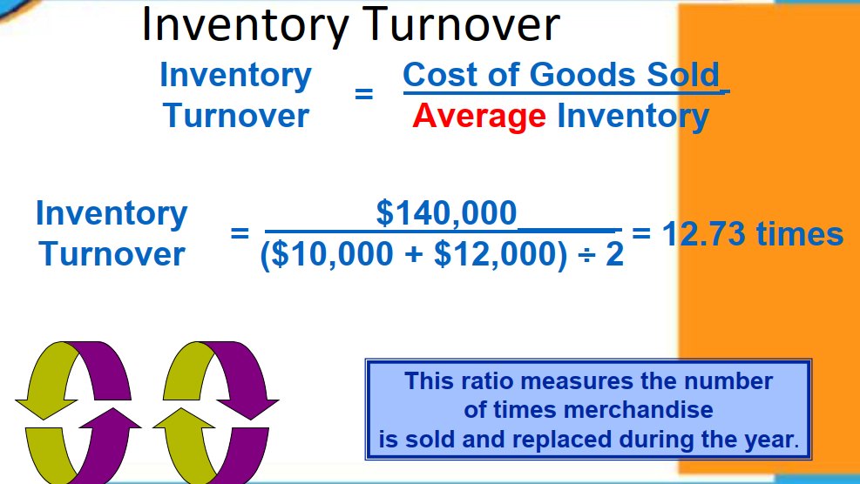

Slide 15
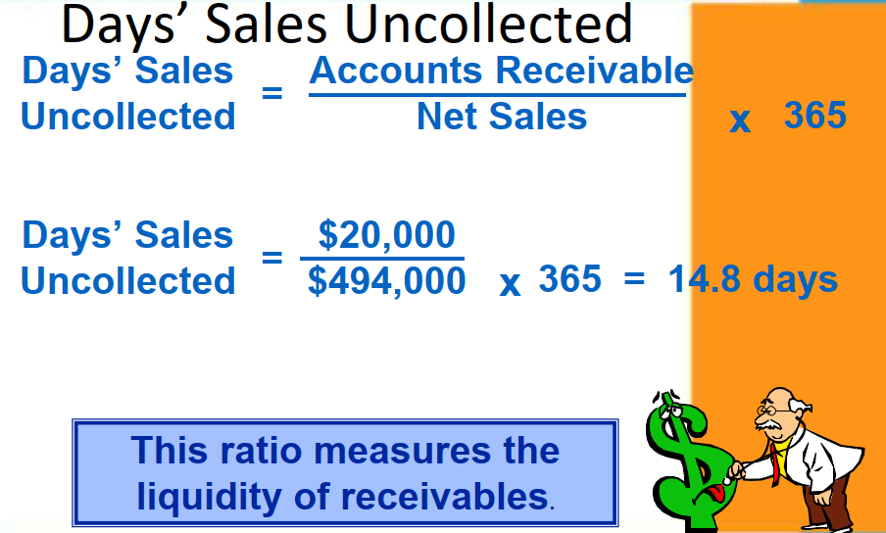

Slide 16
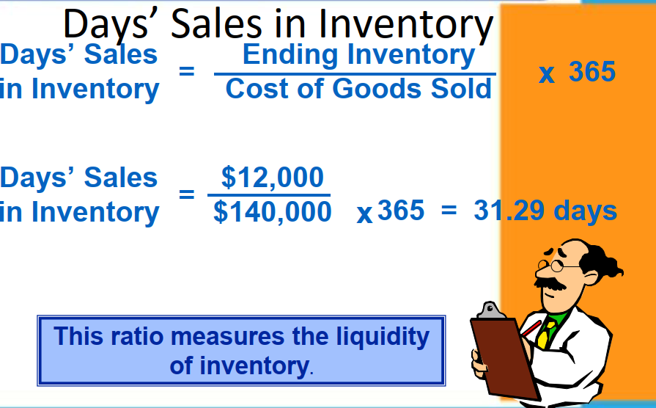

Slide 17
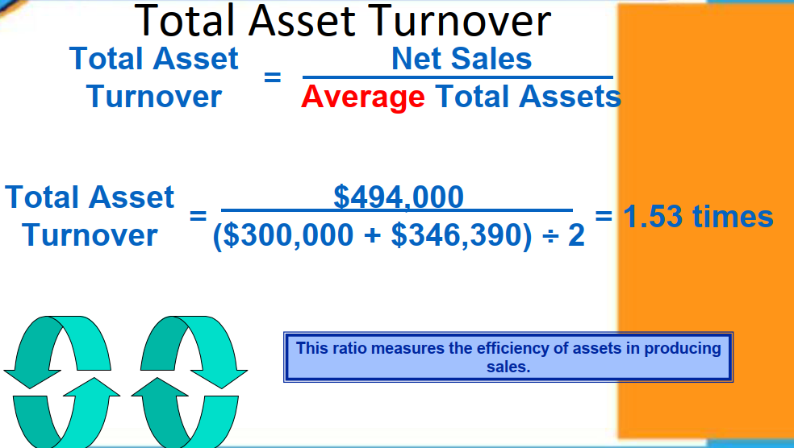

Slide 18
Solvency Ratios
Analyze the ability to generate future revenues and meet long-term obligations

Slide 19
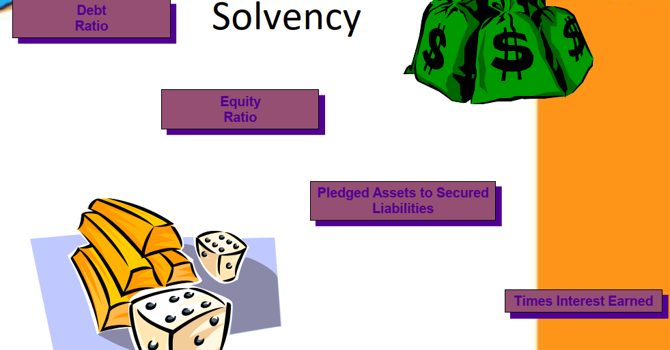

Slide 20
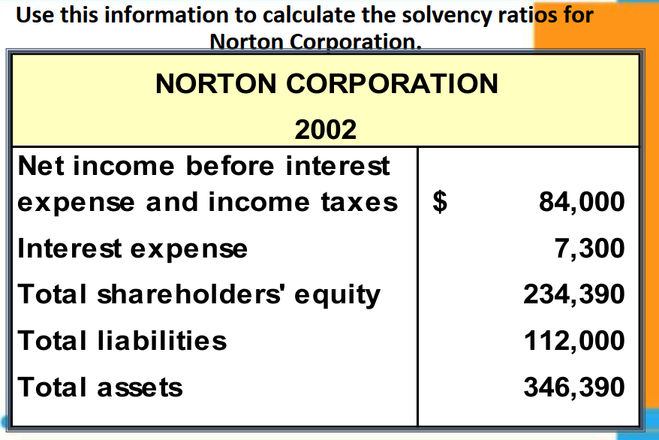

Slide 21
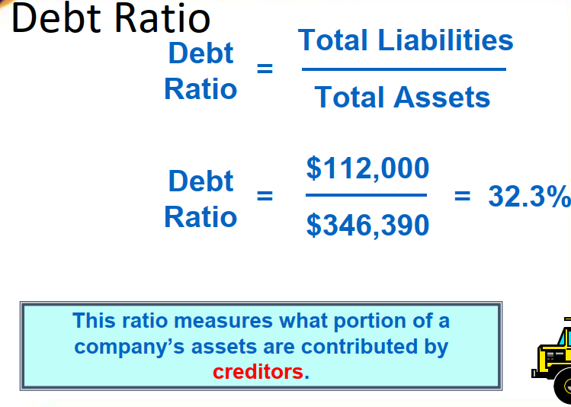

Slide 22
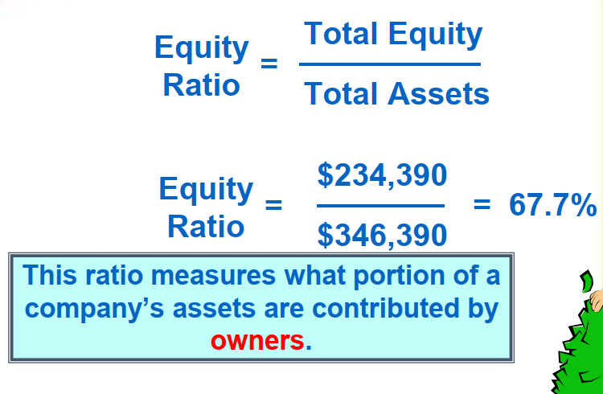

Slide 23
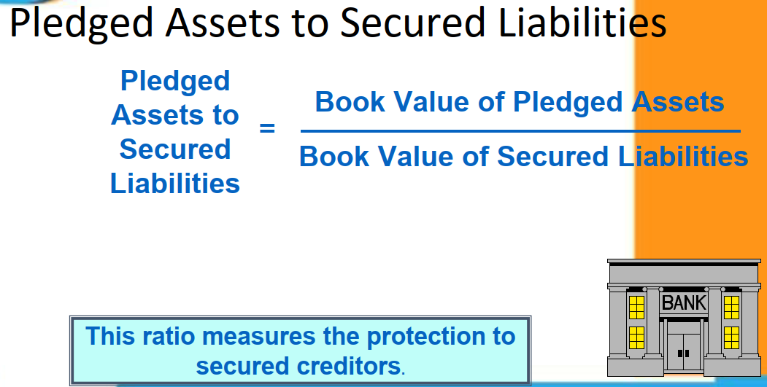

Slide 24
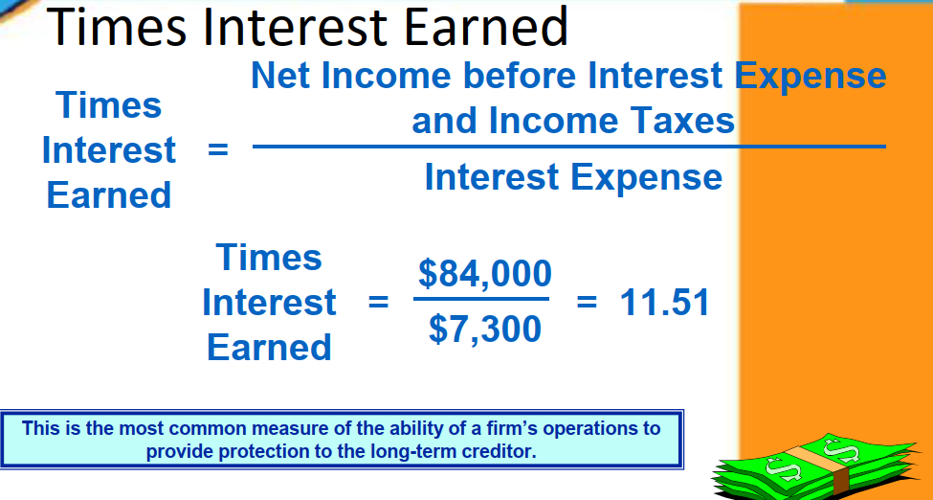

Slide 25
Profitability Ratios
Ability to provide financial rewards sufficient to attract and retain financing

Slide 26
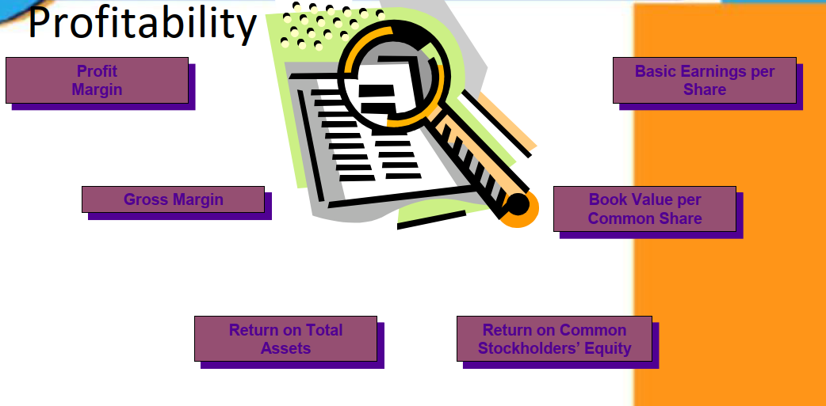

Slide 27
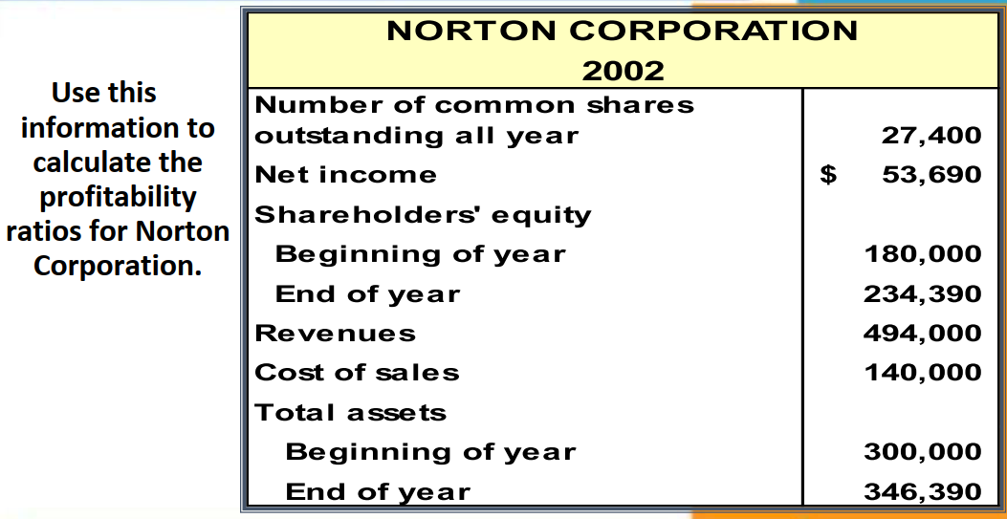

Slide 28
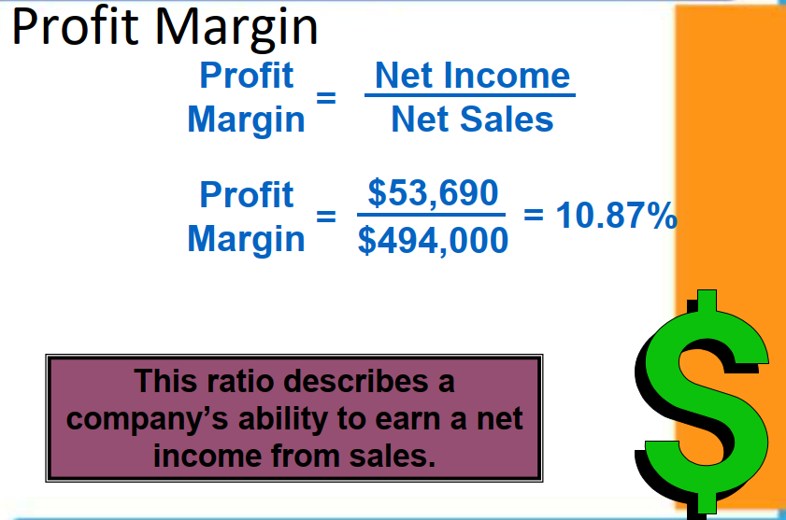

Slide 29
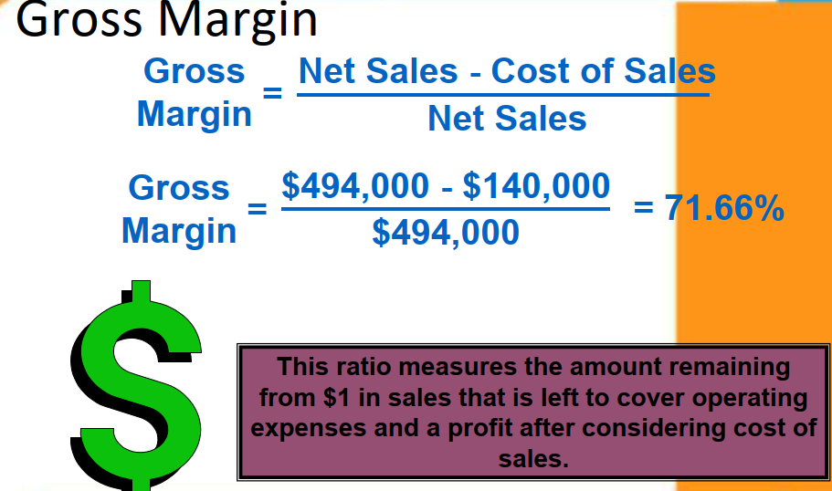

Slide 30
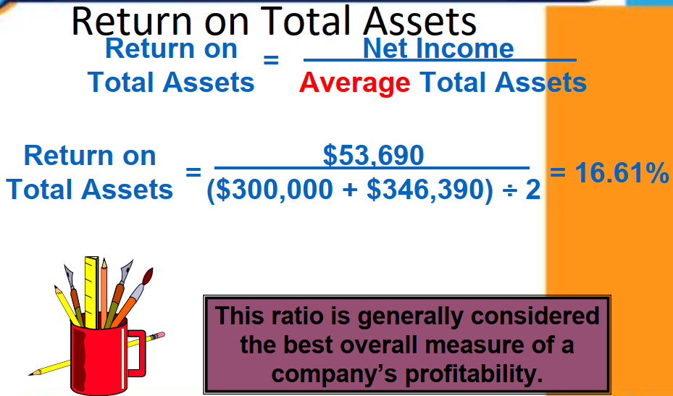

Slide 31
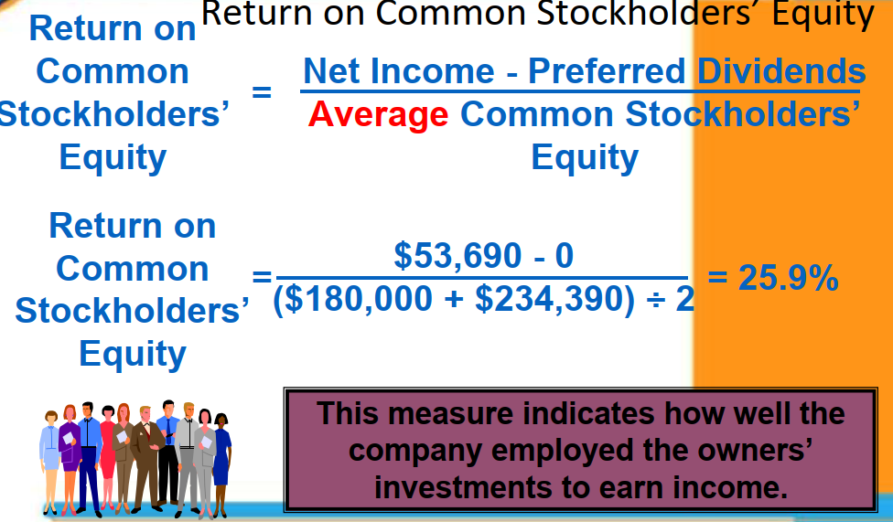

Slide 32
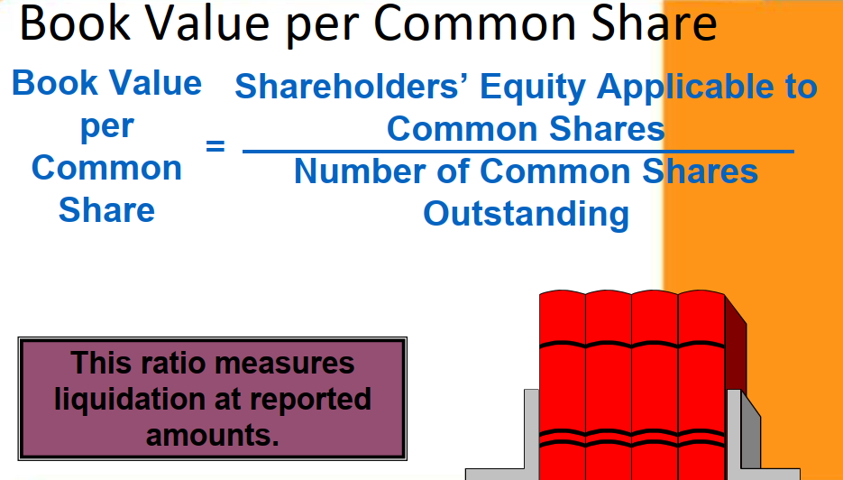

Slide 33
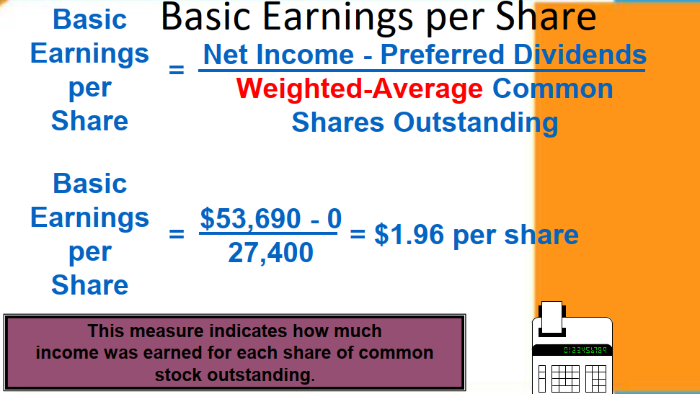

Slide 34
Market Ratios
Ability to generate positive market expectations

Slide 35
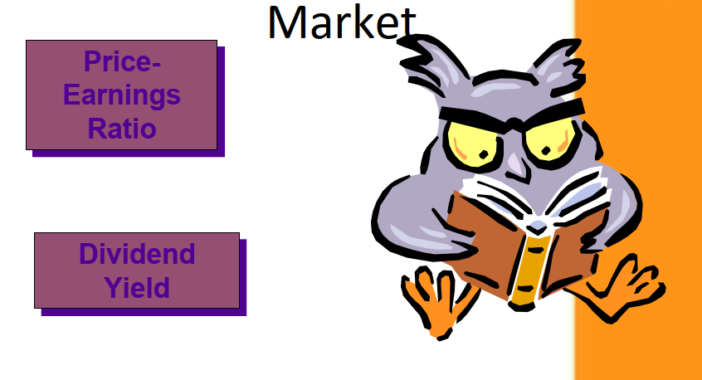

Slide 36
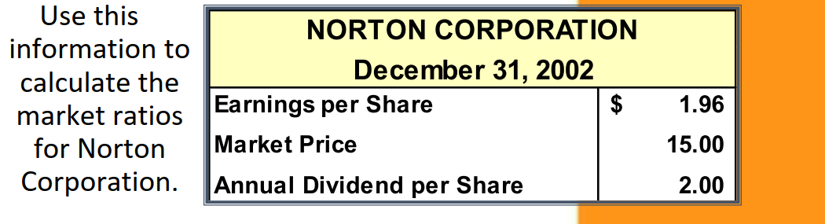

Slide 37
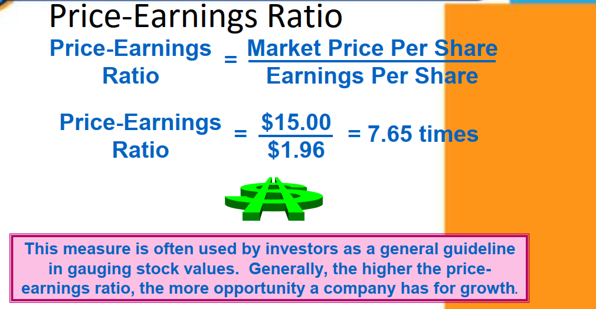

Slide 38
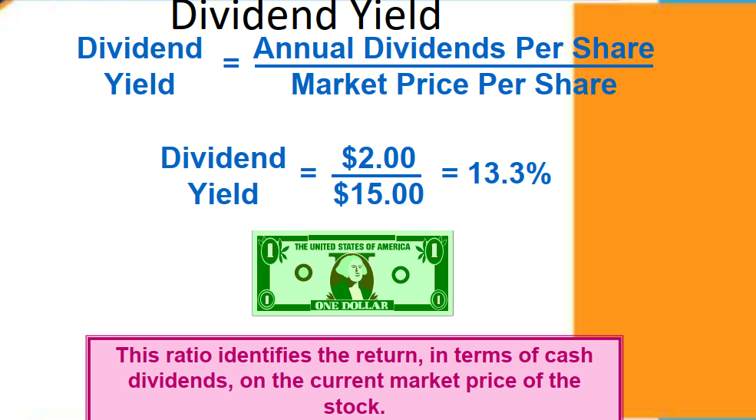

Slide 39


Thank You

