Slide 1


Cybersecurity
Concepts
Prepared by Dr. Diaa Salama
FNT625
Classical Encryption Techniques (part 2)
Lecture 6

Slide 2




Cybersecurity
Concepts
Lecture 6
FNT625
Classical Encryption Techniques(part 2)
Prepared by
Dr. Diaa Salama
www.midocean.ae

Slide 3


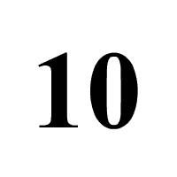


Slide 4

Lecture
Lets Start the sixth Lecture
06
Classical Encryption Techniques Part 2
www.midocean.ae

Slide 5




Symmetric Encryption
Substitution Techniques
Caesar Cipher
Monoalphabetic Cipher
www.midocean.ae

Slide 6
Symmetric Encryption
Substitution Techniques
Caesar Cipher
Monoalphabetic Cipher
www.midocean.ae

Slide 7
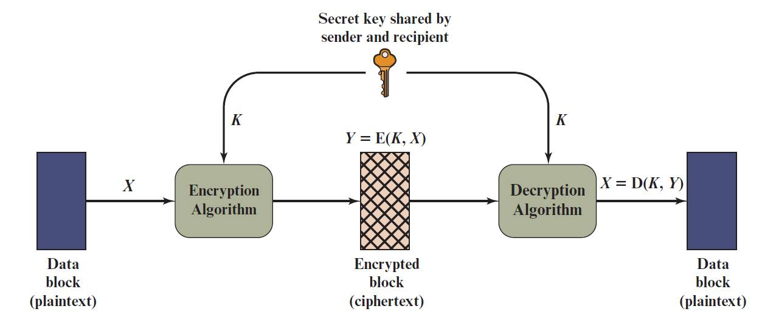
Lecture
06
Figure 3.1 Simplified Model of Symmetric Encryption
www.midocean.ae

Slide 8
Definitions (1 of 2)
Lecture
06
Plaintext
  An original message
Ciphertext
  The coded message
Enciphering/encryption
  The process of converting from plaintext to ciphertext
Deciphering/decryption
  Restoring the plaintext from the ciphertext
www.midocean.ae

Slide 9
Lecture
06
Definitions (2 of 2)
Cryptography
  The area of study of the many schemes used for encryption
Cryptographic system/cipher
  A scheme
Cryptanalysis
  Techniques used for deciphering a message without any knowledge of the enciphering details
Cryptology
  The areas of cryptography and cryptanalysis
www.midocean.ae

Slide 10
Symmetric Encryption
Substitution Techniques
Caesar Cipher
Monoalphabetic Cipher
www.midocean.ae

Slide 11
Lecture
06
Substitution Techniques
Caesar Cipher
Monoalphabetic Ciphers
Playfair Cipher
Hill Cipher
Polyalphabetic Ciphers
Vigenère Cipher
Autokey Cipher
Vernam Cipher
www.midocean.ae

Slide 12
Symmetric Encryption
Substitution Techniques
Caesar Cipher
Monoalphabetic Cipher
www.midocean.ae

Slide 13
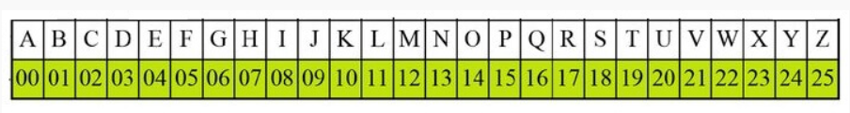
Lecture
06
Caesar Cipher Algorithm
Example: 1 Use the Caesar cipher to encrypt and decrypt the message "JAVATPOINT," and the key (shift) value of this message is 3.
Encryption
We apply encryption formulas by character, based on alphabetical order.
The formula of encryption is:
En (x) = (x + n) mod 26
www.midocean.ae

Slide 14
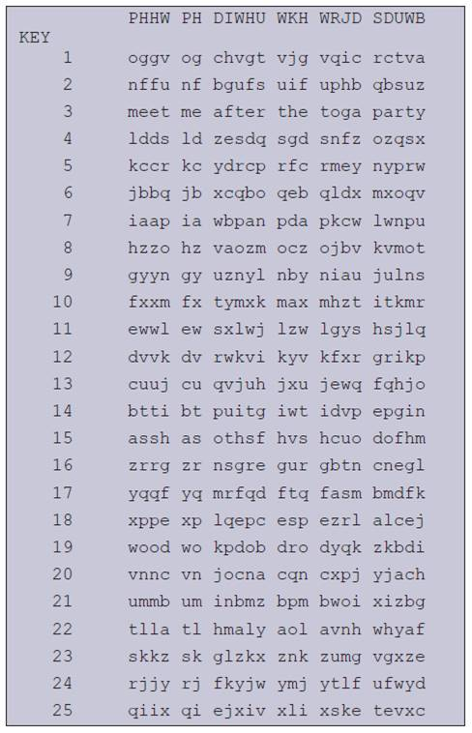
Lecture
Figure 3.3 Brute-Force Cryptanalysis of Caesar Cipher
06
www.midocean.ae

Slide 15
Symmetric Encryption
Substitution Techniques
Caesar Cipher
Monoalphabetic Cipher
www.midocean.ae

Slide 16
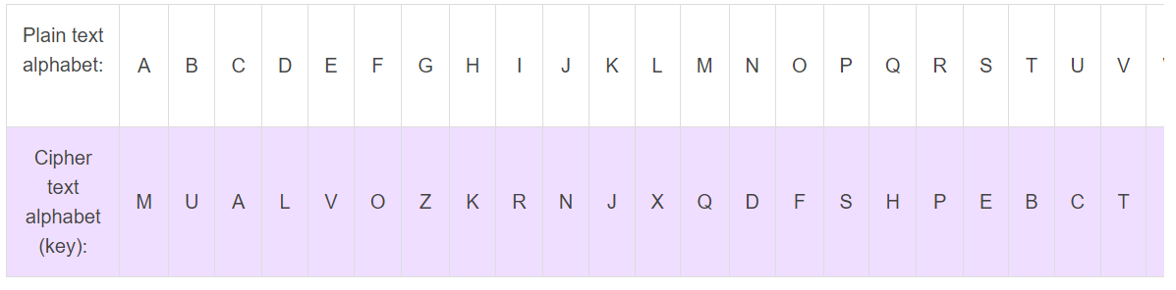
Lecture
monoalphabetic cipher
06
A mono-alphabetic cipher (aka simple substitution cipher) is a substitution cipher where each letter of the plain text is replaced with another letter of the alphabet.
It uses a fixed key which consist of the 26 letters of a “shuffled alphabet”.
Plaintext : How Are you cipher text : ?????
https://www.101computing.net/mono-alphabetic-substitution-cipher/
www.midocean.ae

Slide 17
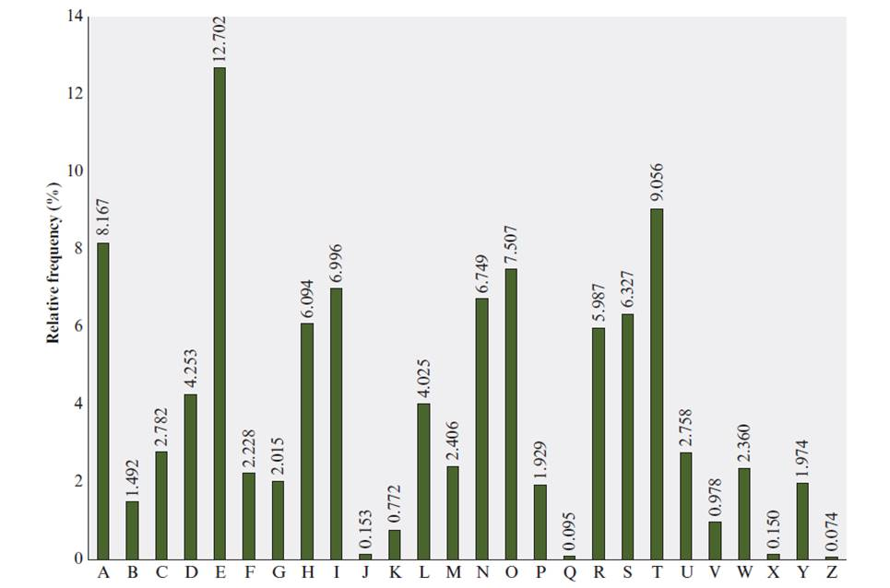
Lecture
Figure 3.5 Relative Frequency of Letters in English Text
06
www.midocean.ae

Slide 18

Symmetric Encryption
Substitution Techniques
Caesar Cipher
Monoalphabetic Cipher
Playfair Cipher
www.midocean.ae

Slide 19
Playfair cipher
The Playfair system was invented by Charles Wheatstone, who first described it in 1854.
Used by many countries during wartime
The Playfair algorithm is based on the use of a 5 x 5 matrix of letters constructed using a keyword.
www.midocean.ae

Slide 20
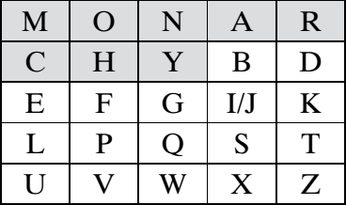
Playfair cipher
In this case, the keyword is monarchy.
www.midocean.ae

Slide 21
Encryption and Decryption
plaintext is encrypted two letters at a time
if a pair is a repeated letter, insert filler like 'X’
if both letters fall in the same row, replace each with letter to right (wrapping back to start from end)
if both letters fall in the same column, replace each with the letter below it (wrapping to top from bottom)
otherwise each letter is replaced by the letter in the same row and in the column of the other letter of the pair
www.midocean.ae

Slide 22
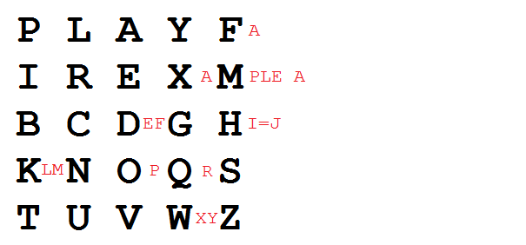
Example
Encrypting the message "Hide the gold in the tree stump":
Using "playfair example" as the key
hi de th eg ol di nt he tr ex es tu mp
www.midocean.ae

Slide 23
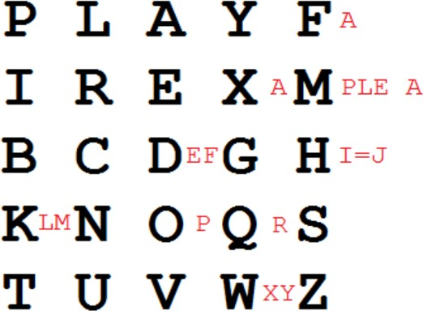
Playfair cipher
How to build 5x5 Matrix (assuming that I and J are interchangeable), the table becomes (omitted letters in red):
www.midocean.ae

Slide 24
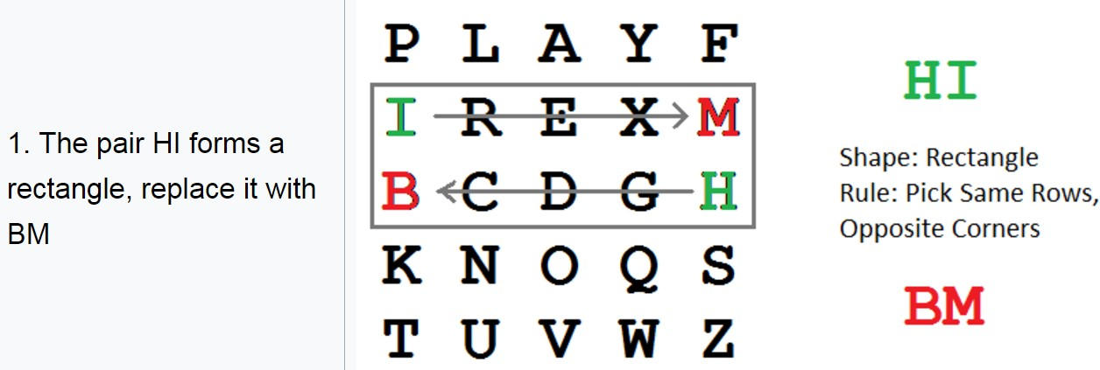
Playfair cipher
P= HI DE TH EG OL DI NT HE TR EX ES TU MP
www.midocean.ae

Slide 25
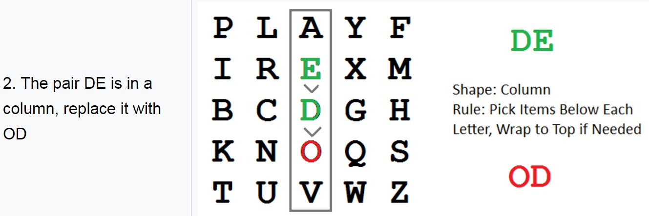
Playfair cipher
P= HI DE TH EG OL DI NT HE TR EX ES TU MP
www.midocean.ae

Slide 26
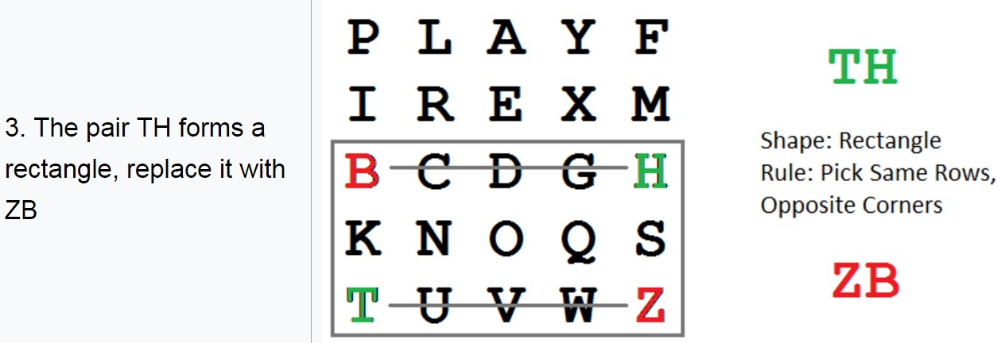
Playfair cipher
P= HI DE TH EG OL DI NT HE TR EX ES TU MP
www.midocean.ae

Slide 27
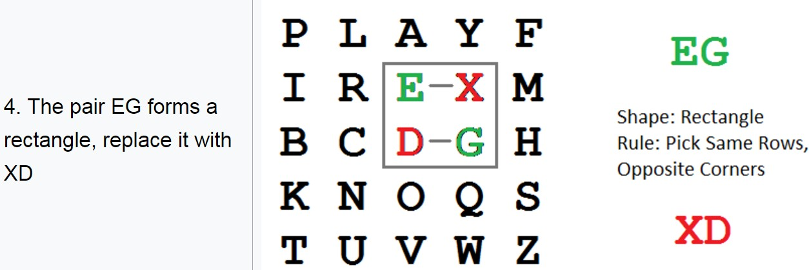
Playfair cipher
P= HI DE TH EG OL DI NT HE TR EX ES TU MP
www.midocean.ae

Slide 28
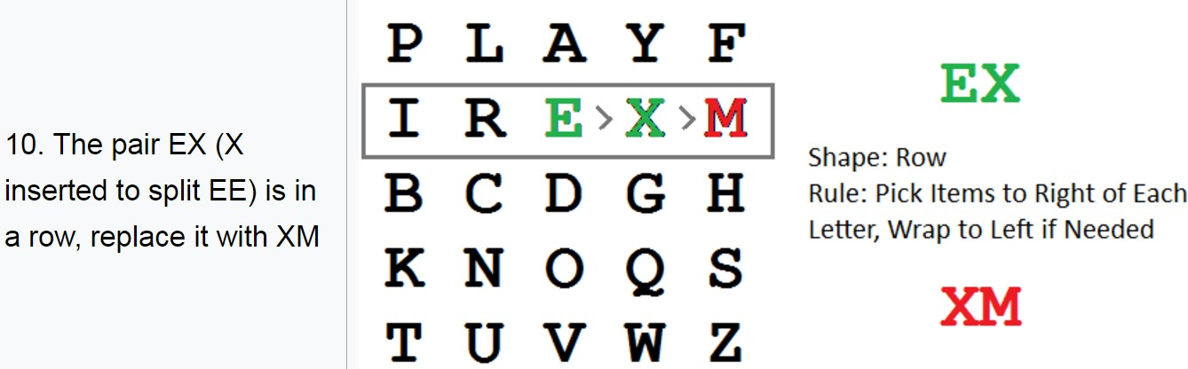
Playfair cipher
P= HI DE TH EG OL DI NT HE TR EX ES TU MP
www.midocean.ae

Slide 29
Lecture
05
Playfair cipher
C= BM OD ZB XD NA BE KU DM UI XM MO UV IF
the message "Hide the gold in the tree stump" becomes "BMODZ BXDNA BEKUD MUIXM MOUVI F"
www.midocean.ae

Slide 30
Lecture
05
Playfair cipher
the message "Hide the gold in the tree stump" becomes "BMODZ BXDNA BEKUD MUIXM MOUVI F"
www.midocean.ae

Slide 31
Polyalphabetic Ciphers
Vigenère Cipher
Autokey Cipher
Vernam Cipher
Transposition Techniques
Rail Fence Cipher
Row Transposition Cipher
www.midocean.ae

Slide 32
Lecture
06
polyalphabetic cipher
A polyalphabetic cipher is any cipher based on substitution, using multiple substitution alphabets.
polyalphabetic cipher techniques have the following features in common:
A set of related monoalphabetic substitution rules is used.
A key determines which particular rule is chosen for a given transformation.
www.midocean.ae

Slide 33

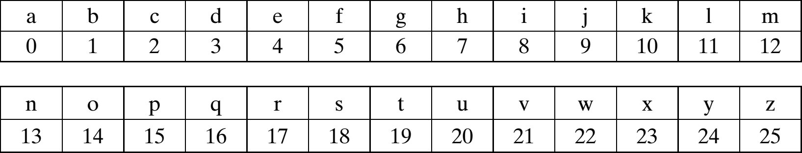
polyalphabetic cipher
Assume
Then We set these Rules:
www.midocean.ae

Slide 34
polyalphabetic cipher
Then We set Key as Rules:
Shift the first letter three position to the right
Shift the second letter five position to the right
Shift the third letter seven position to the right
Given Plaintext = security
www.midocean.ae

Slide 35
polyalphabetic cipher
Given Plaintext = security
1) Divide Plaintext to three words
P= sec uri ty
C= VJJ XWP WD
www.midocean.ae

Slide 36
polyalphabetic cipher Decryption
Then We set Key as Rules: (reverse)
Shift the first letter three position to the left
Shift the second letter five position to the left
Shift the third letter seven position to the left
Given Ciphertext = VJJXWPWD
www.midocean.ae

Slide 37
polyalphabetic cipher Decryption
Given C= VJJXWPWD
1) Divide Plaintext to three words as your rules number
C= VJJ XWP WD
C= SEC URI TY
www.midocean.ae

Slide 38







Polyalphabetic Ciphers
Vigenère Cipher Autokey Cipher Vernam Cipher
Transposition Techniques Rail Fence Cipher
Row Transposition Cipher
www.midocean.ae

Slide 39
Vigenère cipher
The Vigenère cipher, was invented by a Frenchman, Blaise de Vigenère in the 16th century.
Vigenère cipher is a simple polyalphabetic cipher
𝐶_{𝑖} = 𝑃_{𝑖} + 𝐾 𝑚𝑜𝑑 26
𝑃_{𝑖} = 𝐶_{𝑖} − 𝐾 𝑚𝑜𝑑 26
Repeating key
www.midocean.ae

Slide 40
Vigenère cipher
𝐶_{𝑖} = 𝑃_{𝑖} + 𝐾 𝑚𝑜𝑑 26
𝑃_{𝑖} = 𝐶_{𝑖} − 𝐾 𝑚𝑜𝑑 26
Repeating key
www.midocean.ae

Slide 41
Vigenère cipher Encryption
𝐾=deceptive
𝑃=we are discovered save yourself
www.midocean.ae

Slide 42
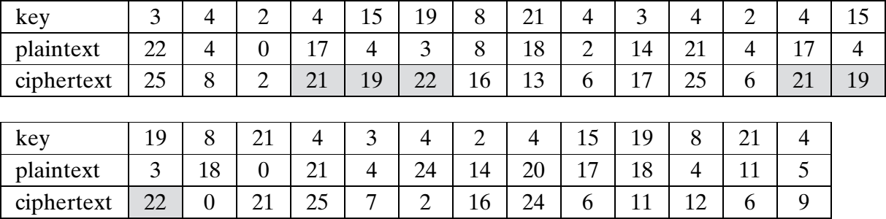
Vigenère cipher Encryption
www.midocean.ae

Slide 43
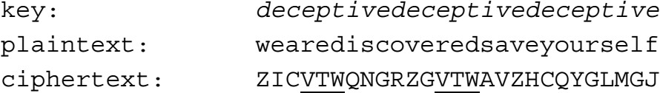
Vigenère cipher Encryption
Result
www.midocean.ae

Slide 44
Vigenère cipher Encryption
The strength of Vigenère Cipher is that there are multiple ciphertext letters for each plaintext letter
www.midocean.ae

Slide 45
Vigenère cipher Decryption
decryption simply works in reverse
𝑃_{𝑖} = 𝐶_{𝑖} − 𝐾 𝑚𝑜𝑑 26
www.midocean.ae

Slide 46
Polyalphabetic Ciphers
Vigenère Cipher Autokey Cipher Vernam Cipher
Transposition Techniques Rail Fence Cipher
Row Transposition Cipher
www.midocean.ae

Slide 47
autokey cipher
An autokey cipher (also known as the autoclave cipher) is a cipher which incorporates the message (the plaintext) into the key.
𝑃 = {𝑝₁, 𝑝₂, 𝑝₃, … , 𝑝_{𝑛}}
𝐾 = {𝑘₁, 𝑝₁, 𝑝₂, 𝑝₃, … , 𝑝_{𝑛−1}}
𝐶 = {𝑐₁, 𝑐₂, 𝑐₃, … , 𝑐_{𝑛}}
www.midocean.ae

Slide 48
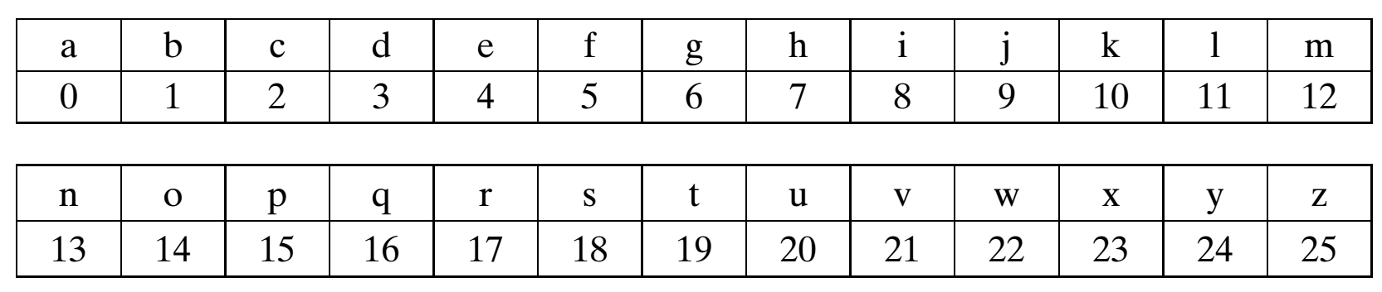
autokey cipher
𝐶_{𝑖} = 𝑃_{𝑖} + 𝐾_{𝑖} 𝑚𝑜𝑑 26
𝑃_{𝑖} = 𝐶_{𝑖} − 𝐾_{𝑖} 𝑚𝑜𝑑 26
www.midocean.ae

Slide 49
autokey cipher Encryption
𝑲=m
𝑷=a ttack is today
Plaintext | a | t | t | a | c | k | i | s | t | o | d | a | y
P Value | 0 | 19 | 19 | 0 | 2 | 10 | 8 | 18 | 19 | 14 | 3 | 0 | 24
Key | 12 | 0 | 19 | 19 | 0 | 2 | 10 | 8 | 18 | 19 | 14 | 3 | 0
C Value | 12 | 19 | 12 | 19 | 2 | 12 | 18 | 0 | 11 | 7 | 17 | 3 | 24
Ciphertext | m | t | m | t | c | m | s | a | l | h | r | d | y
www.midocean.ae

Slide 50
autokey cipher Decryption
𝑲=m
𝑪=mtmtcmsalhrdy
Ciphertext | m | t | m | t | c | m | s | a | l | h | r | d | y
C Value | 12 | 19 | 12 | 19 | 2 | 12 | 18 | 0 | 11 | 7 | 17 | 3 | 24
Key | 12 | 0 | 19 | 19 | 0 | 2 | 10 | 8 | 18 | 19 | 14 | 3 | 0
P Value | 0 | 19 | 19 | 0 | 2 | 10 | 8 | 18 | 19 | 14 | 3 | 0 | 24
Plaintext | a | t | t | a | c | k | i | s | t | o | d | a | y
www.midocean.ae

Slide 51
Polyalphabetic Ciphers
Vigenère Cipher Autokey Cipher Vernam Cipher
Transposition Techniques Rail Fence Cipher
Row Transposition Cipher
www.midocean.ae

Slide 52
Vernam cipher
Vernam Cipher was introduced by an AT&T engineer named Gilbert Vernam in 1918.
The ultimate defense against such a cryptanalysis is to choose a keyword that is as long as the plaintext and has no statistical relationship to it.
www.midocean.ae

Slide 53
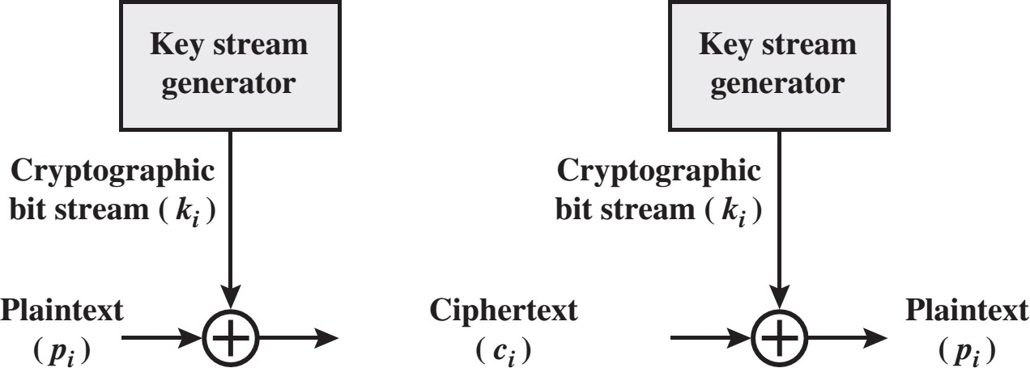
Vernam cipher
www.midocean.ae

Slide 54
Vernam cipher
Encryption
  𝐶 = 𝑃 𝑋𝑂𝑅 𝐾
Decryption
  𝑃 = 𝐶 𝑋𝑂𝑅 𝐾
www.midocean.ae

Slide 55
Vernam cipher Encryption
P=11100011101010101101
K=1001010101
P=11100011101010101101
K=10010101011001010101
C=01110110110011111000
www.midocean.ae

Slide 56
Vernam cipher Decryption
C=01110110110011111000
K=10010101011001010101
P=11100011101010101101
www.midocean.ae

Slide 57
Polyalphabetic Ciphers
Vigenère Cipher Autokey Cipher Vernam Cipher
Transposition Techniques Rail Fence Cipher
Row Transposition Cipher
www.midocean.ae

Slide 58
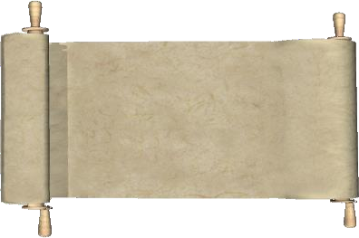
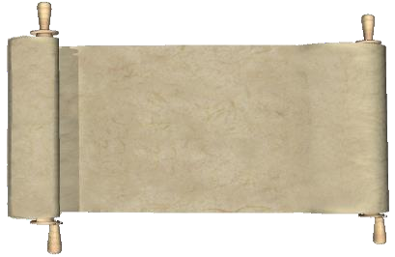
The clear text message would be
encoded using a key of 3.
1
FLANK EAST
ATTACK AT DAWN
Clear Text
2
F...K...T...T...A...W.
Use a rail fence cipher and a
key of 3.
.L.N.E.S.A.T.A.K.T.A.N
..A...A...T...C...D...
3
FKTTAW LNESATAKTAN AATCD
The clear text message would appear as follows.
Ciphered Text

Slide 59
Transposition Techniques
Transposition Techniques performing some sort of permutation on the plaintext letters (reorder the position of letters in plaintext).
Types:
  Rail Fence Cipher
  Row Transposition Cipher
www.midocean.ae

Slide 60
Polyalphabetic Ciphers
Vigenère Cipher Autokey Cipher Vernam Cipher
Transposition Techniques Rail Fence Cipher
Row Transposition Cipher
www.midocean.ae

Slide 61
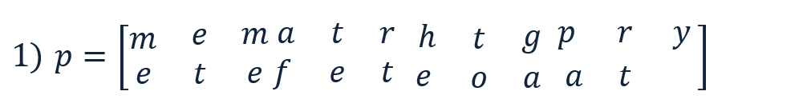
Rail Fence Cipher Encryption
P= meet me after the toga party
K=2
2) C=mematrhtgpryetefeteoaat
www.midocean.ae

Slide 62
Rail Fence Cipher Decryption
C=mematrhtgpryetefeteoaat
K=2
𝑒
𝑒 𝑡
𝑚 𝑎
𝑒 𝑓
𝑡 𝑟 ℎ
𝑒 𝑡 𝑒
𝑡
𝑜 𝑎
𝑔 𝑝 𝑟 𝑦
𝑎 𝑡
1) 𝐶 = ^{𝑚}
2) P= meetmeafterthetogaparty
www.midocean.ae

Slide 63
Polyalphabetic Ciphers
Vigenère Cipher Autokey Cipher Vernam Cipher
Transposition Techniques Rail Fence Cipher
Row Transposition Cipher
www.midocean.ae

Slide 64
Row Transposition Cipher Encryption
P= attack postponed until two am
K= 4312567
4 |  | 3 | 1 | 2 | 5 | 6 | 7
𝑎 |  | 𝑡 | 𝑡 | 𝑎 | 𝑐 | 𝑘 | 𝑝
𝐶 = | 𝑜 | 𝑠 | 𝑡 | 𝑝 | 𝑜 | 𝑛 | 𝑒 | = 𝑡𝑡𝑛𝑎𝑎𝑝𝑡𝑚𝑡𝑠𝑢𝑜𝑎𝑜𝑑𝑤𝑐𝑜𝑖𝑥𝑘𝑛𝑙𝑥𝑝𝑒𝑡𝑥
 | 𝑑 | 𝑢 | 𝑛 | 𝑡 | 𝑖 | 𝑙 | 𝑡
 | 𝑤 | 𝑜 | 𝑎 | 𝑚 | 𝑥 | 𝑥 | 𝑥
www.midocean.ae

Slide 65
Row Transposition Cipher Decryption
C= 𝑡𝑡𝑛𝑎𝑎𝑝𝑡𝑚𝑡𝑠𝑢𝑜𝑎𝑜𝑑𝑤𝑐𝑜𝑖𝑥𝑘𝑛𝑙𝑥𝑝𝑒𝑡𝑥 = Len(C)=28
K= 4312567
Each Column have 28/7= 4 letter
4 |  | 3 | 1 | 2 | 5 | 6 | 7
𝑎 |  | 𝑡 | 𝑡 | 𝑎 | 𝑐 | 𝑘 | 𝑝
𝑃 = | 𝑜 | 𝑠 | 𝑡 | 𝑝 | 𝑜 | 𝑛 | 𝑒 | = 𝑎𝑡𝑡𝑎𝑐𝑘𝑝𝑜𝑠𝑡𝑝𝑜𝑛𝑒𝑑𝑢𝑛𝑡𝑖𝑙𝑡𝑤𝑜𝑎𝑚𝑥𝑥𝑥
 | 𝑑 | 𝑢 | 𝑛 | 𝑡 | 𝑖 | 𝑙 | 𝑡
 | 𝑤 | 𝑜 | 𝑎 | 𝑚 | 𝑥 | 𝑥 | 𝑥
www.midocean.ae

Slide 66




Task
As shown in Figure below, use Multiplicative Cipher to encrypt “enemy attack tonight” with key = 4.
𝑷𝒍𝒂𝒊𝒏𝒕𝒆𝒙𝒕
Sender
𝑲
𝑪 = 𝑷𝒙𝑲 𝒎𝒐𝒅 𝟐𝟔
Encryption
𝑪
www.midocean.ae

Slide 67



Thank You

