Slide 1



Business Data Analysis
MGM509
Lecture 3
Building Better Models: Regression, SVMs, and Model Fitting
Prepared by
Eng. Ahmed Hussein, MBA, PfMP©, PMP©, CMP APMG

Slide 2

Lecture
What we will cover
3
Data Preparation (Steps, sources, formats, tools, and storage of data)
What is Model Fitting?
Regression Types and How to choose the suitable Model
3 – 2

Slide 3


Lecture
Data Preparation
03
3 – 3

Slide 4
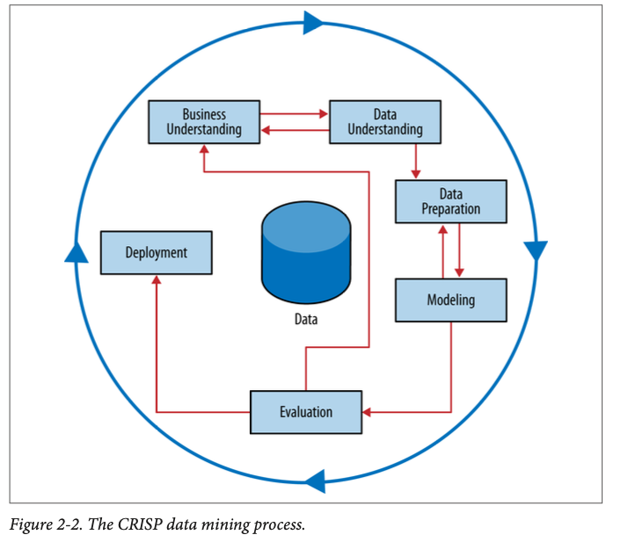
Data Mining Process Overview (CRISP-DM)
Lecture
3
Cross Industry Standard Process for Data Mining
Not strictly sequential; often involves loops and iteration
3 – 4

Slide 5
Lecture
What is Data Preparation?
3
Good models need well-prepared features
Ensures that models receive reliable, usable, and valid inputs
Prevents errors, overfitting, and bias in analysis
Raw data is often incomplete, inconsistent, or noisy
The process of cleaning, transforming, and organizing data before modeling
Often consumes 70–80% of the total project time
3 – 5

Slide 6
Lecture
Data Preparation Matters!
3
Cleans and structures raw data
Includes integration, transformation, and enrichment
Builds the foundation for accurate models
3 – 6

Slide 7
Lecture
Main Steps in Data Preparation
3
1. Data Cleaning
2. Data Integration
3. Data Transformation
4. Feature Engineering
5. Data Reduction
6. Data Splitting
3 – 7

Slide 8
Lecture
Data Cleaning
3
Handling Missing Values
Techniques: removal, mean/median imputation, predictive filling
Consider: why is the data missing (random vs. systematic)?
Correcting Inconsistencies
Standardizing formats (e.g., dates, text casing, currencies)
Resolving conflicting entries (e.g., “NY” vs. “New York”)
Removing Duplicates
Fixing Invalid Entries
Out-of-range values (e.g., age = 220)
Typos or malformed inputs (e.g., email = “abc@com”)
Outlier Detection & Treatment
Use statistical methods (IQR, Z-score) or domain knowledge
Decide whether to keep, transform, or remove
3 – 8

Slide 9
Lecture
Data Integration
3
Combining data from multiple sources to produce a unified, consistent view that supports analysis, reporting, and modeling.
It enables organizations to consolidate fragmented information, gain richer insights, and support cross-functional analysis
Key Integration Tasks:
Match fields across systems (schema alignment)
Key Matching & Joining
Data Deduplication
Resolving Conflicts
3 – 9

Slide 10
Lecture
Data Transformation
3
Converting raw data into a suitable format for analysis and machine learning. Involves adjusting variables’ structure, scale, type, and representation to improve model performance and consistency.
Common Transformation Tasks:
Normalize or scale data
Convert types (e.g., date to age)
Encode categorical variables
Binning / Bucketing
Text Cleaning and Tokenization (for NLP)
Transformation turns available data into actionable input.
3 – 10

Slide 11
Lecture
Feature Engineering
3
Creating, modifying, or selecting variables that improve a model’s ability to learn meaningful patterns.
Key Techniques:
Derived features:
Create new variables from existing ones
Example: Age = Today’s Date – Date of Birth
Interaction features:
Combine two or more features to capture relationships
Example: Income × Education Level
Time-based features
Extract from timestamps: hour, day, time since last event
Example: Days Since Last Purchase
Text Features (for NLP):
Word counts, keyword flags, sentiment scores
Example: Review Length, Presence of Negative Words
3 – 11

Slide 12
Lecture
Data Reduction
3
Minimizing the volume and dimensionality of data while preserving its core informational content. It makes datasets easier to process, store, and model without compromising accuracy.
Balances model performance and interpretability
Techniques:
Remove irrelevant or redundant features
Dimensionality reduction (e.g., PCA Principal Component Analysis))
Sampling and Aggregation
3 – 12

Slide 13
Lecture
Train/Test Split
3
Split data into:
  Training set: used to fit the model
  Testing set: used to evaluate performance
Sometimes include validation set for tuning
Ensures honest performance evaluation and prevents overfitting
Type of Split | Common Ratios | When to Use
Train/Test Only | 70/30 or 80/20 | Simple evaluations
Train/Validation/Test | 60/20/20 or 70/15/15 | Hyperparameter tuning required
3 – 13

Slide 14
Lecture
Sources of Data
3
Data source reliability impacts preparation needs
Internal Systems
CRM, ERP, web logs, databases
External Data
Public datasets, APIs, social media, sensors
Manual Collection
Surveys, forms, customer feedback
Streaming Sources
IoT devices, clickstream, mobile apps
3 – 14

Slide 15
Lecture
Loading Data
3
Getting Raw Data Into Your Environment
Loading is the first technical step in preparing data
Flat files:
CSV, Excel, JSON, XML
Databases:
SQL (MySQL, PostgreSQL, Oracle)
NoSQL (MongoDB, Cassandra)
APIs:
REST, GraphQL for external sources
Data Pipelines:
Airflow, Spark, Azure Data Factory
3 – 15

Slide 16
Lecture
Storing Data for Preparation
3
Choosing Where and How to Store It
Storage choice impacts speed, collaboration, and security
Local storage (CSV, Excel): good for small-scale work
Cloud storage (AWS S3, Azure Blob, Google Cloud): scalable and accessible
Databases and warehouses
PostgreSQL, Snowflake, BigQuery
Allow structured querying and indexing
Data lakes
Store unstructured and semi-structured data (e.g., Hadoop, Delta Lake)
3 – 16

Slide 17
Lecture
Tools for Data Preparation
3
Excel (quick fixes)
Pandas (Python) – powerful tabular processing
R (tidyverse) – statistical cleaning and reshaping
SQL – for querying and joining data
ETL tools – for enterprise data pipelines
3 – 17

Slide 18
Lecture
Common Pitfalls
3
Data leakage: using future info to train model
Over-imputation: filling missing data without logic
Under-documentation: losing track of changes made
3 – 18

Slide 19
Lecture
Best Practices
3
Document every cleaning and transformation step
Use visualizations to detect problems
Collaborate with domain experts for feature creation
Automate repeatable steps using pipelines
3 – 19

Slide 20
Lecture
Ready for Modelling?
3
With high-quality, structured data, you can now move on to:
  Feature Selection
  Model Training
  Evaluation
  Deployment
“Better data beats fancier algorithms.” – Peter Norvig
3 – 20

Slide 21
Lecture
Modelling: Model Fitting and Regression
03
3 – 21

Slide 22
Lecture
Model Fitting
3
Defining the Core Task of Predictive Modeling
Model fitting means finding a function that maps inputs (X) to outputs (Y) using data
The model adjusts its internal parameters to minimize error
Example: In linear regression, this means finding the best-fitting line
Model fitting is the foundation of machine learning — it’s how models learn
3 – 22

Slide 23
Lecture
Why do we Fit Models?
3
For the Purpose of Induction
Fitting turns raw data into generalizable rules
We use models to:
Remember: The goal isn’t just to match past data — it’s to make future predictions
Predict unknown outcomes
Support business decisions
Learn patterns in data
3 – 23

Slide 24
Lecture
What Happens During Fitting?
3
Turn Input Data to Model Parameters
Training data contains examples with known outcomes
Model uses optimization to find the best parameters
This process is known as induction
Example:
Predicting price from square footage → model finds best slope/intercept
3 – 24

Slide 25
Lecture
Objectives of Model Induction
3
What Are We Trying to Achieve?
Build a model that is:
  Accurate
  Interpretable
  Deployable
The objective isn’t just to fit — it’s to fit wisely and usefully
Minimize prediction error
Balance bias and variance
Capture relevant patterns (not noise)
3 – 25

Slide 26
Lecture
What is Generalization?
3
Generalization = model’s ability to perform well on unseen data
The true test is not how well it fits training data, but how well it predicts future outcomes
A good model:
  Learns patterns, not noise
  Performs consistently across samples
If a model can’t generalize, it can’t be trusted
3 – 26

Slide 27
Lecture
The Unknown True Function
3
What We’re Really Trying to Learn
In data science, there exists a true underlying function
  It maps inputs (X) to outputs (Y)
  But we can never observe it directly
Instead, we observe samples from it through noisy, imperfect data
Modeling is about approximating the truth, not finding it exactly
3 – 27

Slide 28
Lecture
The Model Function
3
Our Best Approximation of Reality
The model function is what we build using data
It tries to imitate the target function as closely as possible
Trained using:
  Labeled data
  Optimization (e.g., minimizing loss)
All models are approximations — but some are useful
3 – 28

Slide 29
How We Approximate the Target Function
Lecture
3
Through the Process of Induction:
  Learn from examples (input/output pairs)
  Use algorithms to fit a pattern (model function)
  Apply to new data to make predictions
Key factors:
  Quality & quantity of training data
  Chosen model type
  Optimization method
3 – 29

Slide 30
Lecture
What is Regression?
3
Regression is a method to predict a numeric or categorical outcome
Maps input features (X) to an output (Y)
Helps make data-driven predictions or classifications
  Types of Regression Models
Linear Regression
Logistic Regression
Support Vector Machines (SVM)
3 – 30

Slide 31
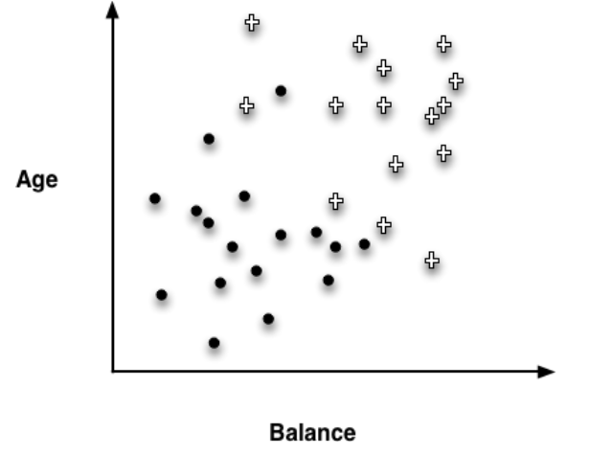
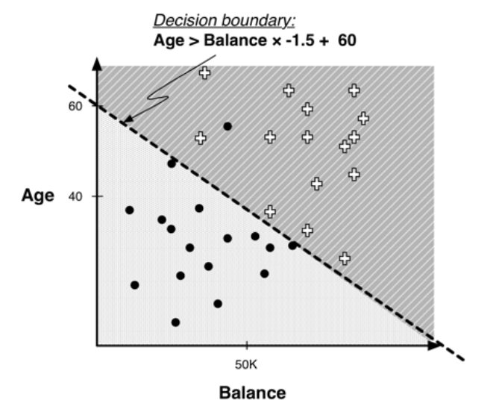
Lecture
Linear Regression
3
Predicts a continuous numerical value
Fits a straight line (Y = aX + b) through data
Goal: Minimize the error between predicted and actual values
Example: Predicting house price from square footage
Y= b0 + b1*Size
Simple, fast, and interpretable — ideal for linear numeric relationships
3 – 31

Slide 32
Linear Regression Key Concepts and Limitations
Lecture
3
Assumes linearity between features and target
Evaluation metrics:
  Mean Squared Error (MSE): The average squared difference between predicted and actual values. Penalizes larger errors more than smaller ones. Lower MSE = better model performance
  R² (coefficient of determination): The proportion of variance in the target explained by the model. Compares model against a naive baseline (mean prediction). R² = 1 → Perfect fit
3 – 32

Slide 33
Linear Regression Key Concepts and Limitations
Lecture
3
Use Cases:
  Predicting revenue, sales, prices, or demand
  Estimating project timelines or costs
Not suitable for:
Binary outcomes
Nonlinear relationships
Highly correlated features (multicollinearity)
3 – 33

Slide 34
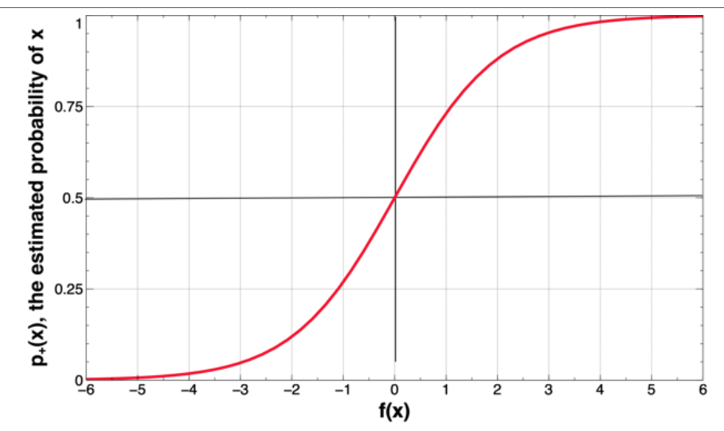
Lecture
Logistic Regression
3
Used for binary or categorical classification
Predicts the probability of a class
Output is passed through a logistic (sigmoid) function
Sigmoid function:
P(Y=1) = 1 / (1 + e^-(b0 + b1X1 + b2X2 + ...))
Output ranges from 0 to 1 → interpreted as probability
3 – 34

Slide 35
Logistic Regression Strengths and Limitation
Lecture
3
Strengths:
  Interpretable coefficients
  Simple and efficient for linearly separable classes
  Works well for probability-based decision-making
Struggles with:
  Non-linear boundaries
  Highly imbalanced data
  Complex interactions between features
3 – 35

Slide 36
Lecture
Support Vector Machines (SVM)
3
SVM is a powerful classification and regression technique
Finds the optimal hyperplane that separates classes
Maximizes the margin between data points and the boundary
Works in high-dimensional spaces (e.g., text, images)
Can create linear or nonlinear decision boundaries using kernels
SVM focuses on robust generalization, not just best training fit
3 – 36

Slide 37
Support Vector Machines (SVM) – Key Terms & Use Cases
Lecture
3
Support Vectors: Critical data points closest to the boundary
Hyperplane: The decision boundary
Kernel: Transforms data for nonlinear separation
Use Cases:
  Image recognition
  Bioinformatics (gene classification)
  Text classification and sentiment analysis
3 – 37

Slide 38
Lecture
Strengths and Limitations of SVM
3
Strengths | Limitations
Powerful for Complex Classification • Works well with nonlinear boundaries using kernel tricks • Handles high-dimensional spaces (e.g., text, images) • Less prone to overfitting with proper regularization • Effective even with small datasets Ideal for tasks where linear models fail and interpretability is less important | Computationally intensive on large datasets Hard to interpret compared to regression models Sensitive to: • Choice of kernel • Regularization parameter (C) • Feature scaling
Best suited when performance matters more than explanation
3 – 38

Slide 39
Lecture
Types of Regression Comparison
3
Model Type | Output Type | Interpretability | Key Feature | Suitable for | Common Use Cases
Linear Regression | Continuous (numeric) | High | Line Fitting | Trend/pattern prediction | Sales forecasting, pricing
Logistic Regression | Binary/Categorical/probability | Moderate | Binary Classification | Yes/No Outcomes | Churn prediction, fraud detection
SVM | Binary or multiclass (class label) | Low | Margin Optimization | Complex/High-Dimensional data | Classification, margin maximization
3 – 39

Slide 40
Lecture
Choosing the Right Model
3
Not all regression techniques are suited for every task
Selecting the right model improves accuracy, interpretability, and business impact
Use Linear Regression when:
Your target is a continuous variable
Relationships appear linear
Use Logistic Regression when:
You need probabilities or binary classification
Interpretability is important
Use SVM when:
Data has complex, nonlinear patterns
Accuracy and margin-based separation are key
3 – 40

Slide 41
Lecture
Model Assumptions
3
Every Model Makes Assumptions
Examples:
  Linear regression assumes linear relationships
  Logistic regression assumes log-odds linearity
  SVM assumes margin-based separability
Violating these assumptions can reduce accuracy and Lead to misleading conclusions
Understanding assumptions helps you choose the right model for the right data
3 – 41

Slide 42
Lecture
Examples
3
Forecasting Revenue Based on Ad Spend
Goal: Predict monthly sales based on marketing investment
Inputs: TV, radio, online ad budget
Output: Predicted sales (numeric)
Linear Regression:
✔ Relationship is mostly linear
✔ Output is continuous
✔ Quick and interpretable for marketing team
3 – 42

Slide 43
Lecture
Examples
3
Detecting Handwritten Digits
Goal: Classify handwritten digits (0–9)
Inputs: Pixel values from images
Output: Predicted digit class
SVM:
✔ Data is high-dimensional
✔ Decision boundary is nonlinear
✔ Accuracy is more important than interpretability
3 – 43

Slide 44
Lecture
Key Points
3
Data Preparation Is Essential
Clean, integrated, and well-structured data leads to better models.
Model Fitting = Learning Patterns
Fitting means training models to minimize prediction error.
Choose the Right Regression Tool
Linear = numeric prediction, Logistic = classification, SVM = complex boundaries
Evaluate with the Right Metrics
Use MSE for error measurement, R² for model explanation.
Train/Test Splits Ensure Reliability
Splitting data detects overfitting and improves generalization.
3 – 44

Slide 45

For Discussion Panel and Next Lecture:
Use the open-source Telco Customer Churn dataset available on Kaggle.
Apply Linear Regression to Forecast Customer Lifetime Value (CLV)
Lecture
3
For Discussion Panel and Next Lecture
3 – 45

Slide 46



Thank You

