Slide 1


Slide 2


Slide 3
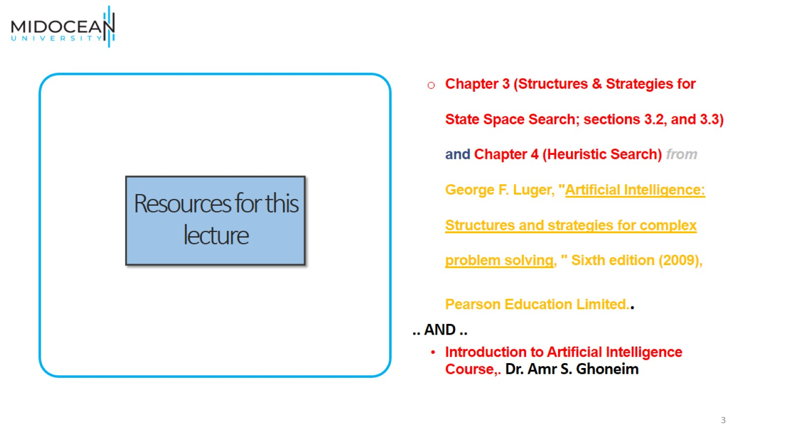
Resources for this lecture

Slide 4
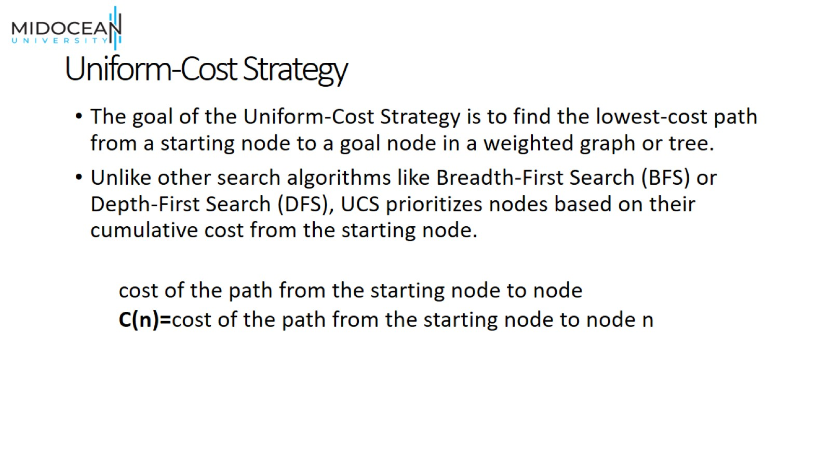
Uniform-Cost Strategy

Slide 5
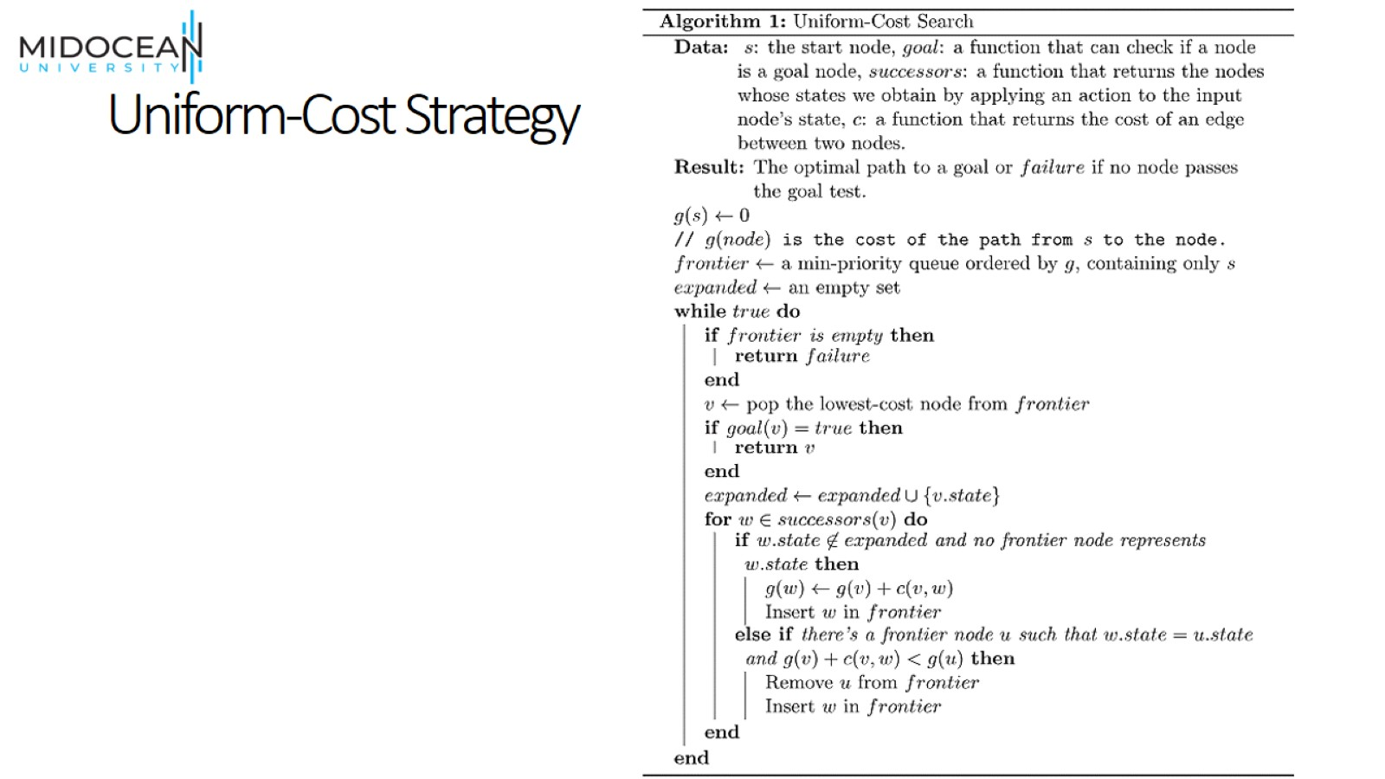
Uniform-Cost Strategy

Slide 6
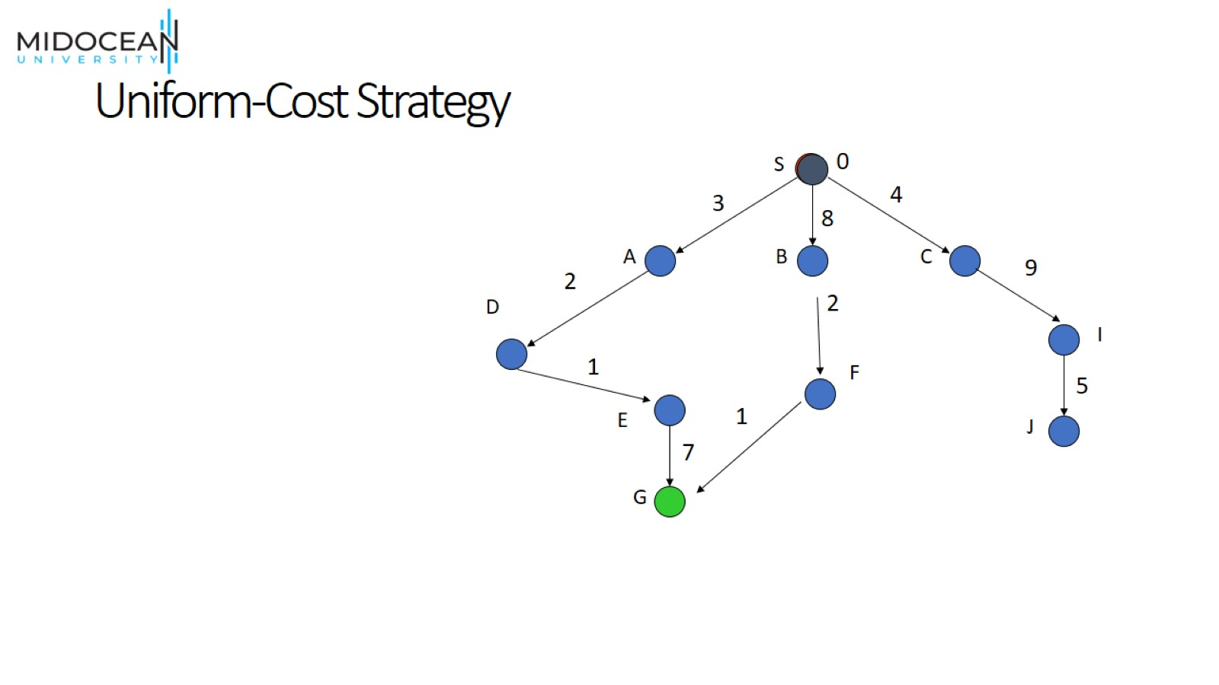
Uniform-Cost Strategy

Slide 7
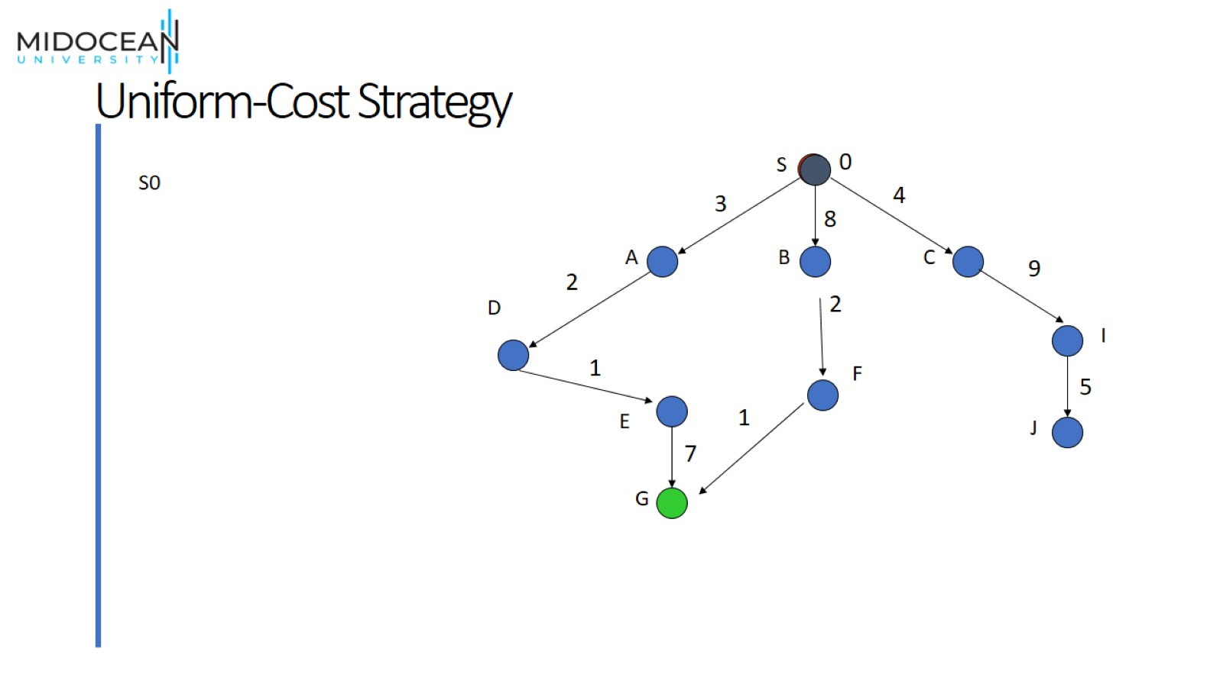
Uniform-Cost Strategy

Slide 8
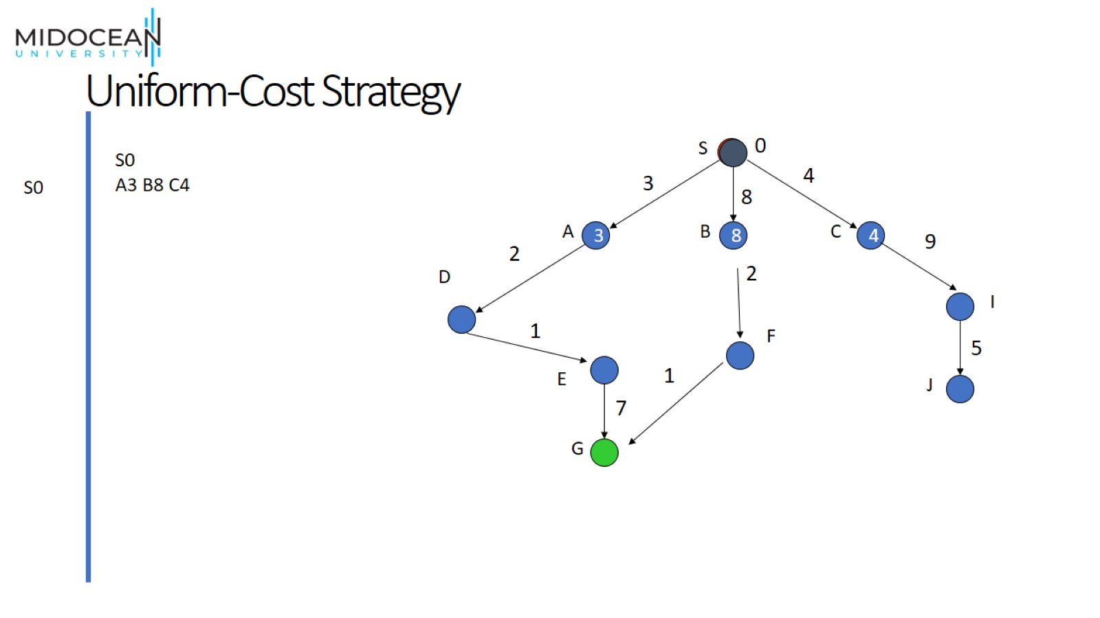
Uniform-Cost Strategy

Slide 9
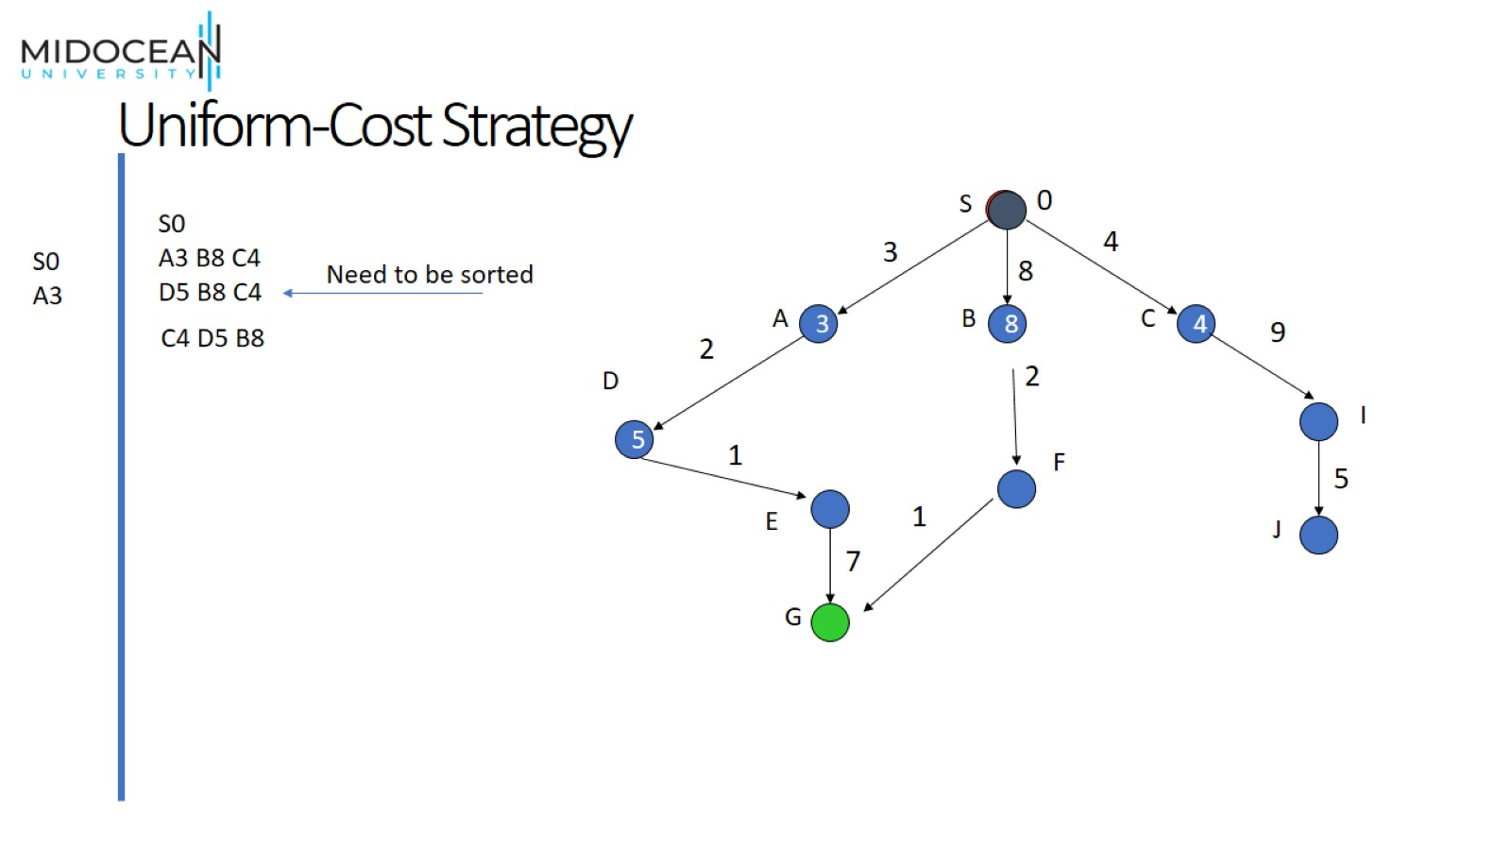
Uniform-Cost Strategy

Slide 10
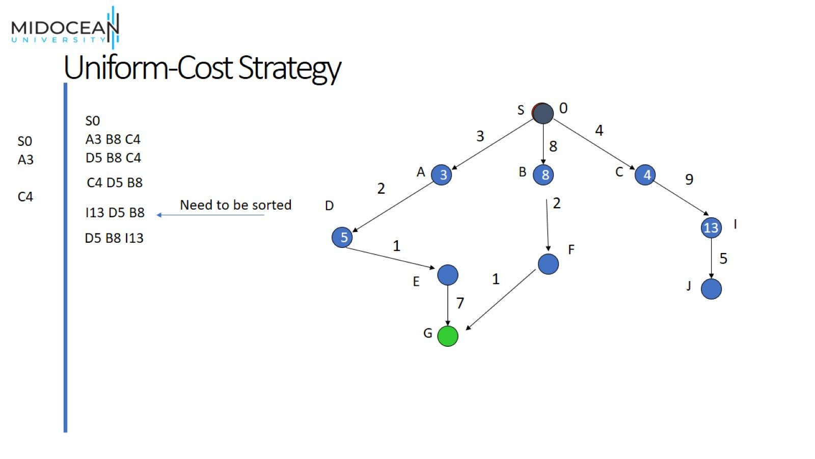
Uniform-Cost Strategy

Slide 11
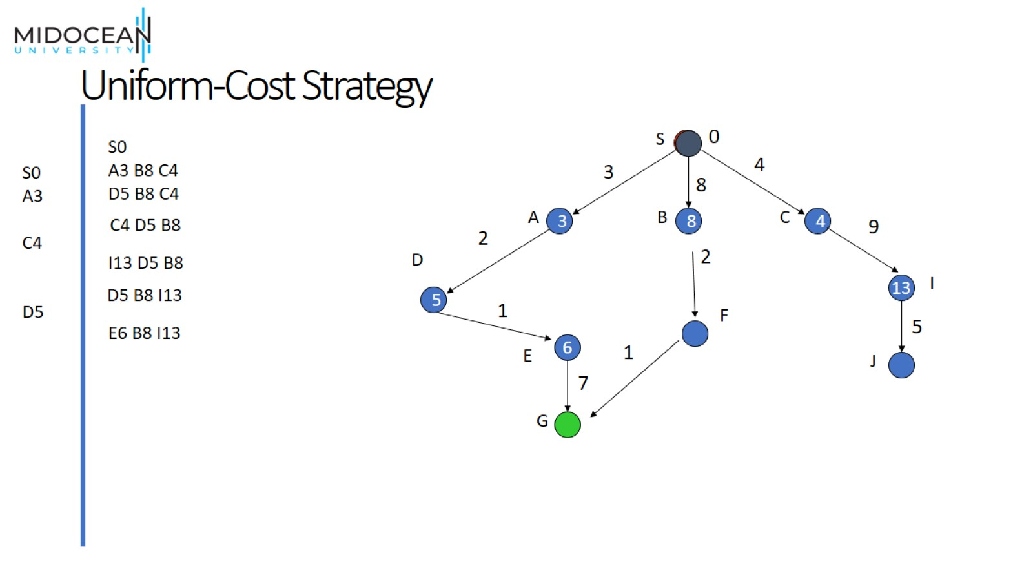
Uniform-Cost Strategy

Slide 12
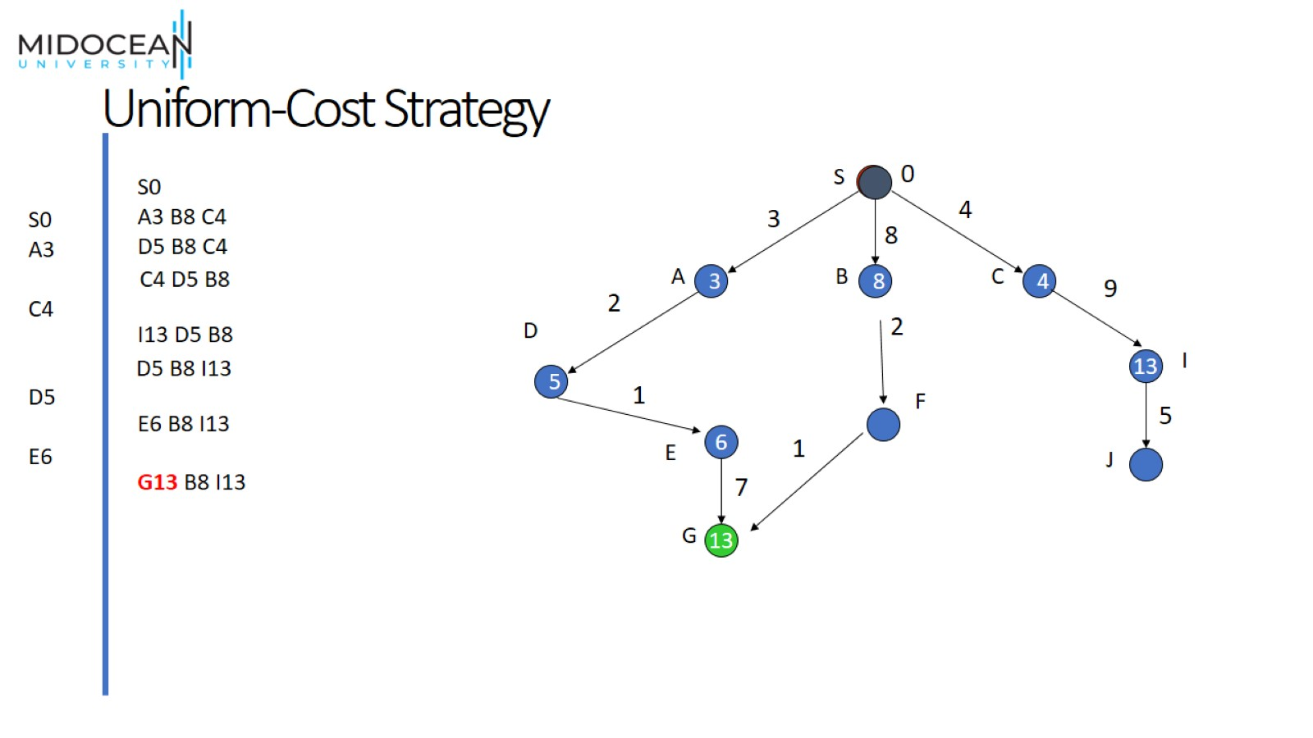
Uniform-Cost Strategy

Slide 13
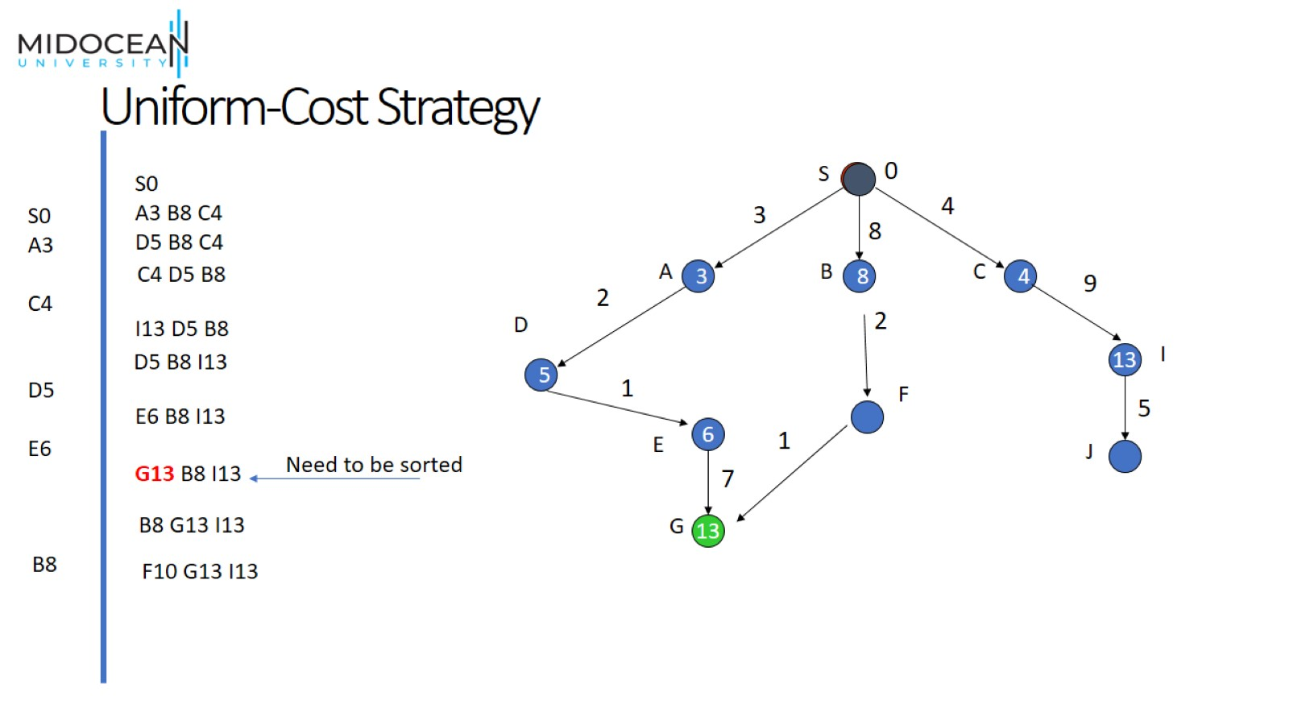
Uniform-Cost Strategy

Slide 14
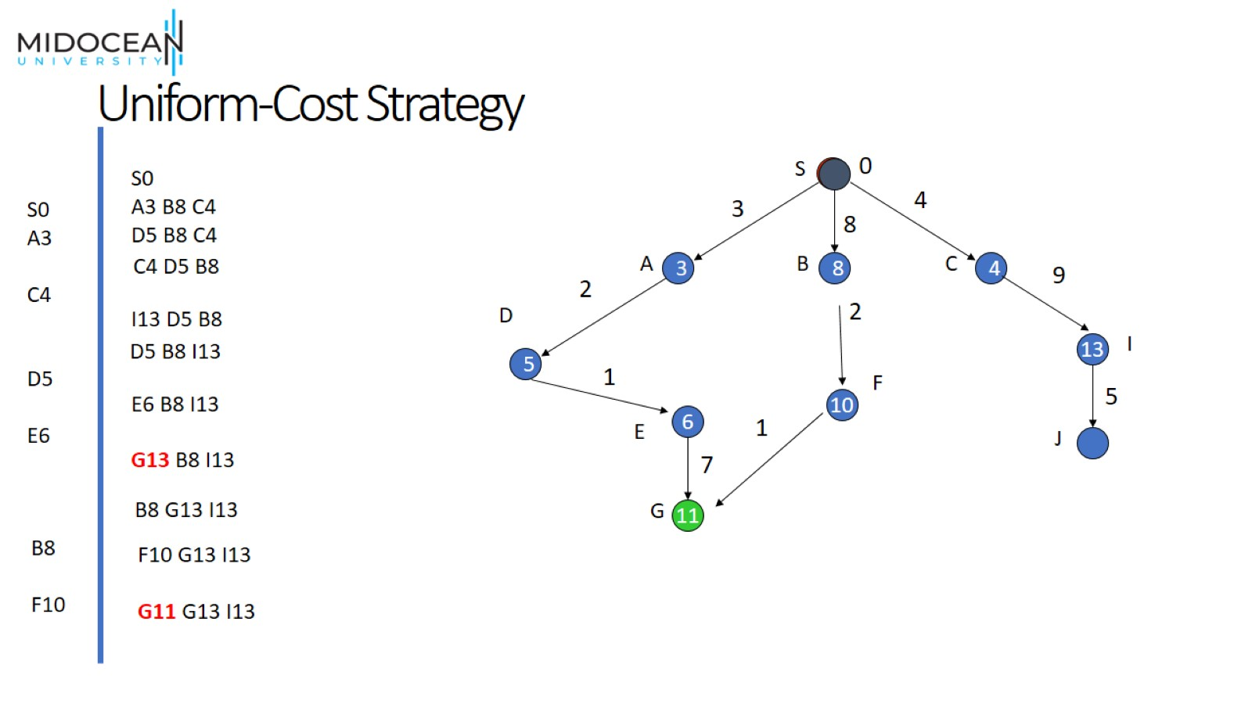
Uniform-Cost Strategy

Slide 15
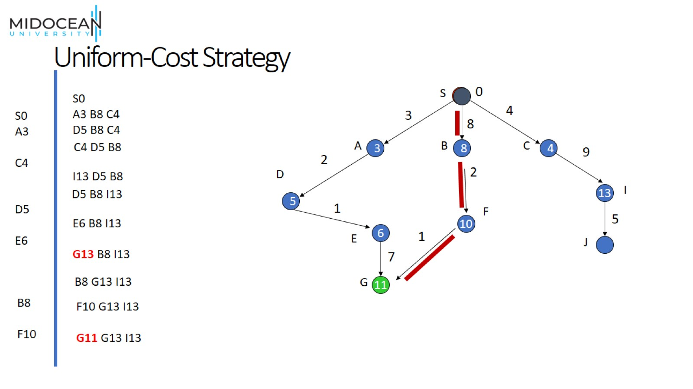
Uniform-Cost Strategy

Slide 16

Informed Search
[ Heuristic Search ]

Slide 17
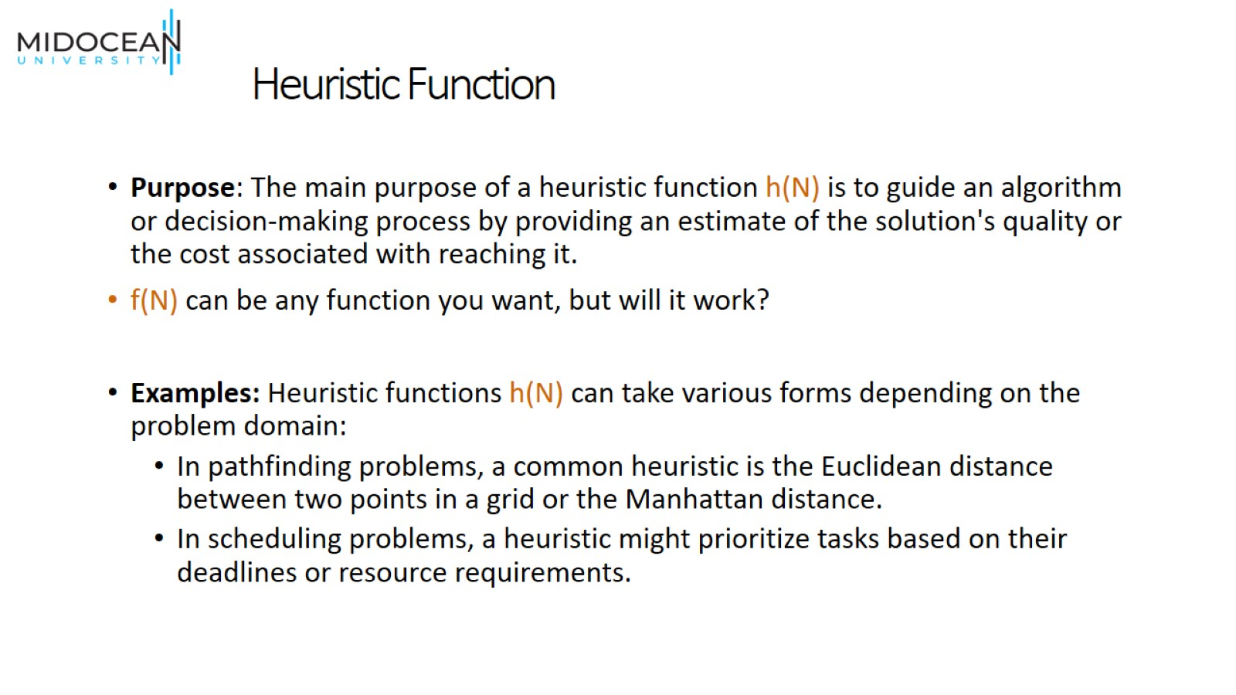
Heuristic Function

Slide 18
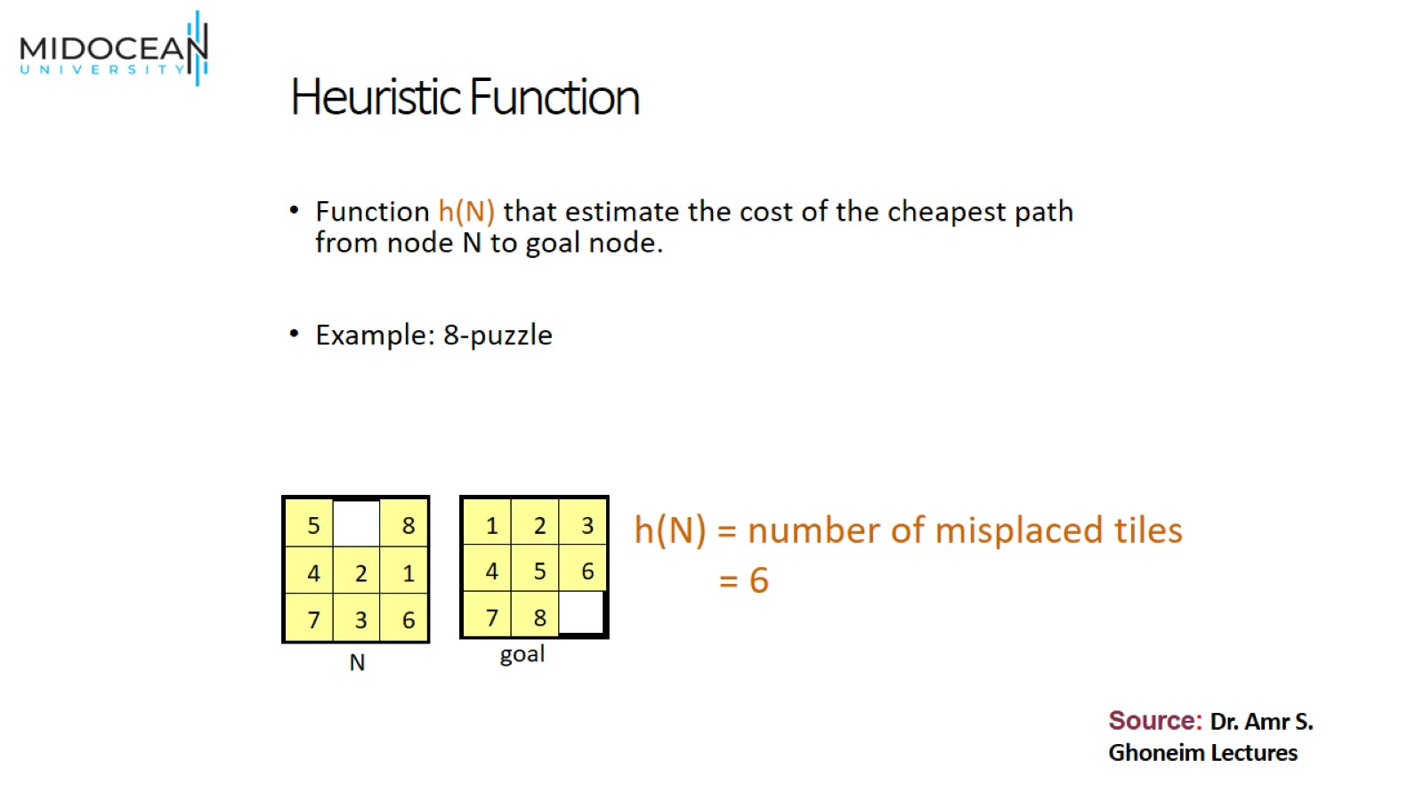
Heuristic Function

Slide 19
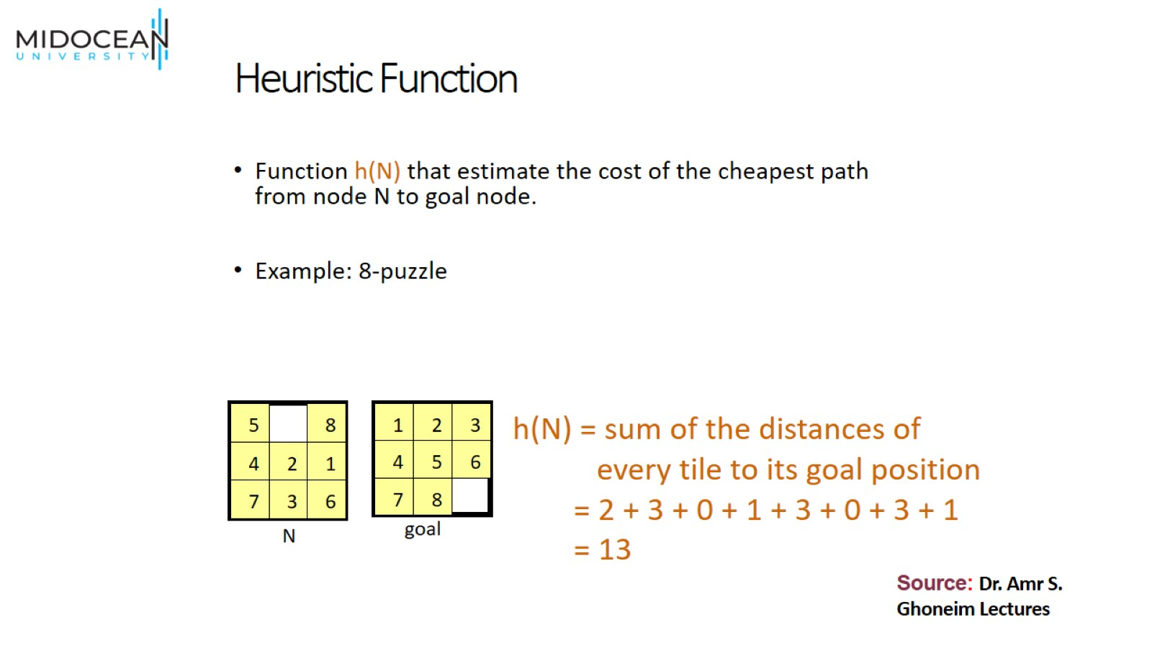
Heuristic Function

Slide 20
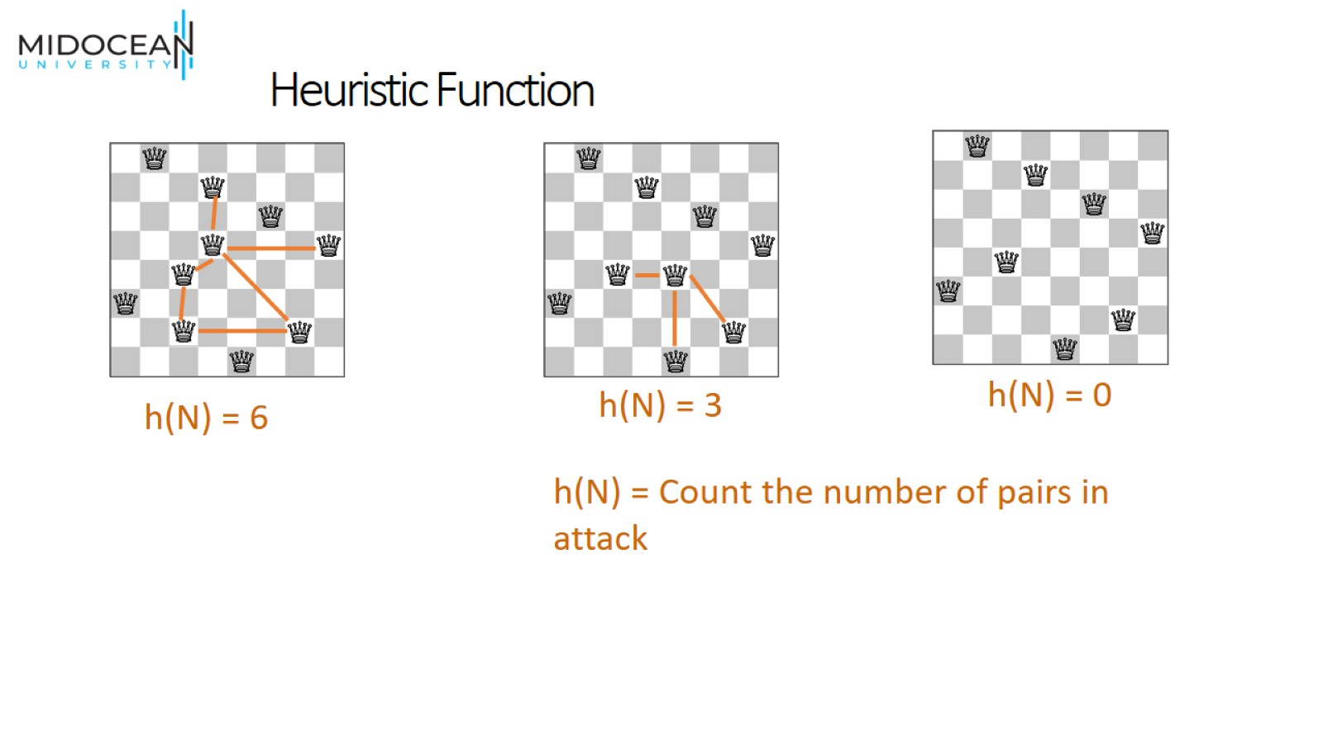
Heuristic Function

Slide 21
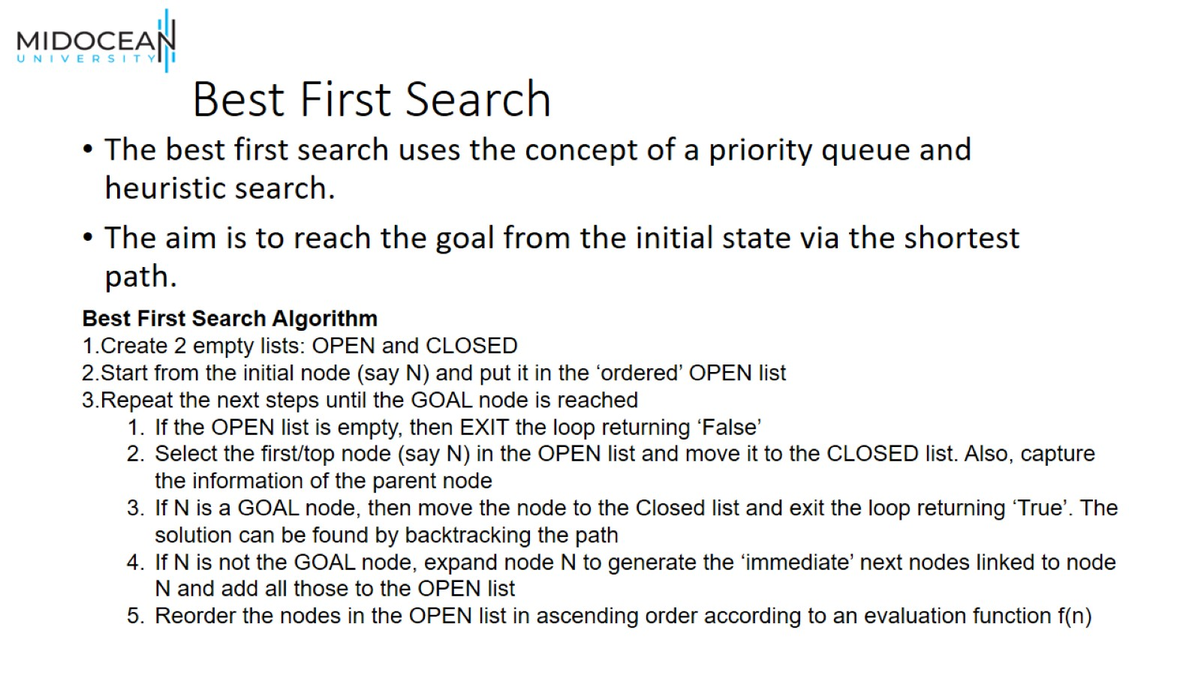
Best First Search

Slide 22
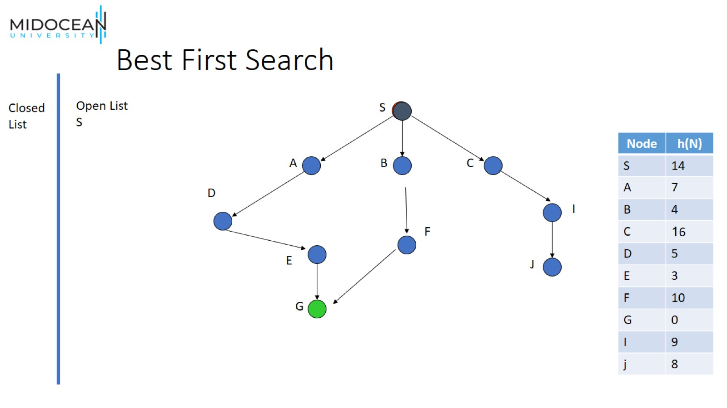
Best First Search

Slide 23
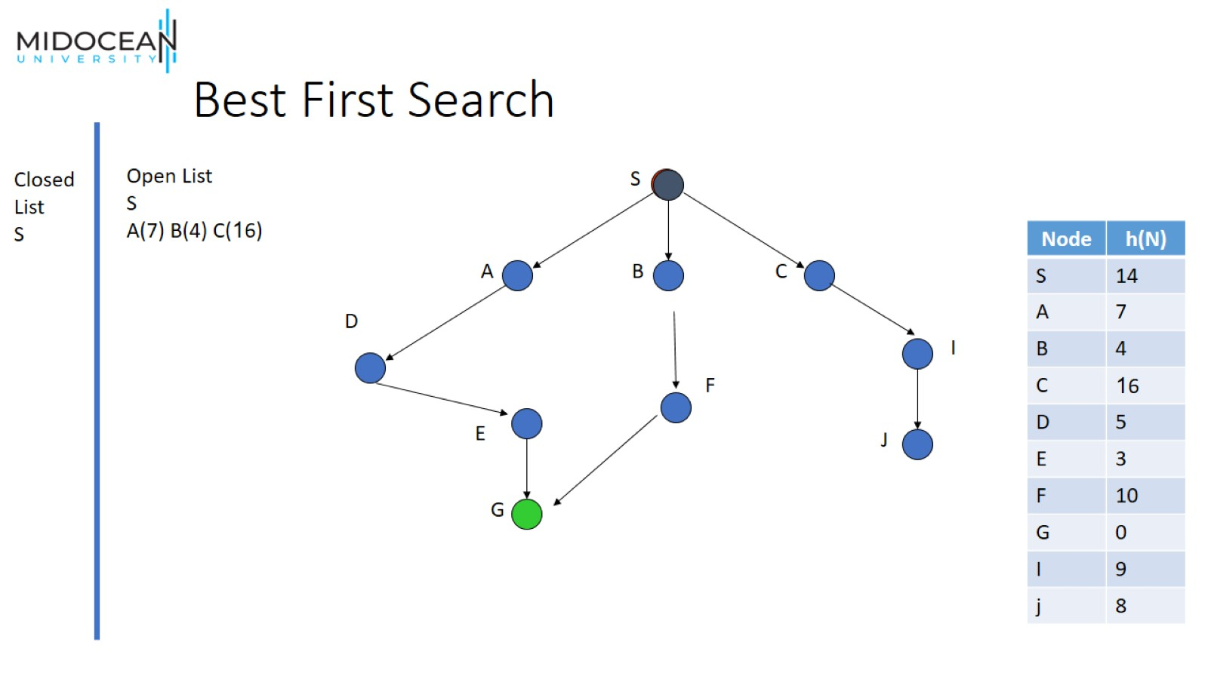
Best First Search

Slide 24
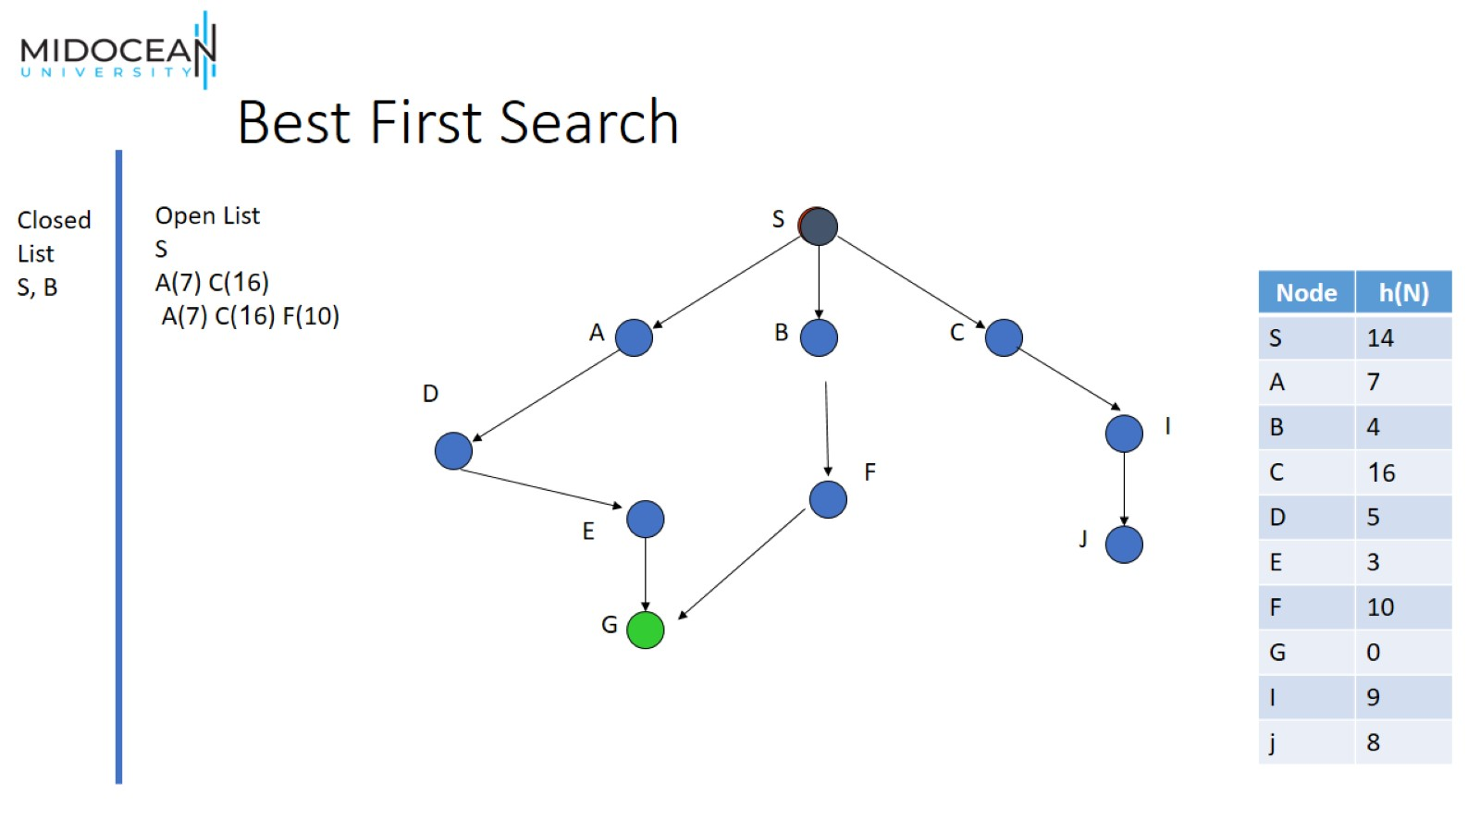
Best First Search

Slide 25
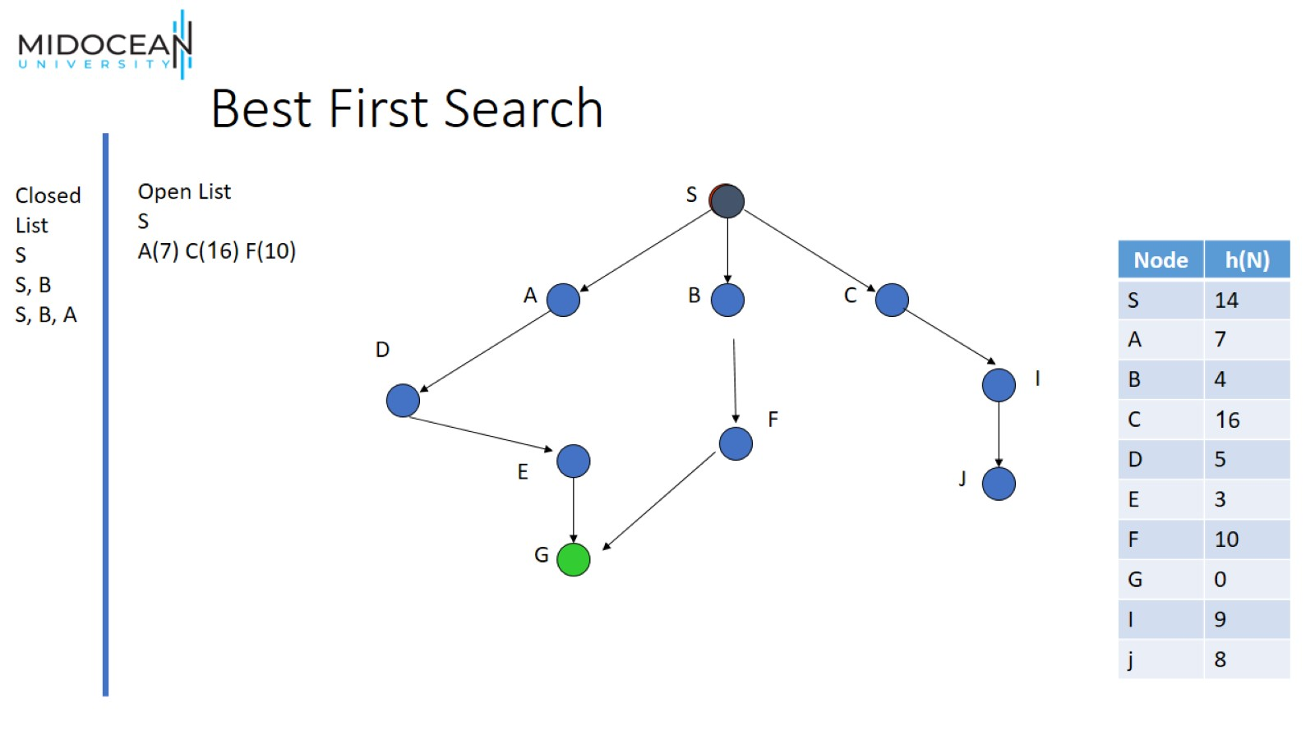
Best First Search

Slide 26
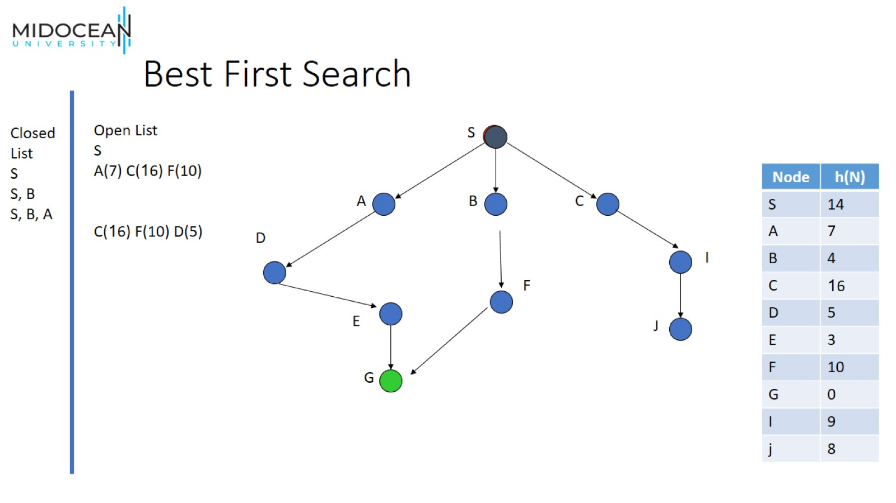
Best First Search

Slide 27
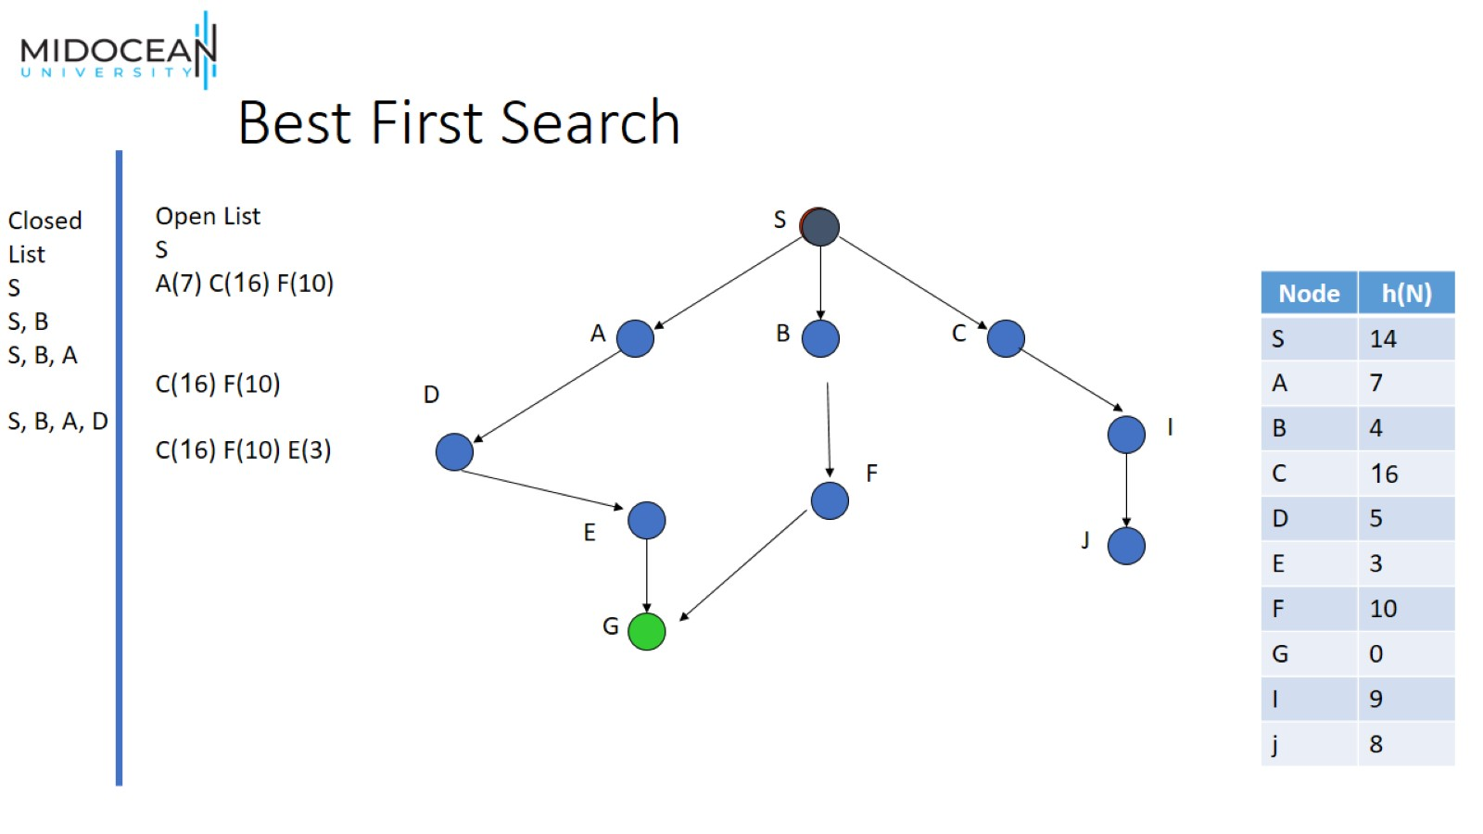
Best First Search

Slide 28
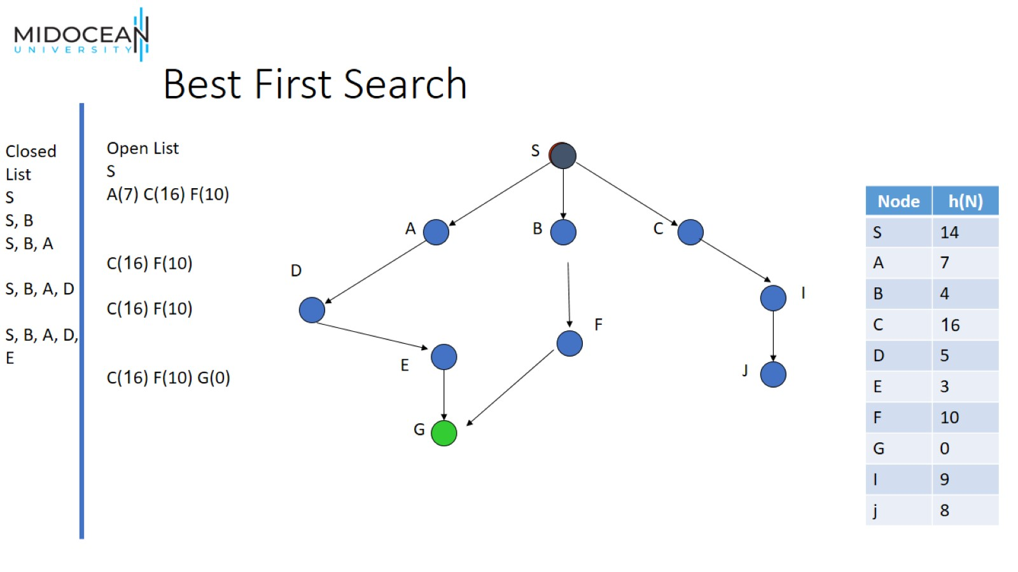
Best First Search

Slide 29
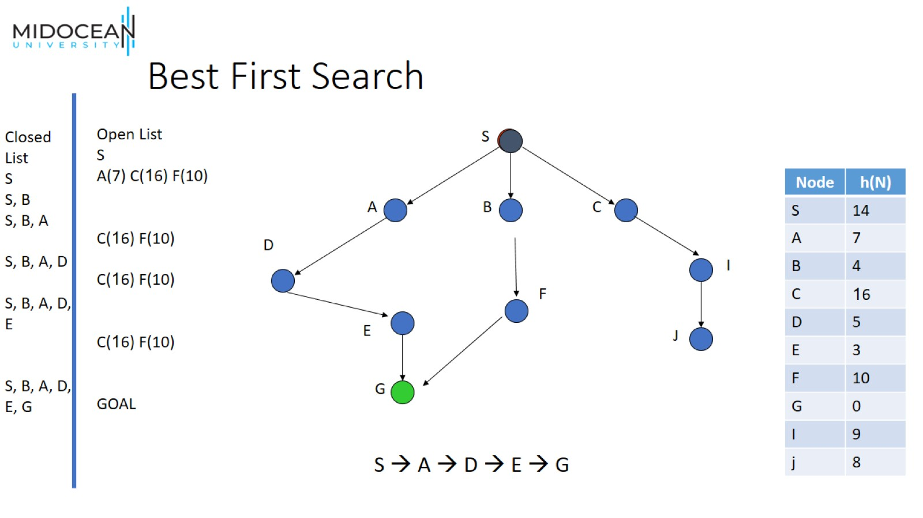
Best First Search

Slide 30
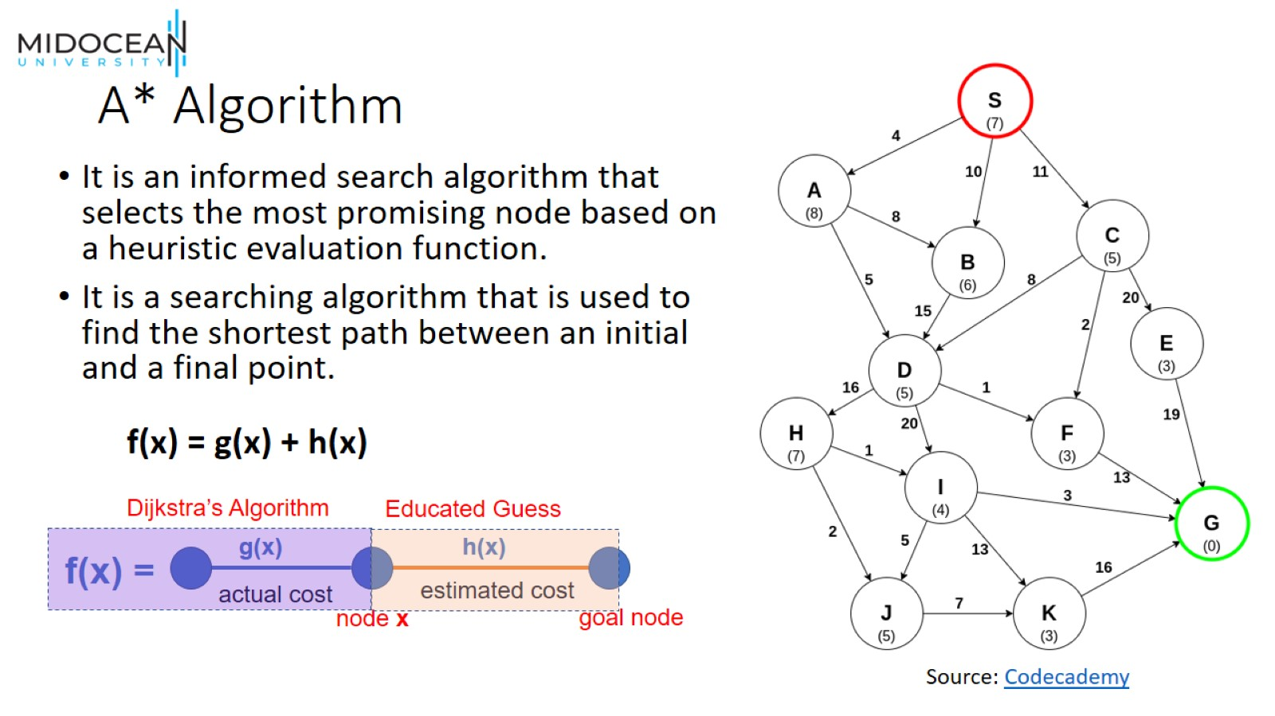
A* Algorithm

Slide 31
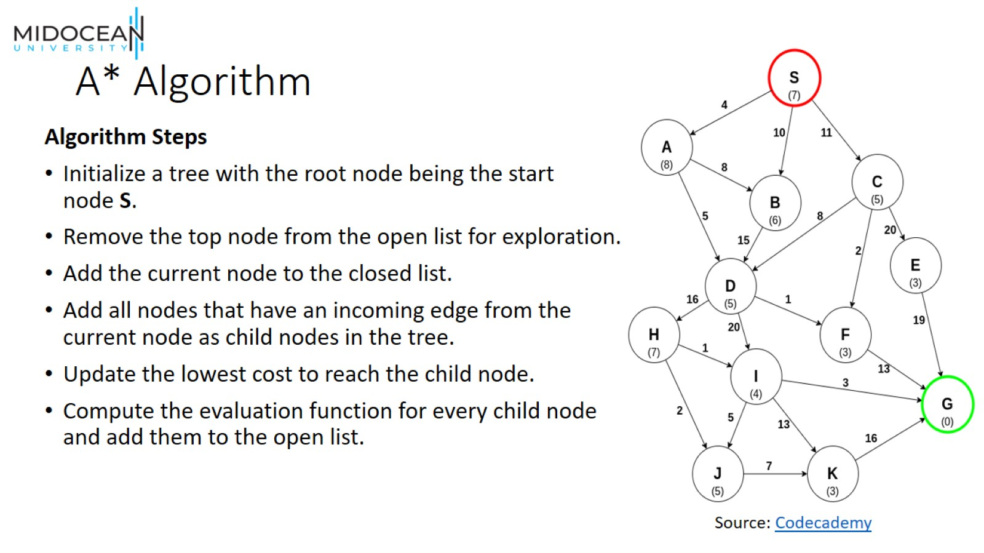
A* Algorithm

Slide 32
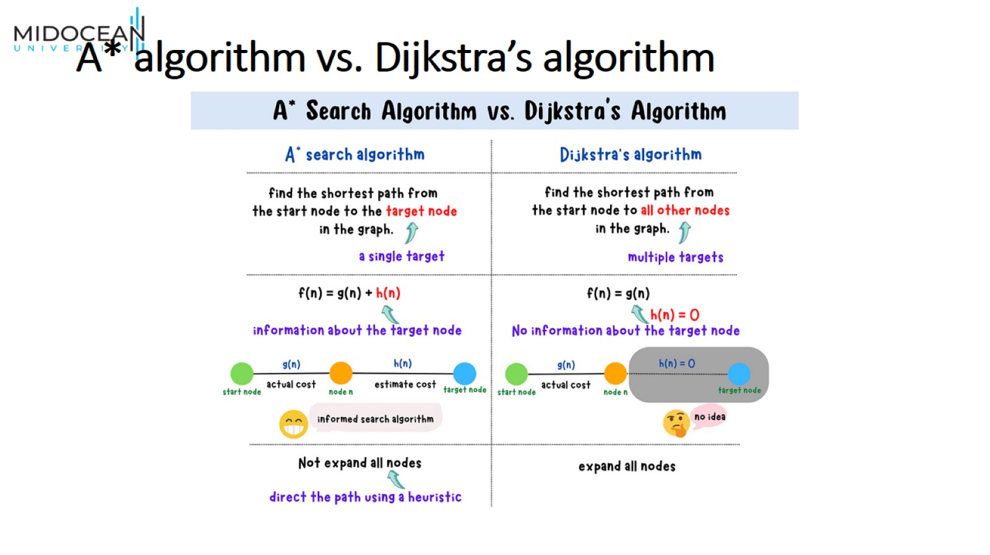
A* algorithm vs. Dijkstra’s algorithm

Slide 33
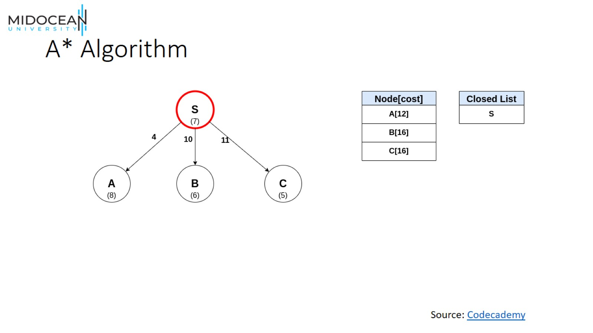
A* Algorithm

Slide 34
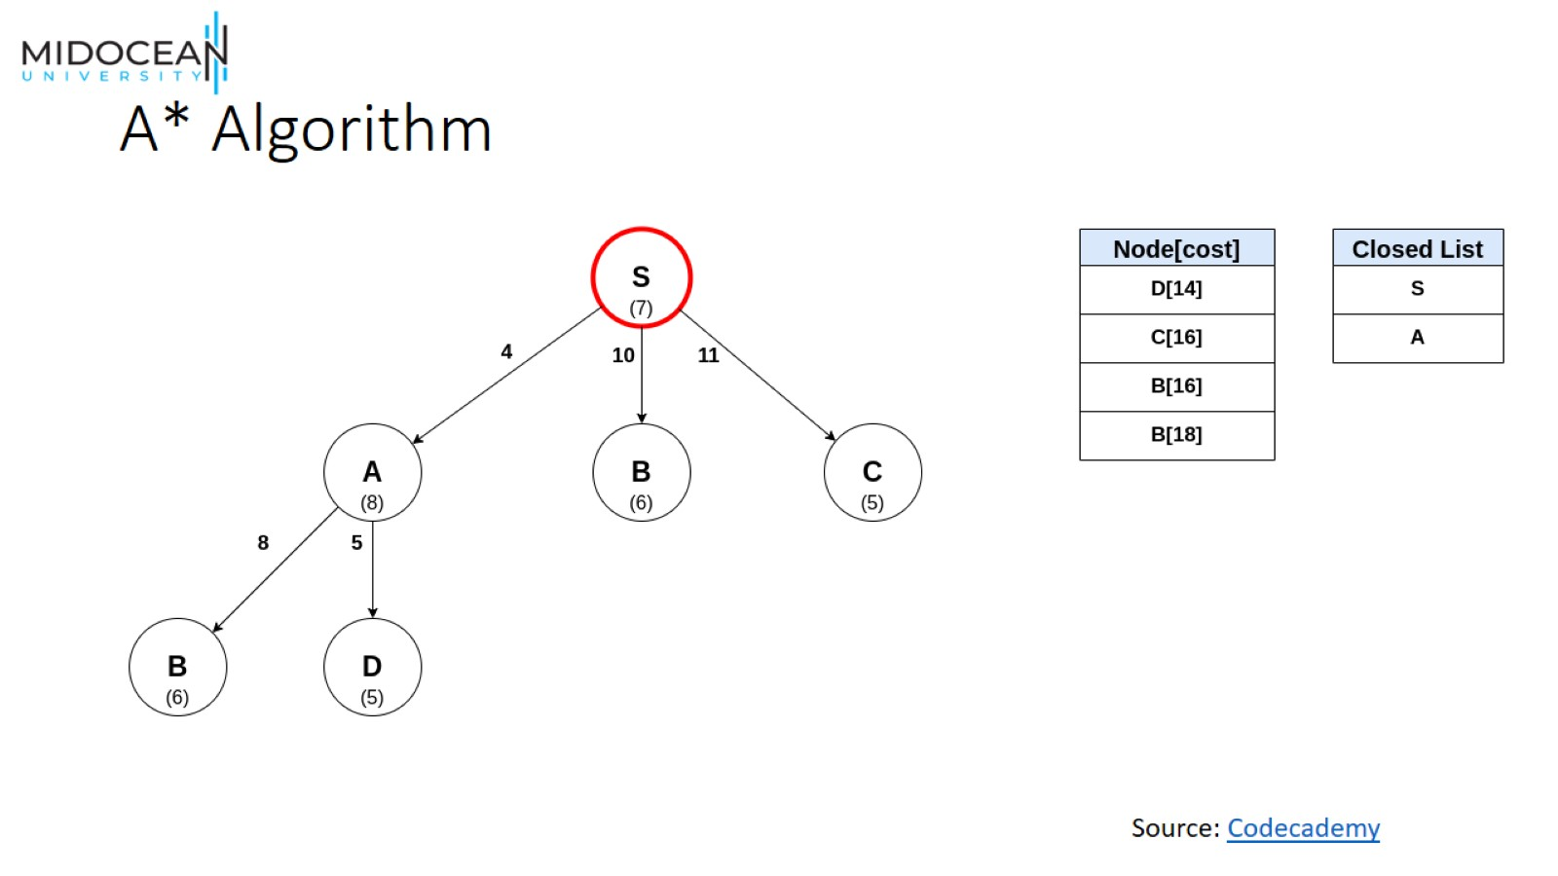
A* Algorithm

Slide 35
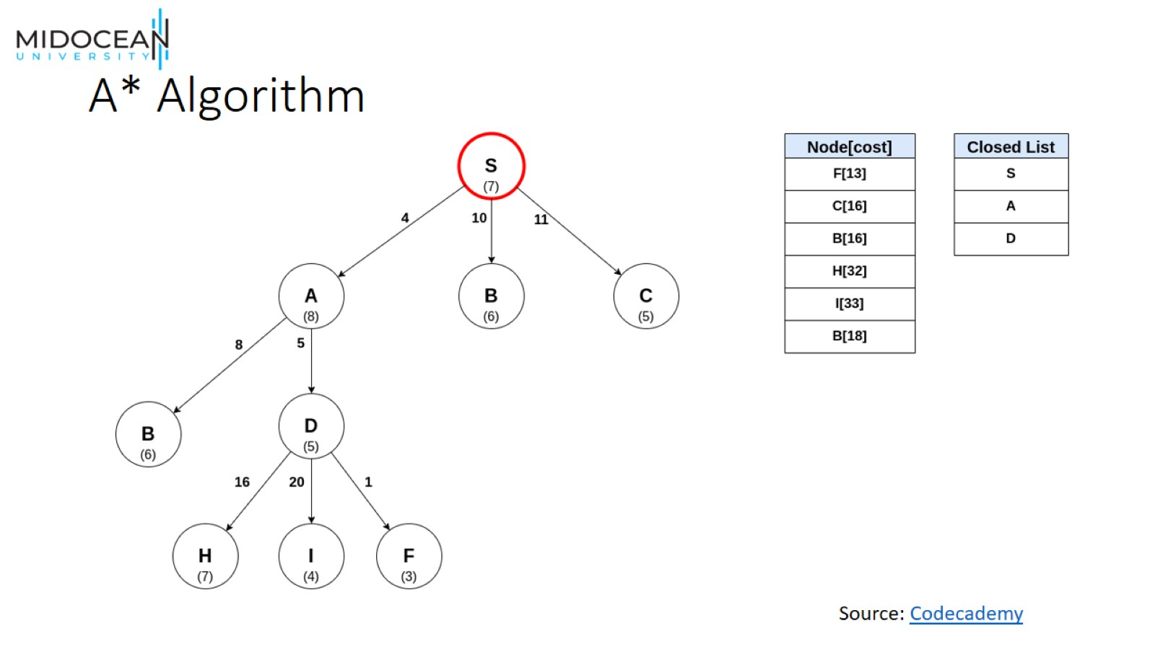
A* Algorithm

Slide 36
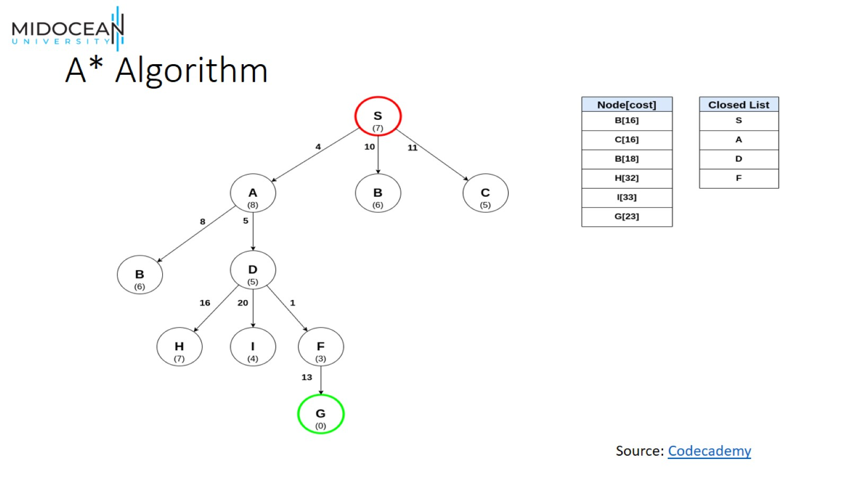
A* Algorithm

Slide 37
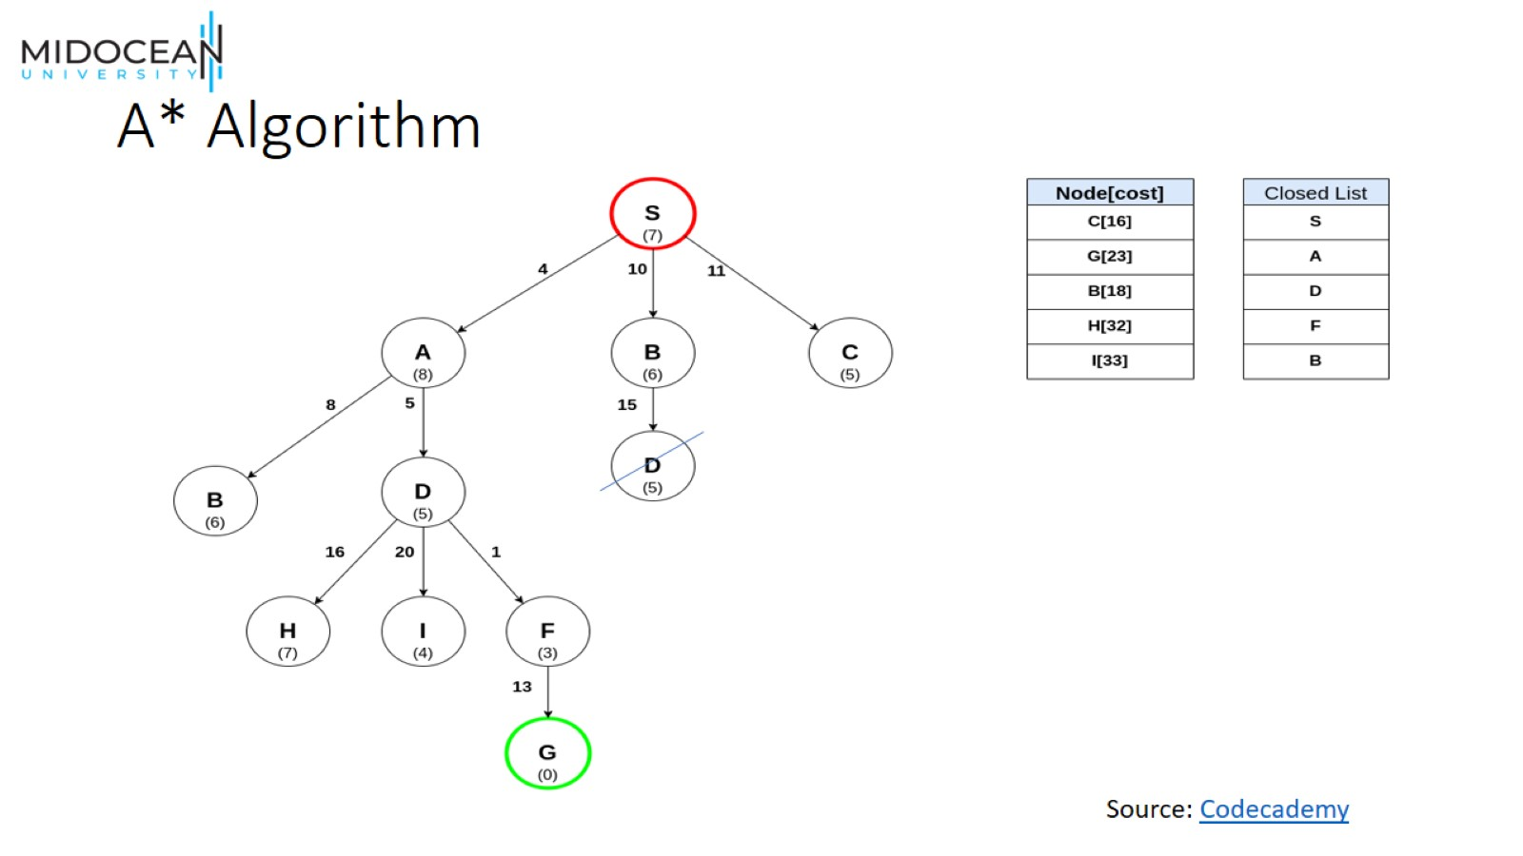
A* Algorithm

Slide 38
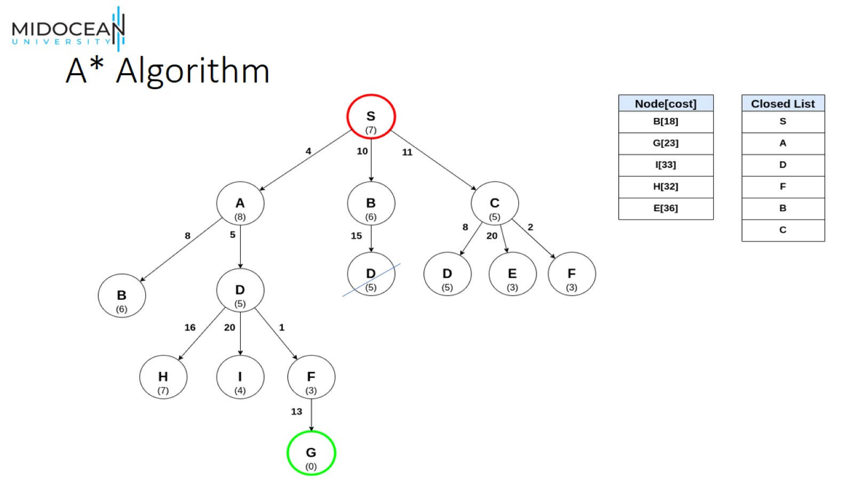
A* Algorithm

Slide 39
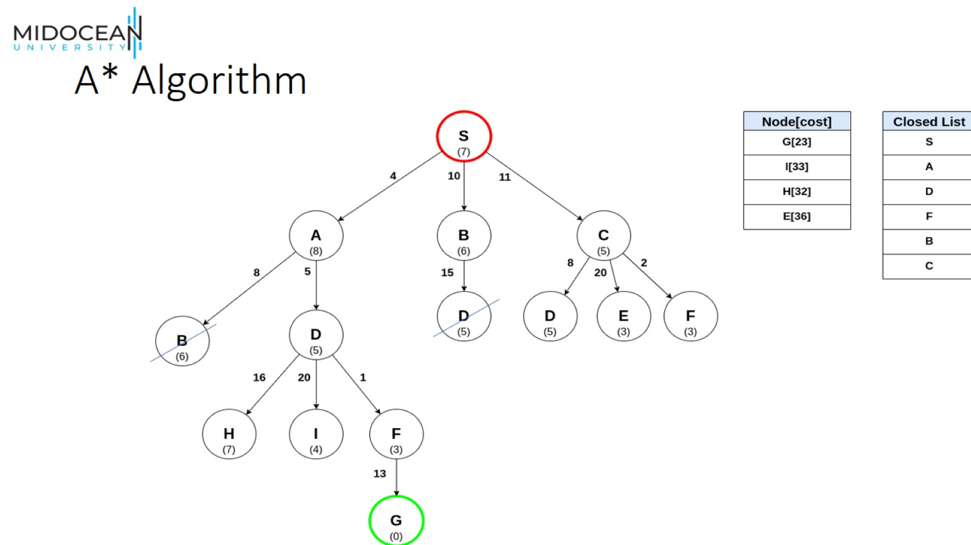
A* Algorithm

Slide 40
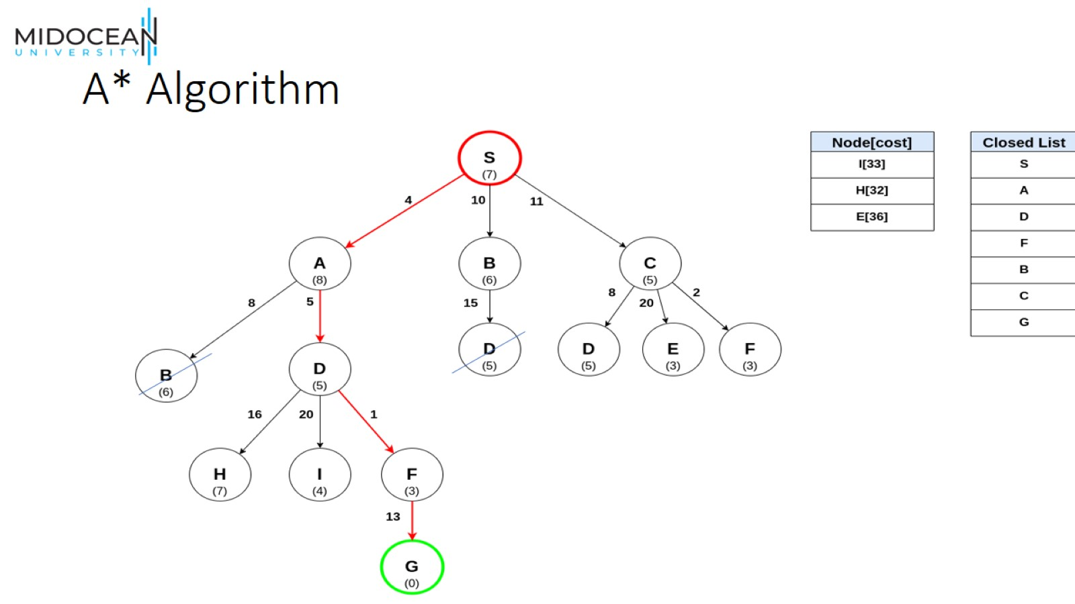
A* Algorithm

Slide 41
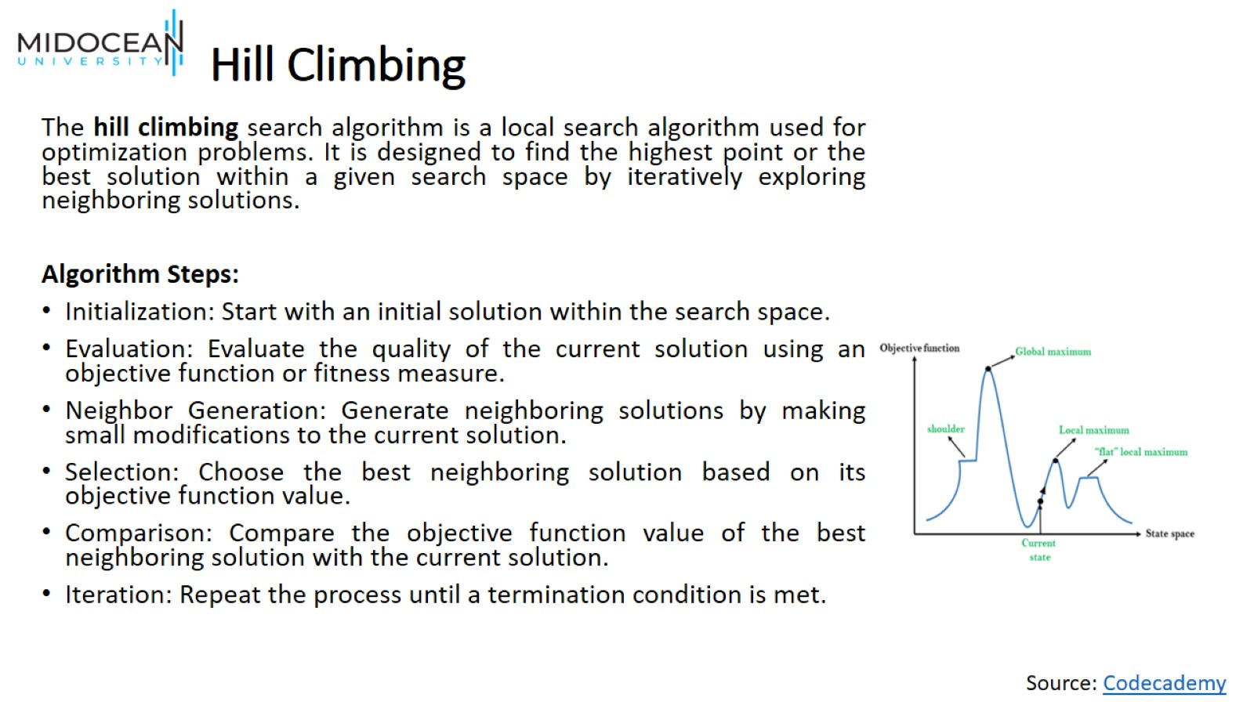
Hill Climbing

Slide 42
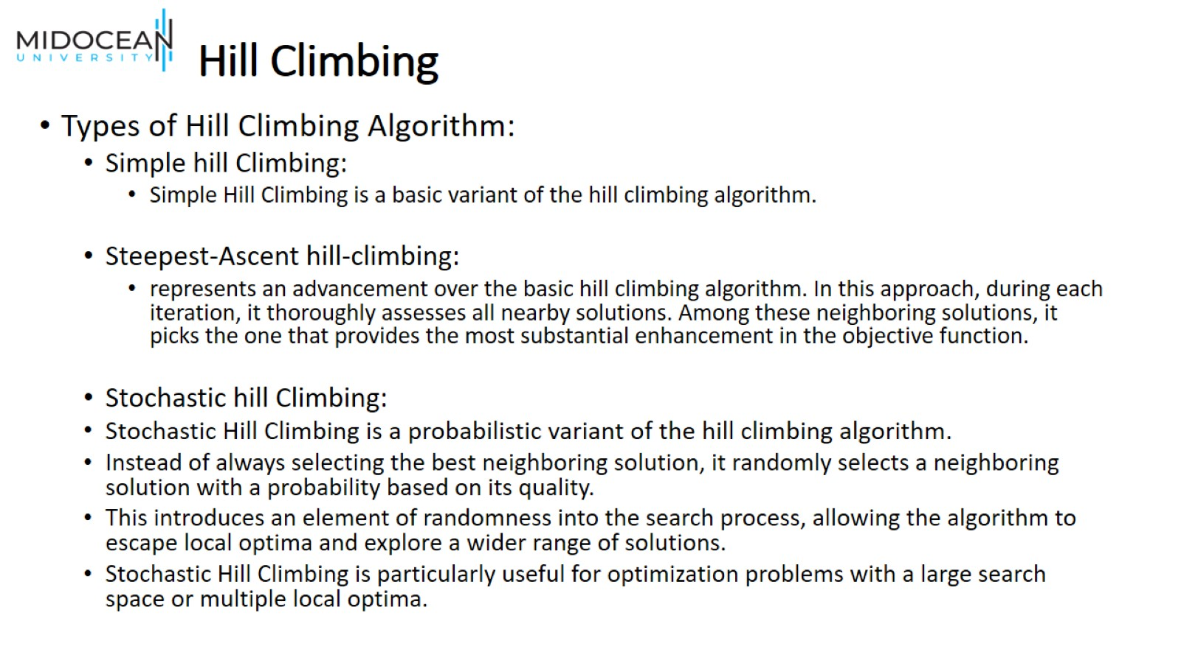
Hill Climbing

Slide 43
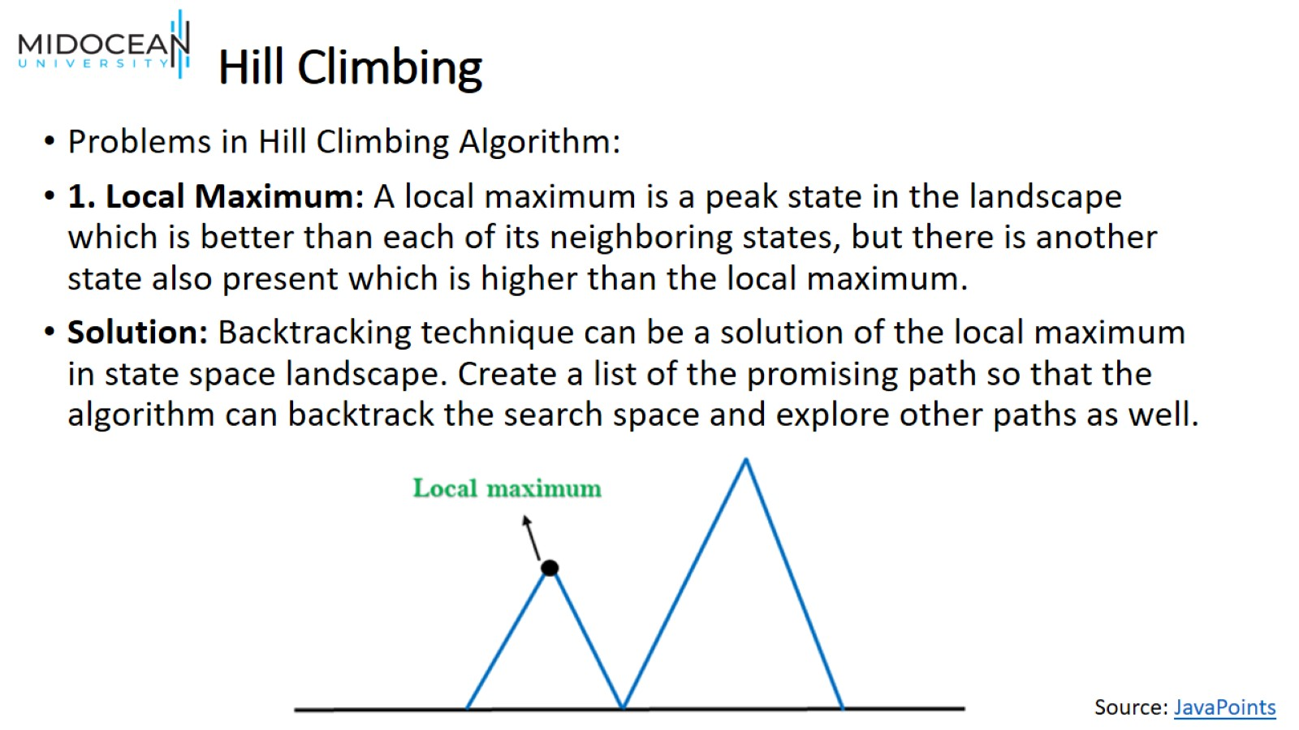
Hill Climbing

Slide 44
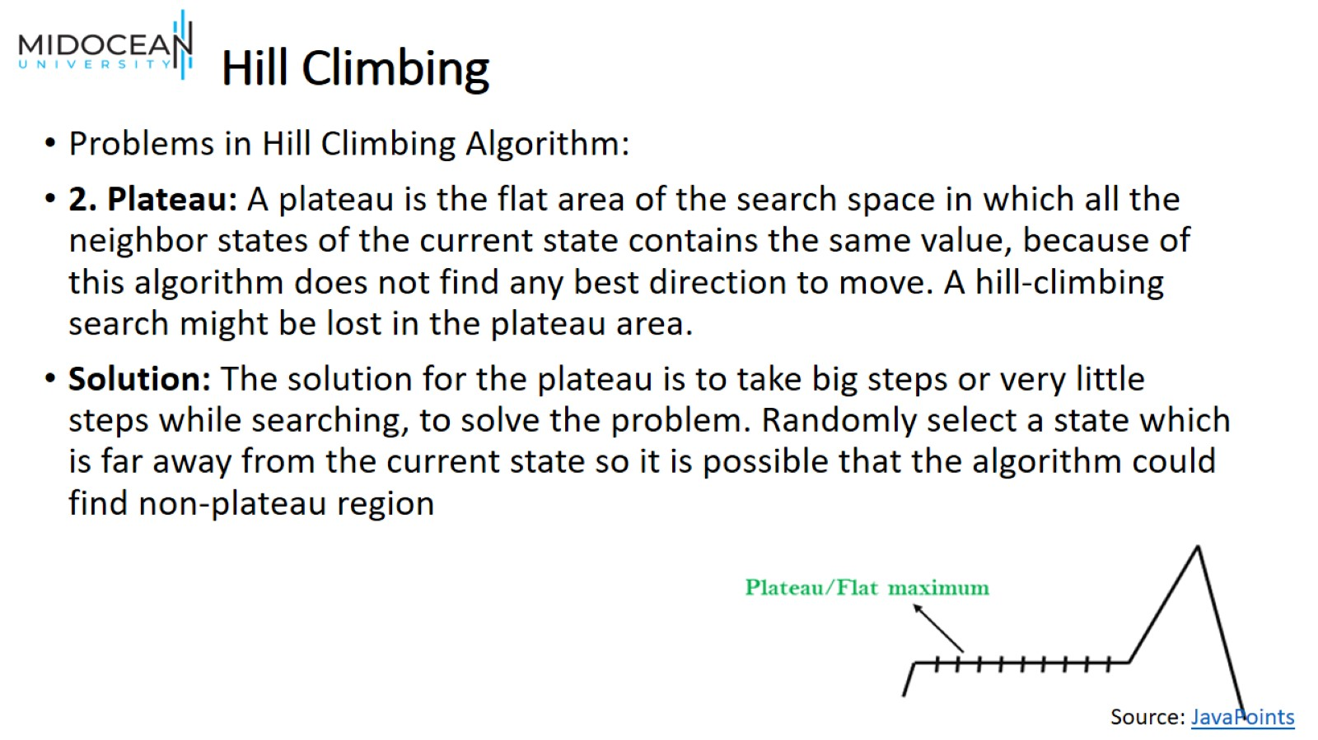
Hill Climbing

Slide 45
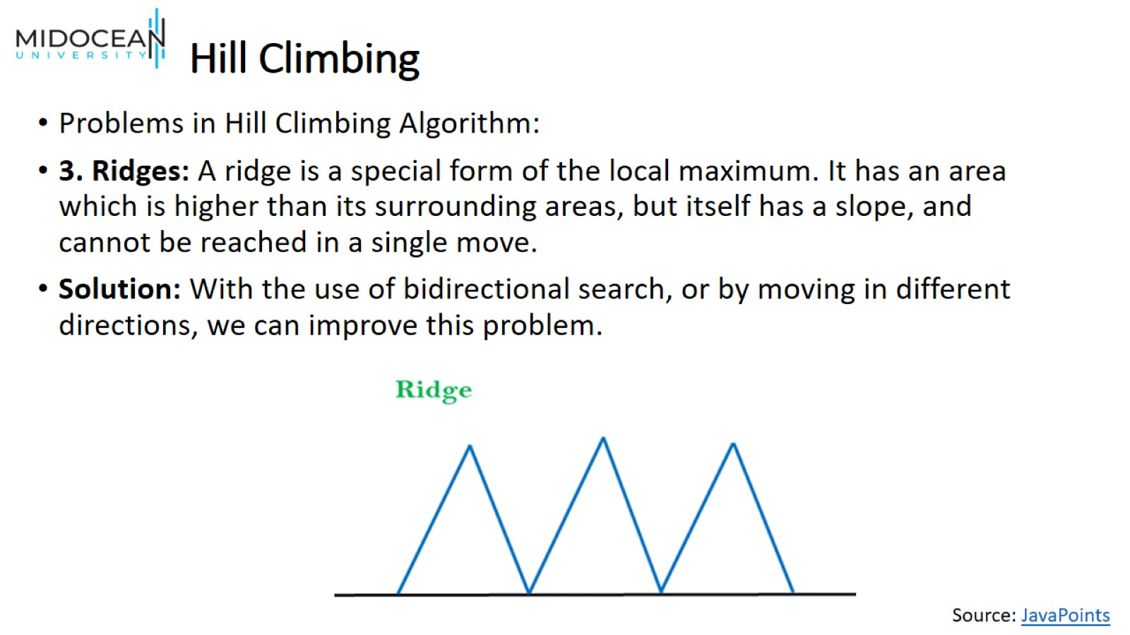
Hill Climbing

Slide 46
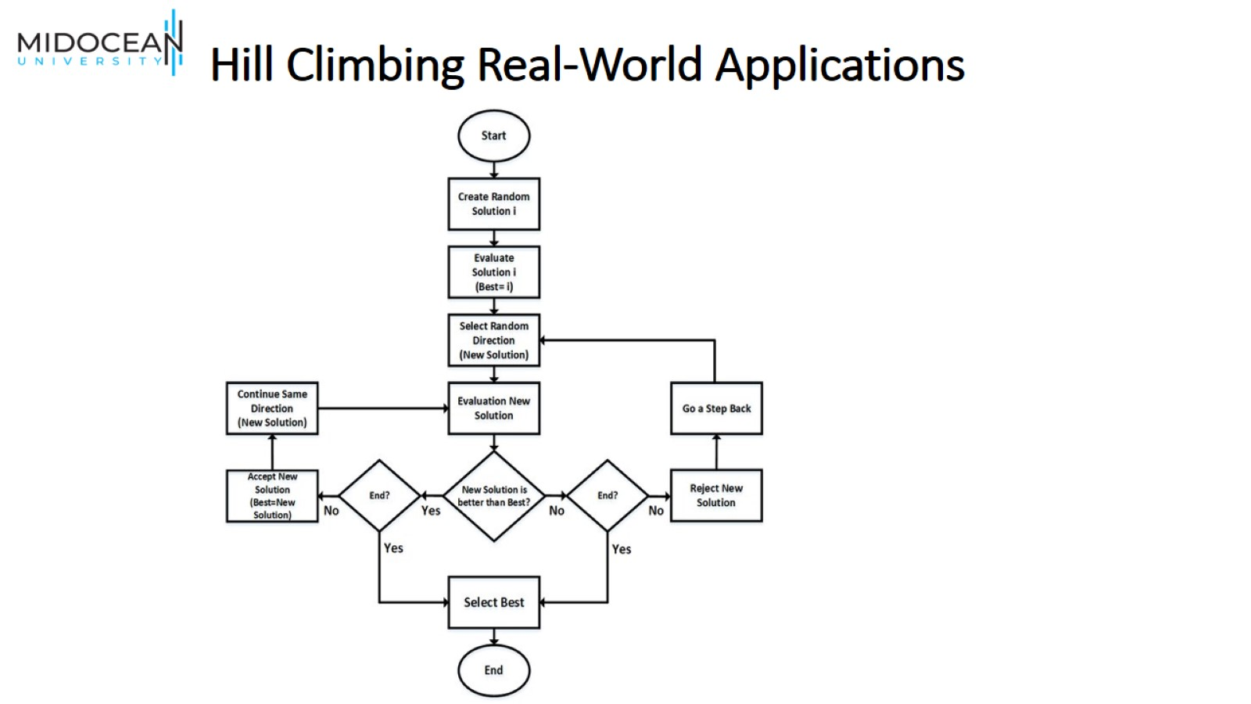
Hill Climbing Real-World Applications

Slide 47
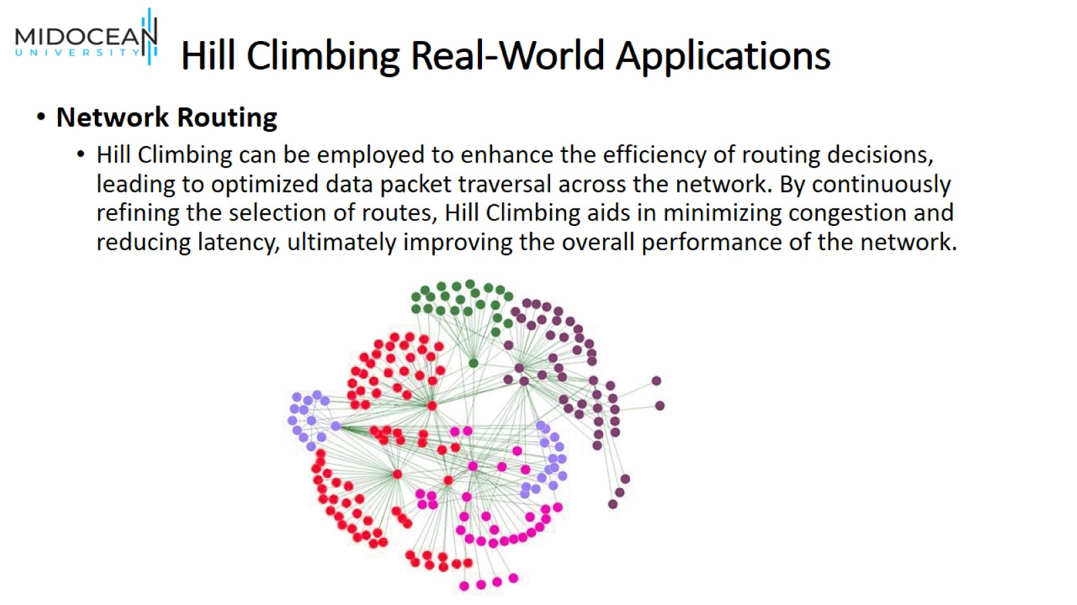
Hill Climbing Real-World Applications

Slide 48
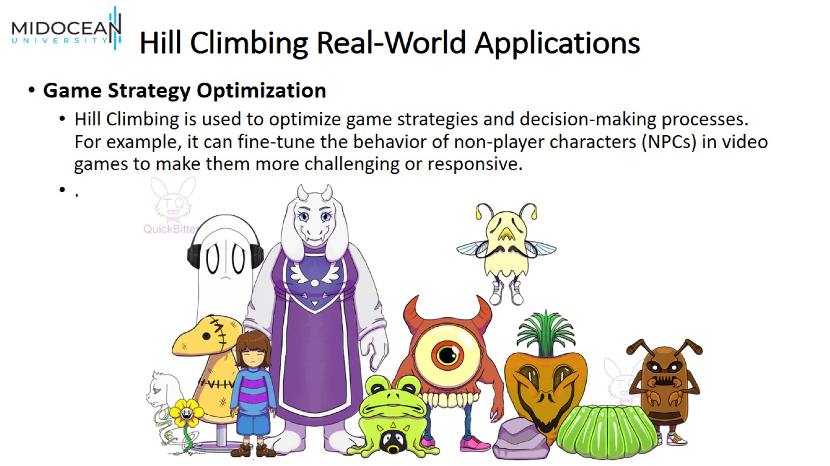
Hill Climbing Real-World Applications

Slide 49
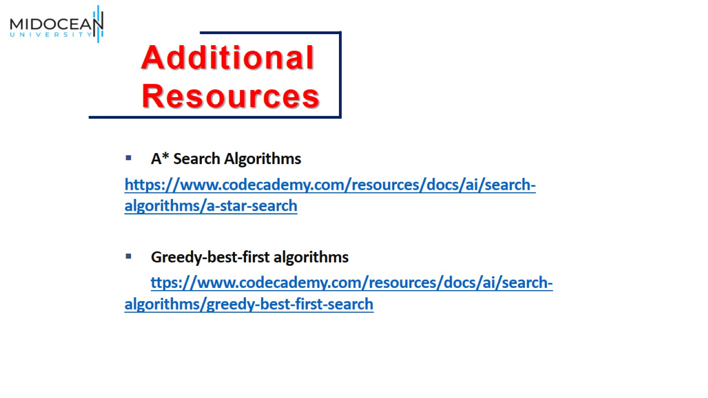

Slide 50
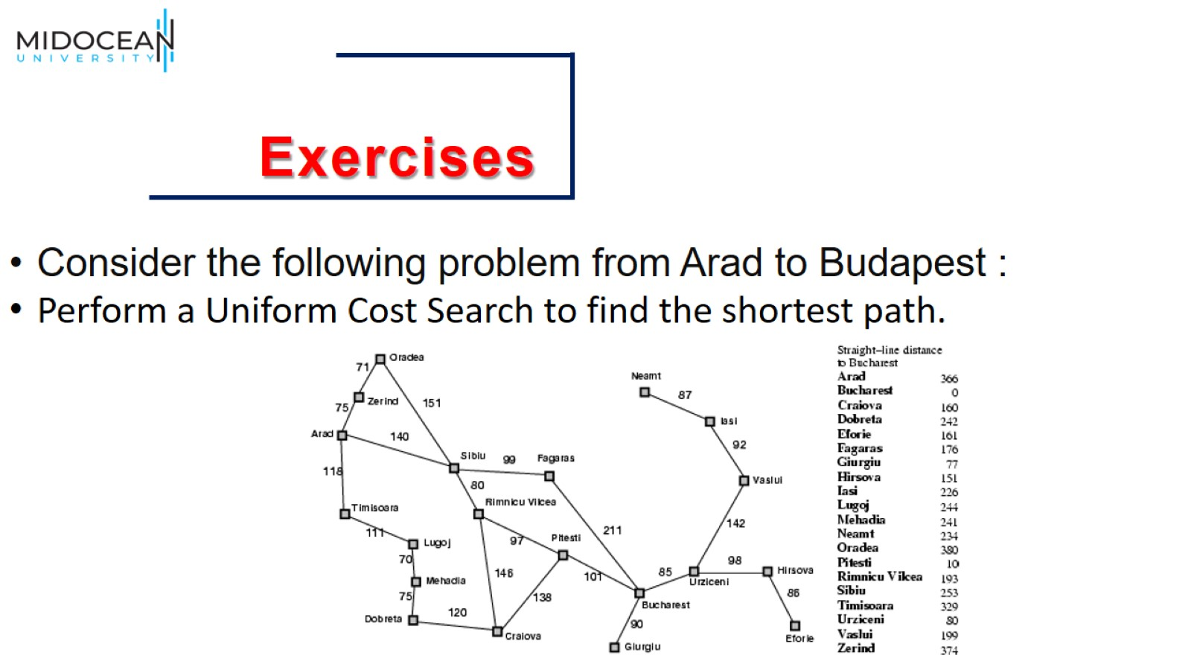

Slide 51


