Slide 1




AWS Cloud Security Foundations– AWS-CSF
Dr. Ibrahim Gomaa
Lecture Intro - Course Overview

Slide 2

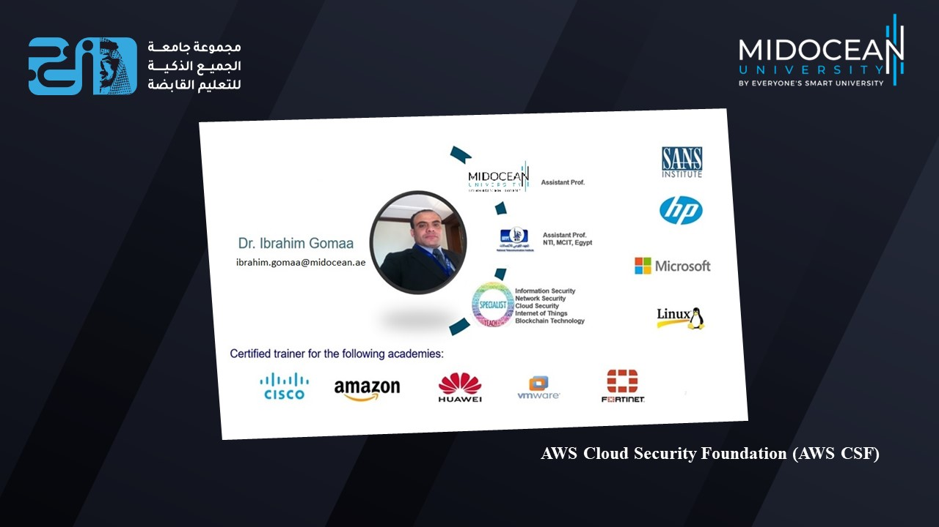

Course Staff
AWS Cloud Security Foundations– AWS-CSF
Lecture Intro – Course Overview
Dr. Ibrahim Gomaa

Slide 3
Lecture
Course Overview
Intro
This course is designed to help students gain a foundational knowledge of cybersecurity principles and services for cloud computing through a guided hands-on approach. This course includes demonstrations, instructional guides, and real-life scenarios.
AWS Cloud Security Foundations– AWS-CSF
Lecture Intro – Course Overview
Dr. Ibrahim Gomaa

Slide 4
Lecture
Learning Outcomes
Intro
Upon completion of this course, students will be able to do the following:
Identify security benefits and responsibilities of using the Amazon Web Services (AWS) Cloud.
Use the identity and access management features of AWS.
Describe how to secure network access to AWS resources.
Explain the available methods for encrypting data at rest and data in transit.
Determine which AWS services can be used for monitoring and incident response.
AWS Cloud Security Foundations– AWS-CSF
Lecture Intro – Course Overview
Dr. Ibrahim Gomaa

Slide 5
Lecture
Course Prerequisites
Intro
This course requires a strong foundation in IT concepts and skills. To ensure success in this course, students should have the following:
Completed the AWS Academy Cloud Foundations course or have equivalent
experience.
Worked with distributed systems.
Worked with multi-tier architectures.
Introduced general networking concepts.
Introduced cloud computing concepts.
AWS Cloud Security Foundations– AWS-CSF
Lecture Intro – Course Overview
Dr. Ibrahim Gomaa

Slide 6
Lecture
Course Outline
Intro
Lecture 1: Cloud Concepts and Pricing
Lecture 2: AWS Identity, Networking and Content Delivery
Lecture 3: AWS Foundational Services - Compute
Lecture 4: AWS foundational services – Storage and database
Lecture 5: Automatic Scaling, Logging and Monitoring
Lecture 6: AWS Cloud Security
Lecture 7: Securing Access to Cloud Resources
Lecture 8: Securing your infrastructure
Lecture 9: Protecting data in your application
Lecture 10: Responding to and Managing an Incident
AWS Cloud Security Foundations– AWS-CSF
Lecture Intro – Course Overview
Dr. Ibrahim Gomaa

Slide 7

Lecture
Course Outline
Intro
Lecture 1: Cloud Concepts and Pricing
Topics
Introduction to cloud computing
Advantages of cloud computing
Introduction to Amazon Web Services (AWS)
Fundamentals of pricing
Total Cost of Ownership
AWS Organizations
AWS Billing and Cost Management
Technical Support
Activities
AWS Pricing Calculator
Demo
Overview of the Billing Dashboard
Knowledge check
AWS Cloud Security Foundations– AWS-CSF
Lecture Intro – Course Overview
Dr. Ibrahim Gomaa

Slide 8
Lecture
Course Outline
Intro
Lecture 2: AWS Identity, Networking and Content Delivery
Topics
AWS shared responsibility model
AWS Identity and Access Management (IAM)
Networking basics
Amazon VPC, networking and security
Amazon Route 53
Amazon CloudFront
Activities
Label a network diagram
Demo
VPC demonstration
Lab
Build your VPC and launch a web server
Knowledge check
AWS Cloud Security Foundations– AWS-CSF
Lecture Intro – Course Overview
Dr. Ibrahim Gomaa

Slide 9
Lecture
Course Outline
Intro
Lecture 3: AWS Foundational Services - Compute
Topics
Compute services overview
Amazon EC2
Amazon EC2 cost optimization
Container services
Introduction to AWS Lambda
Introduction to AWS Elastic Beanstalk
Activities
Amazon EC2 versus Managed Service
Demo
Recorded demonstration of Amazon EC2
Lab
Introduction to Amazon EC2
Knowledge check
AWS Cloud Security Foundations– AWS-CSF
Lecture Intro – Course Overview
Dr. Ibrahim Gomaa

Slide 10
Lecture
Course Outline
Intro
Lecture 4: AWS Foundational Services – Storage and Database
Topics
  Amazon Elastic Block Store (Amazon EBS)
  Amazon Simple Storage Service (Amazon S3)
  Amazon Elastic File System (Amazon EFS)
  Amazon Simple Storage Service Glacier
Amazon Relational Database Service (Amazon RDS)
Amazon DynamoDB
Amazon Redshift
Amazon Aurora
Activities
Storage solution case study
Database case studies
Demo
Amazon EBS console
Amazon RDS console
Lab
Working with Amazon EBS
Build Your DB Server and Interact with Your DB Using an App
Knowledge check
AWS Cloud Security Foundations– AWS-CSF
Lecture Intro – Course Overview
Dr. Ibrahim Gomaa

Slide 11
Lecture
Course Outline
Intro
Lecture 5: Automatic Scaling, Logging and Monitoring
Topics
Elastic Load Balancing
Amazon CloudWatch
Amazon EC2 Auto Scaling
Importance of logging and monitoring
Capture and collect
AWS services with built-in logs
Monitor and report
Activities
Elastic Load Balancing activity
Amazon CloudWatch
Demo
Amazon EBS console
Security Hub
Lab
Scale and Load Balance Your Architecture
Monitoring and Alerting with CloudTrail and CloudWatch
Knowledge check
AWS Cloud Security Foundations– AWS-CSF
Lecture Intro – Course Overview
Dr. Ibrahim Gomaa

Slide 12
Lecture
Course Outline
Intro
Lecture 6: AWS Cloud Security
Topics
Security in the AWS Cloud
Security design principles
Shared responsibility model
Securing a new AWS account
Securing accounts
Securing data on AWS
Working to ensure compliance
Activities
AWS shared responsibility model activity
Demo
Recorded demonstration of IAM
Lab
Introduction to AWS IAM
Knowledge check
AWS Cloud Security Foundations– AWS-CSF
Lecture Intro – Course Overview
Dr. Ibrahim Gomaa

Slide 13
Lecture
Course Outline
Intro
Lecture 7: Securing Access to Cloud Resources
Topics
IAM fundamentals
Authenticating with IAM
Authorizing with IAM
Examples of authorizing with IAM
Additional authentication and access management services
Using AWS Organizations
Demo
Amazon S3 Cross-Account Resource-Based Policy
Lab
Using Resource-Based Policies to Secure an S3 Bucket
Knowledge check
AWS Cloud Security Foundations– AWS-CSF
Lecture Intro – Course Overview
Dr. Ibrahim Gomaa

Slide 14
Lecture
Course Outline
Intro
Lecture 8: Securing your infrastructure
Topics
Structure of a three-tier web application
Using a VPC
Setting up public and private subnets and internet protocols
Using AWS security groups
Using AWS network ACLs
Using AWS load balancers
Pulling it all together
Protecting your compute resources
Lab
Securing VPC Resources by Using Security Groups
Knowledge check
AWS Cloud Security Foundations– AWS-CSF
Lecture Intro – Course Overview
Dr. Ibrahim Gomaa

Slide 15
Lecture
Course Outline
Intro
Lecture 9: Protecting data in your application
Topics
Protect data at rest
Amazon S3 protection features
Protection through encryption
Protect data in transit
Best practices to protect data in Amazon S3
Additional data protection services
Lab
Encrypting Data at Rest by Using AWS KMS
Knowledge check
AWS Cloud Security Foundations– AWS-CSF
Lecture Intro – Course Overview
Dr. Ibrahim Gomaa

Slide 16
Lecture
Course Outline
Intro
Lecture 10: Responding to and Managing an Incident
Topics
Identifying an incident
AWS services that support the discovery
and recognition phase
AWS services that support the resolution
and recovery phase
Best practices for handling an incident
Lab
Remediating an Incident by Using AWS Config and Lambda
Knowledge check
AWS Cloud Security Foundations– AWS-CSF
Lecture Intro – Course Overview
Dr. Ibrahim Gomaa

Slide 17
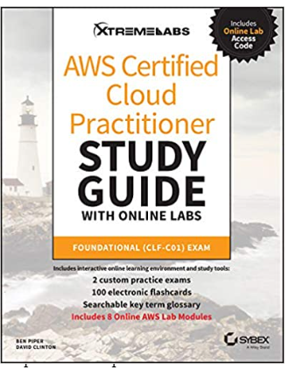
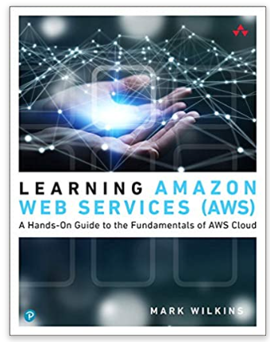
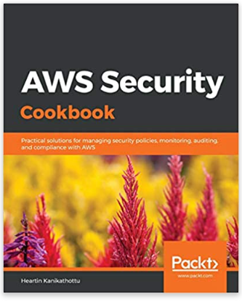
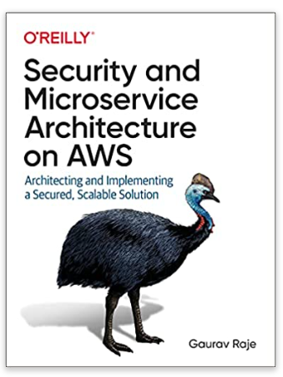
References
https://docs.aws.amazon.com/
AWS Certified Cloud Practitioner Study Guide with Online Labs: Foundational (CLF-C01) Exam 1st Edition, Ben Piper (Author), David Clinton (Author)
Learning Amazon Web Services (AWS): A Hands-On Guide to the Fundamentals of AWS Cloud 1st Edition, Mark Wilkins (Author)
AWS Security Cookbook: Practical solutions for managing security policies, monitoring, auditing, and compliance with AWS, Heartin Kanikathottu (Author)
Security and Microservice Architecture on AWS: Architecting and Implementing a Secured, Scalable Solution 1st Edition, Gaurav Raje (Author)
AWS Cloud Security Foundations– AWS-CSF
Lecture Intro – Course Overview
Dr. Ibrahim Gomaa

Slide 18
Lecture
Course Overview
Intro
Thanks
AWS Cloud Security Foundations– AWS-CSF
Lecture Intro – Course Overview
Dr. Ibrahim Gomaa

