Slide 1



Discrete Mathematics
Dr. Shahira Ahmed
IT241
Lecture 7

Slide 3

Learning Outcomes
Understand the basic concepts used in propositional logic
Construct truth tables to evaluate the truth value of compound propositions.
Understand the concepts of predicate logic, including variables, predicates, quantifiers
Applications of propositional and predicate logic
www.midocean.ae

Slide 4
Lecture Outline
Propositional logic
  Propositional variables
  Logical connectives (AND, OR, NOT)
  Truth values
  Logical Equivalences
Predicate Logic
  The Language of Quantifiers
  Logical Equivalences
Valid Argument
www.midocean.ae

Slide 5
Propositions
A proposition is a declarative sentence that is either true or false.
Examples of propositions:
  The Moon is made of green cheese.
  IT241 is an easy class.
  1 + 0 = 1
  0 + 0 = 2

Slide 6
Propositions
Examples that are not propositions.
  Sit down!
  What time is it?
  x + 1 = 2
  x + y = z

Slide 7
Propositional Logic
Constructing Propositions
  Propositional Variables: p, q, r, s, …
  The proposition that is always true is denoted by T and the proposition that is always false is denoted by F.

Slide 8
Propositional Logic
Compound Propositions; constructed from logical connectives and other propositions
    Negation ¬
    Conjunction ∧
    Disjunction ∨
    Implication →
    Biconditional ↔

Slide 9
Logical Connectives: Negation
  The negation of a proposition p is denoted by ¬p and has this truth table:
Example: If p denotes “The earth is round.”, then ¬p denotes “It is not the case that the earth is round,” or more simply “The earth is not round.”
p | ¬p
T | F
F | T

Slide 10
Logical Connectives : Conjunction
The conjunction of propositions p and q is denoted by p ∧ q and has this truth table:
Example: If p denotes “I am at home.” and q denotes “It is raining.” then p ∧q denotes “I am at home and it is raining.”
p | q | p ∧ q
T | T | T
T | F | F
F | T | F
F | F | F

Slide 11
Logical Connectives : Disjunction
The disjunction of propositions p and q is denoted by p ∨q and has this truth table:
Example: If p denotes “I am at home.” and q denotes “It is raining.” then p ∨q denotes “I am at home or it is raining.”
p | q | p ∨ q
T | T | T
T | F | T
F | T | T
F | F | F

Slide 12
The Connective Or in Natural Languages(1)
In English “or” has two distinct meanings.
  “Inclusive Or” :
    In the sentence “Students who have taken IT241 or IT120 may take this class” we assume that students need to have taken one of the prerequisites, but may have taken both. This is the meaning of disjunction.
    For p ∨ q to be true, either one or both of p and q must be true.

Slide 13
The Connective Or in Natural Languages(2)
“Exclusive Or” (Xor): “Either it will rain or I will play football”
In p ⊕ q , one of p and q must be true, but not both.
The truth table for ⊕ is:
p | q | p ⊕q
T | T | F
T | F | T
F | T | T
F | F | F

Slide 14
Logical Connectives : Implication
If p and q are propositions, then p →q is a conditional statement or implication which is read as “if p, then q ”.
Example: If p denotes “I am at home.” and q denotes “It is raining.” then p →q denotes “If I am at home then it is raining.”
In p →q , p is the hypothesis (antecedent or premise) and q is the conclusion (or consequence).

Slide 15
Logical Connectives : Implication
p=“I am hungry”
q=“I will eat”
If I am hungry then I will eat.
p | q | p →q
T | T | T
T | F | F
F | T | T
F | F | T

Slide 16
Converse, Contrapositive, and Inverse
From p →q we can form new conditional statements .
  ¬ p → ¬ q is the inverse of p →q
  q →p is the converse of p →q
  ¬q → ¬ p is the contrapositive of p →q

Slide 17
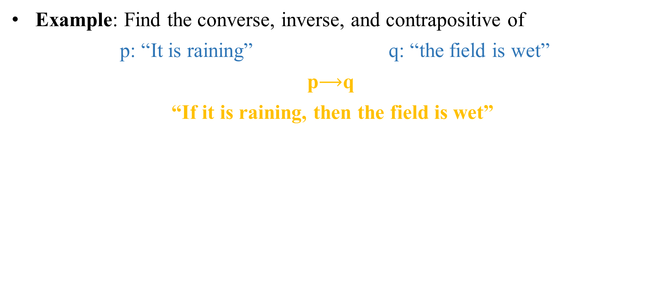
Converse, Contrapositive, and Inverse
Example: Find the converse, inverse, and contrapositive of
p: “It is raining” q: “the field is wet”
p$⟶$q
“If it is raining, then the field is wet”
hypothesis
Conclusion

Slide 18
Converse, Contrapositive, and Inverse
Example: Find the converse, inverse, and contrapositive of
p: “It is raining” q: “the field is wet”
p→q “If it is raining, then the field is wet”
Solution:
  Inverse: If it is not raining, then the field is not wet.
¬ p → ¬ q

Slide 19
Converse, Contrapositive, and Inverse
Example: Find the converse, inverse, and contrapositive of
p: “It is raining” q: “the field is wet”
p→q “If it is raining, then the field is wet”
Solution:
  Inverse: If it is not raining, then the field is not wet.
  Converse: If the field is wet, then it is raining.
p: “It is raining”
q: “the field is wet”
p: “It is raining”
q→ p

Slide 20
Converse, Contrapositive, and Inverse
Example: Find the converse, inverse, and contrapositive of
p: “It is raining” q: “the field is wet”
p→q “If it is raining, then the field is wet”
Solution:
  Inverse: If it is not raining, then the field is not wet.
  Converse: If the field is wet, then it is raining.
  Contrapositive: if the field is not wet, then it is not raining
p: “It is raining”
q: “the field is wet”
¬q → ¬ p

Slide 21
Logical Connectives: Biconditional
If p and q are propositions, then we can form the biconditional proposition p ↔q , p iff q, read as “p if and only if q .
If p denotes “I am at home.” and q denotes “It is raining.” then
p ↔q denotes “I am at home if and only if it is raining.”
p | q | p ↔q
T | T | T
T | F | F
F | T | F
F | F | T

Slide 22
Truth Tables For Compound Propositions
Construction of a truth table:
Rows
  Need a row for every possible combination of values for the atomic propositions=2^n.
Columns
  Need a column for the compound proposition (usually at far right)
  Need a column for the truth value of each expression that occurs in the compound proposition as it is built up

Slide 23
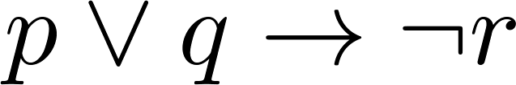
Example Truth Table
Construct a truth table for
p | q | r | ¬r | p ∨ q | p ∨ q → ¬r
T | T | T | F | T | F
T | T | F | T | T | T
T | F | T | F | T | F
T | F | F | T | T | T
F | T | T | F | T | F
F | T | F | T | T | T
F | F | T | F | F | T
F | F | F | T | F | T

Slide 24
Equivalent Propositions ≡
Two propositions are equivalent if they always have the same truth value.
Example: Show using a truth table that the conditional is equivalent to the contrapositive(≡).
Solution:
p | q | ¬ p | ¬ q | p →q | ¬q → ¬ p
T | T | F | F | T | T
T | F | F | T | F | F
F | T | T | F | T | T
F | F | T | T | T | T

Slide 25
Equivalent Propositions
Two propositions are equivalent if they always have the same truth value.
Example: Show using a truth table that the conditional is equivalent to the contrapositive.
Solution:
p | q | ¬ p | ¬ q | p →q | ¬q → ¬ p
T | T | F | F | T | T
T | F | F | T | F | F
F | T | T | F | T | T
F | F | T | T | T | T

Slide 26
Using a Truth Table to Show Non-Equivalence
Example: Show using truth tables that neither the converse nor inverse of an implication are not equivalent to the implication.
Solution:
p | q | ¬ p | ¬ q | p →q | ¬ p →¬ q | q → p
T | T | F | F | T | T | T
T | F | F | T | F | T | T
F | T | T | F | T | F | F
F | F | T | T | T | T | T

Slide 27
Problem
How many rows are there in a truth table with n propositional variables?
Solution: 2^{n}

Slide 28
Precedence of Logical Operators
p ∨q → ¬r
(p ∨q) → ¬r

Slide 29
Precedence of Logical Operators
Operator | Precedence
¬ | 1
∧ ∨ | 2 3
→ ↔ | 4 5
p ∨q → ¬r is equivalent to (p ∨q) → ¬r
If the intended meaning is p ∨(q → ¬r )
then parentheses must be used.

Slide 30
Precedence of Logical Operators
Negation
¬
Conjunction
∧
Disjunction
v
Implication
→
Biconditional
↔

Slide 31
Applications of Propositional Logic: Summary
Translating English to Propositional Logic
System Specifications
Logic Circuits

Slide 32
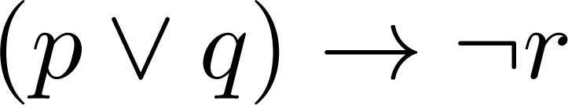
Translating English Sentences
convert an English sentence to a statement in propositional logic
“If I go to Harry’s or to the country, I will not go shopping.”
  p: I go to Harry’s
  q: I go to the country.
  r: I will go shopping.
If p or q then not r.

Slide 33
Tautologies, Contradictions, and Contingencies
A tautology is a proposition which is always true.
  Example: p ∨¬p
A contradiction is a proposition which is always false.
  Example: p ∧¬p
P | ¬p | p ∨¬p | p ∧¬p
T | F | T | F
F | T | T | F

Slide 34
Logically Equivalent
This truth table shows that ¬p ∨ q is equivalent to p → q.
Two compound propositions p and q are logically equivalent if p↔q is a tautology.
Two compound propositions p and q are equivalent if and only if the columns in a truth table giving their truth values agree.
We write this as p⇔q or as p≡q where p and q are compound propositions.
p | q | ¬p | ¬p ∨ q | p→ q
T | T | F | T | T
T | F | F | F | F
F | T | T | T | T
F | F | T | T | T
p↔q
T
T
T
T

Slide 35
Tautologies, Contradictions
A tautology is a proposition which is always true.
  Example: p ∨¬p
A contradiction is a proposition which is always false.
  Example: p ∧¬p
P | ¬p | p ∨¬p | p ∧¬p
T | F | T | F
F | T | T | F

Slide 36
Introducing Predicate Logic
Predicate logic(First-Order Logic (FOL)) uses the following new features:
  Variables: x, y, z
  Predicates: P(x), M(x)
  Quantifiers:
Propositional functions are a generalization of propositions.
  They contain variables and a predicate, e.g., P(x)
  Variables can be replaced by elements from their domain.

Slide 37
Propositional Functions
The statement P(x) is said to be the value of the propositional function P at x.
P(x) denote “x > 0” and the domain be the integers. Then:
  P(-3) is false.
  P(0) is false.
  P(3) is true.
Often the domain is denoted by U. So in this example U is the integers.

Slide 38
Examples of Propositional Functions
Let “x + y = z” be denoted by R(x, y, z) and U (for all three variables) be the integers. Find these truth values:
  R(2,-1,5)
  R(3,4,7)
  R(x, 3, z)
    Solution:
    False
    True
    Not a Proposition

Slide 39
Examples of Propositional Functions
Now let “x - y = z” be denoted by Q(x, y, z), with U as the integers. Find these truth values:
  Q(2,-1,3)
    Solution: T
  Q(3,4,7)
    Solution: F
  Q(x, 3, z)
    Solution: Not a Proposition

Slide 40
Compound Expressions
Connectives from propositional logic carry over to predicate logic.
If P(x) denotes “x > 0,” find these truth values:
  P(3) ∨ P(-1) Solution: T
  P(3) ∧ P(-1) Solution: F
  P(3) → P(-1) Solution: F
  P(3) → ¬P(-1) Solution: T
Expressions with variables are not propositions and therefore do not have truth values. For example,
  P(3) ∧ P(y)
  P(x) → P(y)

Slide 41
Quantifiers
The two most important quantifiers are:
  Universal Quantifier, “For all,” symbol: ∀
  Existential Quantifier, “There exists,” symbol: ∃
We write as in ∀x P(x) and ∃x P(x).
∀x P(x) asserts P(x) is true for every x in the domain.
∃x P(x) asserts P(x) is true for some x in the domain.

Slide 42
Universal Quantifier
  ∀x P(x) is read as “For all x, P(x)” or “For every x, P(x)”
  Examples:
    If P(x) denotes “x > 0” and U is the integers, then ∀x P(x) is false.
    If P(x) denotes “x > 0” and U is the positive integers, then ∀x P(x) is true.

Slide 43
Existential Quantifier
∃x P(x) is read as “For some x, P(x)”, or as “There is an x such that P(x),” or “For at least one x, P(x).”
  Examples:
    If P(x) denotes “x > 0”
      U is the integers, then ∃x P(x) is true.
      It is also true if U is the positive integers.
    If P(x) denotes “x < 0” and U is the positive integers, then ∃x P(x) is false.

Slide 44
Applications
Application in artificial intelligence: Propositional logic is used in knowledge representation and reasoning in artificial intelligence systems.
System specifications
Logic Gates

Slide 45
Logical Inference
All cats have tails.
Fluffy is a cat.
---------------------------------------------
Therefore, Fluffy has tail.

Slide 46
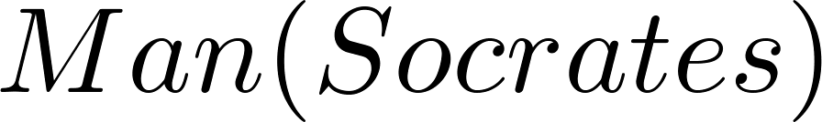
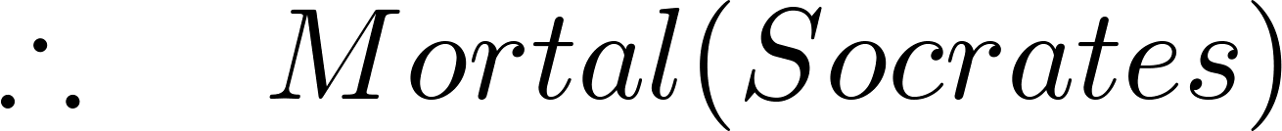
Logical Inference
We can express the premises (above the line) and the conclusion (below the line) in predicate logic as an argument:

Slide 47
Valid Argument
An argument in propositional logic is a sequence of propositions premises &conclusion.
The argument is valid if the premises imply the conclusion

Slide 48
Recap

Slide 49
Quiz
Which of these sentences are propositions?
a) Cairo is the capital of Egypt.
b) Miami is the capital of Florida.
c) 2 + 3 = 5.
d) 5 + 7 = 10.
e) x + 2 = 11.
f ) Answer this question.
Solution: a) Yes b) Yes c) Yes d) Yes e) No f) No

Slide 50
Quiz
Express each of These English sentences as compound propositions
p: “Swimming at the New Jersey shore is allowed”
q : “Sharks have been spotted near the shore
.a) Sharks have not been spotted near the shore.
b) Swimming at the New Jersey shore is allowed, and sharks have been spotted near the shore.
c) Swimming at the New Jersey shore is not allowed, or sharks have been spotted near the shore.
d) If swimming at the New Jersey shore is allowed, then sharks have not been spotted near the shore
a) ¬ q b) p ∧ q c) ¬ p ∨ q d) p → ¬ q

Slide 51
Quiz
p: “Swimming at the New Jersey shore is allowed q : “Sharks have been spotted near the shore
e) If sharks have not been spotted near the shore, then swimming at the New Jersey shore is allowed.
f)If swimming at the New Jersey shore is not allowed, then sharks have not been spotted near the shore.
g)Swimming at the New Jersey shore is allowed if and only if sharks have not been spotted near the shore.
h) Swimming at the New Jersey shore is not allowed, and either swimming at the New Jersey shore is allowed or sharks have not been spotted near the shore.
Solution e) ¬ q → p f ) ¬ p → ¬ q g) p ↔ ¬ q h) ¬ p ∧ (p∨ ¬ q)

Slide 52
Quiz
Determine whether each of these conditional statements is true or false.
If 1 + 1 = 2, then 2 + 2 = 5.
If 1 + 1 = 3, then 2 + 2 = 4.
If 1 + 1 = 3, then 2 + 2 = 5.
If monkeys can fly, then 1 + 1 = 3.
Solution. a) False b) True c) True d) True
p | q | p →q
T | T | T
T | F | F
F | T | T
F | F | T

Slide 53
Quiz
What is the inverse of the statement
“If two triangles are not similar, their corresponding angles are not congruent”?
1) If two triangles are similar, their corresponding angles are not congruent.
2) If corresponding angles of two triangles are not congruent, the triangles are not similar.
3) If two triangles are similar, their corresponding angles are congruent.
4) If corresponding angles of two triangles are congruent, the triangles are similar
Solution : 3
  ¬ p → ¬ q is the inverse of p →q
  q →p is the converse of p →q
  ¬q → ¬ p is the contrapositive p →q
https://jmap.org/Worksheets/G.CO.C.9.InverseConverseandContrapositive1a.pdf

Slide 54
Quiz
What is the inverse of the statement
“If Mike did his homework, then he will pass this test”?
If Mike passes this test, then he did his homework.
If Mike does pass this test, then he did not do his homework.
If Mike did not do his homework, then he will not pass this test.
If Mike did not do his homework, then he will pass this test.
Solution : 3
  ¬ p → ¬ q is the inverse of p →q
  q →p is the converse of p →q
  ¬q → ¬ p is the contrapositive p →q

Slide 55
Quiz
What is the inverse of the statement
“If Roba works hard, then she succeeds”?
If Roba succeeds, then she works hard.
If Roba does not succeed, then she does not work hard.
If Roba works hard, then she does not succeed.
If Roba does not work hard, then she does not succeed
Solution : 4
  ¬ p → ¬ q is the inverse of p →q
  q →p is the converse of p →q
  ¬q → ¬ p is the contrapositive p →q

Slide 56
Quiz
What is the inverse of the statement
“If Roba works hard, then she succeeds”?
If Roba succeeds, then she works hard.
If Roba does not succeed, then she does not work hard.
If Roba works hard, then she does not succeed.
If Roba does not work hard, then she does not succeed
Solution : 4
  ¬ p → ¬ q is the inverse of p →q
  q →p is the converse of p →q
  ¬q → ¬ p is the contrapositive p →q

Slide 57
Quiz
What is the converse of
“If an angle measures 90 degrees, then it is a right angle”?
1) If an angle is a right angle, then it measures 90 degrees.
2) An angle is a right angle if it measures 90 degrees.
3) If an angle is not a right angle, then it does not measure 90 degrees.
4) If an angle does not measure 90 degrees, then it is not a right angle
Solution : 1
  ¬ p → ¬ q is the inverse of p →q
  q →p is the converse of p →q
  ¬q → ¬ p is the contrapositive p →q

Slide 58
Quiz
What is the contrapositive of
“If I am tall, then I will bump my head”?
1) If I bump my head, then I am tall.
2) If I do not bump my head, then I am tall.
3) If I am tall, then I will not bump my head.
4) If I do not bump my head, then I am not tall.
Solution : 4
  ¬ p → ¬ q is the inverse of p →q
  q →p is the converse of p →q
  ¬q → ¬ p is the contrapositive p →q

Slide 59
Quiz
True or false
¬ p ∨ q ≡ ¬p → q
Solution False
p | q | ¬ p | ¬ p ∨ q | ¬p → q
T | T | F | T | T
T | F | F | F | T
F | T | T | T | T
F | F | T | T | F

Slide 60
Quiz
Let P(x) denote the statement “x ≤ 4.” What are these truth values?
a) P(0) b) P(4) c) P(6)
2. Let P(x) be the statement “The word x contains the letter a.” What are these truth values?
a) P(orange) b) P(lemon)
Solution
    1.T T F
    2.T F

Slide 61
Lecture Summary
Propositional logic: propositions, logical connectives, truth values
Equivalence
Tautologies , contradictions
Predicate logic :Variables, Predicates, and quantifiers
Valid argument
www.midocean.ae

