Slide 1


Slide 2


Slide 3

Contents:

Slide 4
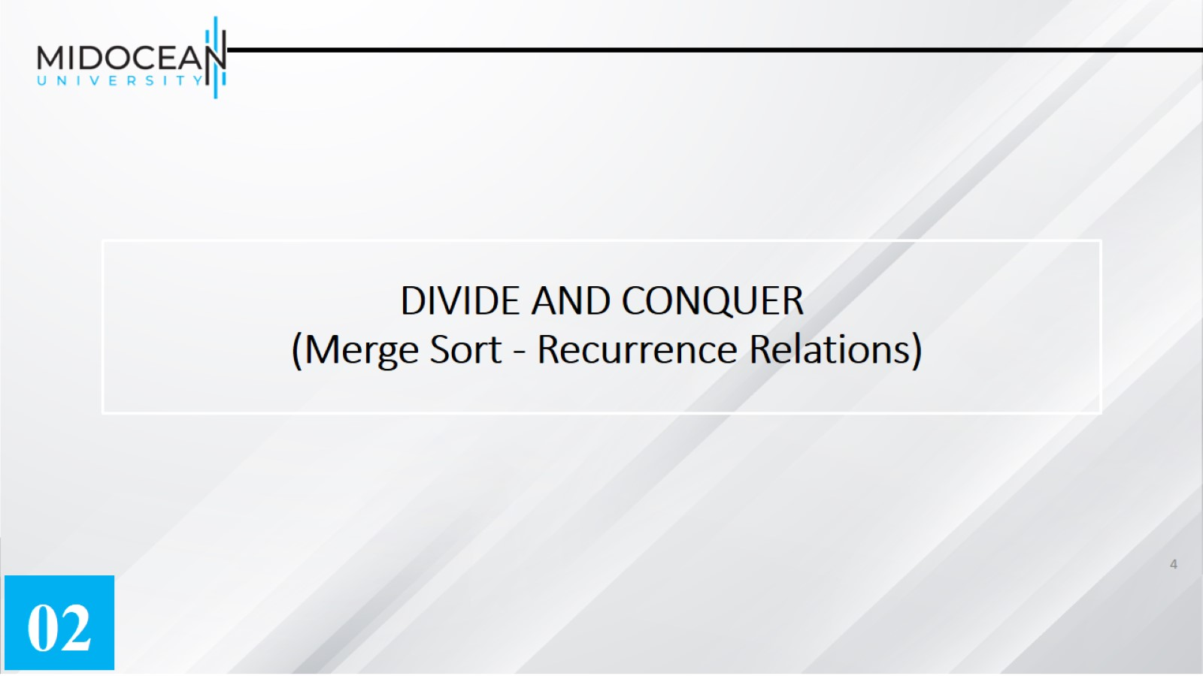
DIVIDE AND CONQUER
(Merge Sort - Recurrence Relations)

Slide 5
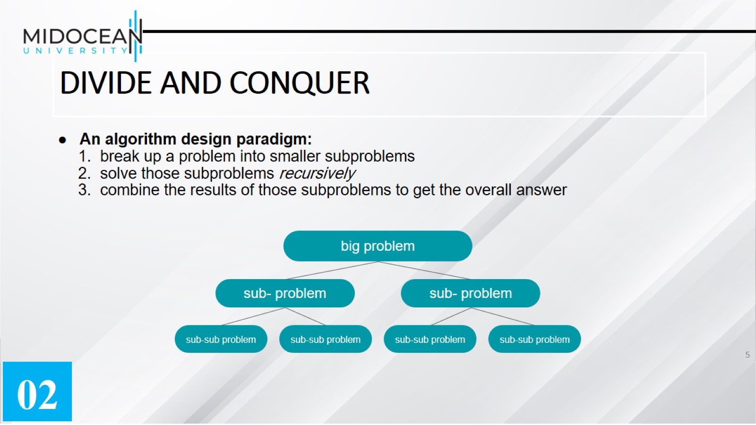
DIVIDE AND CONQUER

Slide 6
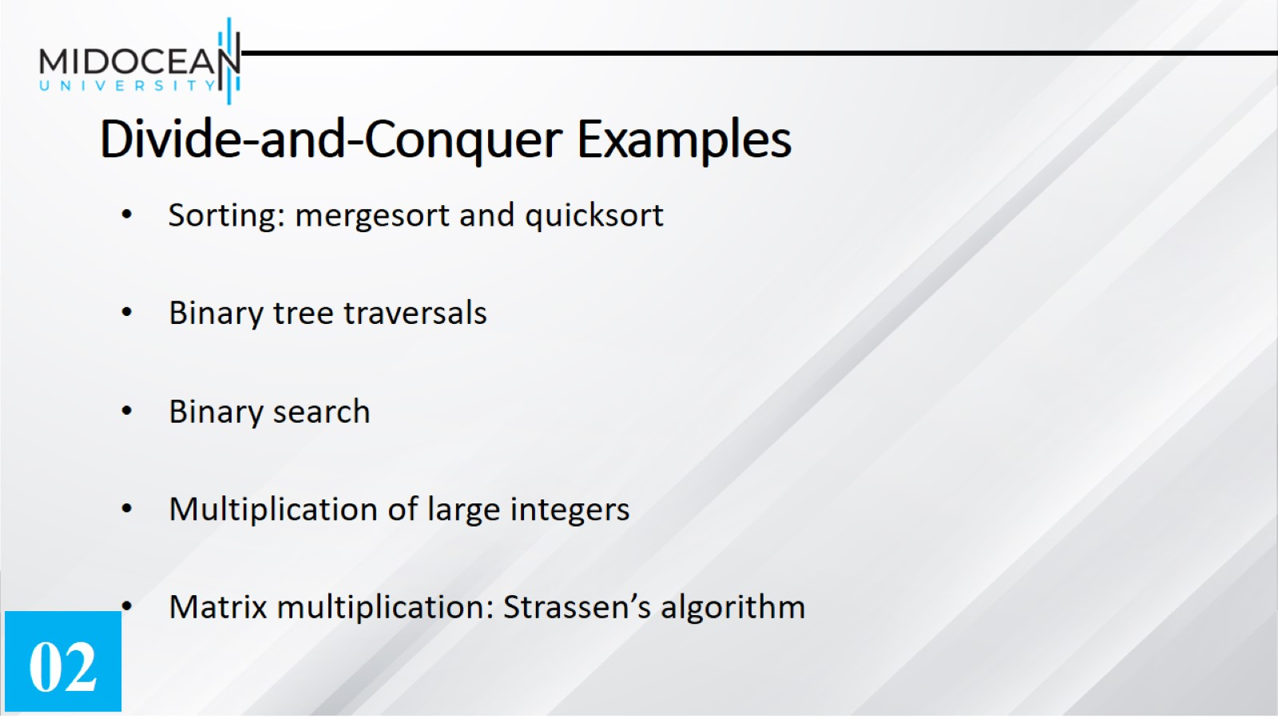
Divide-and-Conquer Examples

Slide 7
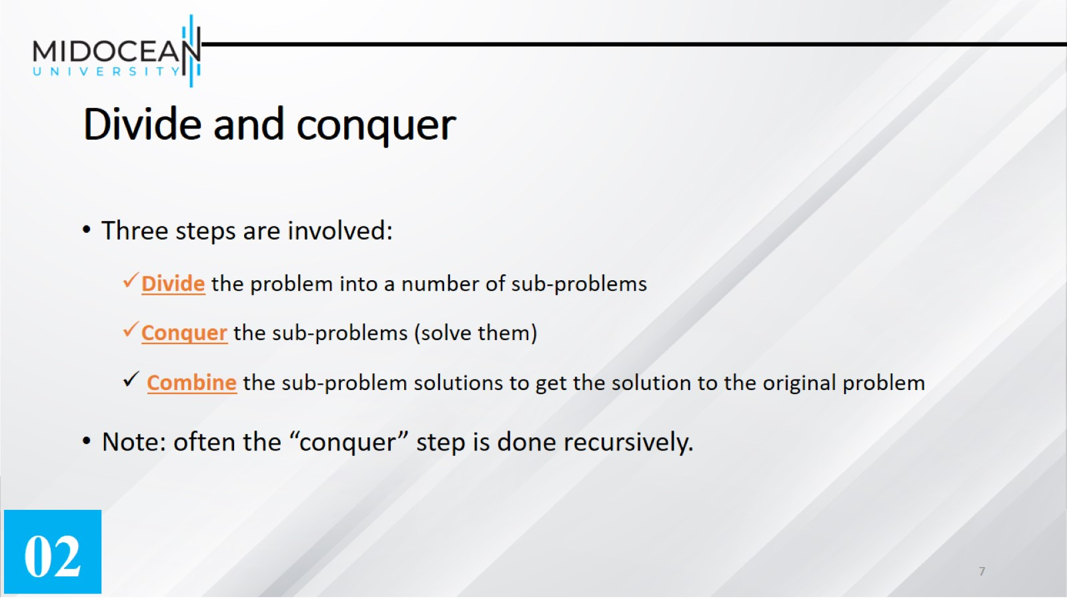
Divide and conquer

Slide 8
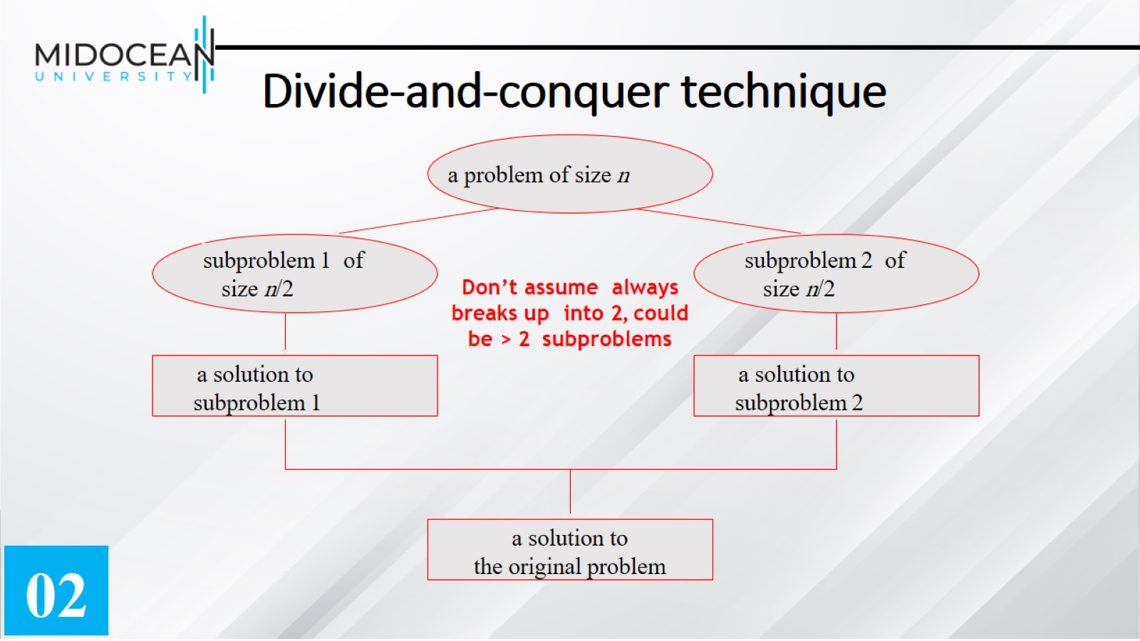
Divide-and-conquer technique

Slide 9
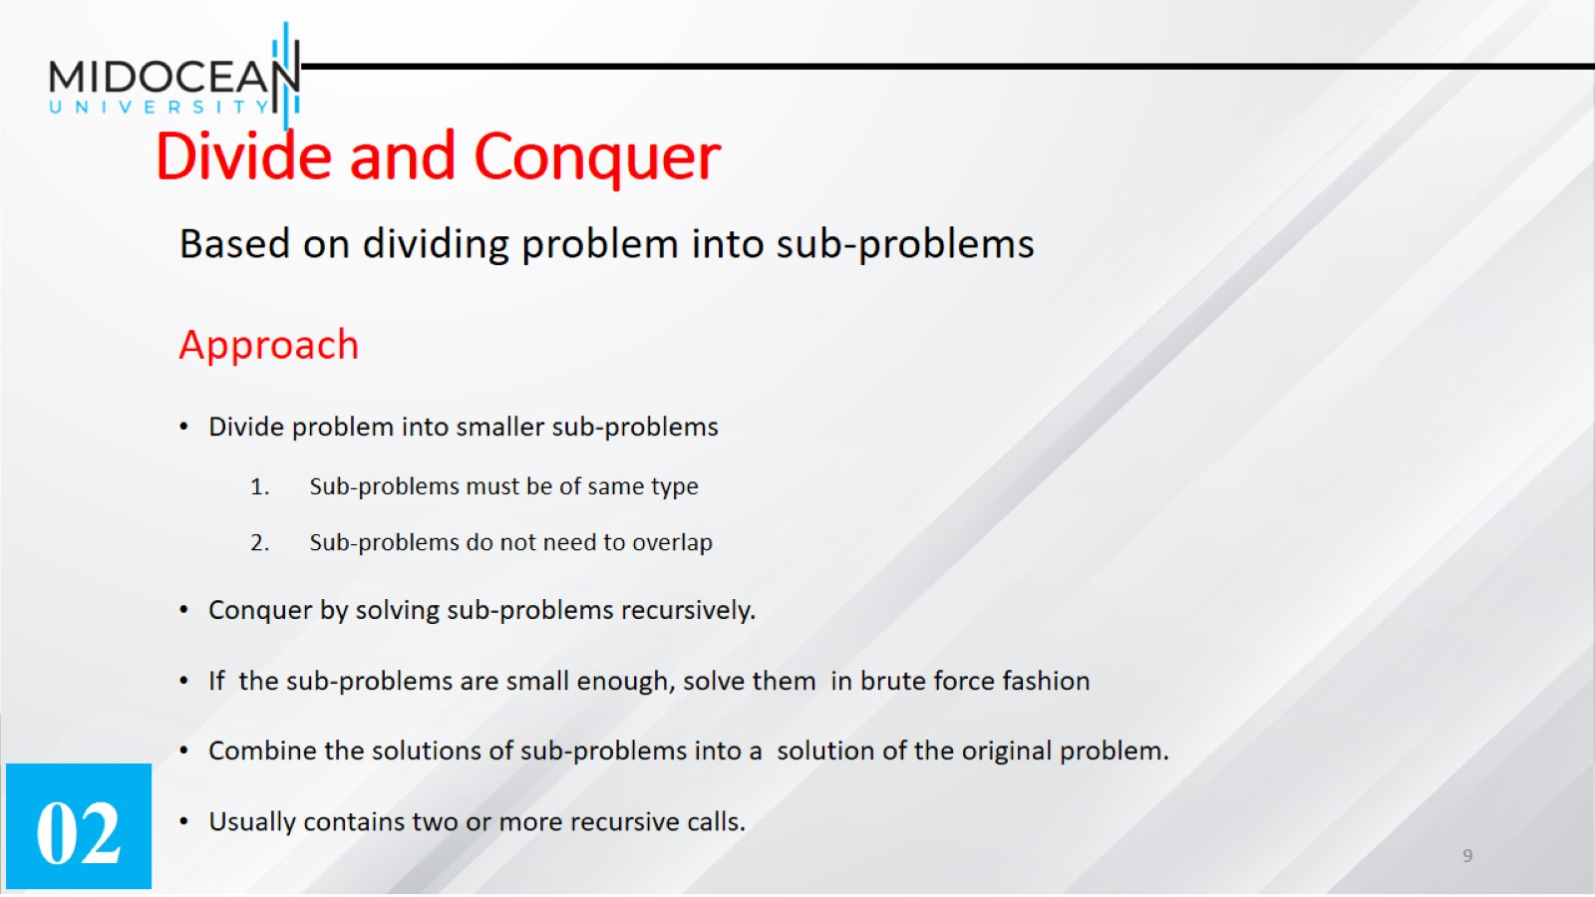
Divide and Conquer

Slide 10
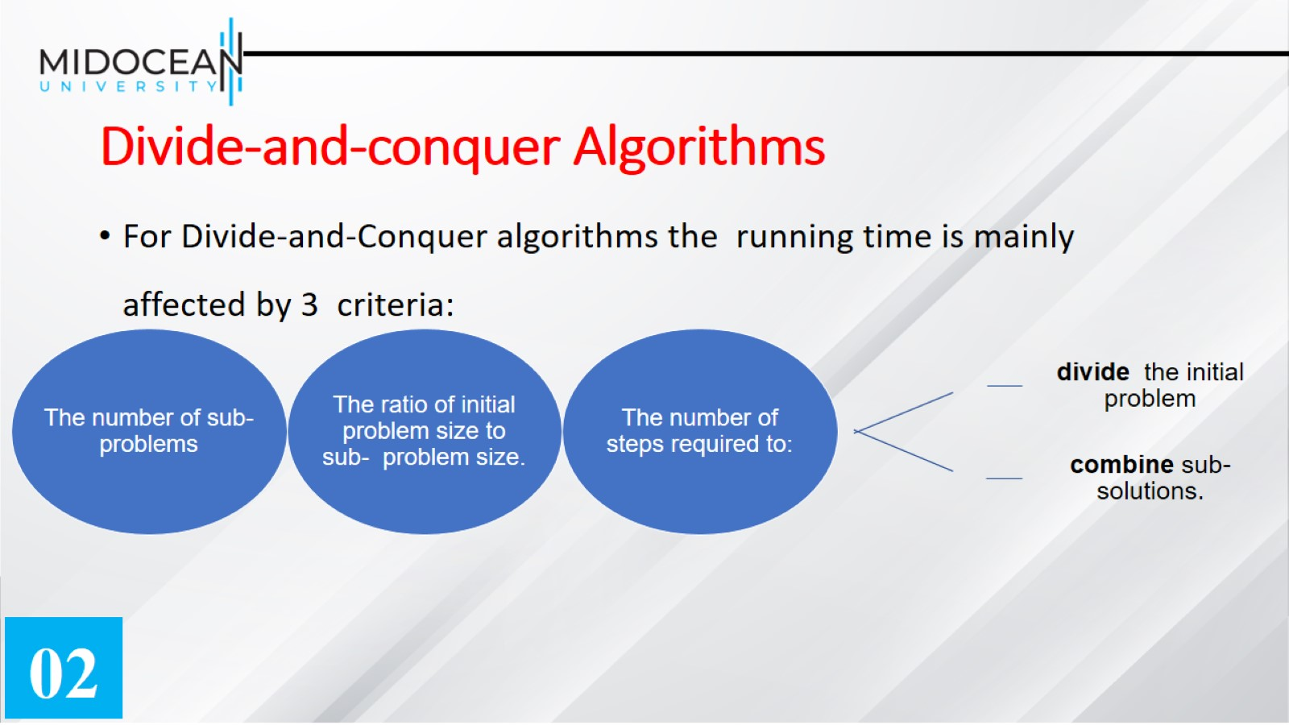
Divide-and-conquer Algorithms

Slide 11
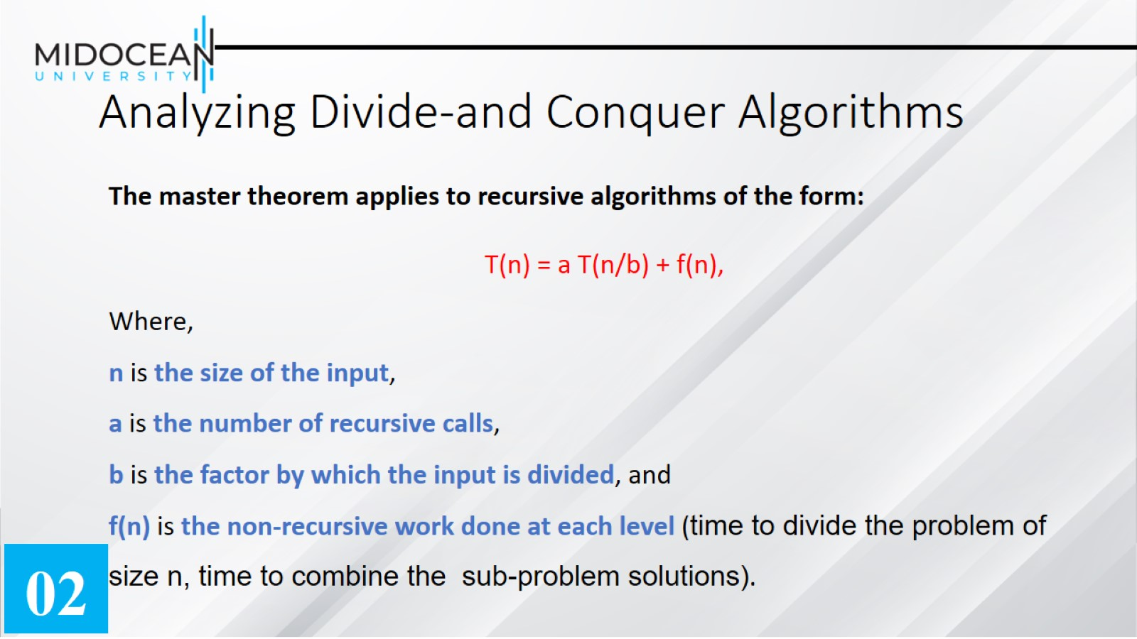

Slide 12


Slide 13
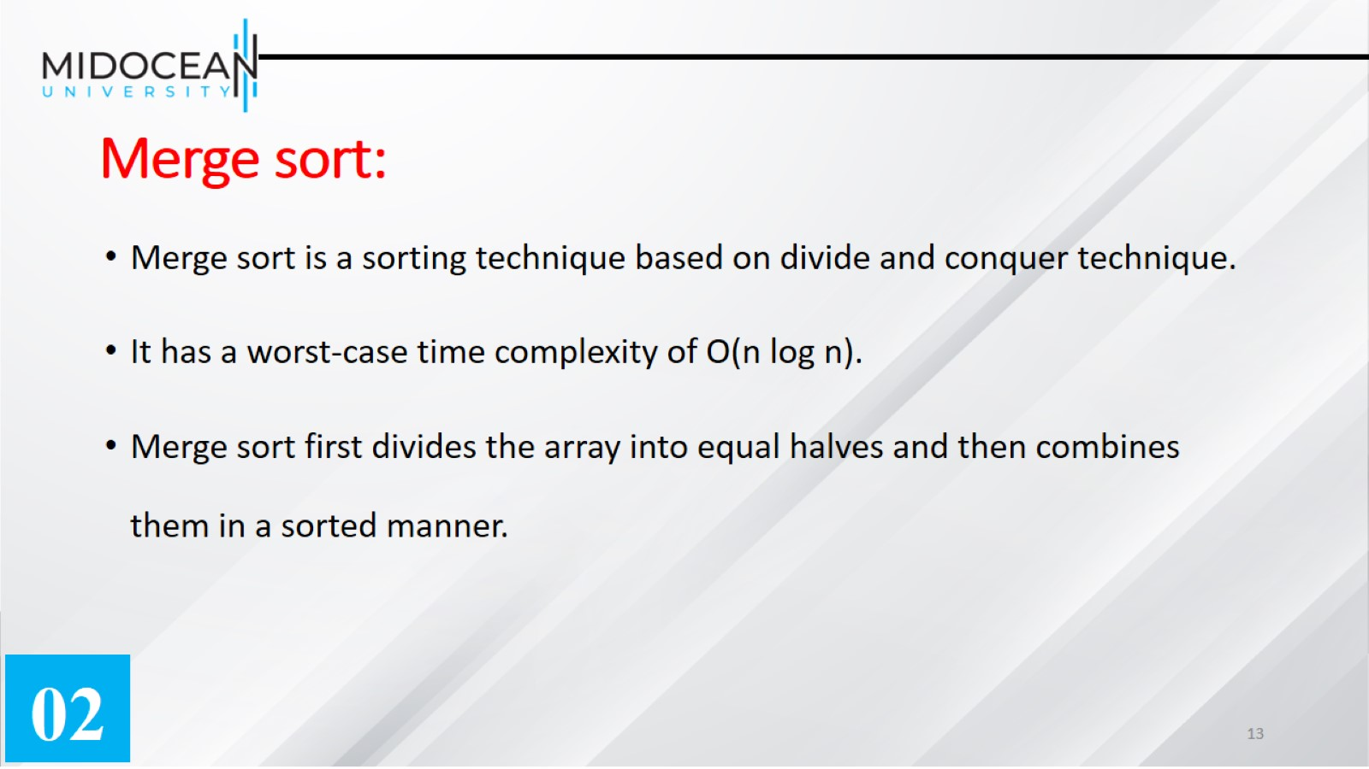
Merge sort:

Slide 14
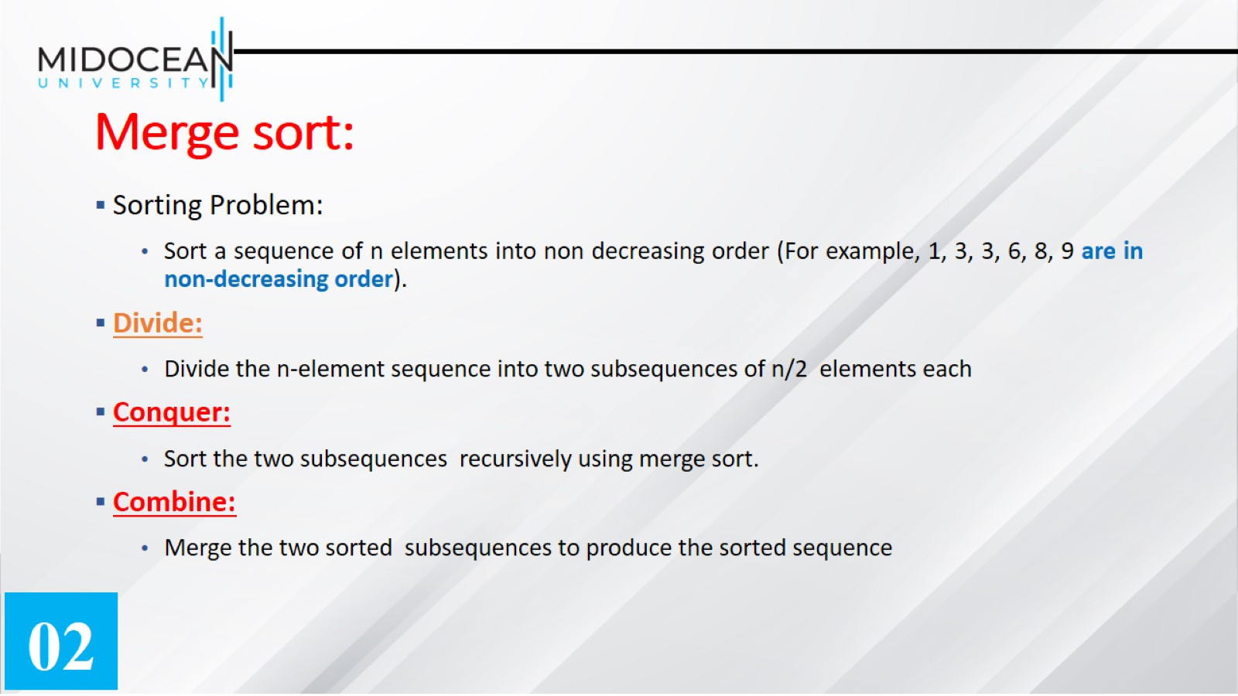
Merge sort:

Slide 15


Slide 16
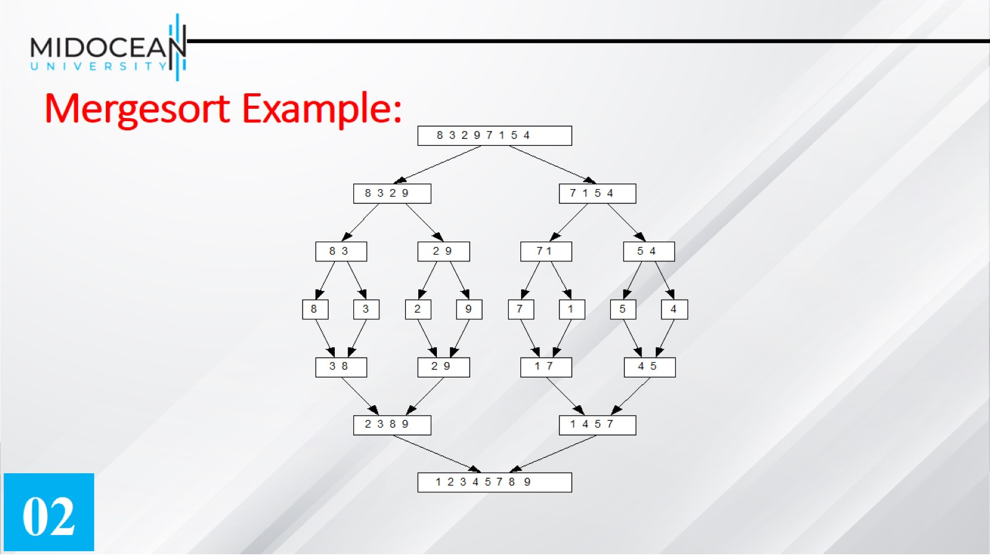
Mergesort Example:

Slide 17
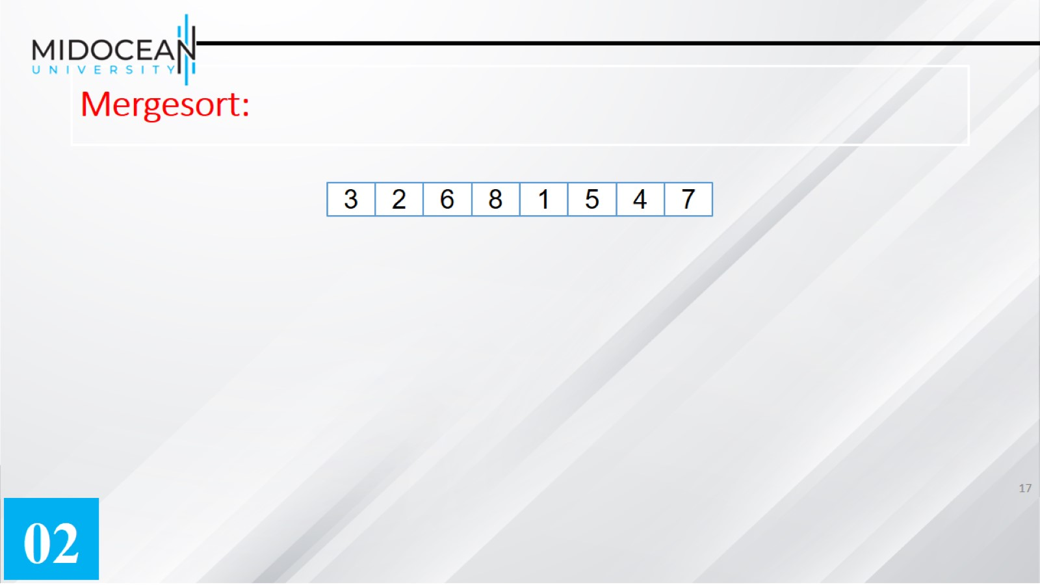
Mergesort:

Slide 18


Slide 19
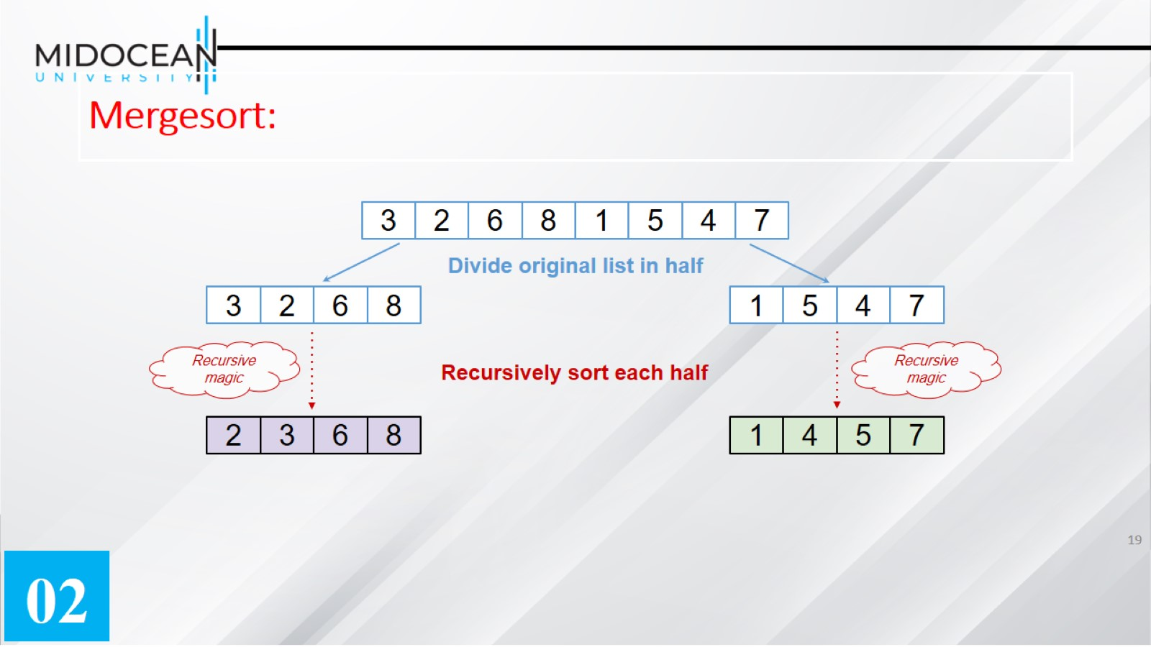
Mergesort:

Slide 20
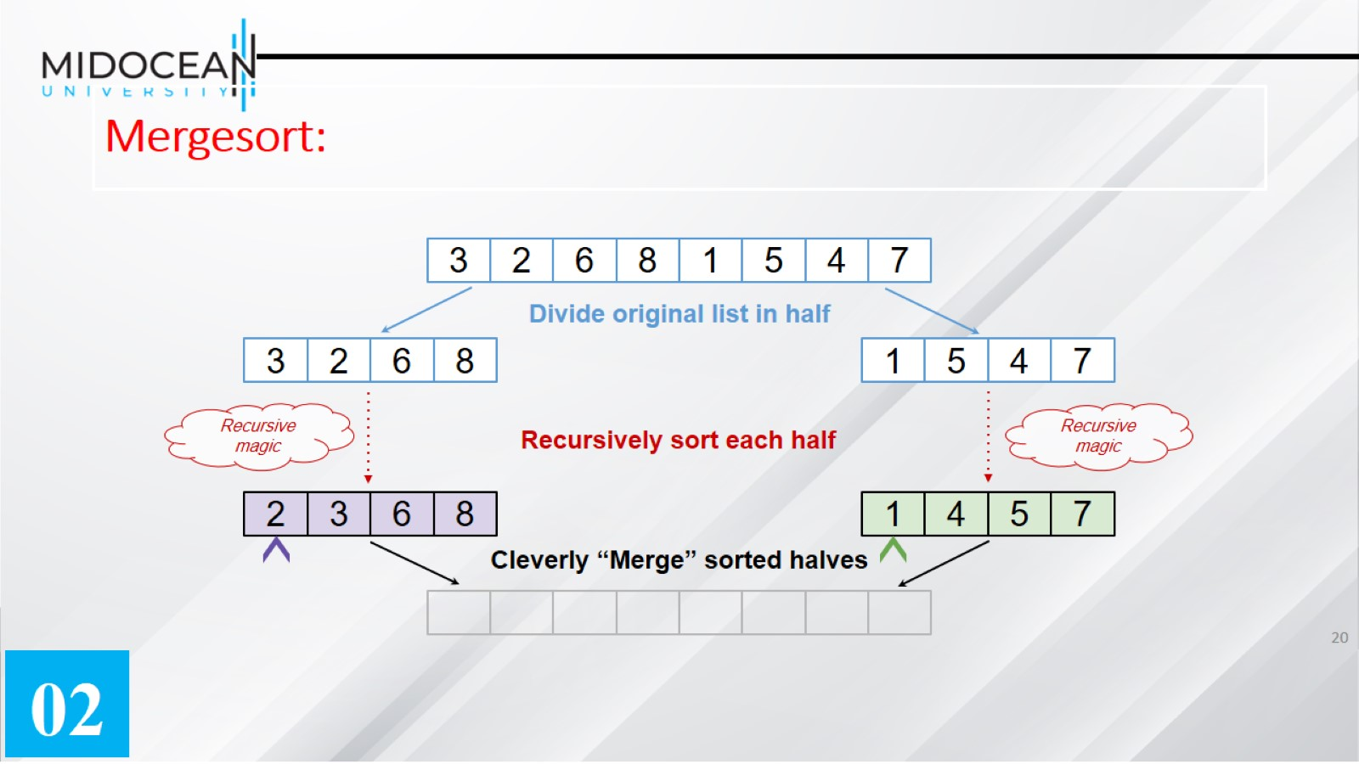
Mergesort:

Slide 21
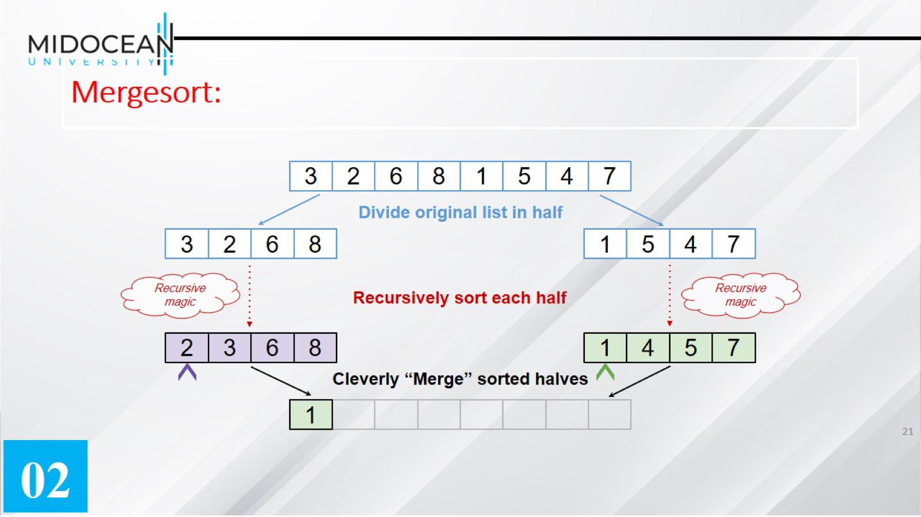
Mergesort:

Slide 22
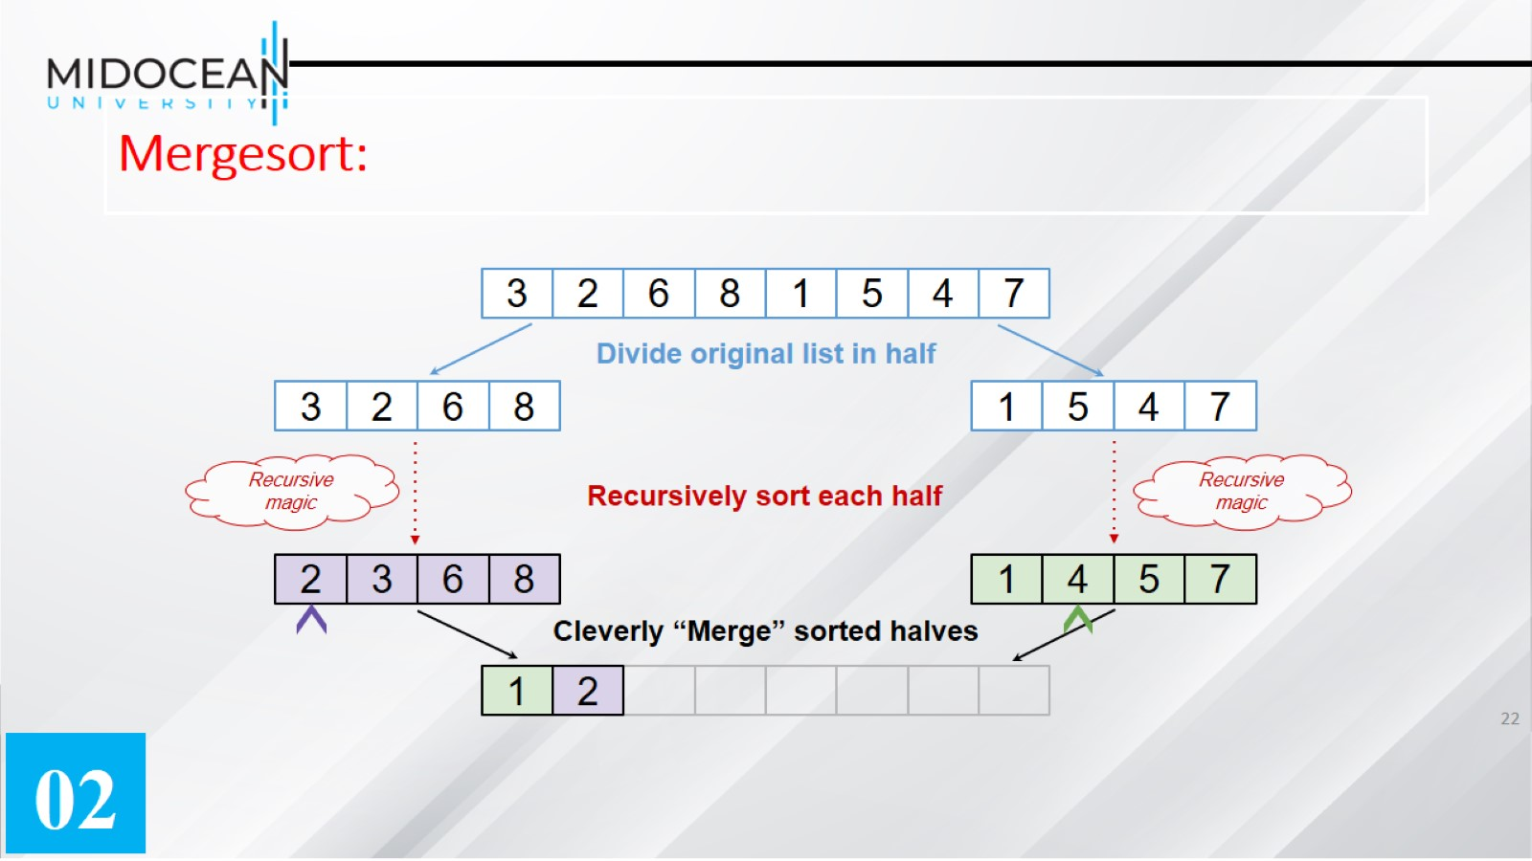
Mergesort:

Slide 23

Mergesort:

Slide 24
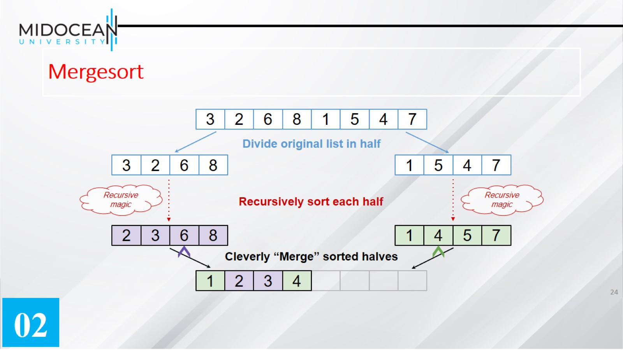
Mergesort

Slide 25
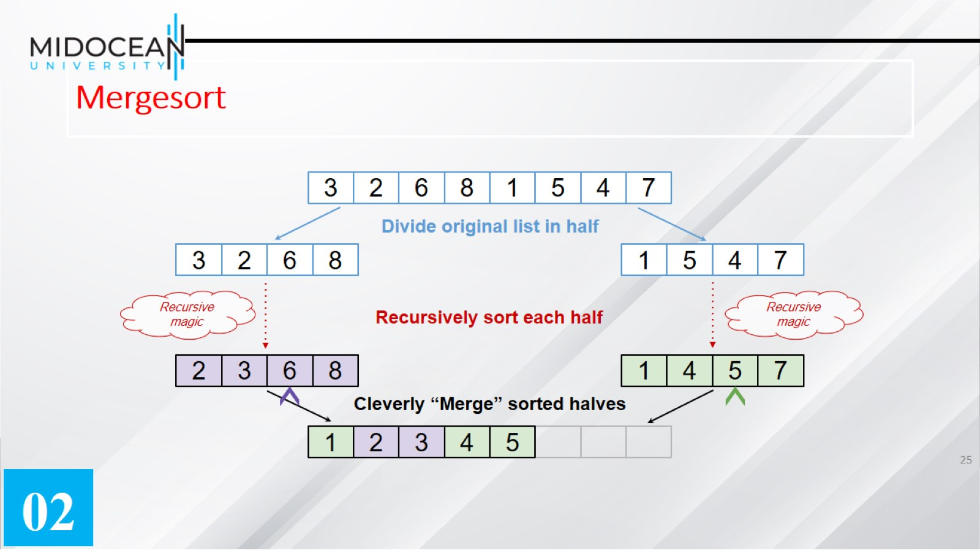
Mergesort

Slide 26
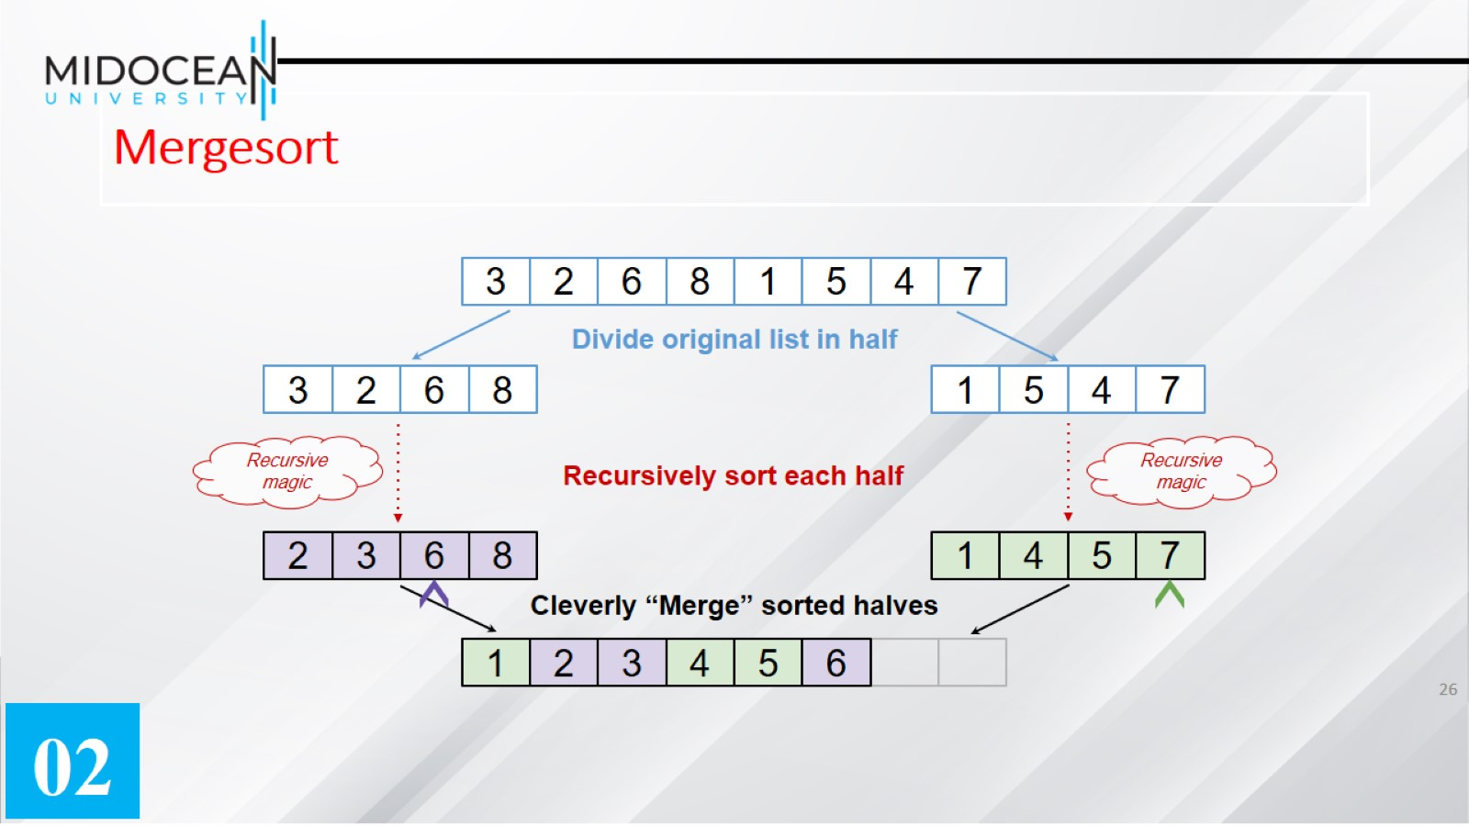
Mergesort

Slide 27
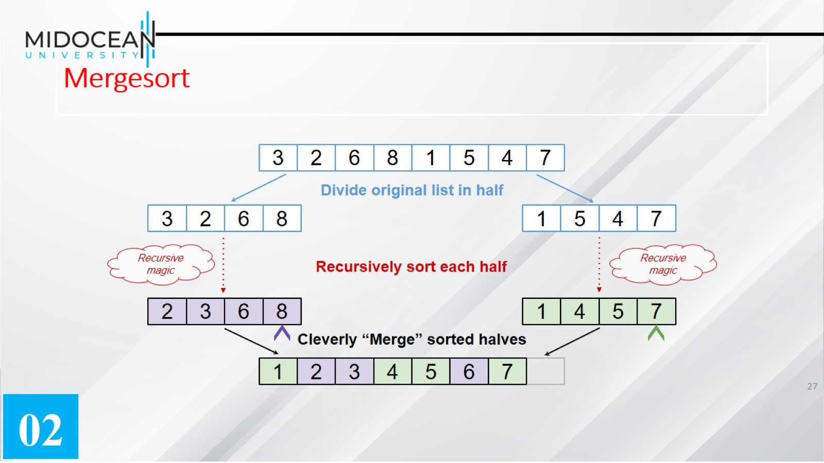
Mergesort

Slide 28
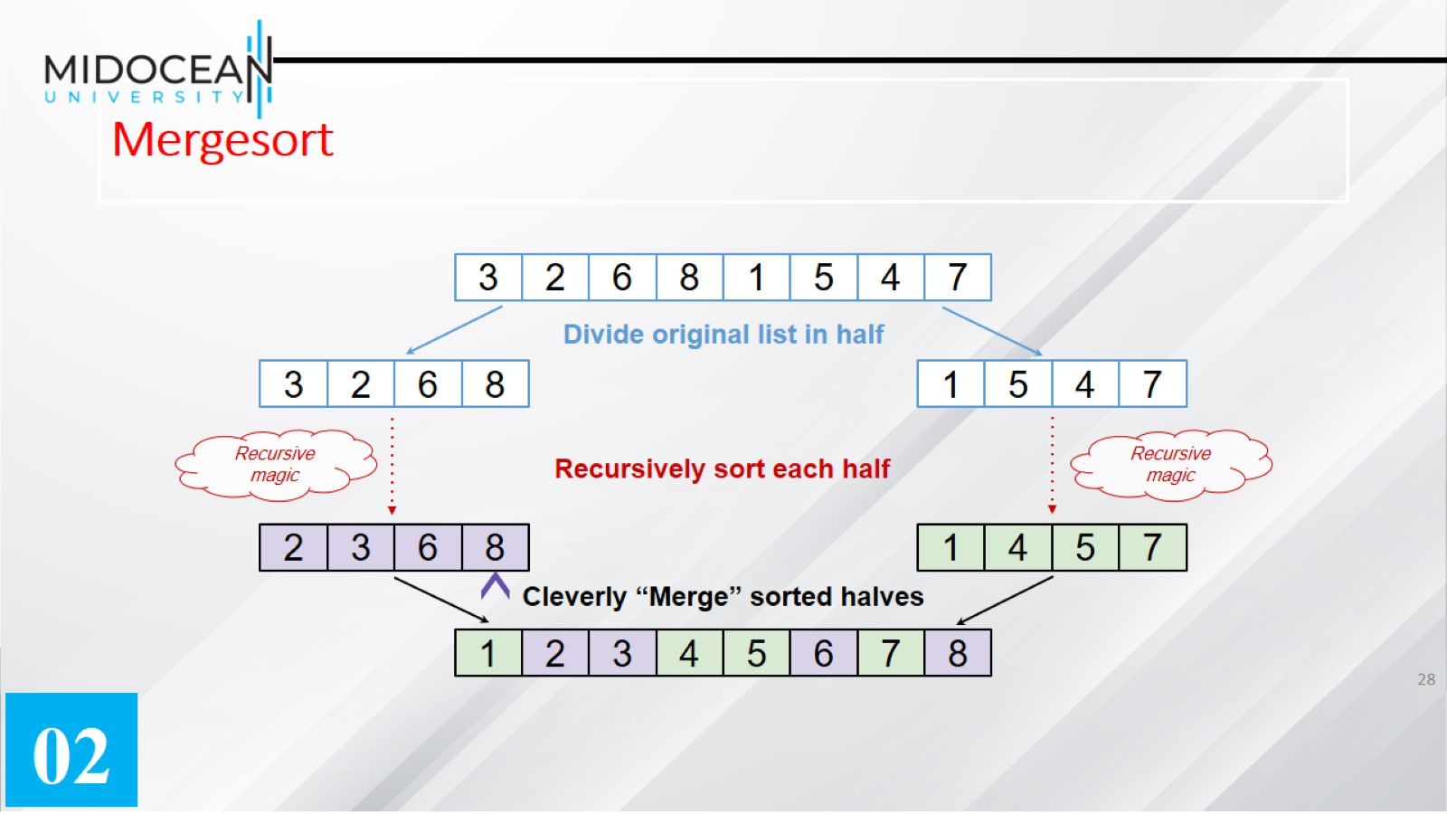
Mergesort

Slide 29
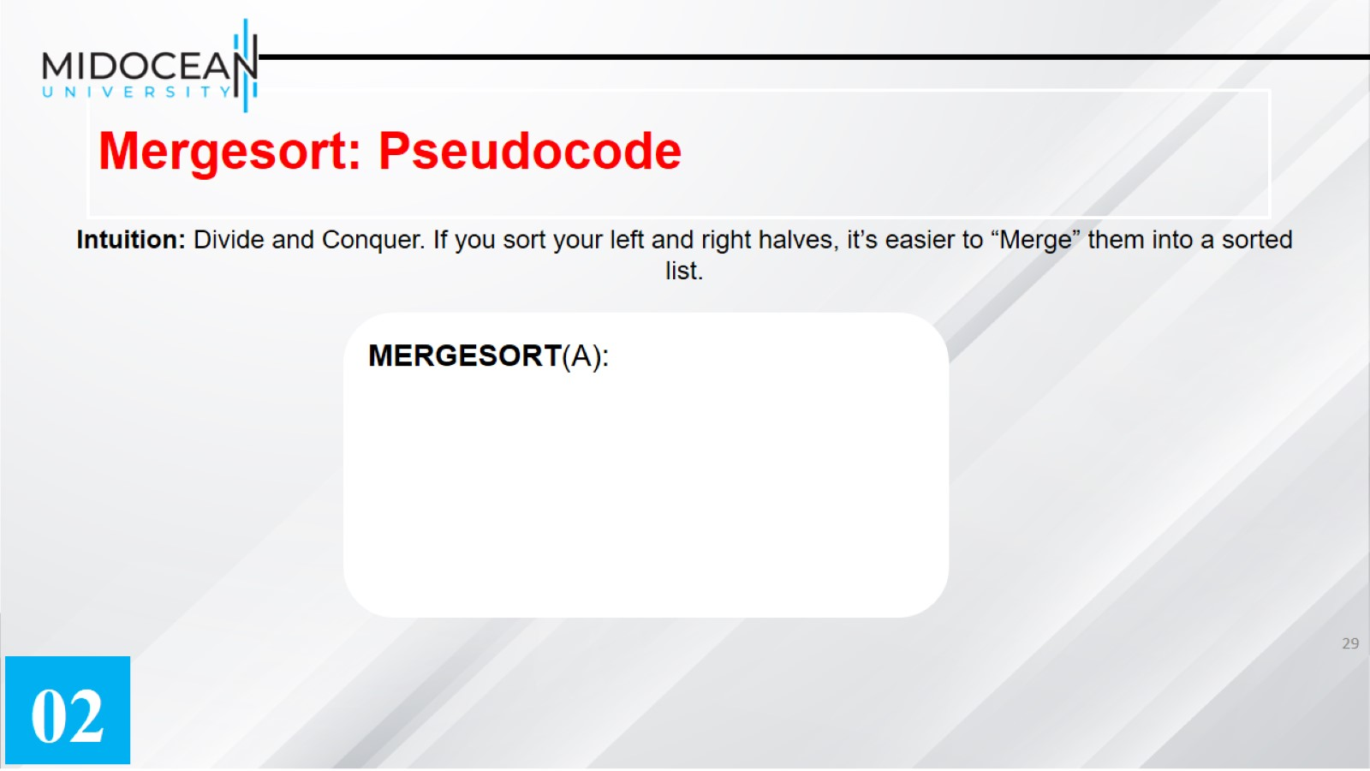
Mergesort: Pseudocode

Slide 30
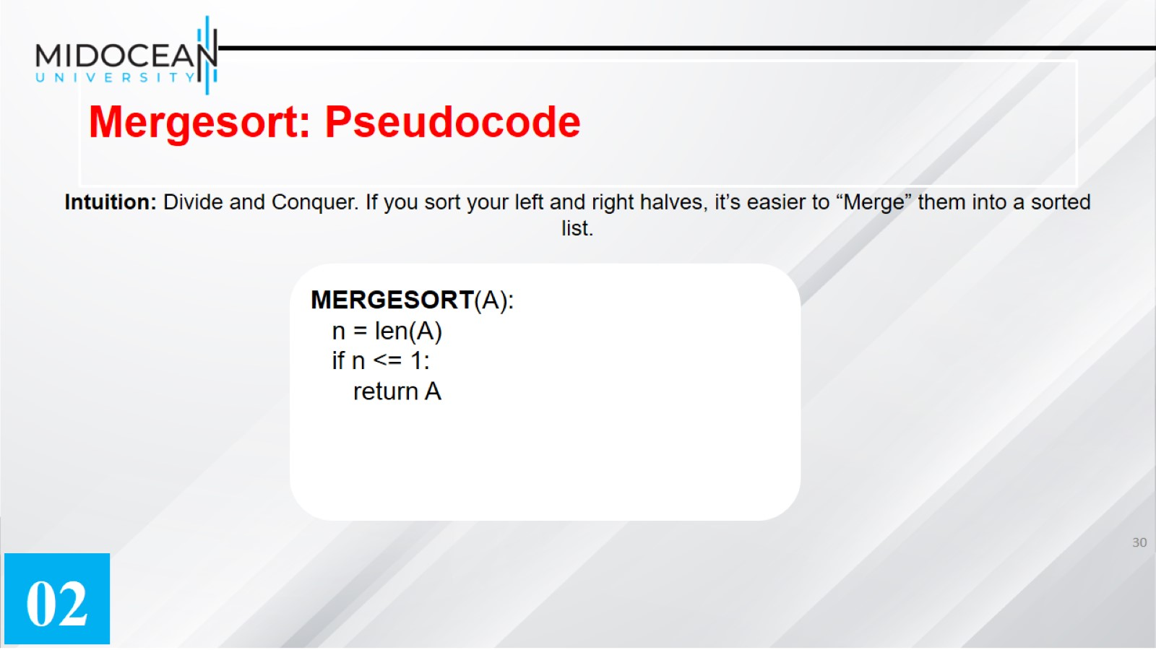
Mergesort: Pseudocode

Slide 31
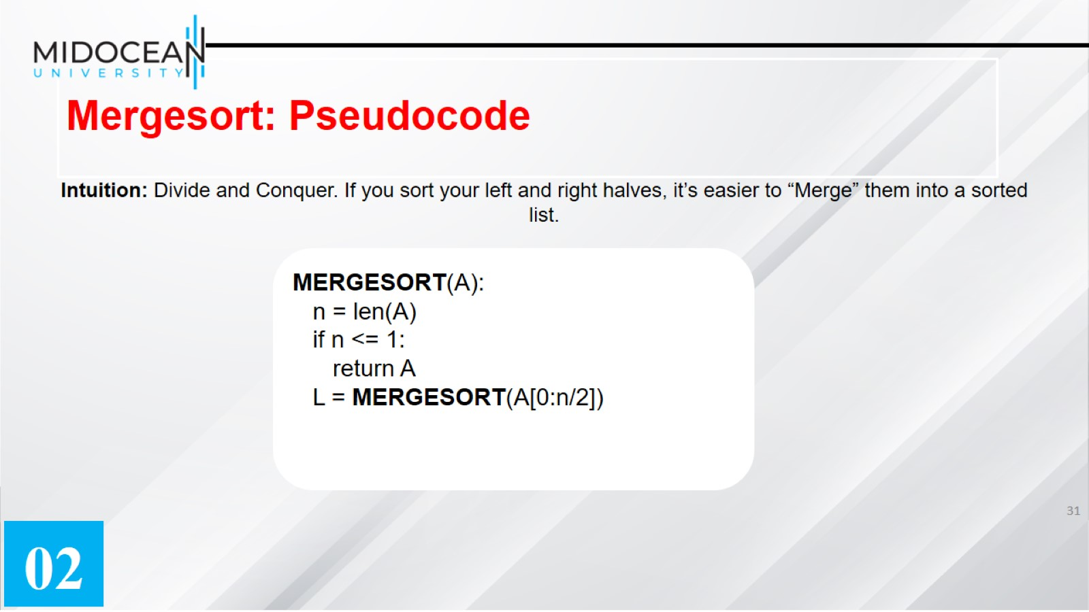
Mergesort: Pseudocode

Slide 32
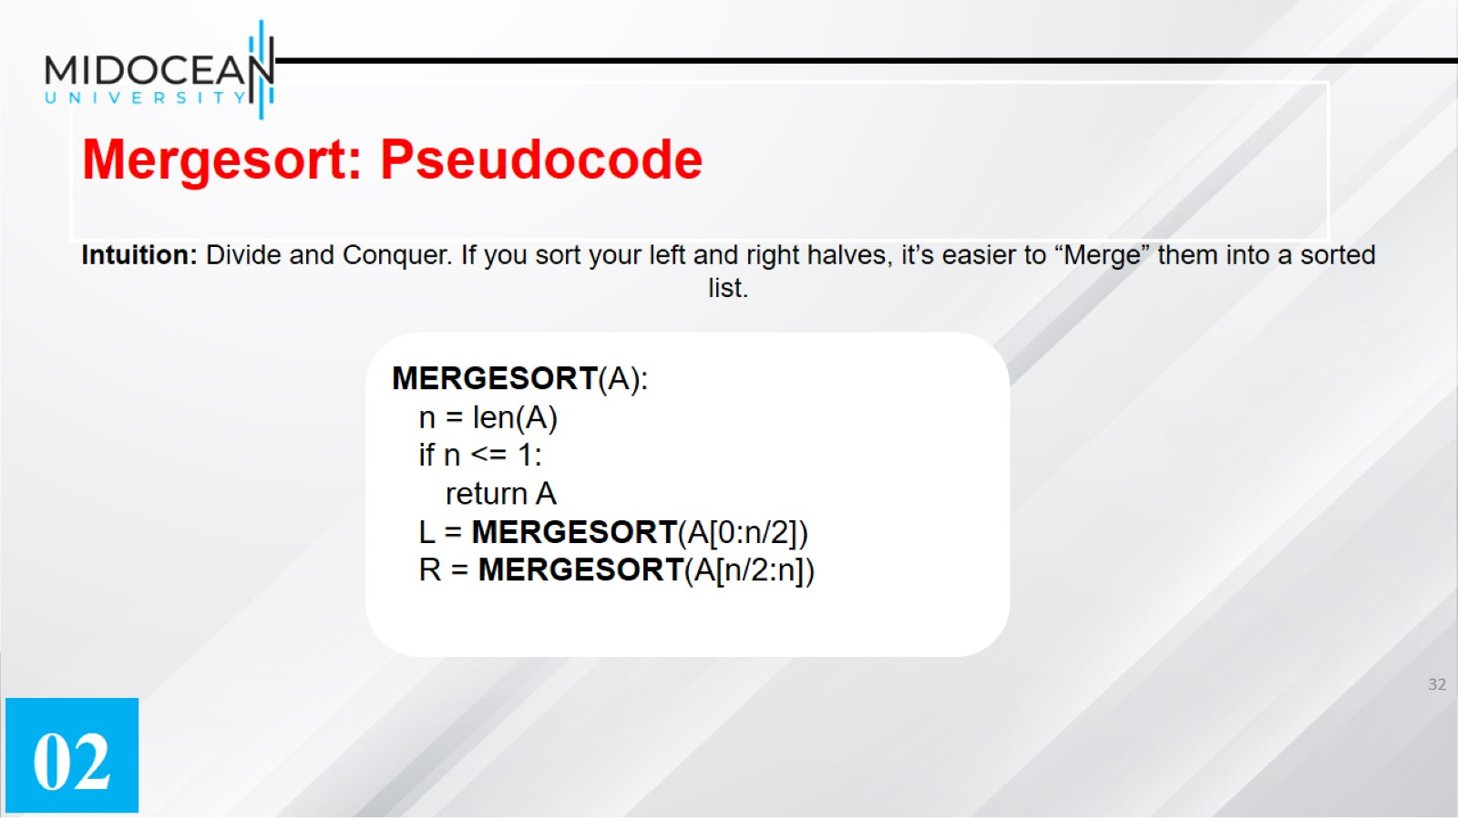
Mergesort: Pseudocode

Slide 33
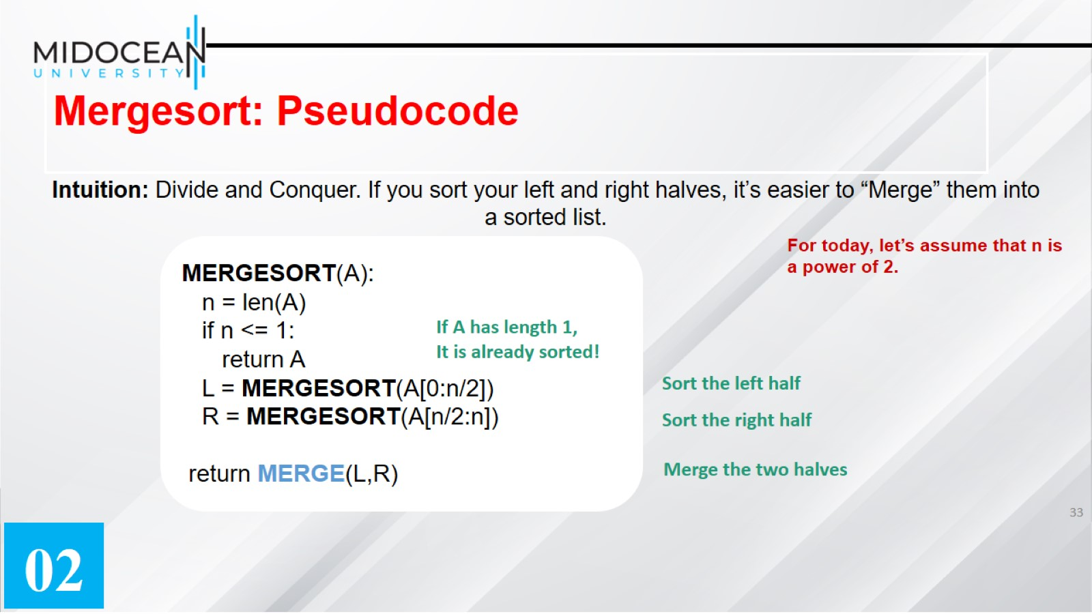
Mergesort: Pseudocode

Slide 34
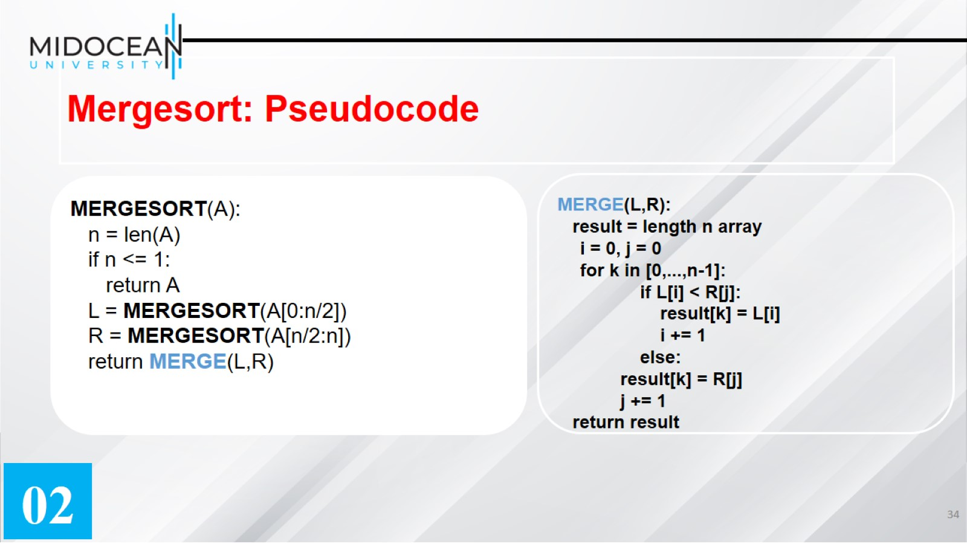
Mergesort: Pseudocode

Slide 35
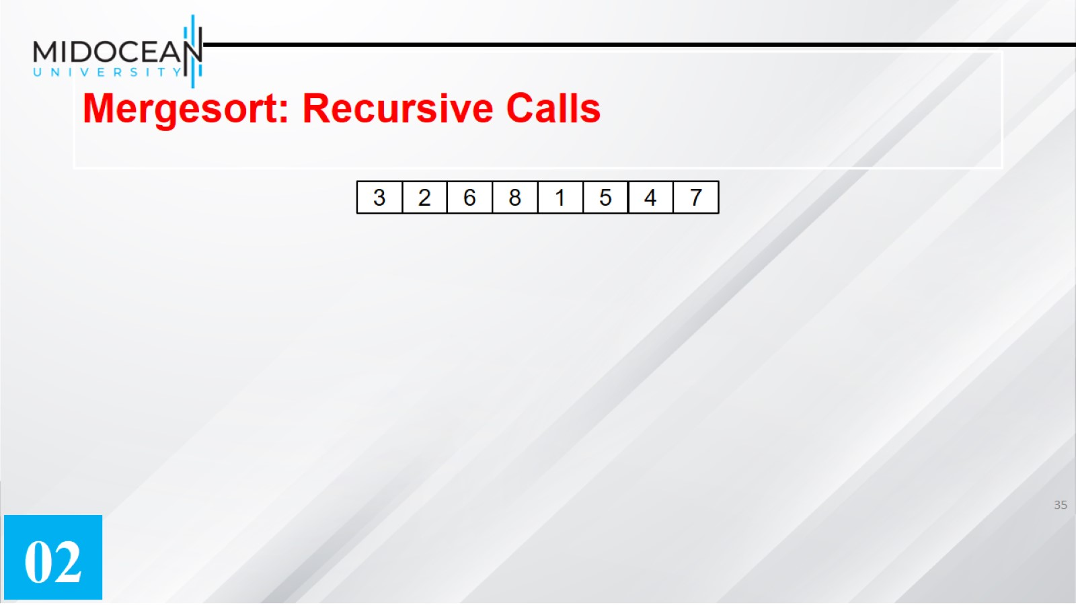
Mergesort: Recursive Calls

Slide 36
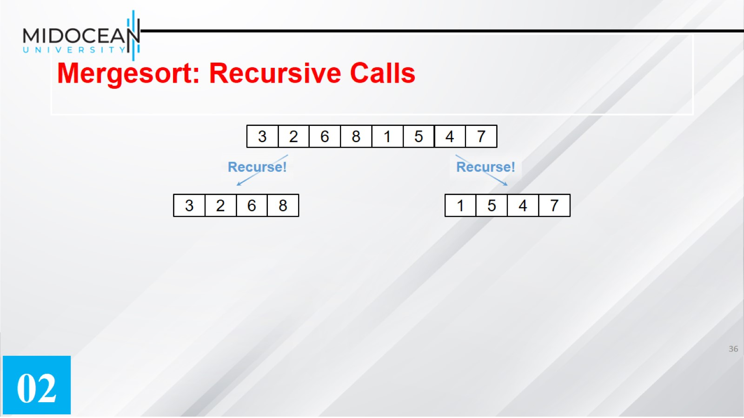
Mergesort: Recursive Calls

Slide 37
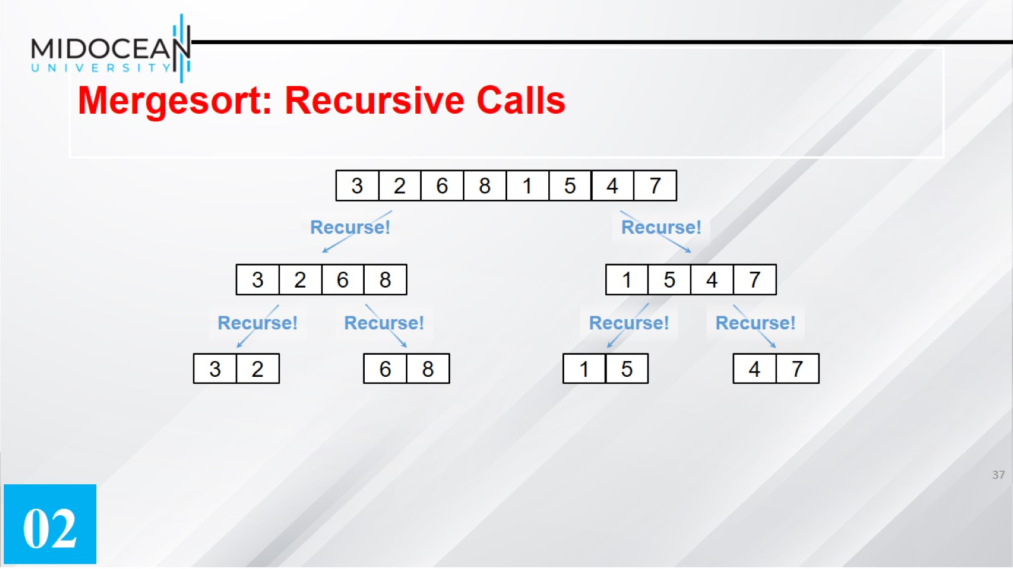
Mergesort: Recursive Calls

Slide 38
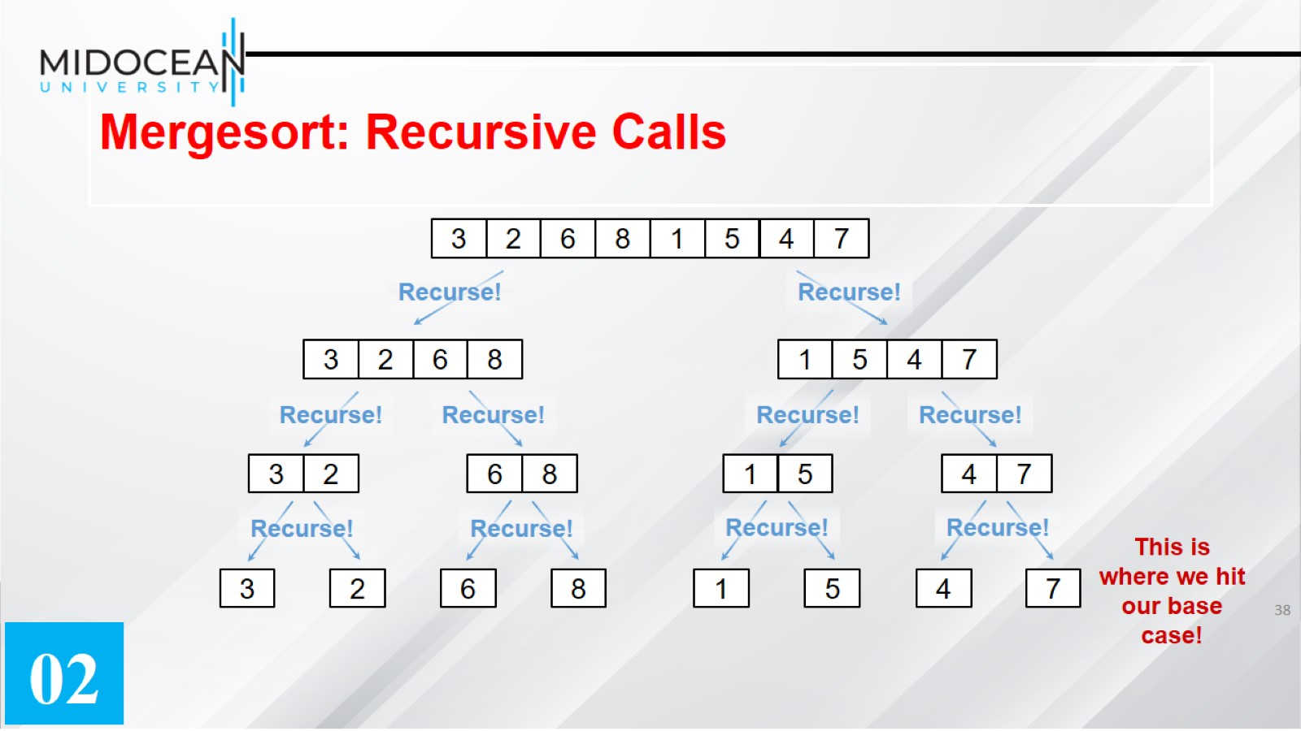
Mergesort: Recursive Calls

Slide 39
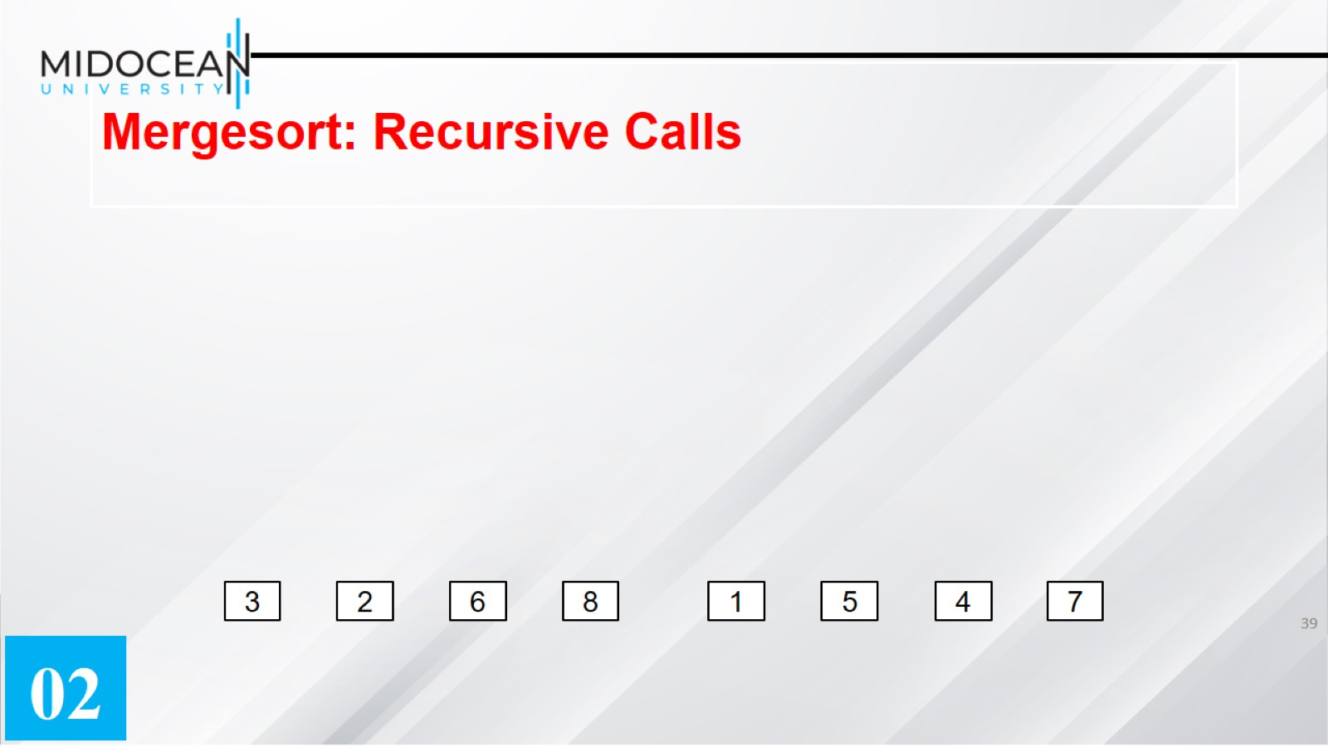
Mergesort: Recursive Calls

Slide 40
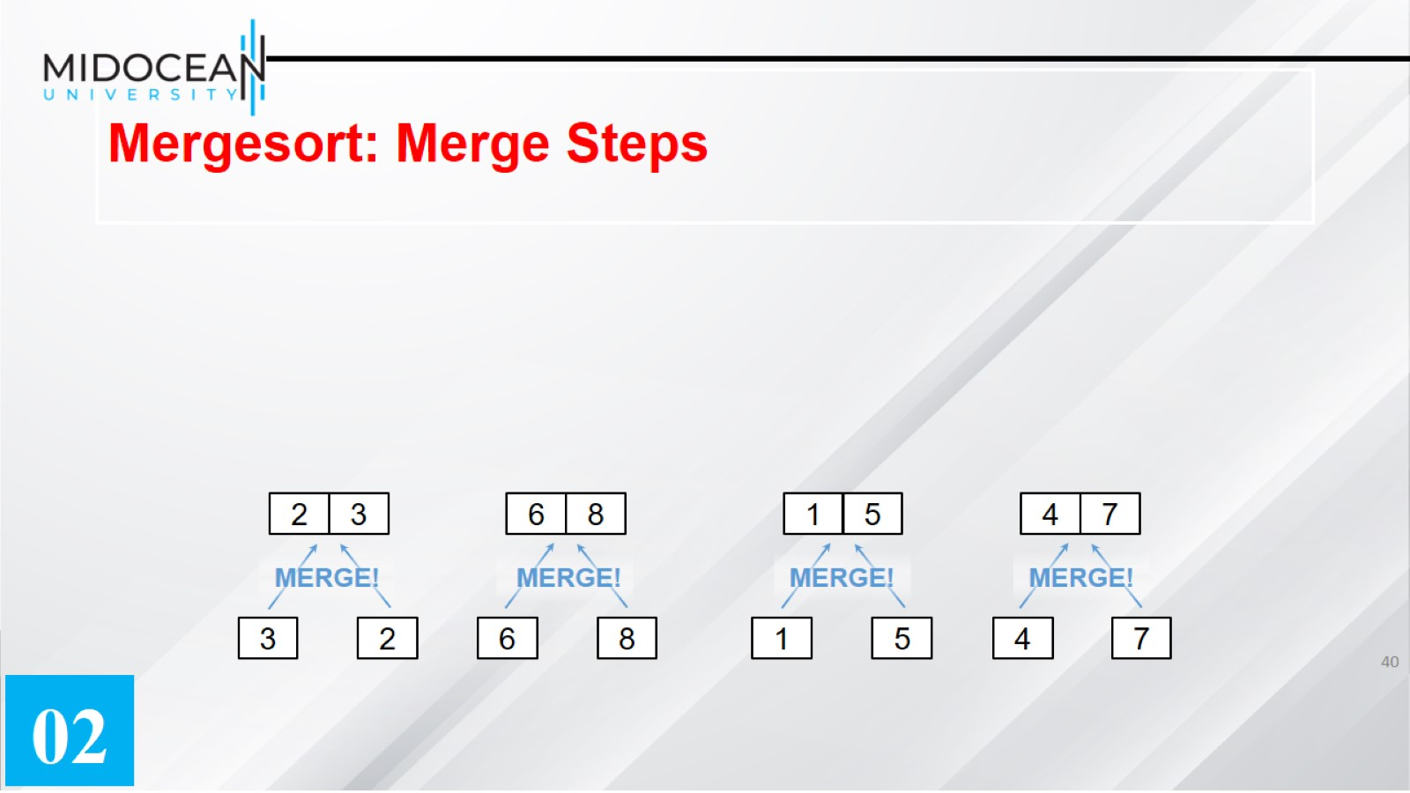
Mergesort: Merge Steps

Slide 41
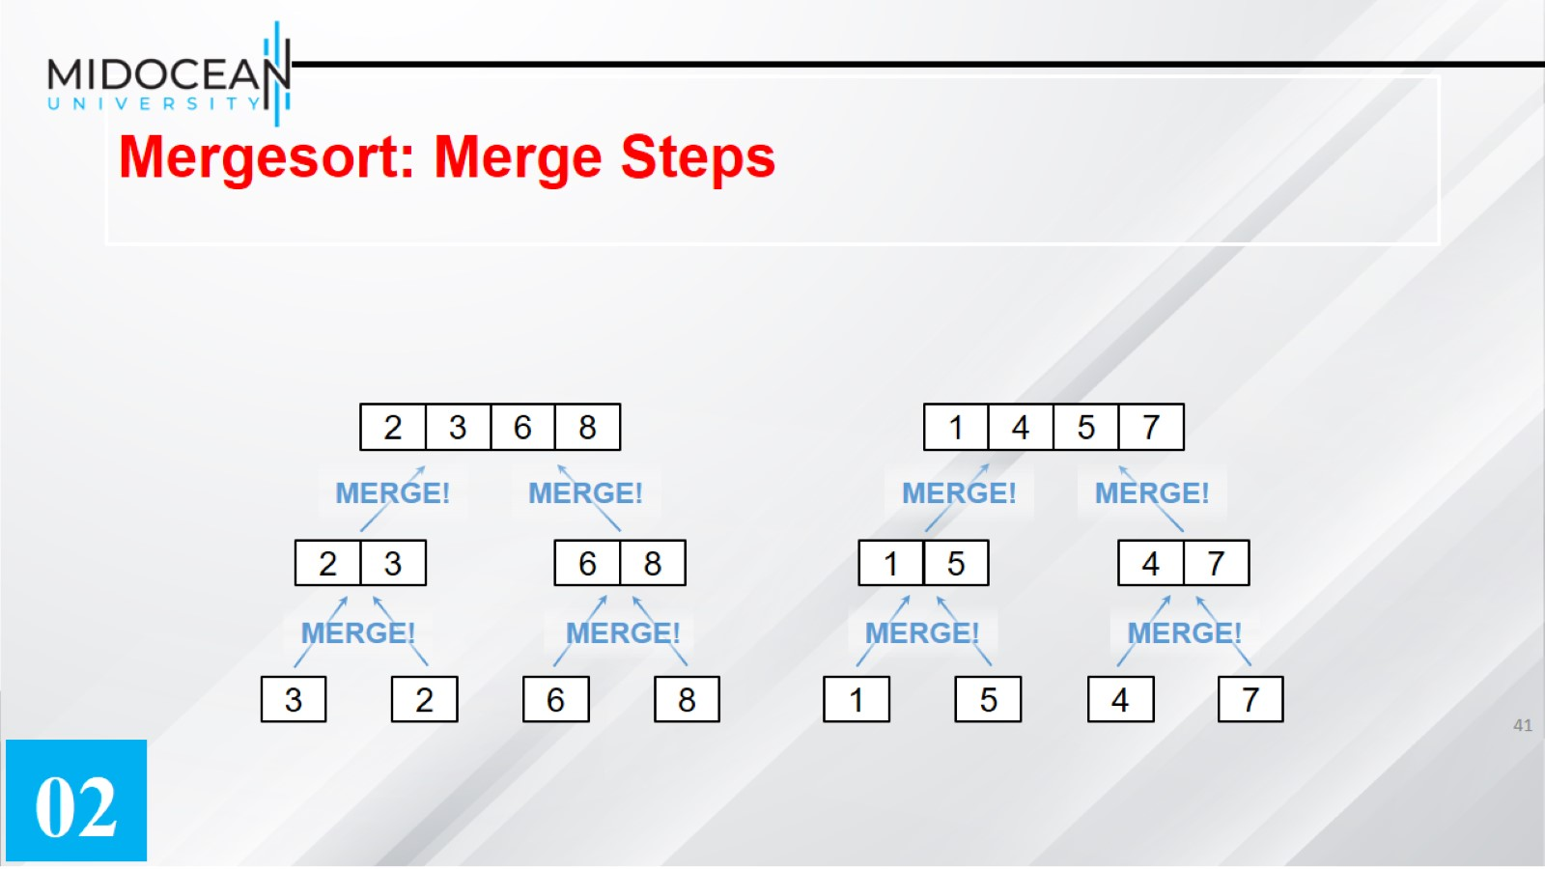
Mergesort: Merge Steps

Slide 42
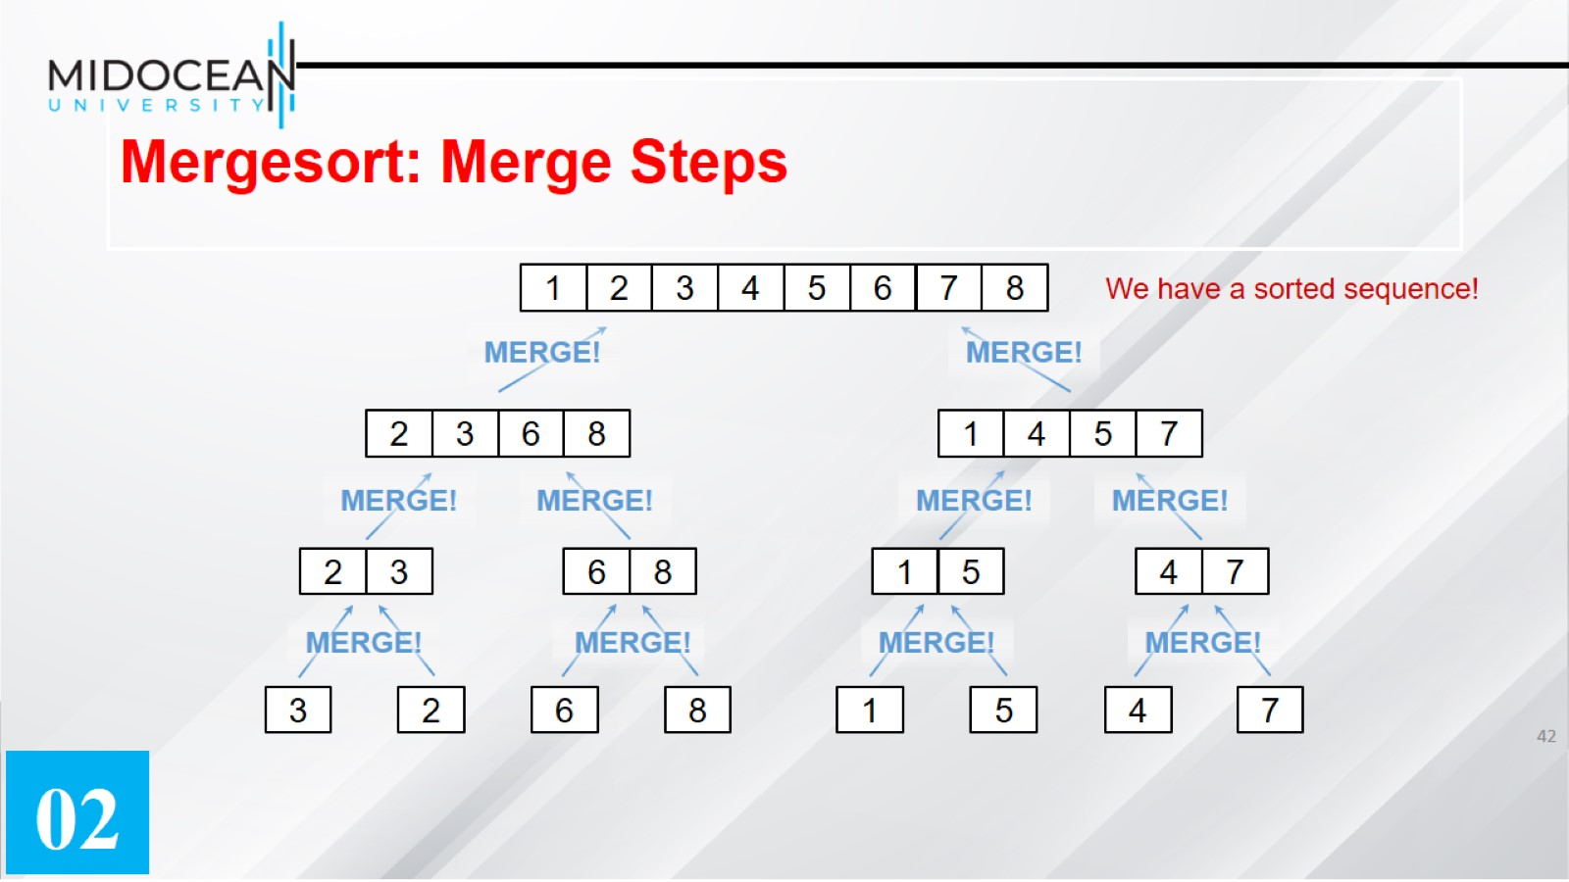
Mergesort: Merge Steps

Slide 43
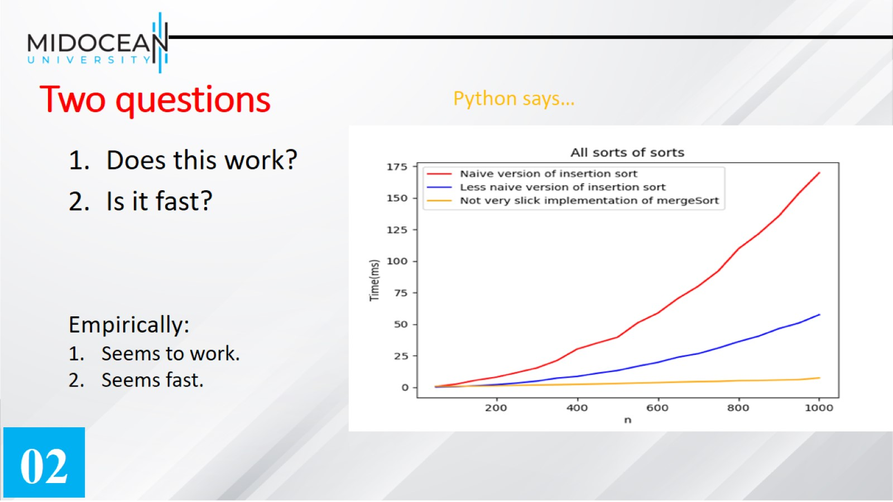
Two questions

Slide 44
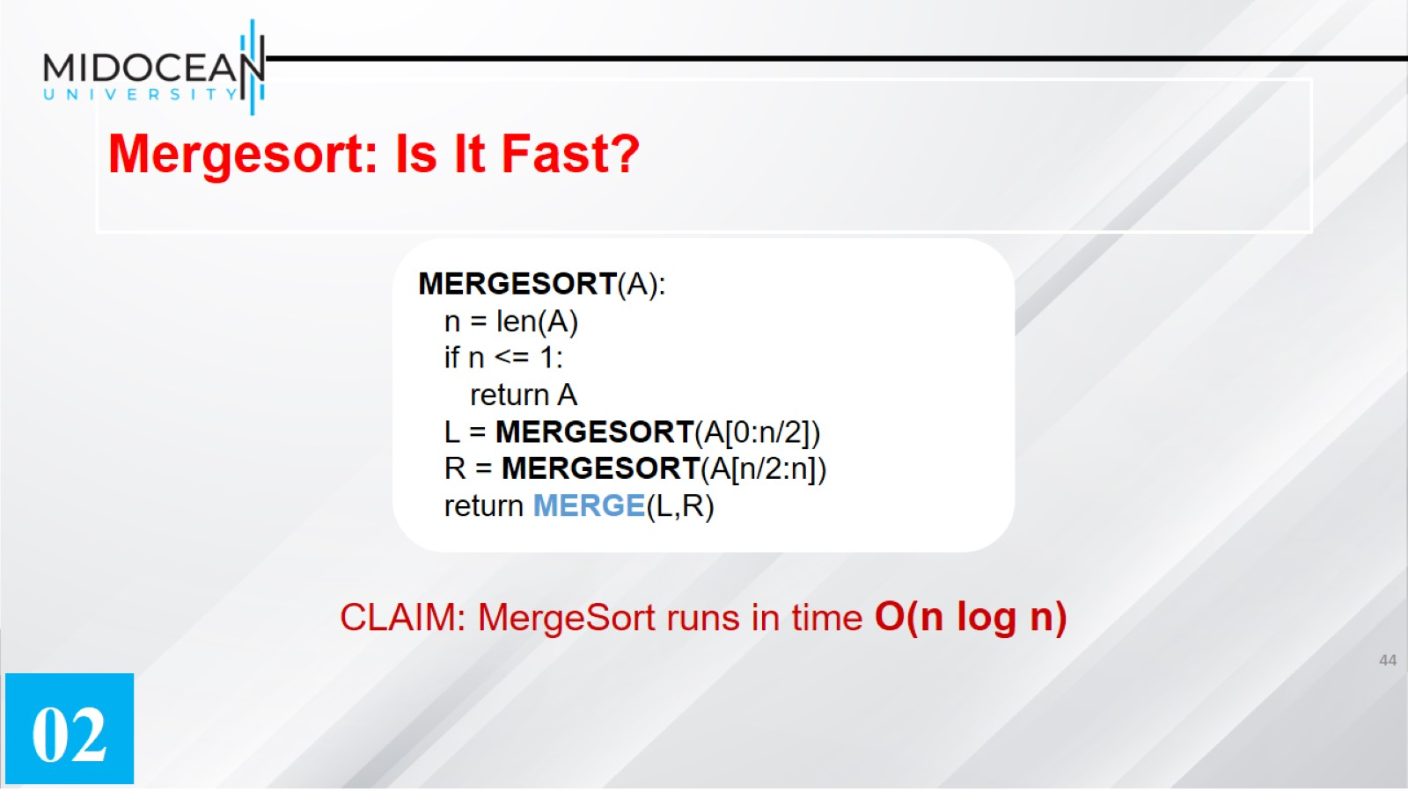
Mergesort: Is It Fast?

Slide 45


