Slide 1

International Business Management
Prepared by Dr. Badur elgasim
Lecture 10
MGM 506
International Human Resource Management

Slide 2

Learning Objective
Learning Objectives
The Transition From a Domestic to an International Position
Recruitment and Selection
Product Life Cycle and International Human Resource Management
International Management and Intercultural Training and Preparation
Repatriation Problems
Compensation

Slide 3

Introduction
Motorola and the Secrets of the Orient. More than 100 years ago, Kipling said, “East is East and West is West, and never the twain shall meet.” Today, however, Motorola Corporation is proving otherwise, and the meeting is providing Motorola with considerable sales growth in Asia’s booming telecommunication and semiconductor markets. To ensure continuous growth, Motorola has established more than a dozen factories in several East Asian countries, including new factories in China, Malaysia, and Singapore. These countries not only produce a variety of Motorola products, but they are also the source of new products

Slide 4

Motorola’s success in Asia could be attributed to its ability to tap the human resources and brain power of the East. It has integrated Asian managers into its corporate power structure and has granted them considerable decision-making authority. These managers often combine Asian cultural beliefs with modern management practices. The Motorola story portrays an organization that has adopted a global perspective and uses the capabilities of its human resources all over the world. This change in perspective is an evolutionary process that begins when an organization takes its first step in expanding beyond the home market boundaries

Slide 5
The Transition From a Domestic to an International Position
Most firms begin as domestic corporations. Their operations are geographically limited to the boundaries of their own home market, and they serve the customers of their home country. The firm often becomes more willing to expand abroad as it becomes more familiar with foreign markets and the procedures of exportation.
It starts by establishing branches, offices, and production facilities in foreign countries in an attempt to better serve those markets and take advantage of foreign market opportunities

Slide 6
Recruitment and Selection
Increasingly, international competitiveness is becoming a requirement for domestic success. The ability of a firm to compete in the world market may be determined by the quality of its human resources. In turn, the quality of a firm’s human resources primarily depends on its HRM practices, which are shaped by the organization’s staffing philosophy.
Such a philosophy serves as a screening mechanism, allowing only certain types of people to join the firm.

Slide 7
Recruitment Philosophy
An international corporation has the option of hiring from a global pool of applicants. An objective selection process would result in choosing the best-qualified applicant. Most international staffing decisions are supposed to be based on objective criteria. Research has shown, however, that these decisions are strongly influenced by the attitudes of the top executives toward the people of the host cultures. Managers’ opinions and attitudes determine whether expatriates are selected for management positions in foreign subsidiaries (expatriate managers are home country managers on assignment to host countries).

Slide 8
MNCs may follow any of four recruitment approaches: home country, host country, regional, or global (Table 11.1). Home Country Approach. Managers using the home country approach tend to staff all key positions, at the home office and abroad, with home country executives. They feel that this group is the most intelligent, capable, and reliable. This decision, however, may not be based on prejudice; the decision-maker may lack knowledge of and experience with foreign persons and cultures. This type of attitude is most evident in firms that are highly centralized and rely on the low-cost production of commodity-type products for international markets

Slide 9
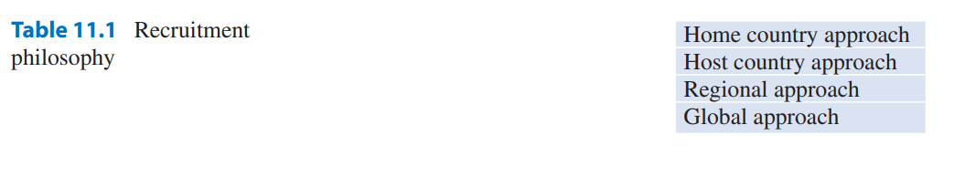

Slide 10
Host Country Approach
Managers using a host country approach believe that the management and staffing of subsidiary firms should be left to host country nationals because they think that natives will be better able to understand the requirements of the assignment. To the MNC executives, the foreign operation is a mysterious undertaking best left to foreign executives. As long as the firm remains profitable and the objectives are achieved, host country executives are allowed to operate the organization in any way they feel appropriate.

Slide 11
Regional Approach
Managers who use the regional approach believe that the global market should be handled regionally.
For example, all European markets would be coordinated through a headquarters in France, all markets in North and South America through a headquarters in the United States, and so on. Consequently, personnel selection is carried out regionally

Slide 12
Global Approach
This approach is characterized by a global systems approach to management. Managers with this perspective believe that top qualified people can come from any background and culture. They also believe that the whole world is their market.
Therefore, resource allocation, staffing, manufacturing, and marketing should be done within the framework of the global economy

Slide 13
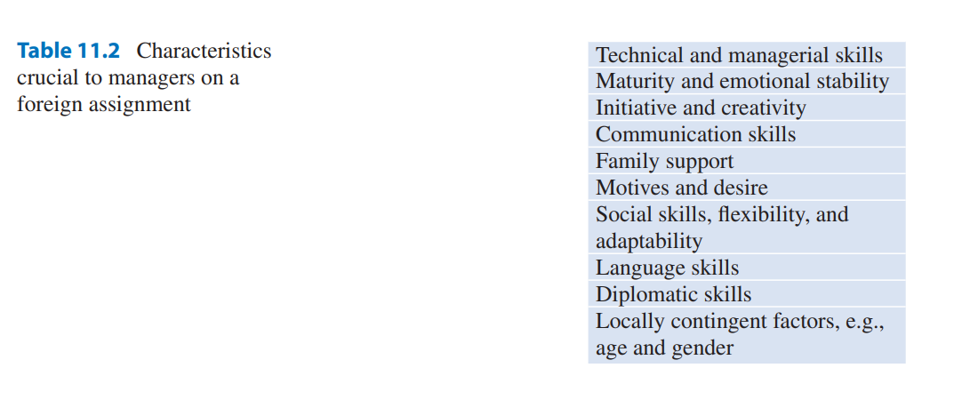
Selection Criteria
The success or failure of an operation hinges on the quality of home country managers assigned to foreign business operations. The following are characteristics crucial for any manager sent on a foreign assignment (see Table 11.2):

Slide 14
Technical and Managerial Skills
are very crucial for a manager assigned to a foreign operation. In foreign assignments, managers will need all the technical, administrative, and managerial skills that make them succeed at home. An international manager is usually expected to train local employees. Many of these employees are being introduced to a new method, a new process, or the use of new machinery. Support from other colleagues may not be readily available. Therefore, expatriate managers must be able to function with minimum or no support. Innovative ability and insight are crucial in assignments where the expatriate is the only expert in the organization.

Slide 15
Motives and Desire.
Individuals who possess a genuine interest in foreign countries, their people, and their cultures are ideal candidates for a position abroad. Those who seek the assignment solely for extra money, added prestige, or the “boost” such an assignment might give to their careers are not as likely to be successful in expatriate situations. A good indication of a manager’s interest is past experience. If a manager knows foreign languages, has taken international business courses, and has traveled extensively or lived abroad, he or she is obviously interested in foreign countries and cultures.

Slide 16
Social Skills
Probably the most important success factor for the international manager is social skills. These are not necessarily the same social skills that are successful at home. A person socially skilled in a domestic operation is a person who has learned the rules and norms for developing and maintaining relationships with people and knows the proper behavior for various circumstances. International managers must be able to understand why foreigners behave the way they do. To understand people, we have to understand their culture.

Slide 17
Diplomatic Skills
On foreign assignments, international managers interact with business associates, governmental agencies, and political leaders. In most developing countries, the government assumes a larger role in business and trade than is customary in the United States. Diplomatic skills are needed to relate to government officials properly and to conduct business transactions under unfamiliar conditions. The manager serves as an ambassador, representing the company to other businesses and to host government bureaucrats. Successful managers in global companies should have the qualities of diplomats, such as patience and sharp negotiating skills, to achieve desired, favorable terms

Slide 18
Maturity and Stability.
Venturing into a strange environment, facing unfamiliar conditions, and dealing with unexpected situations are all part of going abroad and conducting business transactions in a foreign country. Emotionally and intellectually mature persons more readily handle the burden of foreign assignments. They recognize their own assumptions, values, motives, needs, and shortcomings. Consequently, they are in a better position to understand the attitudes and behaviors of other people, appreciate cultural differences for what they are, and be able to suspend judgment when there is insufficient understanding of circumstances

Slide 19
Family Factors.
When evaluating candidates for foreign assignments, it is very important to review both the candidate and the family. The inability of spouses or children to adapt to their new surroundings is a major reason for failure in overseas transfers, including premature returns and job performance slumps. While the expatriate manager has the relative security of a familiar work and office routine, the family must cope with an unfamiliar environment every day. To prevent failures due to family difficulties, MNCs have to address family-related issues

Slide 20
Locally Contingent Attributes
For assignments to certain countries, attributes such as the candidate’s age and gender must also be considered. Older people are respected, and seniority is emphasized in many countries, such as Asia and Africa. In these cultures, young representatives may have a great deal of difficulty in gaining access to important personnel and key decision-makers. In some countries, women encounter a great deal of resistance from superiors, subordinates, colleagues, and clients. Many high-level officials refuse to work with women and do not promote them to key decision-making positions

Slide 21
Personnel Selection Options
The selection and hiring process of MNCs is a very complex and difficult task. Each foreign office has different staffing requirements and needs. There are a multitude of other factors, such as local laws and contractual obligations, that have to be considered. In addition, the MNC’s management philosophy regarding staffing plays a pivotal role in personnel selection. The prevailing managerial philosophy influences the choice among the three alternatives: expatriate, host country national, or third-country national managers

Slide 22
The Expatriate Manager. The MNC may choose expatriates to fill managerial positions in its foreign offices. The selection of expatriates for foreign assignments is influenced by the ethnocentric attitudes and philosophy of the MNC’s top executives. It may also be determined by operational needs.
For example, home country managers may have a long history of service with the parent company.

Slide 23
They possess an in-depth knowledge and understanding of the policies and procedures of the firm and are familiar with the business and industry. They may also have technical training or possess functional expertise that local managers lack. Sometimes, due to a shortage of well-trained local managers, expatriates are the only logical choice .
MNCs may also select expatriates to fill foreign positions as part of their corporate managerial training program

Slide 24
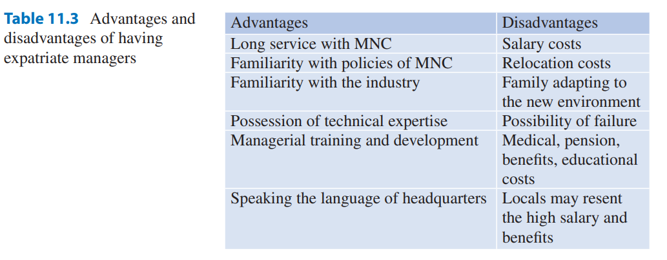

Slide 25
The Host Country National Manager. In the past, many multinational firms displayed an ethnocentric view, staffing foreign offices almost exclusively with expatriate personnel. Today, many MNCs are selecting more host country and third-country nationals to fill managerial positions in their foreign subsidiaries. This is due to the increasing costs and the high failure rate of expatriate assignments. The cost of relocation can be very high for the company and the expatriate. Host country nationals may be selected because of their knowledge and understanding of local markets, consumers, and governments. Local managers may provide the company with valuable governmental contacts

Slide 26
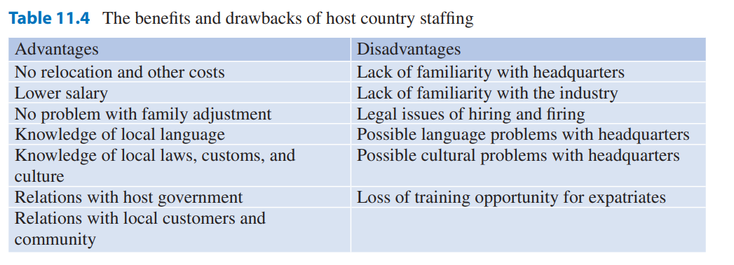

Slide 27
The Third-Country National Manager. Sometimes, local managers do not have enough managerial expertise or do not wish to work for the MNC. In those situations, third-country managers may provide a viable staffing alternative. For example, because of the political tensions in Iran during the early 1980s, American firms doing business in Iran often used British or Canadian personnel to represent their interests in Iran. Sometimes, the third-country national may simply be the best person and the right manager for the job. Third-country executives often speak several languages and know the region and its industry well. Many international hotel firms commonly employ third-country nationals

Slide 28
Host Country or Third-Country Staffing Criteria
The criteria for selecting a host country and third-country national managers are much the same as those used for selecting expatriate managers. Technical expertise, adaptability, flexibility, and communication and decision-making skills are key desirable characteristics.
Making the decision to hire a host country manager may be much easier than finding a local citizen who has the qualifications for the job and/or who is willing to take up a job with the MNC

Slide 29
Product Life Cycle and International Human Resource Management
The advent of the Internet has enabled some new ventures to directly start off as an international enterprise, but this is not very common. During its evolution, the MNC establishes its basic HRM policies and practices. These policies and practices are usually the outgrowths of the cultural environment of its diverse markets. As the MNC expands to different markets, it gains experience in dealing with different cultures. The four stages that MNCs go through are (1) high tech or product orientation, (2) growth and internationalization or market orientation, (3) multinationalization or price orientation, and (4) globalization.

Slide 30
International Product Life Cycle
In Phase 1, the product-orientation stage, firms produce new and unique products that command a high price relative to direct costs.
They depend on R&D and apply advances in science and engineering to product development. At this stage, there are only a few firms capable of producing these products

Slide 31
Phase 2 is the market-orientation stage. It begins with the entrance of competition, which forces firms to focus on expanding to new markets.
International expansion is an option they may choose. Initially, foreign markets are supplied by exports from the home country

Slide 32
Phase 3 is the price orientation stage. It marks the realization that competitive advantage can be achieved only by managing and controlling costs. Increased competition and standardization of products at the end of Phase 2 drives prices down and creates a need for further cost reduction
Phase 4, however, is the culmination of the previous three phases. It is the result of dramatic changes in market forces that are best described as a progression from one stage to another, as follows

Slide 33
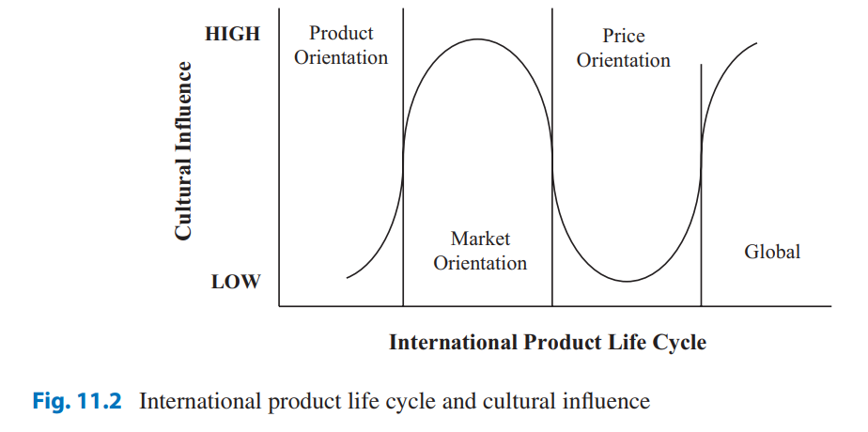

Slide 34
HRM Practices
Product lifecycle indicates the impact of culture on the firm. It can be used to suggest corresponding HRM practices for each phase. Firms operating in Phase 1, which produce unique products and sell them primarily to the home market, do not require much international sophistication from their employees. The firms’ monopoly power insulates them from the impact of cultural differences and forces the buyers of the product to absorb the cost of the cross-cultural mismatch. Foreign customers must speak the language of the MNC, accept the MNC’s cultural and managerial practices, and after the purchase, modify products and services themselves to match their needs and requirements

Slide 35
For Phase 2 firms, however, cultural adaptability and sensitivity are important, but personnel selection is still based mostly on technical competence and the willingness to accept foreign assignments. In Phase 2, firms could gain a competitive advantage by producing culturally appropriate products and services and 11 International Human Resource Management 359 tailoring their marketing programs to host countries’ cultural requirements. These firms, besides employing expatriate managers, quite often employ host nationals in some host country positions, such as marketing and personnel.

Slide 36
Survival for a Phase 3 firm in the global market depends on price competitiveness. For geographically dispersed MNCs with a worldwide network of suppliers, manufacturers, and distributors, integration becomes an important undertaking. They become integrated primarily by standardizing their products and services and centralizing their operations and structure. Phase 3 firms attempt to integrate by assuming similarity or creating it. They assume similarity by producing generic products and services to take advantage of economies of scale and scope.

Slide 37
Phase 4 MNCs produce and sell top-quality, least-cost, differentiated products for local tastes globally. The need for global integration and national responsiveness impels Phase 4 firms to select their best people for assignments scattered all over the globe. The home country market is no longer dominant and the boundaries between home country, host country, and third-country managers vanish. Internally and externally, firms are faced with cultural diversity, which they cannot ignore and have to manage. Successful Phase 4 MNCs are those that can identify situations where cultural differences could be used as an asset to serve culturally differentiated market segments worldwide

Slide 38
International Management and Intercultural Training and Preparation
The primary reason for failure is the inability of the employee or the family to adjust properly to the new environment and culture. The failure, however, begins with selecting the wrong person. Adequate screening and proper selection procedures allow MNCs to select managers with a higher probability of success. The screening process includes interviews, tests, and the use of assessment centers. While some psychological and technical skills tests are available, these tests are not widely used by MNCs. This is because, first, there are no specific criteria for overseas success and, second, psychological tests have the potential for cultural bias and have relatively low validity

Slide 39
Repatriation Problems
When expatriates return home, they face problems and cultural shock similar to what they had encountered on the assignment abroad. This is particularly true after a prolonged stay abroad. Not many expatriates are prepared to deal with reentry difficulties. Repatriation issues are quite often ignored by MNCs . It is assumed that coming back to the home country environment should be a very easy task that does not require much preparation. Contrary to this assumption, expatriates not only may find themselves feeling like foreigners in their own country, but they may also face many unpleasant surprises at work. They have to adjust and adapt to changes that have taken place during their absence

Slide 40
Compensation
compensation is a very important and complicated aspect of HRM. The complexity and importance of executive compensation increase as an organization expands beyond its home market. In formulating a compensation package, a domestic business has to deal with only one set of cultural, legal, financial, and structural considerations. In the construction of an international compensation package, these considerations are multiplied. Besides the issue of compensation for executives who serve the global operations, the compensation of local host country employees poses additional difficulties for MNCs

Slide 41
Resources:
Kamal Fatehi & Jeongho Choi
International Business Management
Succeeding in a Culturally Diverse World, Second Edition

