Slide 2
Contents
Why study Boolean Algebra?
Binary Logic and Gates
Boolean Algebra
Canonical and Standard Forms

Slide 3
Binary Logic and Logic Gates
Our objective is to learn how to design digital circuits.
These circuits use binary systems and Deals with binary variables and with operations that assume logical meaning.
Manipulation of binary information is done using circuits called logic gates.

Slide 4
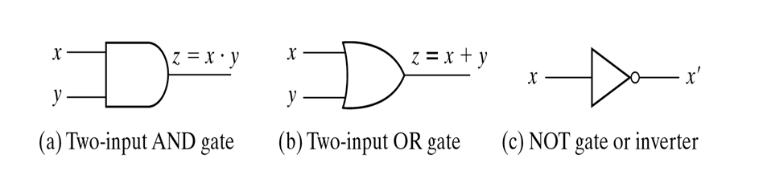
Binary Logic and Logic Gates
Logic gate is a hardware that produce signals of binary when input logic requirements are satisfied.
Basic logical operators are the logic functions AND, OR and NOT.

Slide 5
Boolean Algebra is a system of mathematics based on logic that has its own set of rules or laws which are used to:
  define Boolean expressions.
  reduce Boolean expressions.
  analyse and simplify the digital (logic) circuits.
The variables used in Boolean Algebra have only one of two possible values, a logic “0” and a logic “1”

Slide 6
Boolean Algebra is made up of
1. Elements - variables or constants with value 1 or 0.
2. Operators - AND, OR and NOT etc.
3. Axioms and Theorems - self-evident universally accepted truth.
There are three ways to represent a Boolean Expression/Function.
1. Algebraic Equation
2. Truth Table
3. Circuit Diagram

Slide 7
Boolean function: expression consists of binary variables, constants (0/1), and logic operations.
It can be equal 1 or 0.
The output of any function can be equal to 0 or 1.
Example: F = x + y' z;
Question: When F=1 and F=0?

Slide 8
It can be presented by Truth Table, where number of rows is equal to 2^{n} where n is number of valuables.
The combinations are binary numbers from 0 to 2^{n}-1.
Boolean variable: a variable x is a Boolean variable if value of x∈B
Literal: a variable in complemented or uncomplemented forms.
Truth table - a tabular listing of the values of a function for all possible combinations of values on its arguments

Slide 9
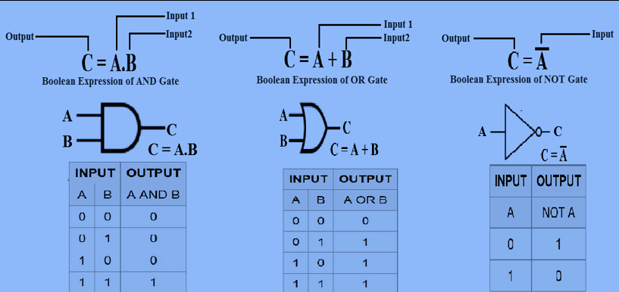
Truth Table of Basic Gates

Slide 10
  In Boolean Algebra, We are going to focus on :
  Simplification of Boolean expression
  Complementing functions
  Representing Boolean functions (Canonical and Standard Forms)
  Boolean Function Evaluation
  The operator precedence for evaluating Boolean Expression is
  Parentheses
  NOT ( Complement)
  AND
  OR

Slide 11
Expression Simplification
By manipulating a Boolean expression according to Boolean algebraic rules, it is often possible to obtain a simpler expression for the same function. This simpler expression reduces both the number of gates in the circuit and the numbers of inputs to the gates.
To see how this is done, we must first study the basic rules of Boolean algebra.

Slide 12
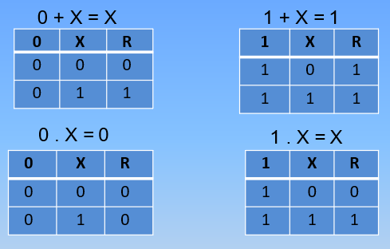
Basic identities of Boolean algebra
  T1 : Properties of 0
    (a) 0 + X = X
    (b) 0.X = 0
  T2 : Properties of 1
    (a) 1 + X = 1
    (b) 1.X = X

Slide 13
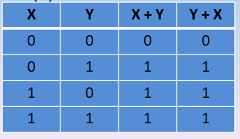
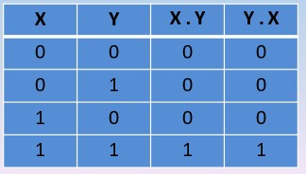
Basic identities of Boolean algebra
  T3 : Commutative Law
    (a) X + Y = Y + X
    (b) X.Y = Y.X

Slide 14
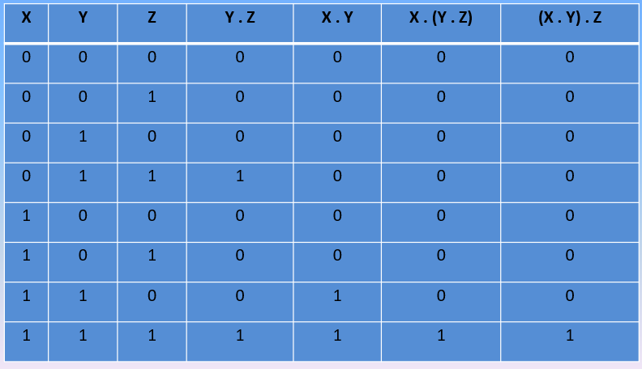
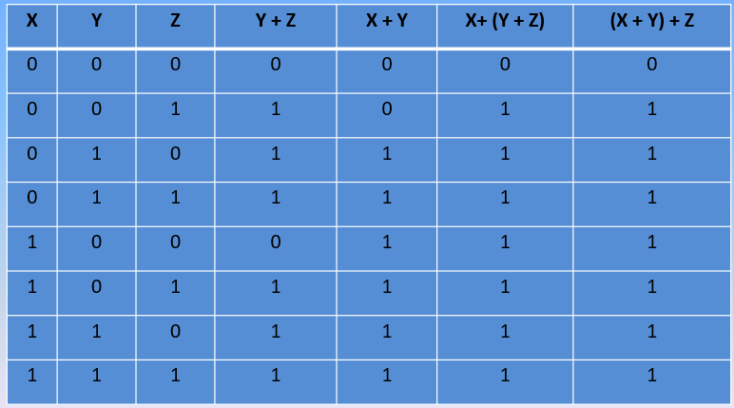
Basic identities of Boolean algebra
  T4 : Associate Law
  (a) (X + Y) + Z = X + (Y + Z) (b) (X.Y).Z = X.(Y.Z)

Slide 15
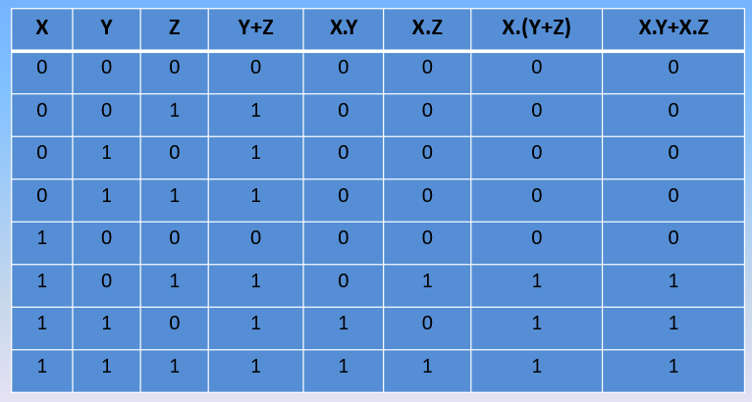
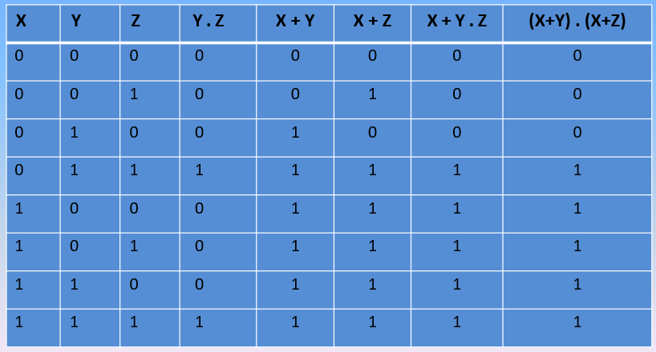
Basic identities of Boolean algebra
  T5 : Distributive Law
  (a) X (Y + Z) = X.Y + X.Z (b) X + (Y.Z) = (X + Y) (X + Z)

Slide 16
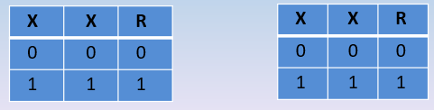
Basic identities of Boolean algebra
T6 : Indempotence Law
  (a) X + X = X (b) X.X = X

Slide 17
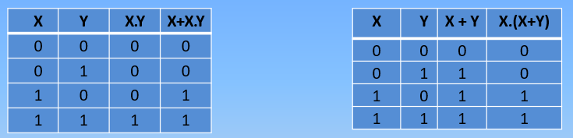
Basic identities of Boolean algebra
  T7 : Absorption (Redundance) Law
  (a) X + X.Y = X (b) X .(X + Y) = X
X +X.Y = X.(1+Y) X.(X+Y)
= X.(1) X.X + X.Y=
= X X + X.Y = X

Slide 18
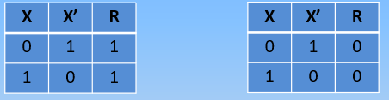
Basic identities of Boolean algebra
T8 : Complementary Law
  (a) X+X’=1 (b) X.X’=0

Slide 19
Basic identities of Boolean algebra
T9 : Involution
  (a) x’’ = x
T10 : De Morgan's Theorem
  (a) (X+Y)’=X’.Y’
  (b) (X.Y)’=X’+Y’

Slide 20
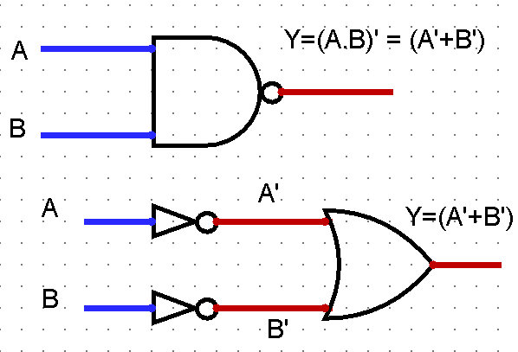
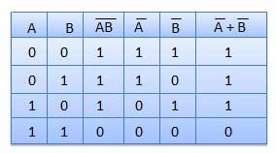
De Morgan's Theorem
  (A . B)’ = (A’ + B’)

Slide 21
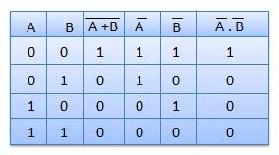
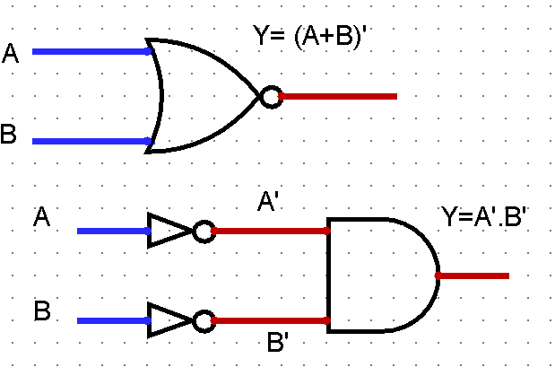
De Morgan's Theorem
  (A + B)’ = A’ . B’

Slide 22
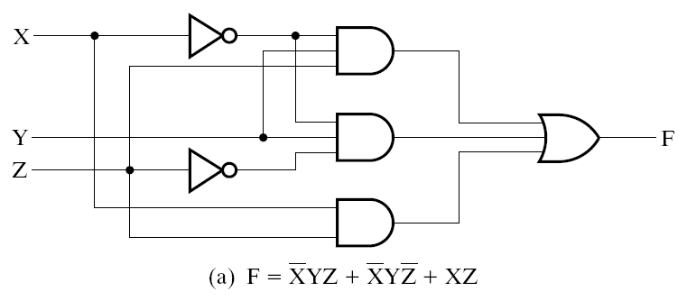
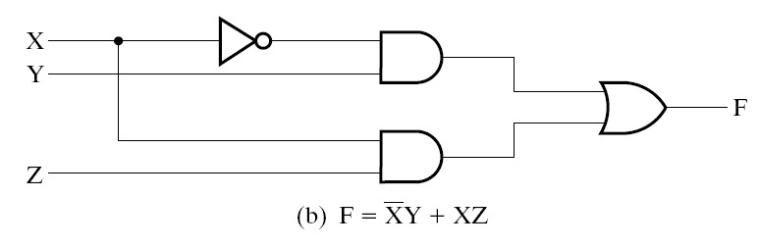
Expression Simplification
When a Boolean expression is implemented with logic gates, each term requires a gate and each variable\literals designates an input to gate.
Simplify to contain the smallest number of literals (complemented and un-complemented variables) and terms
F= X’YZ + X’YZ’ + XZ
F= X’Y(Z + Z’) + XZ
F= X’Y.1 +XZ
F= X’Y + XZ
has three terms and eight literals
has two terms and four literals
It is highly desirable to find the simplest circuit implementation with the smallest number of gates or wires.
Notes:
When a Boolean expression is implemented with logic gates, each term requires a gate and each variable designates an input to gate.

Slide 23
Example 1
For the given truth table, devise the Boolean equation.
Solution
F = X’Y’Z + XY’Z’ + XY’Z + XYZ’+ XYZ
Simplify:
F= X’Y’Z + XY’(Z’ + Z) + XY(Z’+ Z)
F= X’Y’Z + XY’+ XY
F= X’Y’Z + X(Y’+ Y)
F= X’Y’Z + X
Truth Table
X Y Z
F
0 0 0
0
0 0 1
1
0 1 0
0
0 1 1
0
1 0 0
1
1 0 1
1
1 1 0
1
1 1 1
1

Slide 24
Complementing Functions
The complement (inverse) a function F = F’ is obtained from interchanging 0’s to 1’s in the value of F in the truth table.
A Boolean equation for F’ can be derived algebraically by using DeMorgan's Theorem:
  interchange AND and OR operators
  complement each constant value and literal
  Examples:
F=x’yz’+xy’z’ F’=(x+y’+z)(x’+y+z) | G=(a’+bc)d’+e G’=(a(b’+c’)+d)e’

Slide 25
Exercises:
- Simplify the following Boolean expressions to a minimum number of literals:
a. F(x,y) = xy + xy′
    F= x ( y+y′)= x.1 = x
b. F(x,y) = (x + y)(x + y′)
    F = xx + xy′ + yx+yy′ = x + xy′ + xy + 0 = x (1+ y′ + y) = x.1= x

Slide 26
c. F(w,x,y,z) = xy + x(wz + wz′)
    F(w,x,y,z) = xy + xw(z+z′) = xy + xw = x(y+w)
d. F(A,B,C,D) = (BC′+A′D)(AB′+CD′)
        F(A,B,C,D) = AB′BC′ + AB′A′D + CD′BC′ + CD′A′D
        = 0

Slide 27
Reduce the following Boolean expressions to the indicated number of literals:
  F(x,y,z) = x'z' + xyz + xz' to three literals
F= z' (x+x’) + xyz
F= (z + z')(z' + xy)
F= xy + z'

Slide 28
  For the Boolean function
  F(x,y,z) = x'z' + xyz + xz’
  Obtain the truth table of F.
  Draw the logic diagram for the original Boolean expression.
  Use Boolean algebra to simplify the function to a minimum number of literals,
  Draw the logic diagram for the simplified Boolean expression.

Slide 29
Obtain the truth table of F.
X | Y | Z | X’ | Z’ | X’Z’ | XYZ | XZ’ | F
0 | 0 | 0 | 1 | 1 | 1 | 0 | 0 | 1
0 | 0 | 1 | 1 | 0 | 0 | 0 | 0 | 0
0 | 1 | 0 | 1 | 1 | 1 | 0 | 0 | 1
0 | 1 | 1 | 1 | 0 | 0 | 0 | 0 | 0
1 | 0 | 0 | 0 | 1 | 0 | 0 | 1 | 1
1 | 0 | 1 | 0 | 0 | 0 | 0 | 0 | 0
1 | 1 | 0 | 0 | 1 | 0 | 0 | 1 | 1
1 | 1 | 1 | 0 | 0 | 0 | 1 | 0 | 1

Slide 30
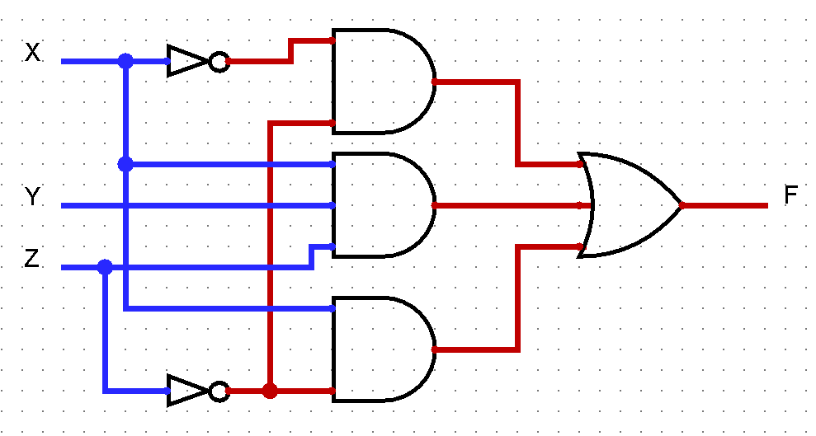
Draw the logic diagram for the original Boolean expression.
F(x,y,z) = x'z' + xyz + xz’

Slide 31
Use Boolean algebra to simplify the function to a minimum number of literals,
  F(x,y,z) = x'z' + xyz + xz'
F= z' (x+x’) + xyz
F= (z + z')(z' + xy)
F= xy + z'

Slide 32
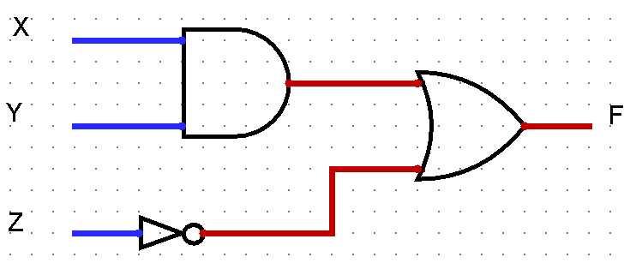
Draw the logic diagram for the simplified Boolean expression
X | Y | Z | XY | Z’ | F
0 | 0 | 0 | 0 | 1 | 1
0 | 0 | 1 | 0 | 0 | 0
0 | 1 | 0 | 0 | 1 | 1
0 | 1 | 1 | 0 | 0 | 0
1 | 0 | 0 | 0 | 1 | 1
1 | 0 | 1 | 0 | 0 | 0
1 | 1 | 0 | 1 | 1 | 1
1 | 1 | 1 | 1 | 0 | 1

Slide 33
  Reduce the following Boolean expressions to the indicated number of literals:
  F(w,x,y,z) = w'x (z' + y'z) + x(w + w'y z) to one literal
F= x(w'z' + w'y'z + w + w'yz)
F= x(w'z' + w + w'z(y + y’)
F= x(w + w'(z' + z))
F= x(w + w’)
F= x

Slide 34
  Reduce the following Boolean expressions to the indicated number of literals:
  F(w,x,y,z) = wxy’z + w’xz + wxyz to two literal
F= xz(wy' + w' + wy)
= xz(w (y +y’)+ w’ )
= xz(w + w’ )
=xz

Slide 35
End of Lecture 3

