Slide 1

Secure Operating systems
by Dr. Hesham Abou Elfetouh
Lecture 6

Slide 2

06 Introduction
In Previous Lecture you learned:
What is “Program security”
Basic approaches to having secure programs
Controls for Security
Developmental Controls for Security
Administrative Controls for Security
Operating System Controls for Security

Slide 3
Lecture
6
Lecture 6 TOPICS
This chapter covers the following topics and concepts:
User authentication
  Password authentication
  Probable Passwords
  Passwords Likely for a User
  Password Selection Criteria
  One-Time Passwords
  Salt

Slide 4
06 Lecture 6 GOALS
When you complete this chapter, you will be able to:
Know What is the “User authentication”
Explain the Password Authentication
Illustrate the Implementation of Access Control
Know the Passwords Likely for a User

Slide 5


User authentication
“The process of verifying an identity claimed by or for a system entity.”
driver's license
passports
voice recognition
fingerprint
retina matching

Slide 6
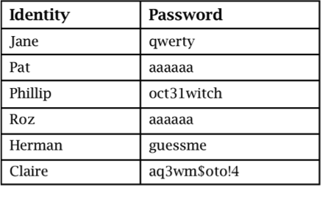
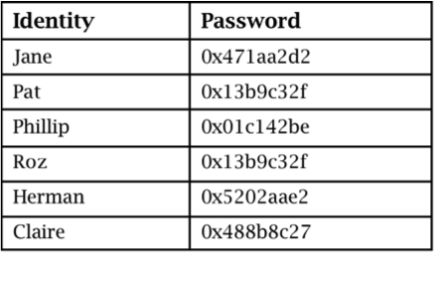
Password Storage
Plaintext
Concealed
Notes:
Passwords should never be stored in plaintext but rather should always be concealed. We talk more about proper password storage later.

Slide 7
Password Authentication
The most common authentication mechanism for user to operating system is a password.
A "word" known to computer and user.
widely used line of defense against intruders
  user provides name/login and password to the security system (identification step)
  system compares password with the one stored for that specified login (verification step)
the user ID:
  determines that the user is authorized to access the system
  determines the user’s privileges
  is used in access control
Notes:
A widely used line of defense against intruders is the password system. Virtually all multiuser systems, network-based servers, Web-based e-commerce sites, and other
similar services require that a user provide not only a name or identifier (ID) but also a password. The system compares the password to a previously stored password
for that user ID, maintained in a system password file. The password serves to authenticate the ID of the individual logging on to the system. In turn, the ID
provides security in the following ways:
• The ID determines whether the user is authorized to gain access to a system.
In some systems, only those who already have an ID filed on the system are allowed to gain access.
• The ID determines the privileges accorded to the user. A few users may have supervisory or “superuser” status that enables them to read files and perform
functions that are especially protected by the operating system. Some systems have guest or anonymous accounts, and users of these accounts have more
limited privileges than others.
The ID is used in what is referred to as discretionary access control. For example, by listing the IDs of the other users, a user may grant permission to them
to read files owned by that user. An authentication process consists of two steps:
Identification step: Presenting an identifier to the security system. (Identifiers
should be assigned carefully, because authenticated identities are the basis for other security services, such as access control service.)
Verification step: Presenting or generating authentication information that
corroborates the binding between the entity and the identifier.
For example, user Alice Toklas could have the user identifier ABTOKLAS. This information needs to be stored on any server or computer system that Alice wishes
to use and could be known to system administrators and other users. A typical item of authentication information associated with this user ID is a password, which is
kept secret (known only to Alice and to the system)2. If no one is able to obtain or guess Alice’s password, then the combination of Alice’s user ID and password enables
administrators to set up Alice’s access permissions and audit her activity. Because Alice’s ID is not secret, system users can send her e-mail, but because her password is
secret, no one can pretend to be Alice.
In essence, identification is the means by which a user provides a claimed identity to the system; user authentication is the means of establishing the validity of the claim.
Note that user authentication is distinct from message authentication. As defined in Chapter 2, message authentication is a procedure that allows communicating parties
to verify that the contents of a received message have not been altered and that the source is authentic. This chapter is concerned solely with user authentication.

Slide 8
Authentication Methods
the four means of authenticating user identity are based on:
something the individual knows
  password, PIN, answers to prearranged questions
something the individual possesses (token)
  smartcard, electronic keycard, physical key
something the individual is (static biometrics)
  fingerprint, retina, face
something the individual does (dynamic biometrics)
  voice pattern, handwriting, typing rhythm
Notes:
There are four general means of authenticating a user's identity, which can be used alone or in combination:
• Something the individual knows: Examples includes a password, a personal identification number (PIN), or answers to a prearranged set of questions.
• Something the individual possesses: Examples include electronic keycards, smart cards, and physical keys. This type of authenticator is referred to as a token.
• Something the individual is (static biometrics): Examples include recognition by fingerprint, retina, and face.
• Something the individual does (dynamic biometrics): Examples include recognition by voice pattern, handwriting characteristics, and typing rhythm.
All of these methods, properly implemented and used, can provide secure user authentication. However, each method has problems. An adversary may be able to guess or steal a password. Similarly, an adversary may be able to forge or steal a token. A user may forget a password or lose a token. Further, there is a significant administrative overhead for managing password and token information on systems and securing such information on systems. With respect to biometric authenticators, there are a variety of problems, including dealing with false positives and false negatives, user acceptance, cost, and convenience.

Slide 9
Authentication mechanisms
Two or more forms can be combined for more solid authentication.
a bank card and a PIN combine something the user has with something the user knows.

Slide 10
Why Passwords?
Why is “something you know” more popular than “something you have” and “something you are”?
Cost: passwords are free
Convenience: easier for System Administrator to reset password than to issue user a new thumb

Slide 11
Basic password scheme
User
Password file
kiwifruit
exrygbzyf
kgnosfix
ggjoklbsz
…
…
hash function

Slide 12
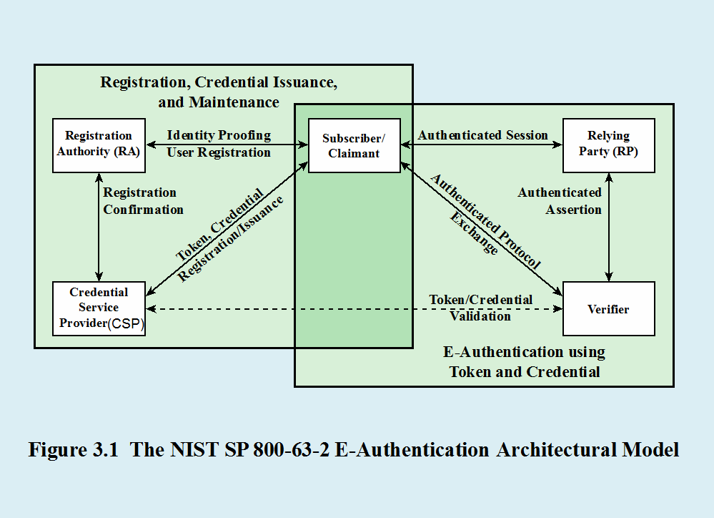
Authentication model
Notes:
SP 800-63-2 defines a general model for user authentication that involves a number of entities and procedures. We discuss this model with reference to Figure 3.1.
The initial requirement for performing user authentication is that the user must be registered with the system. The following is a typical sequence for registration.
(1) An applicant applies to a registration authority (RA) to become a subscriber of a credential service provider (CSP) . In this model, the RA is a trusted entity that establishes
and vouches for the identity of an applicant to a CSP. The CSP then engages in an exchange with the subscriber. Depending on the details of the overall authentication
system, (2) the CSP issues some sort of electronic credential to the subscriber. The credential is a data structure that authoritatively binds an identity and additional
attributes to a token possessed by a subscriber, and can be verified when presented to the verifier in an authentication transaction. The token could be an encryption
key or an encrypted password that identifies the subscriber. The token may be issued by the CSP, generated directly by the subscriber, or provided by a third party. The
token and credential may be used in subsequent authentication events.
Once a user is registered as a subscriber, the actual authentication process can take place between the subscriber and one or more systems that perform authentication
and, subsequently, authorization. The party to be authenticated is called a claimant and the party verifying that identity is called a verifier . When a claimant
successfully demonstrates possession and control of a token to a verifier through an authentication protocol, the verifier can verify that the claimant is the subscriber
named in the corresponding credential. (3) The verifier passes on an assertion about the identity of the subscriber to the relying party (RP) . That assertion includes identity
information about a subscriber, such as the subscriber name, an identifier assigned at registration, or other subscriber attributes that were verified in the registration
process. The RP can use the authenticated information provided by the verifier to make access control or authorization decisions.
An implemented system for authentication will differ from or be more complex than this simplified model, but the model illustrates the key roles and functions
needed for a secure authentication system.

Slide 13
Basic password scheme
Hash function h : strings → strings
  Given h(password), hard to find password
  No known algorithm better than trial and error
User password stored as h(password)
When user enters password
  System computes h(password)
  Compares with entry in password file
No passwords stored on disk

Slide 14
Passwords difficulties
Loss
  if the user loses the password, a new one must be assigned.
Use
  Supplying a password for each access to a file can be inconvenient and time consuming.
Disclosure
  If a password is disclosed to an unauthorized individual, the file becomes immediately accessible.
  If the user changes the password, all the other users must be informed of the new password because their old password will fail.
Revocation
  To revoke one user's access right to a file, someone must change the password, thereby causing the same problems as disclosure.

Slide 15
Password Vulnerabilities
offline dictionary attack
popular password attack
workstation hijacking
exploiting multiple password use
specific account attack
password guessing against single user
exploiting user mistakes
electronic monitoring
Notes:
In this subsection, we outline the main forms of attack against password-based authentication and briefly outline a countermeasure strategy. The remainder of
Section 3.2 goes into more detail on the key countermeasures.
We can identify the following attack strategies:
• Offline dictionary attack: Typically, strong access controls are used to protect
the system’s password file. However, experience shows that determined hackers can frequently bypass such controls and gain access to the file. The
attacker obtains the system password file and compares the password hashes against hashes of commonly used passwords. If a match is found, the attacker
can gain access by that ID/password combination.
• Specific account attack: The attacker targets a specific account and submits
password guesses until the correct password is discovered.
• Popular password attack: A variation of the preceding attack is to use a popular
password and try it against a wide range of user IDs. A user’s tendency is to choose a password that is easily remembered; this unfortunately makes
the password easy to guess.
• Password guessing against single user: The attacker attempts to gain knowledge
about the account holder and system password policies and uses that knowledge to guess the password.
• Workstation hijacking; The attacker waits until a logged-in workstation is
unattended.
• Exploiting user mistakes: If the system assigns a password, then the user is
more likely to write it down because it is difficult to remember. This situation creates the potential for an adversary to read the written password. A user
may intentionally share a password, to enable a colleague to share files, for example. Also, attackers are frequently successful in obtaining passwords by
using social engineering tactics that trick the user or an account manager into revealing a password. Many computer systems are shipped with preconfigured
passwords for system administrators. Unless these preconfigured passwords are changed, they are easily guessed.
• Exploiting multiple password use. Attacks can also become much more
effective or damaging if different network devices share the same or a similar password for a given user.
• Electronic monitoring: If a password is communicated across a network to
log on to a remote system, it is vulnerable to eavesdropping. Simple encryption will not fix this problem, because the encrypted password is, in effect, the
password and can be observed and reused by an adversary

Slide 16
Countermeasures
controls to prevent unauthorized access to password file
intrusion detection measures
rapid re-issuance of compromised passwords
account lockout mechanisms
policies to inhibit users from selecting common passwords
training in and enforcement of password policies
automatic workstation logout
policies against similar passwords on network devices
Notes:
Typically, a system that uses password-based authentication maintains a password file indexed by user ID. One technique that is typically used is to store not the user’s
password but a one-way hash function of the password, as described subsequently.
• Offline dictionary attack: Countermeasures include controls to prevent unauthorized access to the password file, intrusion detection
measures to identify a compromise, and rapid reissuance of passwords should the password file be compromised.
• Specific account attack: The standard countermeasure is an account lockout mechanism, which locks out access to the
account after a number of failed login attempts. Typical practice is no more than five access attempts.
• Popular password attack: Countermeasures include policies to inhibit the selection by users of common passwords and scanning the IP addresses of
authentication requests and client cookies for submission patterns.
• Password guessing against single user: Countermeasures include training in and enforcement of password policies that make passwords difficult to guess.
Such policies address the secrecy, minimum length of the password, character set, prohibition against using well-known user identifiers, and length of time
before the password must be changed.
• Workstation hijacking; The standard countermeasure is automatically logging the workstation out after a period of inactivity. Intrusion detection schemes can be
used to detect changes in user behavior.
• Exploiting user mistakes: Countermeasures include user training, intrusion detection, and simpler passwords combined with another authentication mechanism.
• Exploiting multiple password use. Countermeasures include a policy that forbids the same or similar password on particular network devices.
• Electronic monitoring: If a password is communicated across a network to
log on to a remote system, it is vulnerable to eavesdropping. Simple encryption will not fix this problem, because the encrypted password is, in effect, the
password and can be observed and reused by an adversary

Slide 17
Additional Authentication Information
Limiting users to certain workstations or certain times of access.
Using additional authentication information is called multifactor authentication
Two forms of authentication (which is, not surprisingly, known as two-factor authentication) are better than one,

Slide 18
Risk Assessment for User Authentication
Assurance Level
Potential impact
Areas of risk
There are three separate concepts:
Notes:
Security risk assessment in general is dealt with in Chapter 14. Here, we introduce a specific example as it relates to user authentication. There are three separate
concepts we wish to relate to one another: assurance level, potential impact, and areas of risk.

Slide 19
Assurance Level
Describes an organization’s degree of certainty that a user has presented a credential that refers to his or her identity
More specifically is defined as:
Four levels of assurance
The degree of confidence in the vetting process used to establish the identity of the individual to whom the credential was issued
Level 1
  Little or no confidence in the asserted identity's validity
Level 2
  Some confidence in the asserted identity’s validity
The degree of confidence that the individual who uses the credential is the individual to whom the credential was issued
Level 3
  High confidence in the asserted identity's validity
Level 4
  Very high confidence in the asserted identity’s validity
Notes:
An assurance level describes an organization’s degree of certainty that a user has presented a credential that refers to his or her identity.
More specifically, assurance is defined as (1) the degree of confidence in the vetting process used to establish the identity of the individual to whom the credential was
issued and (2) the degree of confidence that the individual who uses the credential is the individual to whom the credential was issued. SP 800-63-2 recognizes four levels of assurance:
• Level 1: Little or no confidence in the asserted identity’s validity. An example of where this level is appropriate is a consumer registering to participate in
a discussion at a company web site discussion board. Typical authentication technique at this level would be a user-supplied ID and password at the time of the transaction.
• Level 2: Some confidence in the asserted identity’s validity. Level 2 credentials are appropriate for a wide range of business with the public where organizations
require an initial identity assertion (the details of which are verified independently prior to any action). At this level, some sort of secure authentication
protocol needs to be used, together with one of the means of authentication summarized previously and discussed in subsequent sections.
• Level 3: High confidence in the asserted identity’s validity. This level is appropriate to enable clients or employees to access restricted services of high value
but not the highest value. An example for which this level is appropriate:
A patent attorney electronically submits confidential patent information to the U.S. Patent and Trademark Office. Improper disclosure would give competitors
a competitive advantage. Techniques that would need to be used at this level require more than one factor of authentication; that is, at least two
independent authentication techniques must be used.
• Level 4: Very high confidence in the asserted identity’s validity. This level is appropriate to enable clients or employees to access restricted services of very
high value or for which improper access is very harmful. For example, a law enforcement official accesses a law enforcement database containing criminal
records. Unauthorized access could raise privacy issues and/or compromise investigations. Typically, level 4 authentication requires the use of multiple
factors as well as in-person registration.

Slide 20
Potential Impact
There are three levels of potential impact on organizations or individuals should there be a breach ( failure) of security:
  Low
    An authentication error could be expected to have a limited adverse effect on organizational operations, organizational assets, or individuals
  Moderate
    An authentication error could be expected to have a serious adverse effect
  High
    An authentication error could be expected to have a severe or catastrophic adverse effect
Notes:
A concept closely related to that of assurance level is potential impact. FIPS 199 (Standards for Security Categorization of Federal Information and
Information Systems , 2004) defines three levels of potential impact on organizations or individuals should there be a breach of security (in our context, a failure in user authentication):
• Low: An authentication error could be expected to have a limited adverse effect on organizational operations, organizational assets, or individuals. More
specifically, we can say that the error might: (1) cause a degradation in mission capability to an extent and duration that the organization is able to perform its
primary functions, but the effectiveness of the functions is noticeably reduced; (2) result in minor damage to organizational assets; (3) result in minor financial
loss to the organization or individuals; or (4) result in minor harm to individuals.
• Moderate: An authentication error could be expected to have a serious adverse effect. More specifically, the error might: (1) cause a significant degradation
in mission capability to an extent and duration that the organization is able to perform its primary functions, but the effectiveness of the functions is
significantly reduced; (2) result in significant damage to organizational assets; (3) result in significant financial loss; or (4) result in significant harm to individuals
that does not involve loss of life or serious life threatening injuries.
• High: An authentication error could be expected to have a severe or catastrophic adverse effect. The error might: (1) cause a severe degradation in or
loss of mission capability to an extent and duration that the organization is not able to perform one or more of its primary functions; (2) result in major damage
to organizational assets; (3) result in major financial loss to the organization or individuals; or (4) result in severe or catastrophic harm to individuals
involving loss of life or serious life threatening injuries.

Slide 21
Access Control
Two parts to access control
Authentication: Are you who you say you are?
  Determine whether access is allowed
  Authenticate human to machine
  Or authenticate machine to machine
Authorization: Are you allowed to do that?
  Once you have access, what can you do?
  Enforces limits on actions
Note: “access control” often used as a synonym for authorization

Slide 22
Federated Identity Management
Notes:
A federated identity management scheme is a union of separate identification and authentication systems. Authentication is performed in one place, and separate processes and systems determine that an already authenticated user is to be activated. Federated identity management is discussed in much greater detail in Chapter 8.

Slide 23
Single Sign-On
Notes:
Single sign-on lets a user log on once per session but access many different applications/systems. It often works in conjunction with federated identity management, with the federated identity provider acting as the source of authentication for all the applications.

Slide 24
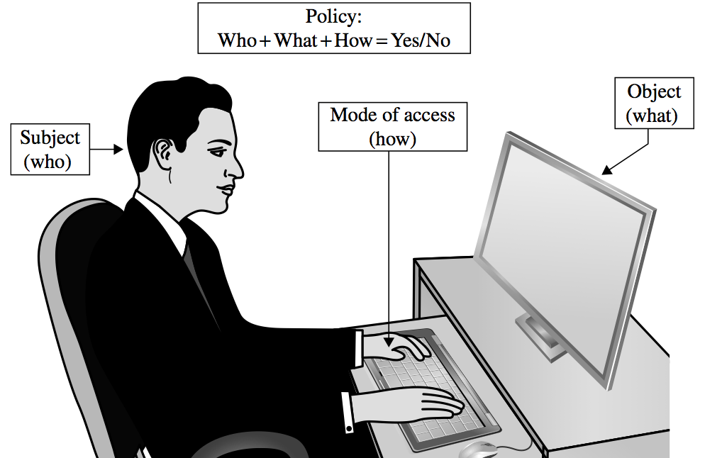
Access Control

Slide 25
Access Policies
Goals:
  Check every access
  Enforce the least privilege
  Verify acceptable usage

Slide 26
Implementing Access Control
Reference monitor
Access control directory
Access control matrix
Access control list
Privilege list
Capability
Procedure-oriented access control
Role-based access control
Notes:
Many of these items are shown in more detail in the following slides. Access control directories, matrixes, and lists are shown in self-explanatory visual representations.

Slide 27
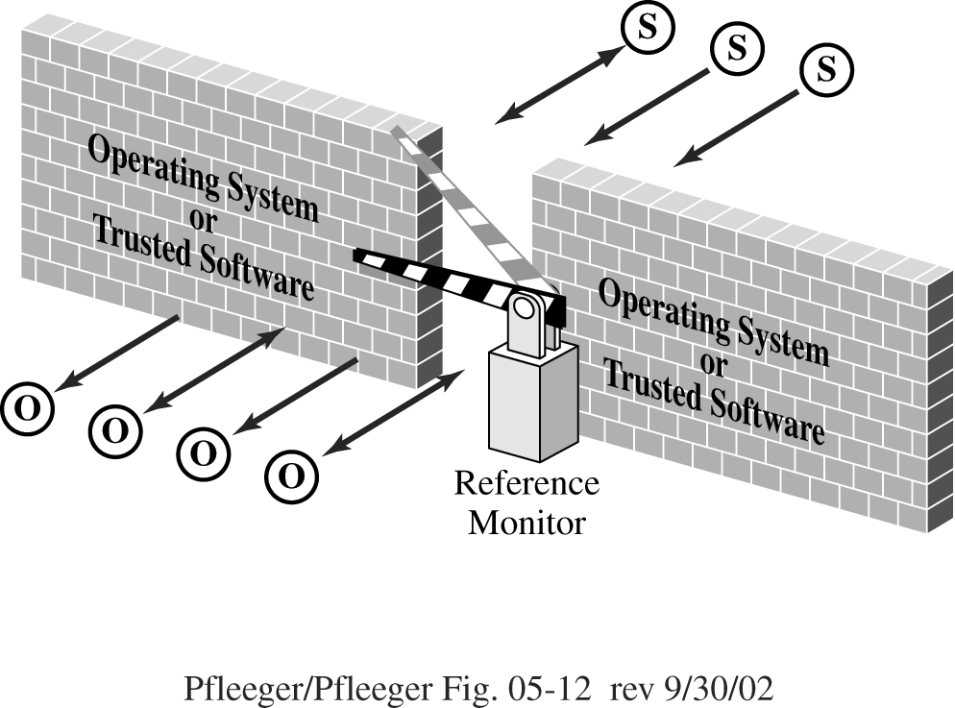
Reference Monitor
Notes:
A reference monitor is the primary access control enforcement mechanism of the operating system. It is discussed in more detail in Chapter 5.

Slide 28
Access Control Directory

Slide 29
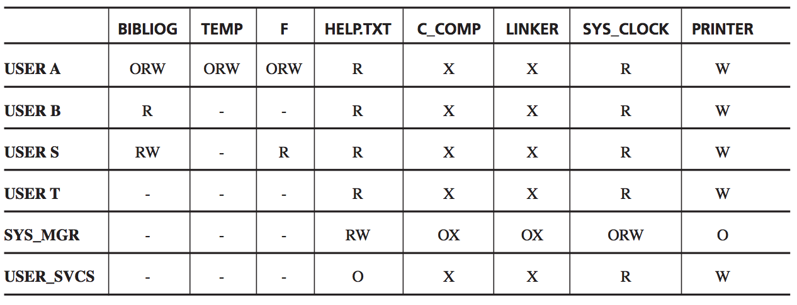
Access Control Matrix

Slide 30
Access Control List

Slide 31
Probable Passwords
Think of a word

Slide 32
Probable Passwords (count)
  Is the word you thought of long?
  Is it uncommon?
  Is it hard to spell or pronounce?
The answer to all three of these questions is probably no.

Slide 33
Probable Passwords (count)
If people prefer short passwords to long ones, the penetrator will plan to try all passwords but to try them in order by length.
There are only 26¹ + 26² + 26³=18,278 passwords of length 3 or less.
At the assumed rate of one password per millisecond, all of these passwords can be checked in 18.278 seconds,

Slide 34
Probable Passwords (count)
the trials to 4 or 5 characters raise the count only to 475 seconds (about 8 minutes) or 12,356 seconds (about 3.5 hours), respectively.
People tend to choose names or words they can remember
Many computing systems have spelling checkers that can be used to check for spelling errors and typographic mistakes in documents.
Trying all of these words as passwords takes only 80 seconds.

Slide 35
Passwords Likely for a User
People typically choose personal passwords, such as the name of a spouse, a child, a brother or sister, a pet, a street name, or something memorable or familiar.
If we restrict our password attempts to just names of people (first names), streets, projects, and so forth, we generate a list of only a few hundred possibilities at most.

Slide 36
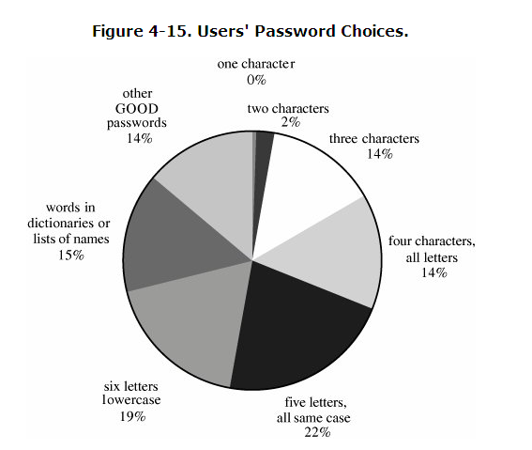
Passwords Likely for a User (count)

Slide 37
Passwords Likely for a User (count)
The British online bank found users still choosing weak passwords :
  A full 50 percent of passwords for their online banking service were family members' names
  23 percent children's names
  19 percent a spouse or partner
  9 percent their own

Slide 38
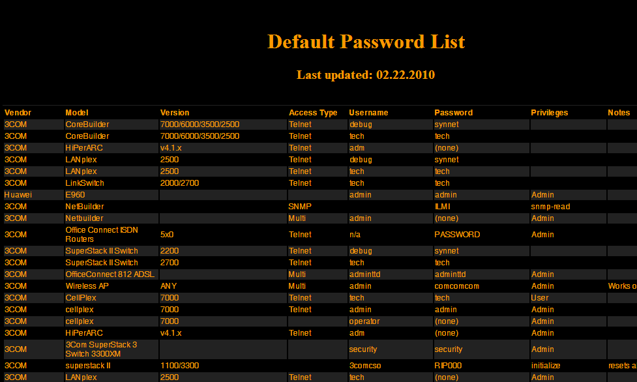
www.phenoelit.de/dpl/dpl.html

Slide 39
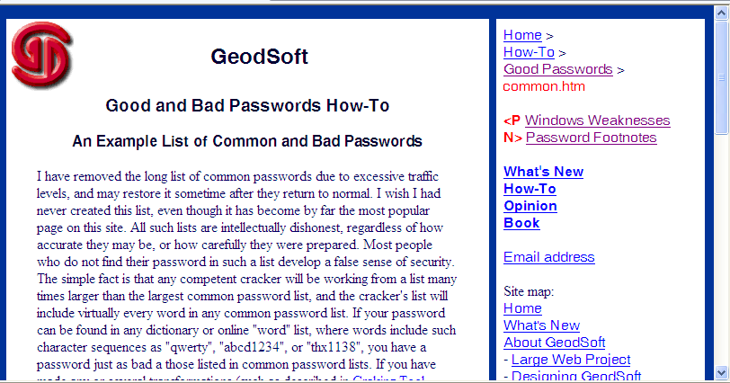
geodsoft.com/howto/password/common.htm

Slide 40
Passwords Likely for a User (count)
Several network sites post dictionaries of phrases, science fiction characters, places, mythological names, Chinese words, and other specialized lists.
All these lists are posted to help site administrators identify users who have chosen weak passwords.
but the same dictionaries can also be used by attackers of sites

Slide 41
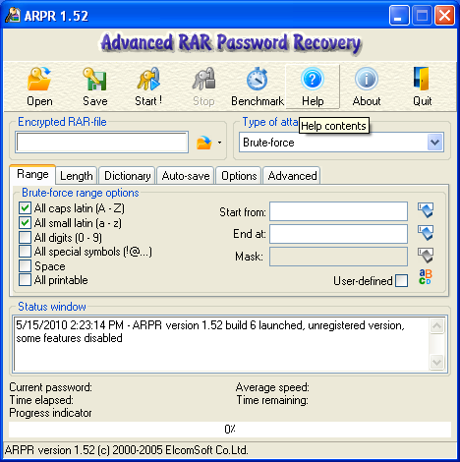
Passwords Likely for a User (count)
Now Internet sites offer so-called password recovery software as freeware or shareware.

Slide 42
Summary
0 6
In this lecture we talked about :
User authentication and its definition and we know that it is the process of verifying an identity claimed by or for a system entity.
The most common authentication mechanism for user to operating system is a password.
We discussed the access control
We discussed the Probable Passwords and the Passwords Likely for a User

