Slide 1

Business Mathematics
Prepared by Dr. Faisal Hasan
Lecture NO 4
MTH 112
Business Mathematics

Slide 2
Business Mathematics
Prepared by Dr. Faisal Hasan
Lecture NO 4
MTH 112
Business Mathematics

Slide 3
Business Mathematics
Prepared by Dr. Faisal Hasan
Lecture NO 4
MTH 112
Business Mathematics

Slide 4

Topics
Chapter 1: Mathematical preliminaries
Chapter 2: The straight line and applications
Chapter 3: Functions and Graphs
Chapter 4: Limits and Continuity
Chapter 5: Financial Mathematics
Chapter 6: Differentiation
Chapter 7: Methods of Differentiation
Chapter 8: Function of several variables
Chapter 9: Integration and applications
Chapter 10: Linear algebra and applications

Slide 5
Chapter
04
Objectives
1: The Concept of Limits
2: Computation of Limits
3: Methods of Limits
4: Continuity

Slide 6
Chapter
04
The Concept of Limits
When the values successively attributed to a variable approach indefinitely to a fixed value, in a manner so as to end by differing from it as little as one wishes, this last is called the limit of all the others.

Slide 7
Chapter
04
The Concept of Limits
Positive value

Slide 8
Chapter
04
The Concept of Limits
Negative value

Slide 9
Chapter
04
The Concept of Limits
Zero

Slide 10
Chapter
04
The Concept of Limits
Divided any number by infinity , we will obtain Zero
Divided any number by Zero 0 , we will obtain infinity

Slide 11
Chapter
04
The Concept of Limits
Infinity

Slide 12
Chapter
04
The Concept of Limits
Zero

Slide 13
Chapter
04
The Concept of Limits

Slide 14
Chapter
04
The Concept of Limits
If the first substitution give Undefined Value
We Should solve the Limits

Slide 15
Chapter
04
The Concept of Limits
To get the limit of function as approach to 2

Slide 16
Chapter
04
The Concept of Limits
1.9 | 3.9
1.99 | 3.99
1.999 | 3.999
1.9999 | 3.9999
1.99999 | 3.99999
2.1 | 4.1
2.01 | 4.01
2.001 | 4.001
2.0001 | 4.0001
2.00001 | 4.00001

Slide 17
Chapter
04
The Concept of Limits
We can say that

Slide 18
Chapter
04
The Concept of Limits
Factorization

Slide 19
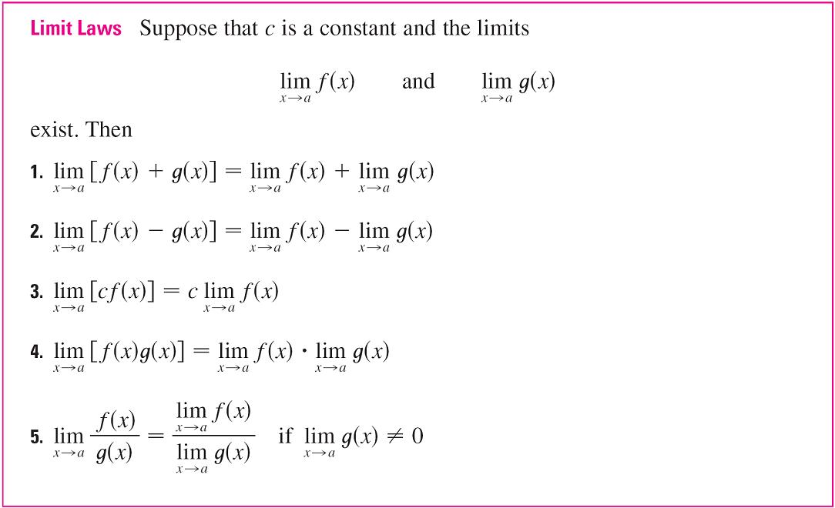
Chapter
04
Computation of Limits

Slide 20
Chapter
04
Computation of Limits
These five laws can be stated verbally as follows:
Sum Law 1. The limit of a sum is the sum of the limits.
Difference Law 2. The limit of a difference is the difference of the limits.

Slide 21
Chapter
04
Computation of Limits
Constant Multiple Law 3. The limit of a constant times a function is the constant times the
limit of the function.
Product Law 4. The limit of a product is the product of the limits.
Quotient Law 5. The limit of a quotient is the quotient of the limits (provided that the limit of
the denominator is not 0).

Slide 22
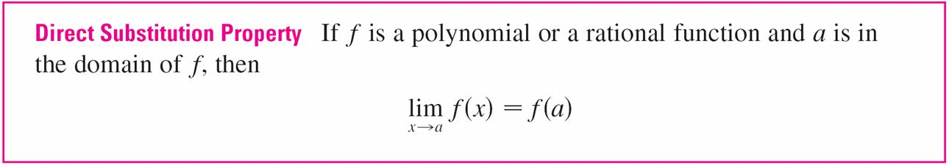
Chapter
04
Computation of Limits
In general, we have the following useful fact.

Slide 23
Chapter
04
The Concept of Limits

Slide 24
Chapter
04
The Concept of Limits

Slide 25
Chapter
04
The Concept of Limits
Factorization

Slide 26
Chapter
04
The Concept of Limits

Slide 27
Chapter
04
The Concept of Limits

Slide 28
Chapter
04
The Concept of Limits
Given that function
Find

Slide 29
Chapter
04
The Concept of Limits
One-Sided Limits

Slide 30
Chapter
04
The Concept of Limits
If we have
The limit is exist and we can say

Slide 31
Chapter
04
The Concept of Limits
If we have
The limit is not exist and we can say

Slide 32
Chapter
04
The Concept of Limits
One-Sided Limits

Slide 33
Chapter
04
The Concept of Limits
we have
The limit is exist and we can say

Slide 34
Chapter
04
The Concept of Limits
Given that function
Find

Slide 35
Chapter
04
The Concept of Limits
0 > -1

Slide 36
Chapter
04
The Concept of Limits
- 4 < -1

Slide 37
Chapter
04
The Concept of Limits
Given that function

Slide 38
Chapter
04
The Concept of Limits
One-Sided Limits

Slide 39
Chapter
04
The Concept of Limits
Given that function
Find

Slide 40
Chapter
04
The Concept of Limits
0 < 3

Slide 41
Chapter
04
The Concept of Limits
5 > 3

Slide 42
Chapter
04
The Concept of Limits
Given that function

Slide 43
Chapter
04
The Concept of Limits
One-Sided Limits

Slide 44
Chapter
04
Continuity
Continuous functions are predictable…
No breaks in the graph
A limit must exist at every x-value or the graph will break.

Slide 45
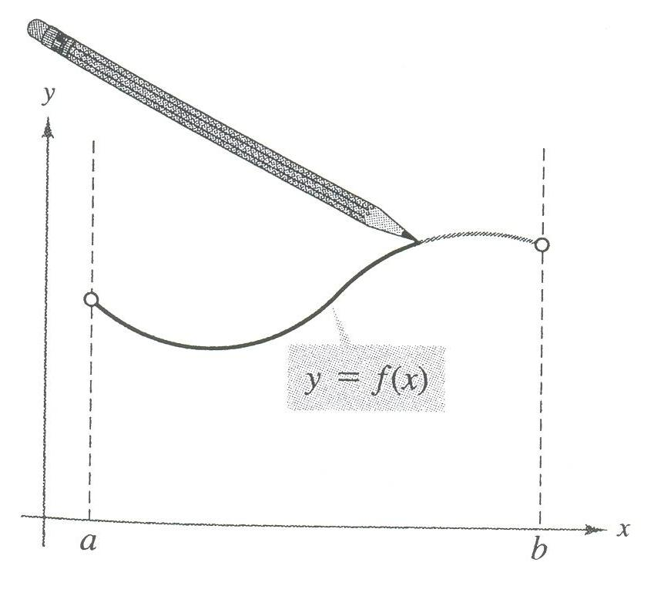
Chapter
04
Continuity
Key Point:
Continuous functions can be drawn with a single, unbroken pencil stroke.

Slide 46
Chapter
04
Continuity
Mathematically speaking…
If f (x) is continuous, then for every x = c in the function,
In other words, if you can evaluate any limit on the function using only the substitution method, then the function is continuous.

Slide 47
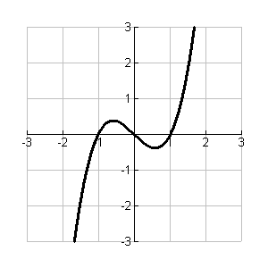
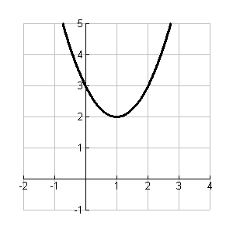
Chapter
04
Continuity
Both functions are continuous on .

Slide 48
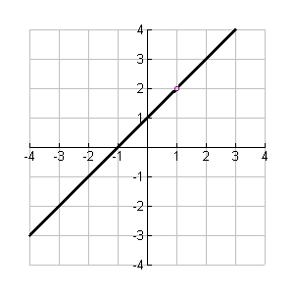
Chapter
04
Continuity
continuous on:
We can say that it continuous on R except {1}

Slide 49
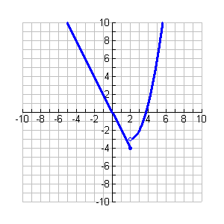
Chapter
04
Continuity
Continuous on R except 2
Function is discontinuous at 2

Slide 50
Chapter
04
Continuity
Discuss the continuity of function at x =3

Slide 51
Chapter
04
Continuity

Slide 52
Chapter
04
Continuity

Slide 53
Chapter
04
The Concept of Limits
One-Sided Limits

Slide 54
Chapter
04
Continuity
We can say that it continuous at

Slide 55
Chapter
04
The Concept of Limits
Discuss the continuity of function at x = -1

Slide 56
Chapter
04
Continuity

Slide 57
Chapter
04
The Concept of Limits

Slide 58
Chapter
04
The Concept of Limits
One-Sided Limits

Slide 59
Chapter
04
Continuity
We can say that it discontinuous at

Slide 60
Chapter
04
The Concept of Limits
Discuss the continuity of function at x = 2

Slide 61
Chapter
04
Continuity

Slide 62
Chapter
04
Continuity

Slide 63
Chapter
04
The Concept of Limits
One-Sided Limits

Slide 64
Chapter
04
Continuity
We can say that it continuous at

Slide 65
Chapter
04
The Concept of Limits
Discuss the continuity of function at x = 2

Slide 66
Chapter
04
Continuity

Slide 67
Chapter
04
Continuity

Slide 68
Chapter
04
The Concept of Limits
One-Sided Limits

Slide 69
Chapter
04
Continuity
We can say that it discontinuous at

Slide 70
Chapter
04
Un Solved Examples
Find the value of

Slide 71
Chapter
04
Un Solved Examples
Find the value of

Slide 72
Chapter
04
Un Solved Examples
Find the value of

Slide 73
Chapter
04
Un Solved Examples
Find the value of

Slide 74
Chapter
04
Un Solved Examples
Given that
Find the value of

Slide 75
Chapter
04
Un Solved Examples
Given that
Find the value of

Slide 76
Chapter
04
Un Solved Examples
Given that
Find the value of

Slide 77
Chapter
04
Un Solved Examples
Given that
Find the value of

Slide 78
Chapter
04
Un Solved Examples
Given that
Find the value of

Slide 79
Chapter
04
Un Solved Examples
Given that
Find the value of

Slide 80
Chapter
04
Un Solved Examples
Given that
Find the value of

Slide 81
Chapter
04
Un Solved Examples
Given that
Discuss the continuity of function

Slide 82
Chapter
04
Un Solved Examples
Given that
Discuss the continuity of function

Slide 83
Chapter
04
Un Solved Examples
Given that
Is the function continuous at

