Slide 1

Mathematics
Prepared by Dr. Israa Lewaa
Lecture 4
MAT 122
Operations for Matrices

Slide 2

Lecture
02
Lecture Outline
Matrix Addition
Matrix Subtraction
Matrix Multiplication
Practice

Slide 3
Lecture
04
Matrix Addition
Sum A + B is the m × n matrix obtained by adding corresponding entries of A and B.

Slide 4
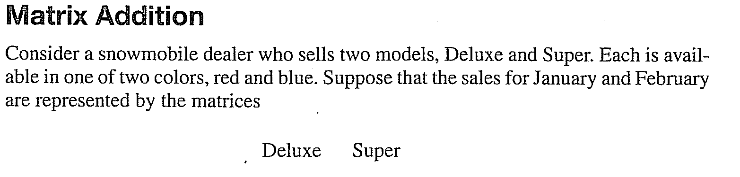
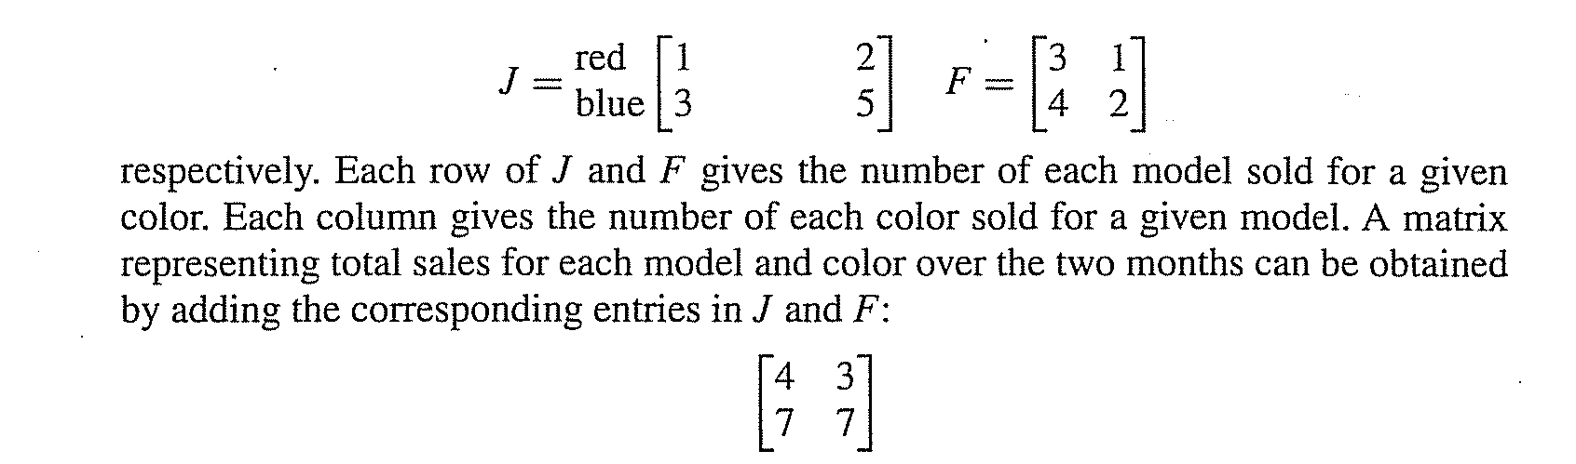
Lecture
04
Matrix Addition

Slide 5
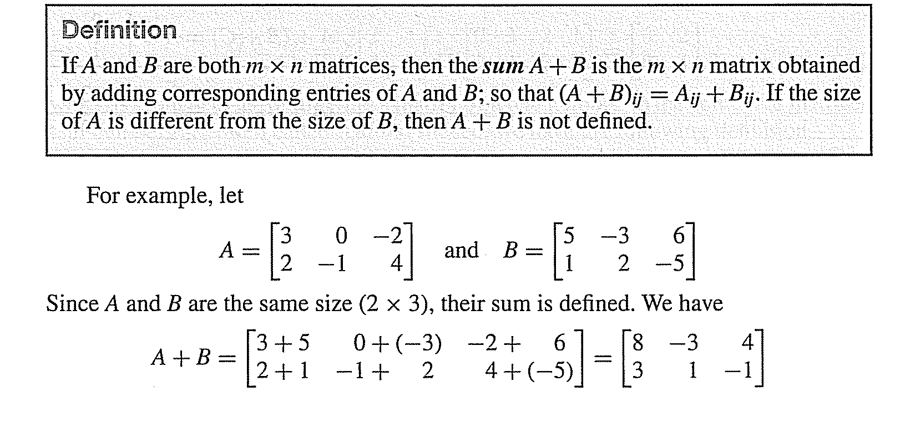
Lecture
04
Matrix Addition

Slide 6
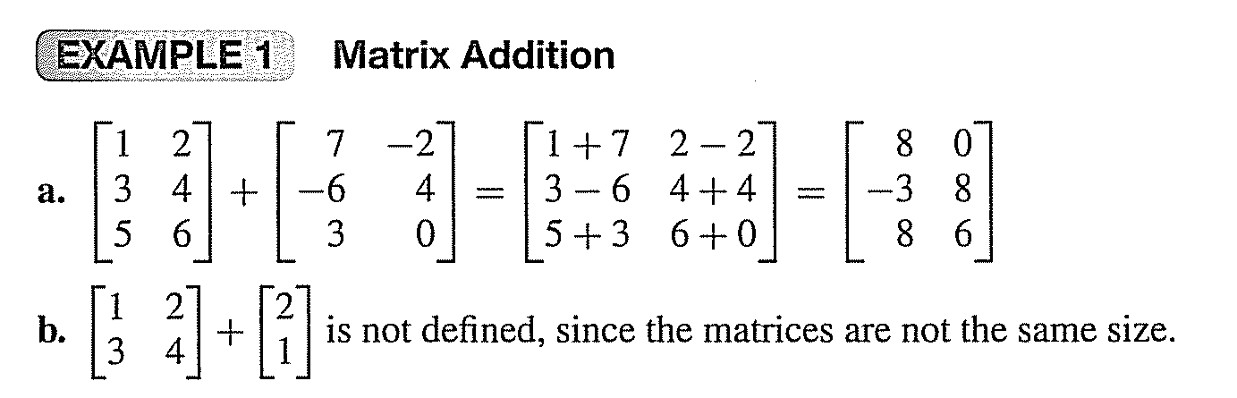
Lecture
04
Matrix Addition

Slide 7
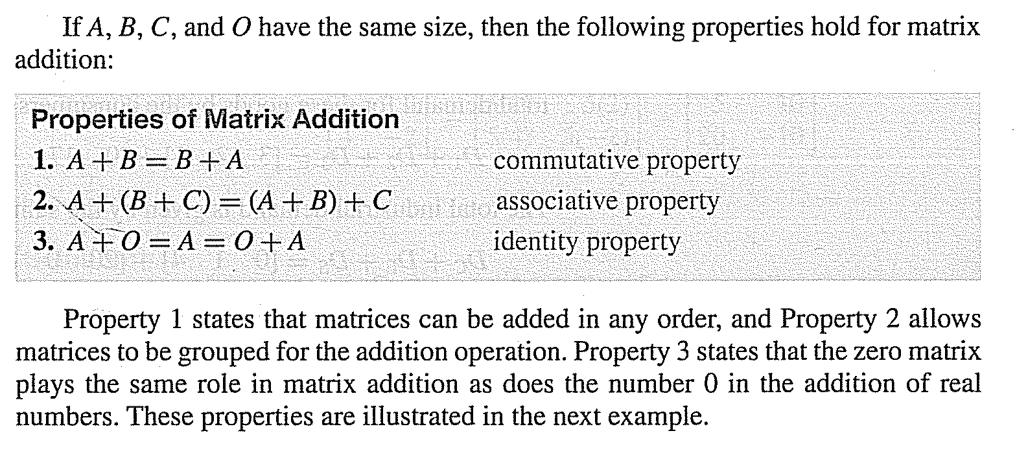
Lecture
04
Matrix Addition

Slide 8
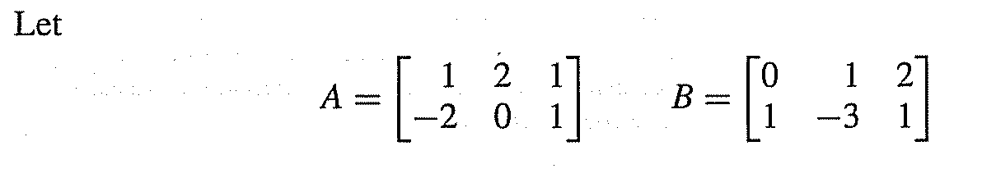
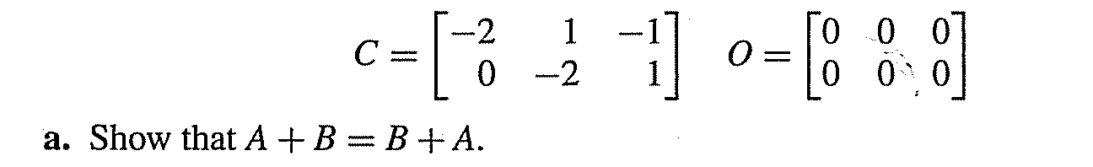


Lecture
04
Example

Slide 9
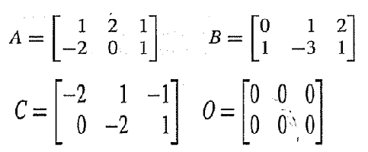
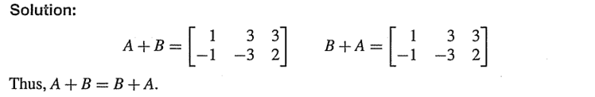
Lecture
04
Solution

Slide 10
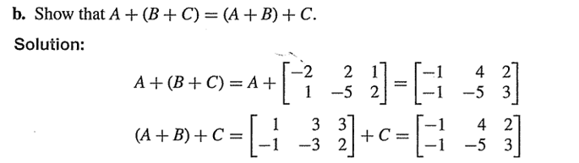
Lecture
04
Example

Slide 11
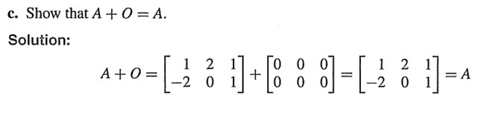
Lecture
04
Solution

Slide 12
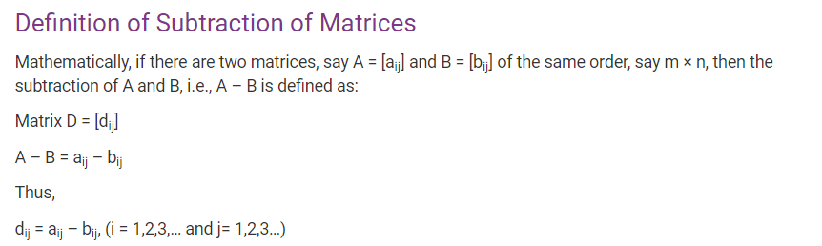
Lecture
04
Matrix Subtraction

Slide 13
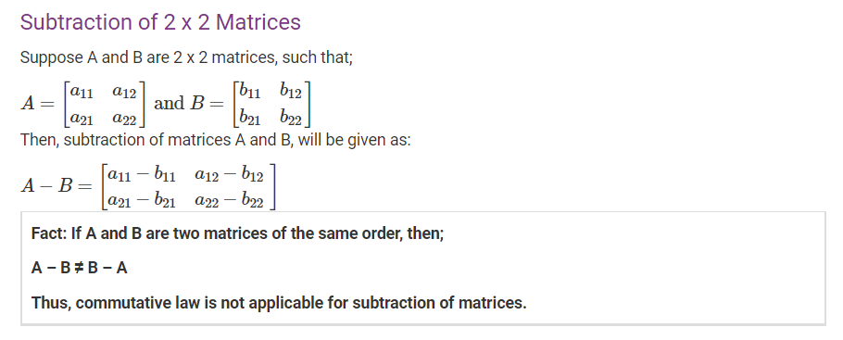
Lecture
04
Subtraction of 2*2 Matrices

Slide 14
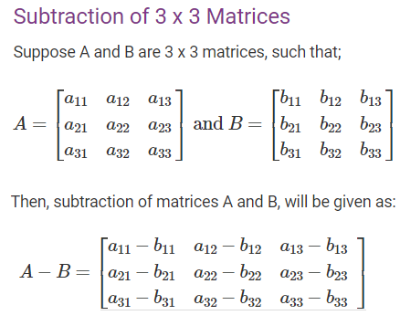
Lecture
04
Subtraction of 3*3 Matrices

Slide 15
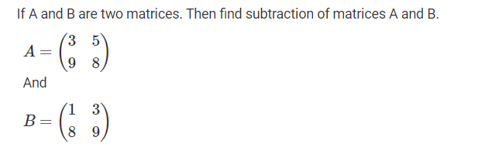
Lecture
04
Example

Slide 16
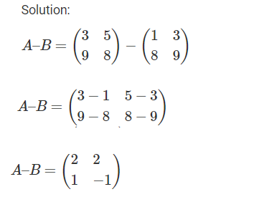
Lecture
04
Solution

Slide 17
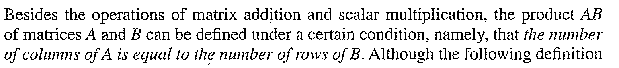
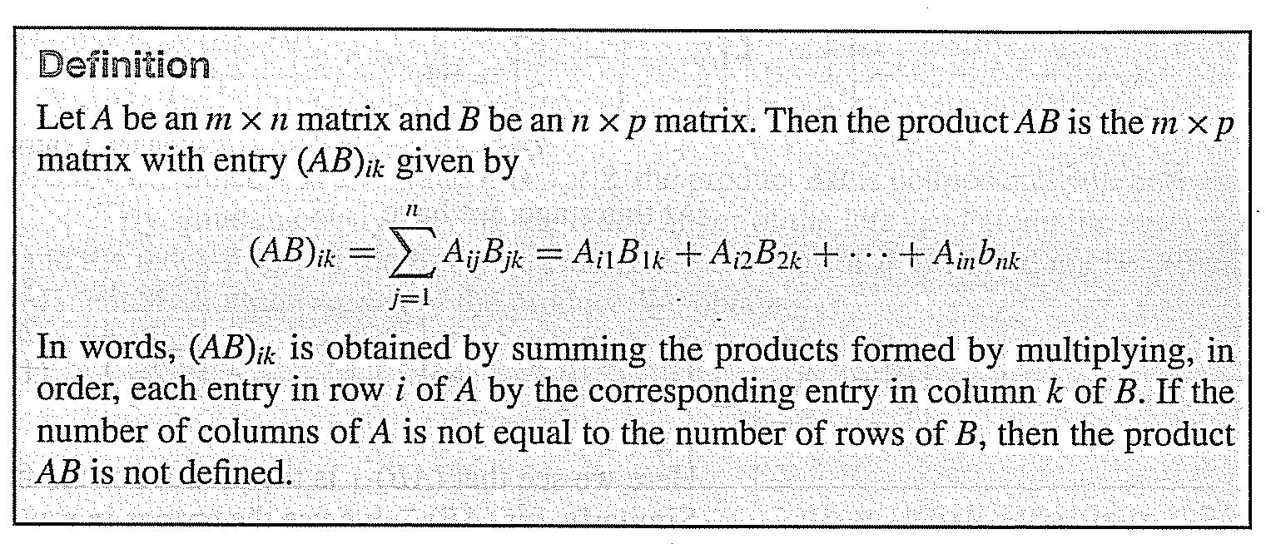
Lecture
04
Matrix Multiplication

Slide 18
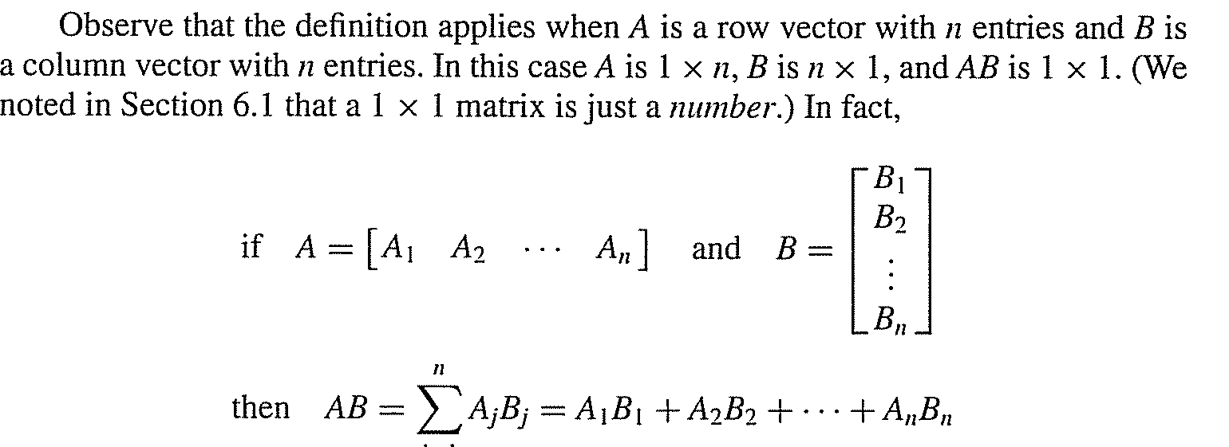
Lecture
04
Matrix Multiplication

Slide 19
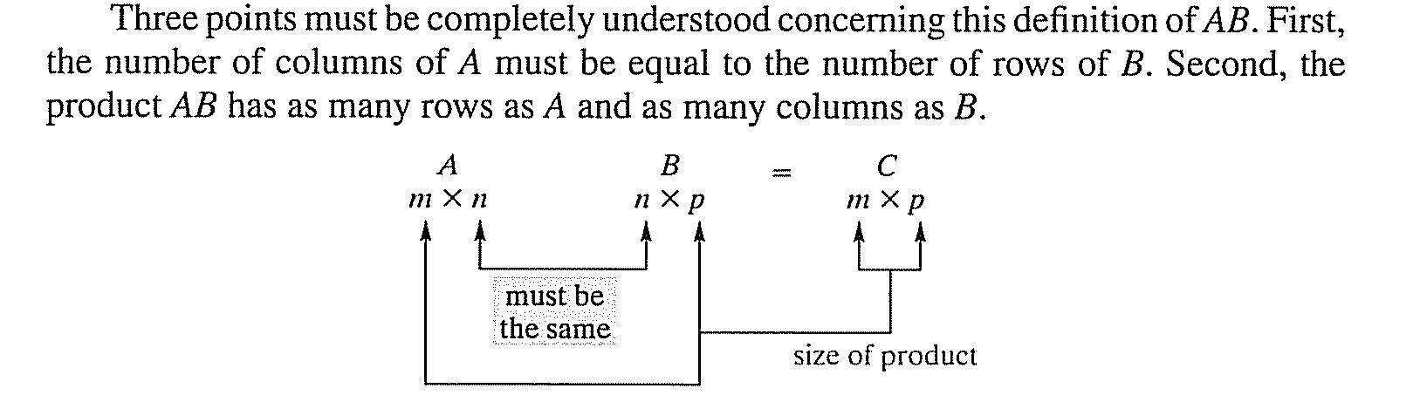
Lecture
04
Matrix Multiplication

Slide 20
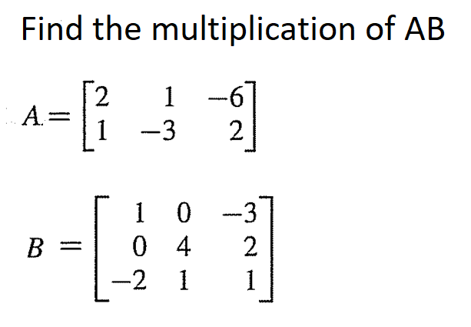
Lecture
04
Matrix Multiplication - Example

Slide 21
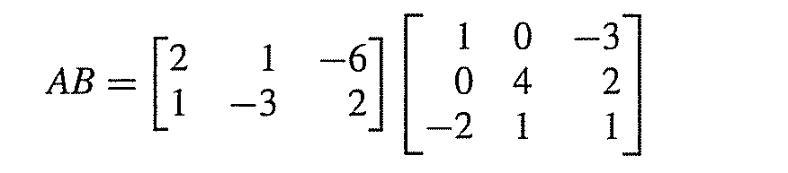
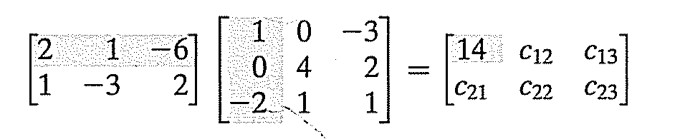
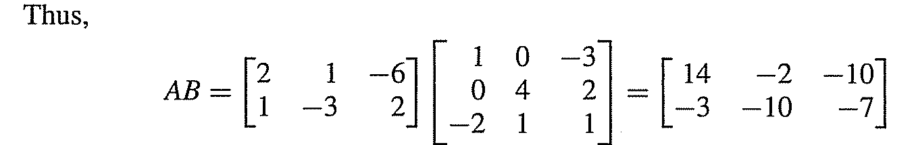
Lecture
04
Matrix Multiplication

Slide 22

Lecture
04
Matrix Multiplication

Slide 23
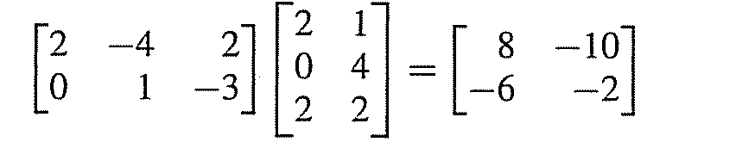
Lecture
04
Solution of Example

Slide 24
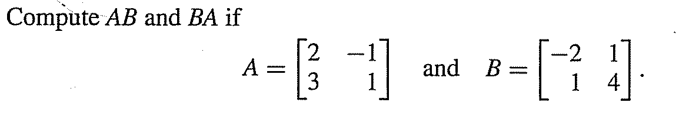
Lecture
04
Example

Slide 25
Lecture
04
Example

Slide 26
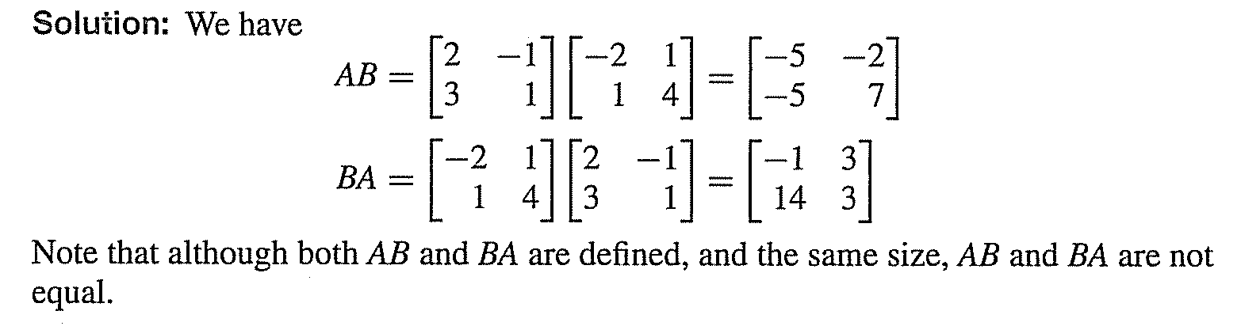
Lecture
04
Solution

Slide 27
Lecture
04
Practice
Let’s Practice

Slide 28
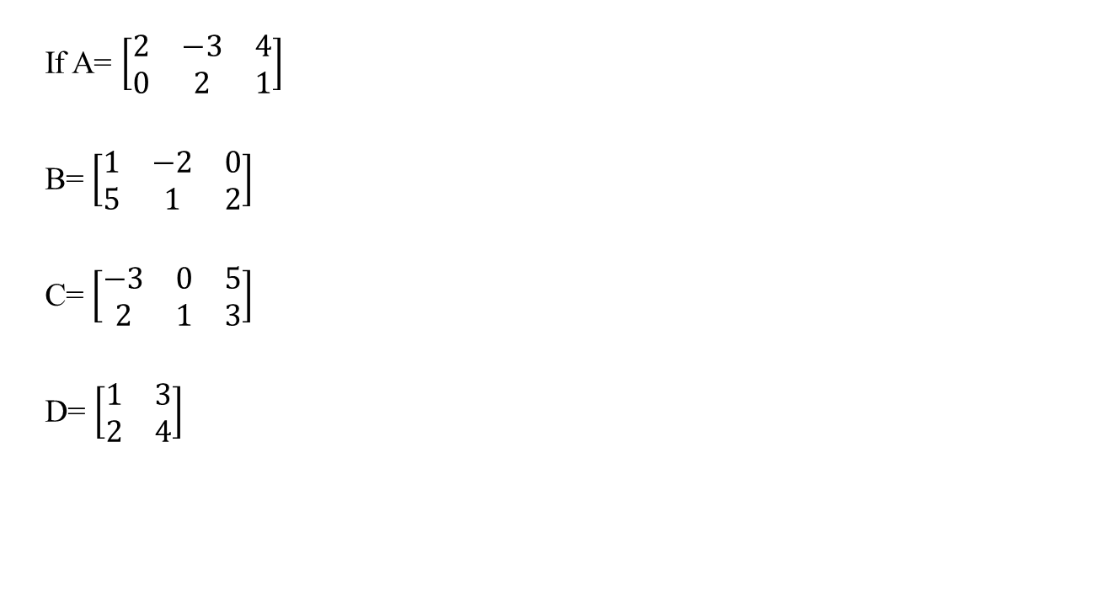
Lecture
04
Example 1
If A= $\left[\begin{matrix}2 & −3 & 4 \\ 0 & 2 & 1\end{matrix}\right]$
B= $\left[\begin{matrix}1 & −2 & 0 \\ 5 & 1 & 2\end{matrix}\right]$
C= $\left[\begin{matrix}−3 & 0 & 5 \\ 2 & 1 & 3\end{matrix}\right]$
D= $\left[\begin{matrix}1 & 3 \\ 2 & 4\end{matrix}\right]$

Slide 29
Lecture
04
Example 1 Con’d
Find a) A + B
b) B + C d) A – B
c) A + C e) B – C
f) A – C h) A+D

Slide 30
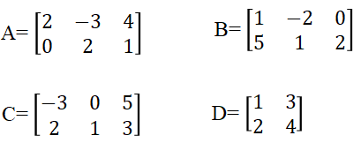
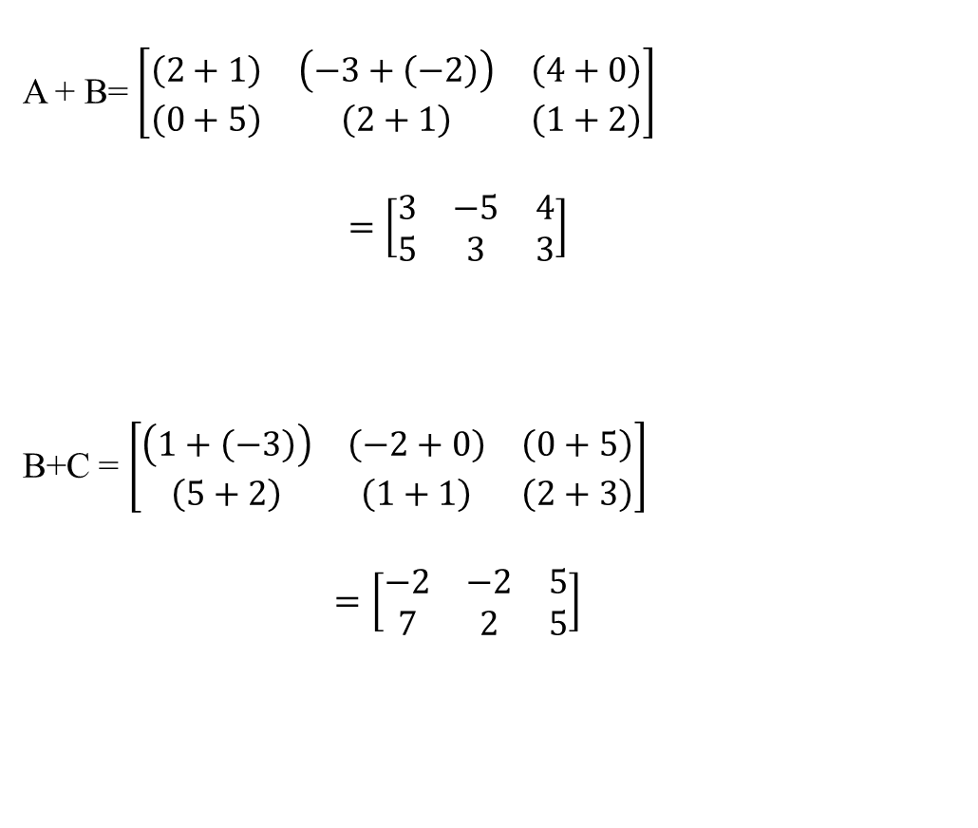
Lecture
04
Solution of Example 1
A + B= $\left[\begin{matrix}\left(2+1\right) & \left(−3+\left(−2\right)\right) & \left(4+0\right) \\ \left(0+5\right) & \left(2+1\right) & \left(1+2\right)\end{matrix}\right]$
$$=\left[\begin{matrix}3 & −5 & 4 \\ 5 & 3 & 3\end{matrix}\right]$$
B+C = $\left[\begin{matrix}\left(1+\left(−3\right)\right) & \left(−2+0\right) & \left(0+5\right) \\ \left(5+2\right) & \left(1+1\right) & \left(2+3\right)\end{matrix}\right]$
$$=\left[\begin{matrix}−2 & −2 & 5 \\ 7 & 2 & 5\end{matrix}\right]$$

Slide 31
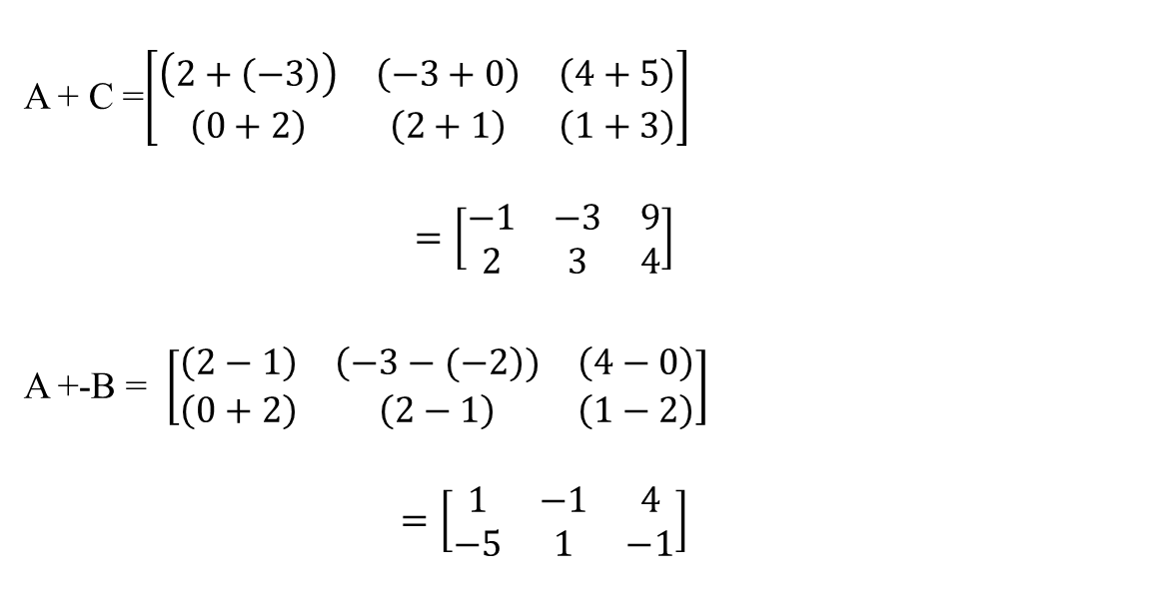
Lecture
04
Solution of Example 1
A + C =$\left[\begin{matrix}\left(2+\left(−3\right)\right) & \left(−3+0\right) & \left(4+5\right) \\ \left(0+2\right) & \left(2+1\right) & \left(1+3\right)\end{matrix}\right]$
$$=\left[\begin{matrix}−1 & −3 & 9 \\ 2 & 3 & 4\end{matrix}\right]$$
A +-B = $\left[\begin{matrix}\left(2−1\right) & \left(−3−(−2\right)) & \left(4−0\right) \\ \left(0+2\right) & \left(2−1\right) & \left(1−2\right)\end{matrix}\right]$
$$=\left[\begin{matrix}1 & −1 & 4 \\ −5 & 1 & −1\end{matrix}\right]$$

Slide 32
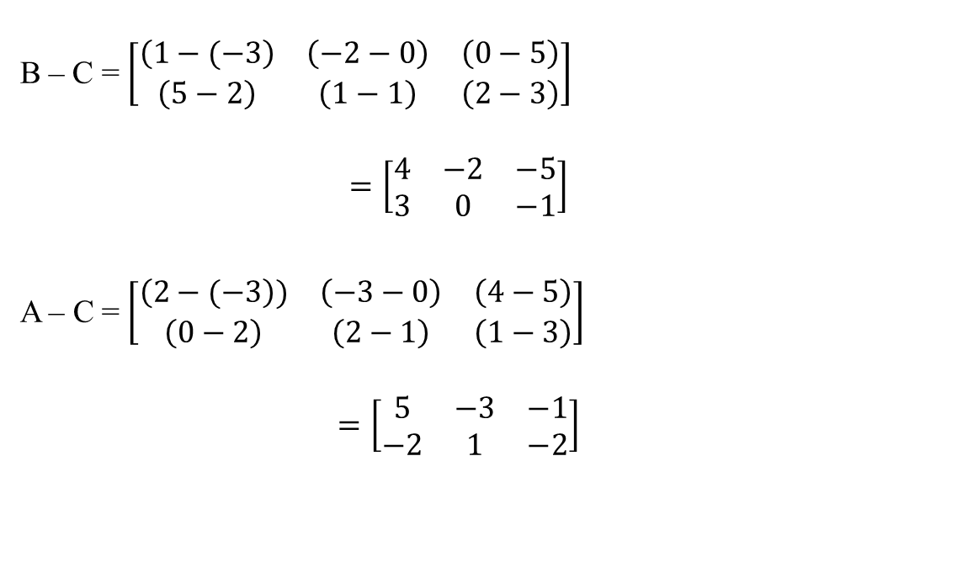
Lecture
04
Solution of Example 1
B – C = $\left[\begin{matrix}\left(1−(−3\right) & \left(−2−0\right) & \left(0−5\right) \\ \left(5−2\right) & \left(1−1\right) & \left(2−3\right)\end{matrix}\right]$
$$=\left[\begin{matrix}4 & −2 & −5 \\ 3 & 0 & −1\end{matrix}\right]$$
A – C = $\left[\begin{matrix}\left(2−(−3\right)) & \left(−3−0\right) & \left(4−5\right) \\ \left(0−2\right) & \left(2−1\right) & \left(1−3\right)\end{matrix}\right]$
$$=\left[\begin{matrix}5 & −3 & −1 \\ −2 & 1 & −2\end{matrix}\right]$$

Slide 33
Lecture
04
Solution of Example 1
A + D
It is impossible to find the value of this addition because it should be in the same size

Slide 34
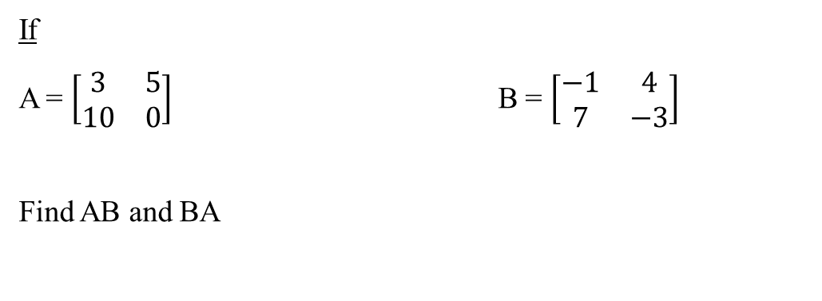
Lecture
04
Example 2
If
A = $\left[\begin{matrix}3 & 5 \\ 10 & 0\end{matrix}\right]$ B = $\left[\begin{matrix}−1 & 4 \\ 7 & −3\end{matrix}\right]$
Find AB and BA

Slide 35
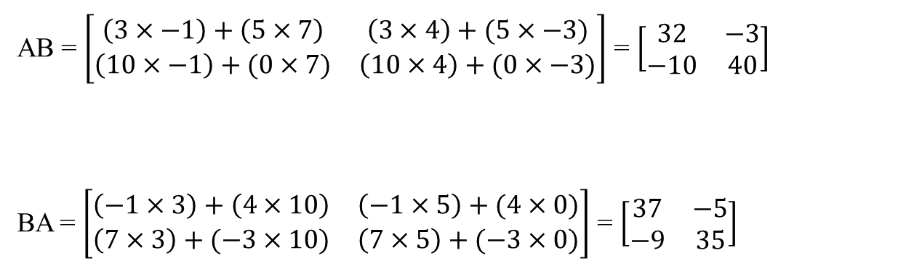
Lecture
04
Solution of Example 2
AB = $\left[\begin{matrix}\left(3×−1\right)+\left(5×7\right) & \left(3×4\right)+(5×−3) \\ \left(10×−1\right)+(0×7) & \left(10×4\right)+(0×−3)\end{matrix}\right]$ = $\left[\begin{matrix}32 & −3 \\ −10 & 40\end{matrix}\right]$
BA = $\left[\begin{matrix}\left(−1×3\right)+\left(4×10\right) & \left(−1×5\right)+(4×0) \\ \left(7×3\right)+(−3×10) & \left(7×5\right)+(−3×0)\end{matrix}\right]$ = $\left[\begin{matrix}37 & −5 \\ −9 & 35\end{matrix}\right]$

Slide 36
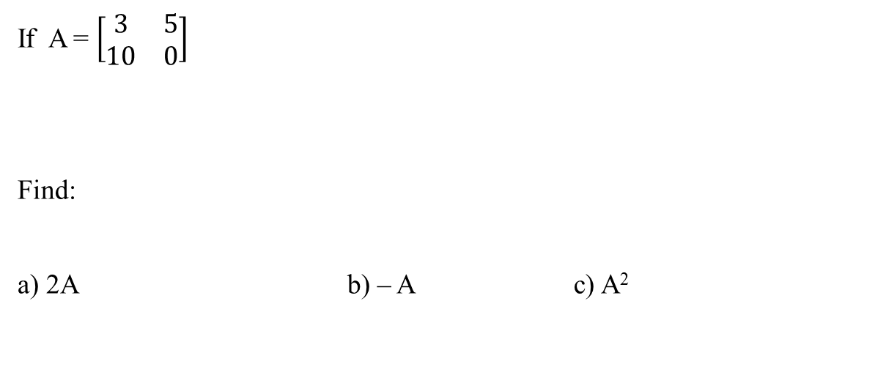
Lecture
04
Example 3
If A = $\left[\begin{matrix}3 & 5 \\ 10 & 0\end{matrix}\right]$
Find:
a) 2A b) – A c) A²

Slide 37
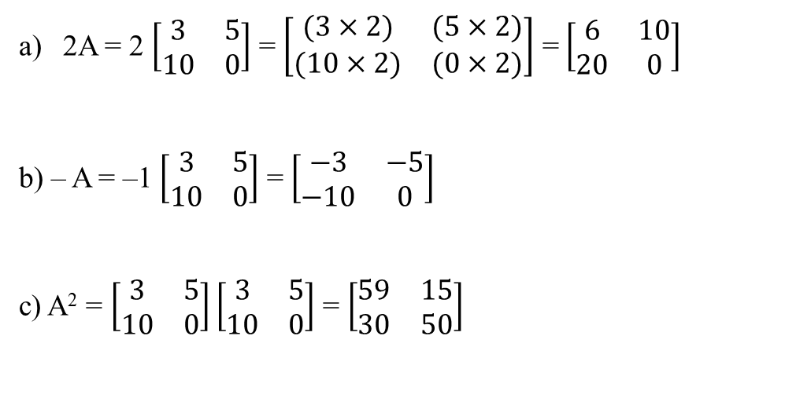
Lecture
04
Solution of Example 3
2A = 2 $\left[\begin{matrix}3 & 5 \\ 10 & 0\end{matrix}\right]$ = $\left[\begin{matrix}(3×2) & (5×2) \\ (10×2) & (0×2)\end{matrix}\right]$ = $\left[\begin{matrix}6 & 10 \\ 20 & 0\end{matrix}\right]$
b) – A = –1 $\left[\begin{matrix}3 & 5 \\ 10 & 0\end{matrix}\right]$ = $\left[\begin{matrix}−3 & −5 \\ −10 & 0\end{matrix}\right]$
c) A² = $\left[\begin{matrix}3 & 5 \\ 10 & 0\end{matrix}\right]\left[\begin{matrix}3 & 5 \\ 10 & 0\end{matrix}\right]$ = $\left[\begin{matrix}59 & 15 \\ 30 & 50\end{matrix}\right]$

Slide 38
Lecture
04
Solution of Example 3
2A = 2 $\left[\begin{matrix}3 & 5 \\ 10 & 0\end{matrix}\right]$ = $\left[\begin{matrix}(3×2) & (5×2) \\ (10×2) & (0×2)\end{matrix}\right]$ = $\left[\begin{matrix}6 & 10 \\ 20 & 0\end{matrix}\right]$
b) – A = –1 $\left[\begin{matrix}3 & 5 \\ 10 & 0\end{matrix}\right]$ = $\left[\begin{matrix}−3 & −5 \\ −10 & 0\end{matrix}\right]$
c) A² = $\left[\begin{matrix}3 & 5 \\ 10 & 0\end{matrix}\right]\left[\begin{matrix}3 & 5 \\ 10 & 0\end{matrix}\right]$ = $\left[\begin{matrix}59 & 15 \\ 30 & 50\end{matrix}\right]$

Slide 39
Lecture
04
Lecture Summary
Matrix Addition
Matrix Subtraction
Matrix Multiplication

