Slide 1

CCNA (200-301) Cisco Certified Network Associate
Prepared by Eng. Taghreed Elsayed
Lecture 4
VLAN Configuration

Slide 2

Chapter
02
VLAN Configuration
dot 1q
Use Native VLAN
Packets from Native VLAN untagged
BY default VLAN1 is the Native VLAN
Only one Native VLAN is defined in the switch
If we change Native VLAN in one switch , we must change it in the others.

Slide 3
Chapter
02
VLAN Configuration
Configuring VLANs You configure VLANs in VlAN global configuration command by entering a VLAN ID. Enter a new VLAN ID to create a VLAN, or enter an existing VLAN ID to modify that VLAN. When you have finished the configuration, you must exit VLAN configuration mode for the configuration to take effect. You can enter the copy running-configuration startup-configuration privileged EXEC command to save the configuration in the startup configuration file. To display the VLAN configuration, enter the show VlAN privileged EXEC command.

Slide 4
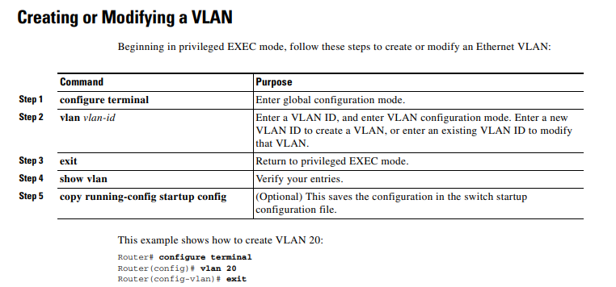
Chapter
02
VLAN Configuration

Slide 5
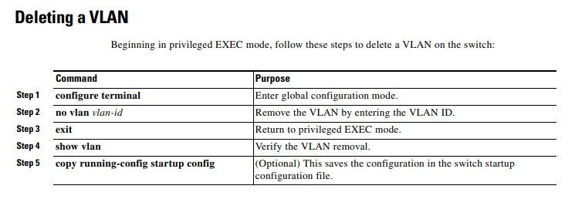
Chapter
02
VLAN Configuration
To delete configuration files of VLAN : Delete VLAN.dat
As it stores in Flash

Slide 6
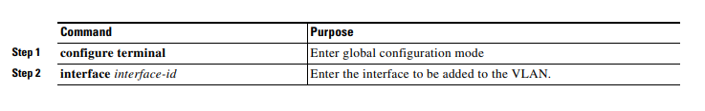
Chapter
02
VLAN Configuration

Slide 7
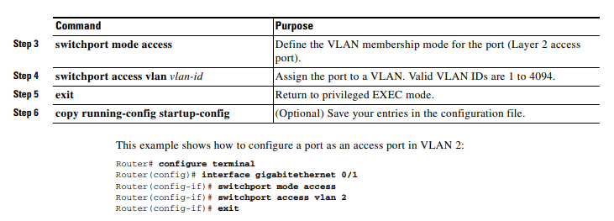
Chapter
02
VLAN Configuration

Slide 8
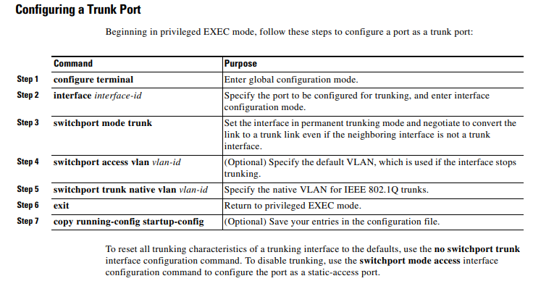
Chapter
02
VLAN Configuration

