Slide 1


Finance Concepts
Prepared by Dr. Omar Al-kasasbeh
FNT 615
Finance Concepts
Lecture 6

Slide 2



Finance Concepts
FNT 615
Finance Concepts
Lecture 6
Prepared by
Dr. Omar Al-kasasbeh

Slide 3
Chapter
05
Time Value of Money II: Equal Multiple Payments

Slide 4

Chapter
Table of contents
06
1- Perpetuity
2- Calculating the Present Value of an Annuity
3- Calculating Annuities Used in Structured Settlements
4- Loan Amortization
5- Stated versus Effective Rates

Slide 5
Chapter
05
In Time Value of Money I, we learned that the value of money changes with the passage of time. Decisionmakers consider how investments, projects, and even opportunity costs gain value as we move forward into the future. They similarly consider how value in the future can be reduced to a value in present or past periods. We saw that these value projections are called determination of future value (compounding, moving forward on a timeline) or present value (discounting, moving backward on a timeline). The easiest way to visualize this movement through time, whether forward or backward, is by use of a timeline.
Throughout the first chapter on the time value of money, we were analyzing a single amount. In this chapter, we deal with a stream of payments made periodically in other words, payments made or received regularly over a span of time. We begin with the illustration of a perpetuity.

Slide 6
What Is a Perpetuity?
A perpetuity is a series of payments or receipts that continues forever, or perpetually. One of the best ways to analyze the basics of an annuity (the stream of payments to be paid or received in the future) is by starting with a perpetuity.
for example is preferred stock. Most preferred stock issues carry a fixed and predetermined rate of dividend. If we assume that the dividend will not change in future years, then preferred dividend shareholders will receive a fixed amount of money in future years assuming, of course, that the company’s board of directors declares the dividends sufficient to fund these requirements. If we assume that the dividend is declared and paid and that it remains constant, this represents a perpetuity.
For example, Shaw Inc. has issued 100,000 shares of preferred stock with a stated value of $50 and a 4% dividend. Therefore, if they can fund and decide to declare dividends for the full amount, they will pay out $200,000, or $2.00 per preferred share. Because shares such as these are created with the intention of continuity, the owner of this preferred stock can theoretically expect this dividend income stream in perpetuity.

Slide 7
To place a current market value on this stream of future income, how much should an investor pay for one share of this preferred stock? The calculation is a present value. The amount the investor pays today for that one share is equal to the annual dividend (assuming it is declared and paid) divided by the rate of return. But be careful it is not the rate on the face of the preferred stock but the required rate of return, the “market rate” that investors expect from a stock of this level of risk. We must also note an important fact affecting all investment valuations: the value of an investment generally represents our expectations of all future cash flows from that investment, discounted to today’s dollars. Because a perpetuity is a stream of payments continuing indefinitely, determining the future value isn’t possible.
Determining the present value, however, is possible, although one might wonder how. As we learned earlier, the greater the amount of time used in a present value calculation, the smaller the amount of dollars needed at the beginning, regardless of the interest rate involved. Therefore, when we discount each payment in an infinite series, remembering that we would then add them together once we discount them to the present, the infinite payments become negligible at some point and will no longer have a significant impact on today’s value.

Slide 8
To grow to one dollar 70 years from now, even at a growth rate of 5% per year, we would only need $0.0329 not even four cents. Keeping all other facts the same, if we had 100 years to grow an investment to one dollar, we would only need 0.76 cents not even a whole penny! There is no question that the effect of time is substantial and dramatic.
The study of perpetuities in corporate finance is a first step to understanding valuation models of certain investments, such as the dividend discount model and the constant growth model, to be addressed in other chapters. Our ability to discount future cash flows, even infinite cash flows, to a present value is a clue to the
price at which a company’s stock might trade. From a personal financial planning perspective, the individual investor is also better able to be certain that they are paying a fair price for holdings in their portfolio. For purposes of long-term or retirement planning, the investor must consider that a fixed and unchanging dividend, such as from preferred stock, might not adequately protect the holder from inflation in times of rising prices.

Slide 9
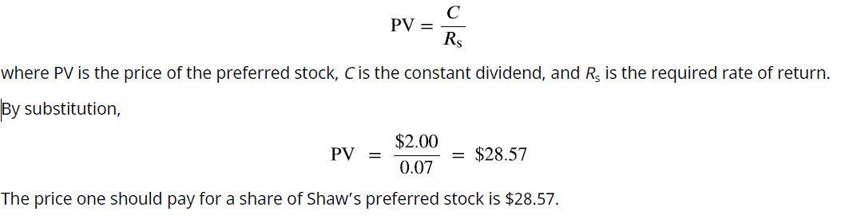
How to Value a Perpetuity
Given these facts, how do we place a value on a perpetuity? Let’s keep the preferred stock example for Shaw Inc. in mind. The holder of one share will expect to receive a $2.00 dividend for every share owned. Although a perpetuity may allow for growth of that dividend, we will hold that constant now. We must know one additional fact: the required rate of return. This is our random variable, which can cause fluctuation in the price of the preferred stock. Let’s assume that the required rate of return, which we’ll call RS, is 7%. This is the rate of return that the market expects in order to take on the risk of an investment such as Shaw. Determination of the price of Shaw’s preferred stock becomes quite simple because the expected annual cash flow should not change, making it a constant perpetuity. The constant perpetuity formula is

Slide 10
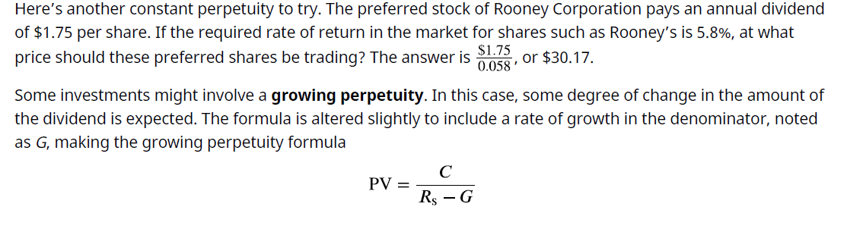
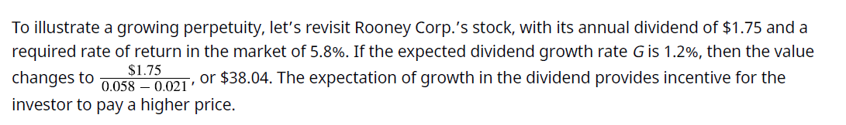

Slide 11
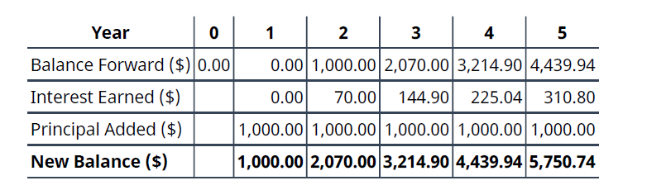
Calculating the Present Value of an Annuity
An annuity is a stream of fixed periodic payments to be paid or received in the future. Present or future values of these streams of payments can be calculated by applying time value of money formulas to each of these payments. We’ll begin with determining the present value.
Before exploring present value, it’s helpful to analyze the behavior of a stream of payments over time. Assume that we commit to a program of investing $1,000 at the end of each year for five years, earning 7% compounded annually throughout. The high rate is locked in based partly on our commitment beginning today, even though we will invest no money until the end of the first year. Refer to the timeline shown in Table

Slide 12
At the end of the first year, we deposit the first $1,000 in our fund. Therefore, it has not yet had an opportunity to earn us any interest. The “new balance” number beneath is the cumulative amount in our fund, which then carries to the top of the column for the next year. In year 2, that first amount will earn 7% interest, and at the end of year 2, we add our second $1,000. Our cumulative balance is therefore $2,070, which then carries up to the top of year 3 and becomes the basis of the interest calculation for that year. At the end of the fifth year, our investing arrangement ends, and we’ve accumulated $5,750.74, of which $5,000 represents the money we invested and the other $750.74 represents accrued interest on both our invested funds and the accumulated interest from past periods. Notice two important aspects that might appear counterintuitive: (1) we’ve “wasted” the first year because we deposited no funds at the beginning of this plan, and our first $1,000 begins working for us only at the beginning of the second year; and (2) our fifth and final investment earns no interest because it’s deposited at the end of the last year. We will address these two issues from a practical application point of view shortly. Keeping this illustration in mind, we will first focus on finding the present value of an annuity. Assume that you wish to receive $25,000 each year from an existing fund for five years, beginning one year from now. This stream of annual $25,000 payments represents an annuity. Because the first payment will be received one year from now, we specifically call this an ordinary annuity. We will look at an alternative to ordinary annuities later. How much money do we need in our fund today to accomplish this stream of payments if our remaining balance will always be earning 8% annually? Although we’ll gradually deplete the fund as we withdraw periodic payments of the same amount, whatever funds remain in the account will always be earning interest.

Slide 13
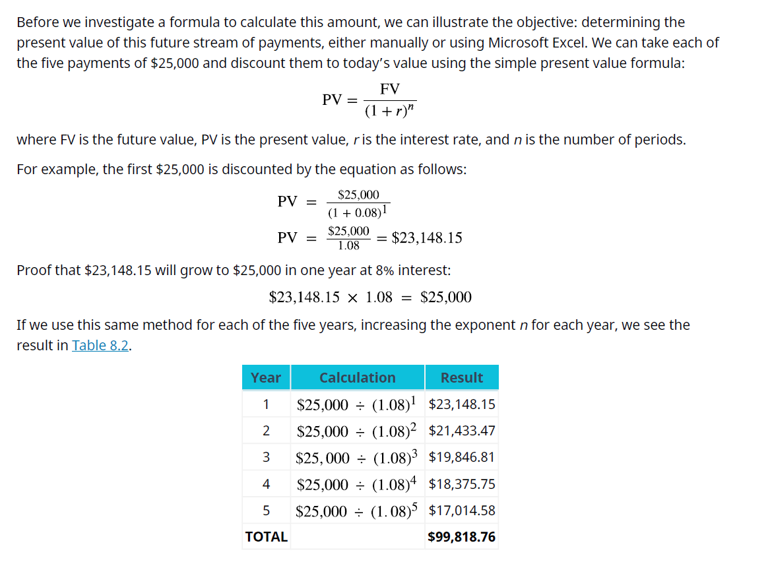




Slide 14
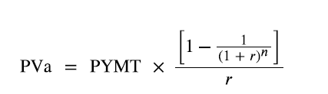
We begin with the amount calculated in our table, $99,818.76. Before any money is withdrawn, a year’s worth of interest at 8% is compounded and added to our balance. Then our first $25,000 is withdrawn, leaving us with $82,804.26. This process continues until the end of five years, when, aside from a minor rounding difference, the fund has “done its job” and is equal to zero. However, we can make this simpler. Because each payment withdrawn (or added, as we will see later) is the same, we can calculate the present value of an annuity in one step using an equation. Rather than the multiple steps above, we will use the following equation:
where PVa is the present value of the annuity and PYMT is the amount of one payment.
In this example, PYMT is $25,000 at the end of each of five years. Note that the greater the number of periods and/or the size of the amount borrowed, the greater the chances of large rounding errors. We have used six decimal places in our calculations, though the actual time value of money factor, combining interest and time, can be much longer. Therefore, our solutions will often use ≅ rather than the equal sign. By substitution, and then following the proper order of operations:

Slide 15
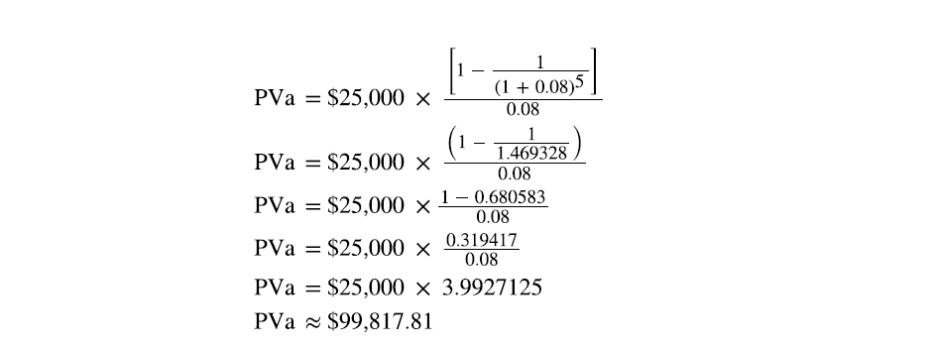
In both cases, barring a rounding difference caused by decimal expansion, we come to the same result using the equation as when we calculate each of multiple years. It’s important to note that rounding differences can become significant when dealing with larger multipliers, as in the financing of a multimillion-dollar machine or facility. In this text, we will ignore them. In conclusion, five payments of $25,000, or $125,000 in total, can be funded today with $99,817.81, with the difference being obtained from interest always accumulating on the remaining balance at 8%. The running balance is obtained by calculating the year’s interest on the previous balance, adding it to that balance, and subtracting the $25,000 that is withdrawn on the last day of the year. In the last (fifth) year, just enough interest will accrue to bring the balance to the $25,000 needed to complete the fifth payment.

Slide 16
A common use of the PVa is with large-money lotteries. Let’s assume you win the North Dakota Lottery for $1.2 million, and they offer you $120,000 per year for 10 years, beginning one year from today. We will ignore taxes and other nonmathematical considerations throughout these discussions and problems. The Lottery Commission will likely contact you with an alternative: would you like to accept that stream of payments … or would you like to accept a lump sum of $787,000 right now instead? Can you complete a money-based analysis of these alternatives? Based purely on the dollars, no, you cannot. The reason is that you can’t compare future amounts to present amounts without considering the effect of time that is, the time value of money. Therefore, we need an interest rate that we can use as a discounting factor to place these alternatives on the same playing field by expressing them in terms of today’s dollars, the present value. Let’s use 9%. If we discount the future stream of fixed payments (an ordinary annuity, as the payments are identical and they begin one year from now), we can then compare that result to the cash lump sum that the Lottery Commission is offering you instead.

Slide 17
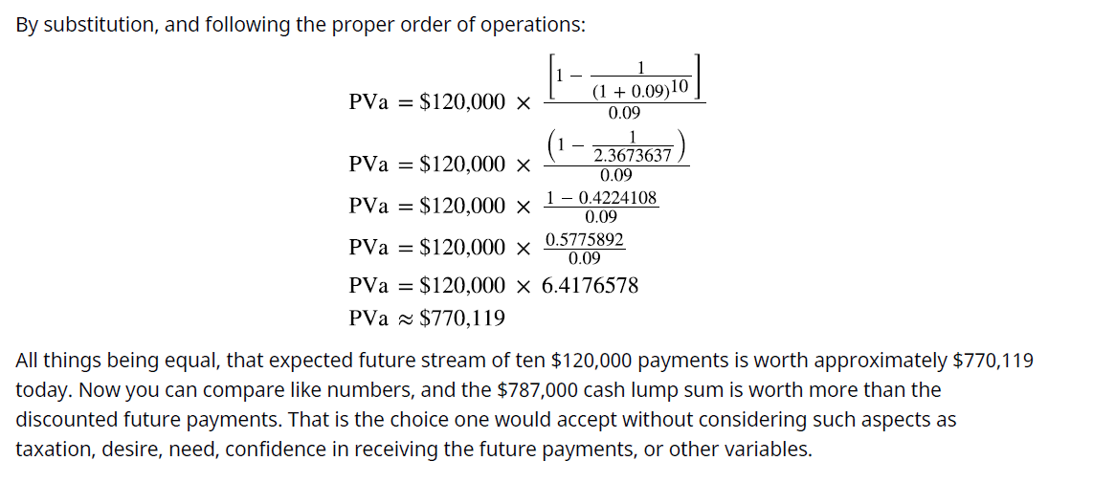
Chapter
06

Slide 18
Calculating the Present Value of an Annuity Due
Earlier, we defined an ordinary annuity. A variation is the annuity due. The difference between the two is one period. That’s all just one additional period of interest. An ordinary annuity assumes that there is a one period lag between the start of a stream of payments and the actual first payment. In contrast, an annuity due assumes that payments begin immediately, as in the lottery example above. We would assume that you would receive the first annual lottery check of $120,000 immediately, not a year from now. In summary, whether calculating future value (covered in the next section) or present value of an annuity due, the one-year lag is eliminated, and we begin immediately. Since the difference is simply one additional period of time, we can adjust for this easily by taking the formula for an ordinary annuity and multiplying by one additional period. One more period, of course, is (1 + i). Recall from Time Value of Money I that the formula for compounding is (1 + i)N, where i is the interest rate and N is the number of periods. The superscript N does not apply because it represents 1, for one additional period, and the power of 1 can be ignored. Therefore, faced with an annuity due problem, we solve as if it were an ordinary annuity, but we multiply by (1 + i) one more time.

Slide 19
In our original example from this section, we wished to withdraw $25,000 each year for five years from a fund that we would establish now. We determined how much that fund should be worth today if we intend to receive our first payment one year from now. Throughout this fund’s life, it will earn 8% annually. This time,
let’s assume we’ll withdraw our first payment immediately, at point zero, making this an annuity due. Because we’re trying to determine how much our starting balance should be, it makes sense that we must begin with a larger number. Why? Because we’re pulling our first payment out immediately, so less money will remain to start compounding to the amount we need to fund all five of our planned payments! Our rule can be stated as follows:
Whether one is calculating present value or future value, the result of an annuity due must always be larger than that of an ordinary annuity, all other facts remaining constant. Here is the stream of solutions for the example above, but please notice that we will multiply by (1 + i), one additional period, following the same order of operations:

Slide 20
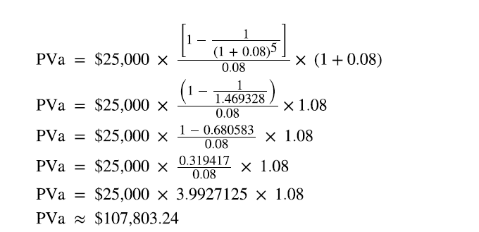
That’s how much we must start our fund with today, before we earn any interest or draw out any money. Note that it’s larger than the $99,817.81 that would be required for an ordinary annuity. It must be, because we’re about to diminish our compounding power with an immediate withdrawal, so we have to begin with a larger amount.
We notice several things:
1. The formula must change because the annual payment is subtracted first, prior to the calculation of
annual interest.
2. We accomplish the same result, aside from an insignificant rounding difference: the fund is depleted once the last payment is withdrawn.
3. The last payment is withdrawn on the first day of the final year, not the last. Therefore, no interest is
earned during the fifth and final year.

Slide 21
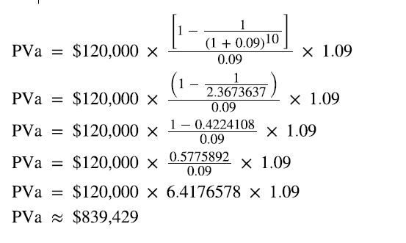
To reinforce this, let’s use the same approach for our lottery example above. Reviewing the facts, you have a choice of receiving 10 annual payments of your $1.2 million winnings, each worth $120,000, and you discount at a rate of 9%. The only difference is that this time, you can receive your first $120,000 right away; you don’t have to wait a year. This is now an annuity due. We solve it just as before, except that we multiply by one additional period of interest, (1 + i):
Again, this result must be larger than the amount we determined when this was calculated as an ordinary annuity.
The calculations above, representing the present values of ordinary annuities and annuities due, have been presented on an annual basis. In Time Value of Money I, we saw that compounding and discounting calculations can be based on non-annual periods as well, such as quarterly or monthly compounding and discounting. This aspect, quite common in periodic payment calculations, will be explored in a later section of this chapter.

Slide 22
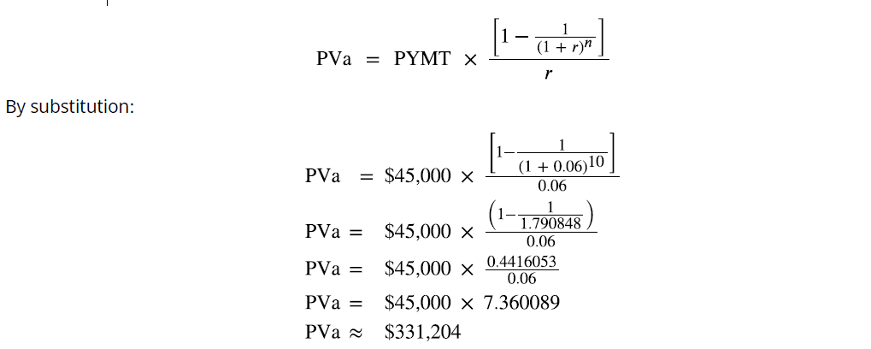
Calculating Annuities Used in Structured Settlements
In addition to lottery payouts, annuity calculations are often used in structured settlements by attorneys at law. If you win a $450,000 settlement for an insurance claim, the opposing party may ask you to accept an annuity so that they can pay you in installments rather than a lump sum of cash. What would a fair cash distribution by year mean? If you have a preferred discount rate (the percentage we all must know to calculate the time value of money) of 6% and you expect equal distributions of $45,000 over 10 years, beginning one year from now, you can use the present value of an annuity formula to compare the alternatives:

Slide 23


If the opposing attorney offered you a lump sum of cash less than that, all things equal, you would refuse it; if the lump sum were greater than that, you would likely accept it. What if you negotiate the first payment to be made to you immediately, turning this ordinary annuity into an annuity due? As noted above, we simply multiply by one additional period of interest, (1 + 0.06). Repeating the last step of the solution above and then multiplying by (1 + 0.06), we determine that
You would insist on that number as an absolute minimum before you would consider accepting the offered stream of payments. To further verify that ordinary annuity can be converted into an annuity due by multiplying the solution by one additional period’s worth of interest before applying the annuity factor to the payment, we can divide the difference between the two results by the value of the original annuity. When the result is expressed as a percent, it must be the same as the rate of interest used in the annuity calculations. Using our example of an annuity with five payments of $25,000 at 8%, we compare the present values of the ordinary annuity of $99,817.81 and the annuity due of $107,803.24.
The result shows that the present value of the annuity due is 8% higher than the present value of the ordinary annuity.

Slide 24
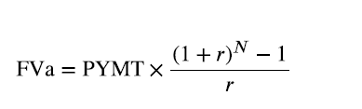
Calculating the Future Value of an Annuity
In the previous section, we addressed discounting a periodic stream of payments from the future to the present. We are also interested in how to project the future value of a series of payments. In this case, an investment may be made periodically. Keeping with the definition of an annuity, if the amount of periodic investment is always the same, we may take a one-step shortcut to calculate the future value of that stream by using the formula presented below:
where FVa is the future value of the annuity, PYMT is a one-time payment or receipt in the series, r is the interest rate, and n is the number of periods.
As we did in our section on present values of annuities, we will begin with an ordinary annuity and then proceed to an annuity due.
Let’s assume that you lock in a contract for an investment opportunity at 4% per year, but you cannot make the first investment until one year from now. This is counterintuitive for an investor, perhaps, but because it is the basis of the formula and procedures for ordinary annuities, we will accept this assumption. You plan to invest $3,000 at the end of each year. How much money will you have at the end of five years?

Slide 25
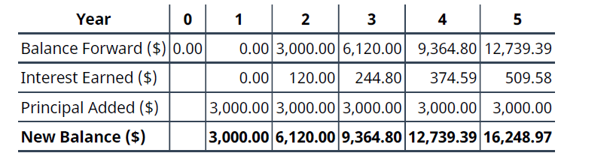
Let’s start by placing this on a timeline like the one appearing earlier in this chapter (see Table):
As we explained earlier when describing ordinary annuities, the payment for year 1 is not invested until the last day of that year, so year 1 is wasted as a compounding opportunity. Therefore, the amount only
compounds for four years rather than five. Also, our fifth payment is not made until the last day of our
contract in year 5, so it has no chance to earn a compounded future value. The investor has lost on both ends.
In the table above, we have made five calculations, and for a longer-term contract such as 10, 25, or 40 years, this would be tedious. Fortunately, as with present values, this ordinary annuity can be solved in one step because all payments are identical.

Slide 26
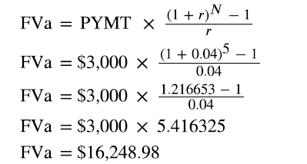
Repeating the formula, and then by substitution:
This proof emphasizes that year 1 is wasted, with no compounding because the payment is made on the last day of year 1 rather than immediately. We lose compounding through this ordinary annuity in another way:
year 5’s investment is made on the last day of this five-year contract and has no chance to accumulate interest. A more intuitive method would be to enter a contract for an annuity due so that our first payment can be made immediately. In this way, we don’t waste the first year, and all five payments work in year 5 as well. As stated previously, this means that annuities due will yield larger results than ordinary annuities, whether one is discounting (PVa) or compounding (FVa).
Let’s hold all facts constant with the previous example, except that we will invest at the beginning of each year, starting immediately upon locking in this five-year contract. We follow the same technique as in the present value section: we multiply by one additional period to convert this ordinary annuity factor into a factor for an annuity due. Whether one is solving for a future value or a present value, the result of an annuity due must always be larger than an ordinary annuity. With future value, we begin investing immediately, so the result will be larger than if we waited for a period to elapse. With present value, we begin extracting funds immediately rather than letting them work for us during the first year, so logically we would have to start with more.

Slide 27
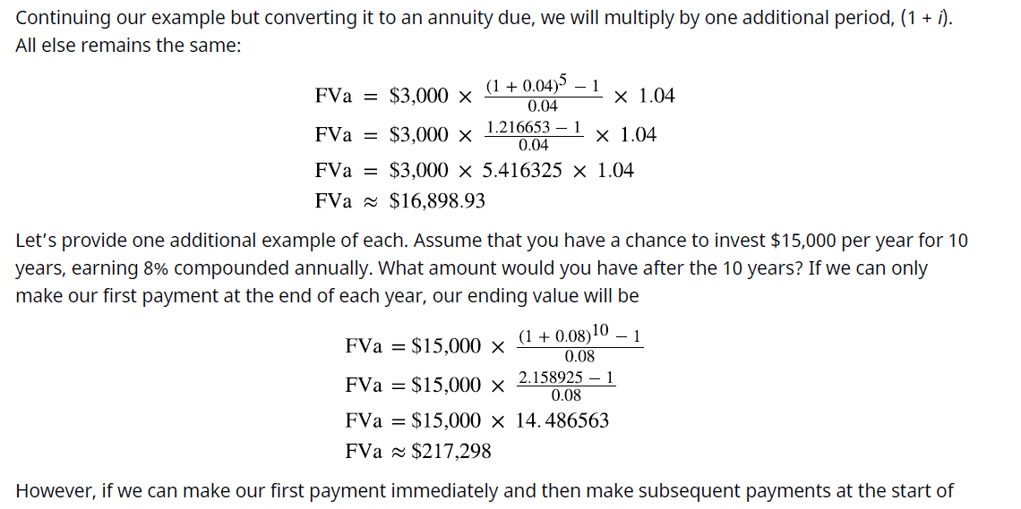
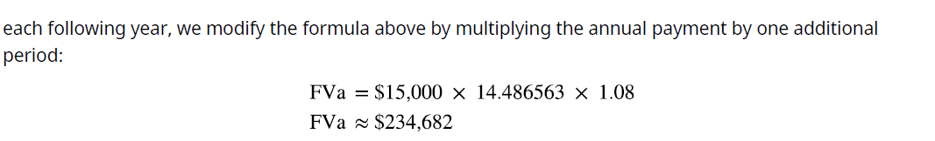

Slide 28
How Annuities Are Used for Retirement Planning
On a final note, how might annuities be used for retirement planning? A person might receive a lump-sum windfall from an investment, and rather than choosing to accept the proceeds, they might decide to invest the sum (ignoring taxes) in an annuity. Their intention is to let this invested sum produce annual distributions to supplement Social Security payments. Assume the recipient just received $75,000, again ignoring tax effects.
They have the chance to invest in an annuity that will provide a distribution at the end of each of the next five years, and that annuity contract provides interest at 3% annually. Their first receipt will be one year from now.
This is an ordinary annuity.
We can also solve for the payment given the other variables, an important aspect of financial analysis. If the person with the $75,000 windfall wants this fund to last five years and they can earn 3%, then how much can they withdraw from this fund each year? To solve this question, we can apply the present value of an annuity formula. This time, the payment (PYMT) is the unknown, and we know that the PVa, or the present value that they have at this moment, is $75,000:

Slide 29
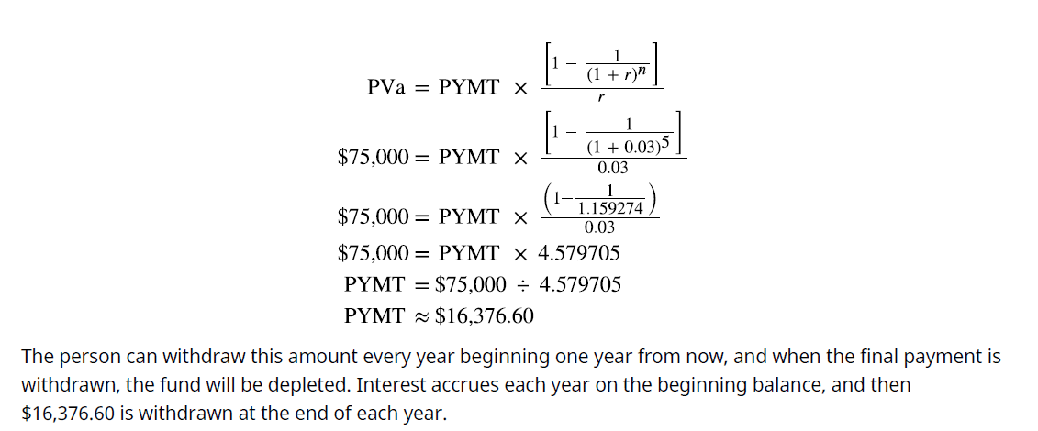

Slide 30
Loan Amortization
Types of Loans
Funds can be loaned to businesses of any type, including corporations, partnerships, limited liability
companies, and proprietorships. Bankers often refer to these lending structures as facilities, and they can be
tailored to the specific needs of the borrower in a number of ways. Similarly, lenders develop loans and lines of credit for individuals. Whether for a business or an individual, the purpose of the loan, method of repayment, interest rate, specific terms, and time involved must all be tailored to the goals of the borrower and the lender.
In this chapter, we will focus on fixed-rate loans, although other alternatives exist.
Typical business loans include the following:
• Term loans generally bear a maturity date and a set rate of interest and are typically used to finance
investments in assets such as equipment, buildings, and possibly other acquired firms. The length of the
term loan is generally designed to match the useful life of the asset being financed, and it will usually be
repaid on a monthly schedule. It’s common for a term loan to be backed by collateral, such as the asset
itself or other assets of the business.
• Revolving lines of credit (revolvers), are used to finance the short-term working capital needs of a
business. Revolvers will have a specific maximum but no set schedule of monthly payments. Interest
accrues on the amount of cash that a company has drawn down from the facility. These credit lines may
be secured by accounts receivable, inventory, other assets of the business, or sometimes simply the good faith and credit of the company if the firm is strong, creditworthy, and established with the lender.

Slide 31
Revolvers must often be fully repaid and unused for a short period of time to assure the lender that the borrower is not using this facility for longer-term needs. Personal loans also come in several types, designed for the purpose the borrower (consumer) has in mind, with assistance from the lender in determining the appropriate structure:
• Personal lines of credit are similar to lines of credit on bank cards, with interest being charged on the
outstanding balance of the credit line. These are available on the basis of personal credit scores, with data
being supplied by the three best-known credit reporting firms: Experian, Equifax, and TransUnion.
Individuals should check their scores with each of these companies at least once per year, which they can
do for no charge. Additional requests from the same company require a small fee.
• An unsecured personal loan is an installment loan, initially drawn for a fixed amount and repaid on a
periodic schedule with interest, as we have seen in our annuity examples. Unsecured means that the loan
is not secured by collateral but is instead based on the strong credit history of the borrower.
• In contrast, a secured personal loan has an asset backing up the unpaid amount, and if the consumer
defaults on the debt, the asset can be seized by the lender to satisfy their claim. A common example is an
auto loan, which is secured by the car being purchased; nonpayment or default on the loan can lead to the
borrower’s car being repossessed.

Slide 32
A mortgage loan is another type of secured personal loan, but for a longer period, such as 20, 25, or even
30 years. The home being purchased or built is the collateral, and the home may be foreclosed upon if the
borrower defaults. Full title to the home typically remains with the lender as long as an unpaid balance
remains on the debt.
• Student loans are borrowings intended to fund college or career education, and they can come from a financial institution or the federal government. Interest rates on these loans are generally low and advantageous, and repayment does not begin until after the borrower’s education Is
complete (or if they drop below a certain level of time status, such as becoming a half-time student).

Slide 33

Calculating Loan Payments Using Simple Amortization
Loan amortization refers to a schedule of how and when a debt will be repaid with interest. As noted, we will focus on fixed-rate debts, such as auto loans, personal loans with installment payments, or mortgages. Before entering into a borrowing agreement, the borrower can use any of a number of tools to verify the terms being offered, such as the monthly payment on a car loan financed by the dealer. In many cases, this is accomplished by using the present value of an annuity formula:
We’ve already reviewed the present value of ordinary annuities in several examples. Before we look into business or consumer loans and their repayment, we must review an area of Time Value of Money I. We’re not likely to make annual payments on a home mortgage or auto loan, as these are commonly paid on a monthly basis. Fortunately, our formulas are easily adjusted from annual to non-annual periods. You will recall that we solve for non-annual periods in the same way, with two adjustments: (1) we divide the annual interest rate by the number of periods in the year, and (2) we multiply the time periods by the number of those periods within a year. Therefore, in the case of monthly debt service, including interest and principal, we use 12 periods.
Given a three-year car loan at 6%, rather than using 6% and 3 periods in our formula, we would instead use 0.5% (6% ÷ 12) and 36 periods (3 years × 12), and then apply the present value of an annuity formula in the same way. Let’s say the three-year, 6% auto loan is for $32,000. You need to know if you can squeeze the monthly payment into your budget. For our examples, we will ignore any other charges, fees, taxes, or extras that your lender might include in these payments, and we will focus only on interest and principal repayment.

Slide 34
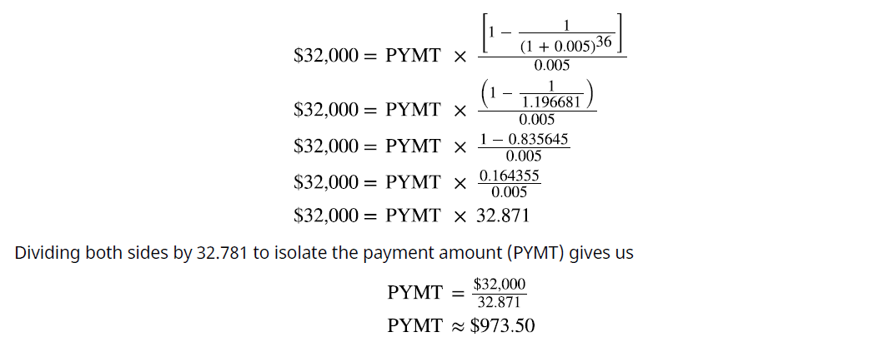
You will make the first payment one month from now, making this an ordinary annuity. What is the amount of your monthly debt service? In this case, you would be solving for a different unknown: the payment amount. By substitution into the present value of an annuity formula, adjusting for monthly payments as noted:
Solving for the payment, we find that it’s approximately $973.50 per month. You consult your monthly budget and find that you can cover this monthly payment, so you conclude the deal. Ask the salesperson for the amortization table on this debt to show how your 36 payments of $973.50 will cover your interest plus repayment of the principal amount of the debt. At this point, you know how to complete your own table. Using a financial calculator or Microsoft Excel simplifies the operation above to a few keystrokes, as presented later in this chapter.

Slide 35
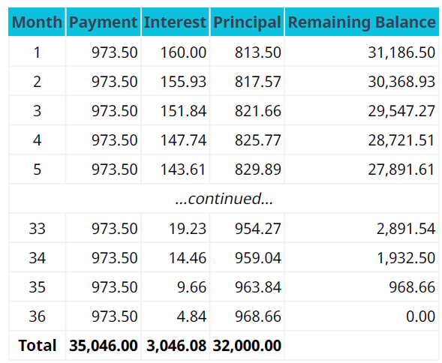
Two extracts from an amortization table are shown in Table
This table resembles proofs we have seen of annuities, but let’s focus on some details:
1. Each fixed payment contains both interest and principal repayment.
2. Because the payments are fixed and the amount of remaining debt is decreasing, the monthly interest
portion is always decreasing, and the amount of principal payment therefore must be increasing.

Slide 36

We can conclude that the lender is making more of their revenue (interest) in the early months than in the later months. In addition, the debt is decreasing slowly in the early months and more rapidly in the later months. We can all agree that lenders are compensated for the risks they take earlier rather than later. Of the 36 payments of $973.50, $32,000 has been repaid as the principal borrowed. The remaining $3,046.08 is the lender’s revenue, the cost of credit.
For an additional example, one that drives home the point that more interest is paid in the early months of a long-term loan, we will consider a 20-year home mortgage. Home mortgage payments are typically made monthly, and again, we will ignore additional charges by the lender, such as real estate tax and homeowner’s insurance. Let’s assume you buy a $200,000 home, pay $60,000 as a cash deposit, and will finance the remaining $140,000 over 20 years. The bank offers you a 3.6% annual interest rate. What will the amount of your monthly payment be for the interest and principal repayment? The bank will tell you, of course, but let’s prove it for ourselves. We’ll do it in exactly the same fashion as the car loan above, using the present value of an annuity formula. Remember that you are not financing the entire $200,000 purchase; you pay $60,000 in cash, so you are only financing the remaining $140,000.
We modify the periods from years to months by multiplying by 12, and we modify the annual rate to a monthly rate by dividing by 12, resulting in

Slide 37
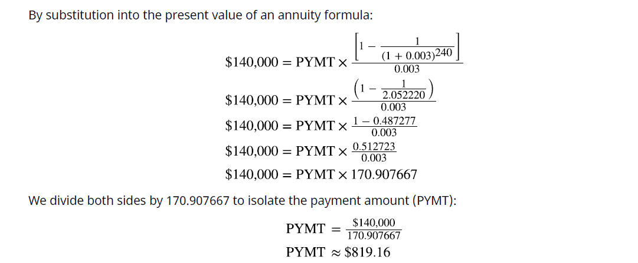

Slide 38
Stated versus Effective Rates
The Difference between Stated and Effective Rates
If you look at the bottom of your monthly credit card statement, you could see language such as “The interest rate on unpaid balances is 1.5% per month.” You might think to yourself, “So, that’s 12 months times 1.5%, or 18% per year.” This is a fine example of the difference between stated and effective annual interest rates. The effective interest rate reflects compounding within a one-year period, an important distinction because we tend to focus on annual interest rates. Because compounding occurs more than once per year, the true annual rate is higher than appears. Please remember that if interest is calculated and compounded annually, the stated and effective interest rates will be the same. Keep in mind that the following principles work whether you are the debtor paying off an obligation or an investor hoping for more frequent compounding. The dynamics of the time value of money apply in either direction.
Effective Rates and Period of Compounding Let’s remain with our example of a credit card statement that indicates an interest rate of 1.5% per month on unpaid balances. If you use this card only once, to make a $1,000 purchase in January, and then fail to pay the bill when it comes due, the issuer will bill you $15. Now you owe them $1,015. Assume you completely ignore this bill and never pay it throughout the rest of the year.

Slide 39
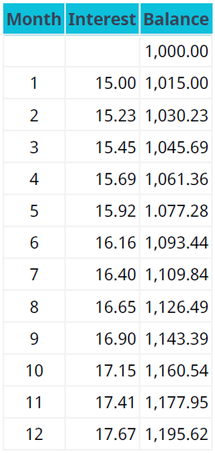

The monthly calculation of interest starts to compound on past interest assessments in addition to the $1,000 initial purchase (see Table).
Because interest compounds monthly rather than annually, the effective annual rate is 19.56%, not the intuitive rate of the stated 1.5% times 12 months, or 18%. Our basic compounding formula of (1+i)^n by
substitution shows:
To isolate the effective annual rate, we then deduct 1 because our interest calculations are based on the value
of $1:
Therefore, it falls to the consumer/borrower to understand the true cost of borrowing, especially when larger dollar amounts are involved. If we had been dealing with $10,000 rather than $1,000, the annual difference would be more than $156.

Slide 40
the payday advance loan (PAL). The practice of offering such loans can be controversial because it can lead to very high rates of interest, perhaps even illegally high, in an act known as usury. Although some states have outlawed PALs and others place limits on them, some do not. A PAL is a short-term loan in anticipation of a person’s next paycheck. A person in need of money for short-term needs will write a check on Thursday but date the check next Thursday, which is their normal payday; assume this transaction is for $200. The lender, typically operating from a storefront, will advance the $200 cash and hold the postdated check. The lender charges a fee let’s say $14 as their compensation. The following Thursday, the borrower is expected to pay off the advance, and if they do not, the lender can deposit the postdated check. If that check has insufficient funds, more fees and penalties will likely be assessed. One primary reason that arrangements such as these are controversial is the excessively high nominal (stated) interest rate that they can represent. For a one-week loan of $200, the borrower is paying $14, or 7% of the borrowed amount. If this is annualized, with 52 seven-day periods in a year, the stated rate is 364%! While a PAL might seem to be an effective immediate solution to a cash shortfall, the mathematics behind the true cost of borrowing simply do not make sense, and a person who uses such arrangements regularly is placing themselves at a dreadful financial disadvantage.

Slide 41
Summary
1 Perpetuities
A perpetuity is an investment that is intended to provide an expected return indefinitely, either remaining constant or growing by an incremental amount. Preferred stock is a common example with a preestablished dividend formula. An indefinite stream of payments cannot be compounded into a future value, but it can be discounted to a present value, providing an opportunity to determine the amount an investor should be willing to pay for a share of that stock.
2 Annuities
An annuity is a stream of fixed periodic payments that is expected to be paid or received. Calculations of future value or present value are commonly performed on these payment streams for a wide number of reasons in business and personal financial analysis, as seen in the chapter focusing on single amounts, particularly in loan repayment. Annuities may be ordinary annuities, in which the first cash flow of a series occurs at the end of the first period, or annuities due, if the first cash flow occurs at the beginning point of the first period.

Slide 42
3 Loan Amortization
Loans are contracts between a lender and a borrower. Failure to observe the rules of that contract, such as payment of interest or repayment of the amount owed, can subject the borrower to substantial penalties as well as damage to their credit. Loan agreements bearing a fixed rate of interest have a scheduled amortization, or rate and time of repayments with interest. Several types of business and personal loans were described.
4 Stated versus Effective Rates
For a borrower to understand the true cost of financing, they must be familiar with interannual compounding, which can cause a stated interest rate that appears to be annual to actually be higher. The effective rate of interest was demonstrated to understand that true cost.

Slide 43



Thank You

