Slide 1


Finance Concepts
Prepared by Dr. Omar Al-kasasbeh
FNT 615
Finance Concepts
Lecture 5

Slide 2



Finance Concepts
FNT 615
Finance Concepts
Lecture 5
Prepared by
Dr. Omar Al-kasasbeh

Slide 3
Chapter
05
Time Value of Money I: Single Payment Value

Slide 4

Chapter
Table of contents
05
1- Now versus Later Concepts
2- Time Value of Money (TVM) Basics
3- Methods for Solving Time Value of Money Problems
4- Applications of TVM in Finance

Slide 5
Chapter
05
Introduction
One of the single most important concepts in the study of finance is the time value of money (TVM). This concept puts forward the idea that a dollar received today is worth more than, and therefore preferable to, a dollar received at some point in the future. The three primary reasons for this are that (1) money received now can be saved or invested now and earn interest or a return, resulting in more money in the future; (2) any promise of future payments of cash will always carry the risk of default; and (3) it is simple human nature for people to prefer making their purchases of goods and services in the present rather than waiting to make them at some future time.
For this reason, it is important to incentivize people to give up their present consumption patterns by offering them greater value in the future. Based on the concept of TVM, it can be said that a dollar was worth more to us, and thus carried more value, yesterday than it is to us today. It also then follows that a dollar in our possession right now carries a greater value for us than a dollar we might receive tomorrow or at some other point in the future..

Slide 6
The entire concept of the time value of money is particularly important because it allows savers and investors to make better-informed decisions about what to do with their money. TVM can help a person understand which option may be best based on the critical factors of overall risk, rates of interest, inflation, and return.
TVM can also be used to help a person understand how much money they’ll need to save in an interest-bearing account in order to reach a desired financial goal, such as saving $50,000 in 10 years in an account that earns 4% compound interest each year. TVM is the key underlying principle of such important financial analytical activities as retirement planning, corporate capital project evaluation, and even deciding on your own personal investments and bank accounts.
If the main concept behind the TVM is that a specific amount of money in hand now is worth more today than that same amount of money will be worth tomorrow, you might think that a person would be better off spending their money now rather than saving it for later use. However, we know that this is not always the case. Sometimes it is simply a better idea to save your money. While inflation can have the effect of making a dollar worth less tomorrow than it is worth today, the positive effect of compound interest works in favor of savers and investors.

Slide 7
How and Why the Passage of Time Affects the Value of Money
The concept of the time value of money (TVM) is predicated on the fact that it is possible to earn interest income on cash that you decide to deposit in an investment or interest-bearing account. As times goes by, interest is earned on amounts you have invested (present value), which effectively means that time will add value (future value) to your savings. The longer the period of time you have your money invested, the more interest income will accrue. Also, the higher the rate of interest your account or investment is earning, again, the more your money will grow. Understanding how to calculate values of money in the present and at different points in the future is a key component of understanding the material presented in this chapter and of making important personal
financial decisions in your future (see Figure).

Slide 8
The Lump Sum Payment or Receipt
The most basic type of financial transaction involves a simple, one-time amount of cash, which can be either a receipt (inflow) or a payment (outflow). Such a one-time transaction is typically referred to as a lump sum. A lump sum consists of a one-off cash flow that occurs at any single point in time, present or future. Because it is always possible to dissect more complex transactions into smaller parts, the lump sum cash flow is the basis on which all other types of cash flow are treated. According to the general principle of adding value, every type of cash flow stream can be divided into a series of lump sums. For this reason, it is critical to understand the math associated with lump sums if you wish to have a greater appreciation, and a complete understanding, of more complicated forms of cash flow that may be associated with an investment or a capital purchase by a company.

Slide 9
Time Value of Money (TVM) Basics
Because we can invest our money in interest-bearing accounts and investments, its value can grow over time as interest income accrues or returns are realized on our investments. This concept is referred to as future value (FV). In short, future value refers to how a specific amount of money today can have greater value tomorrow.
Single-Period Scenario Let us start with the following example. Your friend is considering putting money in a bank account that will
pay 4% interest per year and is particularly interested in knowing how much money they will have one year from now if they deposit $1,000 in this account. Your friend understands that you are studying finance and turns to you for help. By using the TVM principle of future value (FV), you can tell your friend that the answer is $1,040. The additional $40 that will be in the account after one year will be due to interest earned over that time. You can calculate this amount relatively easily by taking the original deposit (also referred to as the principal) of $1,000 and multiplying it by the annual interest rate of 4% for one period (in this case, one year).

Slide 10
Interest Earned = $1000 * 0.04 = $ 40
By taking the interest earned amount of $40 and adding it to the original principal of $1,000, you will arrive at a total value of $1,040 in the bank account at the end of the year. So, the $1,040 one year from today is equal to $1,000 today when working with a 4% earning rate. Therefore, based on the concept of TVM, we can say that $1,040 represents the future value of $1,000 one year from today and at a 4% rate of interest. We will discuss interest rates and their importance in TVM decisions in more detail later in this chapter; for now, we can consider interest rate as a percentage of the principal amount that is earned by the original lender of funds and/or charged to the borrower of these same funds. Following are a few more examples of the single-period scenario. If a person deposits $300 in an account that pays 5% per year, at the end of one year, they will have
FV= $300 + ($300*0.05)= $315
If a company has earnings of $2.50 per share and experiences a 10% increase in the following year, the earnings per share in year two are
$2.5 + $2.50 * 0.10 = $2.75 per share
If a retail store decides on a 3% price increase for the following year on an item that is currently selling for $50, the new price in the following year will be
$50 + $50 * 0.03 = $51.50

Slide 11
The Impact of Compounding
What would happen if your friend were willing to wait one more year to receive their lump sum payment?
What would the future dollar value in their account be after a two-year period? Returning to our earlier example, assume that during the second year, your friend leaves the principal ($1,000) and the earned interest ($40) in the account, thereby reinvesting the entire account balance for another year. The quoted interest rate of 4% reflects the interest the account would earn each year, not over the entire two-year savings period. So, during the second year of savings, the $1,000 deposit and the $40 interest earned during the first year would both earn 4%:
$1000 * 0.04 + 40 * 0.04 = $41.60
The additional $1.60 is interest on the first year’s interest and reflects the compounding of interest. Compound interest is the term we use to refer to interest income earned in subsequent periods that is based on interest income earned in prior periods. To put it simply, compound interest refers to interest that is earned on interest. Here, it refers to the $1.60 of interest earned in the second year on the $40.00 of interest earned in the first year. Therefore, at the end of two years, the account would have a total value of $1,081.60. This consists of the original principal of $1,000 plus the $40.00 interest income earned in year one and the $41.60 interest income earned in year two.

Slide 12
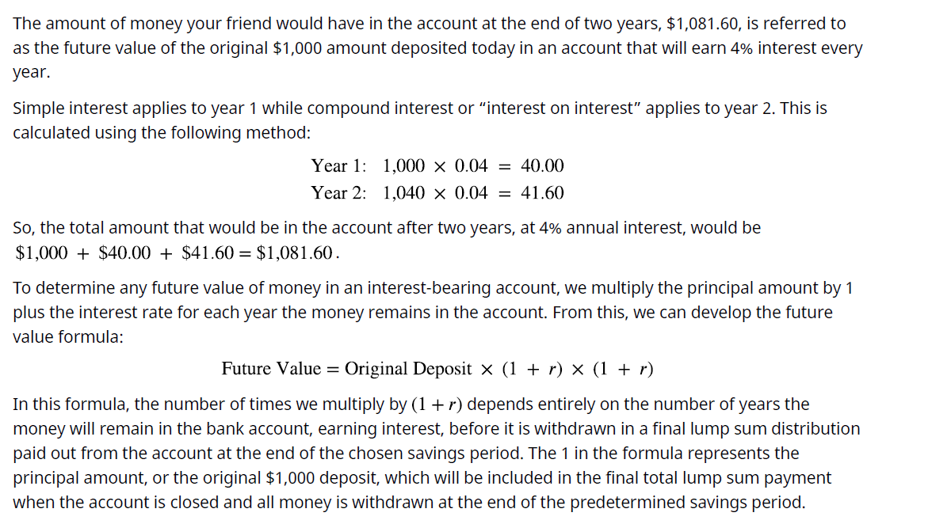

Slide 13
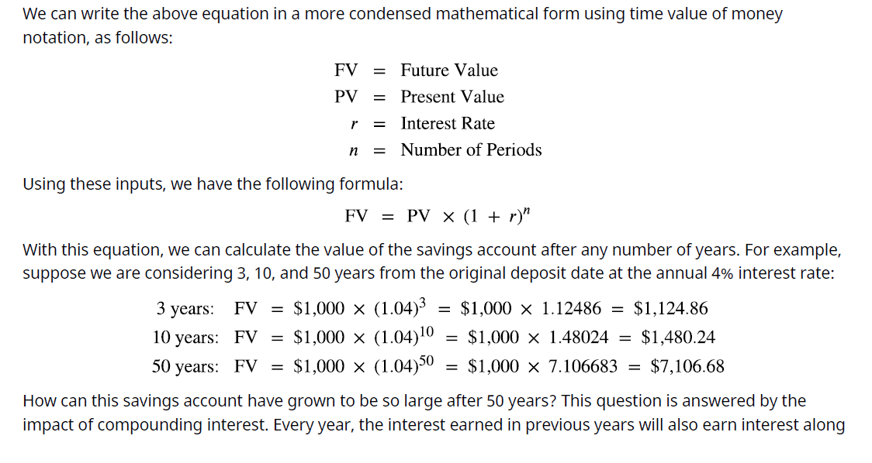
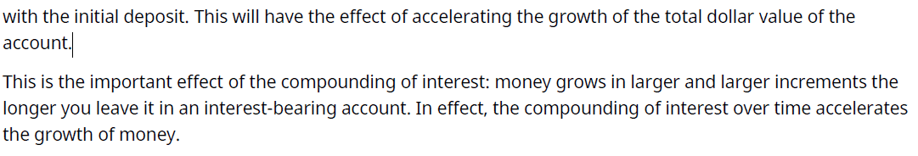

Slide 14

This is the important effect of the compounding of interest: money grows in larger and larger increments the longer you leave it in an interest-bearing account. In effect, the compounding of interest over time accelerates the growth of money.
In order to determine the FV of any amount of money, it will always be necessary to know the following pieces of information: (1) the principal, initial deposit, or present value (PV); (2) the rate of interest, usually expressed on an annual basis as r; and (3) the number of time periods that the money will remain in the account (n). The interest rate is often referred to as the growth rate, or the annual percentage increase on savings or on an investment. When the rate is raised to the power of the number of periods, the formula will yield a number that is commonly referred to as the future value interest factor (FVIF). As a result of this process, as n (time, or the number of periods) increases, the future value interest factor will increase.
Also, as r (interest rate) increases, the FVIF will increases. For these reasons, the future value calculation is directly determined by both the interest rate being used and the total amount of time specifically, the number of periods being considered.

Slide 15
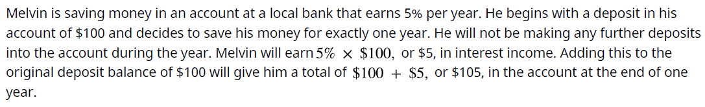
How Time Impacts Compounding
We have just seen that time will lead to the growth of our money. As long as the prevailing growth or interest rate of any account we have our money in is positive, the passage of time will have the effect of growing the value of our money. The longer the period of time, the greater the growth and the larger the future value of the money will be. This can be reinforced very clearly with the following example.
Melvin likes this idea and believes he may be able to keep his money in the account for a longer period of time. How much money will he have in his account, without any further deposits, at the end of years two, three, four, and five?

Slide 16
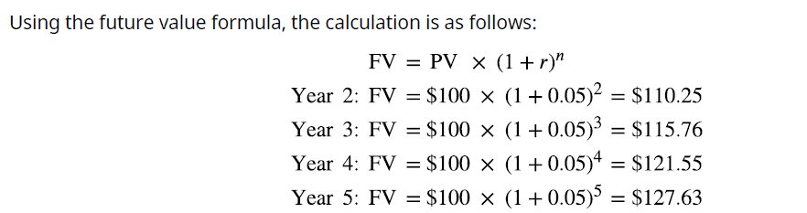
Chapter
05

Slide 17
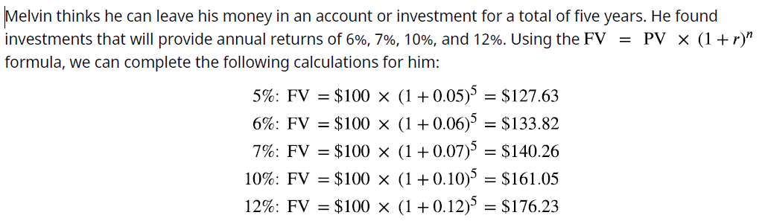
How the Interest Rate Impacts Compounding
Melvin likes the idea of earning more money over time, but he also believes that what he would earn in interest may not be enough for some of the things he plans to buy in the future. His friend suggests finding an account or some form of investment with a greater interest rate than the 5% he can get at his local bank.
Again, Melvin likes this information, and he states that he will try to find the highest interest rate available. This makes sense, but it’s important to remember that investments are usually not guaranteed to earn you specific interest rates, or rates of return. Most investments, other than Treasury investments such as Treasury bonds, carry some form of financial risk, either small or large, and the greater the rate of return, the more likely it is that the risk associated with the investment will also be greater. This risk does not have any effect on the future calculations we have just completed, but it an important factor to bear in mind and consider well before moving ahead and putting your money in any investment or financial instrument.

Slide 18
Methods for Solving Time Value of Money Problems
We can determine future value by using any of four methods: (1) mathematical equations, (2) calculators with financial functions, (3) spreadsheets, and (4) FVIF tables. With the advent and wide acceptance and use of financial calculators and spreadsheet software, FVIF (and other such time value of money tables and factors) have become obsolete, and we will not discuss them in this text. Nevertheless, they are often still published in other finance textbooks and are also available on the internet to use if you so choose. Using Timelines to Organize TVM Information A useful tool for conceptualizing present value and future value problems is a timeline. A timeline is a visual, linear representation of periods and cash flows over a set amount of time. Each timeline shows today at the left and a desired ending, or future point (maturity date), at the right.

Slide 19
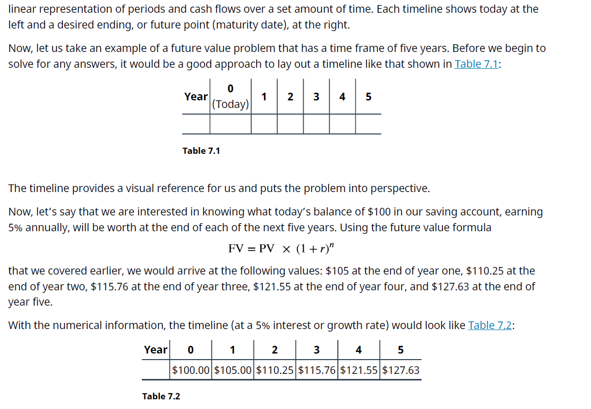
Using timelines to lay out TVM problems becomes more and more valuable as problems become more complex. You should get into the habit of using a timeline to set up these problems prior to using the equation, a calculator, or a spreadsheet to help minimize input errors. Now we will move on to the different methods available that will help you solve specific TVM problems. These are the financial calculator and the Excel spreadsheet.

Slide 20
Suppose that you have $1,000 and that you deposit this in a savings account earning 3% annually for a period of four years. You will naturally be interested in knowing how much money you will have in your account at the end of this four-year time period (assuming you make no other deposits and withdraw no cash). To answer this question, you will need to work with factors of $1,000, the present value (PV); four periods or years, represented by N; and the 3% interest rate.
We use the compound interest formula: A=P(1+r)tA=P(1+r)t,
where P=$1,000P=$1,000, r=0.03r=0.03, and t=4t=4 years.​
Final amount: 1000×(1+0.03)4=1125.511000×(1+0.03)4=1125.51.​
Year | Starting Balance | Interest | Ending Balance
1 | $1,000.00 | $30.00 | $1,030.00
2 | $1,030.00 | $30.90 | $1,060.90
3 | $1,060.90 | $31.83 | $1,092.73
4 | $1,092.73 | $32.78 | $1,125.51

Slide 21
Applications of TVM in Finance
Learning Outcomes
By the end of this section, you will be able to:
• Explain how the time value of money can impact your personal financial goals.
• Explain how the time value of money is related to inflation.
• Explain how the time value of money is related to financial risk.
• Explain how compounding period frequency affects the time value of money.
Single-Period Scenario
Let’s say you want to buy a new car next year, and the one you have your eye on should be selling for $20,000 a year from now. How much will you need to put away today at 5% interest to have $20,000 a year from now?
Essentially, you are trying to determine how much $20,000 one year from now is worth today at 5% interest over the year. To find a present value, we reverse the growth concept and lower or discount the future value back to the current period.

Slide 22
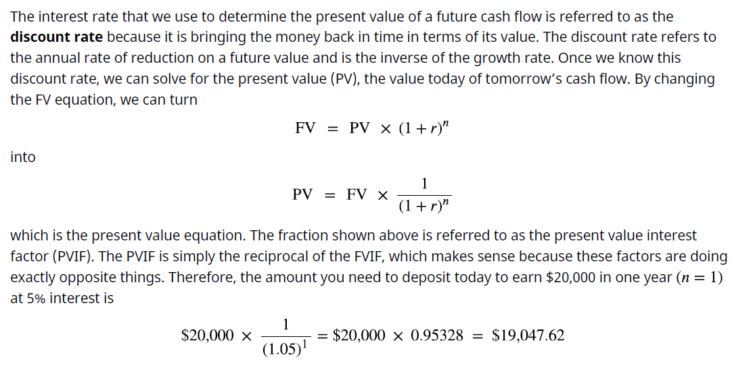

Slide 23
The Multiple-Period Scenario
There will often be situations when you need to determine the present value of a cash flow that is scheduled to occur several years in the future (see Figure). We can again use the formula for present value to calculate a value today of future cash flows over multiple time periods.

Slide 24

An example of this would be if you wanted to buy a savings bond for Charlotte, the daughter of a close friend. The face value of the savings bond you have in mind is $1,000, which is the amount Charlotte would receive in 30 years (the future value). If the government is currently paying 5% per year on savings bonds, how much will it cost you today to buy this savings bond?
The $1,000 face value of the bond is the future value, and the number of years n that Charlotte must wait to get this face value is 30 years. The interest rate r is 5.0% and is the discount rate for the savings bond. Applying the present value equation, we calculate the current price of this savings bond as follows:
So, it would cost you $231.38 to purchase this 30-year, 5%, $1,000 face-valued bond.
What we have done in the above example is reduce, or discount, the future value of the bond to arrive at a
value expressed in today’s dollars. Effectively, this discounting process is the exact opposite of compounding
interest that we covered earlier in our discussion of future value.
An important concept to remember is that compounding is the process that takes a present valuation of
money to some point in the future, while discounting takes a future value of money and equates it to present dollar value terms. Common applications in which you might use the present value formula include determining how much money you would need to invest in an interest-bearing account today in order to finance a college education for your oldest child and how much you would need to invest today to meet your retirement plans 30 years from now.

Slide 25
TVM, Inflation, Compounding Interest, Investing, Opportunity Costs, and Risk
The time value of money (TVM) is a critical concept in understanding the value of money relative to the
amount of time it is held, saved, or invested. The TVM concept and its specific applications are frequently used by individuals and organizations that might wish to better understand the values of financial assets and to improve investing and saving strategies, whether these are personal or within business environments. As we have discussed, the key element behind the concept of TVM is that a given amount of money is worth more today than that same amount of money will be at any point in the future. Again, this is because money can be saved or invested in interest-bearing accounts or investments that will generate interest income over time, thus resulting in increased savings and dollar values as time passes.
Inflation
The entire concept of TVM exists largely due to the presence of inflation. Inflation is defined as a general
increase in the prices of goods and services and/or a drop in the value of money and its purchasing power.
The purchasing power of the consumer dollar is a statistic tracked by the part of the US Bureau of Labor

Slide 26
Statistics and is part of the consumer price index (CPI) data that is periodically published by that government agency. In a way, purchasing power can be viewed as a mirror image or exact opposite of inflation or increases in consumer prices, as measured by the CPI. Figure demonstrates the decline in the purchasing power of the consumer dollar over the 13-year period from 2007 to 2020. With this in mind, we can work with the TVM formula and use it to help determine the present value of money you have in hand today, as well as how this same amount of money may be valued at any specific point in the future and at any specific rate of interest.

Slide 27
The Relationship between TVM and Inflation
As we have seen, the future value formula can be very helpful in calculating the value of a sum of cash (or any liquid asset) at some future point in time. One of the important ideas relating to the concept of TVM is that it is preferable to spend money today instead of at some point in the future (all other things being equal) when inflation is positive. However, in very rare instances in our economy when inflation is negative, spending money later is preferable to spending it now. This is because in cases of negative inflation, the purchasing power of a dollar is actually greater in the future, as the costs of goods and services are declining as we move into the future.
Most investors would be inclined to take a payment of money today rather than wait five years to receive a payment in the same amount. This is because inflation is almost always positive, which means that general prices of goods and services tend to increase over the passage of time. This is a direct function and result of normal economic growth. The crux of the concept of TVM is directly related to maintaining the present value of financial assets or increasing the value of these financial assets at different points in the future when they may be needed to obtain goods and services. If a consumer’s monetary assets grow at a greater rate than inflation over any period of time, then the consumer will realize an increase in their overall purchasing power.
Conversely, if inflation exceeds savings or investment growth, then the consumer will lose purchasing power as time goes by under such conditions.

Slide 28
The Impact of Inflation on TVM
The difference between present and future values of money can be easily seen when considered under the
effects of inflation. As we discussed above, inflation is defined as a state of continuously rising prices for goods and services within an economy. In the study of economics, the laws of supply and demand state that increasing the amount of money within an economy without increasing the amount of goods and services available will give consumers and businesses more money to spend on those goods and services. When more money is created and made available to the consuming public, the value of each unit of currency will diminish.
This will then have the effect of incentivizing consumers to spend their money now, or in the very near future, instead of saving cash for later use. Another concept in economics states that this relationship between money supply and monetary value is one of the primary reasons why the Federal Reserve might at times take steps to inject money into a stagnant, lethargic economy. Increasing the money supply will lead to increased economic activity and consumer spending, but it can also have the negative effect of increasing the costs of goods and services, furthering an increase in the rate of inflation.

Slide 29
Consumers who decide to save their money now and for the foreseeable future, as opposed to spending it now, are simply making the economic choice to have their cash on hand and available. So, this ends up being a decision that is made despite the risk of potential inflation and perhaps losing purchasing power. When inflationary risk is low, most people will save their money to have it available to spend later. Conversely, in times when inflationary risk is high, people are more likely to spend their money now, before its purchasing power erodes. This idea of inflationary risk is the primary reason why savers and investors who decide to save now in order to have their money available at some point in the future will insist they are paid, through interest or return on investment, for the future value of any savings or financial instrument.
Lower interest rates will usually lead to higher inflation. This is because, in a way, interest rates can be viewed as the cost of money. This allows for the idea that interest rates can be further viewed as a tax on holding on to sums of money instead of using it. If an economy is experiencing lower interest rates, this will make money less expensive to hold, thus incentivizing consumers to spend their money more frequently on the goods and services they may require. We have also seen that the more quickly inflation rates rise, the more quickly the general purchasing power of money will be eroded. Rational investors who set money aside for the future will demand higher interest rates to compensate them for such periods of inflation. However, investors who save for future consumption but leave their money uninvested or underinvested in low-interest-bearing accounts will essentially lose value from their financial assets because each of their future dollars will be worth less, carrying less purchasing power when they end up needing it for use. This relationship of saving and planning
for the future is one of the most important reasons to understand the concept of the time value of money.

Slide 30

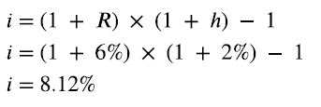
Nominal versus Real Interest Rates
One of the main problems of allowing inflation to determine interest rates is that current interest rates are
actually nominal interest rates. Nominal rates are “stated,” not adjusted for the effects of inflation. In order to determine more practical real interest rates, the original nominal rate must be adjusted using an inflation
rate, such as those that are calculated and published by the Bureau of Labor Statistics within the consumer
price index (CPI).
A concept referred to as the Fisher effect, named for economist Irving Fisher, describes the relationship
between inflation and the nominal and real interest rates and is expressed using the following formula:
where i is the nominal interest rate, R is the real interest rate, and h is the expected inflation rate.
An example of the Fisher effect would be seen in the case of a bond investor who is expecting a real interest
rate of return of 6% on the bond, in an economy that is experiencing an expected inflation rate of 2%. Using
the above formula, we have
So, the nominal interest rate on the bond amounts to 8.12%, with a real interest rate of 6% within an economy that is experiencing a 2% inflation rate. This is a logical result because in a scenario of positive inflation, a real rate of return would always be expected to amount to less than the stated or nominal rate.

Slide 31
Interest and Savings
Savings are adversely affected by negative real interest rates. A person who holds money in the form of cash is actually losing future purchasing value when real interest rates are negative. A saver who decides to hold
$1,000 in the form of cash for one year at a negative real interest rate of −3.65% per year will lose
$1000*- 0.0365 or $36.50, in purchasing power by the end of that year.
Ordinarily, interest rates would rise to compensate for negative real rates, but this might not happen if the
Federal Reserve takes steps to maintain low interest rates to help stimulate and stabilize the economy. When interest rates are at such low levels, investors are forced out of Treasury and money market investments due to their extremely poor returns.
It soon becomes obvious that the time value of money is a critical concept because of its tremendous and
direct impact on the daily spending, saving, and investment decisions of the people in our society. It is
therefore extremely important that we understand how TVM and government fiscal policy can affect our
savings, investments, purchasing behavior, and our overall personal financial health.

Slide 32
Compounding Interest
As we discussed earlier, compound interest can be defined as interest that is being earned on interest. In
cases of compounding interest, the amount of money that is being accrued on previous amounts of earned interest income will continue to grow with each compounding period. So, for example, if you have $1,000 in a savings account and it is earning interest at a 10% annual rate and is compounded every year for a period of five years, the compounding will allow for growth after one year to an amount of $1,100. This comprises the original principal of $1,000 plus $100 in interest. In year two, you would actually be earning interest on the total amount from the previous compounding period the $1,100 amount.
So, to continue with this example, by the end of year two, you would have earned $1,210 ($1,100 plus $110 in interest). If you continue on until the end of year five, that $1,000 will have grown to approximately $1,610. Now, if we consider that the highest annual inflation rate over the last 20 years has been 3%, then in this scenario, choosing to invest your present money in an account where interest is being compounded leaves you in a much better position than you would be in if you did not invest your money at all. The concept of the time value of money puts this entire idea into context for us, leading to more informed decisions on personal saving and investing. It is important to understand that interest does not always compound annually, as assumed in the examples we have already covered. In some cases, interest can be compounded quarterly, monthly, daily, or even continuously. The general rule to apply is that the more frequent the compounding period, the greater the future value of a savings amount, a bond, or any other financial instrument. This is, of course, assuming that all other variables are constant.

Slide 33
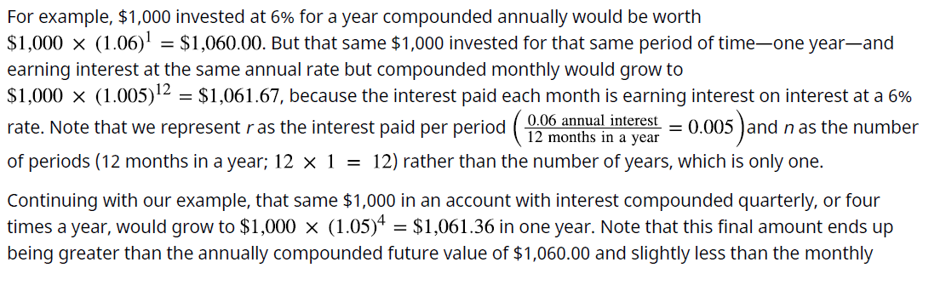
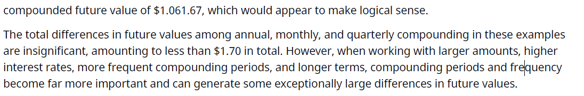

Slide 34
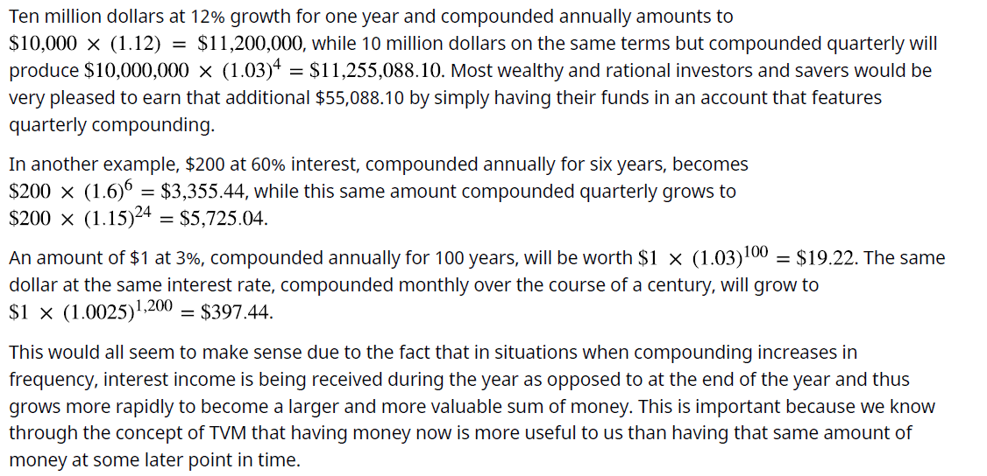

Slide 35
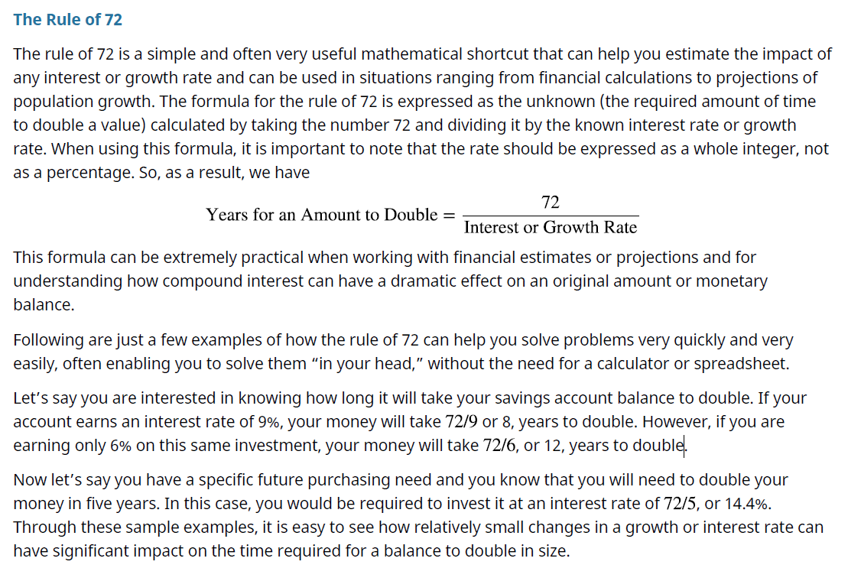

Slide 36
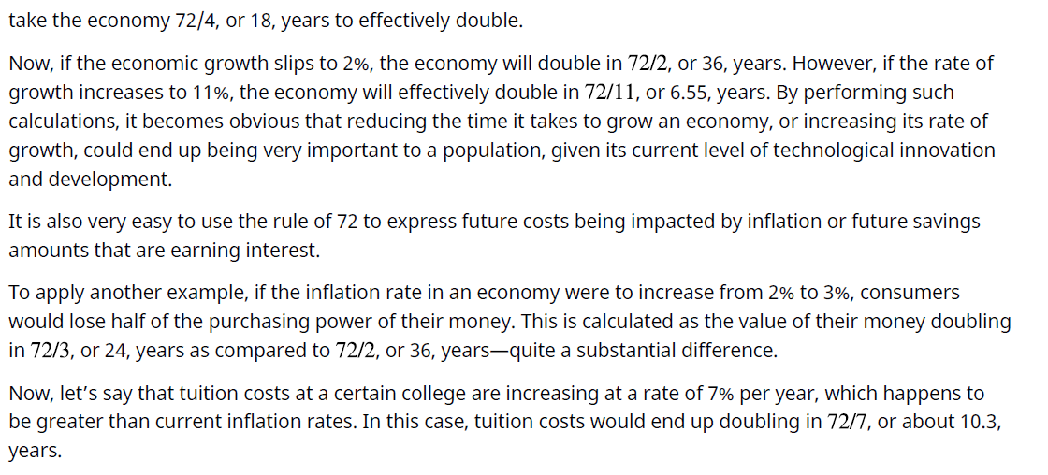

Slide 37
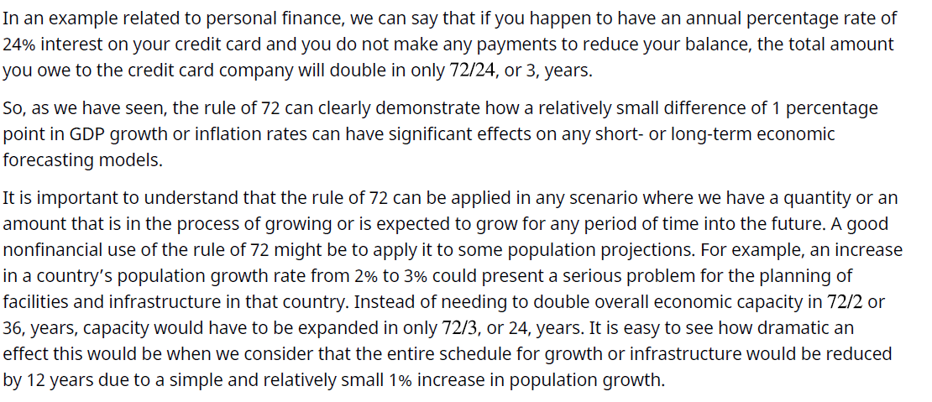

Slide 38
Investing and Risk
Investing is usually a sound financial strategy if you have the money to do so. When investing, however, there are certain risks you should always consider first when applying the concepts of the time value of money. For example, making the decision to take $1,000 and invest it in your favorite company, even if it is expected to provide a 5% return each year, is not a guarantee that you will earn that return or any return at all, for that matter. Instead, as with any investment, you will be accepting the risk of losing some or even all of your money in exchange for the opportunity to beat inflation and increase your future overall wealth. Essentially, it is risk and return that are responsible for the entire idea of the time value of money. Risk and return are the factors that will cause a rational person to believe that a dollar risked should end up earning more than that single dollar.
To summarize, the concept of the time value of money and the related TVM formulas are extremely important because they can be used in different circumstances to help investors and savers understand the value of their money today relative to its earning potential in the future. TVM is critical to understanding the effect that inflation has on your money and why saving your money early can help increase the value of your savings dollars by giving them time to grow and outpace the effects of inflation.

Slide 39
Opportunity Costs
The concept of opportunity cost arises from the idea that there will always be possible options that are sacrificed with every option we decide on or for every choice that we make. For example, let’s consider the decision to go to college after you graduate from high school. This decision, as with just about any other, will involve evaluating opportunity costs. If you choose to go to college, this will result in your sacrificing four years of potential earnings that you could have had if you had decided to take a job instead of attending school.
Also, in addition to the lost salary, you would be losing out on four years of work experience that could have had a positive impact on your résumé or your future earnings prospects. Of course, the entire idea behind furthering one’s education is that you are hopeful that by choosing to go to college, you will increase the likelihood of earning a greater salary over the course of your lifetime than you would have if you had chosen to join the workforce directly out of high school. So, this ends up being a bit of a risk, but one that you have considered. The idea is that you are hoping for a more significant payoff down the road than if you had made the decision not to continue with your studies.

Slide 40
When it comes to opportunity costs and the time value of money, it is obvious that there will always be costs associated with every forgone financial opportunity we pass on when we make a different choice. The logical individual can only hope that these choices produce a better end result than if we had made different choices and pursued any of our forgone alternatives. This also applies in situations where we may sit idly by and decide to take no action at all.
For example, if you are putting $1,000 in a savings account to save for a house, you may be giving up an opportunity to grow that money in an investment account that would earn a greater rate of return. In another example, being able to calculate the future value of your money will tell you that instead of investing, you probably should be paying down your 24% APR credit card debt that is costing you hundreds of dollars a month hundreds of dollars more than you might earn from an investment account.

Slide 41
Summary
1 Now versus Later Concepts
This section discussed the underlying concepts of the time value of money (TVM). Because it is possible to earn interest income on cash that you decide to deposit in an investment or an interest-bearing account, money that you have now or receive sooner will be more valuable to you than the same amount of money received later.
2 Time Value of Money (TVM) Basics
Future value refers to the value that a current amount will eventually grow into at a given interest rate over a specific period of time. The single-period scenario is one way in which future amounts are calculated. Compounding, which is interest earned on interest, also affects the future value of money.
3 Methods for Solving Time Value of Money Problems
Calculations can be used to determine future and present dollar amounts, discount and growth rates, and periods of time required for specific growth. Time value of money problems can be solved using mathematical equations, calculators with financial functions, and spreadsheets. A useful tool for conceptualizing present value and future value problems is a timeline. A timeline is a visual, linear representation of the timing of periods and cash flows over a set amount of time.
4 Applications of TVM in Finance
The idea of the time value of money is often considered to be the cornerstone concept of the study of finance. TVM can help investors and savers understand the value of money today relative to its earning potential in the future. TVM is critical to understanding the effect that inflation has on money and why saving your money early can help increase the value of your savings dollars by giving them time to grow and outpace the effects of inflation. Of course, it is important to remember that there will always be possible options that are sacrificed with every option you decide on and every choice you make.

Slide 42



Thank You

