Slide 1




Organizational Behavior and Projects
PMG421
Prepared by Mrs. Deena Ibrahim
Lecture 10
Common Project Practices
Quality in Practice

Slide 2


1- Common Project Practices
Commonly Used Tools Compliance Matrix. Peer Review.
2- Quality in Practice Project Systems and Solutions. The Red Bead Experiment.
2. Summary.

Slide 3
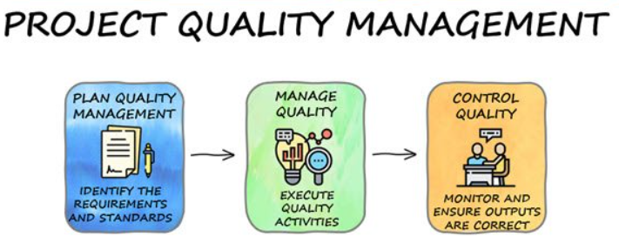
Introduction
Managing project quality is not restricted to using traditional quality tools. Project managers may and should use or develop whatever tools are necessary to deliver quality products and services to customers.

Slide 4
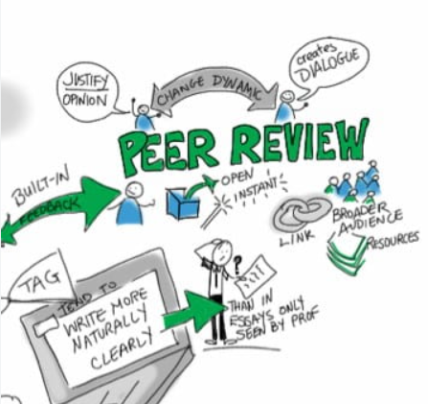
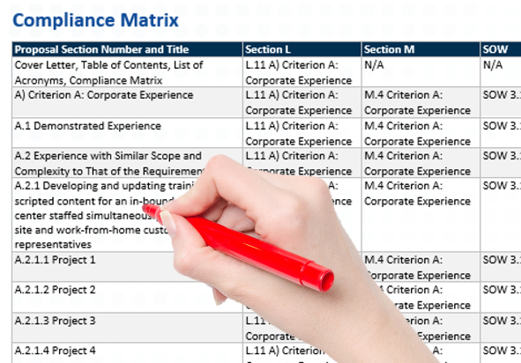
Commonly Used Tools
The two tools described here are not among the set of traditional quality tools, but they are so widespread in use that any discussion of project quality would be incomplete without mentioning them.

Slide 5

Compliance Matrix
A compliance matrix is a tool to ensure that actions comply with requirements. It may be a simple checklist or it may be a little more complex. Its first application to project quality may be during the bid and proposal phase. A good compliance matrix well applied will provide confidence that the proposal responds to all requirements in the solicitation.
It may also be applied during project implementation as a checklist for deliverables.

Slide 6
A good compliance matrix will ensure that all requirements have been met before a deliverable is released to the customer. Project managers may design the matrix structure in any way that meets project needs. The next example includes essential elements of information necessary to ensure compliance with requirements.

Slide 7
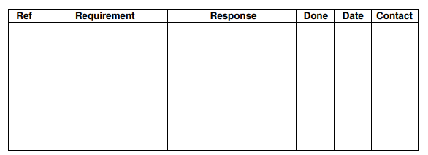
◆ Reference : This column shows the paragraph numbers of the requirements, perhaps from a solicitation document or a task order of some kind.
◆ Requirement : This column includes the exact requirements from the solicitation document or task order. Requirements may be extracted and quoted directly or they may be summarized in language that is meaningful to the project team. Either way, all requirements must be included. Any verb (action word) indicates that what follows is something that must be done.

Slide 8
◆ Response : In the simplest use of a compliance matrix, this column may include brief statements of what the project team will do to comply with the requirement. When the matrix is complete, this column may then be used as a foundation for writing the final proposal.
◆ Done : This column indicates status on completion of the requirement-response connection as a yes/no entry.
◆ Date : This column indicates the date of completion or latest action.
◆ Contact : This column indicates contact data for the individual responsible for the action or individuals who must be included in coordination.

Slide 9
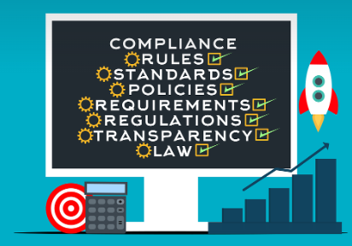
A compliance matrix is both a guide to the evaluator and a checklist for the Proposal Manager to make sure every requirement is answered. It can also be used as a guide by the writers. It helps the customer understand the responses to their requirements.
The compliance matrix is a very important tool in the proposal process. A compliance matrix is used by the team members in different ways, such as;
To develop a compliance strategy.
To understand what the customer is looking for.
To create a guide for the proposal writers.
To check if all the requirements are met.
To track the progress of the proposal.

Slide 10

An effective compliance matrix
By following the tips given below, you can create an effective compliance matrix which will help you win the bid.
Follow the RFP:
The compliance matrix should be created early and updated from time to time. The three major components of compliance are:
Submittal instructions.
Requirements.
Internal compliance.

Slide 11

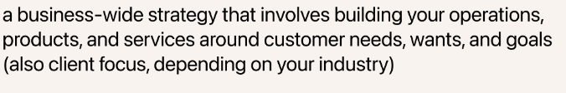
An effective compliance matrix
Start Early and Update Often
This will ensure that your compliance matrix is always up-to-date and accurate.
Make it Customer-Focused
The compliance matrix should be designed with the customer in mind. It should be easy for them to understand and follow.
Use Easy-To-Understand Language
The compliance matrix should be written in clear and concise language. This will make it easier for the customer to follow and understand.
Include all the Necessary Information
All relevant information should be included in the compliance matrix. This will make it more complete and helpful.

Slide 12

Get Input from all Team Members
All team members should have a chance to contribute to the compliance matrix. This will ensure that all perspectives are considered.
Use it as a Guide throughout the Proposal Process
The compliance matrix should be used as a guide throughout the proposal process. It should be consulted often to ensure that all requirements are being met.
Track Progress
The compliance matrix should be used to track the progress of the proposal and compliance with the customer’s requirements. This will help to identify any areas that need improvement.

Slide 13

As a next step, the project team might select its most gifted writer to prepare the final proposal using the information in the “response” column as a guide. When the proposal has been written and coordinated, the compliance matrix might serve as a last-step checklist for reviewing the proposal before it is submitted to the soliciting organization.

Slide 14


Slide 15

Peer review
Peer review is a common practice in most project organizations. Its purpose is to ensure technical soundness of products before they are delivered to customers. Products involved are usually plans, reports, or some other type of intellectual document. Peer review is a simple process. When authors complete documents, they send the finished product to another person who possesses technical expertise equal to or superior to their own.

Slide 16

That person reviews the document for technical soundness. If reviewers disagree about approach, methods, conclusions, or any technical aspects of the documents, they work out the disagreement directly with the authors. If reviewers and authors cannot agree, they escalate the matter to a superior (a task manager or a project manager) for resolution.

Slide 17

Peer review is focused on technical matters only. It is not a review of grammar or writing style; that is an editorial review, which is an entirely different process. Peer reviewers must resist any temptation to force authors to “write it my way.” At the same time, authors must be able to accept technical criticism and not defend on “that’s the way I write.” Peer review is an excellent way to get a second look at important products before they are delivered to customers.

Slide 18

Peer review can have a dark side. Some authors may bias their documents to personal friends who are not likely to criticize their work or to other writers with whom they have an unspoken mutual noncritique agreement. This can lead to ineffective reviews and the phenomenon of “group think.” Some reviewers may use the process to take cheap shots at authors with whom they may see as competitors for promotion, rewards, or influence within the organization. Effective peer review depends on good intentions by all, inoffensive candor by all involved, and non punitive resolution of any technical disagreements.

Slide 19

Quality in Practice

Slide 20

Project Systems and Solutions
Project quality is a result of many things working together to produce a satisfied customer. Things that work together constitute a system. To manage project quality, project managers must, in Dr. Deming’s words, gain an appreciation for systems. They must understand the elements of the system within which they work and how the elements interact with and influence each other. This is no easy task. System performance can be obscured by ignorance, or bias. To overcome these hurdles, Dr. Deming developed a demonstration using red and white beads.

Slide 21
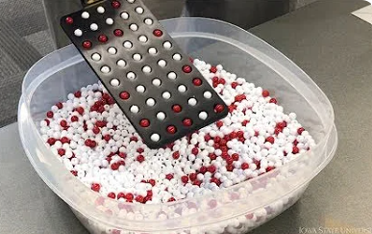
RED BEAD EXPERIMENT
Dr. Deming explained the red bead experiment in his book Out of the Crisis.
The experiment includes the following:
◆ People — Six workers, consistently referred to as “willing workers”; two inspectors and one chief inspector; and one recorder.
◆ Materials — Red and white beads, a container to hold the beads, and a paddle with fifty indentations that will hold one bead each.
◆ Processes — Willing workers dip the paddle into the bead container until it is completely covered, then carefully withdraw it. Gently shaking the paddle and allowing excess beads to roll off results in a paddle with a bead in each of the fifty indentations.

Slide 22

During the experiment, each willing worker, in turn, dips the paddle into the container and produces a sample of fifty beads. This is repeated for several rounds, usually four or five, to simulate a number of workdays; willing workers produce one sample per day. After the willing workers produce their samples, they report to an inspector who counts defects. A defect is a red bead .

Slide 23
Willing workers are provided brief training and told they will have an training period. They are then put directly to work without any period of training . The facilitator announces a quota of no more than one red bead per day. The facilitator praises good performance, a very low number of defects, and condemns or punishes with dismissal poor performance, a very high number of defects.

Slide 24
After several days of work, the facilitator threatens workers with dismissal because of their inconsistent and generally poor performance. After all, no one is meeting the quota of no more than one defect per paddle. The facilitator ensures that senior managers among the participant group are included in the willing worker group and, as the experiment progresses, points out their poor performance to the great glee of the other participants. Finally, when all workdays are complete, the facilitator closes the operation and tells all willing workers to collect their severance pay on the way out.

Slide 25
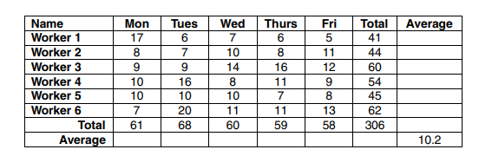
The matrix prepared by the recorder might look something like

Slide 26
The red bead experiment reveals much about system performance. While many system elements interact, in this case, materials determine results. The bead mixture is 80 percent white beads and 20 percent red beads. The paddle holds fifty beads. The worker does not try to change results by quickly dipping the paddle again if it looks like a large number of red beads are on the paddle from the initial.
Or the worker does not bump the paddle against the container and knock some beads off — the number of red beads in each sample of fifty will be about 20 percent, or about ten. As the number of samples increases, the average will get closer and closer to ten.

Slide 27

Other factors may seem to influence results, but they are not relevant:
◆ Inspections (excessive) have no effect on system performance.
◆ Slogans have no effect on system performance.
◆ Management (by the facilitator) has no effect on system performance.
In this case, the only thing that matters — the only factor that affects and determines system performance — is the percentage of red beads in the bead mix.

Slide 28
The lesson is:
Fix the system, do not blame the workers. It calls back to the 85/15 rule that says about 85 percent of a worker’s performance is determined by the system and 15 percent is determined by individual effort. The bead mixture principally determines results. A worker can still influence results to a degree through careless performance (knocking beads from the paddle during production) or by cheating (dipping the paddle twice).

Slide 29

The red bead experiment also reveals something about variation.

Slide 30

A compliance matrix is used to ensure that actions comply with requirements. It may be applied as a checklist or as a tool for developing a comprehensive, responsive proposal.
◆ Peer review is a common method of ensuring technical soundness of intellectual products prior to delivery to customers.
◆ Peer review is technically focused. It is not a review of grammar or writing style.
◆ When managing project quality, project managers must gain an appreciation for systems. They must understand the elements that work together to produce project results.
◆ Quality tools enable understanding of systems. They enable fact-based analysis and decisions that ensure delivery of quality products and services.

Slide 31


