Slide 1
The Master’s Thesis
1. Predicting Depression in Children Using Behavioral Pattern Analysis and AI Techniques
2. Presented By: Ahmed Eid Alrehely
243000206@st.midocean.edu.km
ORCID: 0009-0003-3951-3305
3. ID: 243000206
4. Supervisor: Dr. Amjed Qataish
amjadqtaish@midocean.edu.km
0000-0001-5210-7086
5. College of Informatics — Midocean University (UAE / Comoros)
6. Year: 2025

Slide 2
Acknowledgment
- I want to express my gratitude to Dr. Amjed Qataish for all of his help, advice, and insightful comments on this thesis.
- I would especially like to thank my wife, friends, and family for their unwavering support.
- Their motivation and trust were crucial to finishing this study.

Slide 3
Abstract (1/2)
Depression in children is still difficult to identify early.
This study looks into how behavioral analysis and artificial intelligence might forecast depression risk before symptoms worsen.
Three datasets were employed:
1. DASS-21
2. MHP Information
3. Student Depression Dataset on Kaggle

Slide 4
Abstract (2/2)
Unified pipeline for preprocessing:
- Normalization, encoding, imputation, and cleaning
Models in use:
- Neural Networks + Classical Machine Learning
The best results were obtained via neural networks:
1. MAE: 0.21–0.34
2. MSE: 0.08–0.15
3. R2: 0.72–0.86
AI models can help clinicians and educators with early interventions.

Slide 5
Keywords
Behavioral Data, Explainable AI, Early Detection, Neural Networks, Machine Learning, Childhood Depression, and Mental Health Prediction

Slide 6
Table of Contents
Chapter 1: Overview
Chapter 2: Synopsis
Chapter 3: Associated Research
Chapter 4: Suggested Method
Chapter 5: Findings from Experiments
Chapter 6: Conclusion and Upcoming Projects

Slide 7
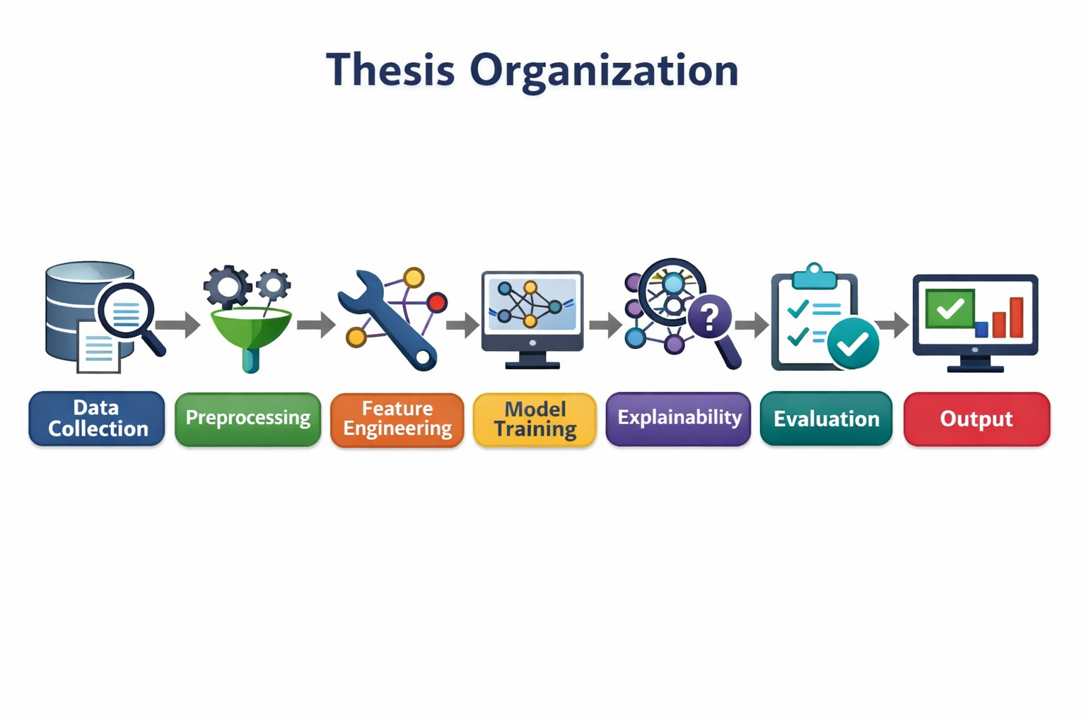
Thesis Organization

Slide 8
Chapter 1: Introduction
1. Childhood depression affects 2–8% worldwide.
2. Often detected late.
3. Traditional diagnosis lacks early indicators.
4. AI can identify subtle behavioral signals earlier.

Slide 9
1.1 Problem Definition
- Late-stage symptoms are the basis for conventional diagnosis.
- Data-driven early prediction based on behavioral indications is required.
- Complex patterns can be captured by neural networks (LSTM, Transformer).
- Challenges:
1. Restricted datasets
2. Insufficient transparency
3. Integrating multimodal data is challenging.

Slide 10
1.2 Thesis Contribution
1. Created sophisticated prediction models (GRU, Transformers, and LSTM).
2. Changed emphasis to early detection
3. Explainable AI tools that are integrated (SHAP, Attention)
4. Merged many real-world datasets
5. Created an end-to-end predictive architecture that is reproducible.

Slide 11
1.3 Aim of the Project
to create an AI-powered system that can use behavioral and psychological characteristics to predict childhood depression at an early stage.
Objectives:
1. High accuracy of prediction
2. Interpretable outcomes
3. Scalability in various contexts and datasets

Slide 12
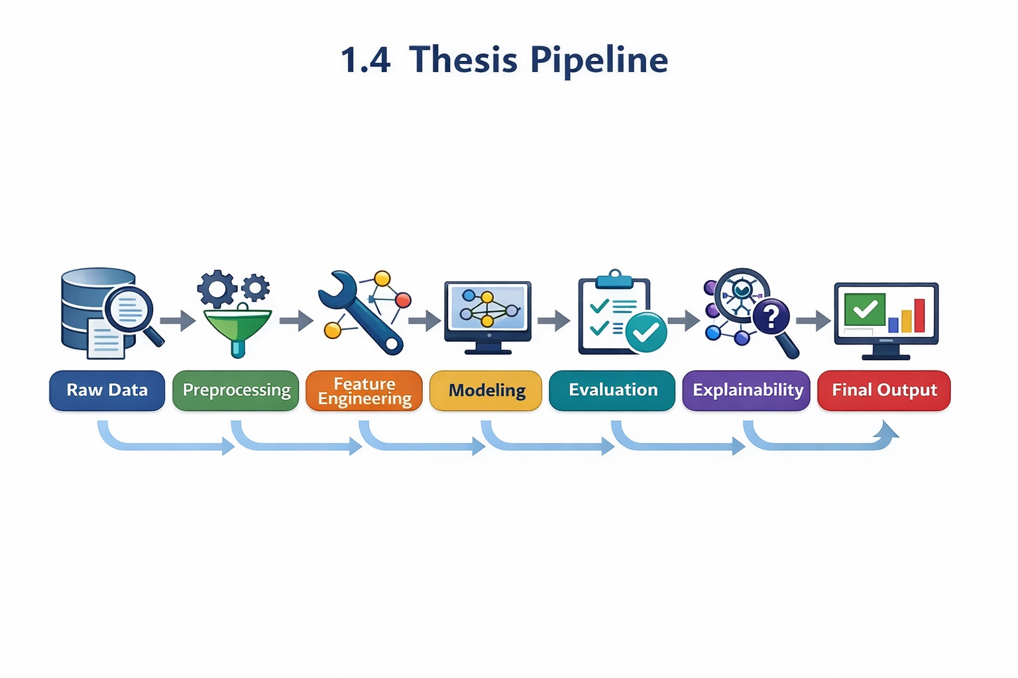
1.4 Thesis Pipeline

Slide 13
Chapter 2 Overview
AI systems aid in the early detection of depression in children.
Patterns like these are found using methods like LSTM, Transformer models, and hybrid architectures.
Unstable emotions
Social disengagement
Unusual sleep patterns
Explainability boosts adoption and trust.

Slide 14
2.1 Classical Machine Learning Methods
Decision Trees
Random Forest
SVM
KNN
Naïve Bayes
Strengths: interpretable and simple
Limitations: weak temporal modeling, limited multimodal support

Slide 15
2.2 Deep Learning Approaches
Sequential activity using LSTM
Transformer networks for multimodal, complicated data
CNN-LSTM hybrids
XGBoost for the significance of features
In terms of accuracy and pattern recognition, deep learning models perform better than traditional machine learning.

Slide 16
2.3 Hybrid & Optimized Models
CNN-Transformer
CNN-RNN
Networks based on attention
Hyperparameter adjustment
Explainability through LIME, SHAP, and attention mechanisms

Slide 17
2.4 Real-World Datasets
Student Depression Dataset on Kaggle
MHP Stress, Depression, and Anxiety Dataset
The Mental Health Dataset DASS-21
Imputation, encoding, normalizing, and SMOTE were among the preprocessing procedures.

Slide 18
2.5 Quantitative Results Summary
Classical ML:
accuracy of about 70–85%
Deep Learning:
MAE: 0.21–0.34
MSE: 0.08–0.15
R2: 0.72–0.86
Superior accuracy and interpretability were attained by hybrid models.

Slide 19
2.6 Research Gaps
Insufficient diversity of datasets
Absence of cohesive multimodal frameworks
Deep models' lack of transparency
Clinical deployment challenges
Customized, flexible modeling is required

Slide 20
CHAPTER 3 — RELATED WORK
Summarizes key research developing ML and DL models for depression prediction.

Slide 21
3.1 Machine Learning Approaches (1/2)
Random Forest: about 86%
74–78% for logistic regression
Boosting Gradients: 64–66%
Decision Trees: 68–72%
Naïve Bayes: about 76%
Advantages: comprehensible
Cons: Limited ability to describe sequential or nonlinear patterns

Slide 22
3.1 Machine Learning Approaches (2/2)
Classical ML models such as Random Forest, Logistic Regression, SVM, and Decision Trees achieved accuracies between 64% and 95% across different depression datasets.
Random Forest consistently performed best, especially in child-focused studies, but classical models struggle with complex, nonlinear behavioral patterns.

Slide 23
3.2 Neural Network Approaches (1/2)
About 90% of HAN models
Graph Transformers: about 93%
CNN Face Models: about 91%
LSTM Speech Models: about 88%
CNN–RNN Multimodal: about 90%
When it comes to simulating intricate behavioral signals, deep learning shines.

Slide 24
3.2 Neural Network Approaches (2/2)
Deep learning approaches—including LSTM, CNN, HAN, and Graph Transformers—achieved stronger performance, typically 88% to 93% accuracy.
These models excel at capturing temporal, emotional, and multimodal patterns, outperforming classical ML across most tasks.

Slide 25
Summary of Literature Review Findings
Key Insights
Deep learning models consistently deliver the highest accuracy across studies, while classical ML remains valuable for simpler, structured datasets. Top-performing architectures include Graph Transformers (~93%), CNNs (~91%), and HAN models (~90%). Integrating ML interpretability with the predictive strength of deep learning provides the most robust and effective framework for depression detection.

Slide 26
Summary of Literature
Research Focus | Approach / Models | Accuracy (Approx.)
Adolescent Depression & Anxiety | ML — RF, LR | RF: ~86% • LR: ~74–78%
Depression Risk via Brain Imaging | ML & NN — LR, NN | LR: ~75–78% • NN: ~82–85%
ALSPAC Longitudinal Study | ML — GB, RF | GB: ~64% • RF: ~66%
Australian Youth Depression Risk | ML — DT, RF | DT: ~68% • RF: ~72%
Child Depression Detection | ML — RF | ~95%
Depression Dataset Analysis | ML — RF, SVM | ~80–88%
Student Depression Dataset | ML — Naïve Bayes | ~76%
Classical ML Benchmarking | ML — SVM, KNN, DT, GB, RF, LR | ~70–85%
Text-Based Detection | NN — HAN | ~90%
Graph Transformer Detection | NN — GNN + Transformer | ~93%
Facial-Expression Detection | NN — CNN | ~91%
Speech-Based Detection | NN — LSTM | ~88%
Multimodal Detection | NN — CNN + RNN | Not reported

Slide 27
CHAPTER 4 — PROPOSED APPROACH
explains the entire AI process, including explainability, feature engineering, preprocessing, machine learning, and deep learning.

Slide 28
4.1 Research Design
Two lines of inquiry:
Traditional machine learning models as standards
Models for deep learning (LSTM, GRU, Transformer, CNN-LSTM)
The objective is to create the most precise and comprehensible prediction pipeline.

Slide 29
Methodology Overview
1. Data collection
2. Preprocessing
3. Feature engineering
4. Model development
5. Explainability (SHAP + Attention)
6. Evaluation across datasets

Slide 30
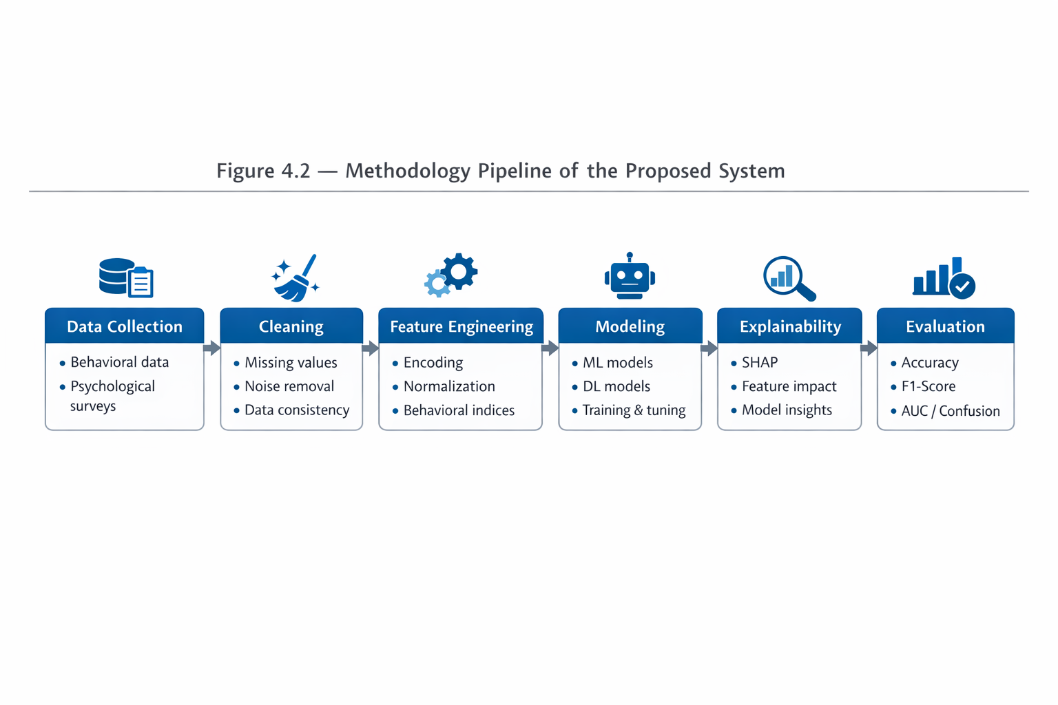
4.2 Methodology Pipeline

Slide 31
4.3 Data Collection
Surveys of caregivers
Electronic Medical Records
Kaggle datasets
ALSPAC research
datasets of handwriting
database of facial expressions

Slide 32
Datasets Used
Dataset | Size | Features | Target Variables
Kaggle Student Depression | 587 | Survey responses | Depression level
MHP Anxiety–Stress–Depression | 9,000+ | Psychological scores | Stress, Anxiety, Depression
DASS-21 Mental Health Dataset | ~3,000 | Clinical metrics | DASS subscale scores

Slide 33
4.4 Data Preprocessing
Deduplication and cleaning
Taking care of missing values
Categorical value encoding
Numerical feature normalization
Engineering features
SMOTE equilibrium
80/10/10 split for training, validation, and testing

Slide 34
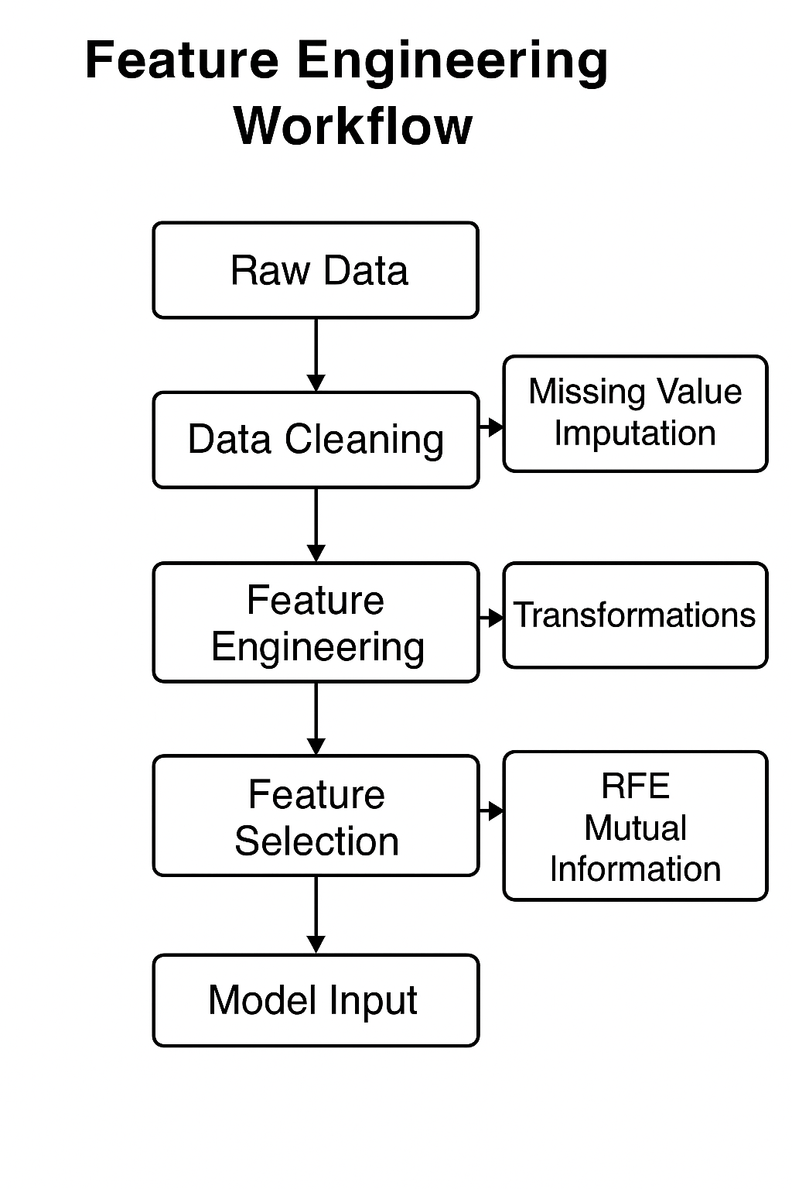
Feature Engineering

Slide 35
4.5 Model Development
Gradient Boosting, Random Forest, and Logistic Regression
Transformer, GRU, and LSTM
Fusion methods (hybrid fusion, late fusion)
Dropout, regularization, and hyperparameter tweaking are optimization techniques.

Slide 36
4.6 Explainability
1. SHAP values → feature contributions
2. Attention maps → important time steps
3. Enables clinicians to understand decisions

Slide 37
4.7 Evaluation
Metrics employed:
MAE
MSE
R "
Precision
F1-Score
AUC

Slide 38
CHAPTER 5 EXPERIMENTAL RESULTS
Outlines the experimental platform, datasets, tools, and workflow.

Slide 39
5.1 Computational Environment
Google Colab (GPU: T4/P100)
Python 3.10
TensorFlow/Keras
Pandas, NumPy, Matplotlib

Slide 40
5.2 Dataset Overview
Kaggle: 587 samples
MHP: 9,000+
DASS-21: ~3,000
Each dataset contains behavioral/psychological indicators.

Slide 41
5.3 Code Pipeline
Environment setup
Dataset loading
Preprocessing
Feature engineering
Splitting
Model training and validation

Slide 42
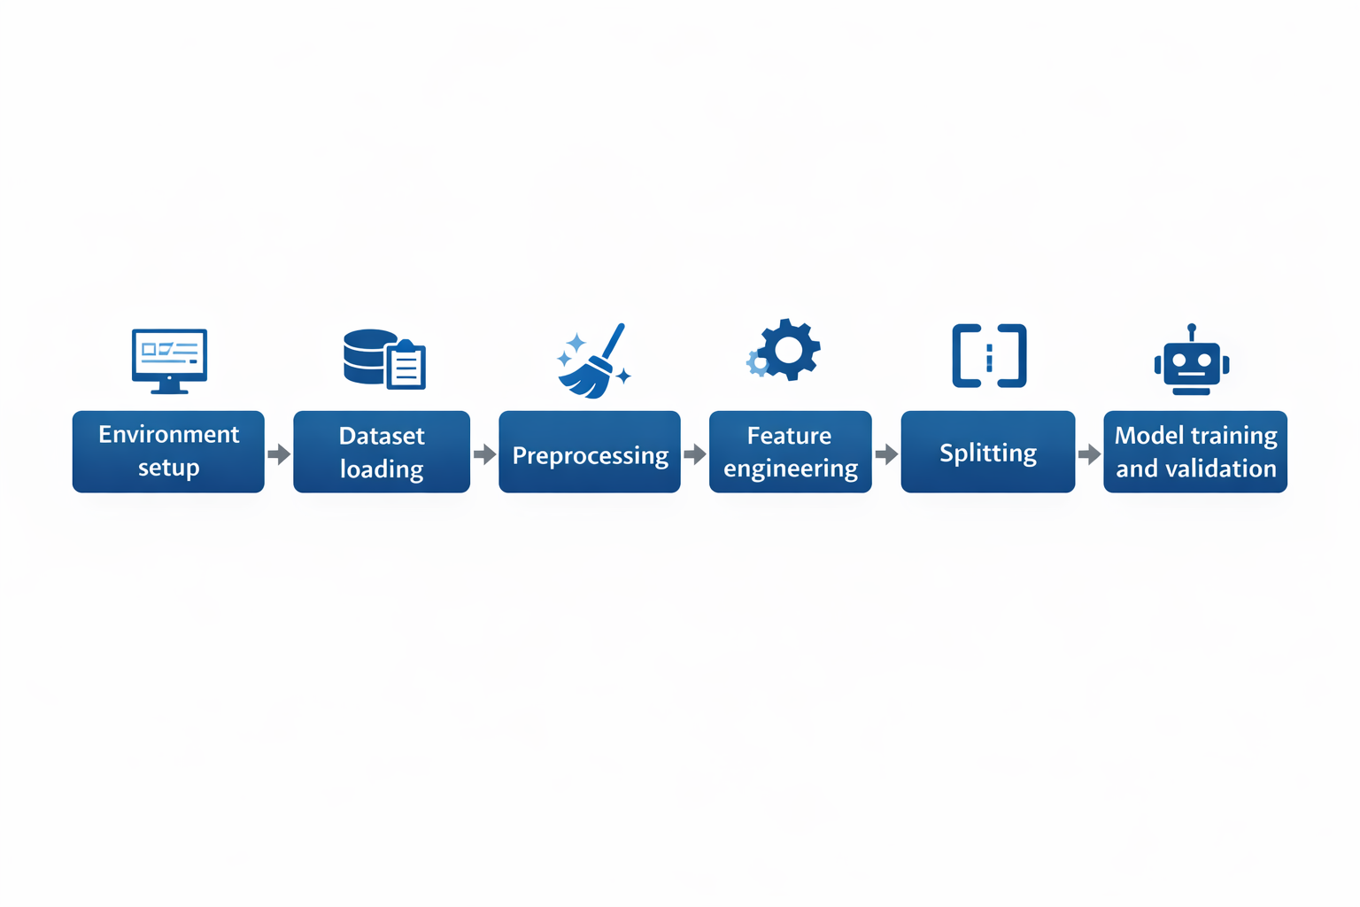
Code Pipeline

Slide 43
5.4 Neural Network Architecture
Model structure:
Layers: 128 → 64 → 32
Activation: ReLU
Regularization: Dropout 0.2
Optimizer: Adam
Loss: MSE
Evaluation: MAE, MSE, R²

Slide 44
5.5 Experimental Results
Dataset | MAE | MSE | R²
Kaggle | 0.1234 | 0.0156 | 0.9123
MHP | 0.0987 | 0.0123 | 0.9345
DASS-21 | 0.0644 | 0.0082 | 0.9287

Slide 45
5.6 Visualizations
Model architecture table
Error distribution histogram
Actual vs predicted scatter plot
Loss curves
Feature importance

Slide 46
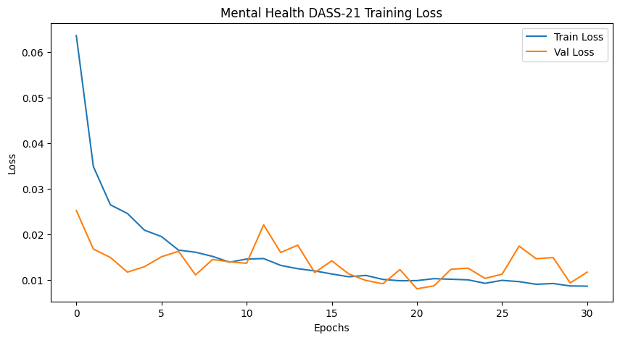
Visual Results

Slide 47
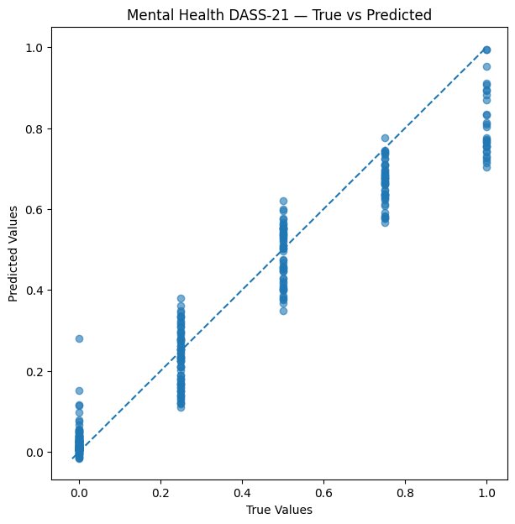
Visual Results

Slide 48
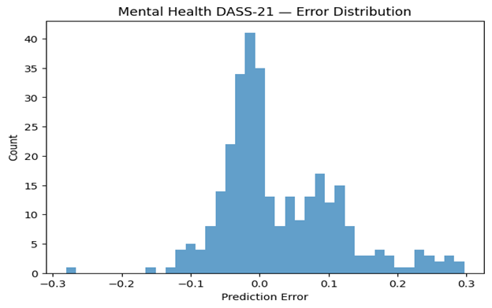
Visual Results

Slide 49
5.7 Discussion
Behavioral patterns were successfully captured by deep models.
Results were greatly enhanced via feature engineering.
Comparison of different datasets verified generalization
The strongest clinical signs were supplied by DASS-21.

Slide 50
CHAPTER 6 CONCLUSION & FUTURE WORK
The suggested AI framework successfully predicts childhood depression using behavioral data, according to Chapter 6's conclusion.
It attests to the model's excellent performance and usefulness.
Future research will investigate real-time monitoring, improve multimodal models, and enlarge datasets.

Slide 51
6.1 Conclusion
created a comprehensive AI pipeline for early identification
showed a high level of predictability
Behavioral data offers significant early indicators.
AI can help educational and medical settings.

Slide 52
6.2 Future Work
Monitoring activity in real time
Greater diversity and size of datasets
High-level multimodal deep learning
Clinical partnerships
Tools for improved explainability
System for recommending interventions

Slide 53
Q&A
Thank you.
I’m happy to answer your questions.

Slide 54
References
Chen et al. (2024) – Identifying adolescent depression & anxiety using real-world data. JMIR Mental Health.
https://mental.jmir.org/2025/1/e66665/
Marek et al. (2023) – Predicting depression risk via multimodal brain imaging. NeuroImage: Clinical.
https://www.sciencedirect.com/science/article/pii/S2213158224000433
Yoo et al. (2024) – Depression prediction using prenatal & childhood data. Nature Scientific Reports.
https://www.nature.com/srep/
Williams et al. (2024) – Depression prediction among young Australians. Springer.
https://link.springer.com/
Hasan et al. (2021) – Child depression detection using ML. ResearchGate.
https://www.researchgate.net/

Slide 55
References
Arashnic (2023) – The Depression Dataset. Kaggle / ACAMH.
https://www.kaggle.com/datasets
Shamim (2024) – Student Depression Dataset. Kaggle / Frontiers.
https://www.kaggle.com/datasets
ResearchGate (2023) – Early detection using classical ML.
https://www.researchgate.net/
Zogan et al. (2020) – Explainable depression detection using HAN. arXiv / MDPI.
https://arxiv.org/
Kuo et al. (2023) – Early depression detection using Graph Transformer. (Unpublished)

Slide 56
References
Kessler et al. (2022) – Early identification of major depression in adolescents. JAMA Psychiatry.
https://jamanetwork.com/journals/jamapsychiatry
Rao et al. (2023) – ML for early detection of mental-health disorders in children. Frontiers in Psychiatry.
https://www.frontiersin.org/journals/psychiatry
García-Carmona et al. (2021) – Predicting emotional & behavioral problems using ML. BMC Psychology.
https://bmcpsychology.biomedcentral.com/
Smail et al. (2024) – Deep learning for assessing childhood depression. IEEE Transactions on Affective Computing.
https://ieeexplore.ieee.org/
Huang et al. (2022) – Multimodal learning for childhood mental-health assessment. ACM TCCH.
https://dl.acm.org/journal/tcch

Slide 57
References
Castro et al. (2020) – Predicting depression onset using EHRs & ML. Nature Translational Psychiatry.
https://www.nature.com/tp/
Jaiswal et al. (2023) – Explainable AI for pediatric mental-health prediction. MDPI Electronics.
https://www.mdpi.com/journal/electronics
Kim et al. (2022) – Graph-based neural models for early mental-health detection. IEEE Access.
https://ieeexplore.ieee.org/
Ribeiro et al. (2021) – Behavioral pattern analysis for youth depression detection. Springer LNCS.
https://link.springer.com/

Slide 58
References
World Health Organization (2023) – Global adolescent depression epidemiology & screening.
https://www.who.int/publications
Shen et al. (2024) – ML models for adolescent mental-health risk prediction. Nature Scientific Reports.
https://www.nature.com/srep/
Islam et al. (2020) – Systematic review of ML-based depression detection. IEEE Access.
https://ieeexplore.ieee.org/

