Slide 1


Descriptive Statistics
(Graphical Presentation)
Prepared by Dr. Hesham Mousli
MHA 613
Statistics in Healthcare
Lecture 4

Slide 2

Numerical Descriptives
Categorical variable:
Frequencies of Categories (%)
Quantitative variable
Non-normally distributed:
Median & Range/IQR
Normally distributed:
Mean & Standard Deviation (SD)

Slide 3

Chapter
Graphical Descriptive Statistics
(Overview)
01
A graphical presentation is a visual display of data and statistical results.
It is often more effective than presenting data in a tabular form.
There are different types of graphical presentation, and which is used depends on the nature of the data and the nature of the statistical result.

Slide 4
Chapter
Graphical Descriptive Statistics
04
Advantages:
Simplifies complex data.
Enhances understanding of data patterns.
Effective communication tool for healthcare professionals.
Enables quick decision-making.

Slide 5
Graphical Descriptive Statistics
(Categorical data)
(Pie Chart)
Chapter
04
A Pie chart displays nominal or ordinal data as a percentage (Proportion) of the whole.
Each pie section should have a label and percentage.
It is ideal for small datasets with distinct category numbers (usually 5 – 6 as a maximum number of categories).

Slide 6
Graphical Descriptive Statistics
(Categorical data)
(Pie Chart)
Chapter
04
To work with the percentage for a pie chart, follow the steps given below:
  Categorize the data.
  Calculate the total.
  Divide the categories.
  Convert into percentages
  Finally, calculate the degrees
Therefore, the pie chart formula is given as
(Each category value/Total value of categories) × 360°

Slide 7
Graphical Descriptive Statistics
(Categorical data)
(Bar Chart)
Chapter
04
A Bar Chart is a graphical representation of data using rectangular bars.
It shows the frequency of each category of data as a bar rising vertically from the horizontal axis.
The lengths of these bars are proportional to the numbers (frequencies) of each represented category.

Slide 8
Graphical Descriptive Statistics
(Categorical data)
(Bar Chart)
Chapter
04
A Bar Chart is commonly used to show the number or proportion of nominal or ordinal data possessing a particular attribute.
The represented categories are usually qualitative.

Slide 9

Note: Pie charts & Bar charts have a discrete domain of categories, so they may be used for a limited number of discrete data categories.

Slide 10
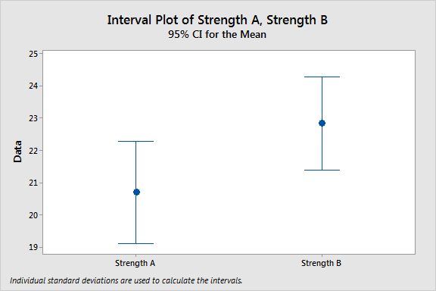
Graphical Descriptive Statistics
(Numerical Continuous data)
(Error Bar)
Chapter
04
Error bars are graphical representations of the variability of continuous data and are used on graphs to indicate the error or uncertainty in a reported continuous measurement.

Slide 11
Graphical Descriptive Statistics
(Numerical Continuous data)
(Error Bar)
Chapter
04
Error bars can be used to compare visually two quantities if various other conditions hold.
It represents the mean together with the 95% Confidence Interval (CI) of the normally distributed continuous data.

Slide 12
Graphical Descriptive Statistics
(Numerical Continuous data)
(Error Bar)
Chapter
04
Relevance in healthcare:
Important for interpreting clinical data and outcomes.
Used in patient care research to assess variability (e.g.: response rates to treatments).
Helps healthcare administrators make evidence-based decisions.

Slide 13
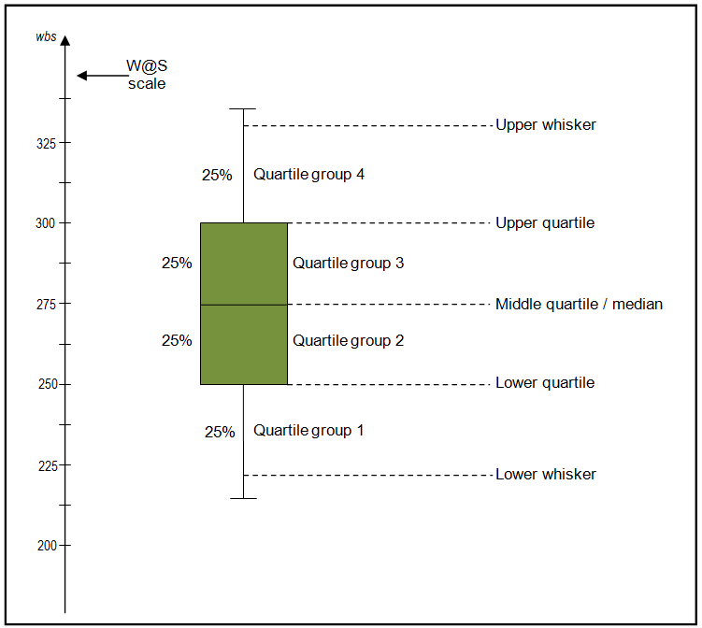
Graphical Descriptive Statistics
(Numerical Continuous data)
(Boxplot)
Chapter
04
It is a method for graphically demonstrating the locality, centeredness, and spread of non-normally distributed continuous numerical data through their quartiles.
It provides a visual summary of the minimum, first quartile, median, third quartile, and maximum of a dataset.

Slide 14
Graphical Descriptive Statistics
(Numerical Continuous data)
(Boxplot)
Chapter
04
First quartile (Q1 or 25th percentile): also known as the lower quartile, it separates the lower 25% data values from the upper 75% data values.
Median (Q2 or 50th percentile): the middle value in the data set (Box center line).

Slide 15
Graphical Descriptive Statistics
(Numerical Continuous data)
(Boxplot)
Chapter
04
Third quartile (Q3 or 75th percentile): also known as the upper quartile, it separates the lower 75% data values from the upper 25% data values.
The minimum and the maximum value of the data set (lower and upper lines outside the box).
The Interquartile Range (IQR) is the distance between Q3 and Q1 (IQR = Q3 - Q1).

Slide 16
Graphical Descriptive Statistics
(Numerical Continuous data)
(Boxplot)
Chapter
04
Relevance in healthcare:
Helps visualize data distributions, identify outliers and compare different groups in healthcare data (e.g.: patient stay lengths, treatment costs).

Slide 17
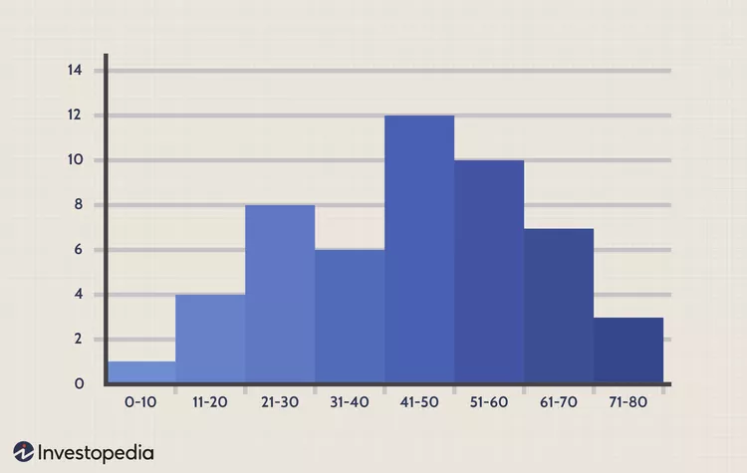
Graphical Descriptive Statistics
(Numerical Continuous data)
(Histogram)
Chapter
04
A Histogram displays Continuous data in the form of ordered columns.
The height of a column (the vertical axis) represents the distribution frequency of a certain range (the amount, or how often values in that range appear in the data set).

Slide 18
Graphical Descriptive Statistics
(Numerical Continuous data)
(Histogram)
Chapter
04
Ranges represented are of a continuous measure such as inches, time in minutes, temperature in Celsius, ……etc.
Columns can be used to visualize patterns of data distributions.

Slide 19
Graphical Descriptive Statistics
(Numerical Continuous data)
(Histogram)
Chapter
04
Relevance in healthcare:
Data Visualization: Helps to summarize large datasets, making it easier to spot trends or irregularities.
Decision Making: Supports administrators in making informed decisions about resource allocation, performance measures, etc.
Example: Frequency of hospital readmissions within 30 days for different age groups.

Slide 20
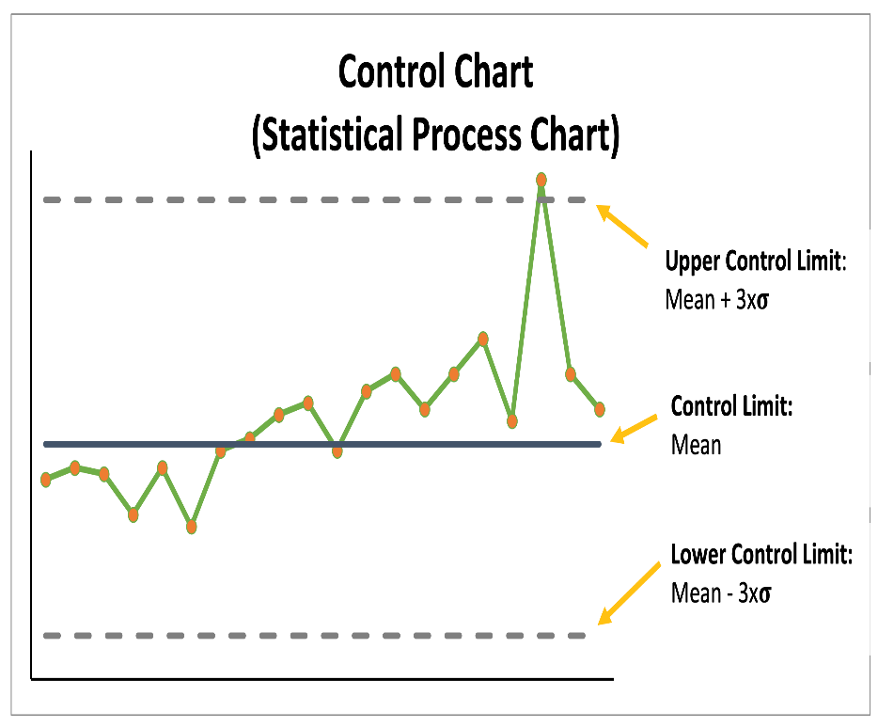
Graphical Descriptive Statistics
(Data over Time)
(Run chart & Control chart)
Chapter
04
Run Chart: A graph that displays observed data in a time sequence to detect trends or patterns.
Control Chart: A more advanced chart which includes upper and lower control limits to monitor process stability over time.

Slide 21
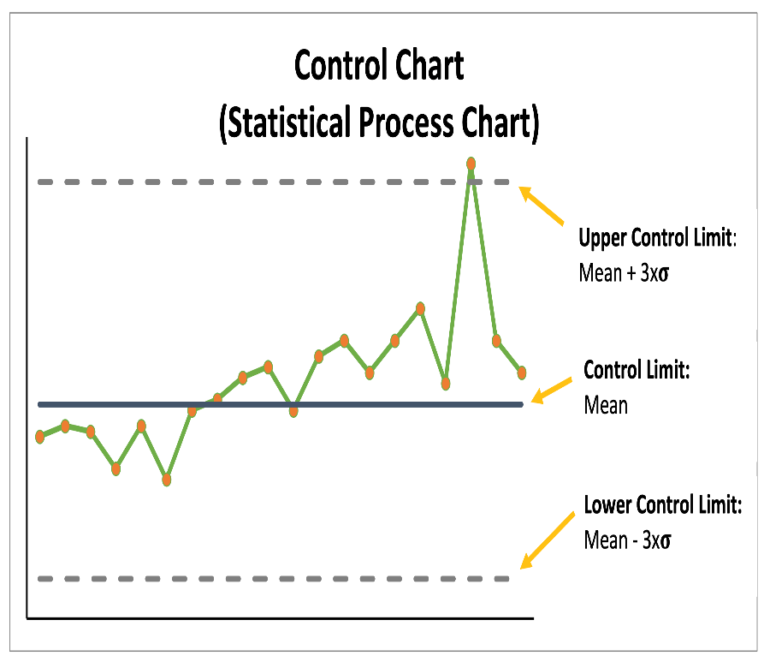
Graphical Descriptive Statistics
(Data over Time)
(Run chart & Control chart)
Chapter
04
Importance:
Track performance over time.
Monitor process improvements.
Detect variations that affect quality.
Support decision-making in healthcare settings.

Slide 22
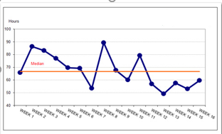
Chapter
Interpreting a Run Chart
04
Patterns to look for:
Trends: Upward or downward movement over time.
Shifts: Sudden changes in process performance.
Cycles: Repeated fluctuations over a consistent period.

Slide 23
Chapter
Control Chart
04
Key Concepts:
Additional Components of a Control Chart:
Control Limits: Upper and lower limits that define process variability.
Centerline (Mean): The average of the data.
Types of Control Charts: X-bar, R-chart, p-chart.

Slide 24
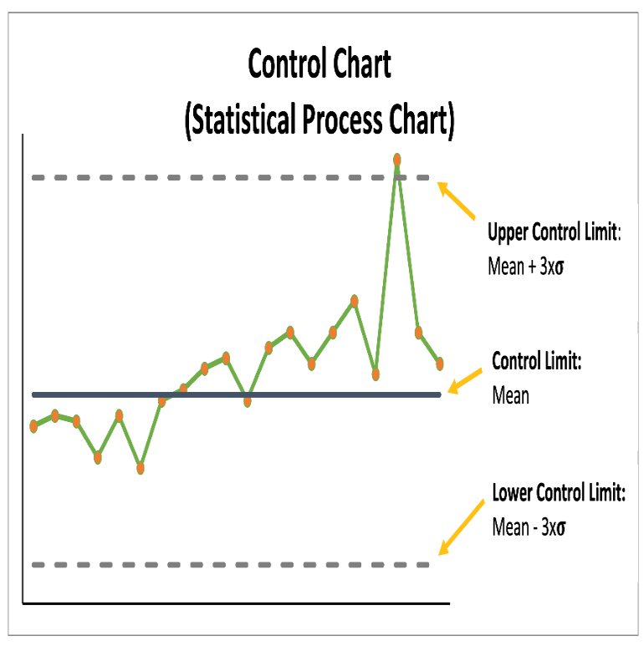
Chapter
Interpreting a Control Chart
04
Key Interpretation Points:
Out-of-Control Signals:
  Points outside the control limits.
  Non-random patterns.
Process Stability: If data points remain within control limits.

Slide 25
Chapter
Run Chart vs. Control Chart
04
Run Chart:
  Easier to create.
  No control limits.
  Suitable for preliminary analysis.
Control Chart:
  Includes control limits.
  Used for detailed process stability analysis.
  Can precisely show variability in process over time.

Slide 26
Chapter
Applications in Healthcare
04
Run Chart Examples:
  Tracking patient satisfaction scores.
  Monitoring staff overtime hours.
Control Chart Examples:
  Controlling infection rates in ICU.
  Monitoring medication errors.

Slide 27
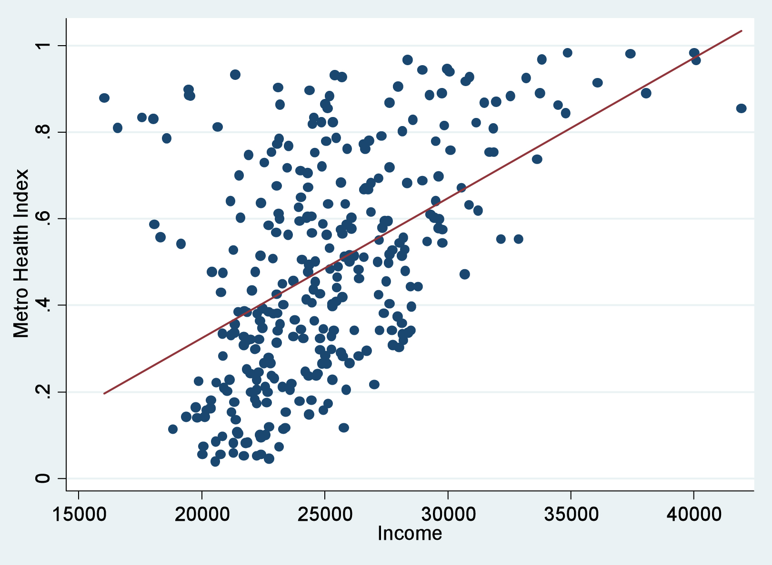
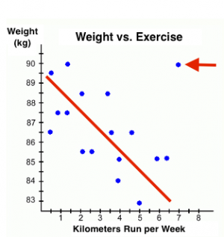
Graphical Descriptive Statistics
(Scatter Plot)
Chapter
04
A scatter plot (scatter graph) uses dots to represent the relationship between values for two different continuous numerical variables.
The position of each dot on the horizontal and vertical axis indicates values for an individual data point.
Identification of positive or negative correlational relationships is common with scatter plots.

Slide 28
Graphical Descriptive Statistics
(Scatter Plot)
Chapter
04
Data for either variable are plotted on the horizontal axis while those for the other variable are plotted on the vertical axis.
The choice of variables for the horizontal or vertical axis doesn’t matter, but rationale can guide the assignment.

Slide 29
Graphical Presentation
Categorical variable
(Distinct discrete categories)
1. Pie Chart
2. Bar Chart
One Quantitative variable
Non-normally distributed
Boxplot
Normally distributed
Error Bar
Two Quantitative variables:
Scatterplot
(Correlational Relationship)
Track performance over time
Run chart & Control chart
Histogram

Slide 30
Chapter
Case Scenario (1)
04
Hospital Bed Occupancy Analysis:
  A hospital faces issues with high bed occupancy rates, especially in the ICU, leading to long wait times for new patients and reduced efficiency in patient flow management.

Slide 31
Chapter
Data and Graphical Representation
04
Data:
  ICU bed occupancy rates.
  Average patient length of stay (LOS) in the ICU.
  Admission rates per hour.
  Discharge times.
  ICU staffing levels (nurses per patient ratio).
Graphical Representation:
  Scatter plots to show the correlation between:
    1. Bed occupancy vs. LOS.
    2. Bed occupancy vs. admission rates.
    3. Bed occupancy vs. discharge times.
    4. Bed occupancy vs. staffing levels.

Slide 32
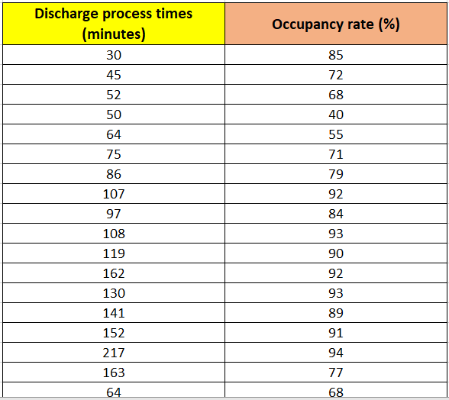

Slide 33

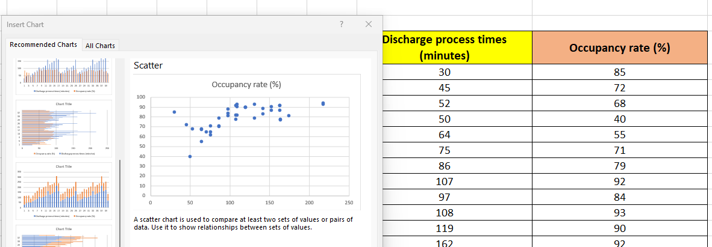

Slide 34
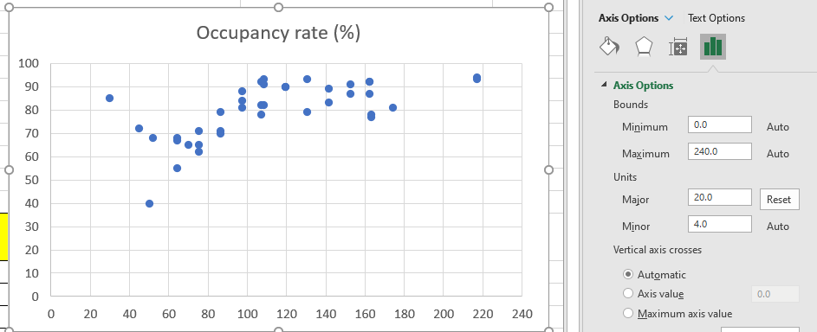

Slide 35
Chapter
Analysis & Decision-Making
04
Analysis: By examining the scatter plots, hospital management can identify which factors (LOS, admission rates, discharge times, or staffing levels) have the strongest correlation with bed occupancy rates. For example, if LOS and admission rates show strong positive correlations, management could focus on improving discharge planning, optimizing patient transfer to lower acuity units, or increasing staffing during peak admission periods.

Slide 36
Chapter
Analysis & Decision-Making
04
Decision: Depending on the correlation results, the hospital could:
  Introduce new discharge protocols to ensure earlier and more spread-out patient discharges.
  Improve ICU staffing during peak admission times.
  Implement patient flow management strategies, such as transferring stable patients from the ICU to intermediate care units earlier.

Slide 37
Chapter
Case Scenario (2)
04
Cost-Benefit Analysis of Implementing a New Electronic Health Record (EHR) System:
  A hospital is debating whether to implement a new EHR system to reduce administrative costs and improve patient care efficiency.

Slide 38
Chapter
Data and Graphical Representation
04
Data:
  Current administrative costs, predicted costs with the EHR system, and time efficiency in administrative processes.
Graphical Representation:
  A cost-benefit bar chart comparing the current and predicted costs over five years.

Slide 39
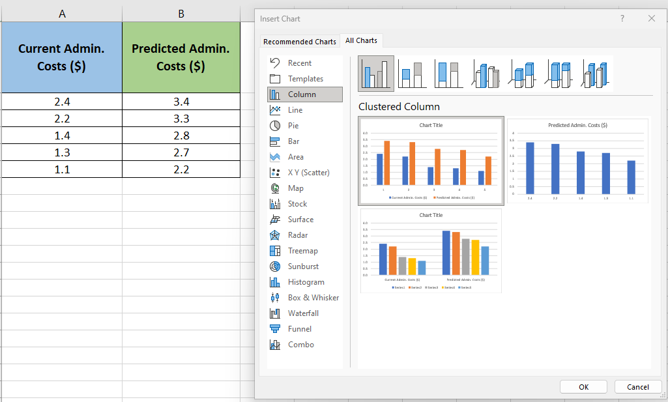

Slide 40
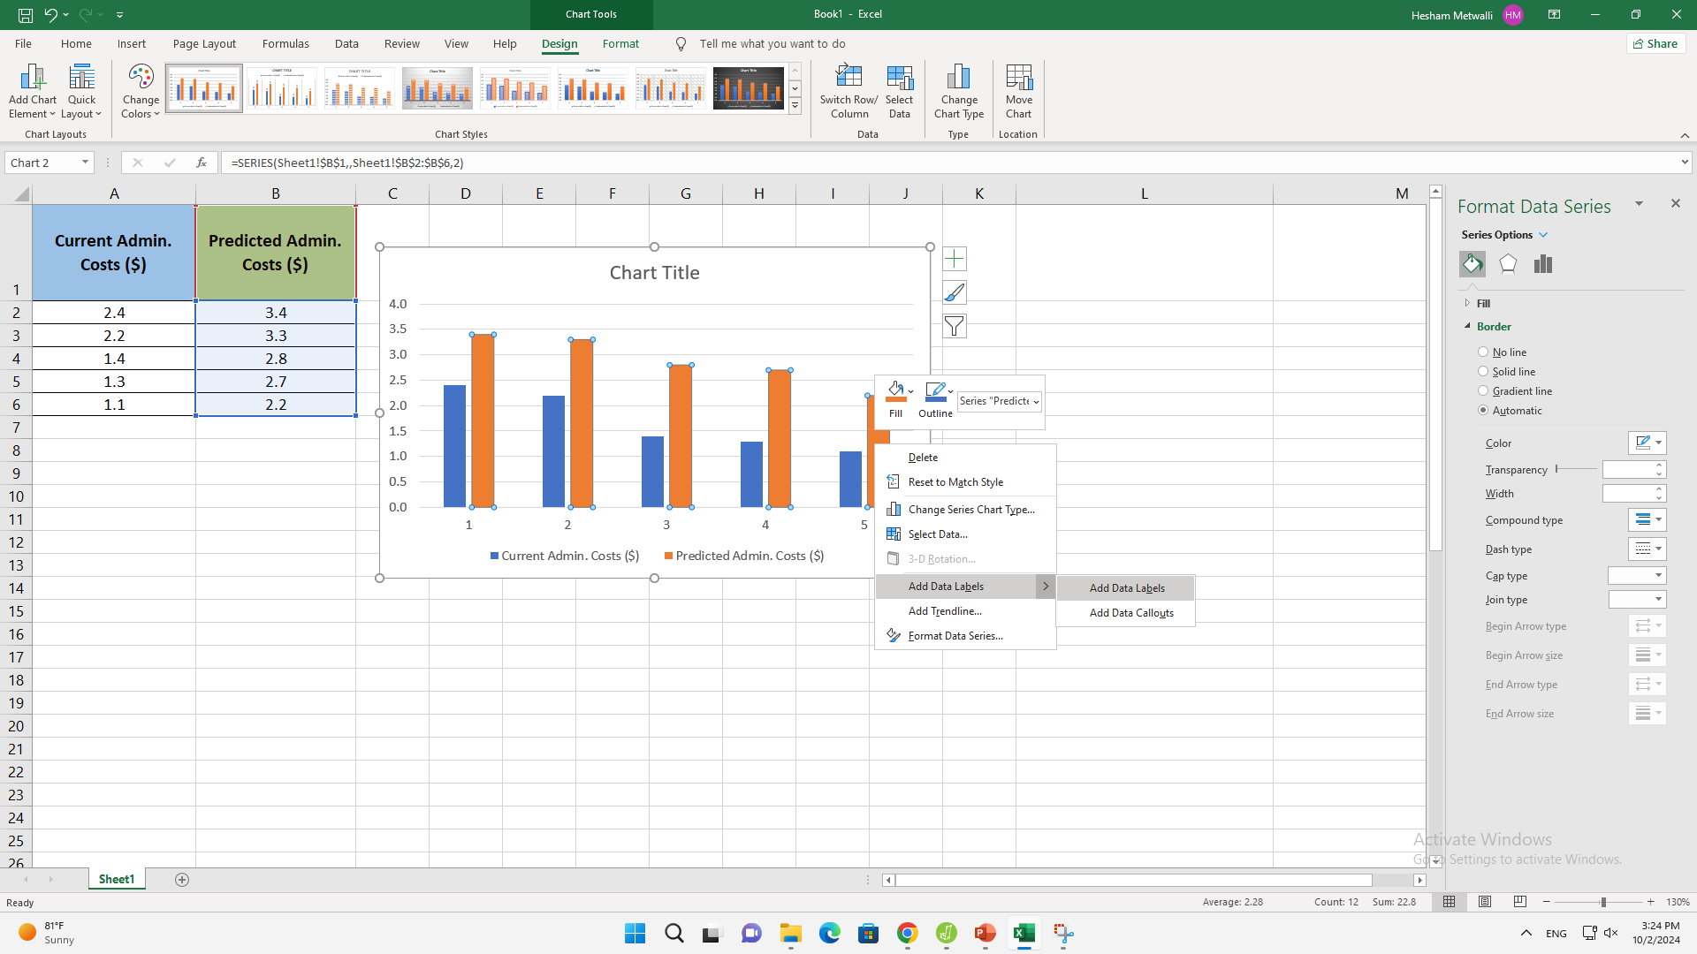

Slide 41
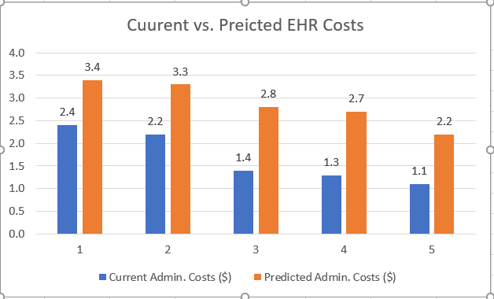

Slide 42
Chapter
Analysis & Decision-Making
04
Analysis:
  The bar chart demonstrates that the initial cost of the EHR system implementation is high, but administrative costs decrease significantly after the second year.
Decision:
  Based on the analysis, the management can decide to implement the system, knowing the long-term savings outweigh the initial investment.

Slide 43
Chapter
TO WRAP UP
04
Graphs like histograms and box plots reveal data patterns such as trends clearly.
Charts like bar and line graphs help quickly compare data sets or groups visually.
Graphs highlight relationships and trends, making insights easier to spot than raw data.
Graphical methods make complex data more understandable for effective communication and decision-making.

Slide 44



Thank You

