Slide 1



Device Initial Login
Lecture 3
HCIA-Security
Prepared by
Dr. Abdelrhman Ahmed

Slide 2
Chapter
03
VRP Overview
• Versatile Routing Platform (VRP)
□ Network operating system
□ Software platform that supports multiple types of devices
□ Provides TCP/IP routing services
• VRP is a network operating system used Huawei routers, Ethernet switches, and service gateways to implement network access and interconnection services. It provides a unified user and management interface, implements control plane functionality, and defines the interface specifications of the forwarding plane (so that the interaction between a product's forwarding plane and the VRP control plane can be implemented). It also implements the network interface layer to shield the differences between the link and network layers of each product.

Slide 3
Chapter
03
Introduction to Command Line
• The CLI is divided into command views. All commands must be executed in command views. You can run a command only after you enter its command view.

Slide 4
Chapter
03
Introduction to Command Line
• VRP commands use level-defined protection. The four command levels are visit, monitoring, configuration, and management levels.
□ Visit level: Network diagnosis commands (such as ping and traced) and commands that are used to access external devices from the local device (for example, Telnet client, SSH, and Rlogin). Commands at this level cannot perform file storage configurations.
□ Monitoring level: Commands at this level are used for system maintenance or service fault diagnosis, including the display and debugging commands. Commands at the monitoring level cannot be saved in configuration files.
□ Configuration level: Service configuration commands, including routing commands and commands at each network layer, are used to provide direct network services for users.
□ Management level: Commands at this level affect normal system operation. Such commands include file system, FTP, TFTP, X modem download, configuration file switchover, standby board control, user management, command level setting, and system internal parameter setting commands.
• The system classifies login users into four levels, each of which correspond to a command level. That is, after logging in to the system, a user can use only the commands that are assigned to a level equal to or lower than the user's level. To switch a user from a lower level to a higher level, run the following command: super password [level user-level] {simple | Cipher} password.

Slide 5
Chapter
03
Command Line Help: Full Help
□ You can also enter a command (if it is a keyword) followed by a space and ? to obtain all keywords and a brief description of each.
• Full help displays all the keywords or parameters after you enter a question mark (?) in the command line.
□ In any command view, enter ? to obtain all commands and a brief description of each in the command view.
□ You can also enter a command (if it is a keyword) followed by a space and ? to obtain all keywords and a brief description of each.

Slide 6
Chapter
03
Command Line Help: Partial Help
□ You can also enter a command (if it is a keyword) followed by a space and ? to obtain all keywords and a brief description of each.
• Partial help displays all the keywords or parameters that start with the character string entered in the command line.
a Type a character string followed by ? to obtain all keywords that begin with the character string
□ You can also enter a command followed by a character string and ? to obtain all keywords starting with the character string.

Slide 7
Chapter
03
Command Line Help: Tab Key
□ You can also enter a command (if it is a keyword) followed by a space and ? to obtain all keywords and a brief description of each.
If there is only one match for an incomplete keyword:
If there are multiple matches for a keyword:

Slide 8
Chapter
03
Command Line Help: Tab Key
• Enter an incomplete keyword and press Tab. The system automatically executes partial help:
□ If the match is unique, the system replaces the original input with a complete keyword and displays the keyword on a new line, with the cursor a space behind.
□ If no keyword is matched or multiple keywords are matched, the prefix is displayed first. Press Tab to switch from one matched keyword to another with the cursor placed on the last letter of the keyword. Press the space bar to enter the next word.
□ If you enter an incorrect keyword and press Tab, the keyword is displayed in a new line. The entered keyword does not change.

Slide 9
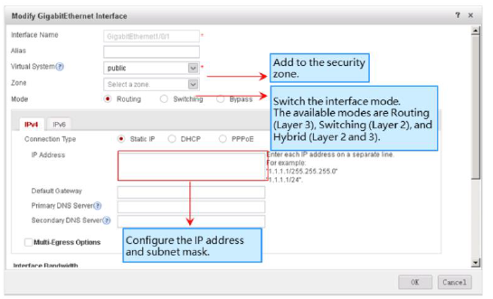
Chapter
03
Configuring Interfaces
• Choose Network > Interface and select the interface to be modified.
• Configure an IP address for the interface and switch the interface mode.

Slide 10
Chapter
03
Configuring Interfaces
• Configuration procedure:
□ Choose Network > Interface and select the interface to be modified.
□ Configure an IP address for the interface and add the interface to the security zone.
• Key commands:
■ Enter the view of an interface.
■ <USG> system-view
■ [USG] interface interface-type interface-number
■ Configure a Layer 3 or Layer 2 Ethernet interface.
■ Configure a Layer 3 Ethernet interface.
■ Ip address Ip-address { mask | mask-length }
■ Configure a Layer 2 Ethernet interface.
■ Port switch
■ Assign the interface to a security zone.
■ Run the system-view command to enter the system view.
■ Run the firewall zone [ name ] zone-name command to create a security zone and enter the view of the security zone.
■ Run the add interface interface-type interface-number command to assign the interface to the security zone.

Slide 11
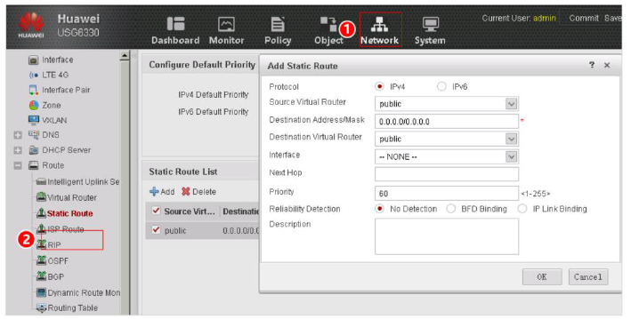
Chapter
03
Configuring Routes
• Choose Network > Route > Static Route and click Add.

Slide 12
Chapter
Configuring Routes
03
• To configure a static route, perform the following operations:
□ Run the system-view command to enter the system view.
□ Run the ip route-static ip-address { mask | mask-length } {interface-type interface­ number | next-ip-address } [ preference value ] [ reject | blackhole ] command to add a static route.
• To configure the default route, perform the following operations:
□ Run the system-view command to enter the system view.
□ Run the ip route-static 0.0.0.0 { 0.0.0.0 | 0 } {interface-type interface-number | next- ip-address } [ preference value ] [ reject | blackhole] command to configure the default route.
• You can configure a static route to ensure that traffic sent between two entities always follows this route. However, if the network topology changes or a fault occurs, the static route does not change automatically and requires manual intervention.
• The default route is used only when no matching access entry is available in the routing table (that is, the routing table does not contain a specific route). The default route is a route to the network 0.0.0.0/0 and is used if the destination IP address of a packet does not match any access entry in the routing table. If no default route exists and the destination IP address of the packet is not in the routing table, the packet is discarded. In this case, an ICMP packet is returned to the source to report that the destination IP address or network is unreachable.

Slide 13
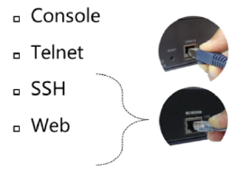
Chapter
03
Overview of Device Login Management
Device Login Management
□ Console: Connect a PC to the console port of a device through an RS-232 serial interface cable. Then, log in to the device through the PC, and configure the device after it is powered on. This login mode is useful if the device cannot be accessed remotely, or the system cannot be started. In the latter case, the console port can be used to diagnose faults or enter the BootROM to upgrade the system.
□ Telnet: Connect a PC to the device over the network. Then, log in to the device through Telnet to perform local or remote configuration. The device performs user authentication according to the configured login parameters. This login mode enables remote management and maintenance of the device.
□ SSH: This login mode uses secure transmission channels to enhance security of data exchange. It provides powerful authentication functions to ensure information security and protect devices against attacks, such as IP spoofing attacks.
□ Web: Access the device through the web browser on a client to control and manage the device.

Slide 14
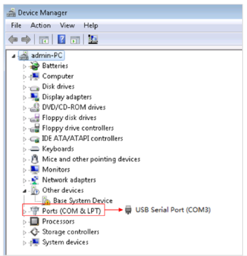
Chapter
03
Login to the Device Through the Console Port (1)
• Check the parameters of the local port.
• Right-click My Computer, choose Properties from the shortcut menu, and click Device Manager. Check parameters in the Device Manager window.

Slide 15
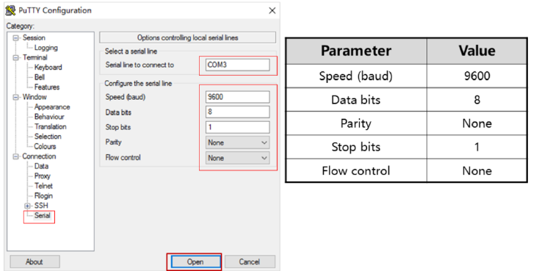
Chapter
03
Login to the Device through the Console Port (2)
• Configure the connection interface and communications parameters:
• In the Serial window shown in the figure, set Serial line to connect to based on the port used by the PC (or configuration device), specify PuTTY configuration parameters on the left according to the parameter table on the right, and click Open.
• The default username and password for logging in to the USG configuration interface are admin and Admin@123 respectively. The username is case insensitive, and the password is case sensitive.

Slide 16
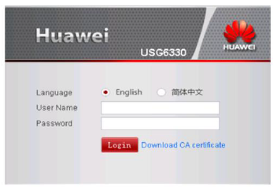
Chapter
03
Web Login: Function Overview
• By default, you can log in to the device through GigabitEthernet O/O/O.
□ Set the IP address obtaining mode for network connection to obtain an IP address automatically on the administrator’ s PC.
□ Directly connect the PC Ethernet interface to the default management interface on the device or connect them through a switch.
□ Enter https://192.168.0.1 in the browser to access the web login page.
□ The default username is admin, and its password is Admin@123.
• Configure a PC to obtain an IP address automatically. Connect the PC Ethernet interface to the default management interface on the device directly or through a switch. Enter https://192.168.0.1 in the PC's web browser to access the web login page.
• The default username and password is admin and Admin@123 respectively.

Slide 17
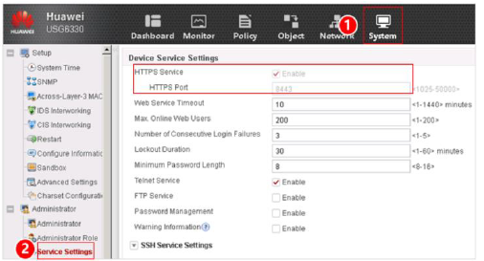
Chapter
03
Web Login: Configuration Management (1)
• Function: forwards data packets between different networks
• A router is a network layer device that forwards packets between different networks. As shown in the figure, host A and host B reside on different networks. When host A wants to communicate with host B, host A sends a frame to host B. Upon receipt of this frame, the router that resides on the same network as host A analyzes the frame. At the data link layer, the router analyzes the frame header and determines that the frame is sent to itself. It then sends the frame to the network layer. At the network layer, the router determines to which network segment the destination address belongs based on the network layer packet header of the frame. It then searches the table and forwards the frame through the corresponding interface to the next hop destined to host B.
• If you need to log in to the device through the service interface in web mode, configure the web login function on the device.
□ Enable the web management function, enable HTTP or HTTPS management according to requirements, and set the port number
• Enable the web management function:
□ [USG] web-manager security enable interface 8443

Slide 18
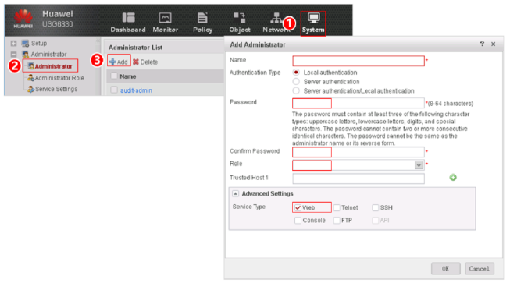
Chapter
03
Web Login: Configuration Management (2)
• A router selects an optimal path for data packets and forwards the packets.
• After receiving a packet, a router selects an optimal path according to the destination IP address of the packet. It then forwards the packet to the next router. The last router on the path forwards the packet to the destination host. The transmission of data packets on the network relay race. Each router forwards data packets to the next­ hop router according to the optimal path, and the packets are forwarded to the destination through the optimal path. In some cases, because certain routing policies are implemented, the path through which the data packets pass may not be optimal.
• A router can determine the forwarding path of data packets. If multiple paths exist to the destination, the router determines the optimal next hop according to calculations specific to the routing protocol in use.
Configure a web administrator
• Configure a web user.
□ [USG] aaa
□ [USG-aaa] manager-user webuser
□ [USG-aaa-manager-user-webuser] password cipherAdmin@123
□ [USG-aaa-manager-user-webuser] service-type web
□ [USG-aaa-manager-user-webuser] level 3

Slide 19
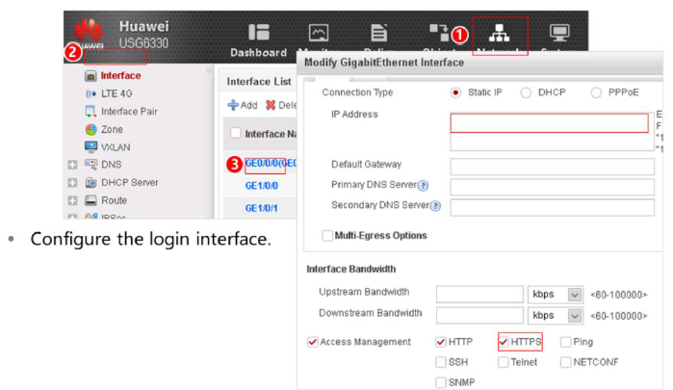
Chapter
03
Web Login: Configuration Management (3)
• Configure web device management on the USG interface:
□ [USG-GigabitEthernet1/0/1] service-manage enable
□ [USG-GigabitEthernet1/0/1] service-manage https permit

Slide 20
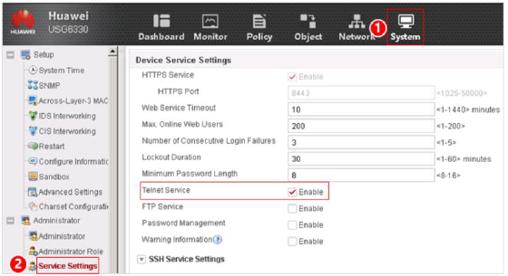
Chapter
03
Telnet Login: Configuration Management (1)
• By default, Telnet login is disabled on the NGFW. To use Telnet, log in to the NGFW in another mode and enable the Telnet service.
□ Enable the Telnet service.
• Enable the Telnet service:
□ [USG] telnet server enable

Slide 21
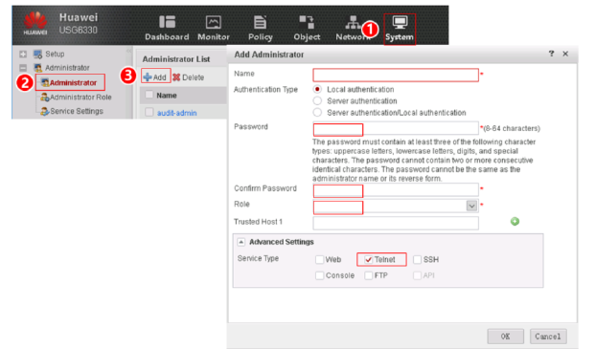
Chapter
03
Telnet Login: Configuration Management (2)
Configure a Telnet administrator.
• Configure the vty interface:
□ [USG] user-interface vty 0 4
□ [USG-ui-vtyO-4] authentication-mode aaa
• Configure a Telnet administrator:
□ [USG] aaa
□ [USG-aaa] manager-user vtyadmin
□ [USG-aaa-manager-user-vtyadmin] password
□ Enter Password
□ [USG-aaa-manager-user-vtyadmin]] service-type telnet
□ [USG-aaa-manager-user-vtyadmin]] level 3

Slide 22
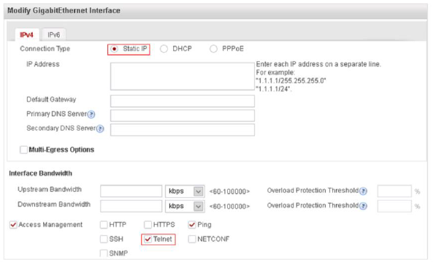
Chapter
03
Telnet Login: Configure Management (3)
• Configure the login interface.
• Configure Telnet device management on the USG interface:
□ [USG-GigabitEthernet1/0/1] service-manage enable
□ [USG-GigabitEthernet1/0/1] service-manage telnet permit

Slide 23
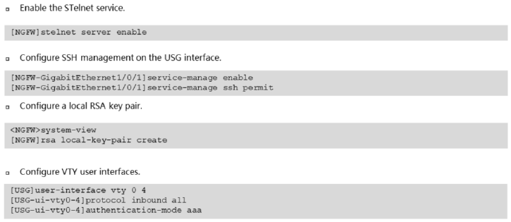
Chapter
03
SSH Login: Configuration Management (1)
• SSH provides greater security and powerful authentication functions for users to log in to the device. Configure SSH device management on the USG interface. The administrator can enable SSH device management as required.
• Configuration commands:

Slide 24
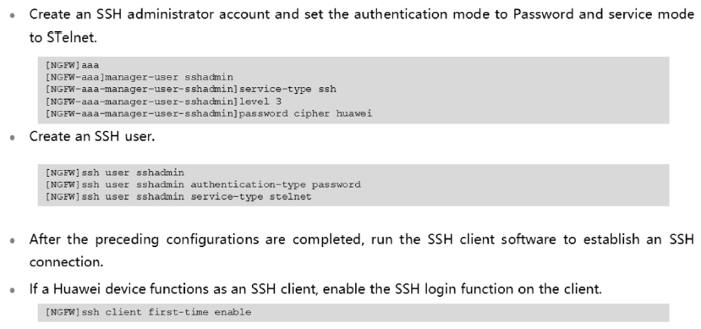
Chapter
03
SSH Login: Configuration Management (2)
• When the device functions as an SSH server, you can set the authentication mode to Password or RSA for SSH users.

Slide 25
Chapter
03
Overview of Device File Management
• Device File Management
□ Configuration file management
□ System file management (software upgrade)
□ License management
• Overview of Device File Management
□ The configuration file contains the configurations that the device will load when it is started. You can save configuration files on the device, modify and remove existing configuration files, and specify which configuration file the device will load upon each startup. System files include the USG software version and signature database files. Generally, management of system files is required during software upgrades.
□ Upgrading system software: The system software can be uploaded to the device through TFTP or FTP. Upgrade the system software to configure the software system for the next startup.
□ A license is provided by a vendor to authorize the usage scope and validity period of product features. It dynamically controls whether certain features of a product are available.

Slide 26
Chapter
03
Configuration File Management
• Configuration file types:
□ Saved-configuration: the configuration file used for the next startup of the USG. It is stored in the flash memory or CF card of the USG and persists across restarts.
□ Current-configuration: the configuration currently in use on the USG. It is modified by command lines and web operations. It is stored in the memory of the USG and persists across restarts. Common operations for the configuration file
□ Save the configuration file.
□ Erase the configuration file (restore to factory settings).
□ Configure the system software and configuration file for the next startup.
□ Restart devices.

Slide 27
Chapter
03
Configuration File Management
• Save the configuration file: Enable the firewall to use the current configuration as the start configuration the next time it restarts.
□ Method 1 (command line): Run the save command in the user view.
□ Method 2 (web): Click Save in the upper right corner of the home page.
• Erase the configuration file (restore to factory settings): After the configuration file is erased, the firewall uses the default parameter settings the next time it restarts.
□ Method 1 (command line): Run the reset saved-configuration command in the userview.
□ Method 2 (web): Choose System > Maintenance > Configuration Management to restore to factory settings.
□ Method 3 (hardware reset button): If the device is not powered on, press and hold the RESET button, and turn on the power switch. When the device indicator blinks twice per second, release the RESET button. The device starts with the default configuration.
□ Method 4 (hardware reset button): If the device is started normally, press and hold the RESET button for more than 10 seconds. The device restarts and uses the default configuration.

Slide 28
Chapter
03
Configuration File Management
• Configure the system software and configuration file for the next startup:
□ Command line: Run the startup system-software sysfile command in the user view.
□ Web: Choose System > Maintenance > System Update, and then select Next Startup System Software.
• Restart the firewall:
□ Function: The firewall will be restarted, and the restart will be recorded in logs.
□ Method 1 (command line): Run the reboot command in the user view.
□ Method 2 (web): Choose System > Maintenance > System Restart.

Slide 29
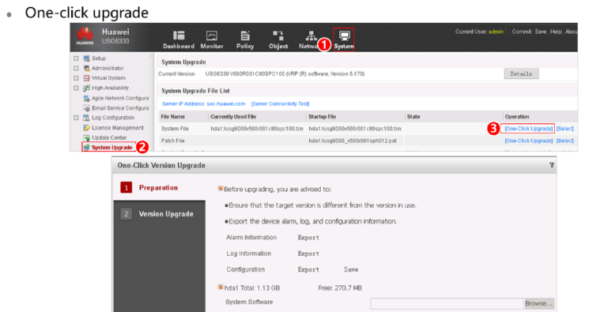
Chapter
03
Version Upgrade

Slide 30
Chapter
03
Version Upgrade
One-click upgrade of the system software:
□ If the device has insufficient storage space available, the device automatically deletes the system software that is running.
• System software files are stored as .bin files.
□ Choose System > System Update.
□ Click One-Click Version Upgrade. The One-Click Version Upgrade wizard is displayed.
□ Optional: Click the Export button sequentially to export the device's alarm, log, and configuration information to the PC. You are advised to save the configuration information to the terminal.
□ Click Browse. Select the system software to be uploaded.
□ If the current network allows the device to restart immediately after upgrade, select either Set as the next startup system software, and restart the system or Set as the next startup system software, and do not restart the system according to requirements.
□ The upgraded system software can be used only after the device restarts.
□ Configuration using commands (the FW acts as an FTP client)

Slide 31
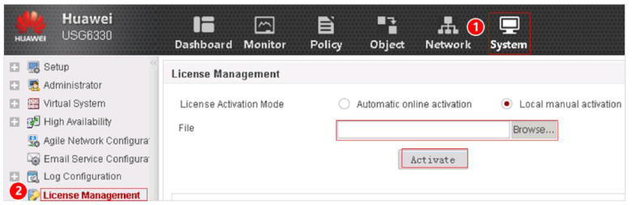
Chapter
03
License Configuration
• A license is provided by a vendor to authorize the usage scope and validity period of product features. It dynamically controls whether certain features of a product are available.
• Activate a license.
• The license can be activated online or offline. You can activate the license automatically through Huawei security center at sdplsp.huawei.com or manually activate it locally.
• License files are stored as .dat files. The software file name cannot contain any Chinese characters.
• Configuration commands:
□ Run the system-view command to enter the system view.
□ Run the license active license-file command to activate the specified license file.
□ Run the display license command to view the license information.

Slide 32



Thank You

