Slide 1

Lecture 3
Leadership Methods & Theories

Slide 2

Last Lecture, we leaned about
Lec.3
Are you a Leader?
How to Be a Leader?
Developing a Vision
Understanding People's Needs
Influencing People
Communication
  Definition
    Elements of Communication

Slide 3
Today’s Lecture we will Know about
Types of Leadership
Methods of leadership
Theories of Leadership
  1. The Great Man Theory
  2. Trait Theories of Leadership
  3. Behavioral Theories of Leadership
  4.Transactional & Transformational Theories
  5.Contingency theory of leadership
  6. Neo-Charismatic Theories
  New Leaders Take Note & Traps
  Leading Effectively: The 70-20-10 Rule
  Self-Assessment
    Do You Have Charismatic Tendencies?
Lec.3

Slide 4
Lec.3
Introduction & Learning Outcomes
Learn about the types, methods, and different theories of leadership, understand its results and apply examples.
Learn about new leaders' advices and traps, and how they can use some rules to lead effectively.

Slide 5



Lec.3
Ice Break

Slide 6

Lec.3
Leadership Self-Assessment
W4 Lecture

Slide 7
Lec.3
Leadership Self-Assessment Exercise
The Interpersonal Skills المهارات الشخصيةChecklist
Instructions: Below are a number of specific aspects of behavior that suggest that a person needs to improve his or her interpersonal skills related to leadership and influence. Check each statement that is generally true for you.
You can add to the reliability مصداقيةof this exercise by asking one or two other people who know you well to rate you. Then compare your self-analysis with their analysis of you.

Slide 8
Lec.3
Leadership Self-Assessment Exercise
Scale Statements: Developmental Needs and Areas for Improvement
The Interpersonal Skills
I'm too shy and reserved. أنا خجول جدا ومتحفظ.
I bully and intimidate others too frequently. أنا أتنمر وأرهب الآخرين بشكل متكرر.
I tell others what they want to hear rather than emphasizing the truth. أقول للآخرين ما يريدون سماعه بدلاً من التأكيد على الحقيقة.
I have trouble expressing my feelings. أجد صعوبة في التعبير عن مشاعري.
I make negative comments about group members too readily. أنا أدلي بتعليقات سلبية حول أعضاء المجموعة بسهولة شديدة.
Very few people pay attention to the ideas I contribute during a meeting.
قلة قليلة من الناس ينتبهون إلى الأفكار التي أسهمت بها خلال الاجتماع.

Slide 9
Lec.3
Leadership Self-Assessment Exercise
The Interpersonal Skills
My personality isn't colorful enough. شخصيتي ليست ملونة بما فيه الكفاية.
People find me boring. الناس يجدونني ممل.
I pay too little attention to the meaning behind what team members and coworkers are saying. إنني لا أهتم كثيرًا بالمعنى الكامن وراء ما يقوله أعضاء الفريق وزملاء العمل.
It is very difficult for me to criticize others. من الصعب للغاية بالنسبة لي انتقاد الآخرين.
I'm too serious most of the time. أنا جاد للغاية في معظم الأوقات.
I avoid controversy in dealing with others. أتجنب الجدل في التعامل مع الآخرين.

Slide 10
Lec.3
Leadership Self-Assessment Exercise
The Interpersonal Skills
I don't get my point across well. لا أعبر عن وجهة نظري بشكل جيد.
It's difficult for me to make small talk with others. من الصعب على إجراء محادثة قصيرة مع الآخرين.
I boast too much about my accomplishments. أنا أفتخر كثيرا بإنجازاتي.
I strive too much for individual recognition instead of looking to credit the team. أنا أبذل قصارى جهدي للحصول على التقدير الفردي بدلاً من التطلع إلى تكريم الفريق.
Self-confidence is my weak point. الثقة بالنفس هي نقطة ضعفي.
My spoken messages are too bland. رسائلي المنطوقة لطيفة للغاية.

Slide 11
Lec.3
Leadership Self-Assessment Exercise
The Interpersonal Skills
My written messages are too bland. رسائلي المكتوبة لطيفة للغاية.
I read people poorly. أنا أقرأ الناس بشكل سيء.
………………………………………………………..(Fill in your own statement).
Now that you have identified specific behaviors that may require change, draw up an action plan.

Slide 12
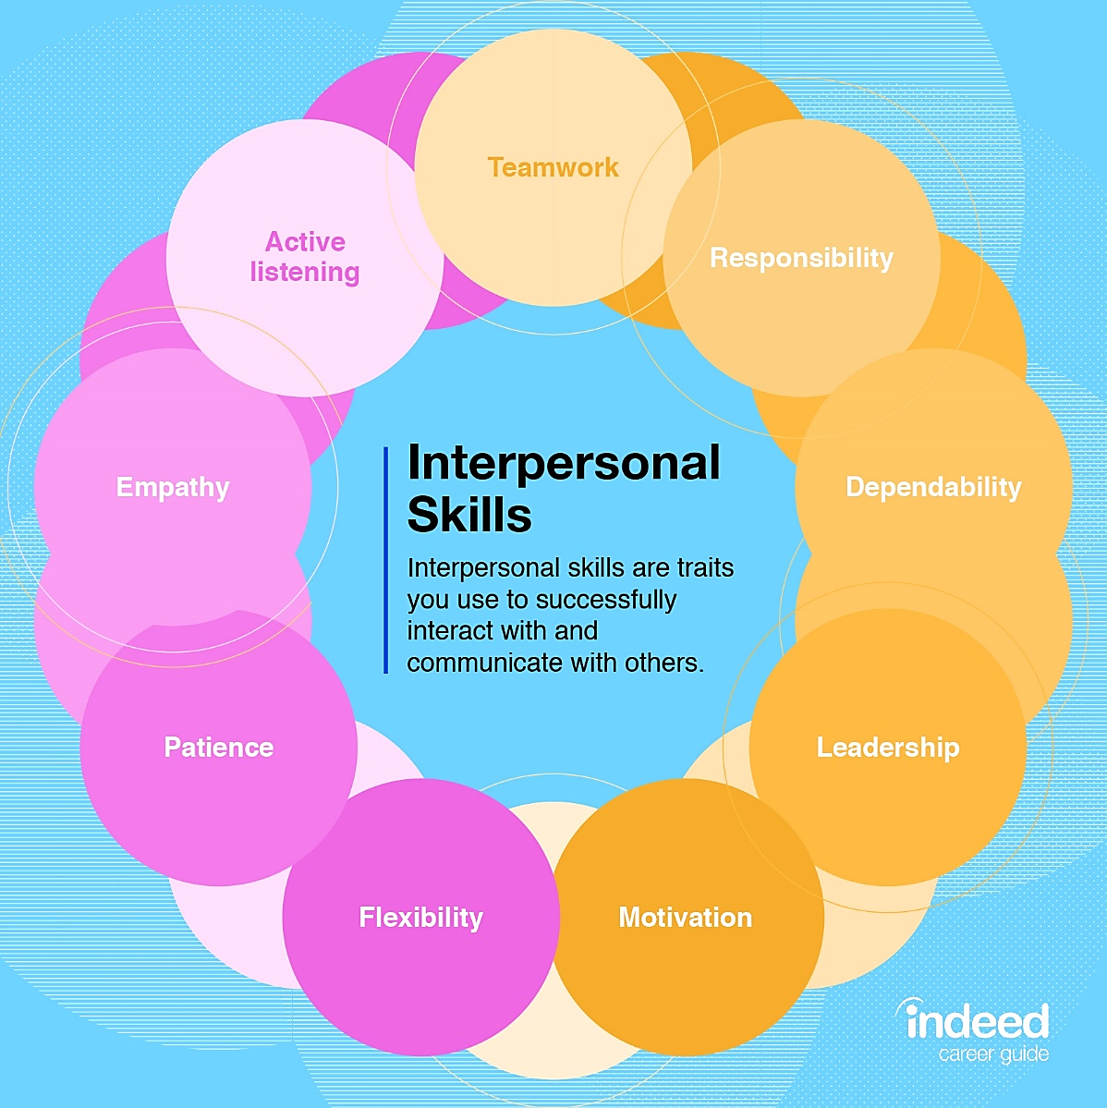
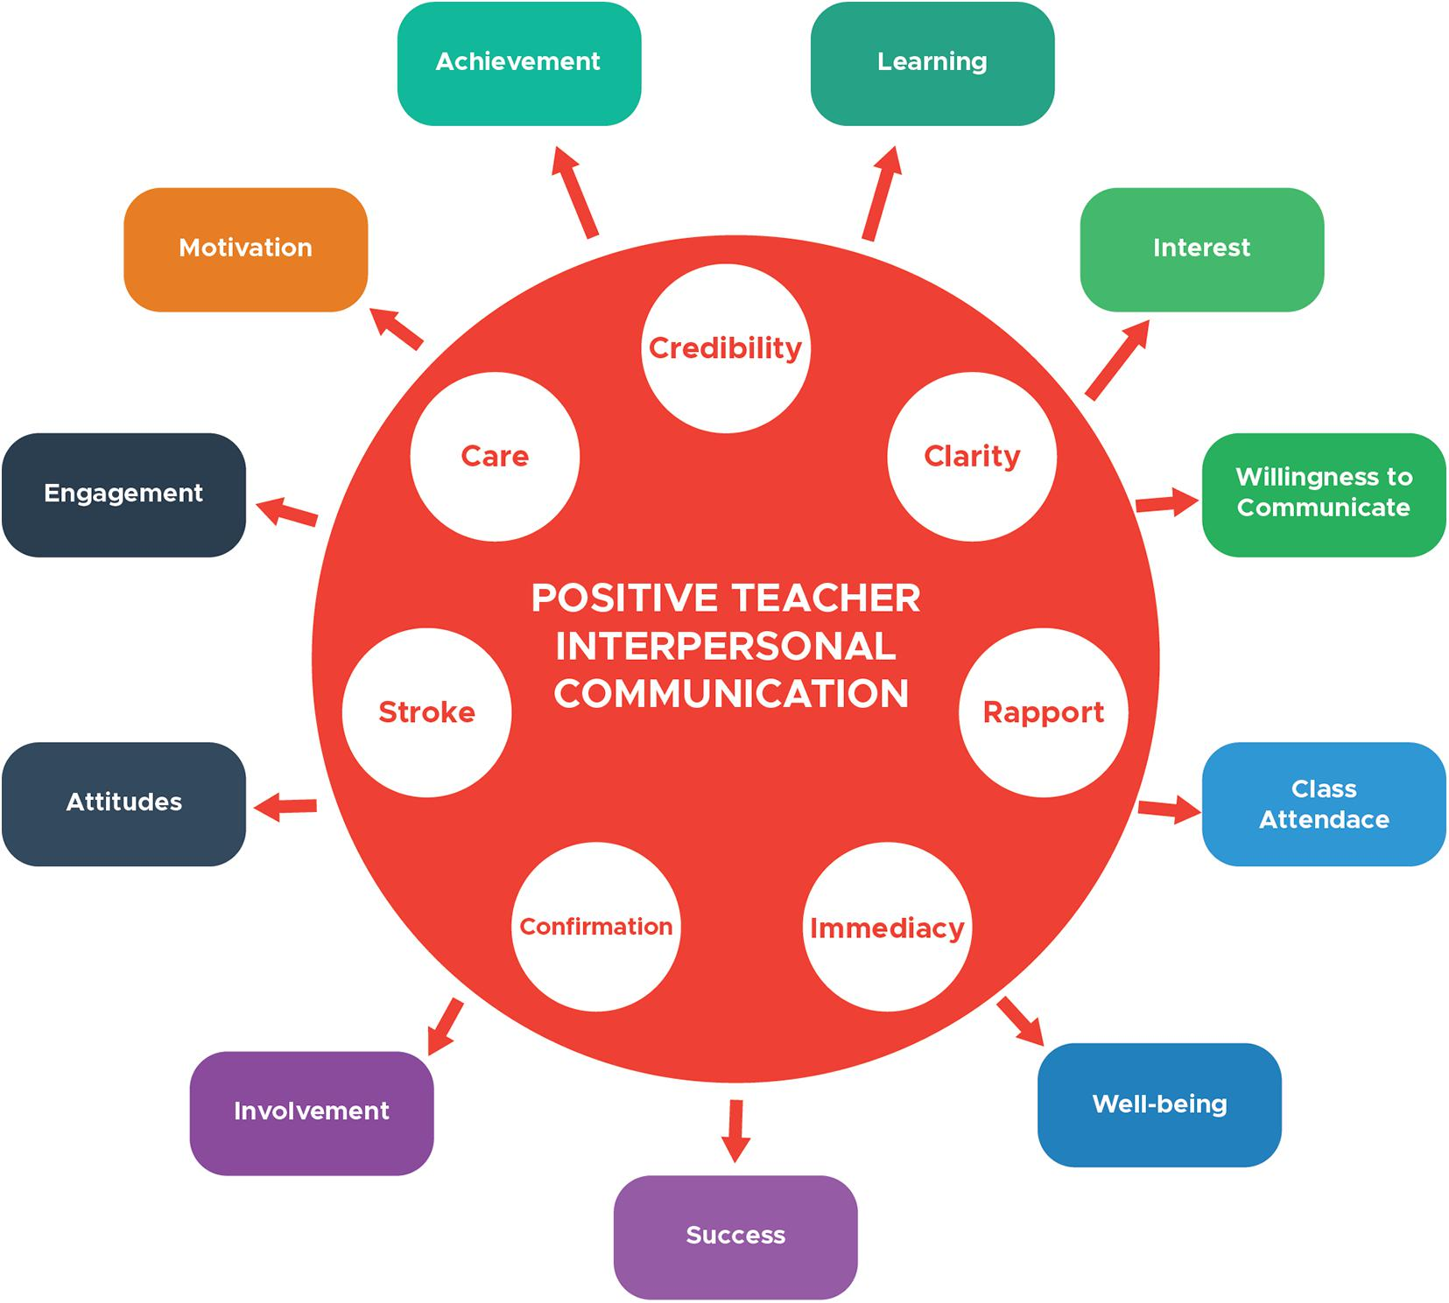
Lec.3
تعاطف
الجدارة/ الثقة
Positive

Slide 13
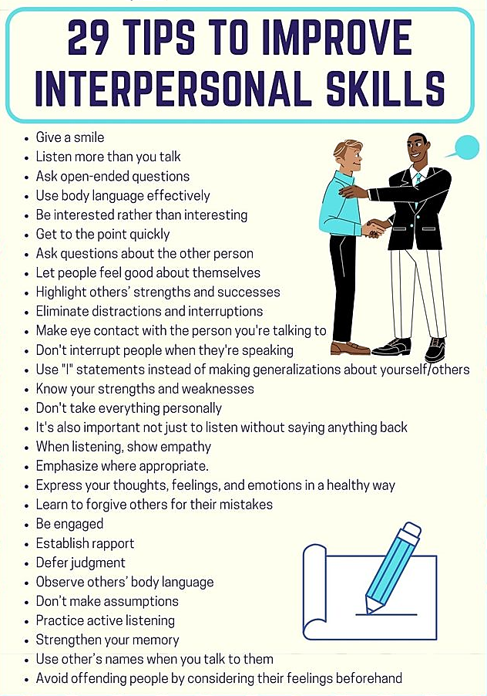
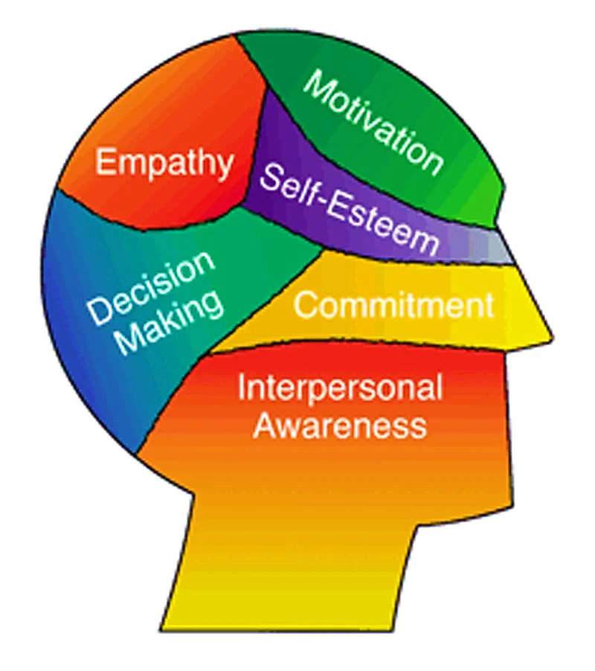
Lec.3

Slide 14

Lec.3

Slide 15
How to Be a Leader?
Lec.3
How do you take your dream and make it a reality?
  Start by creating your own personal vision statement.
  Put your dream into words that communicate to others a picture of what you want to do. Organizations have vision statements; and you, as a leader, can have your own vision statement, too.
  Martin Luther King, Jr. said, "I have a dream that my four little children will one day live in a nation where they will not be judged by the color of their skin but by the content of their character." Now that's a vision statement!
  Now it's your turn. Write out a few sentences of how you want some part of your world to be. Your vision statement will remind you of where you want to be going.

Slide 16
Lec.3

Slide 17
Lec.3
How to Set goals?
Give your vision a sharper image. Turn up the focus. Set some long-term and short term goals. That is how you carve a real path to your vision.
For example, if your vision is: "To create a community where every person can enjoy city parks in safety," then you might set goals like these:
Long-term goals:
  Create more city parks
  Reduce crime in city parks

Slide 18
Lec.3
How to Set goals?
Short-term goals:
  Find out where the city parks are, who uses them, and what the crime levels are
  Establish good working relationships with community police officers and park officials
  Identify what actions might reduce park-related crime
  Decide whether it will be preferable to start a new organization or work through existing organizations.

Slide 19
Lec.3
How to Set goals?
Think about the individuals in the group
As a leader, you need to think about how each individual is affecting the group. Are there individuals whose talents are not being well used? Is someone acting in a way that is divisive or is draining the group of its energy هو شخص يتصرف بطريقة تؤدي إلى الانقسام أو تستنزف طاقة المجموعة? Is there a person who needs some help learning how to work in a team?
Think about the group as a whole
Someone has to think about the group as a whole. Is the group cohesive? Do people in the group have a shared vision? Is there trust and a sense of mutual support? Does the group need some training to help it function better? Are there some policies the group needs to strengthen it?

Slide 20
Lec.3
How to Set goals?
Get the work done & Recruit and teach others to become leaders
Here are some steps you can take:
  • Find people who have leadership potential. There are people all around you who would love to be invited to lead something.
  • Help people view themselves as leaders. You can do this by helping them notice the informal leadership they have already taken in their lives. Are they parents? – that is certainly a leadership position.
  • Help people identify the reasons they want to lead.
  Listen to people talk about what is important to them and what they wish they could change.

Slide 21
Lec.3
How to Set goals?
Get the work done & Recruit and teach others to become leaders
  • Assist people to choose leadership goals that are attainable and that will help them build their confidence. Nothing succeeds like success.
  • Support people while they work to reach their goals. Listen to them talk about their successes and their feelings of discouragement; appreciate them and encourage them to keep going.
  • Support people when they make mistakes. Everybody needs help when they make mistakes. Help them get on the right track and encourage them to stick with it.
  • Challenge people to take the next step.

Slide 22
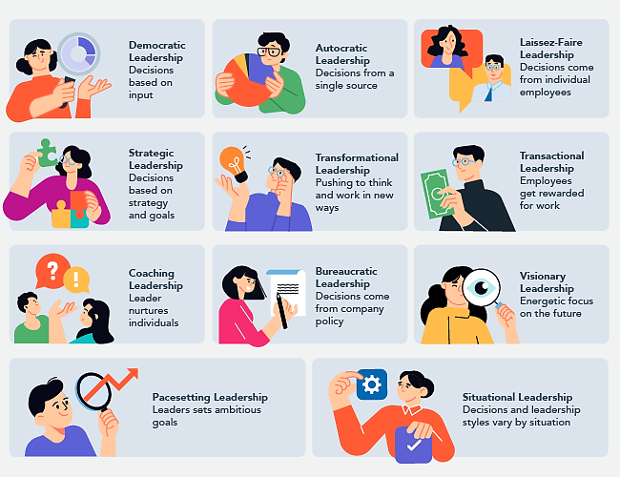
Lec.3
Types of Leadership

Slide 23

Lec.3
Methods of Leadership

Slide 24
Lec.3
Methods of leadership
Pure exercise of power ممارسة نقية للسلطة. "My way or the highway." If you don't do what the leader demands, no matter how unreasonable, you're gone. The leader's decisions are not open to question or discussion, and no one else gets to make decisions.
Political scheming. مكيدة سياسية The leader plays people off against one another, creates factions الفصائل within the organization, cultivates "allies حلفاء " and isolates "enemies," and builds up (through favors or overlooking poor performanceمن خلال المحاباة أو التغاضي عن الأداء الضعيف) personal debt which can be cashed in when needed, in order to manipulate people and events as he wishes.

Slide 25
Lec.3
Methods of leadership
Using relationships استخدام العلاقات . The leader develops strong positive relationships with all or most of the people in the organization, and uses these relationships to steer people in particular directions. People do what they're asked because of their relationships with the leader, rather than for reasons connected to the tasks themselves.
Setting an exampleقدوة أو مثل أعلى . The leader may or may not demand or request particular behavior or actions, but the leader will demonstrate them, and expect or imply that others will follow.

Slide 26
Lec.3
Methods of leadership
Persuasion إقناع . The leader convinces people through argument, reasoning, selling techniques, or other persuasive methods that what the leader wants is, in fact, the best course, or in line with what they want to do.
Sharing power تقاسم السلطة . Some leaders choose to exercise at least some leadership through the other stakeholders in the organization. In this situation they may give up some personal power in return for what they see as more ownership of decisions, goals, and the organization itself by those involved in the decision-making process.

Slide 27
Lec.3
Methods of leadership
Charisma جاذبية. Some leaders are charismatic enough to simply pull others along by the power of their personalities alone. They may, in fact, advocate يدافع عن and accomplish ينجز wonderful things, but they do it through people's loyalty to and awe of them الولاء لهم والرهبة منهم.
Involving followers in the goal إشراك الأتباع في الهدف . The leader gets others to buy into the vision for the organization, and to make it their own. The leader may accomplish this through charisma, through the force of the belief in power and rightness of the vision, or through the nature of the vision itself.

Slide 28
Lec.3
Methods of leadership
Various combinations of these and other methods.
  The combination of the leader's and organization's conception of leadership and the leader's way of leading does much to define leadership style. In addition, the characteristics of the leadership are almost always reflected in the relationships within and among the staff, participants, Board, and others related to the organization, as well as in its policies, procedures, and program.

Slide 29
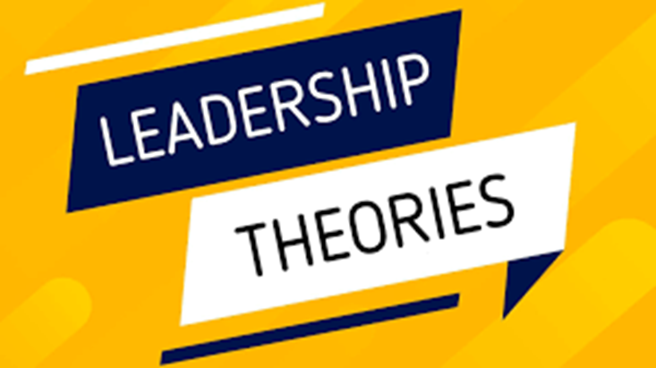
Lec.3

Slide 30
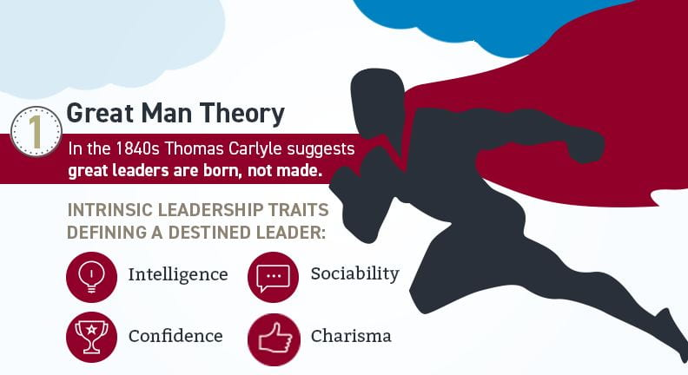
Lec.3
1. The Great Man Theory نظرية الرجل العظيم
One of the first theories on leadership makes the assumption that these qualities are inherent, which indicates that leaders are born, not created, and cannot be learned. This hypothesis asserts that a leader has certain innate human characteristics, such as:
    Glamour
    Decisive
    Wisdom
    Daring
    Assertiveness
    Appeal
البهجة
حاسم
حكمة
جرأة
إصرار
جاذبية

Slide 31
Lec.3
1. The Great Man Theoryنظرية الرجل العظيم
This viewpoint emphasizes the fact that individuals cannot be taught to be effective leaders. It's a quality that either you have, or you don't. These abilities come naturally; thus, you cannot learn them or receive training in them.
In addition, the idea holds that these leadership qualities are constant over time and apply to all organizations, regardless of the setting in which these leaders are employed. The idea that exceptional leaders emerge when they are required is another tenet of this leadership ideology.

Slide 32
Lec.3
2. Trait Theories of Leadership نظرية السمات
Theories that sought personality, social, physical or intellectual traits and differentiated leaders from non-leaders.
Leaders tend to be described as: confident, iron-willed, determined & decisive (Margaret Thatcher, Mandella, Sadat). Whom else??
Other terms used include: Charismatic, Enthusiastic & Courageous
Research failed to show consistent attributes that differentiated LEADERS from NON LEADERS
However, research was successful in identifying traits that were CONSISTENTLY ASSOCIATED WITH LEADERS.

Slide 33
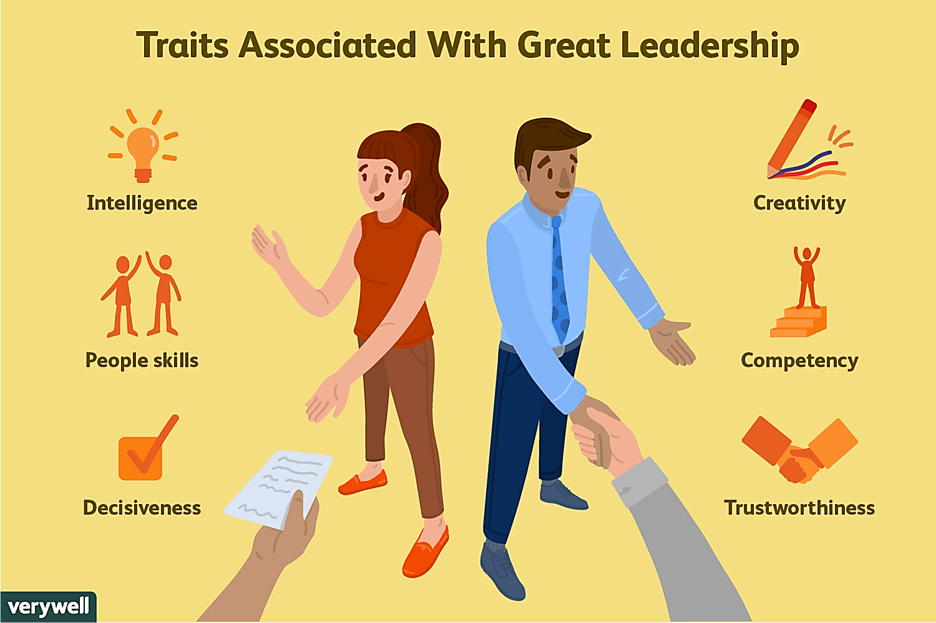
Lec.3
2. Trait Theories of Leadership
6 Traits in which LEADERS Differ from Non-Leaders:
  Ambition & Energy
  The Desire to Lead
  Honesty & Integrity
  Self-Confidence
  Intelligence
  Job-Relevant Knowledge
  High self-monitors (high flexibility in adjusting their behavior in different situations)

Slide 34
Lec.3
2. Trait Theories of Leadership
Personality
  Verbal facility
  Honesty
  Initiative
  Aggressive
  Self-confident
  Ambitious
  Originality
  Sociability
  Adaptability
Intelligence
  More intelligent than non-leaders
  Scholarship
  Knowledge
  Being able to get things done
  Physical
  Doesn‘t seem to be correlated
براعة لفظية
أمانة
مبادر
عنيف
واثق من نفسه
طموح
أصالة
اجتماعي
القدرة على التكيف
أكثر ذكاءً من غير القادة
لديه القدرة على التعلم
معرفة
أن تكون قادرًا على إنجاز الأمور
لا يبدو أنها مرتبطة

Slide 35
Lec.3
2. Leadership Traits from the Follower’s Perspective
A somewhat different approach to identifying leadership characteristics was based on the opinions of individuals who were both followers and leaders. This study collected the views of many thousands of individuals from business and government, participating in university executive development programs (Kouzes and Posner, 2002).
When asked ‘What do you look for and admire in your leader?’, there was considerable consensus among these individuals in that they reported that leaders need to be: 1. honest; 2. forward looking; 3. inspiring; 4. competent; 5. fair minded; 6. supportive; 7. broad minded; 8. intelligent.
1. صادق؛ 2. التطلع إلى الأمام. 3. ملهم؛ 4. كفؤ؛
5. منصف؛ 6. داعم؛ 7. واسع الأفق. 8. ذكي.

Slide 36
Lec.3
2. Leadership Traits in Summary
Research into leadership traits has revealed that the more of the traits individuals possess, the more effective their leadership.
A more practical approach, however, is to recognize that some broad leadership characteristics are relatively central, and although not absolutely required in all cases, will tend to correlate positively with effectiveness in leading others.

Slide 37
Lec.3
3. Behavioral Theories of Leadership النظريات السلوكية للقيادة
This type of leadership theory focuses on a leader’s actions and behavior, with very little emphasis on their qualities and traits.
According to behavioral leadership theory, an effective leader has many acquired skills. In addition to it, the theory also considers that an individual can learn skills to become a good leader.
So, theories proposing that specific behaviors differentiate leaders from non-leaders.
If so, we could train non-leaders to become leaders.
These theories had some success in identifying consistent relationships between Leadership & Group Performance.

Slide 38
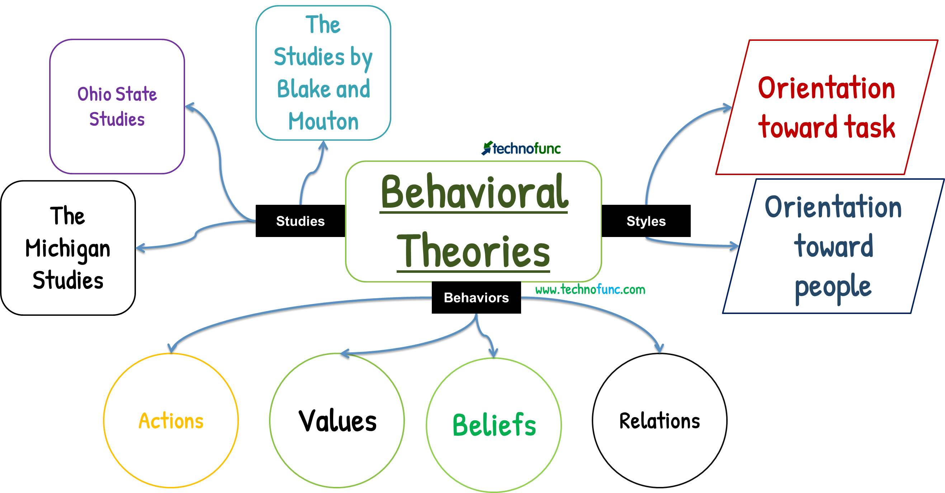
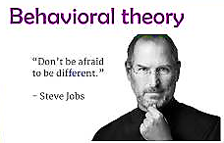

Lec.3
3. Behavioral Theories of Leadership

Slide 39
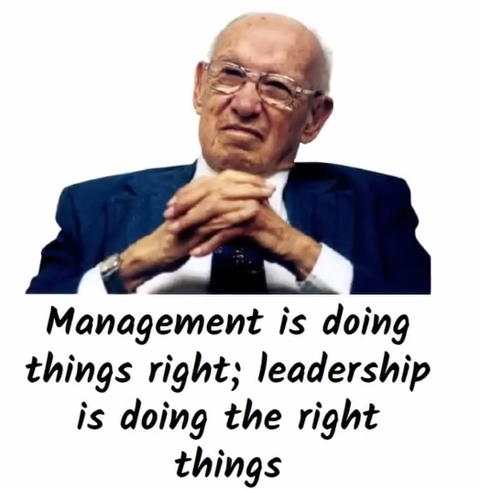

10 Management Skills
Lec.3

Slide 40
نظريات قيادة المعاملات والقيادة التحويلية
Lec.3
4.Transactional & Transformational Theories
A different view, popularized by James MacGregor Burns, contrasts two styles of leadership: transactional and transformational.
Transactional Leader قائد المعاملات : One who guides or motivates their followers in the direction of established goals by clarifying role and task requirements.
  Transactional leadership views leadership as based on transactions between leader and followers. Thus rewards, punishments, exchanges (economic, emotional, physical) and other such "transactions" are the basis of leadership.
    An organization leads by paying you and telling you what you need to do; you respond by doing what you need to do efficiently and well, and the organization will prosper.

Slide 41
Lec.3
4.Transactional & Transformational Theories
Transformational Leader القائد التحويلي : One who inspires followers to transcend (go beyond) their own self-interests for the good of the organization, provide personal consideration and intellectual stimulation, and who possess charisma (heroic or extraordinary leadership abilities observed by the followers).
الشخص الذي يلهم أتباعه لتجاوز مصالحهم الذاتية من أجل مصلحة المنظمة ، وتقديم الاعتبار الشخصي والتحفيز الفكري، والذين يمتلكون الكاريزما (قدرات القيادة البطولية أو الاستثنائية التي يلاحظها الأتباع).
  Transformational leadership sees a true leader as one who can distill the values and hopes and needs of followers into a vision, and then encourage and empower followers to pursue that vision.
  يرى القائد الحقيقي باعتباره الشخص الذي يمكنه استخلاص قيم وآمال واحتياجات الأتباع في رؤية ،
  ثم يشجع الأتباع ويمكّنهم من متابعة هذه الرؤية.

Slide 42
Lec.3
4.Transactional & Transformational Theories
  A transactional leader thinks of improvement or development as doing the same thing better: an organization that reaches more people, a company that makes more money.
  يفكر قائد المعاملات في التحسين أو التطوير على أنه القيام بنفس الشيء بشكل أفضل: منظمة تصل إلى عدد أكبر من الأشخاص ، شركة تحقق أرباحًا أكثر.
  A transformational leader thinks about changing the world, even if only on a small scale.
  يفكر القائد التحويلي في تغيير العالم ، حتى لو كان ذلك على نطاق ضيق.

Slide 43
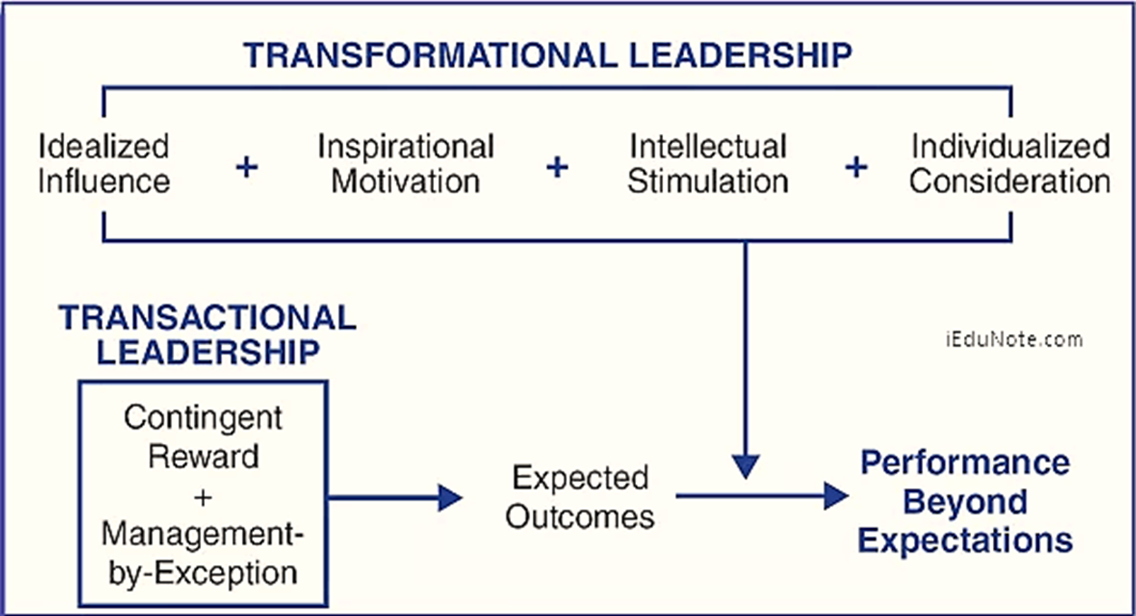
Lec.3
4.Transactional & Transformational Theories

Slide 44
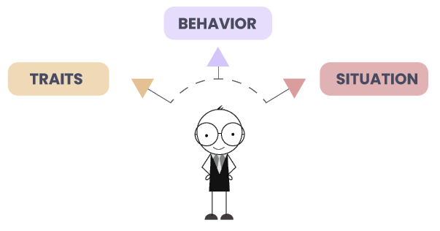
Lec.3
5.Contingency theory of leadership
نظرية الاحتمالات/الطوارئ
Often called the situational leadership theoryنظرية القيادة الموقفية , it is one of the versatile متعدد الجوانبleadership theories that suggest that different leadership styles suit different situations. In these types of leadership theories, leaders must adapt their leadership style depending on their situation, which increases innovation and effectiveness.
The leadership theory helps leaders become versatile متنوع القدرات and adapt to different situations easily. It makes their transition from one phase to another easy and also gives them the skills and knowledge required to tackle difficult situations.

Slide 45
Lec.3
5.Contingency theory of leadership
نظرية الاحتمالات/الطوارئ
According to the contingency hypothesis, there is no one right way to run an organization. Determining the optimal strategy for leading an organization to achieve depends on both internal and external considerations. The right candidate should fit the correct scenario, according to the contingency theory.
The management strategy that will help the organization achieve its objectives in a particular situation is decided by the leader.
According to this view, situations determine whether or not leaders are effective. No matter how successful a leader is, the idea explains, difficult situations will always arise. It emphasizes that the leaders are aware that the conditions in combination with their abilities have a role in their achievement.

Slide 46
Lec.3
5.Contingency theory of leadership
نظرية الاحتمالات/الطوارئ
The following elements influence the leadership style, based on contingency theory:
    Management approach
    Work speed
    Organizational policies and culture
    Employee spirit
    Employees' level of maturity
    Relationship between coworkers or members of a team
    Organizational objectives
    Environment and routine at work
نهج الإدارة
سرعة العمل
السياسات والثقافة التنظيمية
روح الموظف
مستوى نضج الموظفين
العلاقة بين زملاء العمل أو أعضاء الفريق
الأهداف التنظيمية
البيئة والروتين في العمل

Slide 47

Lec.3
6. Neo-Charismatic Theories
النظريات الكاريزمية الجديدة
الرمزية والجاذبية العاطفية والالتزام الاستثنائي من جانب المتابعين
Leadership theories that stress symbolism, emotional appeal and extraordinary follower commitment
They include:
    Charismatic Leadership
    Transformational & Transactional
    Visionary Leadership
Key Characteristics of Charismatic Leaders
Vision & Articulation الرؤية والتعبير (expressed as an idealized goal that proposes a better future than status quo الوضع الراهن & in understandable terms to others)
Personal Risk
Environmental Sensitivity (realistic assessment of environmental constraints قيود & resources to bring about change)
Sensitivity to Follower Needs & Feelings
Unconventional Behavior السلوك غير التقليدي (novel & counter to norms)

Slide 48
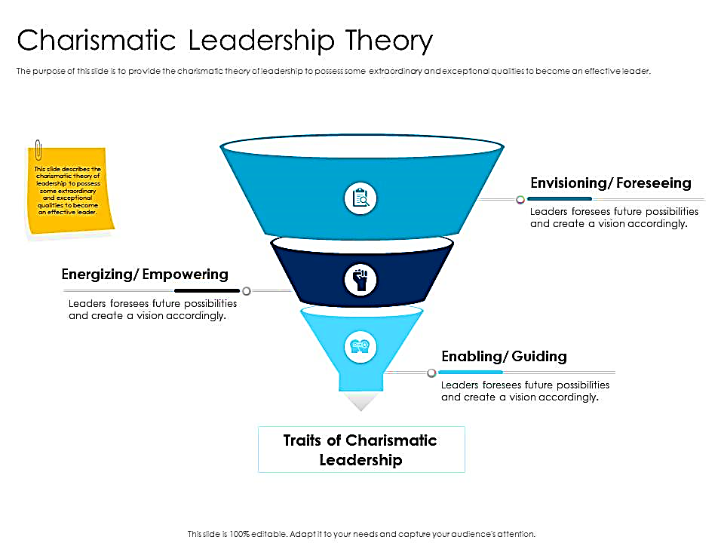
Lec.3
6. Neo-Charismatic Theories
النظريات الكاريزمية الجديدة
3Es: Envisioning, Energizing, Enabling
“Vision, Passion, and Care”
The Charismatic Leader
Charismatic leaders may affect an organization and the individuals they lead in a strong, positive way.
However, this leadership style can also lead to dangerous situations if used in the wrong manner.
Charismatic leadership is defined by three behavioral dimensions: envisioning تصور (communication about vision), energizing تنشيط (communication about passion), and enabling تمكين (communication about care and support).
1
2
3

Slide 49

Lec.3
6. Neo-Charismatic Theories
The Pros and Cons of Being a Charismatic Leader
Pros
  Extremely motivating and encouraging
  Fosters a sense of friendship, cooperation, and community
  Makes subordinates followers feel noticed and appreciated
  Builds momentum for sustainable change
يمكن أن يجعل القادة يركزون على أنفسهم بدلاً من أتباعهم
يمكن أن يشجع السلوكيات المتمحورة حول الذات
كثيرا ما ينظر إليه على أنه سطحي أو مصطنع
Cons
Can cause leaders to concentrate on themselves rather than their followers
Can encourage self-centered behaviors
Often seen as superficial or presumptuous

Slide 50
Lec.3
6. Neo-Charismatic Theories
Visionary Leadership القيادة الحكيمة / الرؤيوية / المتبصرة
Ability to create and articulate a realistic, credible, attractive vision of the future for an organization or department that grows out of and improves upon the present (status quo).
Visions: are inspirational, value-centered, unique, challenging, but attainable ممكن تحقيقها , with superior imagery & articulation, offer a view of the future, fit the times & circumstances and can make an organization ―”stand above the crowd”

Slide 51
Lec.3
6. Neo-Charismatic Theories
Visionary Leadership
Visionary Leaders Have 3 Common Qualities:
  Ability to explain vision
  Express vision thru من خلال his/her behavior
  Extend vision to different leadership contexts so as to be applied in different situations, e.g. in various departments of marketing, sales, accounting, HR, and in all geographic locations of the company

Slide 52
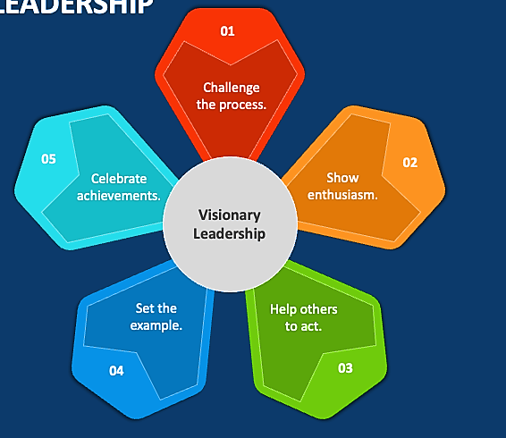
Lec.3
6. Neo-Charismatic Theories
Five Principles Of Visionary Leadership
Challenge the Process - Be a pioneer - encourage innovation and support people with ideas.
Be Enthusiastic - Inspire others through personal enthusiasm to share in a common vision.
Help Others to Act - Be a team player and support the efforts and talents of others.
Set the Example - Provide a consistent role model of how others can and should act.
Celebrate Achievements - Bring emotion into the workplace and rally "hearts" as well as "minds."

Slide 53
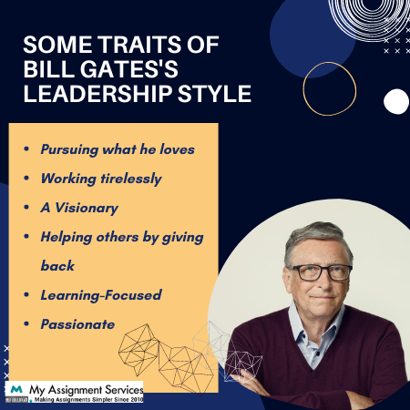
Trait VS Transformational?
Lec.3

Slide 54
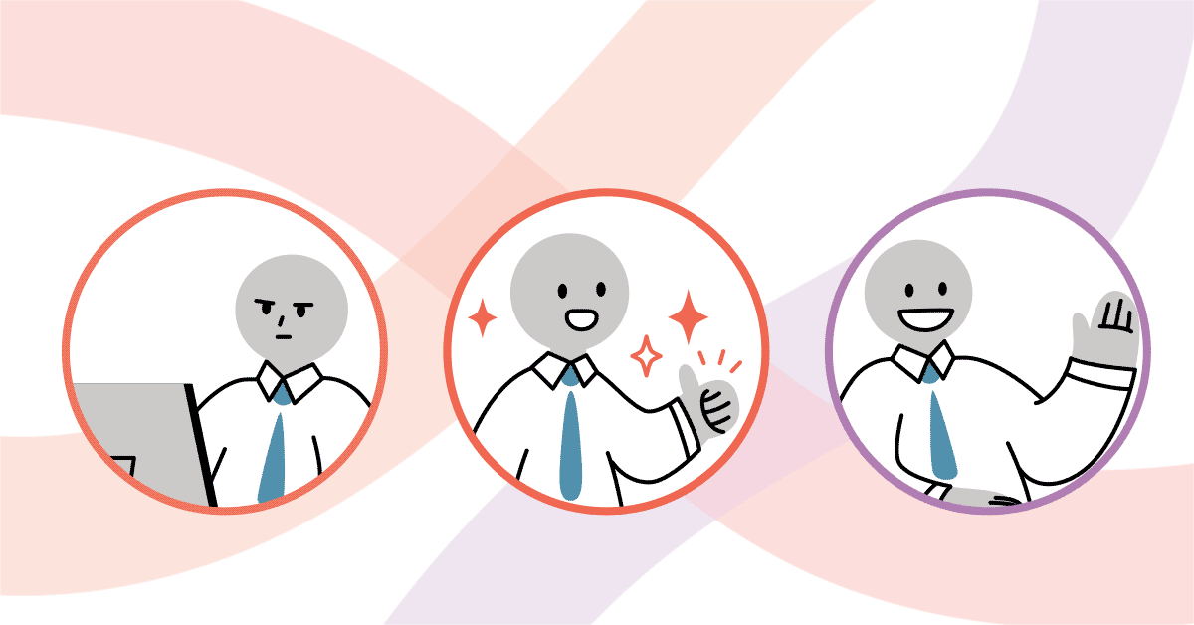
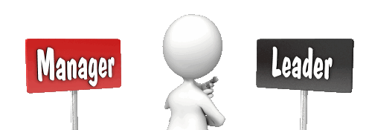
Lec.3
New Leaders

Slide 55

Lec.3
New Leaders Take Note
General Advice
  Take advantage of the transition period
  Get advice and counsel
  Show empathy to predecessor
  Learn leadership
  Challenges
  Need knowledge quickly
  Establish new relationships
  Expectations
  Personal equilibrium التوازن الشخصي
السلف

Slide 56
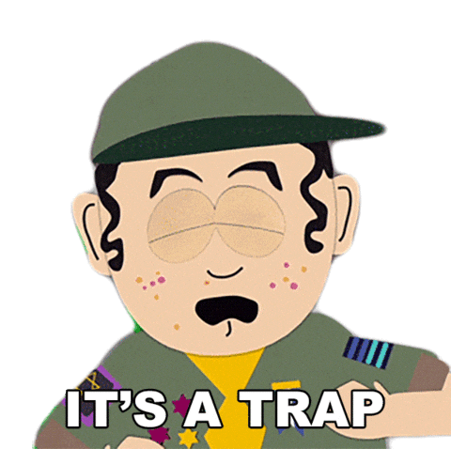
Lec.3
New Leaders Take Note
Not learning quickly
Isolation
Know-it-all
Keeping existing team
Ignoring Potential Problems
Taking the Easy Path
Ignoring Feedback, You Don't Like

Slide 57

Basic Principles
Lec.3
Have 2-3 years to make measurable financial and cultural progress
Come in knowing current strategy, goals, and challenges. Form hypothesis on operating priorities
Balance intense focus on priorities with flexibility on implementation….
Decide about new organization architecture
Build personal credibility and momentum
Earn right to transform entity
Remember there is no ―″one‶ way to manage a transition

Slide 58

Lec.3
Leading Effectively
The 70-20-10 Rule

Slide 59
Leading Effectively
The 70-20-10 Rule for Leadership Development
Lec.3
The 70-20-10 rule emerged from over 30 years of Lessons of Experience research
According to the 70-20-10 rule, leaders learn and grow from 3 types of experience, following a ratio of:
    70% challenging experiences and assignments
    20% developmental relationships
    10% coursework and training
The underlying assumption of the 70-20-10 rule is that leadership can be learned that leaders are made, not born.
A leader’s ability and willingness to learn from experience
is the foundation for leading with impact.
قدرة القائد واستعداده للتعلم من الخبرة هو الأساس للقيادة ذات التأثير.

Slide 60
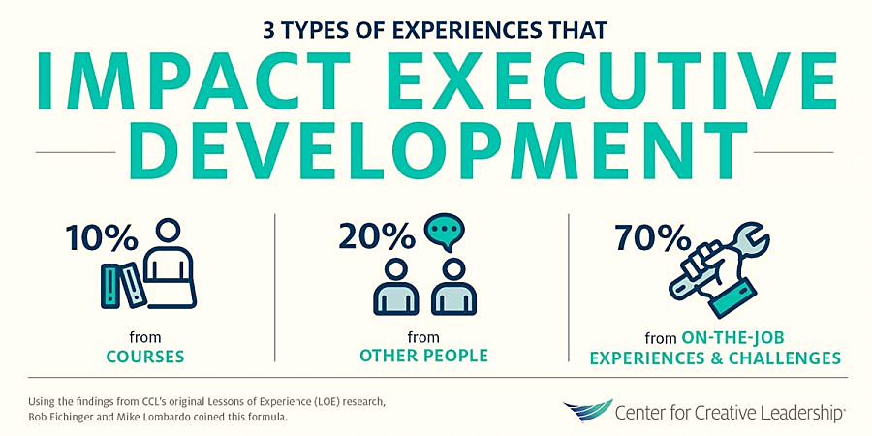
Leading Effectively
The 70-20-10 Rule for Leadership Development
Lec.3
The 70-20-10 rule reveals that individuals tend to learn 70% of their knowledge from challenging experiences and assignments, 20% from developmental relationships, and 10% from coursework and training.
Skilled training specialists can help an organization establish a shared knowledge base and align its members with respect to a common leadership vision and the 70-20-10 rule.

Slide 61
Lec.3
Leadership Self-Assessment
Do You Have Charismatic Tendencies?

Slide 62
Leadership Self-Assessment
Do You Have Charismatic Tendencies?
Lec.3
Instructions: To investigate your charismatic tendencies, answer the questions below. This quiz devised by Prof. Jay Conger, a leadership expert at the USC school of business. If your present situation doesn't apply to the question, imagine how you would react if placed in the situation.

Slide 63
Leadership Self-Assessment
Do You Have Charismatic Tendencies?
Lec.3
Questions
    1. I worry most about
        a. my current competitors.
        b. my future competitors.
    2. I'm most at ease thinking in
        a. generalities
        b. specifics.
    3. I tend to focus on
      a. our missed opportunities.
      b. opportunities we've seized.

Slide 64
Leadership Self-Assessment
Do You Have Charismatic Tendencies?
Lec.3
Questions
    4. I prefer to
        a. promote traditions that made us great.
        b. create new traditions.
    5. I like to communicate an ideas via
        a. a written report.
        b. a one-page chart.
    6. I tend to ask,
        a. "How can we do this better?"
        b. "Why are we doing this?"

Slide 65
Leadership Self-Assessment
Do You Have Charismatic Tendencies?
Lec.3
Questions
    7. I believe
        a. there's always a way to minimize risk.
        b. some risks are too great.
    8. When I disagree with my boss, I typically
        a. coax him/her nicely to alter his/her view.
        b. bluntly tell him/her, "You're wrong."
    9. I tend to sway people by using
        a. emotion.
        b. logic.
        10. I think this quiz is
        a. ridiculous.
        b. fascinating.

Slide 66
Leadership Self-Assessment
Do You Have Charismatic Tendencies?
Lec.3
10 Questions
Scoring and interpretation:
Answers:
1. b; 2. a; 3. a; 4. b; 5. b;
6. b, 7. a; 8. b; 9. a; 10. b
If you responded this way to 4 or fewer questions, you probably don't have much charisma.
7 or more? You ooze it!

Slide 67
Conclusion
We learned about
Types of Leadership
Methods of leadership
Theories of Leadership
  1. The Great Man Theory
  2. Trait Theories of Leadership
  3. Behavioral Theories of Leadership
  4.Transactional & Transformational Theories
  5.Contingency theory of leadership
  6. Neo-Charismatic Theories
  New Leaders Take Note & Traps
  Leading Effectively: The 70-20-10 Rule
  Self-Assessment
    Do You Have Charismatic Tendencies?
Lec.3

Slide 68


Lec.3
References
Bli-Group-Wp. (2011). Leadership Course material. Amideast Egypt. Business Intelligence, Training & Consulting, http://bli-group.com/
Jaiswal, S. (2022, November 30). Leadership theories for every manager in 2022: Leadership: Emeritus India. Emeritus. Retrieved February 11, 2023, from https://emeritus.org/in/learn/leadership-theories-for-every-manager-in-2022/
Simplilearn. (2023, January 18). 10 major leadership theories every manager should master in 2023. Simplilearn.com. Retrieved February 11, 2023, from https://www.simplilearn.com/top-leadership-theories-every-manager-should-know-article
Carter, L. (2022, August 11). Charismatic leadership is the most powerful way to lead. louiscarter.com. Retrieved February 15, 2023, from https://louiscarter.com/charismatic-leadership-style/
Rita Men, L., April Yue, C., & Liu, Y. (2020, May). ‘Vision, Passion, and Care:’ The Impact of Charismatic Executive Leadership Communication on Employee Trust and Support for Organizational Change. UF College of Journalism and Communications. Retrieved February 15, 2023, from https://www.jou.ufl.edu/insights/vision-passion-and-care-the-impact-of-charismatic-executive-leadership-communication-on-employee-trust-and-support-for-organizational-change/
Robbins, S. P., Coulter, M. K., & DeCenzo, D. A. (2011, August). Fundamentals of Management . Fundamentals Of
Leading. Retrieved February 15, 2023, from https://arslanhelpyoucom.files.wordpress.com/2016/05/ch-02-management-functions.ppt

Slide 69



Thank You

