Slide 1
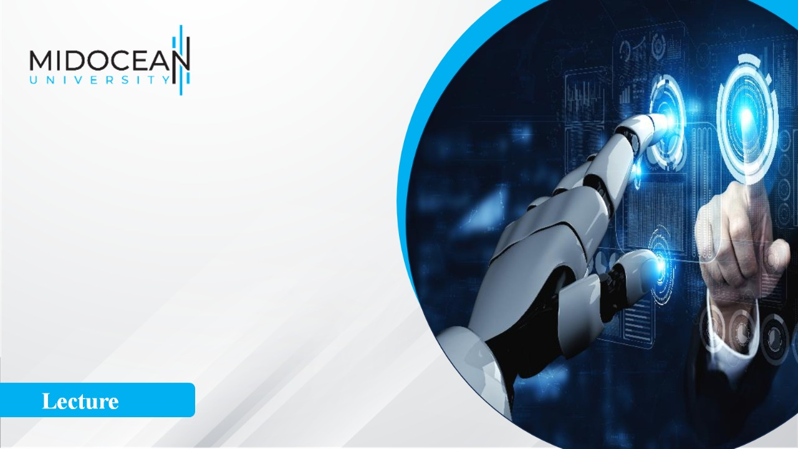
Digital
Consumer Behavior
Dr. Perihan Salah
MKT713
Master of Digital Marketing
3

Slide 2


Consumer Personality
Lecture 3
MKT713
Master of Digital Marketing

Slide 3
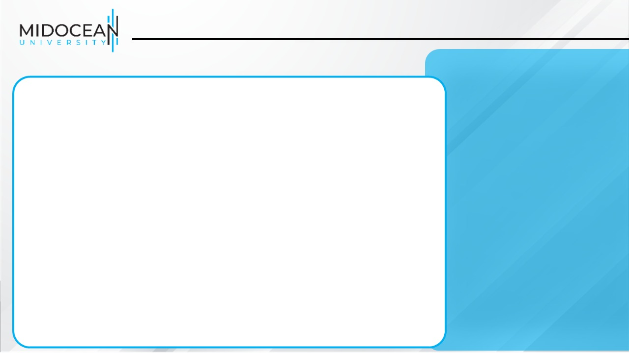
To understand the scope of personality and theories of its development.
To understand how innovativeness and other personality traits influence consumer behavior.
To understand the personification of products and brands and its strategic applications.
To understand self-image and its impact on consumer behavior.

Slide 4
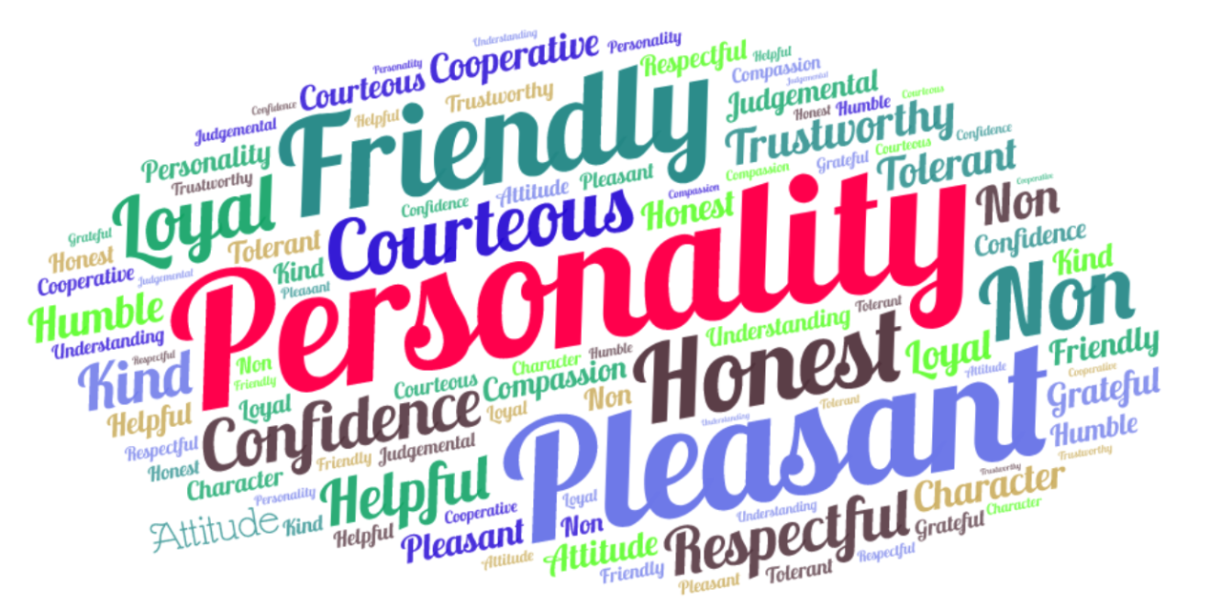
Consumer Personality
Introduction

Slide 5
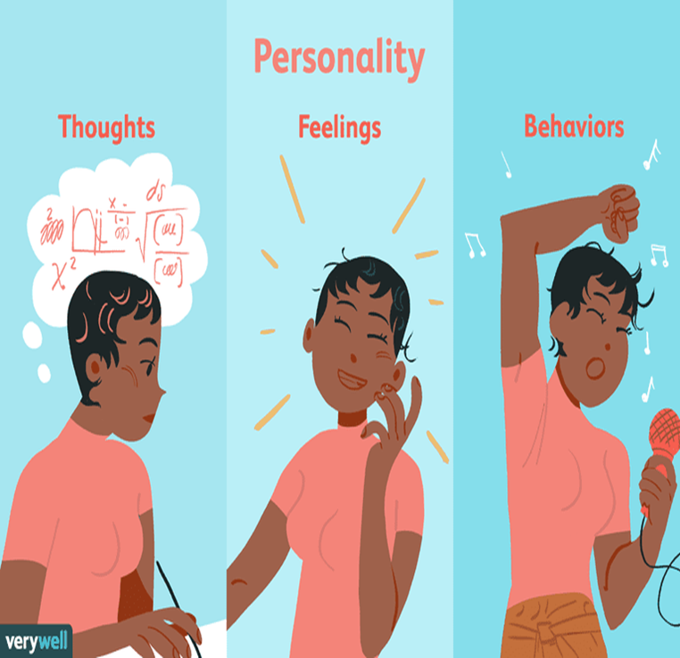
Consumer Personality
The inner psychological characteristics
The specific qualities, attributes, traits, factors, and mannerisms that distinguish one individual from other individuals
Both determine and reflect how we think and act.

Slide 6
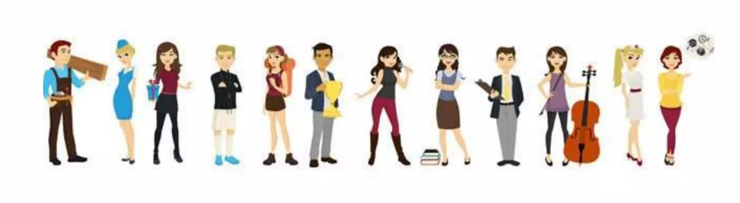
Consumer Personality
Personality reflects individual differences;
Personality is generally consistent and enduring
Personality can sometimes change. (by my will)

Slide 7
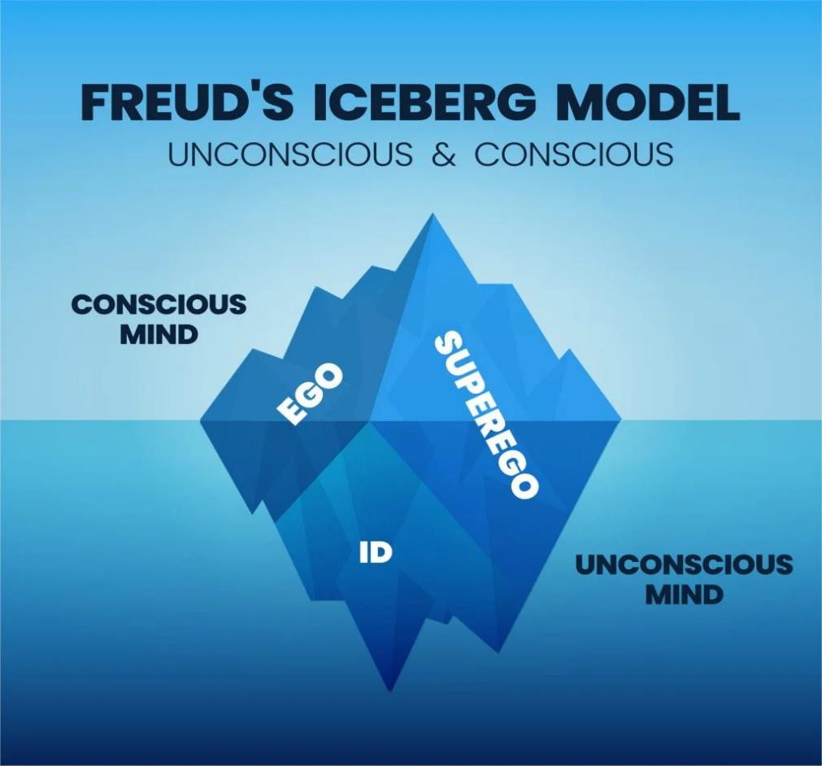
Theories of Personality
1. Sigmund Freud
Introduction

Slide 8

Theories of Personality
Freud suggests unconscious needs or drives are at the heart of human motivation.
  The Id is the “warehouse” of primitive drives, basic physiological needs such as hunger, thirst, and sex.
  The superego drives the individual to fulfill their needs in a socially acceptable function.
  The ego is the internal monitor that balances the needs of the id and the superego.
1. Sigmund Freud

Slide 9
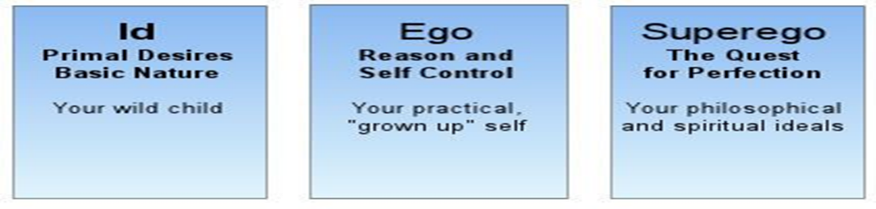
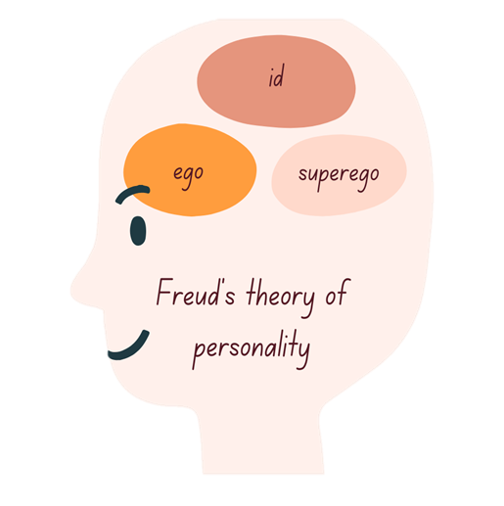
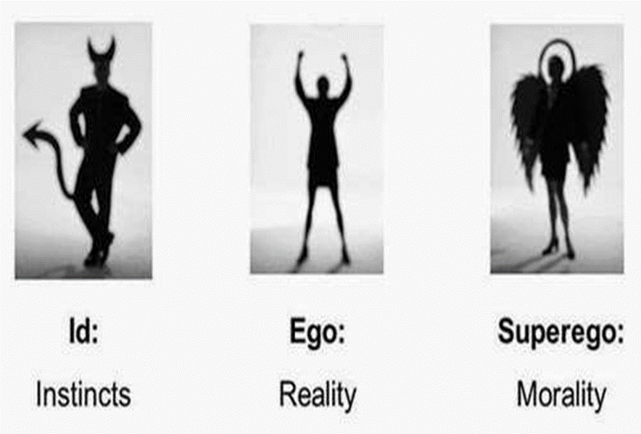
Theories of Personality
1. Freudian Theory
Energy constantly striving to satisfy basic drives
Pleasure Principle
Seeks to gratify the ID in realistic ways
Reality Principle
Voice of conscience that focuses on how we ought to behave

Slide 10
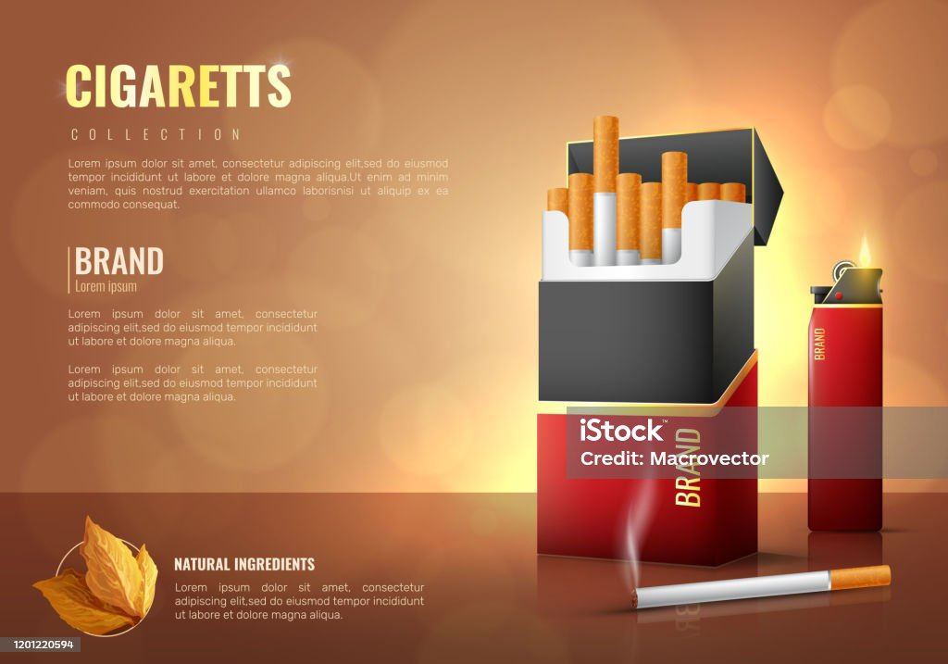
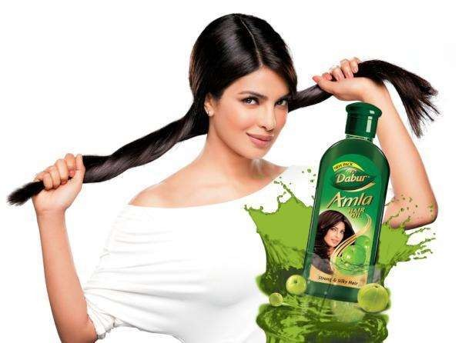
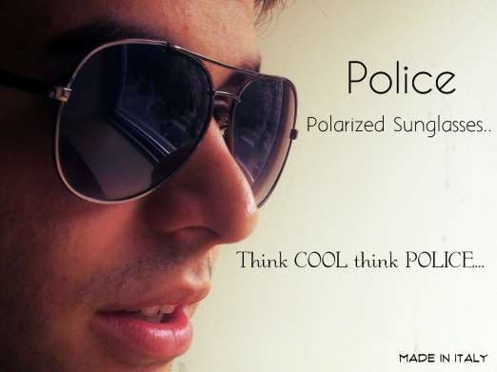
1. Freudian Theory
What are some products that are usually sold by telling you that the use of the product will make you attractive to the opposite gender?
ID

Slide 11

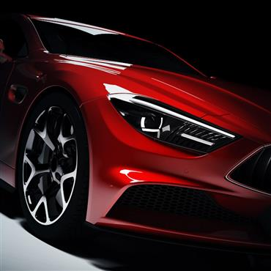
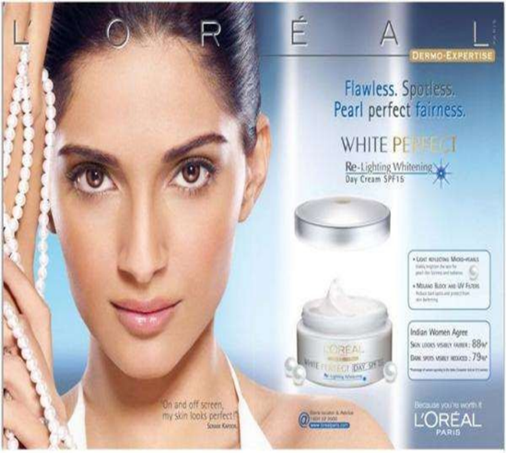
1. Freudian Theory
ID

Slide 12
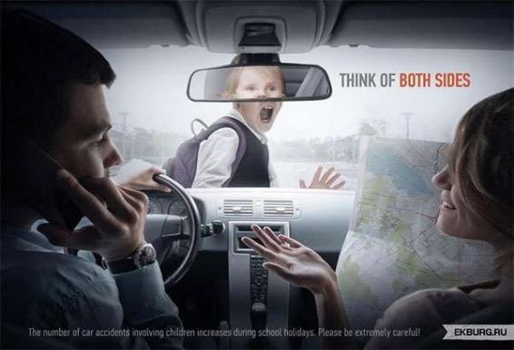



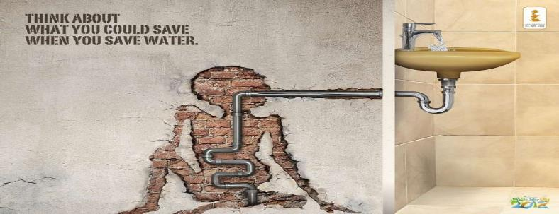
1. Freudian Theory
Super ego

Slide 13



1. Freudian Theory
EGO
(CSR)

Slide 14



1. Freudian Theory
EGO
(CSR)

Slide 15

1. Freudian Theory

Slide 16

1. Freudian Theory

Slide 17
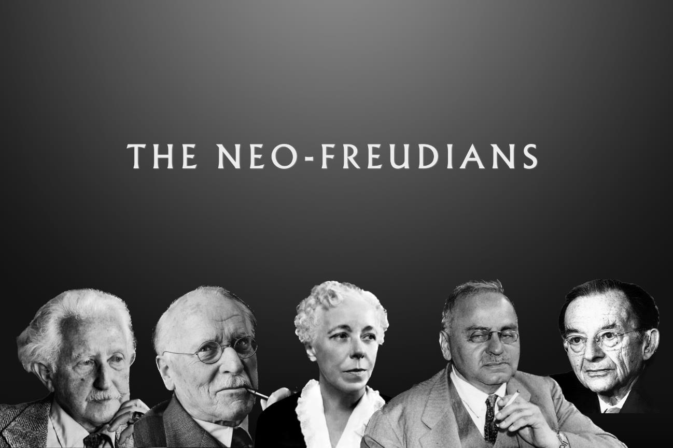
Theories of Personality
2. Neo-Freudian Personality Theory

Slide 18
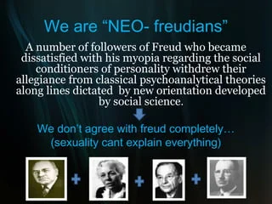
Theories of Personality
2. Neo-Freudian Personality Theory

Slide 19
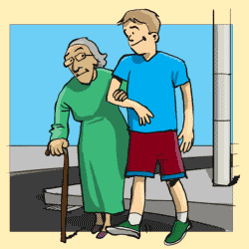

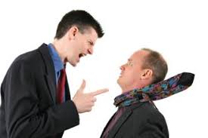
Theories of Personality
Suggests social relationships are fundamental to the formation and development of personality.
Social relationships are fundamental to personality (vs. Freud’s theories, which were based heavily on development).
2. Neo-Freudian Personality Theory

Slide 20
Theories of Personality
People can be classified :(According to Horney).
  A compliant individual desires attention
  an aggressive desires admirations
  a detached person desires independence and freedom from obligation.
  Horney focused on the surrounding effects
2. Neo-Freudian Personality Theory

Slide 21
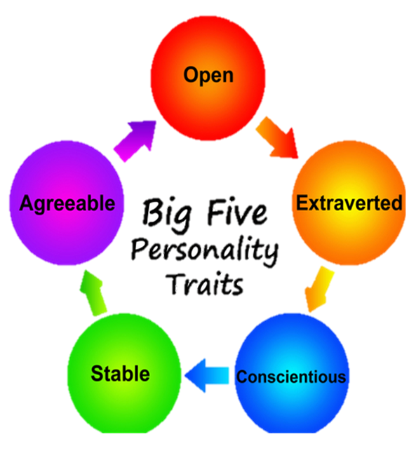
Theories of Personality
Quantitative approach to personality as a set of psychological traits.
A trait is any distinguishing, relatively enduring way in which one individual differs from another.
3. Trait Theory

Slide 22
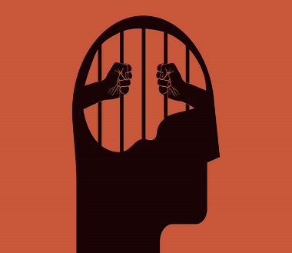
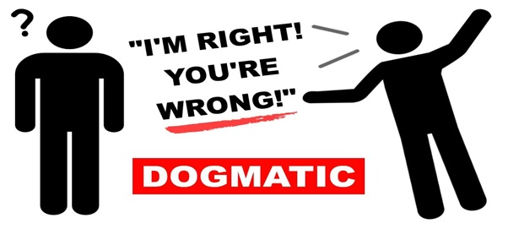
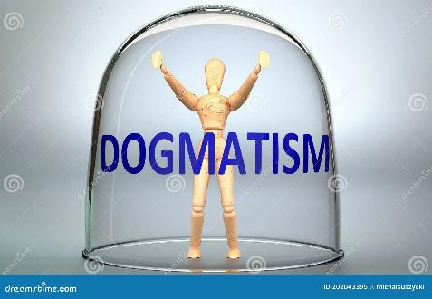
Personality Traits
Closed-mindedness
Dogmatic individuals are less likely to be innovators.
Dogmatism

Slide 23

Personality Traits
Inner-directed
Consumers rely on their own inner values or standards in evaluating new products.
More likely to be innovators.
Tend to prefer ads that stress on product’s benefits and features.
Social Character

Slide 24
Personality Traits
Other-directed
Consumers look to others for guidance . They are influenced by others.
Unlikely to be consumer innovators.
Tend to prefer ads that feature social acceptance.
Social Character

Slide 25


Personality Traits
Acquisition of consumer goods in order to enhance one’s personal and social identity.
Need For Uniqueness

Slide 26

Personality Traits
The degree to which people like novel, complex, and unusual experiences (i.e., high OSL)
Or prefer a simple, uncluttered, and calm existence (i.e., low OSL).
Optimum Stimulation Level (OSL)

Slide 27



Personality Traits
One’s need for varied, novel, and complex sensations and experiences, and the willingness to take risks for the sake of such experiences.
Sensation Seeking

Slide 28

Personality Traits
Prefer promotional messages containing a lot of written, textual, and verbal information.
Verbalizers

Slide 29

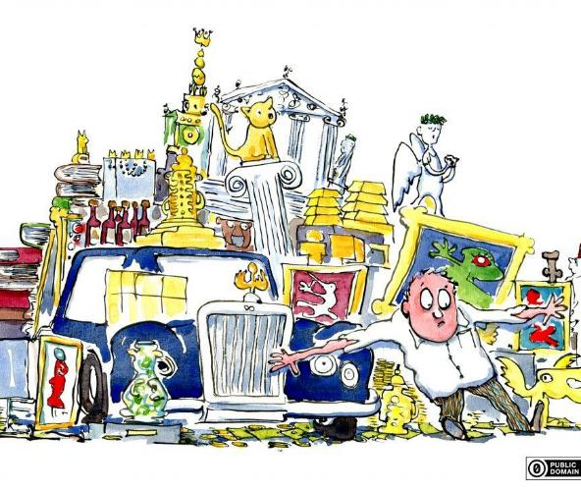
Personality Traits
Gauges, preoccupied with purchasing and showing off physical possessions that are mostly nonessential and often conspicuous luxury goods.
Verbalizers

Slide 30
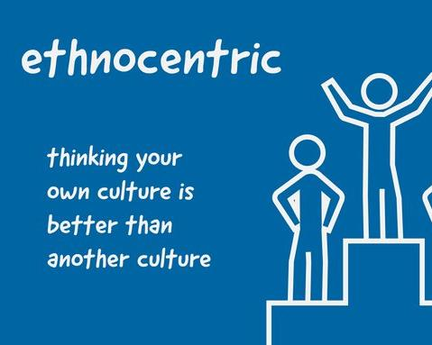

Personality Traits
Willingness to buy or not buy foreign-made products.
Ethnocentrism

Slide 31

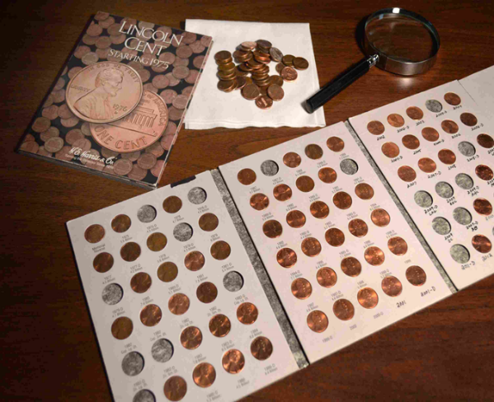
Personality Traits
Refers to collectors’ and hobbyists’ tendency to accumulate items that are related to their interests and show them off to friends and others with similar interests.
Fixated Consumption

Slide 32
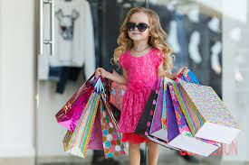


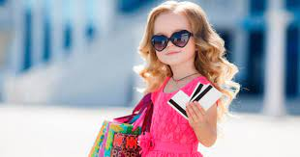
Personality Traits
Addictive and out-of-control buying that often has damaging consequences for both the compulsive shopper and those around him or her. (Shopaholics)
Compulsive Consumption

Slide 33
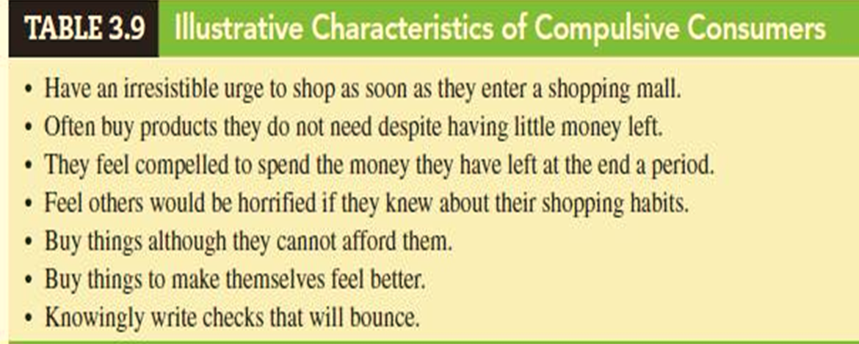
Personality Traits
Compulsive Consumption

Slide 34

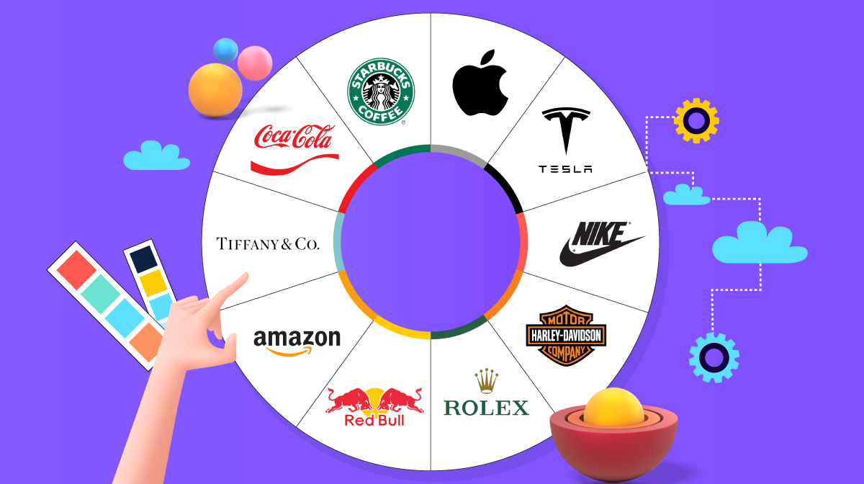
Brand
Personality
Introduction

Slide 35
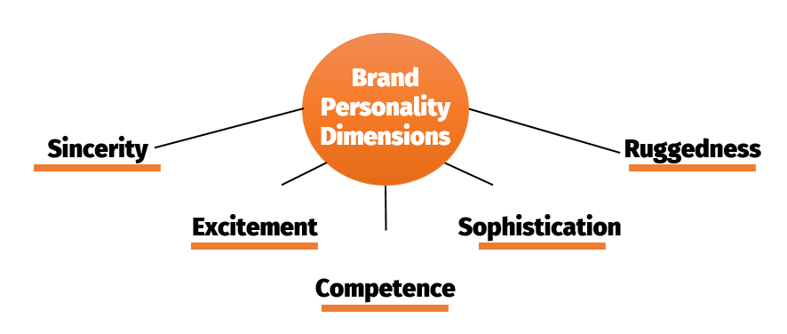
Brand Personality Dimensions

Slide 36
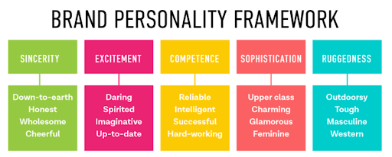
Brand Personality Dimensions
Trust

Slide 37
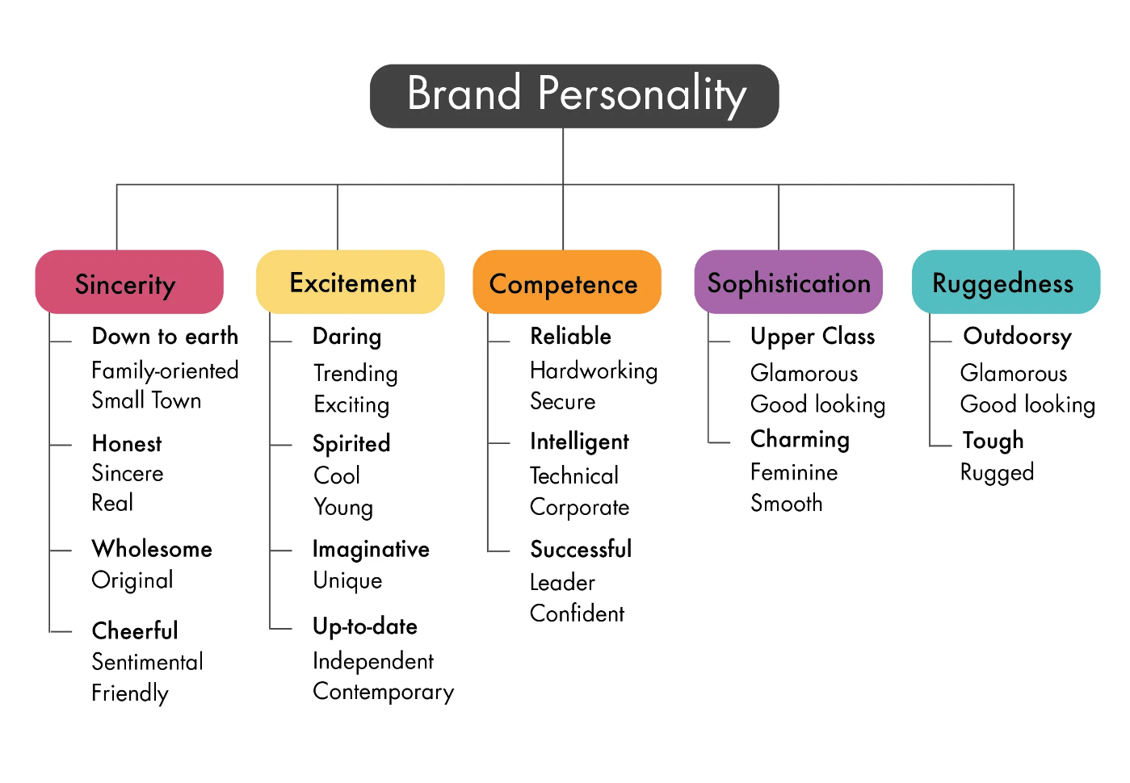
Brand Personality Dimensions

Slide 38
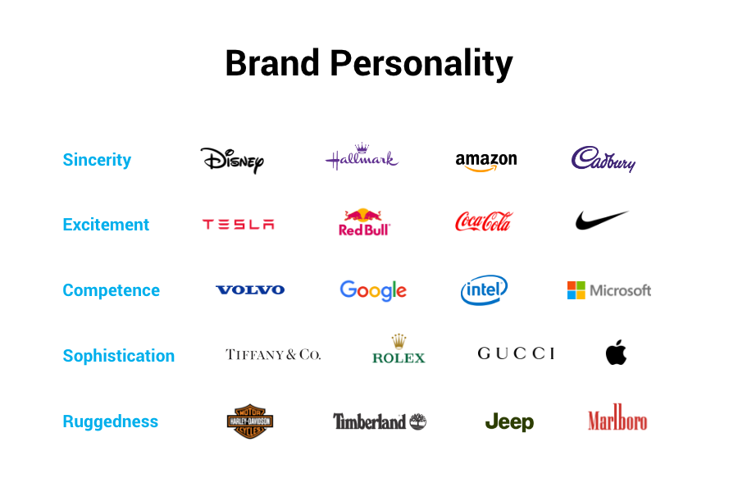
Brand Personality Dimensions

Slide 39
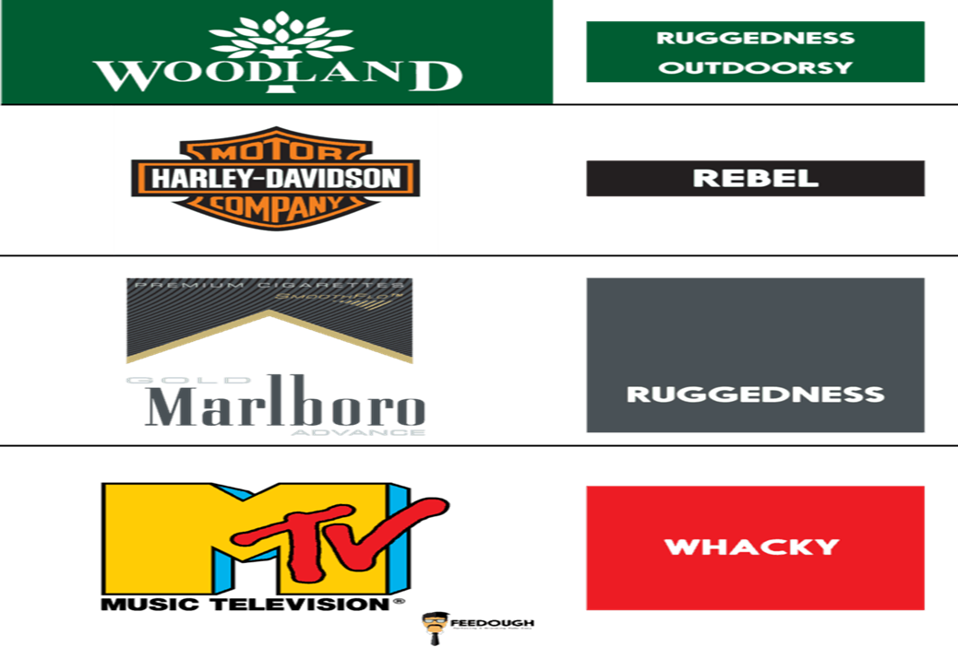
Brand Personality Dimensions

Slide 40
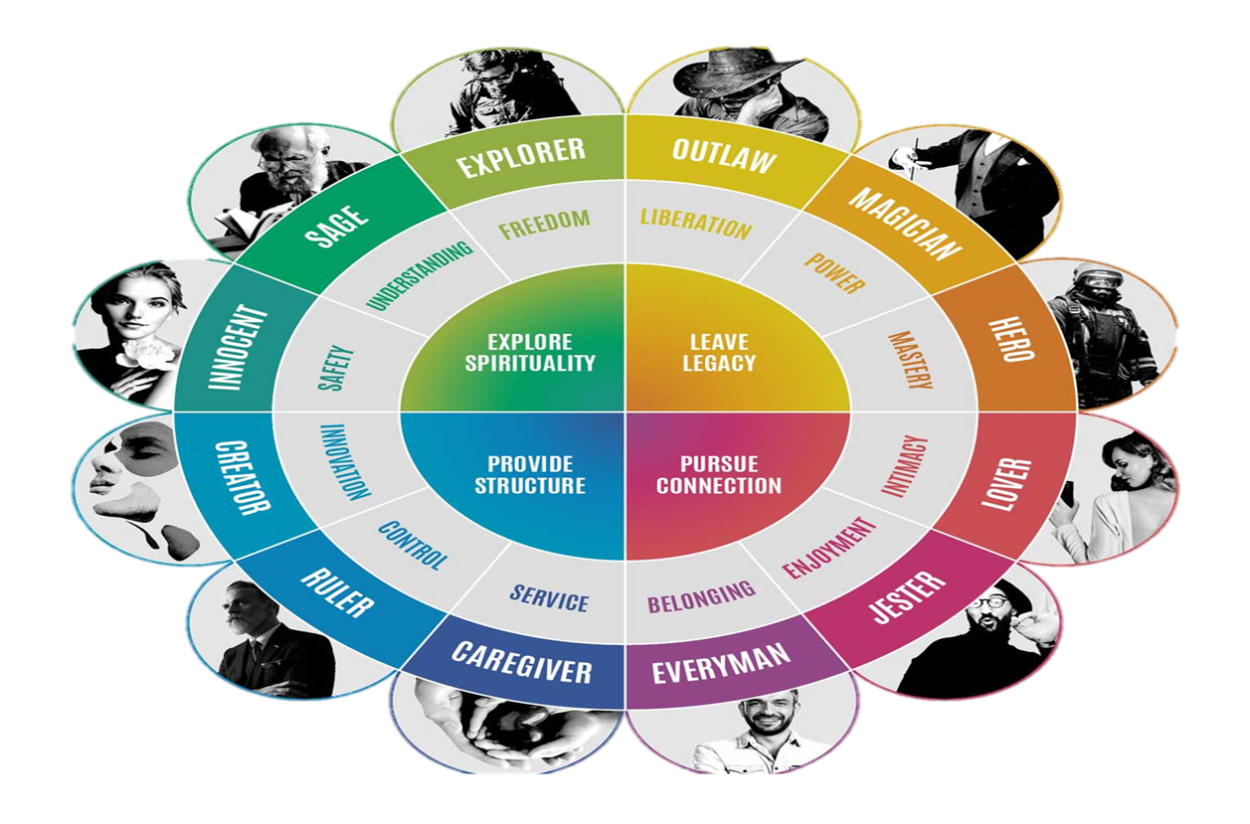
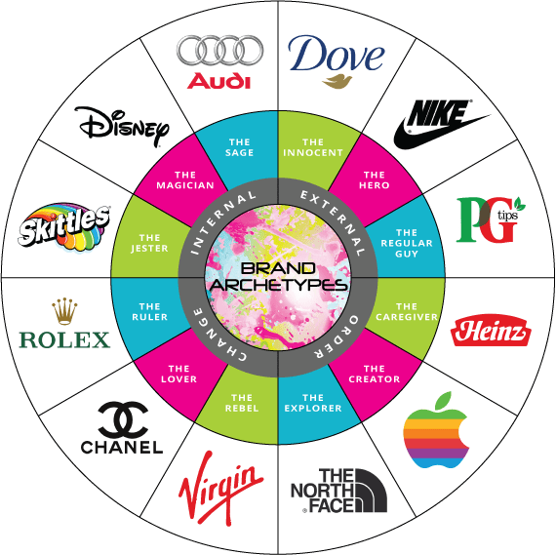
Brand Archetypes
Giving a non-living thing a living character

Slide 41
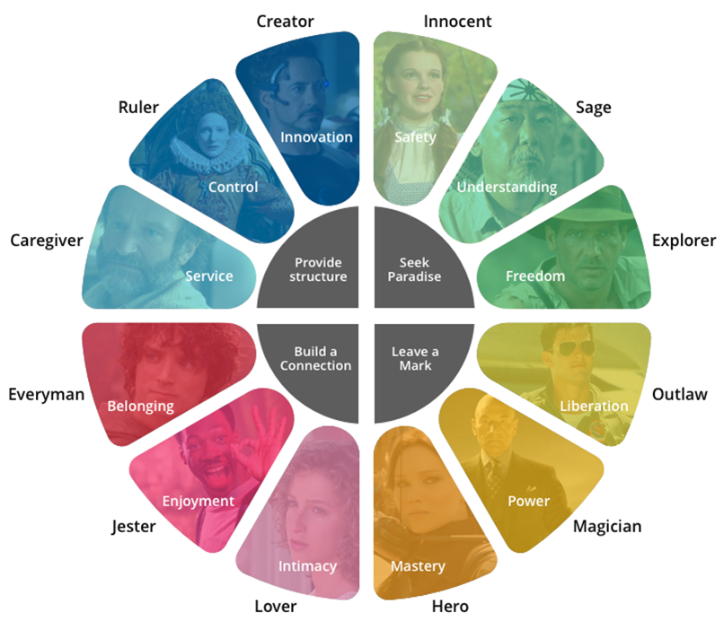
Brand Archetypes

Slide 42
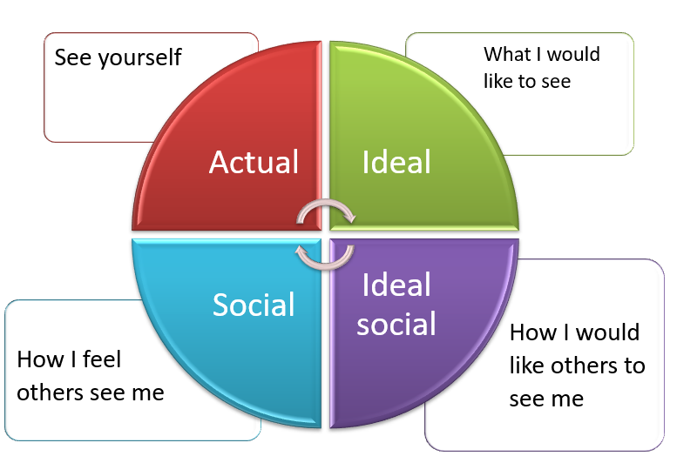
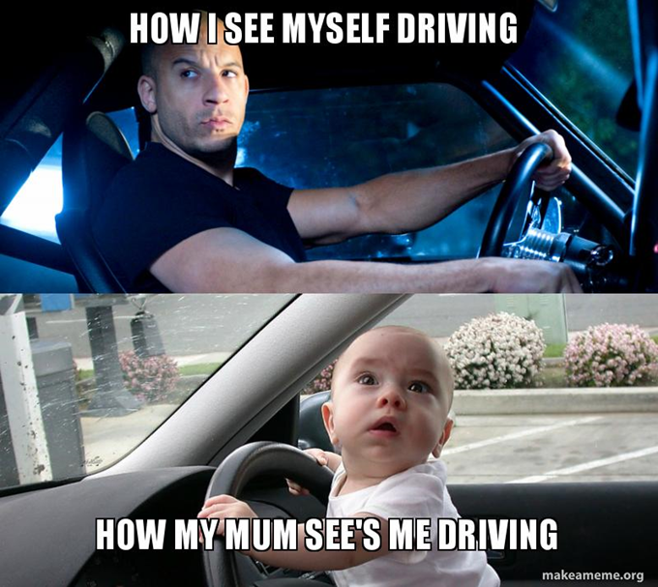
Self-Image
Four Components of Self-Image

Slide 43
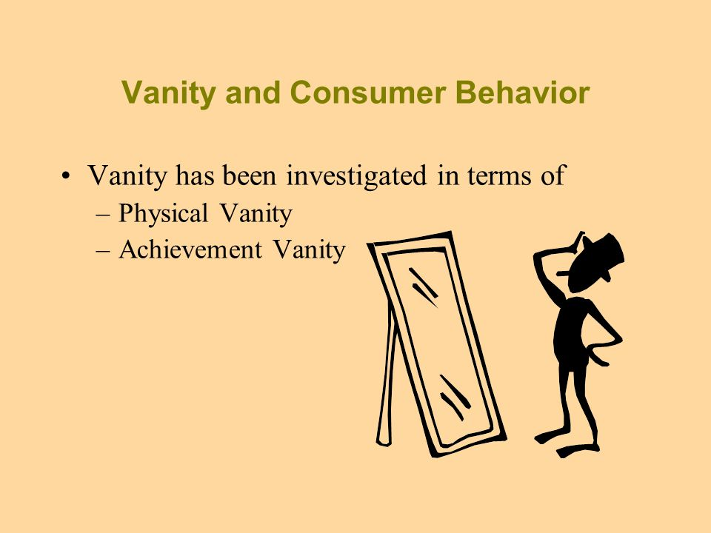
Vanity (Pride)

Slide 44
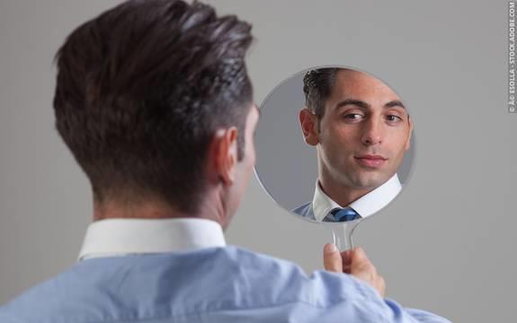

Two Types of Vanity (Pride)
Physical Vanity
Achievement Vanity
which is excessive concern physical appearance
which is excessive concern one’s personal achievements.

Slide 45
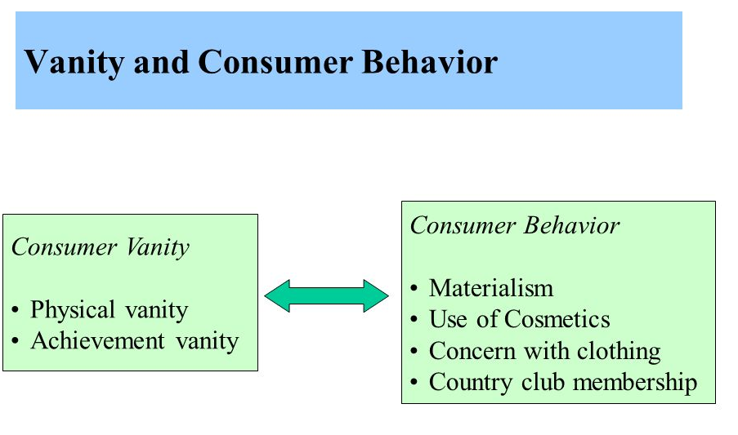

Two Types of Vanity (Pride)

Slide 46
Vain Consumer
Are a lucrative market for personal care and beauty products;
Welcome promotional messages showing that they attract others’ attention;
Are receptive to promotional messages featuring personal achievement.

Slide 47
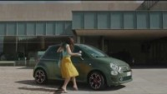
Vain Consumer

Slide 48

To understand the scope of personality and theories of its development.
To understand how innovativeness and other personality traits influence consumer behavior.
To understand the personification of products and brands and its strategic applications.
To understand self-image and its impact on consumer behavior.
03

Slide 49



