Slide 1

Probability and Statistics
Prepared by Dr.Israa Lewaa
Lecture 9
STA 201
Correlation and Regression

Slide 2

Chapter
09
Chapter Outline
9.1 Correlation
9.2 Linear Regression
9.3 Measures of Regression and Prediction Intervals
9.4 Multiple Regression

Slide 3
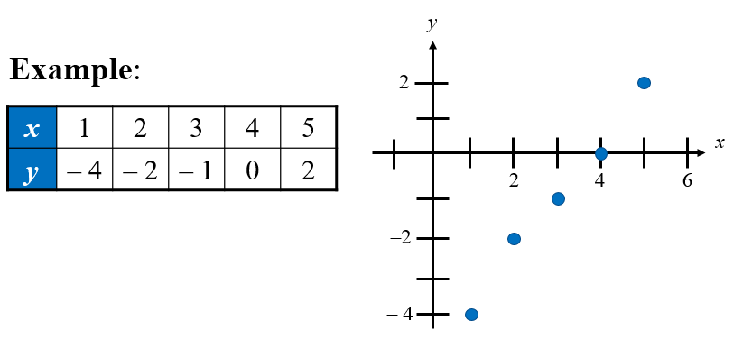
Chapter
09
Section 9.1: Correlation
A relationship between two variables. The data can be represented by ordered pairs (x, y)
  x is the independent (or explanatory) variable
  y is the dependent (or response) variable
  A scatter plot can be used to determine whether a linear (straight line) correlation exists between two variables.

Slide 4
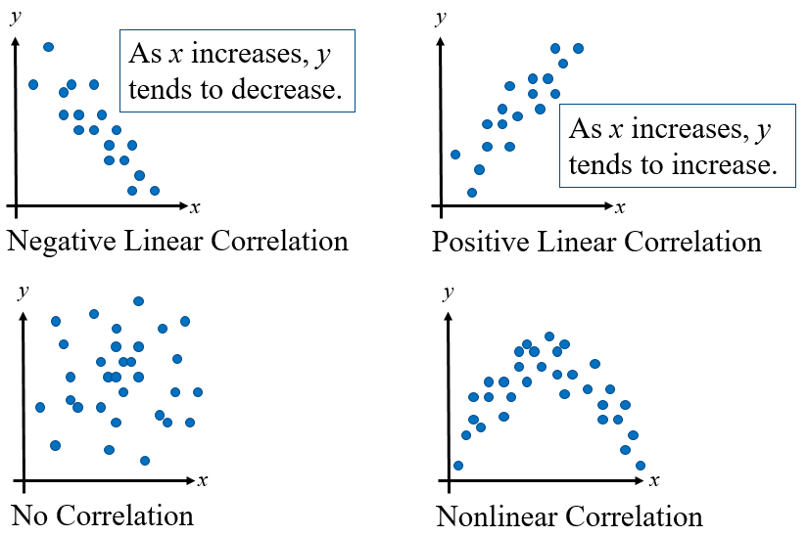
Chapter
09
Types of Correlation

Slide 5
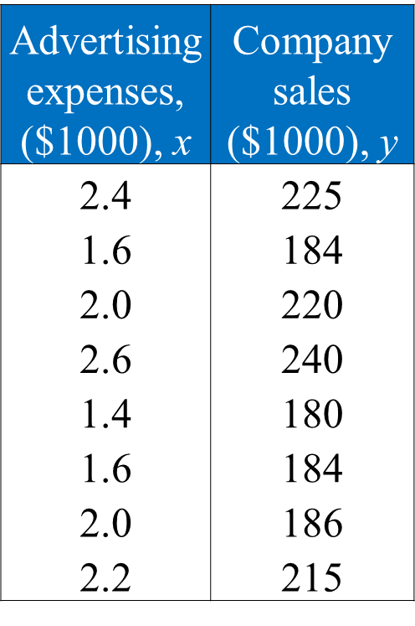
Chapter
09
Example: Constructing a Scatter Plot
  A marketing manager conducted a study to determine whether there is a linear relationship between money spent on advertising and company sales. The data are shown in the table.
  Display the data in a scatter plot and determine whether there appears to be a positive or negative linear correlation or no linear correlation.

Slide 6
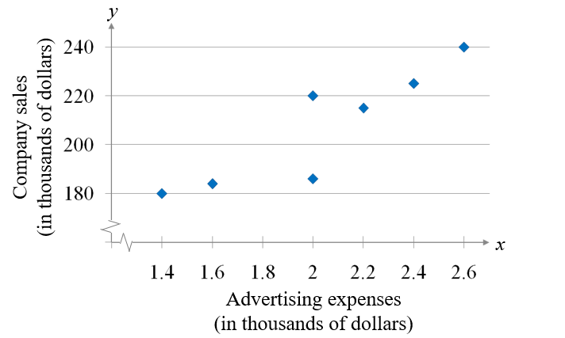
Chapter
09
Solution: Constructing a Scatter Plot
Appears to be a positive linear correlation. As the advertising expenses increase, the sales tend to increase.

Slide 7
Chapter
09
Correlation coefficient
Correlation coefficient
A measure of the strength and the direction of a linear relationship between two variables.
The symbol r represents the sample correlation coefficient.
A formula for r is
The population correlation coefficient is represented by ρ (rho).
n is the number of data pairs

Slide 8
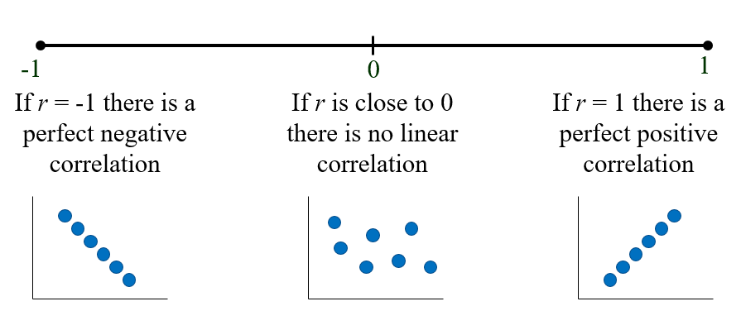
Chapter
09
Correlation Coefficient
The range of the correlation coefficient is -1 to 1.

Slide 9
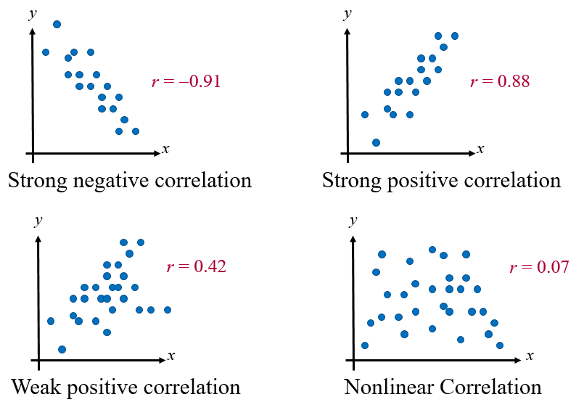
Chapter
09
Linear Correlation

Slide 10
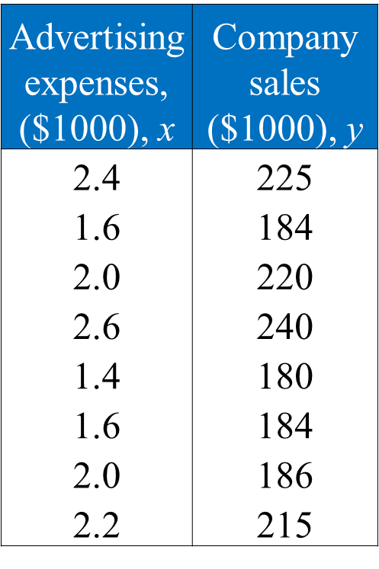
Chapter
09
Example: Finding the Correlation Coefficient
Calculate the correlation coefficient for the advertising expenditures and company sales data. What can you conclude?

Slide 11
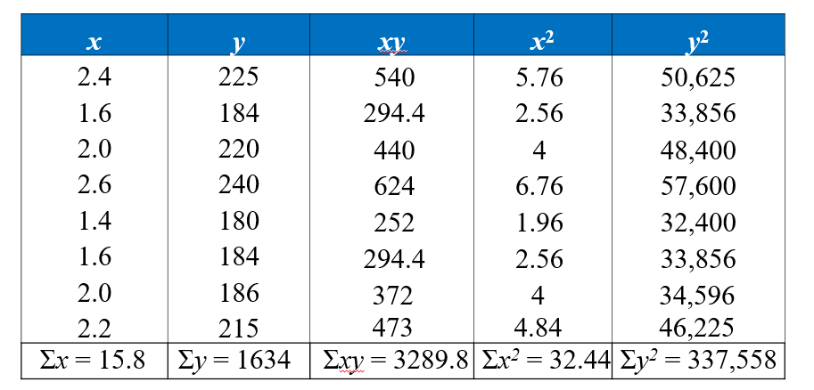
Chapter
09
Solution: Finding the Correlation Coefficient

Slide 12
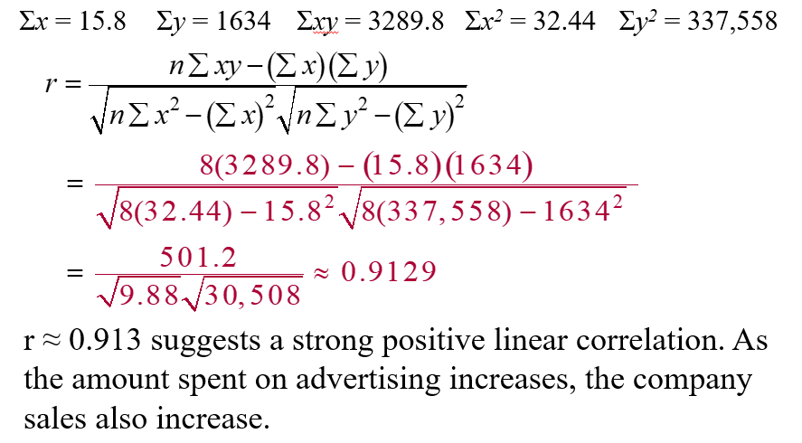
Chapter
09
Solution: Finding the Correlation Coefficient

Slide 13
Chapter
09
Section 9.2: Linear Regression
Find the equation of a regression line
Predict y-values using a regression equation

Slide 14
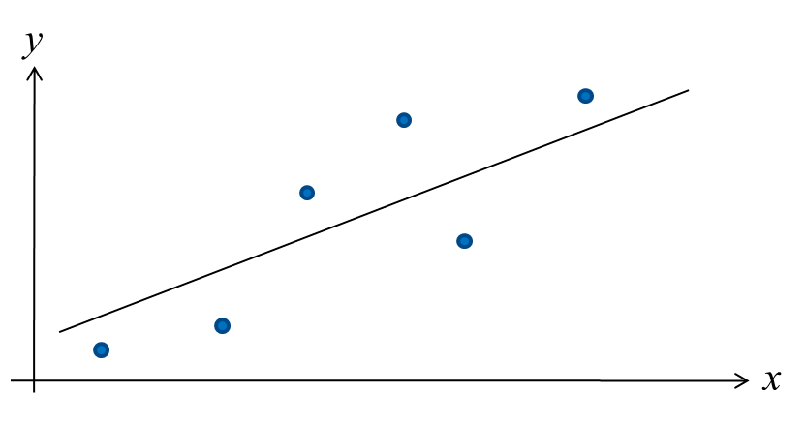
Chapter
09
Regression Line
After verifying that the linear correlation between two variables is significant, next we determine the equation of the line that best models the data (regression line).
Can be used to predict the value of y for a given value of x.

Slide 15
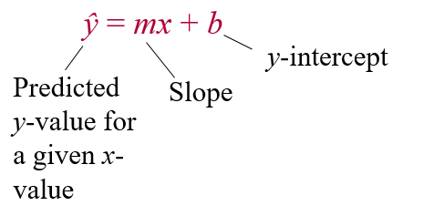
Chapter
09
Regression Line
Regression line (line of best fit)
The line for which the sum of the squares of the residuals is a minimum.
The equation of a regression line for an independent variable x and a dependent variable y is

Slide 16
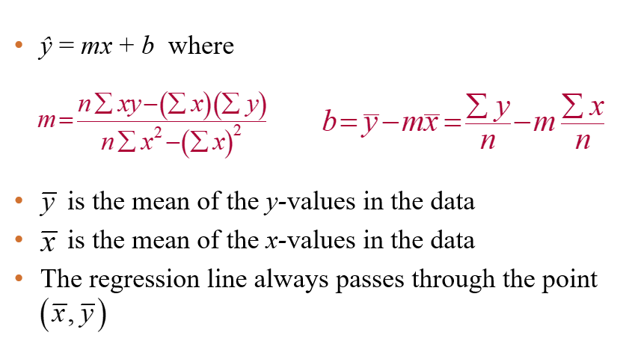
Chapter
09
The equation of a Regression Line

Slide 17
Chapter
09
Example: Finding the Equation of a Regression Line
Advertising expenses, ($1000), x | Company sales ($1000), y
2.4 | 225
1.6 | 184
2.0 | 220
2.6 | 240
1.4 | 180
1.6 | 184
2.0 | 186
2.2 | 215
Find the equation of the regression line for the advertising expenditures and company sales data.

Slide 18
Chapter
09
Solution: Finding the Equation of a Regression Line
Recall from section 9.1:

Slide 19
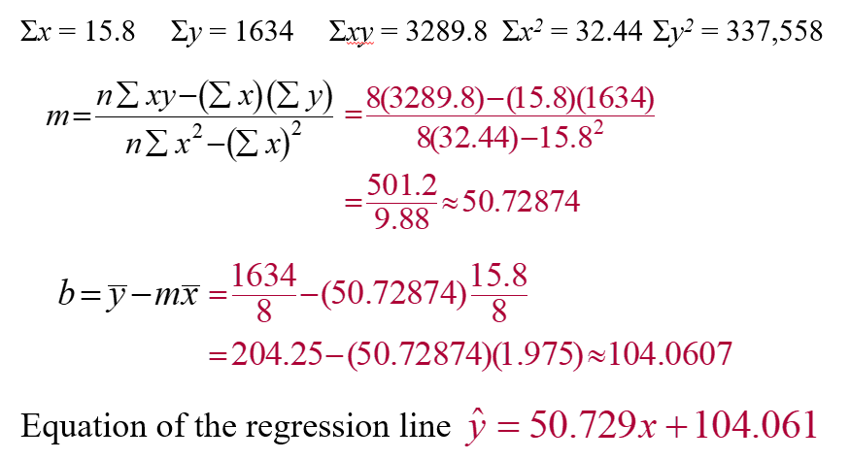
Chapter
09
Solution: Finding the Equation of a Regression Line

Slide 20
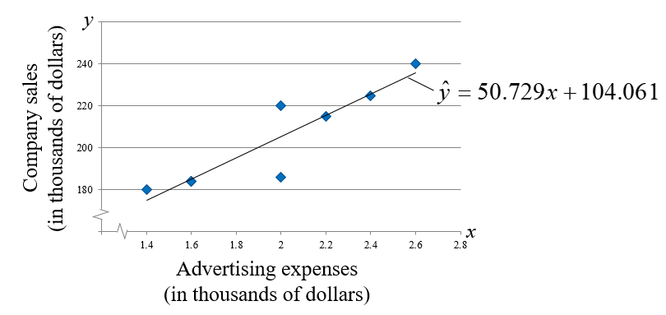
Chapter
09
Solution: Finding the Equation of a Regression Line
To sketch the regression line, use any two x-values within the range of the data and calculate the corresponding y-values from the regression line.

Slide 21
Chapter
09
Example: Predicting y-Values Using Regression Equations
The regression equation for the advertising expenses (in thousands of dollars) and company sales (in thousands of dollars) data is ŷ = 50.729x + 104.061. Use this equation to predict the expected company sales for the following advertising expenses. (Recall from section 9.1 that x and y have a significant linear correlation.)
1.5 thousand dollars
1.8 thousand dollars
2.5 thousand dollars

Slide 22
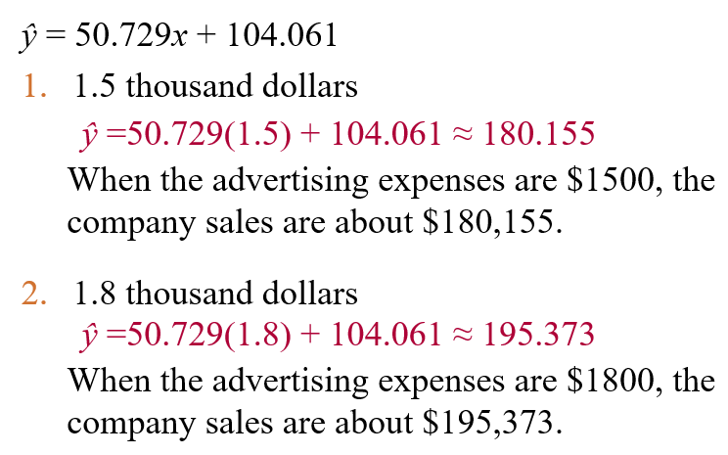
Chapter
09
Solution: Predicting y-Values Using Regression Equations

Slide 23
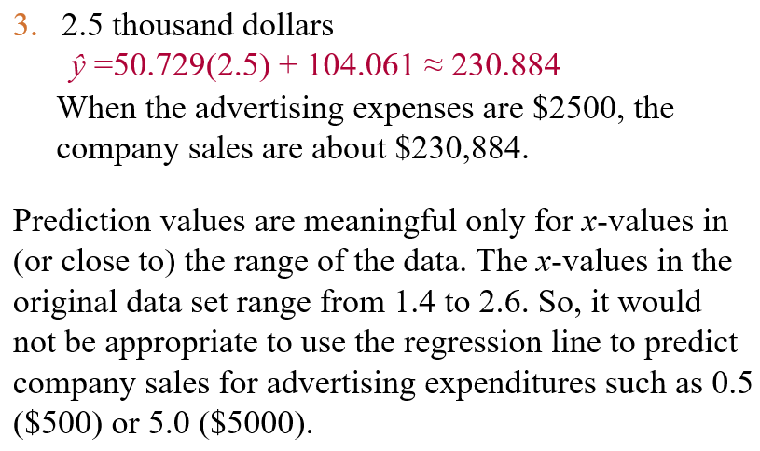
Chapter
09
Solution: Predicting y-Values Using Regression Equations

Slide 24
Chapter
09
Section 9.3: Measures of Regression and Prediction Intervals
Variation About a Regression Line
Three types of variation about a regression line
  Total variation
  Explained variation
  Unexplained variation
To find the total variation, you must first calculate
  The total deviation
  The explained deviation
  The unexplained deviation

Slide 25
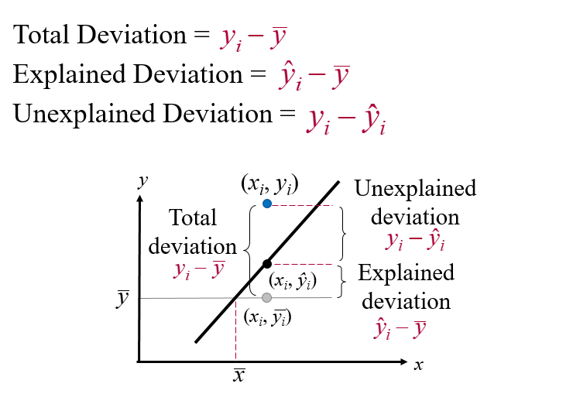
Chapter
09
Variation About a Regression Line

Slide 26
Chapter
09
Variation About a Regression Line

Slide 27
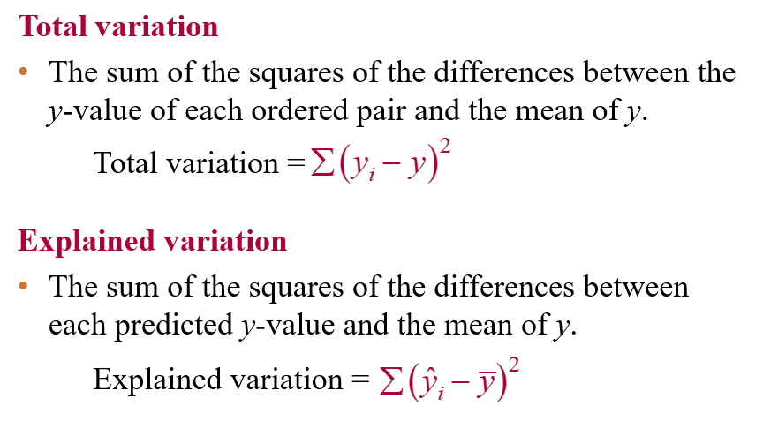
Chapter
09
Variation About a Regression Line

Slide 28
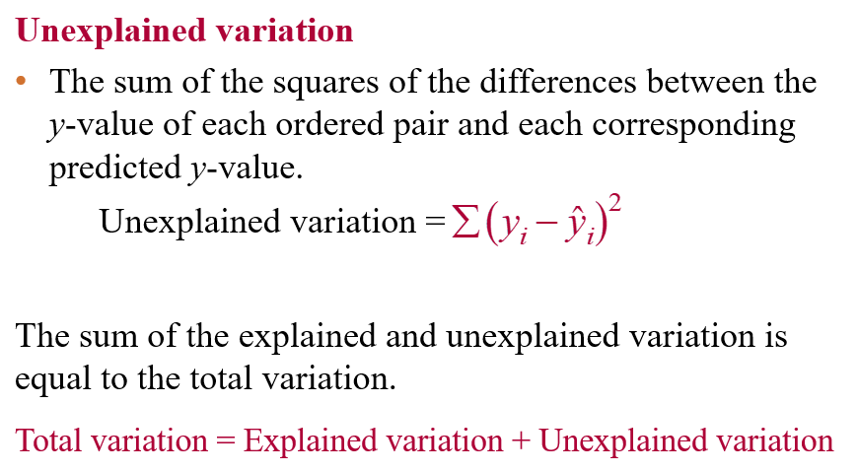
Chapter
09
Variation About a Regression Line

Slide 29
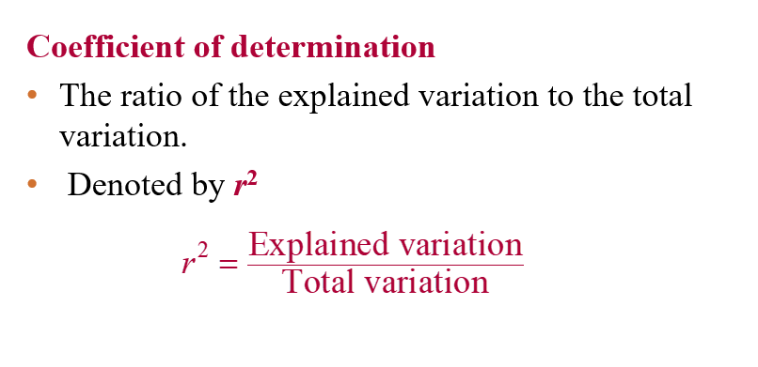
Chapter
09
Coefficient of Determination

Slide 30
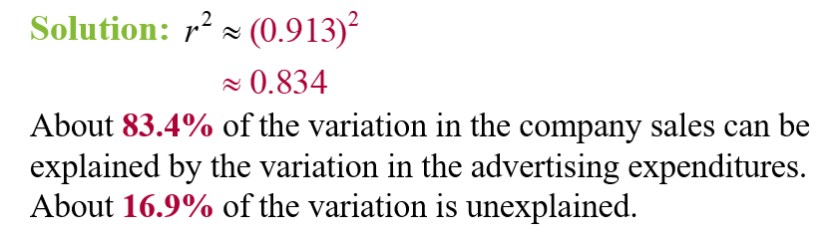
Chapter
09
Example: Coefficient of Determination
The correlation coefficient for the advertising expenses and company sales data as calculated in Section 9.1 is r ≈ 0.913. Find the coefficient of determination. What does this tell you about the explained variation of the data about the regression line? About the unexplained variation?

Slide 31
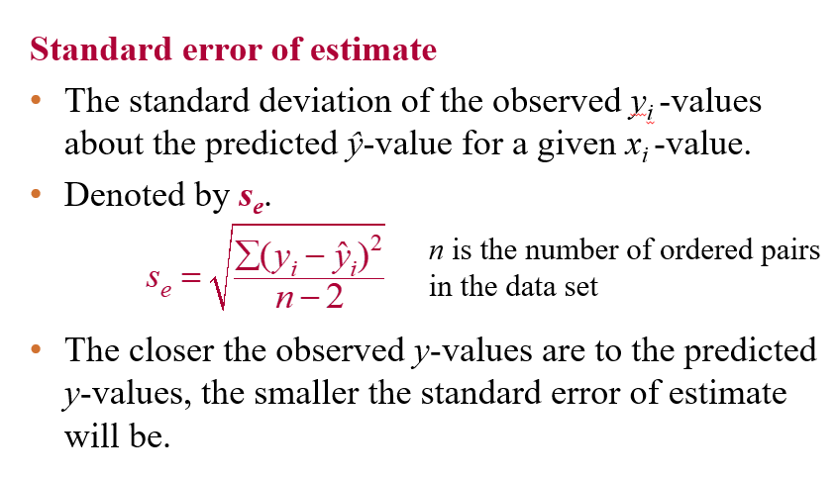
Chapter
09
The Standard Error of Estimate

Slide 32
Chapter
09
Example: Standard Error of Estimate
The regression equation for the advertising expenses and company sales data as calculated in section 9.2 is
ŷ = 50.729x + 104.061
Find the standard error of estimate.
Solution:
Use a table to calculate the sum of the squared differences of each observed y-value and the corresponding predicted y-value.

Slide 33
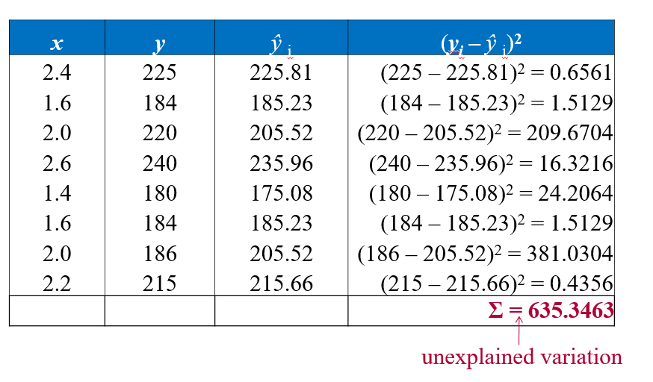
Chapter
09
Solution: Standard Error of Estimate

Slide 34
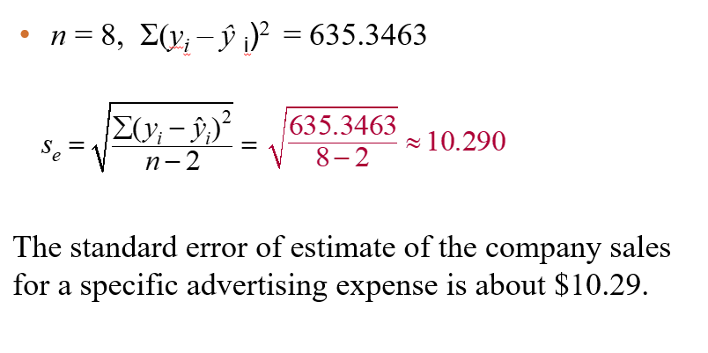
Chapter
09
Solution: Standard Error of Estimate

Slide 35
Chapter
09
Section 9.4: Multiple Regression
Multiple regression equation
ŷ = b + m₁x₁ + m₂x₂ + m₃x₃ + … + m_{k}x_{k}
x₁, x₂, x₃,…, x_{k} are independent variables
b is the y-intercept
y is the dependent variable
* Because the mathematics associated with this concept is complicated, technology is generally used to calculate the multiple regression equation.

Slide 36
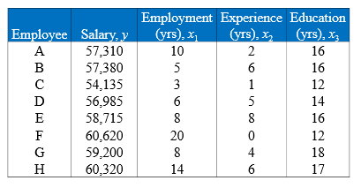
Chapter
09
Example: Finding a Multiple Regression Equation
  A researcher wants to determine how employee salaries at a certain company are related to the length of employment, previous experience, and education. The researcher selects eight employees from the company and obtains the data shown on the next slide. Use Minitab to find a multiple regression equation that models the data.

Slide 37
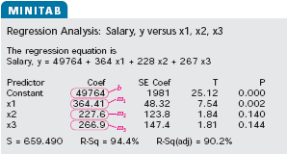
Chapter
09
Solution: Finding a Multiple Regression Equation
The regression equation is
ŷ = 49,764 + 364x₁ + 228x₂ + 267x₃

Slide 38
Chapter
09
Example: Predicting y-Values
  Use the regression equation:
  ŷ = 49,764 + 364x₁ + 228x₂ + 267x₃
  to predict an employee’s salary given 12 years of current employment, 5 years of experience, and 16 years of education.
Solution:
ŷ = 49,764 + 364(12) + 228(5) + 267(16)
= 59,544
The employee’s predicted salary is $59,544.

Slide 39
Chapter
09
Chapter Summary
9.1 Correlation
9.2 Linear Regression
9.3 Measures of Regression and Prediction Intervals
9.4 Multiple Regression

