Slide 1


Prepared by Dr. Rana Maya
REA617
Real Estate & Urban Economics
Lecture 5

Slide 2



Urban Growth, Migration, and Regional Development
Lecture 5
REA617
Real Estate & Urban Economics
Prepared by
Dr. Rana Maya

Slide 3

lecture
Abstract
05
Urban growth and migration are central forces shaping regional development, economic structure, social dynamics, and environmental outcomes.
The lecture examines drivers and consequences of urban growth, the role of agglomeration and connectivity, policy instruments for balanced regional development.

Slide 4

lecture
05
Contents
Introduction
2. Theoretical foundations
3. Drivers of urban growth and migration
4. Patterns and types of migration
Impacts of urban growth and migration on regional development
Policy instruments for balanced regional development
Case studies
Measuring urbanization and regional development
Planning for sustainable and inclusive urbanization

Slide 5
lecture
05
  Learning outcomes
By the end of the lecture, you will be able to:
Define and explain the key concepts of urban growth, migration, and regional development, and understand their interconnections in shaping spatial and economic change.
Analyze global and regional patterns of urbanization using quantitative indicators such as urban population share, regional GDP, and migration flows.
Evaluate the driving forces behind urban growth — including demographic shifts, economic transformation, technological change, and policy interventions.
Assess the impacts of migration (both internal and international) on urban labor markets, housing demand, and regional inequalities.
Interpret and use data from international sources (UN-Habitat, World Bank, OECD, Eurostat) to measure urbanization and regional performance.
Examine the policy instruments — such as housing, transport, and fiscal tools — used to manage urban expansion and reduce regional disparities.

Slide 6


1. Introduction
Cities concentrate people, knowledge, capital, and institutions—making them engines of economic growth and social change.
Urban growth is both a product of development and a driver of further transformation.
Why?
Understand core theoretical frameworks linking urban growth, migration, and regional development.
To identify practical policy tools for balanced, inclusive regional development.

Slide 7
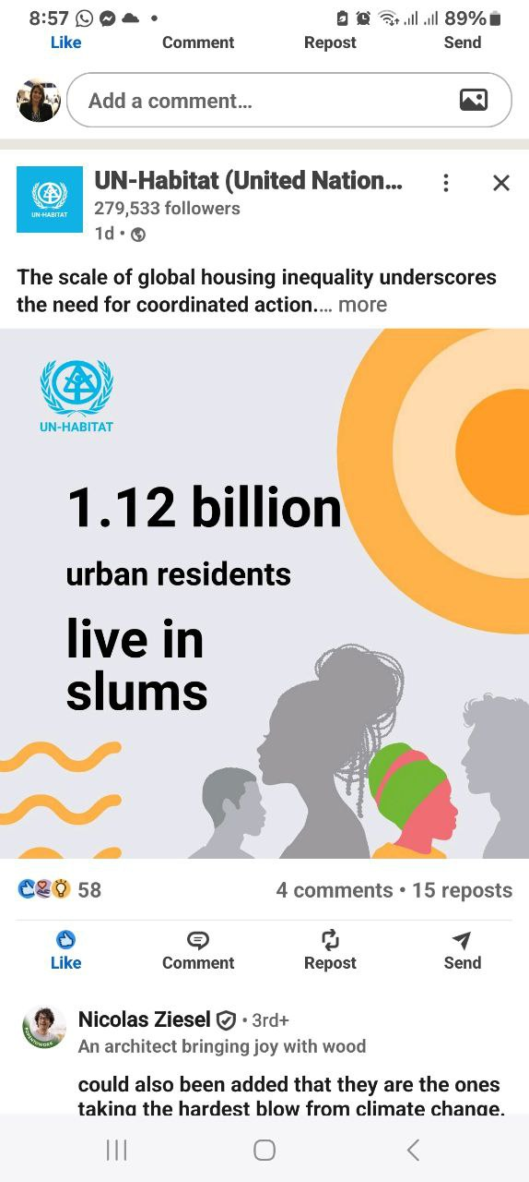
1. Introduction
Migration feeds urban growth and reshapes regional patterns: rural-to-urban flows fuel city expansion; international migration affects labor markets and demographic profiles; forced migration changes settlement patterns abruptly.
Regional development depends on how cities interact with surrounding rural areas, smaller towns, and distant markets.

Slide 8
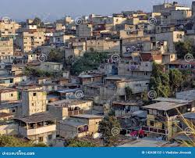
1. Introduction
Specifications of a Poor City
-Low Economic Output:
Low GDP (Gross Domestic Product) per capita and limited industrial or service activity.
-High Unemployment & Informal Economy:
Most jobs are unregulated, low-wage, and insecure.
-Widespread Poverty:
A large share of residents live below the poverty line.
-Inadequate Infrastructure:
Poor access to roads, water, sanitation, and electricity.
-Unplanned Urban Expansion:
Rapid growth of informal settlements and slums.
-Weak Governance:
Limited urban planning, poor service delivery, and corruption.

Slide 9
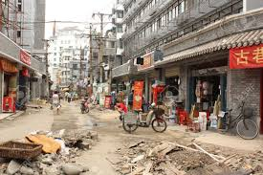
1. Introduction
Specifications of a Poor City
-Low Education & Health Standards:
Insufficient schools, hospitals, and social protection.
-Environmental Degradation:
Pollution, flooding, and loss of green areas due to poor regulation.
-Rapid Population Growth & Migration Pressure:
Rural–urban migration overwhelms housing and jobs.
-High Inequality:
Sharp contrasts between rich and poor neighborhoods.
Examples: Lagos (Nigeria), Dhaka (Bangladesh), Nairobi (Kenya), Karachi (Pakistan).
Source: UN-Habitat (2022), World Bank (2023), UNDP (2022).

Slide 10
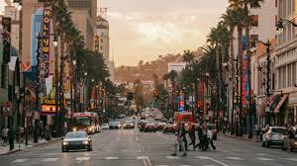
1. Introduction
-Why is Wall Street on Wall Street?
-Why is Hollywood in Hollywood?
-Why is Silicon Valley in Silicon Valley?
-Why was Detroit a center of car manufacturing?
The specialization of local universities often plays a role in determining what industries cluster in an area. The engineering and computer science strengths of Stanford and UC Berkeley, combined with the beautiful weather, played a central role in Silicon Valley locating in the Bay Area.

Slide 11
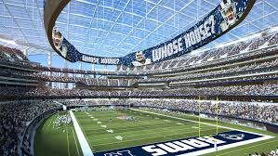
1. Introduction
Sports Stadiums and Team Recruitment as an Economic Growth Strategy
Many middle-sized cities invest to attract and retain sports teams as a way to differentiate themselves from rival cities. Is an investment in sports stadiums a good economic growth strategy?
If a tourist destination city such as Las Vegas builds a great stadium, and if people all over the world fly into the stadium for events that's clearly new money coming into the city. Las Vegas competes with other tourist cities and special events may help it to outperform its rivals.

Slide 12
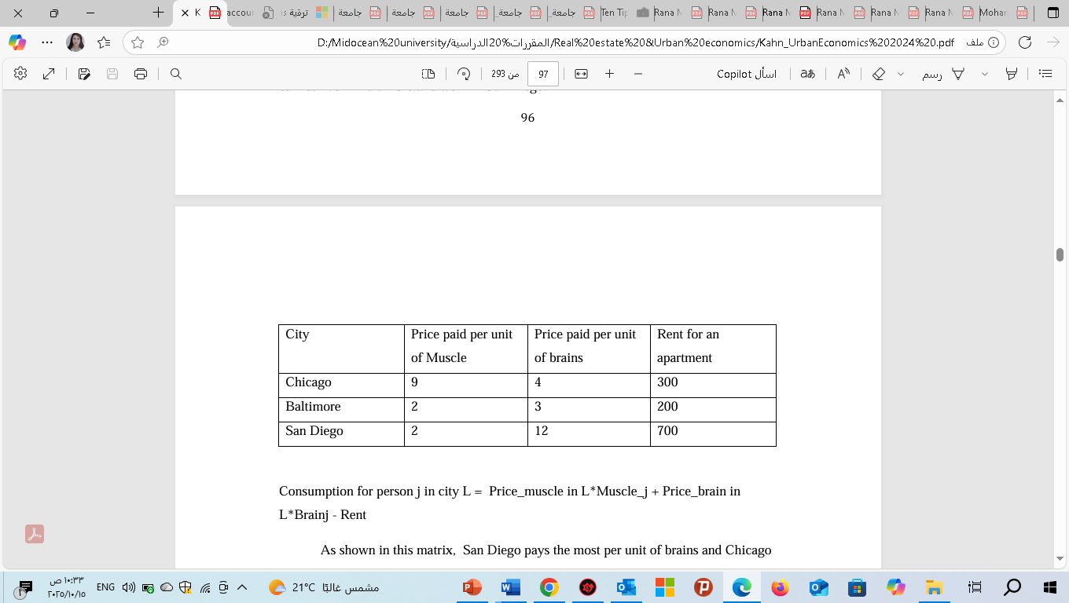
1. Introduction
An Extension Including Taxes and Amenities
An Example of Choosing a City to Live and Work
Each person is a combination of muscle and brains. These two attributes take on values between 0 and 100. So, each person has his/her own unique attributes. Each person knows his own combination of muscle and brains and chooses that city that offers the maximum income net of rents.
An Extension Including Taxes and Amenities
Consider a person with 100 brains and 0 muscle. This person’s consumption
(which equals income – rents) equals $100 in Chicago since 0*9 + 100*4 – 300 equals
100.

Slide 13

2. Theoretical foundations
2.1 Urbanization, agglomeration, and economies of scale
Urbanization concentrates economic activity. Two concepts help explain urban productivity advantages:
Agglomeration economies: spatial concentration reduces transaction costs, facilitates labor market pooling, and accelerates knowledge spillovers, which raises productivity.
Economies of scale: larger cities lower average costs for infrastructure and services per capita.
Agglomeration produces both urban advantages (innovation, higher wages) and diseconomies (congestion, pollution, higher land prices). The balance determines net urban welfare gains.

Slide 14
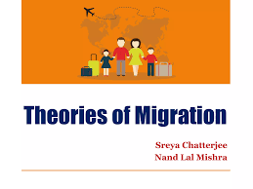
2. Theoretical foundations
2.2 Migration theories
Migration decisions are explained by micro and macro frameworks:
Neoclassical economics: individuals move to maximize expected income (wage differentials and employment probabilities).
New economics of migration: migration as a household strategy to diversify income and manage risks.
Network theory: existing migrant networks reduce migration costs and increase migration persistence.
Structuralist and political economy perspectives: migration driven by unequal development, historical linkages, and institutional factors.
Push–pull dynamics remain useful: push factors (poverty, environmental stress, conflict) drive people out; pull factors (jobs, services, safety) draw them in.

Slide 15
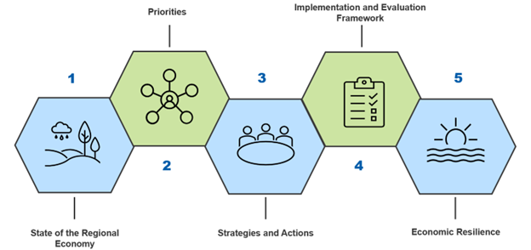
2. Theoretical foundations
2.3 Regional development frameworks
Core–periphery and cumulative causation Prosperity can concentrate in core regions while peripheries lag—leading to self-reinforcing divergence.
Growth pole theory: Strategic investment in specific regions or sectors can stimulate broader regional development by spread effects.
Polycentric development: promoting multiple centers within a region to balance growth and reduce pressure on a single megacity.

Slide 16
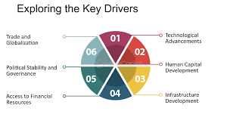
3. Drivers of urban growth and migration
3.1 Economic drivers
Industrialization and structural transformation shift labor from agriculture to manufacturing and services.
Globalization integrates cities into international trade and finance, boosting certain urban nodes (port cities, capitals).
Job creation in urban sectors pulls migrants.

Slide 17

3. Drivers of urban growth and migration
3.3 Institutional and policy drivers
Land-use regulations, housing policy, and infrastructure investment shape urban form and migration flows.
Policies like household registration systems, visa rules, and social benefits alter migrants’ incentives and access to services.
3.4 Environmental drivers
Climate change, land degradation, and disasters produce displacement and longer-term migration patterns to cities perceived as safer or offering better livelihoods.

Slide 18
3. Drivers of urban growth and migration
| Supply Factor | Description |
| ------------------ | ---------------------------------------------- |
| Construction costs | Rising materials/labor costs limit new supply |
| Land availability | Scarcity in CBDs drives densification |
| Regulations | Zoning and permits constrain speed |
| Technology | Modular construction can shorten delivery time |
definition of a good neighborhood is
a place that offers access to the consumption opportunities, amenities, and productive clusters of a city that a person wants to visit. Such a neighborhood is pleasant and clean and safe.
The people who live there are friendly and tolerant.
Children who grow up in the place are not threatened and receive a quality education and can be children.

Slide 19
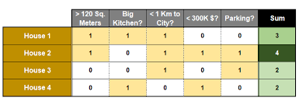
3. Drivers of urban growth and migration
A Decision Matrix is, as its name implies, a Matrix that helps people decide which option among several they should choose.
It is generally used to make an objective decision

Slide 20
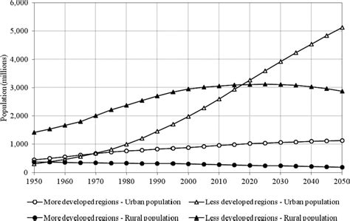
3. Drivers of urban growth and migration
Source: United Nations, Department of Economic and Social Affairs, World Urbanization Prospects: The 2018 Revision
In 1950, around 30% of the global population lived in urban areas. ·
By 2018, that share had grown to ~ 55%.
By 2050, it is projected that about 68% of the world population will be urban
Source: United Nations, World Urbanization Prospects: The 2018 Revision

Slide 21
4. Patterns and types of migration
4.1 Internal rural–urban migration
This is the dominant form of migration historically driving urbanization. It often takes the form of gradual household moves or circular/seasonal migration for work.
4.2 Interurban migration
Movement between cities reshapes regional hierarchies — e.g., from declining industrial towns to growing metropolitan areas.
4.3 International migration
Includes labor migration, skilled migration, and refugee flows. It affects cities’ demographic composition and labor markets differently depending on skill mix and legal regimes.
4.4 Forced and climate-induced migration
Rapid inflows due to conflict or disaster can strain urban absorptive capacity and create protracted humanitarian and governance challenges.

Slide 22

5. Impacts of urban growth and migration on regional development
surge is attributed to the shortage of quality office space and the lack of new supply.
The demand for office leases in 2024 rose by 24% compared to the previous year, indicating a robust market. However, there was a decrease in the average size of leased spaces, suggesting a trend towards more flexible office solutions
| 12 | 200,000 || Year | Average Rent (USD/m²/year) | Vacancy Rate (%) | New Supply (m²) | GDP Growth (%) |
| ---- | -------------------------- | ---------------- | --------------- | -------------- |
| 2018 | 430 | 12 | 200,000 | 2.8 |
| 2019 | 410 | 14 | 250,000 | 2.3 |
| 2020 | 370 | 20 | 150,000 | –6.0 |
| 2021 | 385 | 18 | 100,000 | 3.5 |
| 2022 | 410 | 15 | 180,000 | 5.0 |
2.8 |
| 2019 | 410 | 14 | 250,000 | 2.3 |
| 2020 | 370 | 20 | 150,000 | –6.0 |
| 2021 | 385 | 18 | 100,000 | 3.5 |
| 2022 | 410 | 15 | 180,000 | 5.0 |
5.1 Economic impacts
Productivity: Agglomeration improves productivity in core cities.
Labor markets: Migration increases labor supply—may complement or compete with local workers.
Investment: Cities attract capital, sometimes at the cost of underinvestment in peripheries.
5.2 Social and spatial impacts
Housing and informal settlements: Rapid growth often outpaces formal housing supply, producing informal settlements with inadequate services.
Segregation and inequality: Spatial segregation by income and ethnicity can rise as cities expand.
Service delivery: Education, health, and social services may become overstretched.

Slide 23

5. Impacts of urban growth and migration on regional development
5.3 Environmental impacts
Urban expansion transforms land use, increases energy consumption, and can amplify vulnerability to climate risks if poorly planned.
5.4 Regional spillovers
Positive spillovers: markets for rural goods, remittances, technology diffusion. Negative spillovers: talent drain, resource extraction from periphery without investments.

Slide 24
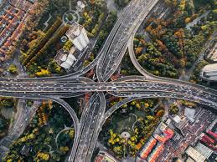
6. Policy instruments for balanced regional development
6.1 Spatial planning and land-use policy
Coordinated metropolitan planning controls urban sprawl, protects agricultural land, and guides infrastructure placement.
Zoning and incremental regularization can upgrade informal settlements.
6.2 Infrastructure and connectivity
Transport corridors and digital connectivity link cities and regions, supporting trade and labor mobility.
Rural infrastructure (roads, energy) reduces isolation and creates employment, moderating migration pressure.

Slide 25
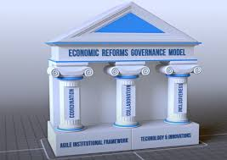
6. Policy instruments for balanced regional development
6.3 Economic and fiscal tools
Special Economic Zones, tax incentives, and investment promotion can stimulate growth in lagging regions—but must be well-targeted to avoid resource capture by elites.
Fiscal decentralization empowers local authorities to invest in regionally specific priorities.
6.4 Human capital and social policies
Education and skills development across regions reduce push factors.
Social protection and housing policies for migrants promote cohesion.
6.5 Governance and institutional reforms
Strengthening local governance, land administration, and participatory planning enhances responsiveness.
Migration policies (labor visas, integration programs) balance labor markets with social inclusion.

Slide 26
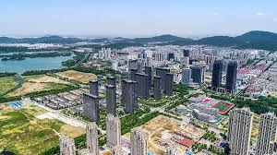
7. Case studies
7.1 China: Rapid urbanization, migration management, and regional strategy
Context & evolution: Since the late 1970s, China’s urbanization has been unprecedented — hundreds of millions moved to cities. The government used industrial policy, infrastructure investment, and urban planning to manage this transformation.

Slide 27
7. Case studies
Key features:
Hukou (household registration): historically limited migrants’ access to public services in destination cities, leading to segmented urban citizenship. Reforms have gradually relaxed restrictions, but disparities remain.
SEZs and city clusters: Shenzhen and the Pearl River Delta became growth poles, later evolving into polycentric clusters (Beijing-Tianjin-Hebei, Yangtze River Delta).
Urban planning and relocation: massive investments in transport (high-speed rail), housing, and industrial parks directed growth and linked regional economies.
Lessons:
Coordinated national policy plus heavy infrastructure investment can rapidly transform regional structures.
Institutional barriers to migrant integration (e.g., hukou) can produce persistent urban inequality unless reformed.

Slide 28
7. Case studies
7.2 Lagos (Nigeria): Mega-urban growth, informalization, and regional dynamics
Context & evolution: Lagos is a megacity born of rapid rural-to-urban migration, economic centrality, and limited formal planning.
Key features:
Informality: Large informal economies and settlements provide livelihoods but limit tax revenues
Infrastructure deficit: Congestion, inadequate water and sanitation, and flood vulnerability.
Regional linkages: Lagos dominates Nigeria’s economy, drawing resources and talent from other regions.
Policy responses:
Investment in transport (metro projects), land reclamation projects, and urban upgrading.
Attempts to formalize land and property rights to attract investment.
Lessons:
Strengthening local governance and revenue generation is critical to confronting infrastructure gaps.
Upgrading informality rather than eviction promotes inclusive outcomes

Slide 29
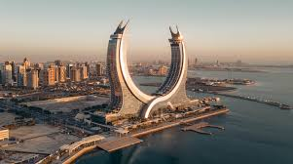
7. Case studies
7.3 The Gulf Cities (Dubai, Doha): International migration and city-building
Context & evolution: Gulf cities engineered rapid urban growth through oil wealth and global capital, relying heavily on international migrant labor.
Key features:
High share of foreign workers: Labor migrants dominate construction and services—often under temporary visa regimes.
Rapid real estate development: Skyward growth, iconic developments, and major infrastructure projects.
Dependency on migrant labor and remittances: Social and political implications, including questions of rights and long-term residency.

Slide 30
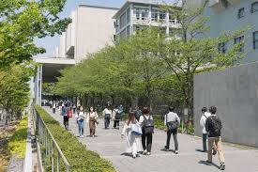
7. Case studies
Policy considerations:
Transition strategies to diversify economies and improve labor protections.
Long-term residency options for skilled migrants to build social capital.
Lessons:
Resource-driven urban growth can create globally connected cities but raises governance and social inclusion challenges.

Slide 31
7. Case studies
7.4 European Union: Cohesion policy and polycentric regional development
Context & evolution: The EU’s cohesion funds seek to reduce disparities across member states and regions via infrastructure, research, and human capital investments.
Key features:
Targeted regional funds: Structural and Cohesion Funds finance transport corridors, innovation clusters, and urban regeneration.
Polycentric planning: Supporting secondary cities reduces pressure on global hubs (Paris, London).
Outcomes:
Successful infrastructure and capacity-building in many member states, though structural disparities persist.
Lessons:
Supranational funding combined with local capacity-building can reduce regional gaps; coordination and absorption capacity are crucial.

Slide 32
7. Case studies
If resale value after year 5 = $6 million, PV = $6M × 0.62 = $3.72MTotal Value ≈ $5.37M
7.5 Forced displacement and urban hosting: Syrian refugees in Jordan and Lebanon
Context & evolution: Large refugee inflows into neighboring countries have concentrated in urban areas as well as camps.
Key features:
Urban hosting: Many refugees settle in existing cities, increasing demand for services and labor supply.
Informal work and service strain: Refugees often work in informal sectors; public services face strain yet international aid often targets camps rather than urban needs.
Policy implications:
Integrating refugees in urban labor markets, improving access to education and health, and engaging municipalities in planning are essential.
Lessons:
Urban responses to displacement require multi-level governance and inclusive policies that benefit both migrants and host communities.

Slide 33
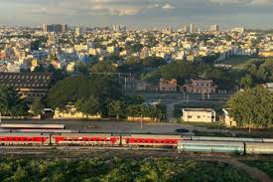
8. Measuring urbanization and regional development
4.6 Lease Structures
Concept Overview
Urbanization and regional development are measured through a combination of demographic, economic, infrastructural, and environmental indicators.
Together, they help policymakers assess:
The extent and pace of urban growth
The quality of life and access to services
The economic balance between regions
The sustainability of urban expansion

Slide 34

8. Measuring urbanization and regional development
4.6 Lease Structures
8.1 Indicators
Key indicators include:
Urbanization rate (share of population in urban areas)
Population growth by city size classes
GDP per capita by region
Employment by sector and informal sector share
Housing affordability measures (price-to-income ratios, rent burden)
Service access (water, sanitation, education, health)
Infrastructure connectivity (travel times, digital access)

Slide 35
8. Measuring urbanization and regional development
Common Indicators of Urbanization
4.6 Lease Structures
Indicator | Definition / Measurement | Source / Real Example
Urbanization Rate (%) | Percentage of the population living in urban areas. | World Bank (2023): 56.9% of the world’s population lives in urban areas; projected to reach 68% by 2050 (UN DESA, 2022).
Urban Growth Rate (%) | Annual percentage increase in the urban population. | India (2010–2020): 2.37% annual urban population growth; compared with 1.1% rural (UN-Habitat, 2022).
Urban Density (people/km²) | Population per square kilometer in urban regions. | Tokyo (Japan): 6,300 people/km²; Cairo (Egypt): 19,400 people/km² (World Urbanization Prospects, 2022).
Extent of Built-up Area (%) | Share of land converted to urban uses (buildings, roads, etc.). | Shenzhen, China: Urban built-up land increased by 743% between 1980–2020 (Dou & Chen, 2017).
Slum Population (% of urban) | Percentage of urban residents living in informal settlements. | Sub-Saharan Africa (2020): ~55% of urban population (UN-Habitat).
Access to Basic Services | Urban access rates to water, sanitation, electricity, and waste management. | Brazil (2021): 99% urban households connected to electricity; 88% have piped water (World Bank).

Slide 36
8. Measuring urbanization and regional development
Indicators of Regional Development
4.6 Lease Structures
Indicator | Definition / Measurement | Real Example
Regional GDP per Capita (PPP) | Economic output per person by region (adjusted for purchasing power). | Germany (2022): GDP per capita ranges from €85,000 (Hamburg) to €28,000 (Mecklenburg-Vorpommern). (Eurostat, 2023)
Employment Rate (%) | Share of working-age population employed in each region. | Spain (2021): Madrid 67%, Andalusia 51% (Eurostat).
Human Development Index (HDI) | Composite index of income, health, and education. | China (2020): Shanghai HDI 0.905 vs. Gansu 0.735 (UNDP China).
Infrastructure Index | Access to transport, ICT, and public services per region. | India (NITI Aayog 2021): Western and Southern states outperform Northern and Eastern in infrastructure and connectivity.
Migration Balance (Net Migration Rate) | Difference between in-migration and out-migration per region. | Turkey (2019): Istanbul +220,000 net migrants; Eastern Anatolia −85,000 (TURKSTAT).

Slide 37
8. Measuring urbanization and regional development
China’s coordinated urban–regional development policies (e.g., Western Development Strategy and New Urbanization Plan 2014–2020) helped integrate inland provinces and balance urban growth.
Case Study 1 — China’s Urbanization and Regional Development
Data Source: National Bureau of Statistics of China (NBS, 2023)
Indicator | 2000 | 2020 | Change
Urbanization Rate | 36% | 65% | +29 points
GDP per Capita (USD) | 959 | 10409 | +985 %
East–West GDP Ratio | 1:2.7 | 1:1.19 | Regional gap narrowed
Migration Flow | +230 million internal migrants (mostly to coastal provinces) | — | Massive labor mobility reshaping regions
Case Study 1 — China’s Urbanization and Regional Development
Data Source: National Bureau of Statistics of China (NBS, 2023)

Slide 38
8. Measuring urbanization and regional development
China’s coordinated urban–regional development policies (e.g., Western Development Strategy and New Urbanization Plan 2014–2020) helped integrate inland provinces and balance urban growth.
Case Study 2 — European Union Regional Cohesion
Data Source: Eurostat (2023), European Commission Regional Policy Reports
Indicator | Core Regions (EU-15) | Peripheral Regions (EU-13)
GDP per Capita (PPP, 2022) | €42000 | €24000
Unemployment Rate | 5.2 % | 10.4 %
R&D Expenditure (% GDP) | 2.7 % | 1.1 %
Broadband Access (%) | 95 % | 82 %
Impact of Policy:
Cohesion and Structural Funds have reduced disparities by 15–20% in income gap since 2004, fostering balanced regional development through investments in infrastructure, innovation, and human capital.

Slide 39
8. Measuring urbanization and regional development
Urbanization in Africa is rapid but often not accompanied by adequate infrastructure or employment, leading to “urbanization without industrialization.”
Programs like AfDB’s Urban Development Strategy 2021–2030 aim to link urban growth with regional infrastructure corridors.
Case Study 3 — African Urbanization and Development Challenge
Data Source: UN-Habitat (2022), African Development Bank (AfDB, 2021)
Indicator | 2000 | 2020
Urbanization Rate (Africa) | 35 % | 44 %
GDP per Capita (USD, constant) | 1870 | 2670
Urban Poverty Rate | 51 % | 43 %
Access to Electricity (urban) | 67 % | 83 %
Urbanization in Africa is rapid but often not accompanied by adequate infrastructure or employment, leading to “urbanization without industrialization.”
Programs like AfDB’s Urban Development Strategy 2021–2030 aim to link urban growth with regional infrastructure corridors.

Slide 40
8. Measuring urbanization and regional development
China’s coordinated urban–regional development policies (e.g., Western Development Strategy and New Urbanization Plan 2014–2020) helped integrate inland provinces and balance urban growth.
Integrated Framework: Urbanization–Regional Development Link
Dimension | Urbanization Indicator | Regional Development Indicator | Expected Relationship
Economic | Share of non-agricultural employment | GDP per capita growth rate | Positive correlation in balanced development
Social | Access to education and health | HDI and regional equality index | Urbanization supports improved human capital
Spatial | Built-up land and density | Infrastructure accessibility | Compact cities reduce regional disparities
Environmental | CO₂ emissions per capita | Regional sustainability index | High urbanization requires green transition policies

Slide 41

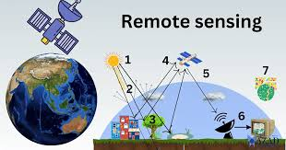
8. Measuring urbanization and regional development
8.2 Data challenges
Definitional differences: what constitutes “urban” varies across countries.
Informal settlements often undercounted.
Timeliness: censuses are infrequent; administrative and remote sensing data can complement.
8.3 Tools
Remote sensing and GIS: mapping urban extent and land-use change.
Household surveys and labor force surveys: migration histories and labor outcomes.
Administrative data and mobile phone records: track movements and population distribution (privacy considerations apply).

Slide 42
9. Planning for sustainable and inclusive urbanization
9. Planning for sustainable and inclusive urbanization
9.1 Principles
Inclusivity: policies must prevent marginalization (housing, services, rights).
Resilience: integrate climate adaptation and disaster risk reduction.
Connectivity: link secondary cities and rural areas to promote balanced growth.
Participatory governance: involve communities and migrants in planning.
Data-driven decisions: use up-to-date, disaggregated data.

Slide 43
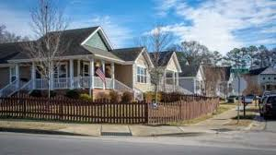
9. Planning for sustainable and inclusive urbanization
5.3 Real Estate Investment Trusts (REITs)
REITs pool investor funds to buy and manage income-producing properties.
They provide liquidity, transparency, and steady dividends, bridging property markets and capital markets.
9.2 Policy instruments in practice
Affordable housing programs (mixed-income developments, incremental housing finance).
Transport investments (mass transit, integrated ticketing, last-mile solutions).
Local economic development (support for SMEs, vocational training).
Urban upgrading (slum upgrading, tenure regularization).
Migration integration (work permits, access to education and health).
.

Slide 44
9. Planning for sustainable and inclusive urbanization
5.3 Real Estate Investment Trusts (REITs)
REITs pool investor funds to buy and manage income-producing properties.
They provide liquidity, transparency, and steady dividends, bridging property markets and capital markets.
Policy Domain | Policy Instrument | Description / Mechanism | Examples / Case Studies | Expected Impacts
Housing Policy | Inclusionary Zoning | Requires private developers to allocate a portion of new housing units as affordable housing. | New York City (USA), London (UK) | Promotes social mix; mitigates segregation; supports low-income residents’ access to housing in high-demand areas.
 | Rent Control / Stabilization | Sets limits on rent increases to protect tenants and prevent displacement. | Berlin (Germany), San Francisco (USA) | Short-term affordability; may discourage new supply if not combined with incentives.
 | Public or Social Housing | Direct government or non-profit provision of subsidized housing units. | Vienna (Austria), Singapore Housing Development Board (HDB) | Increases housing availability; stabilizes urban growth; supports social equity.
 | Urban Densification Incentives | Incentives (e.g., FAR bonuses) for compact development near transport corridors. | Tokyo (Japan), Vancouver (Canada) | Reduces urban sprawl; increases infrastructure efficiency; supports transit-oriented development (TOD).

Slide 45
9. Planning for sustainable and inclusive urbanization
5.3 Real Estate Investment Trusts (REITs)
REITs pool investor funds to buy and manage income-producing properties.
They provide liquidity, transparency, and steady dividends, bridging property markets and capital markets.
Policy Domain | Policy Instrument | Description / Mechanism | Examples / Case Studies | Expected Impacts
Transport Policy | Mass Transit Investment | Development of metro, BRT, or commuter rail to connect peripheries with urban cores. | Curitiba BRT (Brazil), Dubai Metro (UAE) | Enhances mobility; reduces congestion; encourages balanced regional growth.
 | Congestion Pricing | Charges for vehicle entry into central areas to manage traffic demand. | London (UK), Singapore | Reduces private car use; increases public transport demand; lowers emissions.
 | Transit-Oriented Development (TOD) | Integrates high-density land use with transport hubs. | Hong Kong MTR model, Stockholm | Creates compact, mixed-use urban nodes; reduces car dependency.

Slide 46
9. Planning for sustainable and inclusive urbanization
5.3 Real Estate Investment Trusts (REITs)
REITs pool investor funds to buy and manage income-producing properties.
They provide liquidity, transparency, and steady dividends, bridging property markets and capital markets.
Policy Domain | Policy Instrument | Description / Mechanism | Examples / Case Studies | Expected Impacts
Fiscal & Economic Tools | Intergovernmental Transfers | Financial transfers from national to regional/local governments to reduce disparities. | European Union Cohesion Funds; China’s Western Development Strategy | Balances regional development; enhances infrastructure in lagging regions.
 | Tax Incentives for Peripheral Development | Reduced corporate taxes or subsidies to attract firms to less-developed areas. | Ireland’s Regional Enterprise Development Fund; USA Opportunity Zones | Encourages job creation outside congested metropolitan centers.
 | Land Value Capture | Captures part of land value gains from public investments (e.g., transport). | São Paulo (Brazil), Hong Kong MTR property model | Funds infrastructure; promotes equitable urban finance.
 | Urban Growth Boundaries (UGB) | Regulatory limits on urban expansion to preserve rural land. | Portland (USA), Melbourne (Australia) | Controls sprawl; encourages infill development; preserves greenbelts.

Slide 47
9. Planning for sustainable and inclusive urbanization
Policy Domain | Policy Instrument | Description / Mechanism | Examples / Case Studies | Expected Impacts
Migration & Regional Development | Regional Development Zones | Designated areas with incentives for industrial or knowledge-based development. | Shenzhen SEZ (China), Dubai Free Zones (UAE) | Attracts migration and investment; accelerates regional economic diversification.
 | Smart Village / Rural Revitalization Programs | Investment in digital infrastructure, education, and local entrepreneurship in rural areas. | India Digital Village Program, EU LEADER Initiative | Reduces rural-urban migration pressures; supports balanced territorial growth.
 | Decentralization and Local Governance Reform | Shifts decision-making to regional/local authorities for tailored development. | France’s Décentralisation laws, Indonesia’s Regional Autonomy Act | Improves responsiveness; promotes local innovation and accountability.

Slide 48

10. Future trends and emerging challenges
10.1 Climate change and environmental displacement
Rising sea levels, drought, and extreme events are likely to increase migration pressures into cities, especially in low-lying coastal and arid regions. Urban planning must factor in climate migration scenarios.
10.2 Technological change and remote work
Remote work could decentralize some functions away from megacities toward smaller cities or rural areas with good connectivity, potentially easing urban pressures and offering regional revitalization opportunities.

Slide 49

10. Future trends and emerging challenges
10.3 Aging populations in advanced economies
Aging may change migration patterns, labor demands, and regional needs — some peripheral areas may face depopulation while certain cities with universities and tech sectors continue to attract youth and talent.
10.4 New governance paradigms
Multi-level governance, metropolitan authorities, and regional compacts will be crucial to manage cross-jurisdictional challenges (transport, housing, environmental management).

Slide 50

Conclusion
Urban growth and migration are multifaceted processes that shape regional development pathways.
Policy must be integrated — pairing investments in infrastructure and human capital with governance reforms that ensure social inclusion and regional balance.
successful interventions combine national strategy, local implementation, and flexible institutions responsive to demographic and environmental change.
lecture
05
EXERSICE
Identify some indicators of urbanization for a selected city and Forecast demand growth for real estate market?

Slide 51



Thank You

