Slide 1


Design Thinking
Prepared by Dr. Aya Mohamed
ENT 621
Master of Entrepreneurship (semester 2)
Lecture 2

Slide 2

Topics
In Previous Lecture: Design Thinking
The Emergence of Design thinking
The core concepts of design thinking
What is Design Thinking?
The features of Design Thinking
Convergent Vs Divergent Thinking
v
Features
Process
Thinking

Slide 3
Topics
In This Lecture: Design Thinking
v
Detailed Convergent Vs Divergent Thinking in DT
Tips to get the most out of divergent & convergent exercises
The Meaning of Co-design
Unilever Case Study

Slide 4
Topics
In This Lecture: Design Thinking
v
Detailed Convergent Vs Divergent Thinking in DT
Tips to get the most out of divergent & convergent exercises
The Meaning of Co-design
Unilever Case Study
Facilitate Design Thinking in Your Team
Process
Problem Space
Solution Space

Slide 5
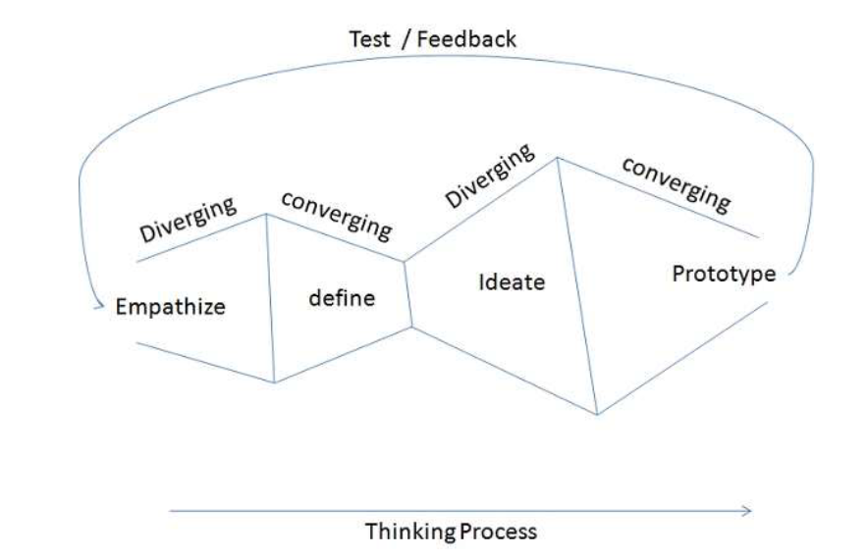

Slide 6

Divergent Vs Convergent Thinking: What's the Difference?
Divergence and convergence is a problem-solving method that emphasizes empathy, experimentation, and iteration. It is a human-centered design approach that focuses on understanding people's needs, behaviors, and motivations to design creative solutions that meet those needs effectively.
Divergence and convergence are like the inhale and exhale of the design thinking process. Divergence creates space and possibilities, while convergence brings focus and direction. Designers move back and forth between these two processes throughout the design thinking process, building on the insights and ideas generated during each cycle to refine and improve the solution.

Slide 7

Divergent Vs Convergent
What is divergence?
Divergence is the process of exploring and generating a wide range of ideas and possibilities without any judgment or criticism. Divergent thinking allows designers to expand the possibilities and consider different perspectives, angles, and dimensions of the problem.
What is convergence?
Convergent thinking refers to the process of selecting, evaluating, and refining the most promising ideas from the divergent phase. It involves narrowing down and refining possibilities by selecting the best ideas and combining them to create a coherent and effective solution.

Slide 8
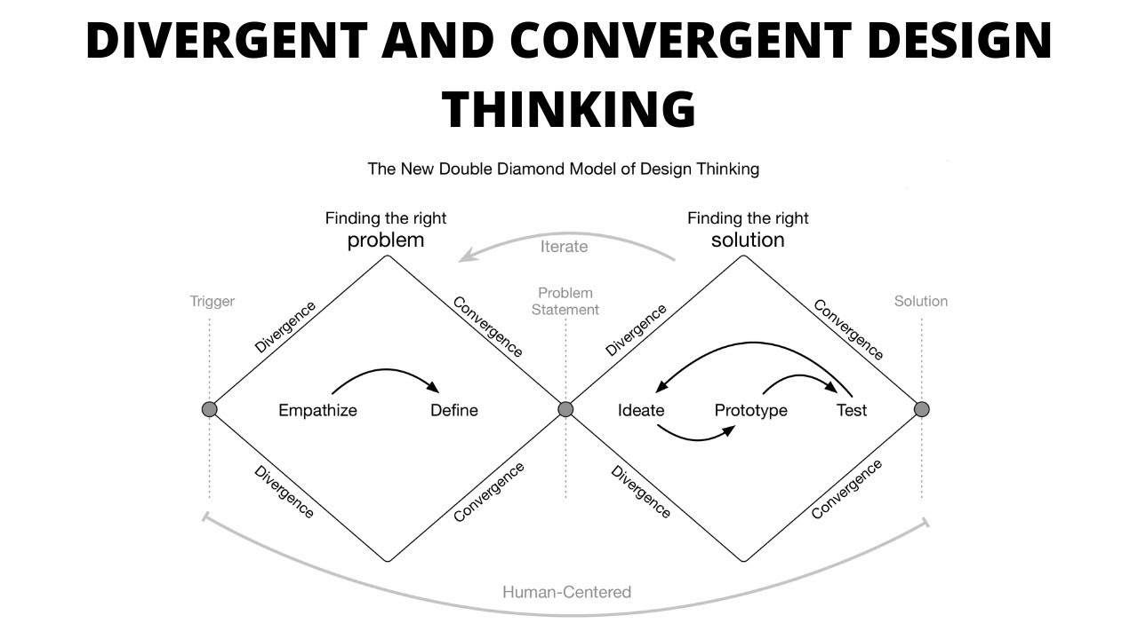
Divergent and convergent phases are non-linear, meaning that when facilitating this process, you may move back and forth as you discover new insights during convergence.

Slide 9

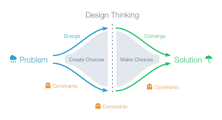
Divergent & Convergent together
Benefits of divergent and convergent thinking
Increased creativity and innovation
Better decision-making
Human-centered design
Enhanced problem-solving
Improved collaboration

Slide 10
How to apply divergent and convergent thinking?
1. Diverge to ideate
Generate a wide range of ideas without judgment or criticism in a brainstorming session or other quick ideation exercise. Use this discovery period to identify the problem and encourage team members to produce many possible solutions.

Slide 11

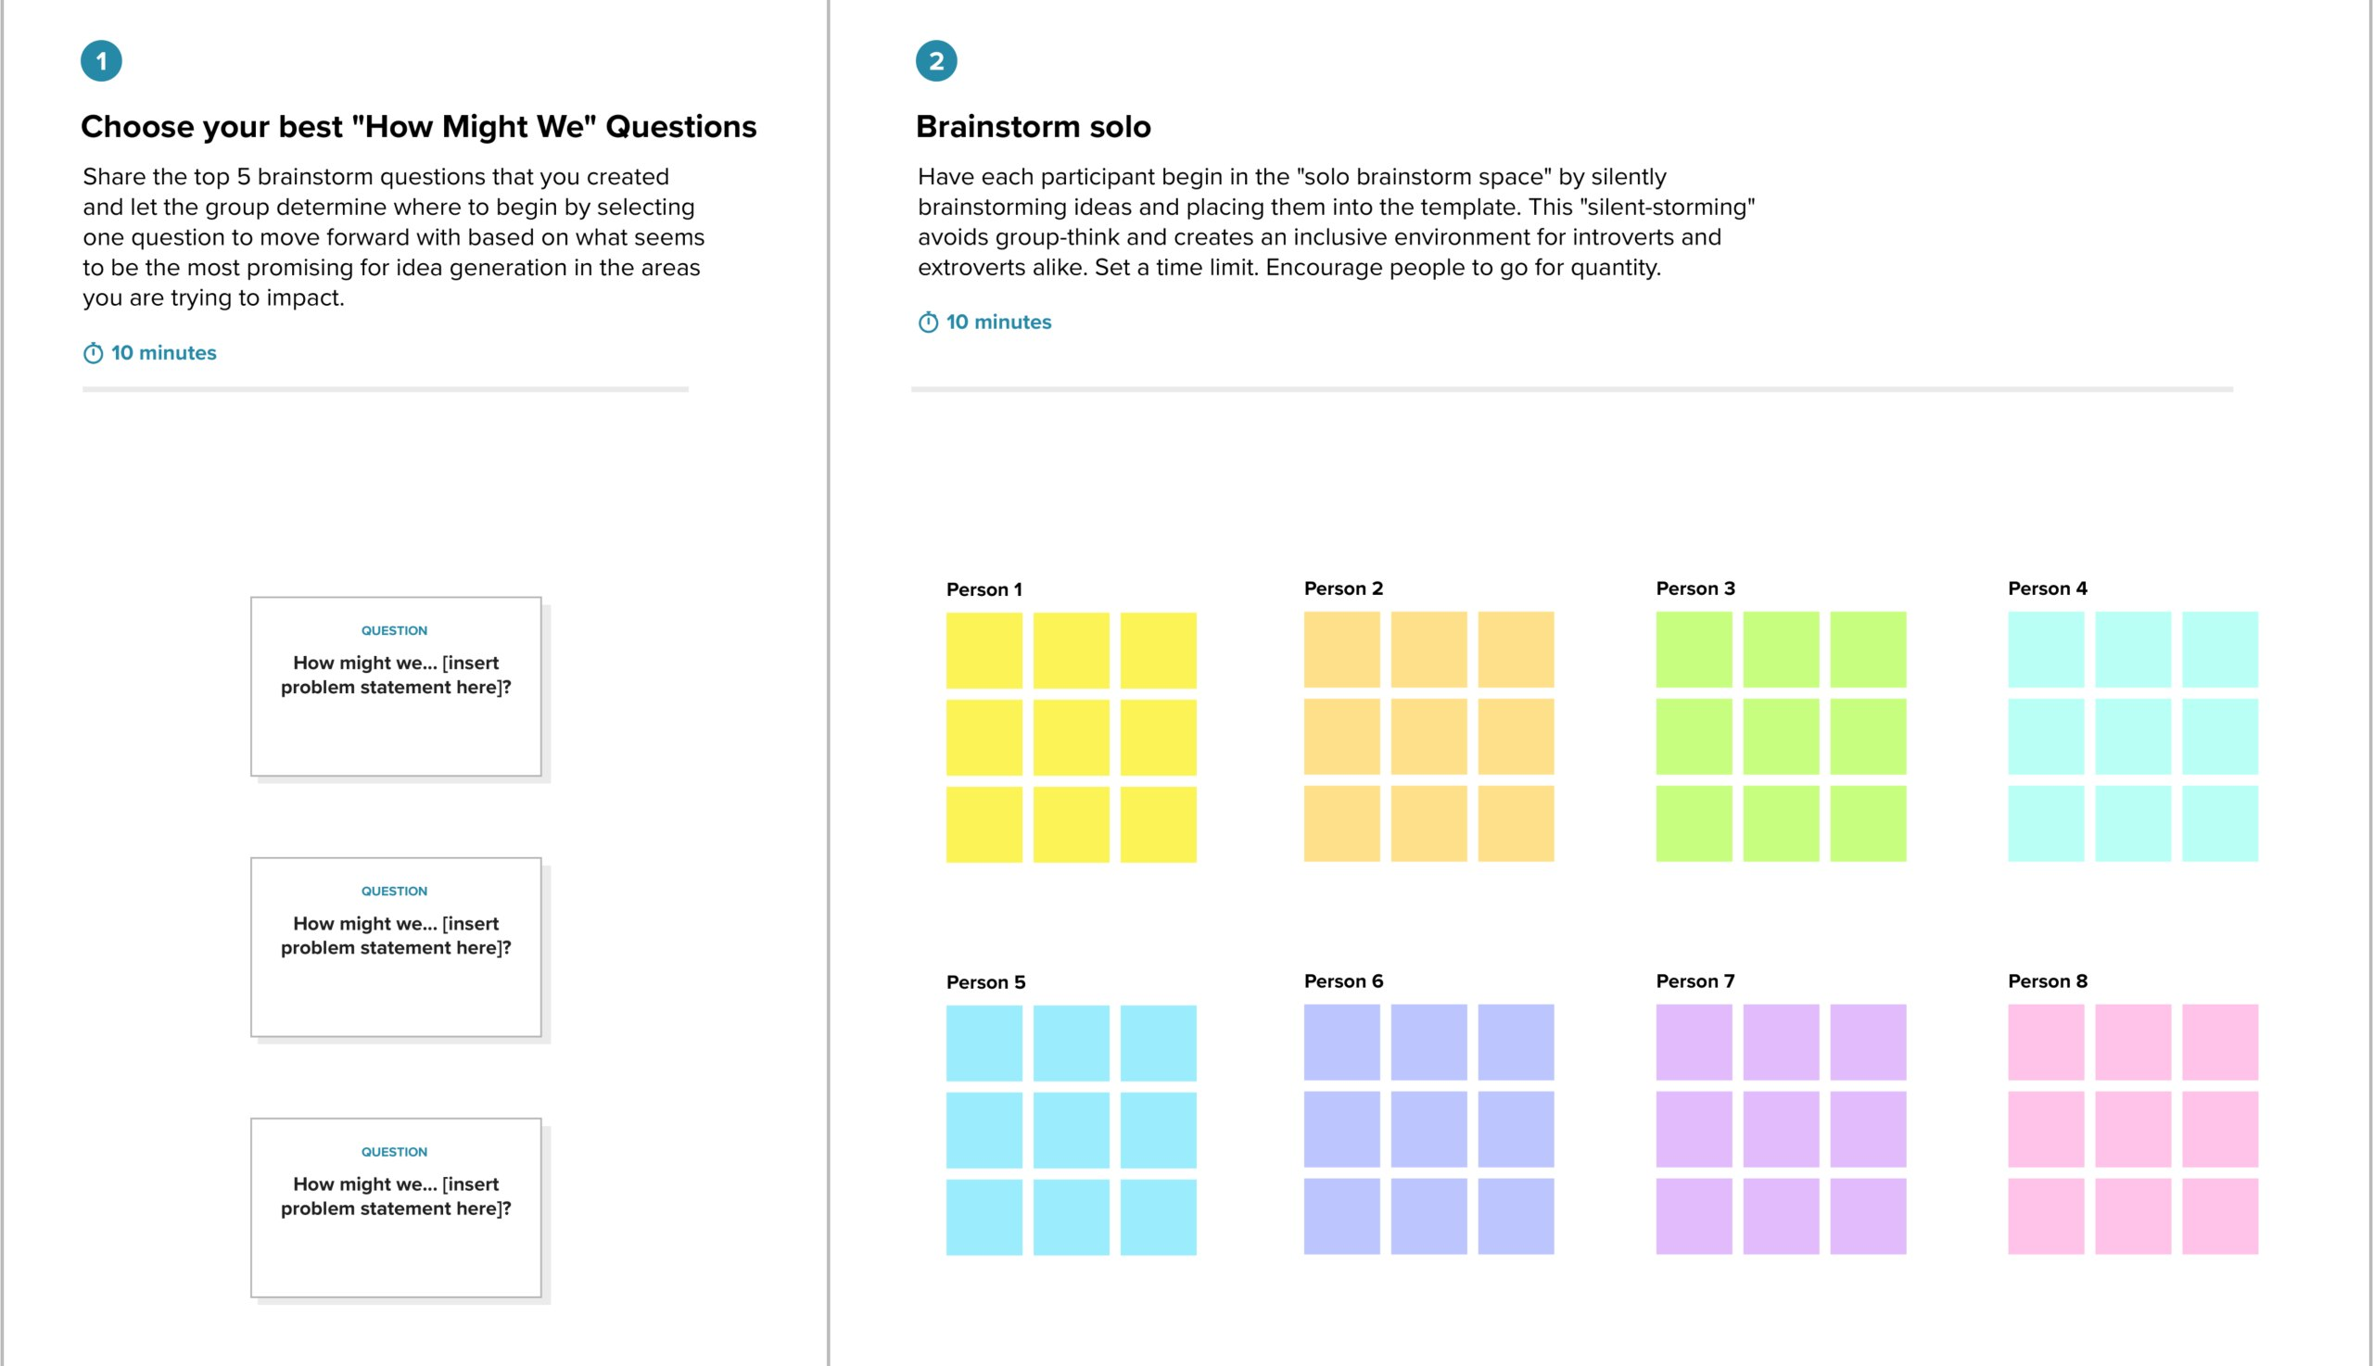
How to apply divergent and convergent thinking?

Slide 12
How to apply divergent and convergent thinking?
2. Converge to evaluate the ideas
Evaluate the ideas based on feasibility, viability, and desirability using decision matrices, prioritization grids, or other evaluation tools.
The goal in this convergent phase is to clearly define the problem, understand and map any assumptions behind the ideas, and clarify the requirements for an effective solution.
How to run a critique of Ideas
Present the ideas and context from the brainstorming session
Invite feedback across three categories: what went well, what didn’t go well, and what could be improved
Gather the feedback, organize it by theme, and create actionable next steps within the same workspace

Slide 13
How to apply divergent and convergent thinking?
3. Diverge again to develop and prototype
Based on the requirements, begin finding solutions that meet requirements and address end-user pain points and concerns. Improve upon the selected ideas using prototyping and user testing, gathering feedback from stakeholders to ensure that the final solution meets their needs and preferences.
4. Converge again to further refine
The final divergent step involves refining the solution, testing it for viability, and getting the buy-in and resources to implement it. This doesn't necessarily have to be the final step in this process, but we find it helps to end the session with a final convergence step to walk through what the final iteration of the solution looks like.
5. Implement
Implement the selected ideas and monitor their effectiveness, iterating the process as needed to continue improving the customer experience.

Slide 14
Tips to get the most out of divergent & convergent exercises
v
Use a variety of ideation techniques
Experiment with different ideation techniques such as brainstorming, mind mapping, to encourage creative thinking and generate a wide range of ideas
Don't get too invested in any single idea
One of the common challenges of design thinking is when team members or designers choose a favorite idea and get too invested in its success. There's nothing wrong with being passionate about a possible solution, however it's important to remember that addressing the end user or individual's problem comes first. Even if the final solution isn't flashy, if it properly addresses the core issue, it's the right call.

Slide 15
Tips to get the most out of divergent & convergent exercises
Avoid premature judgment
Avoid prematurely judging or dismissing ideas during the divergent phase, and instead focus on generating as many ideas as possible during ideation sessions.
Establish some ground rules during the ideation phase to ensure that participants understand the etiquette expected during the session.
Test early and often
Test and validate ideas early and often using prototypes, mockups, and user feedback to ensure that the final solution meets end user needs and preferences. This is helpful not only for validating your initial problem statement, but frequent testing also ensures that assumptions, solutions, and biases are uncovered and evaluated

Slide 16
Tips to get the most out of divergent & convergent exercises
Get stakeholders involved
Including stakeholders or end users in the convergence and divergence cycles can help provide better insight into the user experience, get a different point of view in the design process, and ultimately create a better human-centered solution.
Incorporating multiple stakeholders throughout the process of designing a solution is referred to as co-design.
Use a visual tool to make collaboration easier
Use a visual tool to capture and generate ideas, run interactive feedback sessions, and create prototypes and diagrams all in one place.
Online whiteboards are a good option, but make sure your platform of choice comes with facilitation features that allow for voting, anonymous inputs, and a timer to lead structured, productive sessions.

Slide 17
What is co-design?
Co-design is the process of involving multiple stakeholders in the design and development of products, services, or systems with the goal of creating solutions that are more relevant, effective, and satisfying to the people who will use them.
While human-centered design places people at the center of the process, co-design actively involves people in envisioning and creating solutions that meet their challenges. By its very nature, the co-design process is collaborative

Slide 18
Benefits of using the co-design approach
It leads to a better understanding of user needs
Creates solutions that are more useful, effective, and user-centered
Increases user engagement and helps earn buy-in
Promotes collaboration and stakeholder alignment
Results in more innovative and creative solutions, delighting the end user

Slide 19
Case Study: Unilever
Unilever is one of the world's largest consumer goods companies, owning over 400 well-recognized brands, including Dove, Lipton, Best Foods, and many more.
With operations in 190 countries and products used by over 2.5 billion people daily, Unilever has a massive pool of customers from which to source ideas and solutions to product development questions.
To put this resource to use, Unilever actively looks to its customer base for product solutions, asking startups, academics, designers and customers for ideas and suggestions.

Slide 20
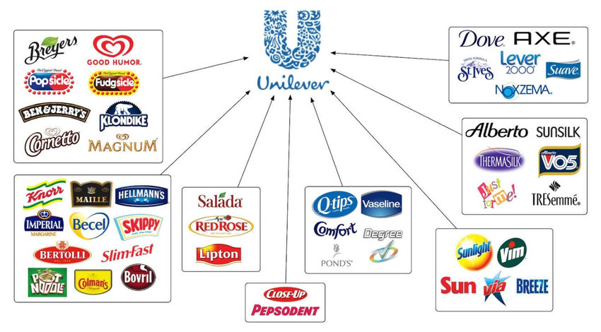
Case Study: Unilever

Slide 21
Case Study: Unilever
Through its Open Innovation platform, launched in 2010, Unilever presents specific challenges to the public, encouraging individuals to submit responses for potential adoption by the company.
These include topics like intelligent product packaging, oil oxidation technology, freezing and cooling systems, and other areas.
If a suggestion is successful, the submitter can be offered a commercial contract for their solution, as well as professional recognition.

Slide 22
Case Study: Unilever
The global response to the Unilever platform has been strong, with the company receiving over 1,000 proposals in the first half of 2012 alone. This approach has also helped develop a more open culture: now, over 60% of Unilever's research projects involve external collaboration.
Unilever's approach to co-design and co-creation reflects the value of open innovation and shows the potential uses of crowdsourcing to solve problems - even complex problems requiring technical knowledge and expertise.

Slide 23
Case Study: Unilever
Common drawbacks and challenges of co-design
It can be time-consuming and resource-intensive to implement the right solution
Conflicting opinions make decision-making more complex
Ideal solutions may not always be feasible or practical
Can be challenging to ensure equitable participation and representation of every stakeholder
Occasionally difficult to measure impact or success
How Unilever could overcome these Drawbacks

Slide 24
3-
Facilitate Design Thinking in Your Team
The design thinking process takes you into unknown and sometimes uncomfortable territory.
Members of a design thinking team need to be open minded, curious, collaborative and willing to have their assumptions challenged.
They also need to prepare themselves for change and take on an accepting, adaptable mindset.

Slide 25
Design thinking not only leads to increased innovation and improved end products, but it also creates a great team spirit, boosts work ethic and bolsters individuals’ confidence in their creative abilities.
"The greatest fear in life is not of death, but unsolicited change.”- Raheel Farooq
Everyone thinks, feels and experiences things differently.
Differences are what we need—especially in the world of design thinking.
These differences also mean certain activities in design thinking projects will not come naturally to the people involved.
Newcomers may feel intimidated, confused or disoriented by the seemingly chaotic approach of the design thinking process. conduct a few short exercises to break through this negative tension, loosen things up and make people feel positive and excited about the project

Slide 26
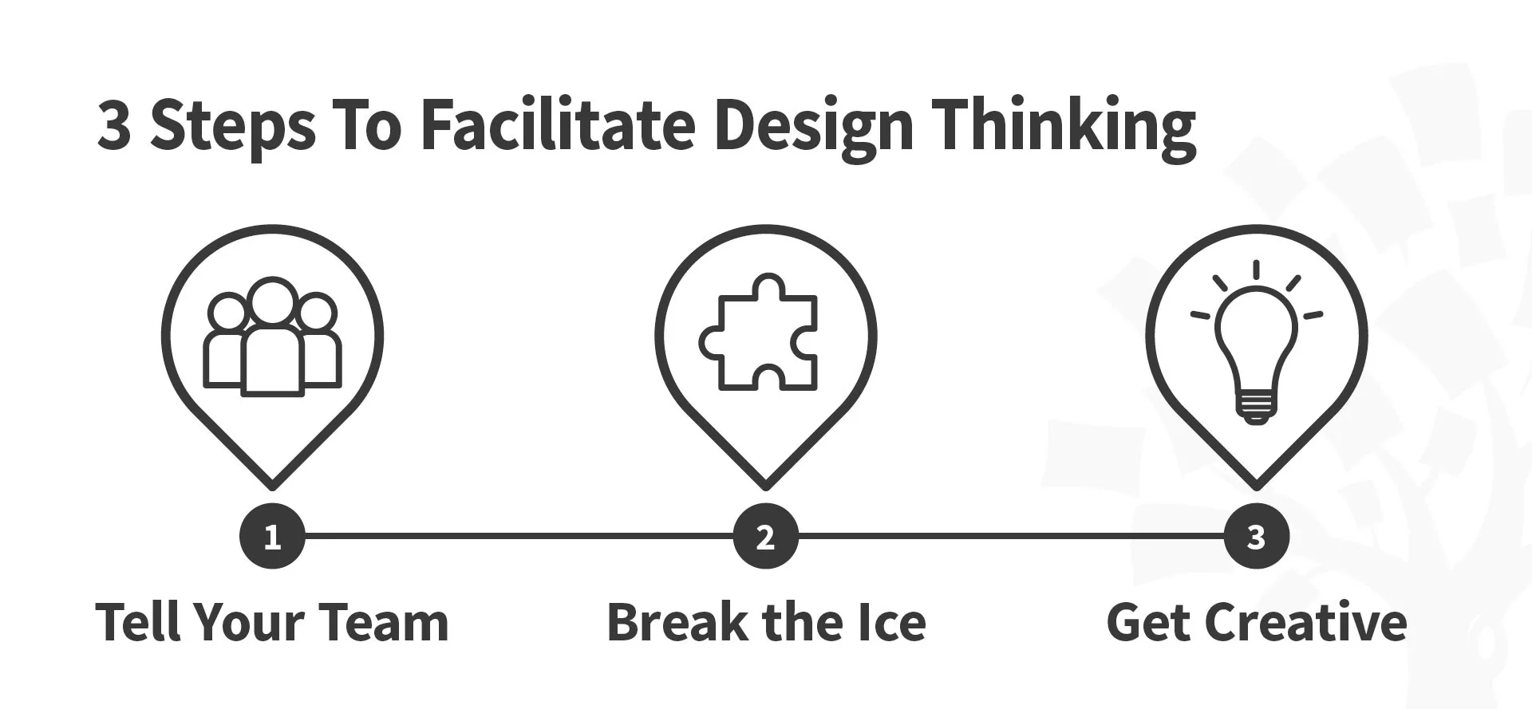

Slide 27
Step 1: Tell Your Team Members About the Process of Design Thinking
Print out the 'Design Thinking: A Non-linear Process, and hand a copy to each member of your team. This will help them understand and recognize the different stages of the process before the project begins and will highlight the iterative and non-linear nature of design thinking.
Run through a definition of each of the five stages:
Empathize—research your users' needs.
Define—state your users' needs and problems.
Ideate—challenge assumptions and create ideas.
Prototype—start to create solutions.
Test—try your solutions out.

Slide 28
Step 1: Tell Your Team Members About the Process of Design Thinking
Explain that the five stages of design thinking are not sequential steps but are there to serve as a guide. You should encourage your team to see the stages as different modes to put themselves in—to iterate on your problem definition, ideas or prototype. The various stages also enable you to learn more about your users at any point in the project.
Tell your team that the iterative, non-linear nature of design thinking means you can carry these stages out in parallel, repeat them and even circle back to previous stages at any point in the design thinking process.

Slide 29
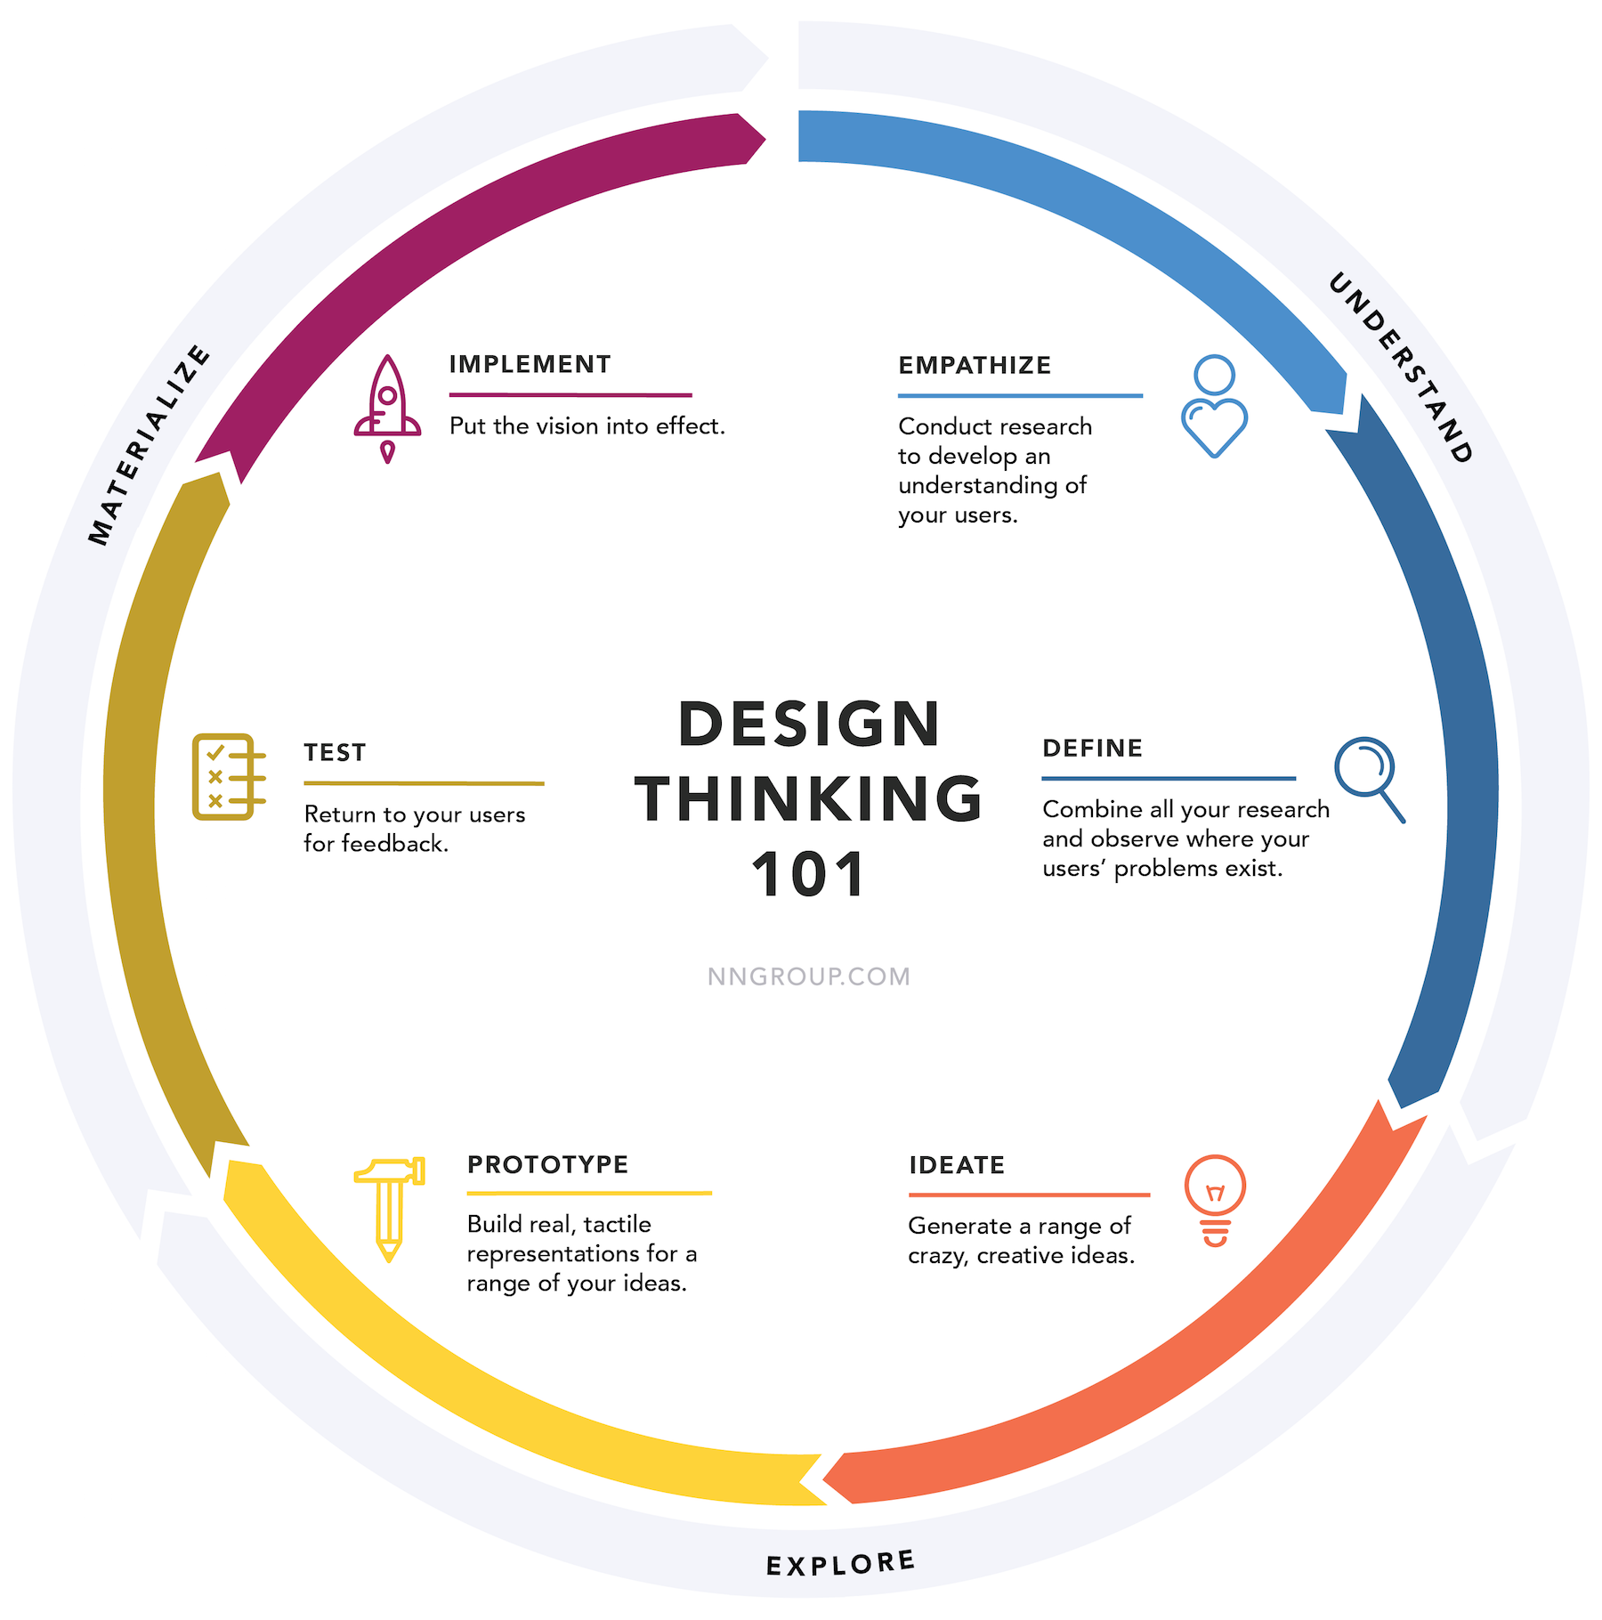
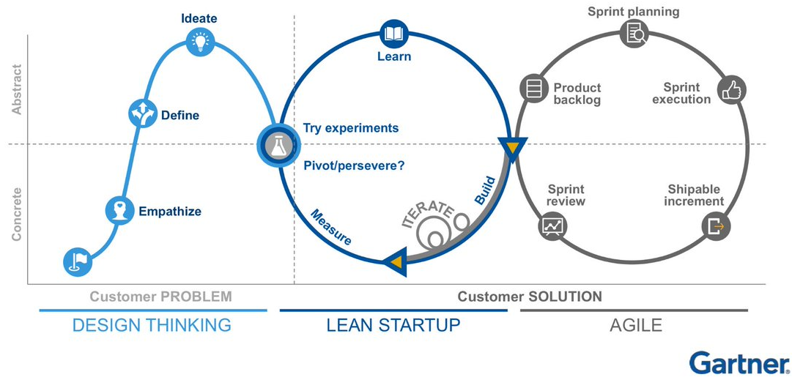
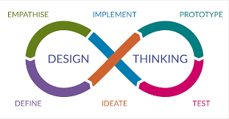

Slide 30
Step 1: Tell Your Team Members About the Process of Design Thinking
Discuss how design thinking creates a third way to approach problem-solving. It combines the analytical and information-driven approach of science with the holistic, empathic and creative ways of thinking in ethnography and design.
Highlight that you’ll apply lots of proven methods and techniques throughout the process—user interviews, brainstorm sessions, affinity clustering, sketching, user testing, etc.

Slide 31
Step 2: Break the Ice
Icebreakers are important techniques to utilize when you want to overcome the barriers which form when team members start to work on something new, or when they work with people they don't yet know or trust.
Each design thinking setting is unique, and the ice that needs to be broken will be different depending on the situation. You may just need to give people enough time to make a proper introduction, and follow that up with an explanation of the process they are about to engage in. Other situations may require more intervention

Slide 32
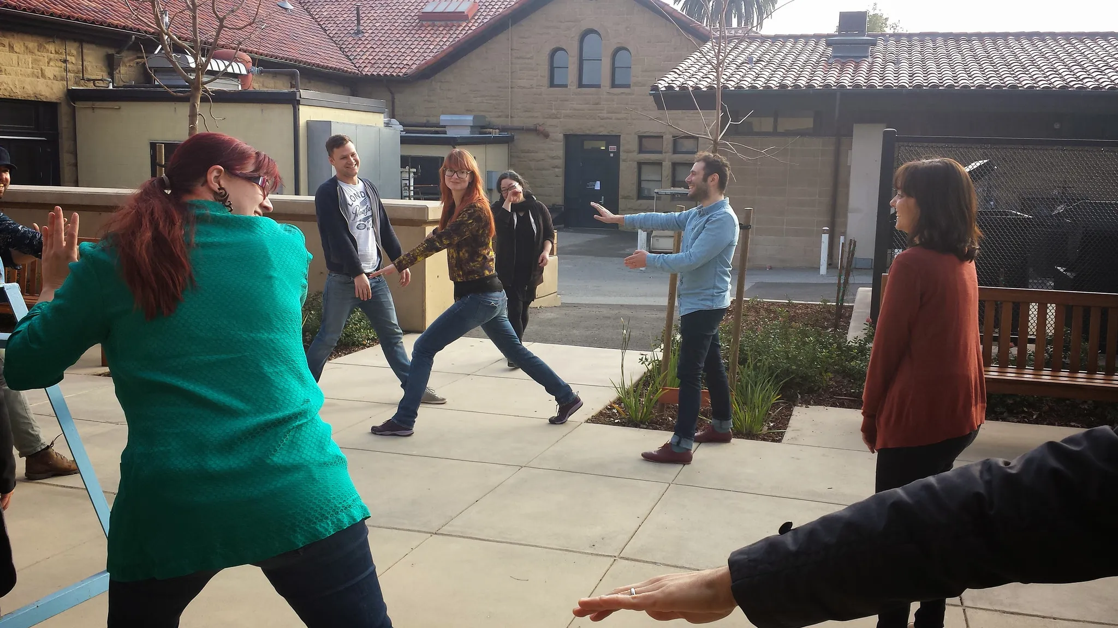


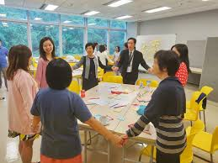



Slide 33
Step 3: Get People in the Mood for Creativity
“Creativity is contagious, pass it on.”—Albert Einstein
It is your job to encourage the creative side to emerge from each team member’s personality when you facilitate a design thinking session.
Group storytelling is a great way to get your design thinking team members to relax and enjoy the creative process.
Choose a topic for the story—it could be a completely unrelated story, something familiar to the team or something related to the challenge at hand.
Briefly outline the task and encourage team members to make the story as crazy as possible.
As the facilitator, start the story off with a brief intro.
Take it in turns to move the story around the team in a circle, with each team member adding a sentence or two.
End the story on your second turn and repeat the game with a different story topic if you feel it appropriate.

Slide 34

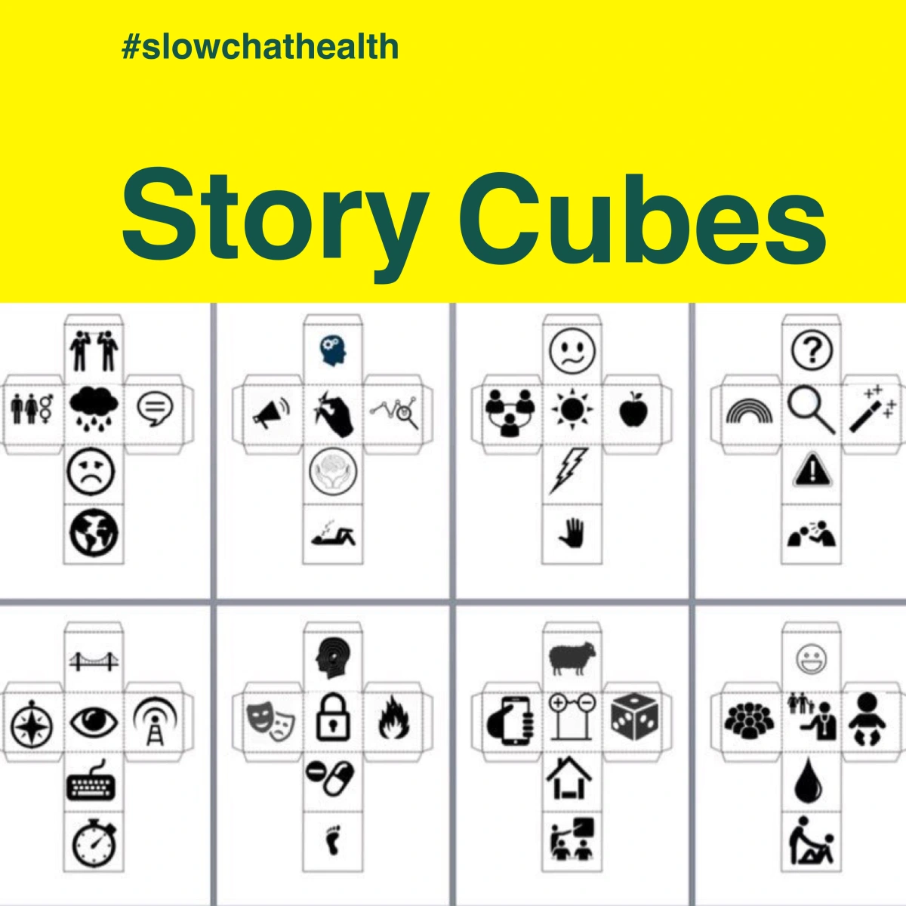
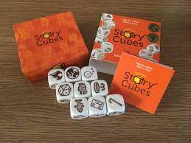
Step 3: Get People in the Mood for Creativity
“Creativity is contagious, pass it on.”—Albert Einstein
A set of story aids like Rory's Story Cubes may help even further, especially with people who are too shy to suggest unconventional storylines or plot twists. The story cubes come with a range of objects, actions and themes which can be mixed and matched to encourage randomized storytelling. It's also an excellent tool to get people in the mood for brainstorming.

Slide 35
Step 3: Get People in the Mood for Creativity
“Creativity is contagious, pass it on.”—Albert Einstein
The visual telephone is another activity which encourages visualization rather than spoken stories. It’s also a great energizer to get everyone engaged in a conversation about creativity, communication and interpretation.
Give everyone a small piece of paper and a pen.
Ask the first player to draw a simple picture in secret, and then pass it on to the person beside them without anyone else seeing the picture.
The second player looks at the image (without showing the rest of the team) and writes down their interpretation of what the image shows.
The next person takes the written explanation (again, without showing anyone) and draws an image to represent the words.
Repeat this method until all team members have either drawn a picture or written an interpretation.
The entire team will then review the end results to find out how each person interpreted the message they received.

Slide 36

Step 3: Get People in the Mood for Creativity

Slide 37
Finally, Your team get involved and inspired
BEFORE | After
Obstacles to innovation Fear of failure Intimidation Low self-esteem Hierarchy Creative blocks Blind spots Specialization bias | Greater inclusiveness Better team cohesion Higher levels of collaboration and interaction Increased confidence in creative abilities

Slide 38

Conclusion
“Some people think design means how it looks. But of course, if you dig deeper, it's really how it works."
– Steve Jobs, Apple
According to Plattner et al. (2009), the Design Thinking process consists of six process steps with iteration loops:
1- Understanding,
2- observing,
3- defining problems,
4- finding ideas,
5- developing prototypes
6- testing.

Slide 39
Wrap up
In This Lecture: Design Thinking
Detailed Convergent Vs Divergent Thinking in DT
Tips to get the most out of divergent & convergent exercises
The Meaning of Co-design
Unilever Case Study
Facilitate Design Thinking in Your Team
Process
Problem Space
Solution Space

Slide 40

Thank You

