Slide 1

Interaction Design (DGM 729)
Prepared by
Dr. Mohamed Owies
Lecture 7
Interaction Design(DGM 729)

Slide 2
Chapter 7
Design Methods
Interaction Design

Slide 3

Lecture 7
Content
lecture 7 includes the following points:
Method 13
Design Brief
Method 14
Design Principles
Method 15
Sketching
Method 16
Sketchboards
Method 17
Task Flows
Method 18
Wireframes
If You Only Do One Thing…

Slide 4
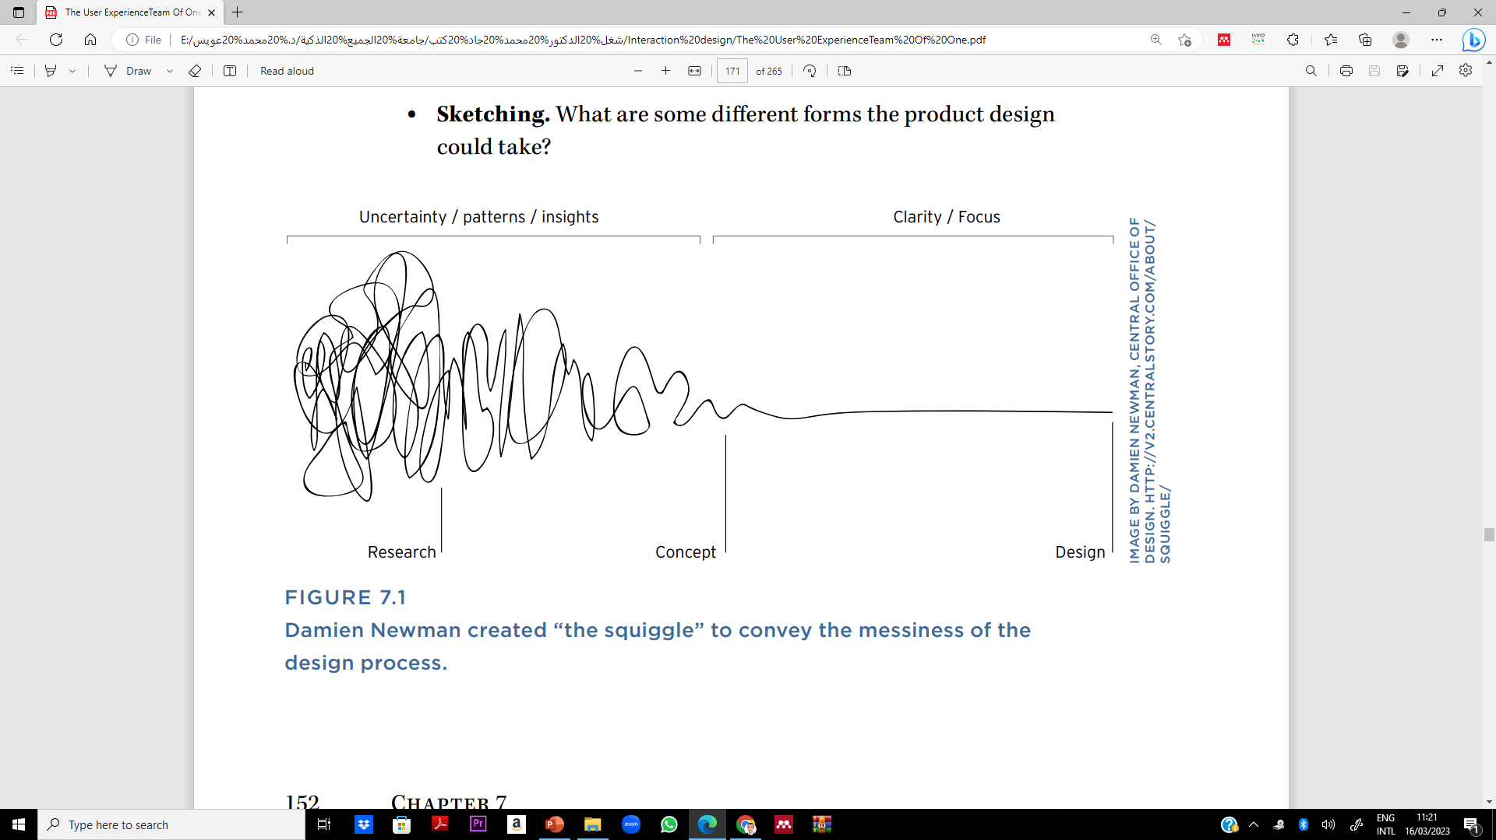
Lecture 7
Chapter 7 Design Methods
Designer Damien Newman created the design process illustration in Figure 7.1 to help illustrate a fundamental but little known truth about the design process: the path to a clean, complete, well-considered product is messy, messy, messy. You generally have to throw away a lot of work before you get to something that you keep. And often you don’t know what should be kept and what’s headed for the trash until you get other people involved in the process.

Slide 5
Lecture 7
Chapter 7 Design Methods
But showing your colleagues the messy design process can be a bit like making sausage: sometimes it can ruin their appetite for the meal. The trick is to follow an iterative design process that enables you to do your best work, but also brings people along for the ride. The methods described in this chapter are tailor-made to get you through that process. They focus on iterative design coupled with structured, facilitative activities that you can do with your non-UX colleagues to make them partners and co-owners of the UX design process.

Slide 6

Lecture 7
Method 13 Design Brief
At a high level, how would you describe your target design solution? What are the features and personality of the product? Who is it designed for, and what activities is it intended to encourage or enable?
The design brief documents your working assumptions about the optimal design of the product and puts forth your hypotheses for how best to bring that design to life. Much like a project brief, a design brief is intended to be a clear summary of what direction you plan to move (see Figure 7.2).

Slide 7
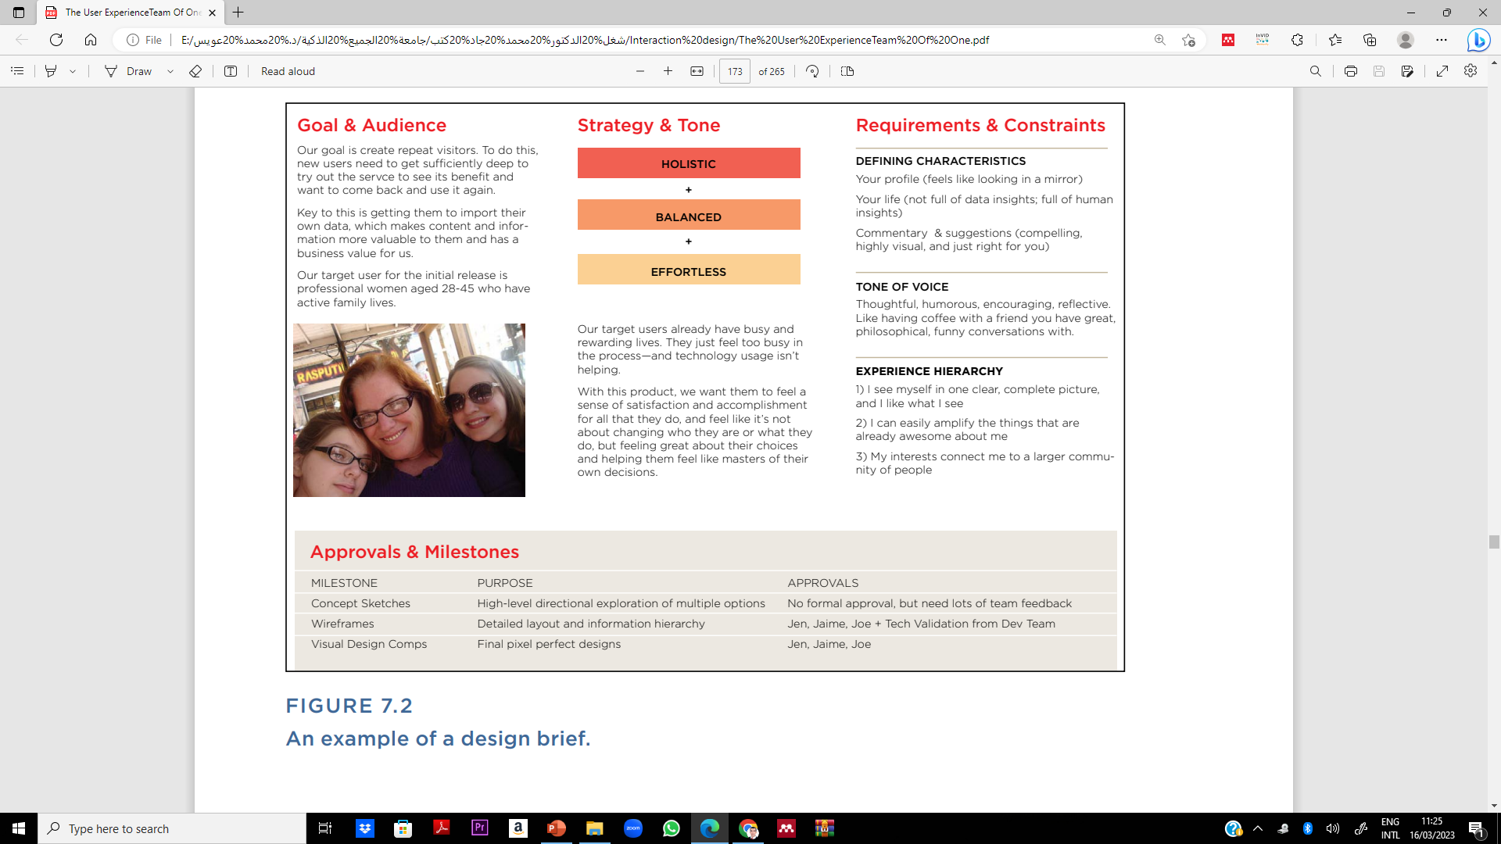
Lecture 7
Method 13 Design Brief
But the design brief is a little more focused on design specifics. It seeks to articulate the vision for the user experience and connect the dots on how that vision will be brought to life. The design brief is something you create for your team, for any stakeholders who need to approve the design direction, and for yourself. Where the project brief helps you get shared vision on the overall project goals, a design brief helps you get shared vision on the personality and essence of the user experience design.
Figure 7.2 An example of a design brief.

Slide 8
Lecture 7
Method 13 Design Brief
Use When
You want to clarify the team’s expectations as far as design is concerned and address early on any gaps or discrepancies in expectations.
As the output of the strategy and research work described in the previous chapters
Try It Out
There are two ways to do a design brief. One way is to start from a good template and fill in the details. (You can use a layout like the one shown in Figure 7.2.) The second is to look at what you know or have learned through your discovery and research work and build from the ground up. In either case, there are a few basic questions that you should answer with your design brief:

Slide 9
Lecture 7
Method 13 Design Brief
1. Focus: What is the focus of the design work? What will be created, improved, etc. as an outcome to this work?
2. Audience: Who will the design serve? Who are the primary audiences or personas that you will be designing for? While a design brief is intended to be brief, this is an area where a little more description will enable you to double-check that your assumptions about users—their needs, mindsets, and priorities—match your teammates’ assumptions.
3. Features and functions.
What are the core screens, states, or scenarios? What pieces of the experience will be central to the product?

Slide 10
Lecture 7
Method 13 Design Brief
4. Feeling: If you are successful, what will the feeling of the user experience be? This is basically about brand. When people use the product, will it feel fun and playful, dark and serious, or crisp and professional? As you’re talking to stakeholders and team members about how they would like to see the products take shape, you will find that in addition to talking about features and functions, people do slip in words that effectively describe the desired feeling of the product. If you notice that language and write it down, put it in the design brief.
5. Restrictions and expectations.
What constraints must be obeyed? What is most critical to the success of the design? What parts must you absolutely get right, and what things can you absolutely not do?

Slide 11
Lecture 7
Method 14 Design Principles
What should the experience of using the product feel like to a user? Design principles help you articulate the characteristics that should endow the user experience with a memorable personality or feeling. Does it sound strange to say that a product has a personality or a feeling? Some products may not have intentional personalities, but they may leave a distinct impression nonetheless. Some may feel confusing, complex, or technical.
You may also have encountered products that feel fun, friendly, simple, and smooth (see Figures 7.3–7.4), or playful, social, productive, creative, and so on. Users tend to appreciate products with those kinds of personalities a bit more.

Slide 12

Lecture 7
Method 14 Design Principles
Design principles are a tool to help you clarify what personality is right for your product, and then to ensure as you progress that you are designing an experience with this personality. Because these design principles set a direction for the product design, they are ideally done before beginning a detailed design.
Design principles can be shared with the team, similar to a design brief, to ensure that you have alignment on the product direction. As a tool for yourself, design principles can be a barometer to continually gauge whether the designs match the principles as you work.

Slide 13
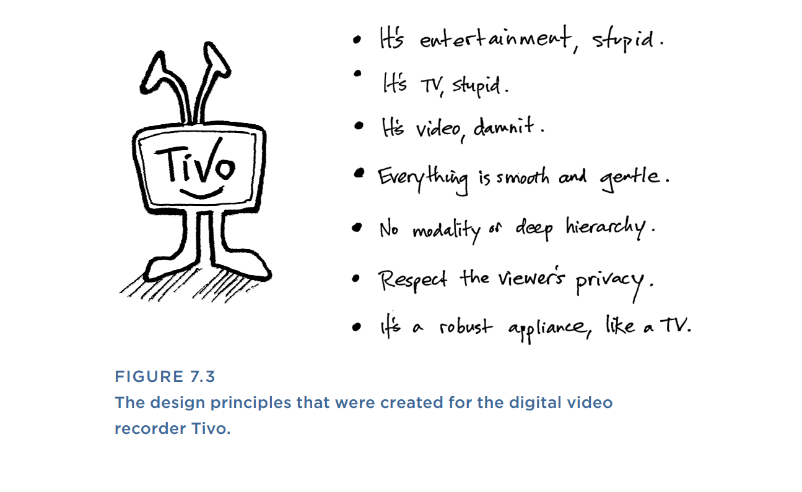
Lecture 7
Method 14 Design Principles

Slide 14
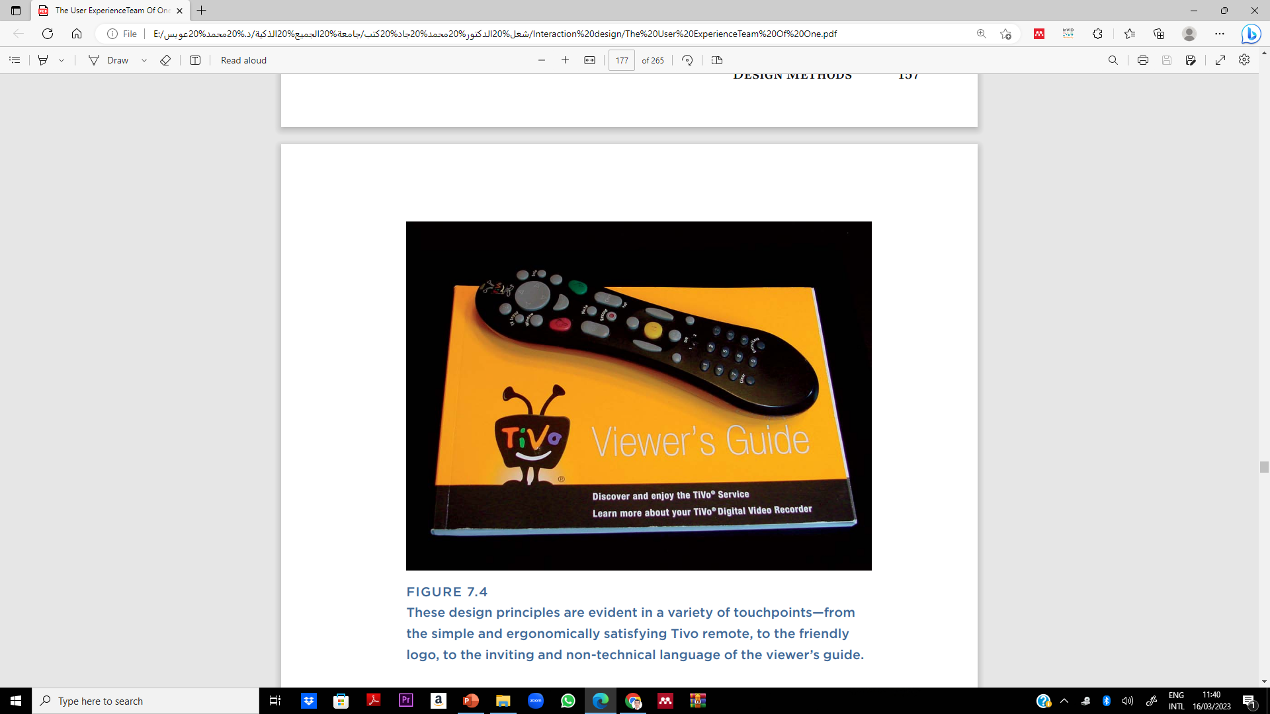
Lecture 7
Method 14 Design Principles
These design principles are evident in a variety of touchpoints—from the simple and ergonomically satisfying Tivo remote, to the friendly logo, to the inviting and non-technical language of the viewer’s guide.

Slide 15
Lecture 7
Method 14 Design Principles
Use When
You need a tool to ensure that your user experience is coherent and consistent.
You’re not sure what the vision or personality for your product is.
Try It Out
1. Consider what makes your offering unique.
Think about what you’ve learned through whatever research you’ve done. Have you discovered any differentiators and special characteristics that are key to your product? Are there any assets in your content patterns that are important to feature? Have you uncovered any interesting opportunities via user research that your product is uniquely positioned to address well?

Slide 16
Lecture 7
Method 14 Design Principles
2. Create a list of principles.
From this information, make a list of statements about what, ideally, the finished product should be like. Try to write short, pithy statements in an informal, human voice. Here, you are trying to capture how you would like a real person to describe your product after using it.
3. Reduce your list.
If you come up with a lot of statements in your list (say, more than five), try to pare it down. Prioritize the statements that most directly give users what they need and create an offering that is differentiated from your competitors. You may be able to combine a few of your statements to come up with more nuanced, less generic statements that really speak to the experience that you’re trying to create for your product. Ultimately, you want to whittle down your list to about five statements.

Slide 17
Lecture 7
Method 14 Design Principles
4. Add more color to each statement: Select a photo (or a few of them) to illustrate the statements symbolically, Add additional notes about some potential implications for each principle. Think about how each principle might influence specific parts of the design.
5. Share and discuss: Once you’re satisfied with your principles, share them with the whole team. Consider creating nicely formatted, poster-sized versions of each principle to give each one a sense of significance and inspire others.
6. Refer back to them regularly: As you progress through design steps like sketching, wireframes, prototyping, and validation, continually refer back to your design principles and ask yourself, “Does what I’m designing feel like this principle?” If not, think about what changes you can make to bring the design more in line with the principle.

Slide 18
Lecture 7
Method 15 Sketching
What are some different forms the product design could take?
Sketching is an activity that should be familiar to pretty much all of humanity. It’s when you sit down with pen and paper and allow yourself to start drawing out your ideas. However, in user experience design, sketching has added significance. It refers to the point in the process when you begin to explore different potential forms that the ultimate design could take. This is an important step before beginning detailed designs.
Sketches are a vital design tool because:
They’re cheap. Sketching is a fast and inexpensive way to iterate and refine your ideas before transitioning to a higher-fidelity and more painstaking medium like wireframes. While you are in the sketching phase, if you discover that a certain idea won’t work, you can quickly evolve or revise the idea. All it takes is another sketch.

Slide 19

Lecture 7
Method 15 Sketching
Sketches are a vital design tool because:
They help you explore. In user experience design, there are usually a variety of directions a design could take. Sketching is a thinking tool that you can use to pinpoint an idea and then adjust and adjust again. It can also be used to generate a range of potential solutions to a particular problem. This makes sketching an excellent tool for exploring constraints and trade-offs, and thinking through the implications of one design over another.
They forestall perfectionism. Because sketching helps you explore multiple directions, it’s a natural deterrent to becoming too wedded to one particular idea too early. Sketching enables you to entertain a variety of ideas all at the same time, and even merge them together and evolve them into something greater than any one individual concept.

Slide 20
Lecture 7
Method 15 Sketching
They invite conceptual feedback. Sketches are messy. No one could confuse them with finished designs. Consequently, if you share a sketch with someone (for instance, a team member), they’re more likely to give feedback on the core concept than to give you detailed feedback on layouts, fonts, colors, and so on. Early in the design process, feedback on the concept is the right level of feedback. Conversely, if you show a more polished-looking design while you’re still working on the basic idea, people may focus on surface aesthetics and feel that it’s too late to give feedback that might change and even improve the overall conceptual direction.

Slide 21

Lecture 7
Method 15 Sketching
They engage others. Perhaps most valuable for a team of one (whose success often depends on getting support from non-UX peers), sketching gives you a way to translate abstract ideas into a tangible, visual language that you can share with others. You can use this to confirm with the team what you’re thinking and incorporate their feedback before investing days of work into higher-fidelity design.
Anyone can do it. You don’t have to be the only one sketching. In fact, inviting your cross-functional team to express their ideas on pen and paper gets them engaged, leads to great new ideas, and is fun.

Slide 22
Lecture 7
Method 15 Sketching
Use When
You’re starting to explore design ideas.
You want to engage the team in a constructive and tangible discussion of possible design directions.
You’re not really sure what direction the designs could go in, and you need a tool to spur your creative thought process.

Slide 23
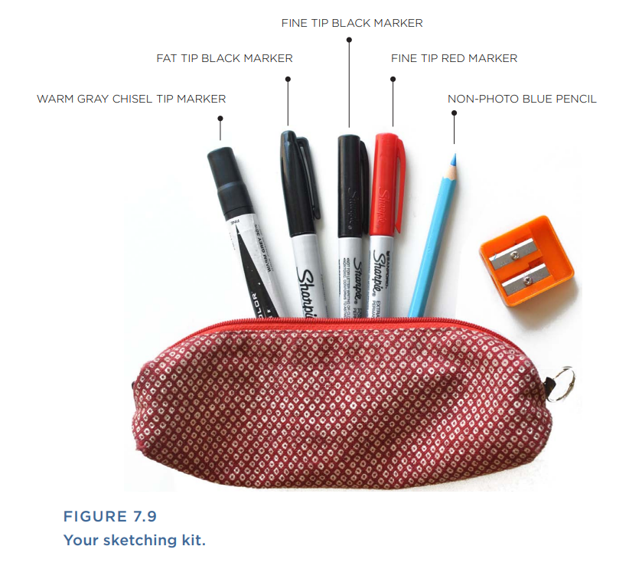
Lecture 7
Method 15 Sketching
Try It Out
1. Start with the right equipment: paper and pen: You can sketch with tools as simple as an old pencil stub and a scrap of paper. However, having pens of varying weight and color, and blank paper (or better yet, a special notebook for sketching) can imbue the sketching process with an air of thoughtful intention, and can also make your sketches clearer to other people. Consider assembling a little sketching kit for yourself, as shown in Figure 7.9. Then stock this minimal set of sketching instruments in your pen case at all times:
Fine-tip black pen or marker—for roughing out a sketch.
Fine-tip red pen or marker—for annotations and notes

Slide 24
Lecture 7
Method 15 Sketching
Fat-tip black pen or marker—for creating thicker lines to draw attention to the more important or structural parts of a sketch.
Non–photo blue pencil—for creating a first draft of a sketch, before inking it in. Especially useful if you are drawing hard things like hands or people. It’s called a “non-photo” pencil because it’s (mostly) invisible to cameras and scanners, which makes it a good way to rough out an idea and then go over it again later in black ink.
Warm gray chisel tip marker—for creating drop shadows or inking in parts of the sketch that should be treated as the background.

Slide 25
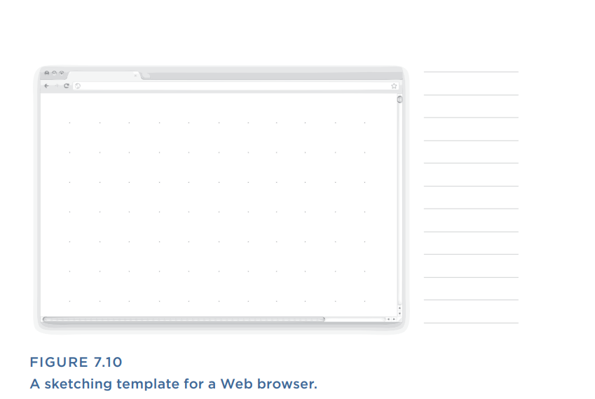
Lecture 7
Method 15 Sketching
For sketching paper, basic copier paper works well. Or, if you are sketching screens for a specific type of device or screen resolution, it can be helpful to sketch on templates like those shown in Figures 7.10–7.13, which include a stencil or outline with an accurate sizing and aspect ratio for the target screen. Paradoxically, if your paper is too nice, it can make you more hesitant to sketch.

Slide 26
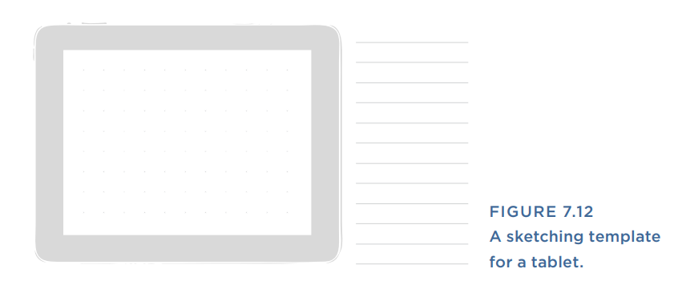
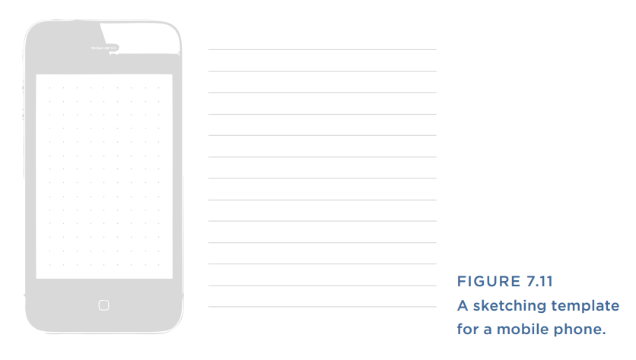
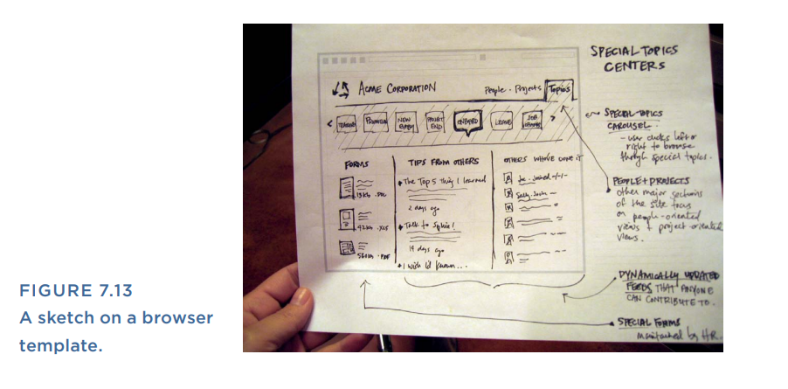
Lecture 7
Method 15 Sketching

Slide 27
Lecture 7
Method 15 Sketching
2. Block off some time: When you’re ready to sit down and start sketching, consider giving yourself a time constraint. For example “I will sketch ideas for the next 30 minutes.” The time constraint is useful because it helps you move quickly rather than deliberating over an idea until it’s perfect. Perfect doesn’t matter when you’re sketching. That comes later in the process. Here, it’s about generating a lot of ideas for what’s possible.
3. Sketch your first ideas for key parts of the experience.
4. Sketch alternatives: After you’ve sketched one or two ideas for a particular state or screen, try to force yourself to sketch at least a few additional ways you could design that part of the product. For example, if the first sketch was a text-heavy design, how about a very visual way that you could present the same information? Continue this exploratory, experimental way of thinking as you drum up at least a few ideas for each screen that you’re sketching.

Slide 28
Lecture 7
Method 15 Sketching
5. Pick the best ideas.
Once you’re satisfied that you’ve done rigorous exploration, identify which directions or ideas seem most promising to develop further. Only then should you fire up your computer and commence detailed design. You may find yourself mixing and matching some ideas from your initial sketches. That’s great! Your sketches should help you arrive at design solutions that are bigger than any one particular idea.

Slide 29
Lecture 7
Method 16 Sketchboards
What might the overall system or product look like, and what range of ideas is possible at each point in the process?
A sketch board is a way to display the sketches that you and the team have created and facilitate a group conversation around them. You can think of a sketch board as a big poster that you create by assembling your sketches and initial ideas for the design of the system. Sketch boards also help you look beyond individual screens and envision how someone will move among multiple parts of a product or system.
Try It Out
1. Assemble your supplies.
After you’ve sketched some preliminary ideas for the product (or part of the product) that you are designing, gather your supplies and prepare to assemble your sketch board. You will need:

Slide 30
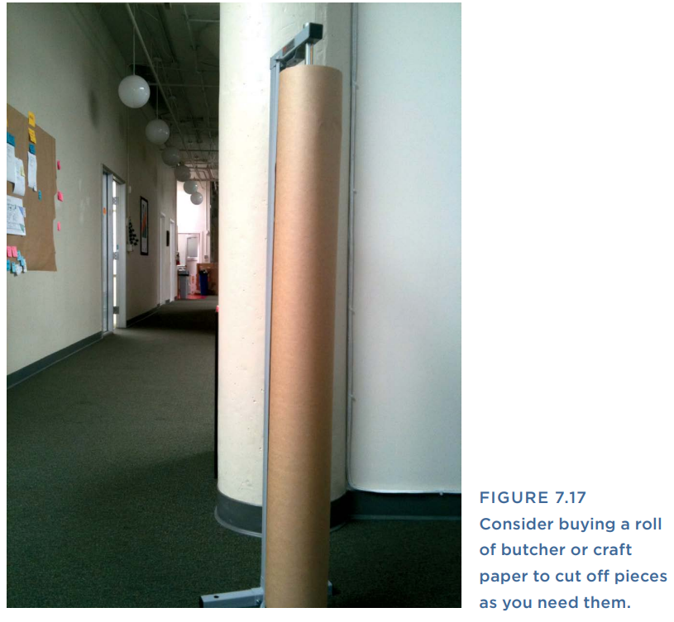
Lecture 7
Method 16 Sketchboards
Paper. A large sheet of paper, approximately 3' × 6', or 1 m × 2 m. Brown paper creates an especially nice work surface because it contrasts sharply with the sketches, which are usually on white paper. Brown paper also seems like a less formal canvas, which has the subtle psychological effect of making you less hesitant to write all over it (see Figure 7.17). Plus, it’s usually cheaper than white paper.
Tape. The tape should be sticky, but not too sticky (see Figure 7.18). Painters tape works well or drafting dots. Drafting dots are single-serving bits of round tape, often used by architects and drafters to
Large markers to make big, clear labels and notes

Slide 31
Lecture 7
Method 16 Sketchboards
2. Assemble your sketchboard.
Now that you’ve got your supplies in order, begin to put together your sketchboard. Start with the structure. Think about all the screens or sections of the product that you are designing.
3. Put up your sketches.
Next, tape up all of your initial designs or sketches within each of the sections that you have labeled, as shown in Figure 7.19. If you find you have a section without any designs taped up, it probably means you need to sketch some more.

Slide 32

Lecture 7
Method 16 Sketchboards
4. Schedule a review session.
Now comes the most important part. Assemble a group of fellow team members, coworkers, or even just friends, and use the sketchboard to explain your ideas and get feedback.
5. Review the best ideas.
Your goal by the end of the sketchboard session is to come away with some sense of which ideas are promising enough to turn into higher fidelity designs.

Slide 33

Lecture 7
Method 17 Task Flows
How will the experience unfold over time? People don’t experience digital products page-by-page or screen-by-screen.
They pop in the back door, jump erratically from one part to another, break your forms, and trick your logic. A task flow gets you thinking about how people really use your product. What are the most likely scenarios and sequences that users will follow? And what are some potential side doors that they may use to end up in the same place? A task flow helps you design an experience that flows smoothly even through the transition points.

Slide 34
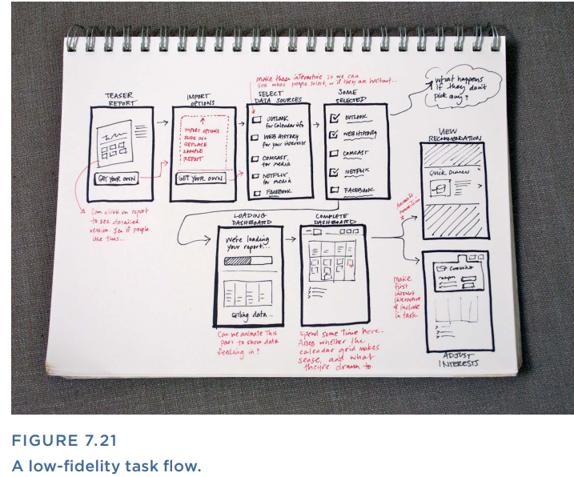
Lecture 7
Method 17 Task Flows
You can make a task flow in any software program that’s good for diagramming. Or you can simply draw it out on paper, as shown here in Figure 7.21. In fact, if you don’t have a lot of time, paper and pen may be preferable because they enable you to add additional details easily without needing to “design” the flow document, which can be its own task.

Slide 35
Lecture 7
Method 17 Task Flows
Try It Out
1. Figure out your starting point: You can do this in a top-down fashion or bottom-up.
When you’re thinking top-down, ask yourself what should a user
encounter first? What is the starting point? What are the major parts of the product? What comes first, and then what might happen as the user works his way deeper into the product?
In the bottom-up approach, start with the most interesting steps in the process, or moments of truth, and ask yourself what comes before and after them?

Slide 36
Lecture 7
Method 17 Task Flows
2. Consider what comes next (or prior): After you’ve picked your starting point, think about how your users would get to that point, and where they would go next. Repeat this process, either working your way from start to finish, or spreading out from the central moment you began with until you hit a reasonable start and end point.
3. Think about alternate entries and exits: For each step in the flow ask yourself, is there another way that someone could get here? Or is there somewhere else they’re like to go from here (not necessarily the next step in the flow)? Also, consider what should happen if people abandon at this point.
4. Add annotations: Once you’ve captured all the key steps or screens for a particular task flow, go back through and add notes for how transitions should take place, or other important points to capture that are not self-evident from simply looking at the task flow.

Slide 37
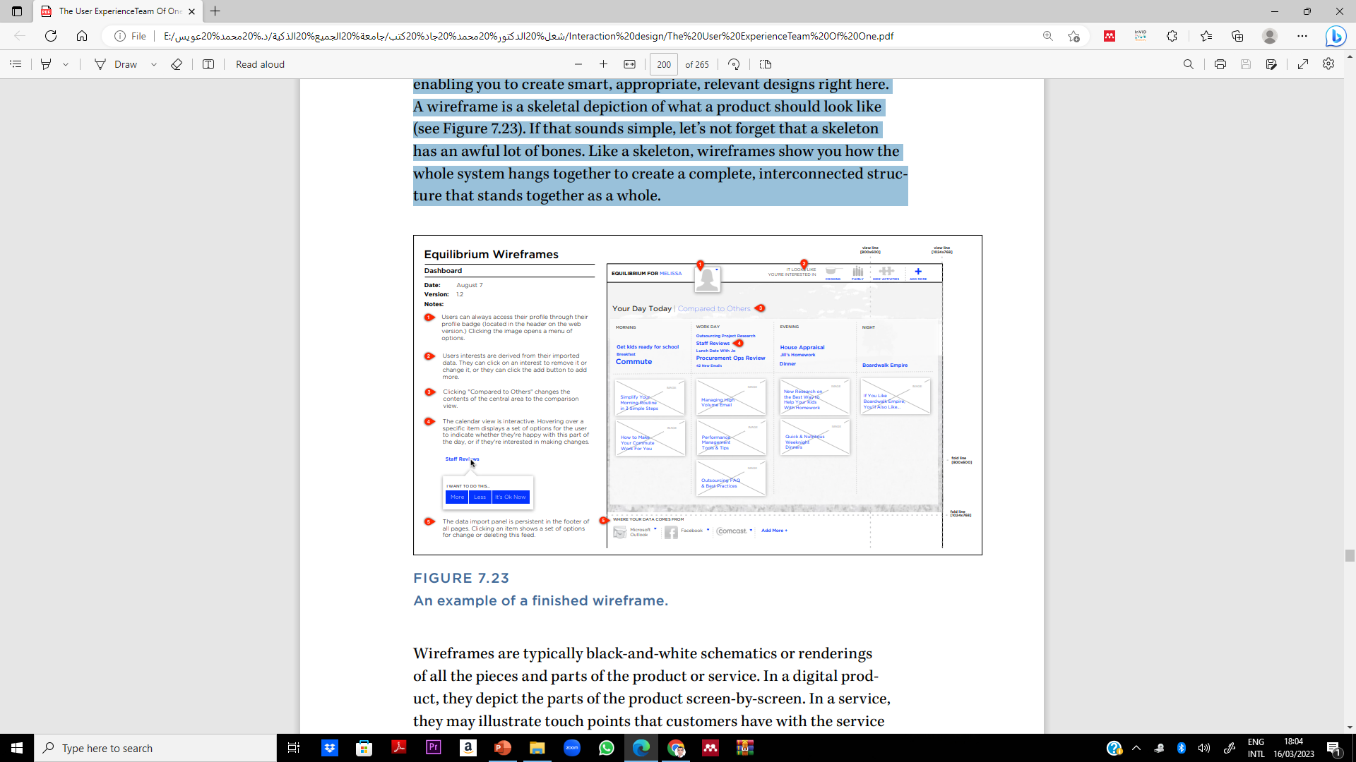
Lecture 7
Method 18 Wireframes
How will the product look and function in detail? Wireframes are the meat and potatoes of user experience design. Many of the methods leading up to this point have all been geared toward enabling you to create smart, appropriate, relevant designs right here.
A wireframe is a skeletal depiction of what a product should look like (see Figure 7.23). If that sounds simple, let’s not forget that a skeleton has an awful lot of bones. Like a skeleton, wireframes show you how the whole system hangs together to create a complete, interconnected structure that stands together as a whole.
Wireframes are typically black-and-white schematics or renderings of all the pieces and parts of the product or service. In a digital product, they depict the parts of the product screen-by-screen. In a service, they may illustrate touch points that customers have with the service (be they digital, paper, or human).

Slide 38
Lecture 7
Method 18 Wireframes
Try It Out
1. Pick your tool.
Start by deciding how you will create your wireframes. Usually, this means selecting a software program. For wireframes, pretty much any program that enables you to draw shapes will work. But there are some programs that are favorites for user experience professionals. Most of them feature easy drawing tools that allow you to easily approximate user interface elements in your diagrams.
2. Create a template.
Once you’ve chosen your tool, your impulse may be to jump right into designing screens. Consider taking a moment first to lay out a template for your wireframes like the one in Figure 7.24—one that takes into account the device or form factor you are designing for.

Slide 39
Lecture 7
Method 18 Wireframes
3. Create a wireframe inventory: One final step before you start creating your wireframes: make a list of the wireframes that you think you’ll need to create and gather together any sketches that you’re planning to turn into wireframes. If there are any screens in your list that you don’t have ideas for yet, take the time to start sketching out the design before you start to create the digital wireframe.
4. Get wireframing: At last, you’re ready to start wireframing. Clear your calendar. Put on some good tunes. Pour yourself a nice cup of tea, and prepare to settle into the time-eclipsing flow of wireframing.
5. Seek and listen to feedback: Share your wireframes with the team (or even just anybody you can ind). Get feedback on whether the designs make sense, if the flow matches how people would expect to move through or use the product, and if anything seems just plain funky.

Slide 40
Lecture 7
Design Methods & AI Integration
Method 13 – Design Brief
A foundational document outlining project goals, users, and constraints.
AI can help generate or analyze briefs using user data, personas, and previous design patterns to suggest optimal design goals.
Method 14 – Design Principles
Guidelines that shape the overall feel and effectiveness of a design (e.g., usability, consistency, accessibility).
AI tools can evaluate adherence to principles using usability testing simulations or by analyzing user interaction data.
Method 15 – Sketching
A fast, visual way to explore ideas and communicate concepts.
AI can assist with auto-completing sketches, recommending improvements, or transforming rough sketches into more polished UI elements.

Slide 41
Lecture 7
Design Methods & AI Integration
Method 16 – Sketchboards
A collection of sketches or screens to visualize user journeys and screen relationships.
AI can identify gaps, recommend screen flow optimizations, or simulate user navigation.
Method 17 – Task Flows
Diagrams showing user steps for completing specific goals.
AI can analyze user behavior to generate or refine task flows and detect friction points.
Method 18 – Wireframes
Low-fidelity representations of interface layouts.
AI can auto-generate wireframes from text inputs, optimize layout based on best practices, or test wireframes with virtual users.

Slide 42
Lecture 7
If You Only Do One Thing…
The methods in this chapter show the range of considerations that you have to think about when doing user experience design, from the core positioning of the product, to what different forms the user experience could take, to the tactical nuts and bolts of how the design will ultimately function.
The underlying spirit of it all is that design should be an exploratory and inclusive process that you help shepherd other people through.

Slide 43
Lecture 5
Thank You

