Slide 1


Introduction to
Research Methods
Prepared by Associate Professor/
Ahmed Rageh Ismail
MGM333
Introduction to research methods
Lecture 1

Slide 2

Chapter
Learning Objectives
1
Learn about positivism, postpositivism, and interpretivism.
Understand ontological, epistemological, and methodological questions.
Recognize differences between qualitative and quantitative methodologies.
Understand the role and application of mixed methods research.
Learn criteria for judging the value of research findings.
www.midocean.ae

Slide 3

Chapter
Introduction to Research Paradigms
1
Purpose
- Provide an overview of the research process.
- Guide researchers through available options.
Importance of Paradigms
- Understanding paradigms is crucial for informed research decisions.
- Awareness of paradigms enhances situational responsiveness and creativity (Patton, 1988).
www.midocean.ae

Slide 4
Chapter
Defining Research Paradigms
1
Three Major Paradigms
- Positivism
- Postpositivism
- Interpretivism
Philosophical Underpinnings
- Ontology: The nature of reality.
- Epistemology: The philosophy of how we can know reality.
- Methodology: The practice of how we come to know reality.
www.midocean.ae

Slide 5
Chapter
Key Questions and Paradigm Boundaries
1
Three Key Questions (Lincoln and Guba, 1985)
1. Ontological Question: What is the nature of reality?
2. Epistemological Question: What is the nature of the relationship between the knower and the known?
3. Methodological Question: How can we come to know it?
Establishing Paradigm Boundaries
- Understanding the answers to these questions helps define the paradigm.
- Paradigms guide the research approach and methodology.
www.midocean.ae

Slide 6
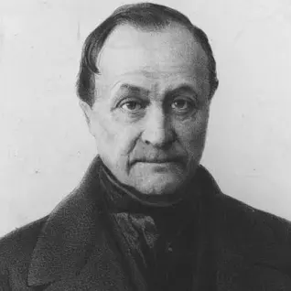
Chapter
Positivist Research - Brief History
1
Three generations of positivist thinkers
1. Original formulation by Auguste Comte.
2. Logical positivism associated with the Vienna Circle.
3. Standard positivism developed in the mid-20th century.
Auguste Comte's social positivism: Examining social phenomena as an empirical science.
Emile Durkheim: First 'sociologist' to pioneer empirical investigation of society.
www.midocean.ae

Slide 7
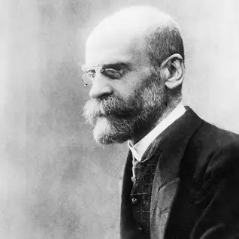
Chapter
Positivist Research - Brief History
1
Early 19th century Comte devised social positivism.
Aimed to apply natural science techniques to social theory and human behavior.
Belief in reconstructing human knowledge to build a better society (Smith, 1998).
Emphasis on empirical science over theological and metaphysical philosophies.
Comte's work was mostly rhetorical; Durkheim pioneered empirical methods.
www.midocean.ae

Slide 8
Chapter
Logical Positivism and Vienna Circle
1
1920s: Philosophers in Vienna (Vienna Circle) developed logical positivism.
Notable members: Moritz Schlick, Rudolf Carnap, Philip Frank, Bertrand Russell.
Rejected Comte’s positivism, favoring 'logical empiricism'.
Focused on verifiable and falsifiable statements as meaningful scientific knowledge.
Emphasized statistical analysis and physical evidence over metaphysical speculation.
Influenced behaviourist traditions like Pavlov's classical conditioning and Skinner’s operant conditioning.
www.midocean.ae

Slide 9
Chapter
Ontology – Realism
1
Positivism assumes an objective, independent, and stable reality available for discovery and analysis.
Only observable phenomena are recognized; metaphysics is strongly rejected.
Social facts exist independently of human interaction, functioning according to their own laws.
Newtonian mechanics are seen as transferable from the natural world to the social world.
www.midocean.ae

Slide 10
Chapter
Epistemology – Objectivist/Dualist
1
The relationship between the knower and the known is one of ‘objective observer’.
The researcher stands apart from the observed and reports on discovered reality.
Dualism: Researcher and subject exist independently of each other.
Objectivity is demonstrated through replication, presuming observation without influence.
www.midocean.ae

Slide 11
Chapter
Methodology – Experimental/Manipulative
1
Reality is dissected into variables representing theoretical constructs.
Variables are manipulated through experimentation to determine 'laws'.
Research begins with a hypothesis, tested empirically through structured experimentation.
Uses complex statistical mechanisms for determining relationships and broad generalizations.
www.midocean.ae

Slide 12
Chapter
Purpose – Prediction/Control/Explanation/Verification
1
Positivist approaches explain how things happen to predict and control future occurrences.
Social reconstruction driven by Comte's ideas remains constant in positivist traditions.
Generalizations are derived from specific examinations and applied universally.
Strives to demonstrate universal validity.
www.midocean.ae

Slide 13
Chapter
1
Postpositivism and Mixed Methods Research (MMR) - Brief History
Positivism emulated natural sciences, particularly physics.
Shift from rigid Newtonian physics to 'uncertainty' and 'relativity' (Einstein, Heisenberg).
Determinism inhibits discovery; social research required refinement (Popper, 1963).
Standard positivism (1930s-1960s) evolved into postpositivism.
www.midocean.ae

Slide 14

Chapter
1
Emergence of Postpositivism
New theories of uncertainty and probability (Popper, 1959-1963).
Introduction of 'falsification' and 'critical realism'.
Objective social facts subject to interpretation.
Reality is perceived through empirical observation and existing theory.
www.midocean.ae

Slide 15
Chapter
1
Mixed Methods Research (MMR) in Postpositivism
MMR as a form of postpositive research.
Pragmatic approach combining qualitative and quantitative methodologies.
Requires multiple investigators with competencies in various methods (Denzin, 2010).
Emphasis on rigour and trustworthiness in combining methods.
www.midocean.ae

Slide 16
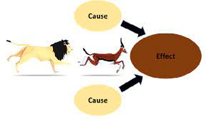
Chapter
1
Ontology – Critical Realism
Objective social facts exist independently but are subject to uncertainty and probability.
Cause and effect relationships exist but are not fully knowable.
Human fallibility creates imperfections, yet reality is out there to be discovered.
www.midocean.ae

Slide 17

Chapter
1
Epistemology – Modified Dualist/Objectivist
Postpositivists accept that all discovery is subject to interpretation.
Responsibility of the researcher to demonstrate objectivity through external validity.
Objectivity is demonstrated by the ability to validate findings externally.
www.midocean.ae

Slide 18
Chapter
1
Methodology – Modified Experimental/Manipulative
Experimentation and hypothesis testing with identified variables.
Statistical techniques measure relationships between variables.
Includes qualitative interpretation allowing prior knowledge to impact perceptions.
Mixed methods research uses an 'a priori' design with varying weights on qualitative and quantitative aspects.
www.midocean.ae

Slide 19
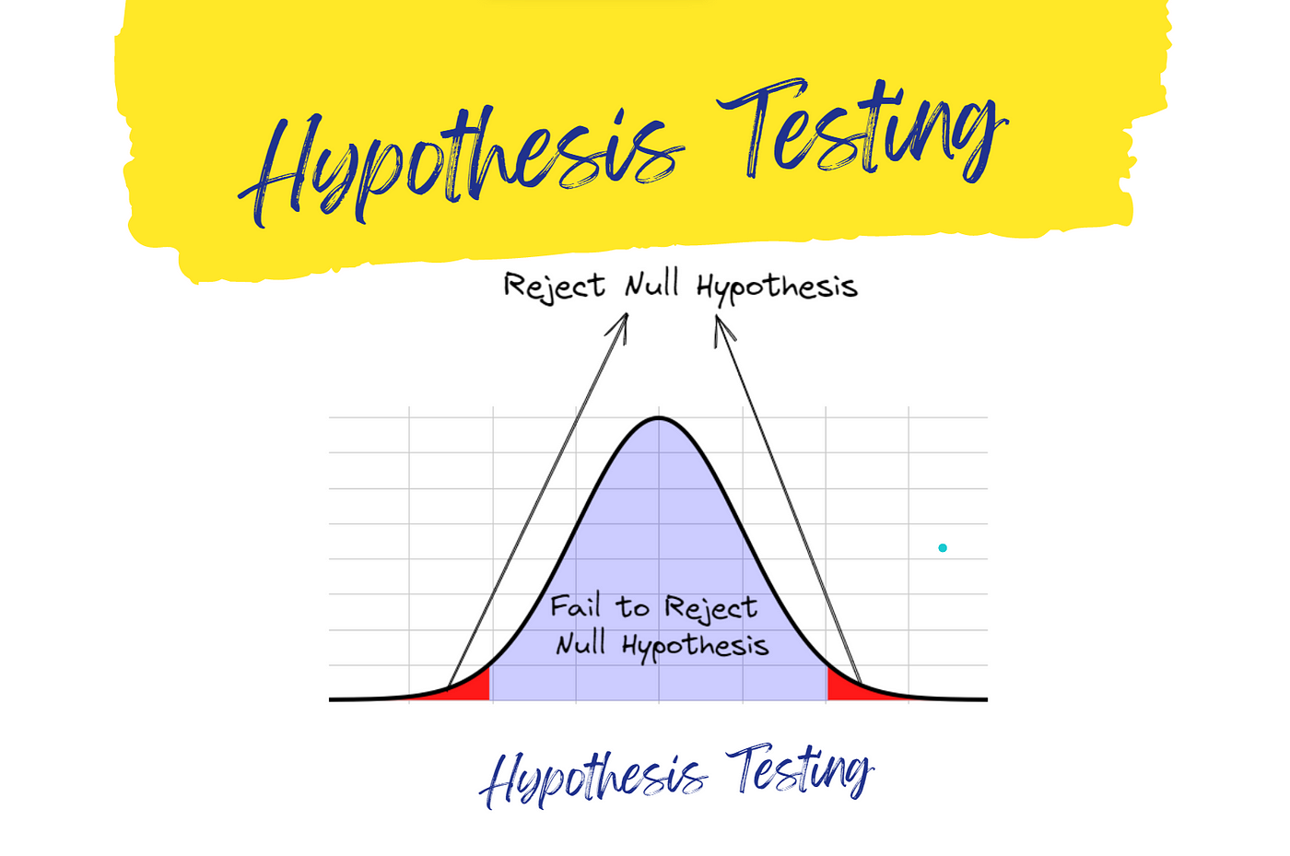

Slide 20

Chapter
1
Purpose – Prediction/Control/Explanation/Falsification
Similar to positivism but includes the notion of falsification.
Disproving the existence of a phenomenon is a valid outcome.
Generalizations about phenomena remain an output.
Methodological dualism (qualitative and quantitative) is accepted in postpositivist research.
www.midocean.ae

Slide 21
Chapter
1
Interpretivist Research - Brief History
Interpretivism covers multiple approaches: 'empirical interpretivism' and 'critical theory'.
Wilhelm Dilthey's critique of positivism is that there is a difference between understanding human thought and explaining nature.
Max Weber is among the proponent of empirical interpretivism, focusing on ethnographic studies.
Barney Glaser and Anselm Strauss formalized empirical interpretivist research procedures (1967).
Expansion into various approaches from 1970 to mid-1980s.
www.midocean.ae

Slide 22

Chapter
1
Ontology – Relativism
Realities are multiple, constructed, and holistic.
No single, tangible reality; only complex, multiple realities of individuals.
Reality is 'individual' and context-dependent, not 'universal' (Flick, 2002).
www.midocean.ae

Slide 23
Chapter
1
Epistemology – Transactional/Subjectivist
The known and the knower influence each other; all descriptions are time- and context-bound.
Impossible to separate cause from effect; entities are in a state of simultaneous shaping (Lincoln and Guba, 1985).
Knowledge is a product of the interaction between the known and the knower.
www.midocean.ae

Slide 24
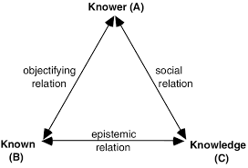

Slide 25

Chapter
1
Methodology – Empathetic Interaction
Research activity alters the subject being studied (Heisenberg, 1958).
Data gathered is influenced by the research process, time, and context.
Understanding meanings behind actions of individuals is key.
Qualitative methodology:
- Dialect interchange, hermeneutics, and contextual analysis.
www.midocean.ae

Slide 26
Chapter
1
Purpose – Transfer of Findings Based on Contextual Applicability
Transferability depends on similarities between 'sending' and 'receiving' contexts.
Detailed descriptions of data in context are required for transferability judgments (Erlandson et al., 1993).
Research is particularized and generalization in the traditional sense is impossible (Dervin, 1997).
www.midocean.ae

Slide 27
Chapter
1
Interpretivist Approaches and Practical Implications
Interpretivist approaches include Human inquiry, Critical theory, Anthropology, Constructivism, Ethnomethodology, etc.
Interpretivists seek to understand the entire context at macro- and micro-environmental levels.
Researchers and subjects are 'changed' by the research experience; knowledge is time- and context-bound.
Positivists/postpositivists as social engineers, interpretivists as storytellers, critical theorists as catalysts of social change.
www.midocean.ae

Slide 28
Chapter
1
Qualitative vs. Quantitative Methodology
Impossible to examine multiple, individual realities in depth using quantitative methods.
Quantitative methodology is about objective reality of social facts.
Qualitative methodology is about social constructions of reality (Gorman and Clayton, 2005).
www.midocean.ae

Slide 29

Chapter
1
Paradigmatic Purity vs. Methodological Dualism
No consensus on the need for paradigmatic purity in research.
Methodological dualism is combining qualitative and quantitative methods.
Both methodologies have limitations; "anything goes" approach.
Therefore, Mixed Methods Research (MMR) is combining methodologies to address research questions (Denzin, 2010).
www.midocean.ae

Slide 30
Chapter
1
Qualitative Research Design
The term "emergent design," as referenced by Lincoln and Guba (1985), refers to a flexible, adaptive approach to research design that develops organically as the study progresses. This concept contrasts with rigid, predetermined designs.
Unfolds: The design reveals itself gradually over time, rather than being fully planned out from the beginning.
Cascades: The process flows and expands like a waterfall, suggesting that once a piece of the design is understood, it can lead to further developments.
www.midocean.ae

Slide 31
Chapter
1
Qualitative Research Design
Rolls: The design progresses in a rolling motion, implying continuous movement and adaptation.
Emerges: The design becomes apparent or comes into being through the research process.
Key components: Literature review, theoretical framework, fieldwork, human instrument, purposive sampling, inductive analysis, emergent design, grounded theory, negotiated outcomes.
Iterative process: Selection of participants, data collection, analysis, building grounded theory, transference of findings.
www.midocean.ae

Slide 32

Chapter
1
Qualitative Research Design
Studying behavior in context requires the human as instrument.
Human complexities and interpersonal relationships need to be understood.
Researcher as instrument allows for understanding and depicting complexities (Maykut and Morehouse, 1994).
www.midocean.ae

Slide 33
Chapter
1
Example of Emergent Design in Practice
Focus group discussions led to alternative methods: handwritten diaries, databases, word files.
Participant involvement in design improved data quality and engagement. They became stakeholders in the research, enhancing diligence.
www.midocean.ae

Slide 34
Chapter
1
Quantitative Research Design
Linear design, providing a concrete framework for new researchers.
Begins with a theoretical framework established from the literature review.
Hypothesis emerges from the framework; variables identified.
Appropriate research method selected, sample calculated, data collection instruments designed.
Data collection, processing, and analysis to support or falsify the hypothesis.
Generalizations or general laws formulated based on findings.
www.midocean.ae

Slide 35
Chapter
1
Mixed Methods Research (MMR)
Combines methodologies to address the same research question.
Common approach is Large-scale survey followed by detailed case study.
Defined as collecting, analyzing data, integrating findings using both qualitative and quantitative methods (Tashakkori and Cresswell, 2007).
No single design; many combinations possible (Tashakkori and Teddlie, 2003).
Journal of Mixed Methods Research by Sage (2007).
www.midocean.ae

Slide 36
Chapter
1
Criteria for Judging Research
Establishing the value of research findings is essential.
Different methodologies require different criteria for establishing 'truth'.
Avoid applying criteria from one research paradigm to another (Wolcott, 1990).
Four concepts for judging research value: 'truth value', 'applicability', 'consistency', 'neutrality' (Lincoln and Guba, 1985).
www.midocean.ae

Slide 37
Chapter
1
Criteria for Judging Research
Establishing the value of research findings is essential.
Different methodologies require different criteria for establishing 'truth'.
Avoid applying criteria from one research paradigm to another (Wolcott, 1990).
www.midocean.ae

Slide 38

Chapter
1
Establishing Trustworthiness in Qualitative Research
Credibility
Transferability
Dependability
Confirmability
www.midocean.ae

Slide 39
Chapter
1
Credibility in Qualitative Research
Demonstrated by prolonged engagement, persistent observation, triangulation of techniques, peer debriefing, and member checks.
Triangulation: Multiple data collection techniques compensate for limitations of individual techniques (Denzin, 1978).
'Objective subjectivity': Recognizing and compensating for subjectivity in qualitative studies (Mellon, 1990).
www.midocean.ae

Slide 40
Chapter
1
Transferability in Qualitative Research
The goal is to allow for transferability of findings rather than wholesale generalization.
Providing detailed descriptions of data in context for judgment on transferability (Erlandson et al., 1993).
Research can only be particularized; generalization in the traditional scientific sense is impossible (Dervin, 1997).
www.midocean.ae

Slide 41
Chapter
1
Dependability in Qualitative Research
Established by an 'inquiry audit' with an external auditor.
Audit trail and research journal maintained by the researcher.
Ensures constructions emerge directly from the data, confirming research findings (Halpern, 1983).
www.midocean.ae

Slide 42
Chapter
1
Confirmability in Qualitative Research
Vital to limit investigator bias.
Ensures results can be traced back to raw data, not influenced by the observer’s worldview (Charmaz, 1995).
'Objectivity' increasingly difficult to defend in postpositivist, qualitative research (Lazar, 1998).
www.midocean.ae

Slide 43
Chapter
1
Confirmability in Quantitively Research
Relies on 'validity, reliability, and generalisability' (Janesick, 1994).
Internal validity: Demonstrates causal relationship between variables.
External validity: Findings generalized to the wider context.
Reliability: Stability of research findings over time and across locations.
Sample representativeness and statistical examination of probability.
www.midocean.ae

Slide 44



Thank You

