Slide 1


Intelligent Detection of Safey
Equipment Violations Using Artificial
Intelligence
  Graduation Project / AI-based System
Prepared By
Kholod Alharbi - 252001457
Bashayer Shaheen - 252001365

Slide 2

INTRODUCTIN
Construction sites are considered among the most hazardous working
environments due to the presence of heavy machinery, elevated structures,
and continuously changing operational conditions. Ensuring that workers
properly use PPE plays a critical role in reducing workplace injuries and
improving safety compliance. However, traditional monitoring methods still
rely heavily on manual supervision, which becomes difficult to maintain in
large-scale construction environments. Therefore, recent advances in deep
learning and computer vision provide an opportunity to develop automated
monitoring systems capable of detecting PPE usage efficiently

Slide 3

Problem Statement
Despite the availability of safety regulations and
protective equipment at construction sites,
maintaining continuous compliance remains a
major challenge, particularly in environments
where manual monitoring is limited.
Main challenges include:
• dependence on human supervision
• limited monitoring coverage
• delayed response to safety violations
• difficulty monitoring large construction areas

Slide 4

Research Objectives
Study automated
PPE monitoring
techniques
Apply deep learning
for object detection
tasks
Assess suitability for
real-time safety
monitoring
Train a yolov8
detection model
Evaluate performance
using precision, recall,
and map

Slide 5

Motivation of the Study
The motivation behind this research arises from the increasing need to
improve workplace safety monitoring using intelligent technologies.
Traditional inspection methods require continuous human effort and
may not provide consistent monitoring coverage in large construction
environments. By integrating deep learning–based detection systems
into safety monitoring workflows, it becomes possible to improve
compliance tracking and support early identification of unsafe situations
that may lead to workplace accident

Slide 6
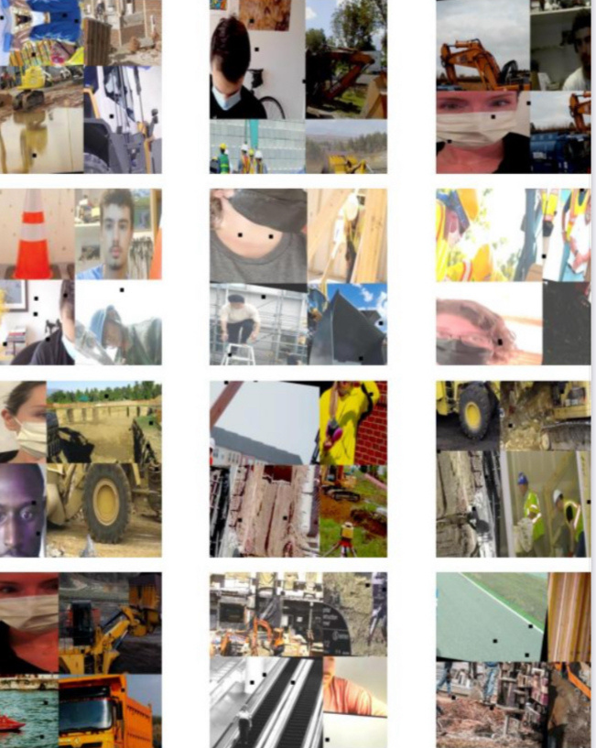
Dataset Description
This study utilized the Construction Site
Safety Dataset collected from publicly
available sources including Kaggle. The
dataset contains annotated images
representing workers and commonly
used protective equipment captured
under different environmental
conditions.
Dataset includes:
• workers
• safety helmets
• reflective safety vests
These variations helped improve model
robustness and detection capability in
realistic construction environments

Slide 7

Proposed Methodology
To achieve reliable PPE detection performance, a
structured methodology was followed consisting of
dataset preparation, preprocessing, transfer
learning–based model training, and performance
evaluation. The YOLOv8 architecture was selected
due to its strong detection accuracy and real-time
processing capability, making it suitable for
construction safety monitoring applications

Slide 8

Transfer Learning Strategy
Training deep learning models from scratch requires
large datasets and extensive computational
resources. Therefore, transfer learning was applied
in this research by fine-tuning pretrained YOLOv8
weights using the construction safety dataset. This
approach significantly reduced training time while
improving detection accuracy and model
convergence performance

Slide 9


Training Environment
Model training was performed using:
• Ultralytics YOLOv8 framework
• Google Colab environment
• pretrained YOLOv8s weights
Evaluation metrics:
Precision
mAP@50
Recall

Slide 10

Experimental Results
The trained detection model demonstrated strong performance
in identifying PPE components across validation and testing
datasets. The obtained results showed reliable object
localization capability and accurate classification performance,
confirming the effectiveness of the YOLOv8 architecture for
construction site safety monitoring applications

Slide 11

Training Performance Analysis
Analysis of training and validation loss curves indicated stable
convergence behavior throughout the training process. The absence of significant divergence between training and validation results confirmed that the model achieved good generalization capability without severe overfitting.

Slide 12
Detection Results
Visualization
The detection model successfully
identified multiple PPE components
under different environmental
conditions, including crowded scenes
and varying illumination levels.
However, minor accuracy reductions
were observed in cases involving small
object sizes or partial occlusion

Slide 13
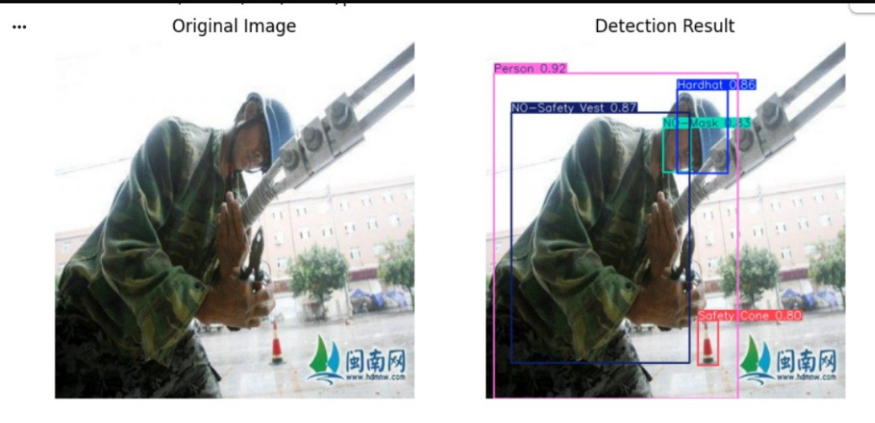

Slide 14
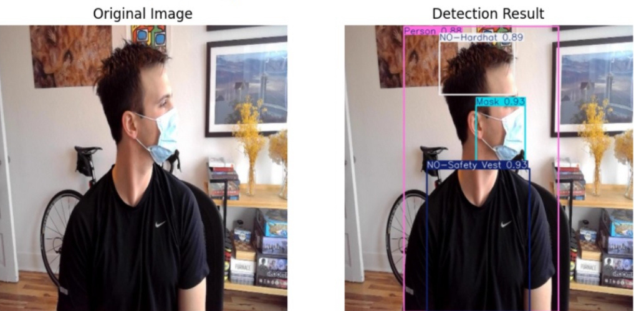

Slide 15

Conclusion and Future Work
This study demonstrated the effectiveness of the YOLOv8 object detection
architecture for automated PPE monitoring in construction site environments.
The proposed detection system achieved reliable performance in identifying
workers and safety equipment under realistic conditions and showed strong
potential for supporting intelligent workplace safety monitoring applications.
Future improvements may include:
• real-time deployment using surveillance cameras
• expanding dataset size and diversity
• detecting additional PPE components
• integration with IoT-based safety monitoring systems
• optimization for edge-device deployment

Slide 16

Expert Opinions
Eng. Mohamed Nigm (15 years), HSE Manager, highlighted that AI-based monitoring improves safety compliance and enhances work quality by reducing missed violations and supporting continuous monitoring.
Eng. Sharaf Aljabarti (9 years), HSE Manager, stated that the system improves efficiency, saves time, and enables faster response to safety violations.

