Slide 1



The Negotiation and Influencing Skills
Communication Skills
Lec.3
ENT623
College of Entrepreneurship and Innovation
Prepared by
Dr. Bothaina Mahmoud Fouad

Slide 2

Identify the concept of communication skills
Understand the principles of effective communication
Our Learning Outcomes

Slide 3
Importance of continuous learning and adaptation.
Combination of skills, mindset, and experience.
What Makes a Successful Entrepreneur/ Employee?

Slide 4
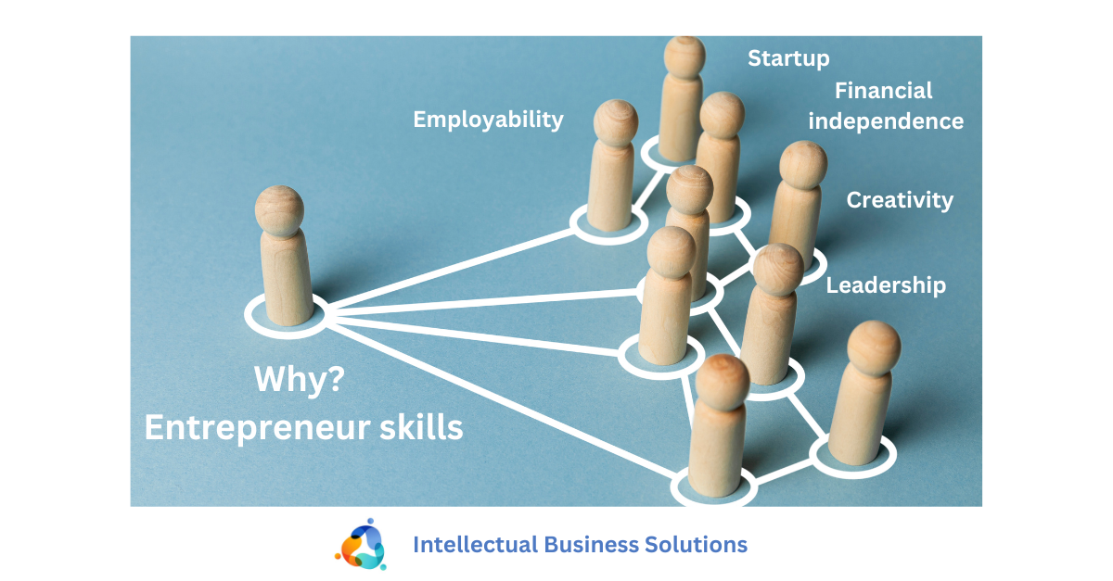
Why Entrepreneurship Skills Are Important

Slide 5
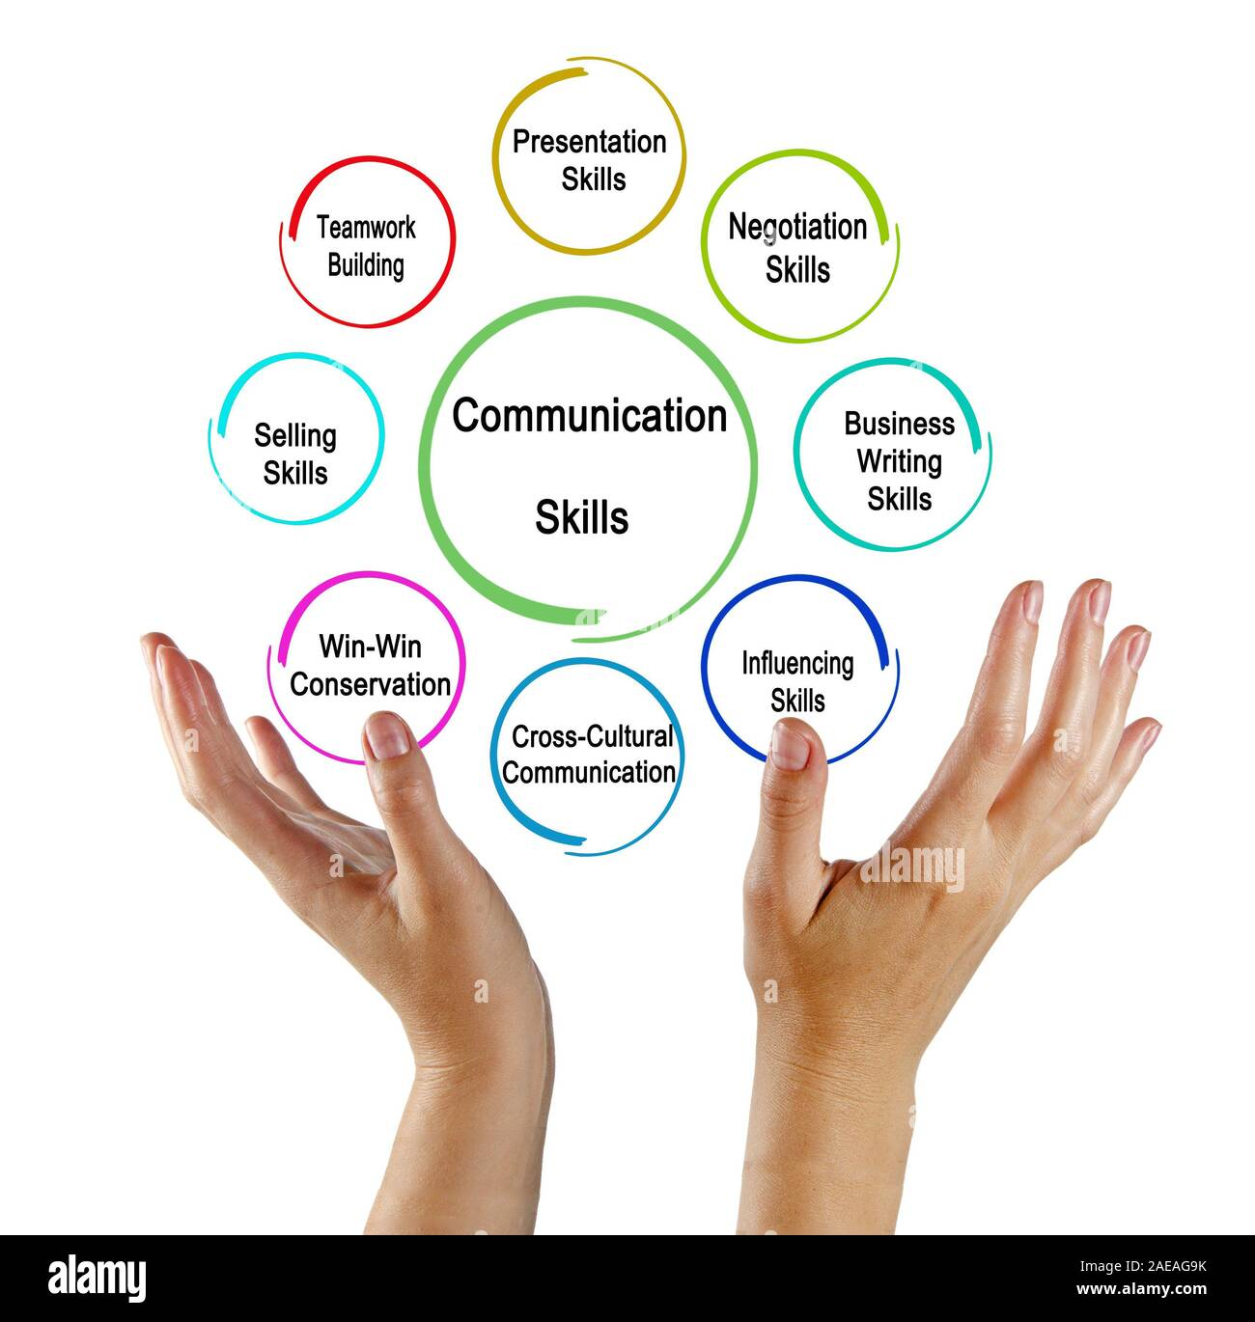
Communication
Skills

Slide 6
Communication skills =
10% words + 30% (tone +tuning) + 60% body language.

Slide 7
What is communication?
Is “an interaction between 2 or more persons that involves the exchange of information between a sender and a receiver”.
It involves the expression of emotions, ideas, and thoughts through verbal and non-verbal signals.

Slide 8
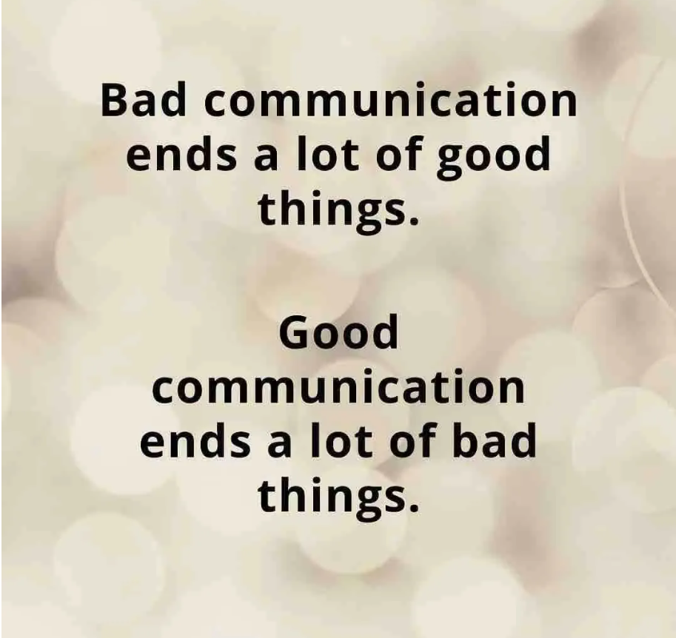
What is communication?
the ability to convey ideas clearly and effectively, both verbally and in writing. This includes active listening, presenting information persuasively, and engaging in meaningful dialogue with team members, investors, and customers.

Slide 9
What is communication? Other Definition
the process by which people exchange information or express their thoughts and feelings

Slide 10
What is communication?
In simple words we can say that ““just to convey the message”
If we go in more detail, we can say that communication is
the process of transmitting (A B) & Receiving
(B A) Messages.

Slide 11

Reason of communication
Share our ideas and opinions
Provide feedback to others
Get information from others
Gain power and influence
Develop social relationships
Maintain self-expression and our culture
other ideas you may have thought of
We communicate to:

Slide 12
What are the most common ways we communicate?
Visual Images
Spoken Word
Written Word
Body Language

Slide 13
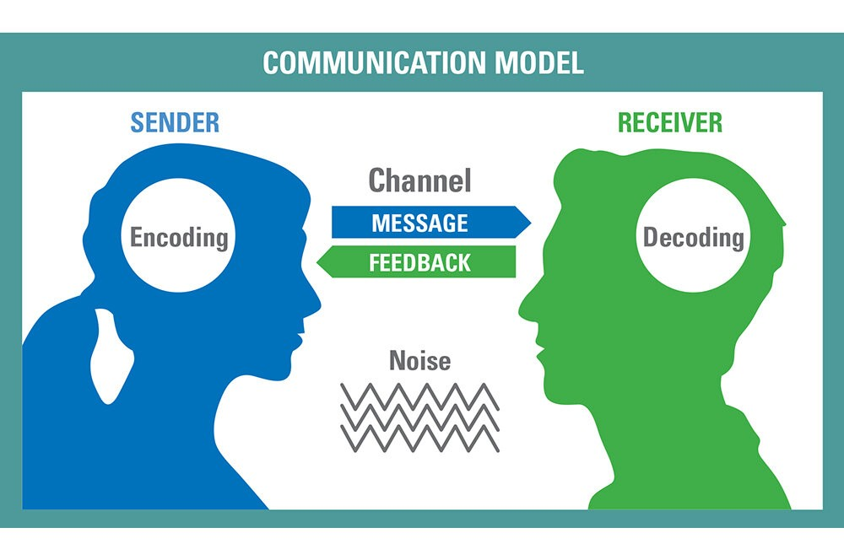
The Communication Cycle ( Process)

Slide 14
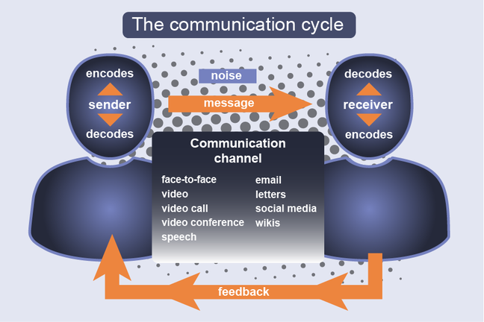
The Communication Cycle ( Process)

Slide 15
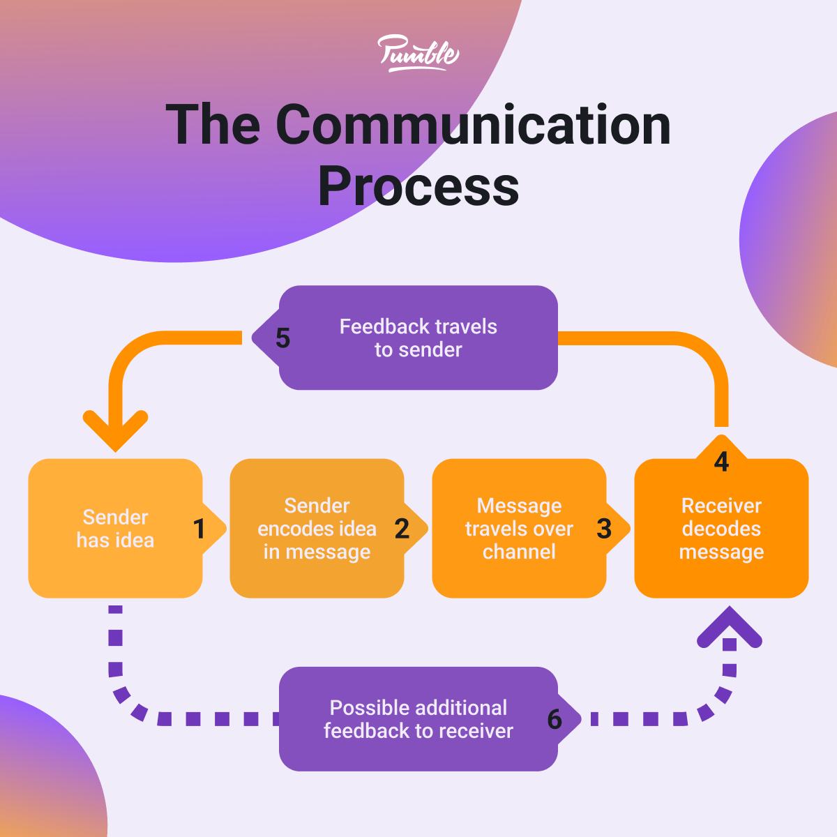
The Communication Cycle ( Process)

Slide 16
Sender (Encoder)
is the person who initiates the communication process. They are responsible for creating the message, choosing the appropriate channel, and encoding the message so that it can be understood by the receiver. Encoding refers to the process of converting a message into a form that can be transmitted through the chosen channel.
Who decides whether the message should be in written or oral. He/She may choose Words, Symbols, Pictures or Graphics that express the objective in the real sense.

Slide 17
Message
is the idea or information that is being communicated. It can be conveyed through various channels, such as verbal, nonverbal, or written. It's important that the message is clear and concise so that it can be easily understood by the receiver.
The message may be Written, Spoken, Symbols, Pictures, ……etc).
This is very much important component of communication “ Your message should be or MUST be clear and easy to understand”
The most important element in message is your receiver . You must be well aware about your receiver, you should keep in mind how your receiver will interpret the message.

Slide 18
Message,Con’t
You (Sender) should also keep in mind your relationship with the receiver while preparing message.
some times wrong message may create a loss to your organization , to yourself or it can create a bad impression for you/your company.

Slide 19
Medium ( Channel )
is the medium through which the message is transmitted. Some common channels include face-to-face communication, email, telephone, and social media. The channel chosen will depend on the situation and the message being conveyed.
E.g. some of effective medium it may be.
    T.V
    Radio
    Papers
    Or all of the above “keeping in view the Importance of the message.”
    When we talk at Micro /Organizational Level the medium may be writing or non-Verbal

Slide 20
Receiver (decoder)
To whom the message is being sent.
is the person who receives the message and decodes it. Decoding refers to the process of interpreting the encoded message so that it can be understood. The receiver is responsible for making sense of the message and responding to it in an appropriate manner.
In simple words we can say that receiver is your reader (in case of press , letters etc.) or Listener (In case of TV, radio, Speaker Etc.)

Slide 21
Feedback
feedback is the response that the receiver gives to the sender after receiving the message. It can be verbal or nonverbal, and it provides the sender with information about how the message was received and if it was understood correctly. Feedback is essential for successful communication, as it helps the sender to adjust their communication approach to better meet the needs of the receiver.
Sender always need feedback to check if the message effectively reached or not…? Or in other words….
Sender need feedback to examine the success or failure of the message.

Slide 22
Noise
is any interference that can distort the message as it's being transmitted. This can include physical noise such as background noise, or semantic noise, which is when the receiver misunderstands the message due to cultural differences or conflicting opinions.

Slide 23
Personal Communication skills, including
  Verbal/Non-verbal communication
  Active listening
  Assertive, not aggressive الحزم وليس العنف والحدة
  Giving and receiving feedback
  Written communication

Slide 24
Verbal Communication
having good communication skills is all about the ability to
Verbal Communication = Speaking + Listening
Non-verbal Communication
Your appearance
Your body language
The tone and the pace of your voice
Eye Contact

Slide 25
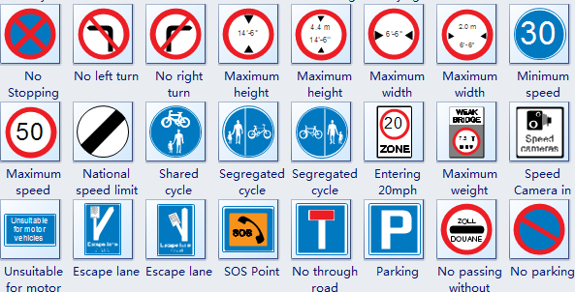
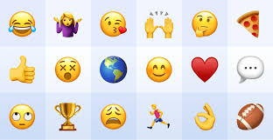
Non-verbal Communication, can include also
Symbols
pictures

Slide 26
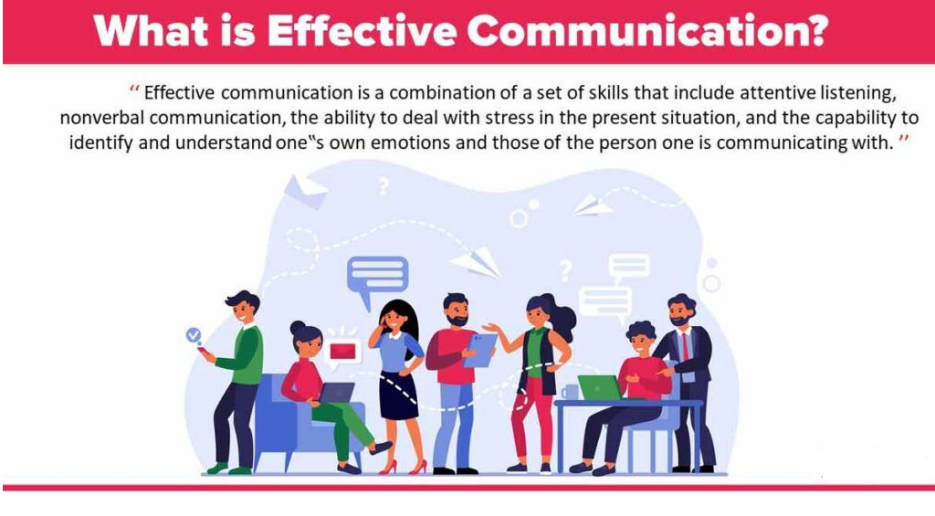
Effective communication definition
is a process of exchanging ideas, thoughts, knowledge and information such that the purpose or intention is fulfilled in the best possible manner.
In simple words, it is nothing but the presentation of views by the sender in a way best understood by the receiver.

Slide 27
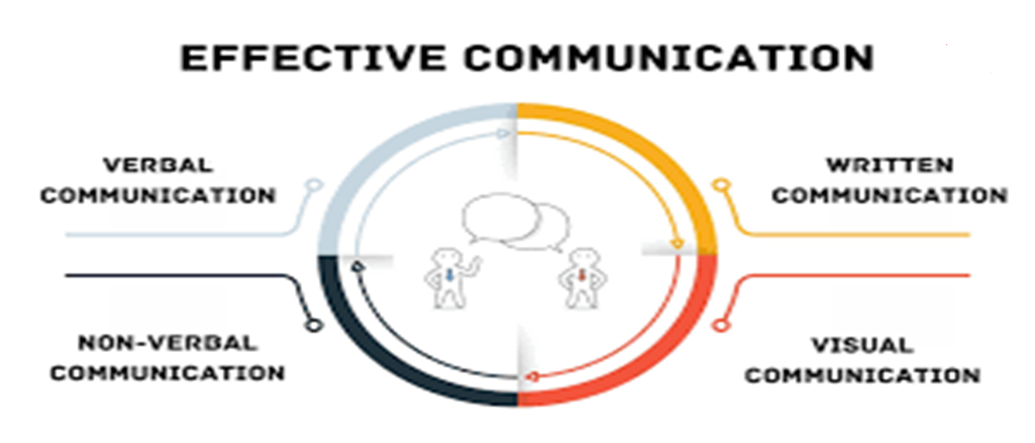
The components of Effective Communication

Slide 28

Characteristics of Effective Communication
the 7 C’s
Clear
Concrete
Concise
Courtesy
Coherent
Complete
Comprehension

Slide 29
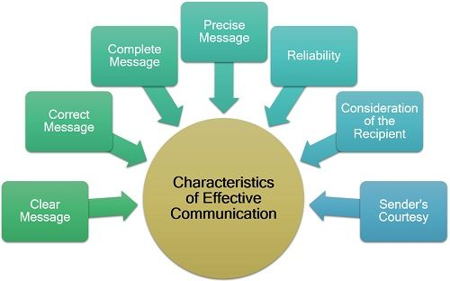
Characteristics of Effective Communication
the 7 C’s

Slide 30
the 7 C’s meaning
Clear
main ideas easily identified and understood
Concise
gets to the point without using unneeded words or images
Concrete
includes specific examples or explanations
polite, professional tone
Coherent
information presented in a logical sequence
Courteous
enough information so the audience can understand
Complete
in information, word choice, and grammar
Correct ( Comprehension)

Slide 31
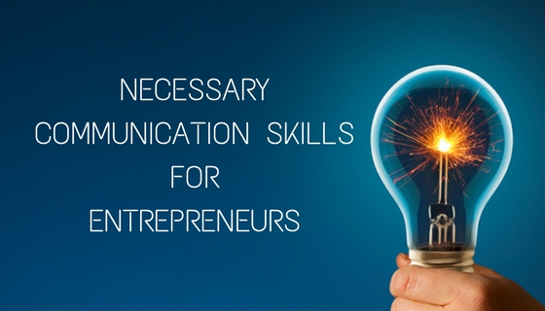
Necessary Communication Skills for Entrepreneurs
Strong and effective communication skills enable entrepreneurs to:
build relationships,
negotiate successfully,
inspire others,
ultimately fostering collaboration and driving business success,
is essential for articulating a vision, providing feedback,
resolving conflicts.

Slide 32
To achieve an effective communication
Encourage creative and Critical Thinking
Consider Audience's Cultural Background
Consider audience’s information needs
Consider Audience's Knowledge of the Subject

Slide 33
Which are Important points to improve communication skills?
1
Confidence
Logical presentation
6
Local language
2
Enthusiasm
7
3
Clear objective / Aim
Effective end
8
4
Self prepared script & Subject matter
Time limit
9
5
Effective start
10
Speed and Clear Voice

Slide 34
BARRIERS TO COMMUNICATION
factors affect on communication
1
Wrong or poor choice of Medium
Socio-psychological Barriers
6
  Poor written or oral expression.
  Failure to recognize nonverbal signals.
2
7
3
Filtering
Physical Distractions
8
4
Selective perception
Lack of feedback
9
5
Information overload
10
Language barrier
https://www.slideshare.net/effectivecommunication/cs-final-ppt-11938630

Slide 35
HOW TO OVERCOME BARRIERS ?
01
Have a Positive attitude about Communication.
04
Make Communication goal Oriented.
Use very simple & familiar words during communication.
Approach Communication as a creative process
02
05
Help other people improve their communication skills by helping them understand their communication problem.
accept the reality of miscommunication and work to minimize its negative impacts.
06
03
https://www.slideshare.net/effectivecommunication/cs-final-ppt-11938630

Slide 36
Case Study No. 1 to Discuss
The promising chemist who buried his results
Bruce, a research chemist for a major petro-chemical company, wrote a dense report about some new compounds he had synthesized in the laboratory from oil-refining by-products.
The bulk of the report consisted of tables listing their chemical and physical properties, diagrams of their molecular structure, chemical formulas and data from toxicity tests.
Buried at the end of the report was a casual speculation that one of the compounds might be a particularly safe and effective insecticide.
https://pressbooks.bccampus.ca/technicalwriting/chapter/casestudy-costpoorcommunication/

Slide 37
Case Study No. 1 to Discuss, Con’t
Seven years later, the same oil company launched a major research program to find more effective but environmentally safe insecticides. After six months of research, someone uncovered Bruce’s report and his toxicity tests.
A few hours of further testing confirmed that one of Bruce’s compounds was the safe, economical insecticide they had been looking for.
Bruce had since left the company, because he felt that the importance of his research was not being appreciated.
https://pressbooks.bccampus.ca/technicalwriting/chapter/casestudy-costpoorcommunication/

Slide 38
Case Study No. 2 to Discuss
The rejected current regulator proposal
The Acme Electric Company worked day and night to develop a new current regulator designed to cut the electric power consumption in aluminum plants by 35%. They knew that, although the competition was fierce, their regulator could be produced more affordably, was more reliable, and worked more efficiently than the competitors’ products.
The owner, eager to capture the market, personally but somewhat hastily put together a 120-page proposal to the three major aluminum manufacturers, recommending that the new Acme regulators be installed at all company plants.
https://pressbooks.bccampus.ca/technicalwriting/chapter/casestudy-costpoorcommunication/

Slide 39
Case Study No. 2 to Discuss, Con’t
It devoted the first 87 pages of the proposal to the mathematical theory and engineering design behind his new regulator, and the next 32 to descriptions of the new assembly line she planned to set up to produce regulators quickly. Buried in an appendix were the test results that compared her regulator’s performance with present models, and a poorly drawn graph showed the potential cost savings over 3 years.
The proposals did not receive any response. Acme Electric didn’t get the contracts, despite having the best product. Six months later, the company filed for bankruptcy.
https://pressbooks.bccampus.ca/technicalwriting/chapter/casestudy-costpoorcommunication/

Slide 40
Communication skills in negotiation
means by which negotiators can achieve objectives, build relationships, and resolve disputes.
Communication skills serve as the linchpin ( محور ) for success in any negotiation scenario. Consider a situation where two parties are working out a business contract.

Slide 41
Reasons of using Communication Skills in Negotiation
Negotiators communicate to clarify their preferences, viewpoints and perspectives, to exchange information and to persuade the other party of their ideas and convictions.
For these reasons, the ability to communicate has been considered as a critical skill in a negotiator

Slide 42
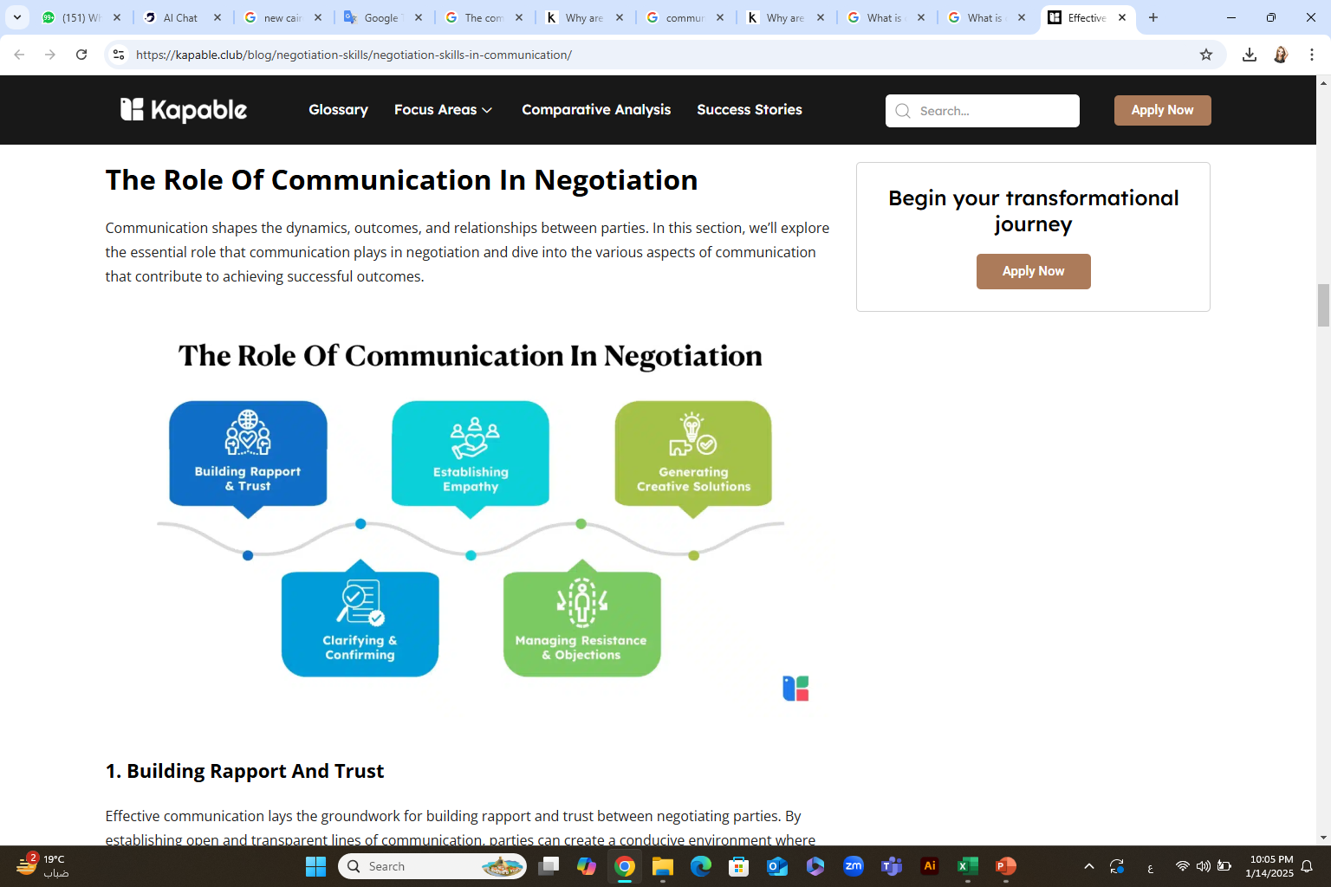
The Role of Communication Skills in Negotiation
The Communication skills help to understand the Power of Patience, Persistence & Perseverance in Negotiation

Slide 43
Patience is especially important in several ways:
Provides More Information: Patience allows you to gather crucial information over time, enabling a comprehensive understanding of the issues at hand. When you patiently listen and observe the other party, you can uncover hidden motivations, preferences, and constraints that may influence your communication and negotiation strategies.
Discovery of Needs and Wants: Rushing through negotiations can overlook the underlying needs and wants of the other party. Patience allows negotiators to go beneath the surface and tap into those core interests driving their counterparts' positions. This deeper understanding paves the way for creative solutions that address everyone's priorities.
Uncovers Challenges: Patience allows underlying issues to present themselves so that negotiators can prevent minor grievances from festering into a major negotiation impasse. This proactive approach ensures that potential problems are addressed swiftly and constructively.

Slide 44
Patience is especially important in several ways:
Manages the Other Party’s Expectations: Through patient and deliberate communication in negotiation, you can manage expectations effectively. Demonstrating a willingness to engage thoughtfully and consider alternative perspectives can temper unrealistic demands and build a more realistic framework for negotiation.
Leads to Concessions: Patience can be a powerful tool for eliciting concessions from the other party. By maintaining a calm and composed demeanor, negotiators create an environment where compromise is seen as a reasonable and necessary step toward mutual agreement.
Realistic Assessments: In the heat of negotiation, impatience can cloud judgment and lead to unrealistic assessments of the situation. Patience allows you to step back, reassess your position, and evaluate the feasibility of potential outcomes more objectively. This lays the groundwork for informed decision-making and effective communication in negotiation.

Slide 45
A negotiator who has a mastery of communication and negotiation can better articulate their terms persuasively, understand the other party's concerns, and navigate towards a long-term agreement.
Successful negotiators know that communication is the most important tool you can have for successful negotiations
Because

Slide 46
Negotiation is primarily a complex process of verbal and non-verbal interaction
Communication is an essential tool in order to exchange messages between negotiators
Communication is only partly responsible for the negotiation outcomes

Slide 47

If a negotiator does not communicate, the relationship with the negotiation partner will break down.

Slide 48
What is communicated during the negotiation
Offers, counteroffers and motives
Information about alternatives
Information about outcomes
Social accounts
    Explanations of mitigating circumstances
    Explanations of exonerating circumstances
    Refarming explanations
David Saunders and others, Essentials of Negotiations

Slide 49
Communicator as a Negotiator
Clear Presentation
Presentation according to the listener needs’
Credibility has to be established
Evidence to support one’s argument
Emotions expressed must be genuine

Slide 50
Top Communication Strategies Crucial to Negotiating Effectively
Here are some essential strategies that can empower you to negotiate with confidence and achieve mutually beneficial outcomes:
Listen Actively: is key to successful communication in negotiation because it allows you to understand and respond to the other party's priorities and concerns in a meaningful way. For example, imagine you're negotiating a business partnership. Actively listening to your potential partner's concerns about timelines and deliverables not only demonstrates respect and empathy but also provides crucial insights into their operational constraints and objectives.
2. Use Collaborative Language: The words you choose can significantly impact negotiation outcomes. If you're negotiating a project scope with a client, using phrases like "Let's explore how we can meet both our objectives" fosters a sense of cooperation and shared goals.
3. Open and Honest Communication: Transparency is a crucial element of communication and negotiation strategies. Clearly expressing your interests, concerns, and expectations while being receptive to the other party's input builds trust and credibility. In salary negotiations, openly discussing your achievements and market research demonstrates integrity and may lead to a fairer offer.

Slide 51
Top Communication Strategies Crucial to Negotiating Effectively
4. Assertiveness: strikes a balance between being passive and aggressive. Clearly and confidently stating your needs without being confrontational is essential. Imagine you're in negotiations with a new supplier, assertively communicating your quality standards and delivery requirements ensures mutual understanding and a satisfactory agreement for all involved.
5. Use Nonverbal Communication: Nonverbal cues can complement verbal communication in negotiation. Mirroring your counterpart's body language and using appropriate facial expressions can establish rapport and convey empathy. For instance, in a real estate negotiation, nodding and maintaining eye contact can signal understanding and trust, fostering a positive atmosphere for reaching an agreement.
6. Know your purpose for the conversation. On what are you willing to negotiate? What are your critical points and your non-negotiables?
Ex. When you need your audience to be an advocate for you, appeal to his/her specific personality types, respect her needs, answer her expectations, and remember to be specific about the purpose of your meeting.

Slide 52
Know your audience. People generally fall into four categories of business personality: the driver, the amiable, the analytic, or the expressive.
Driver types
are straight and to the point, very focused on business and not interested in your personal life.
Amiable types
care strongly about relationships and they go into business with people they like. They want to get to know you and want you to make them feel comfortable with the business opportunity. It usually takes them awhile to make decisions because you have to talk them through each of the steps – they like to take everyone’s opinion into consideration before making a decision.
Analytic types
need a spreadsheet. They like to see the numbers and will know if it works for their company or not based solely on the spreadsheet. They are usually a bit more reserved and do not like to have large amount of conversation.
Expressive types
are similar to drivers, but have a stronger focus on relationships. They will make the best decision for their company in a timely manner, but want to get to know you, too
They want to see profit and success and will need for you to explicitly state how your partnership will help them be successful.

Slide 53
Top Communication Strategies Crucial to Negotiating Effectively
7. Focus on how you deliver your messages. What body language should you be using with your audience? What facial expressions? Do you look and sound likeable, believable, and interesting in your presentation?
Ex. Your smile is our biggest sign that you believe what you’re saying. Use inflection to make meaningful words stick.
8. Mirror your audience’s speed of speech and tone. If he/she is serious, you should be serious. If he/she is talking fast, then you should talk fast. This “mirroring and watching” makes negotiations stronger, shows your respect for him or her, and keeps you at equal business stature.

Slide 54
Top Communication Strategies Crucial to Negotiating Effectively
9. Listen to their “REALLY” emotions: really happy, really excited, or really mad. What words are they using and what senses do they appeal to? Visual, auditory, or kinesthetic? Stay on that same “sensory mode” during that topic. This improves your bonding and rapport while showing respect.
In using this technique, you relate to them and their point of view, what they are seeing, feeling, and hearing. You listen better, and can address the problem in a constructive way that lets them know that you understand why they are feeling that way and that their feelings are valid.
10. Practice saying your content out loud before the meeting. This should include your purpose statement, your opening, and you're closing. Saying it out loud may prompt you to polish and clarify your first key message.
11. Create suspense in relaying the details and why they are important. Suspense in public speaking goes deeper into the emotion centers of our brains. It creates impact and is powerful.

Slide 55



Thank You

