Slide 1


Slide 2


Slide 3
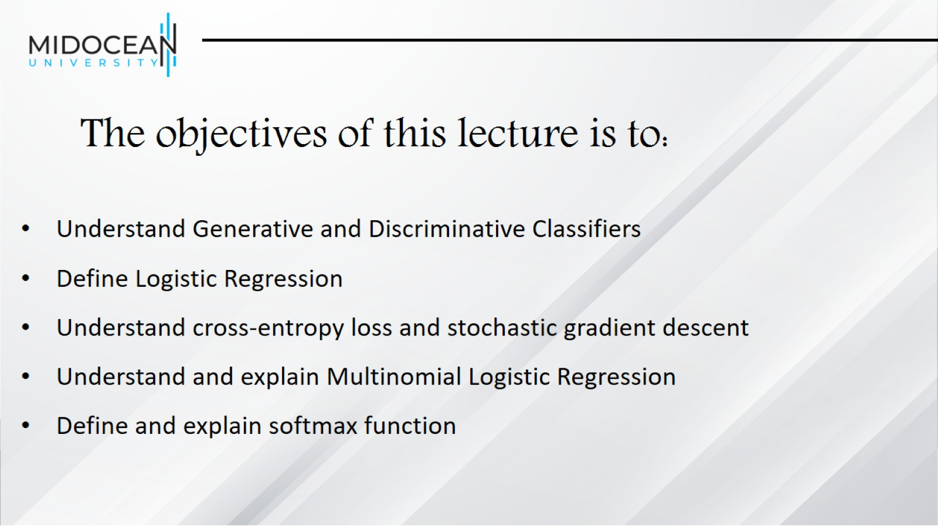
The objectives of this lecture is to:

Slide 4
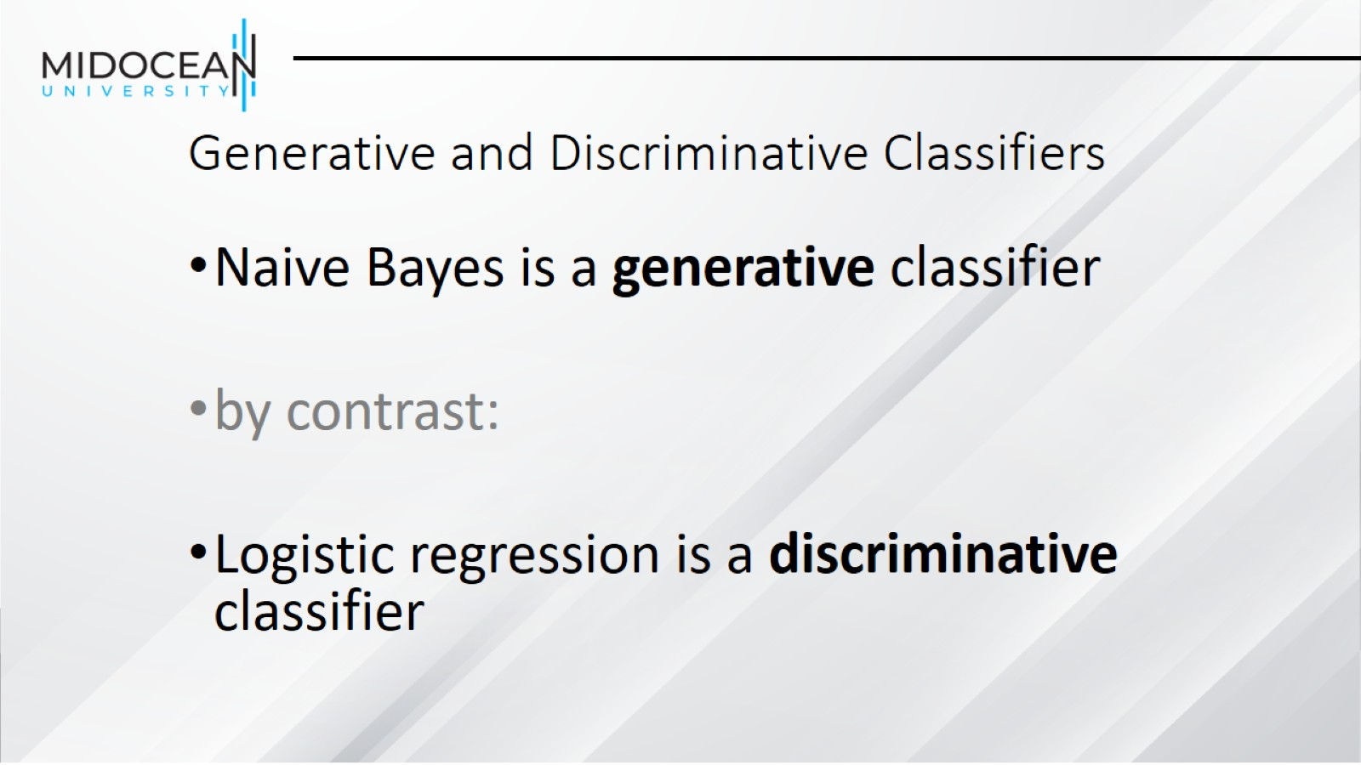
Generative and Discriminative Classifiers

Slide 5
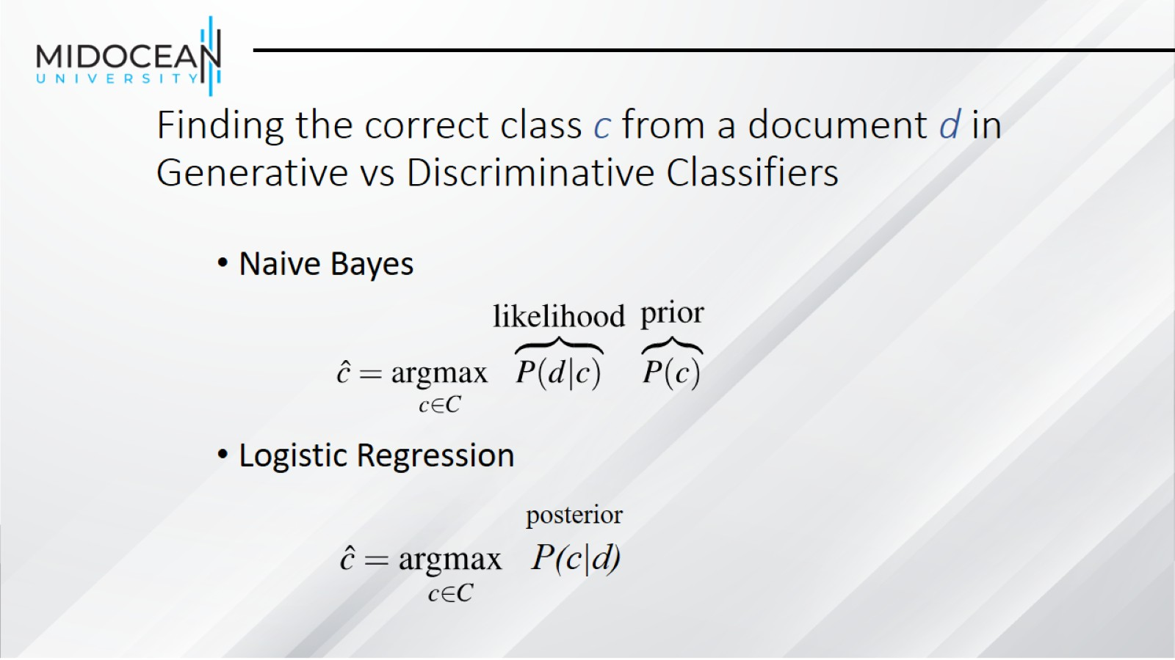
Finding the correct class c from a document d in
Generative vs Discriminative Classifiers

Slide 6
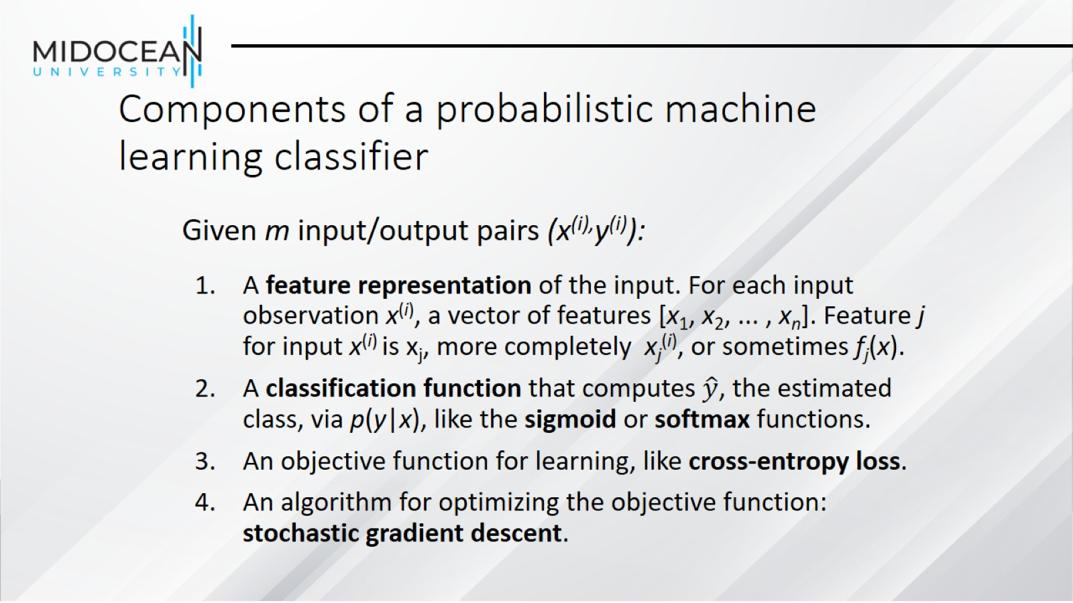
Components of a probabilistic machine learning classifier

Slide 7
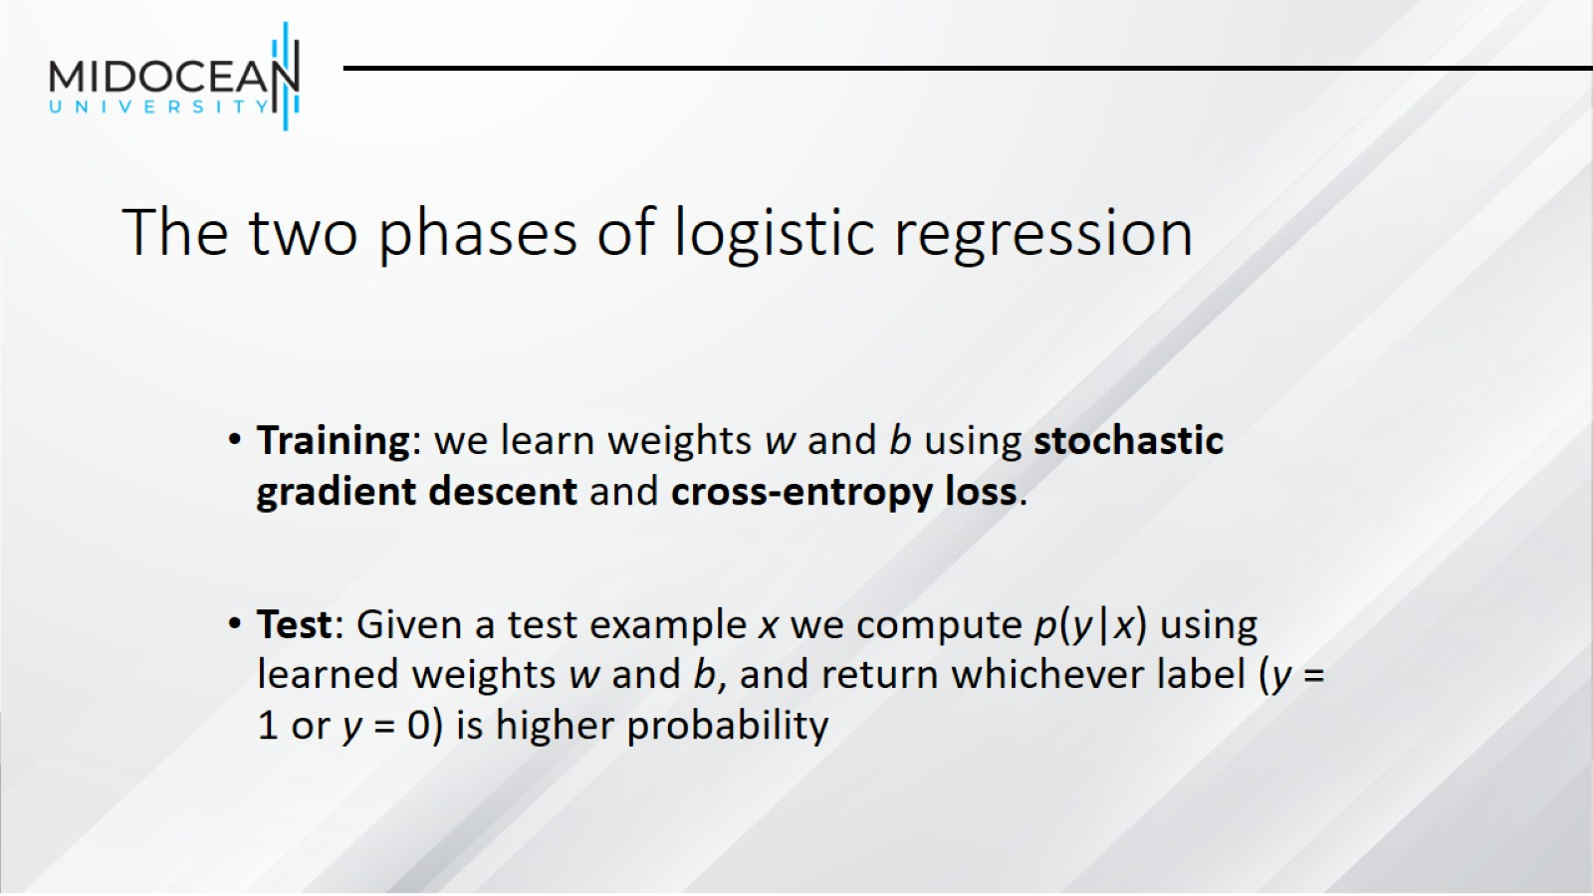
The two phases of logistic regression

Slide 8
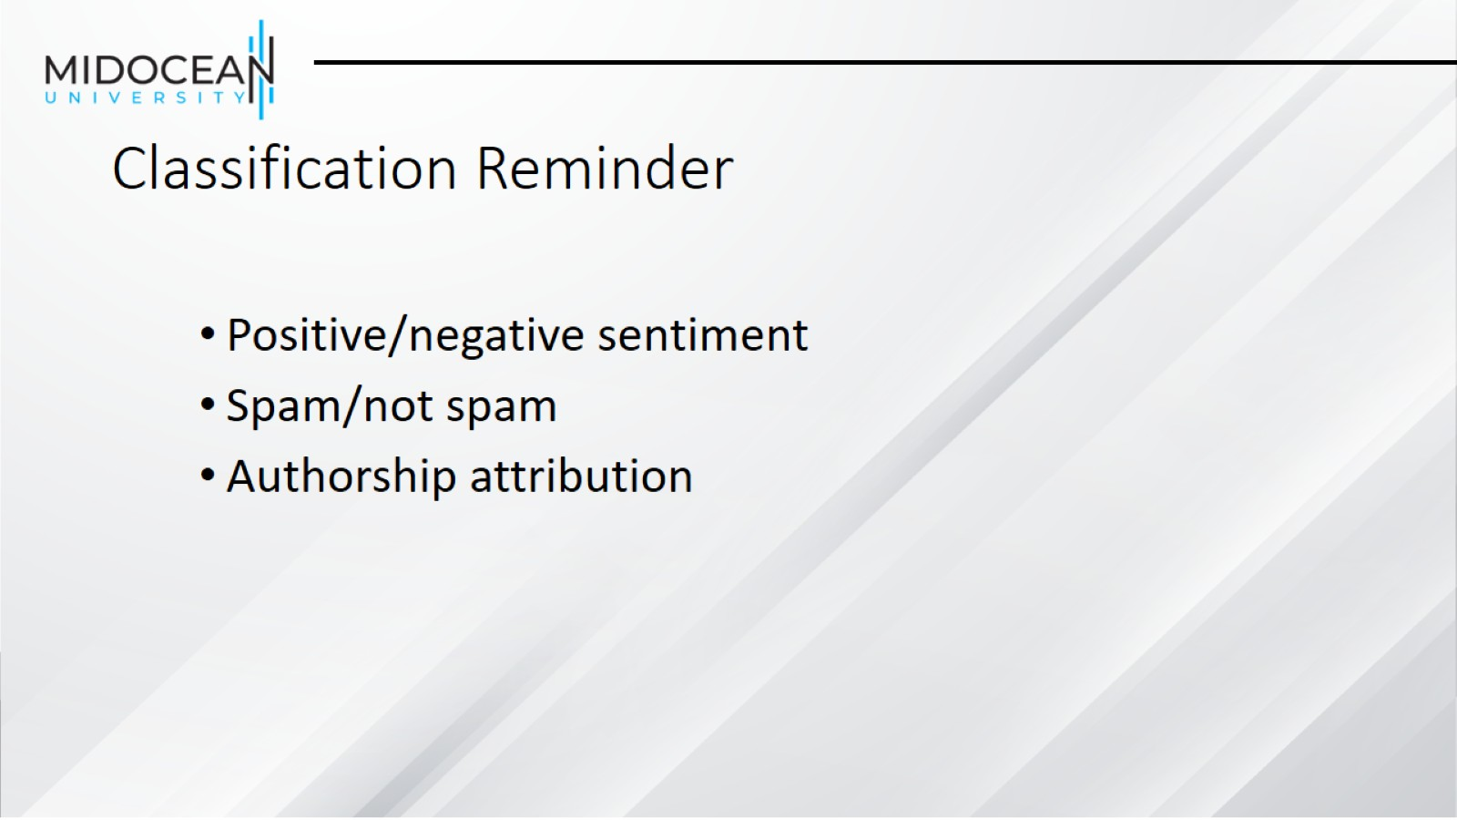
Classification Reminder

Slide 9
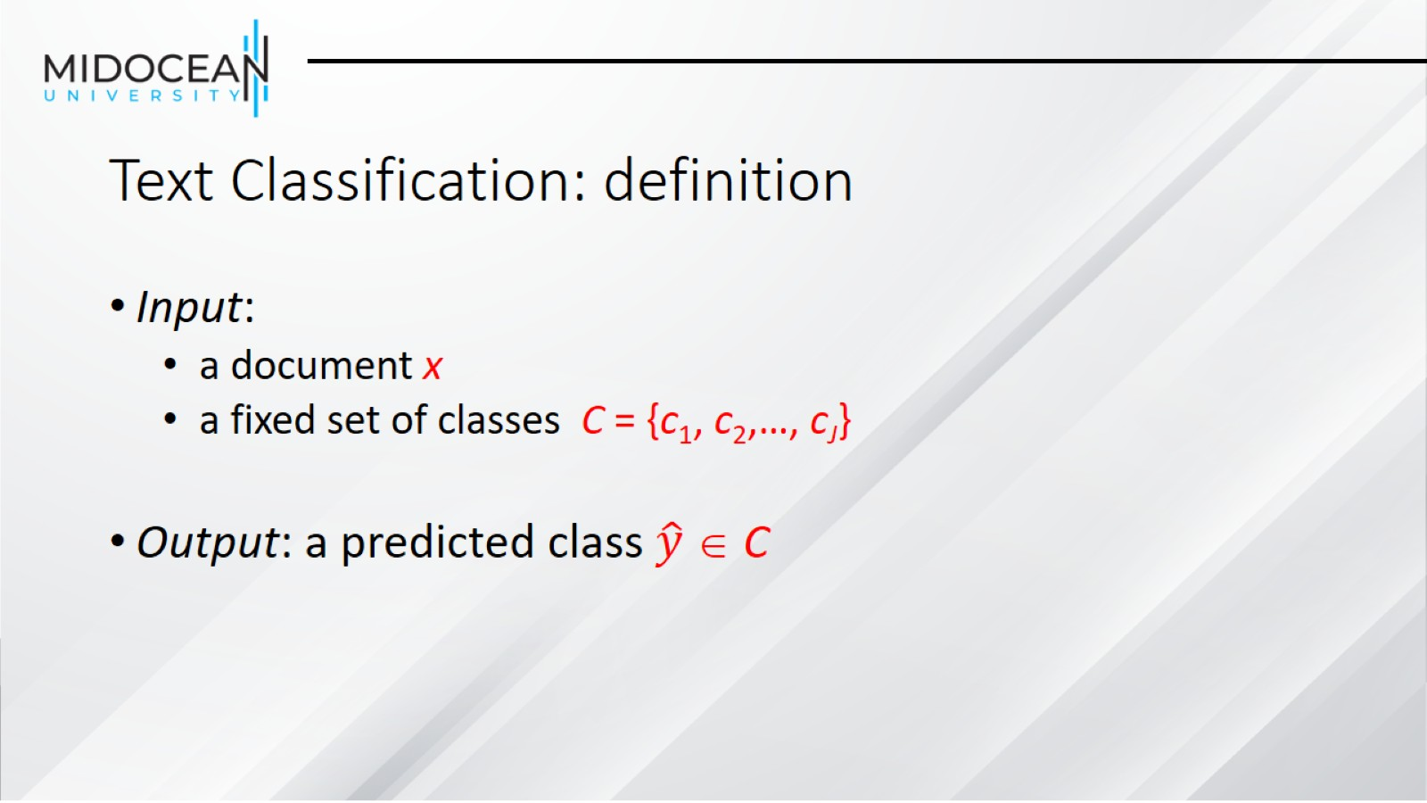
Text Classification: definition

Slide 10
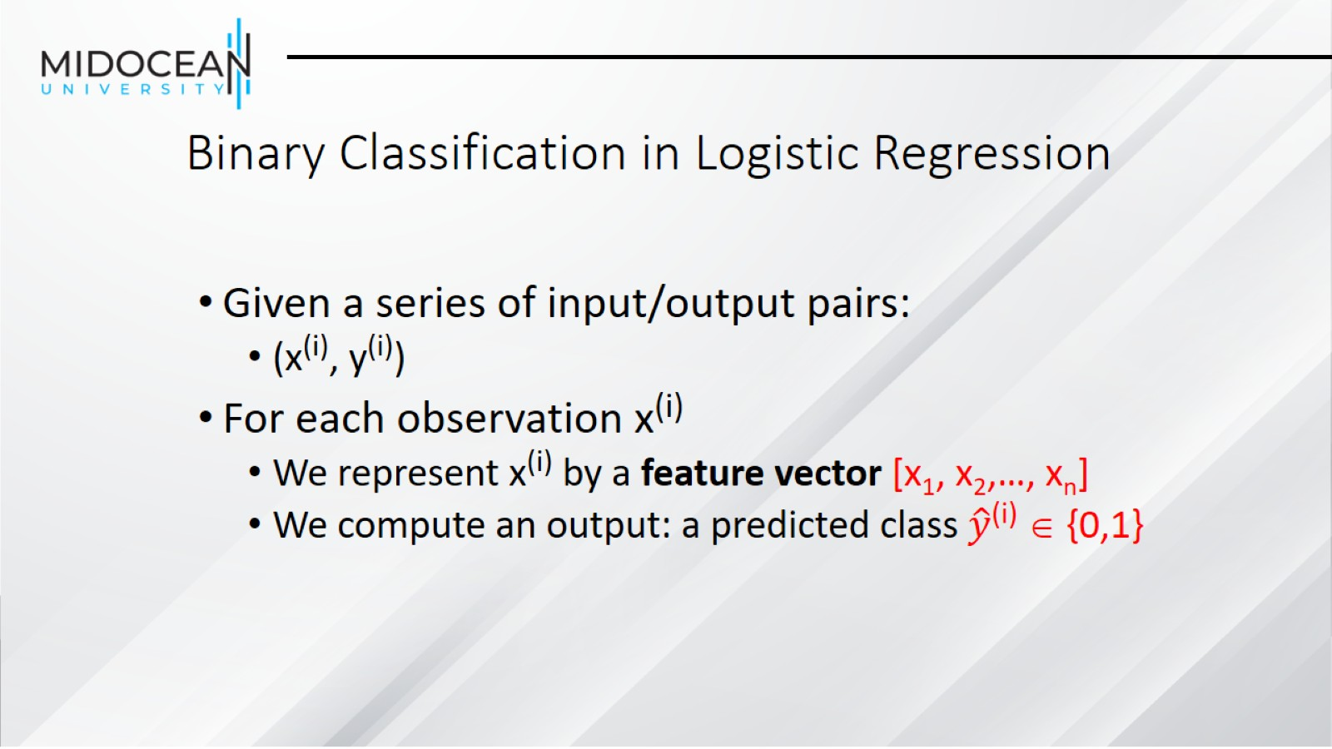
Binary Classification in Logistic Regression

Slide 11
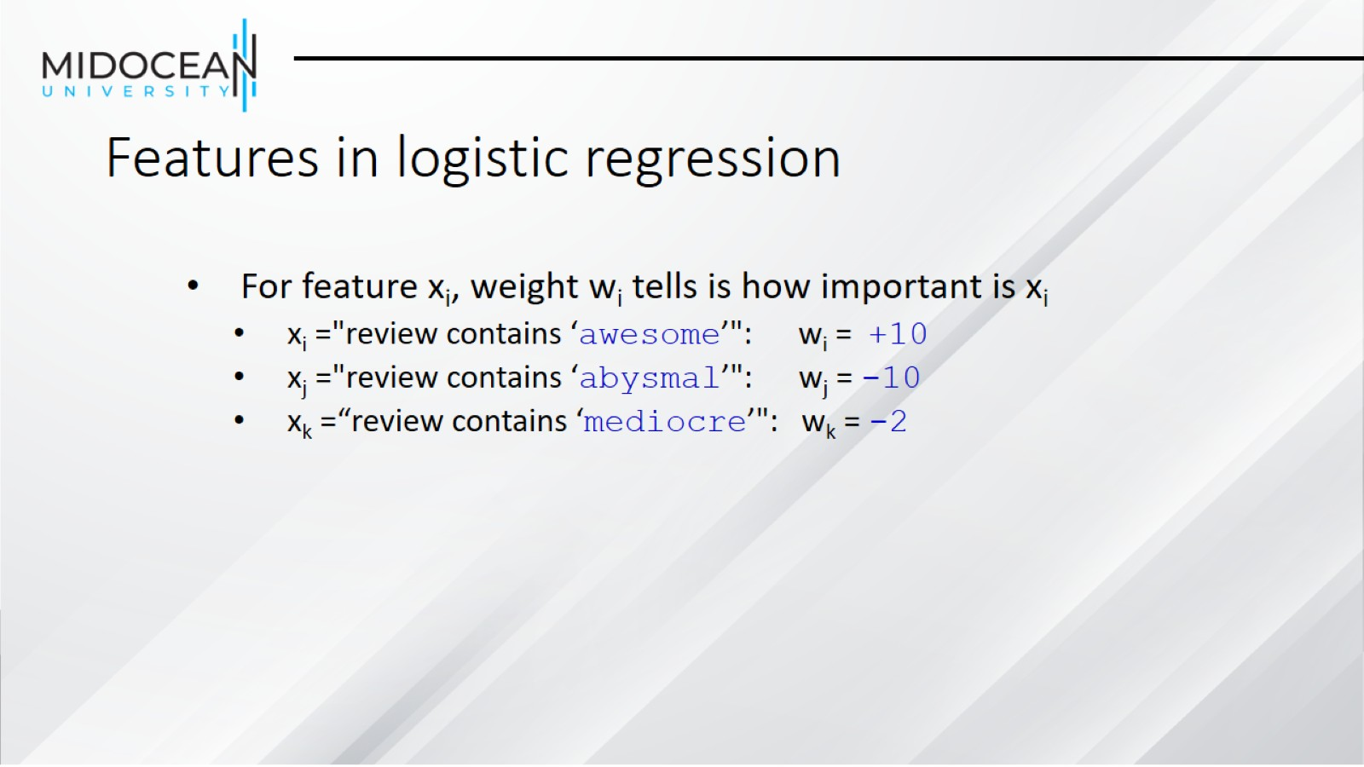
Features in logistic regression

Slide 12
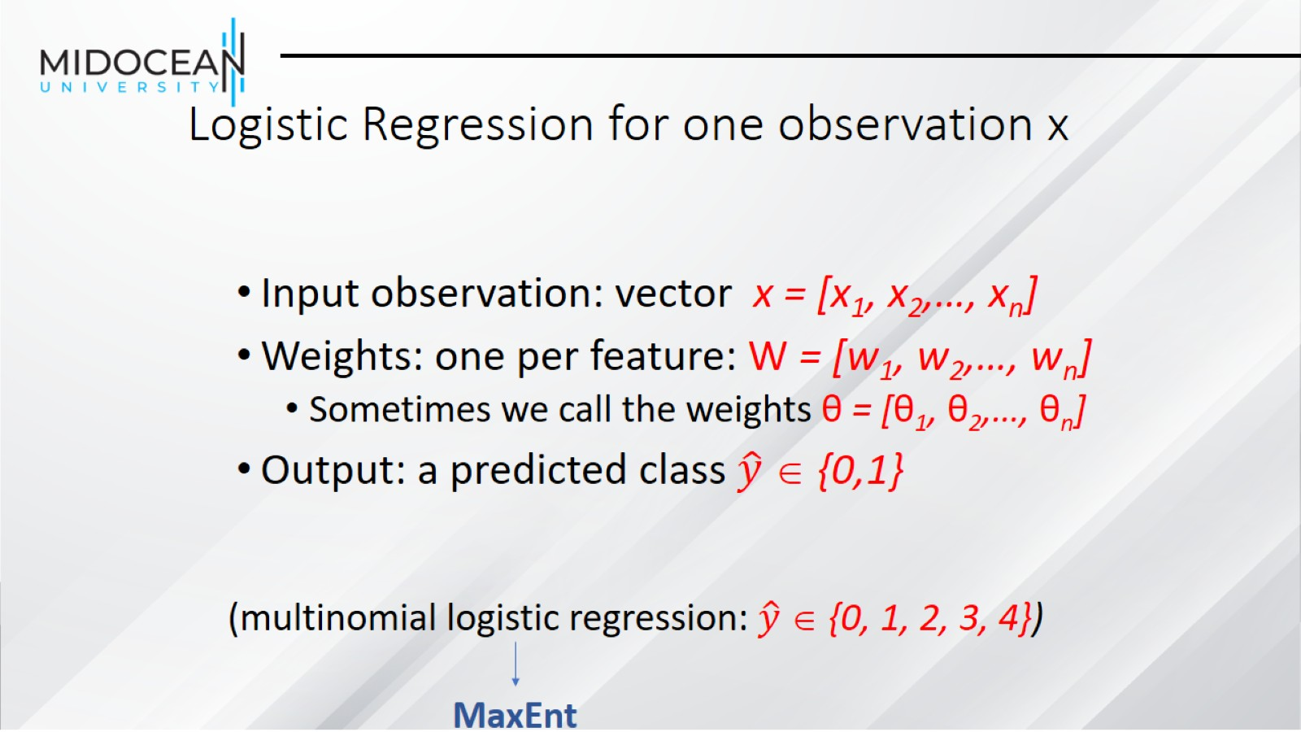
Logistic Regression for one observation x

Slide 13
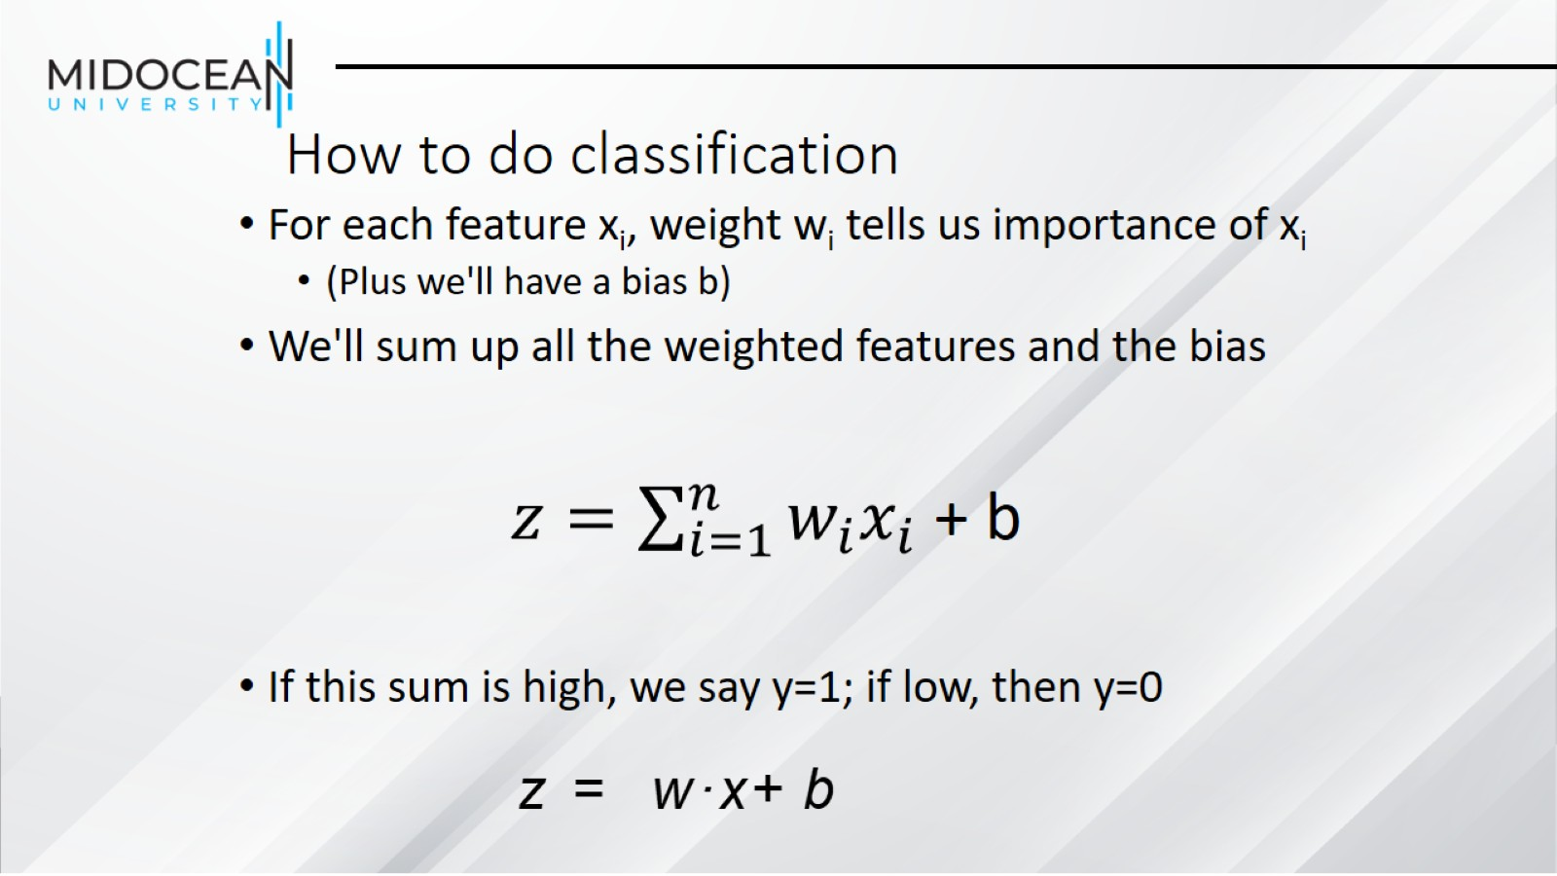
How to do classification

Slide 14
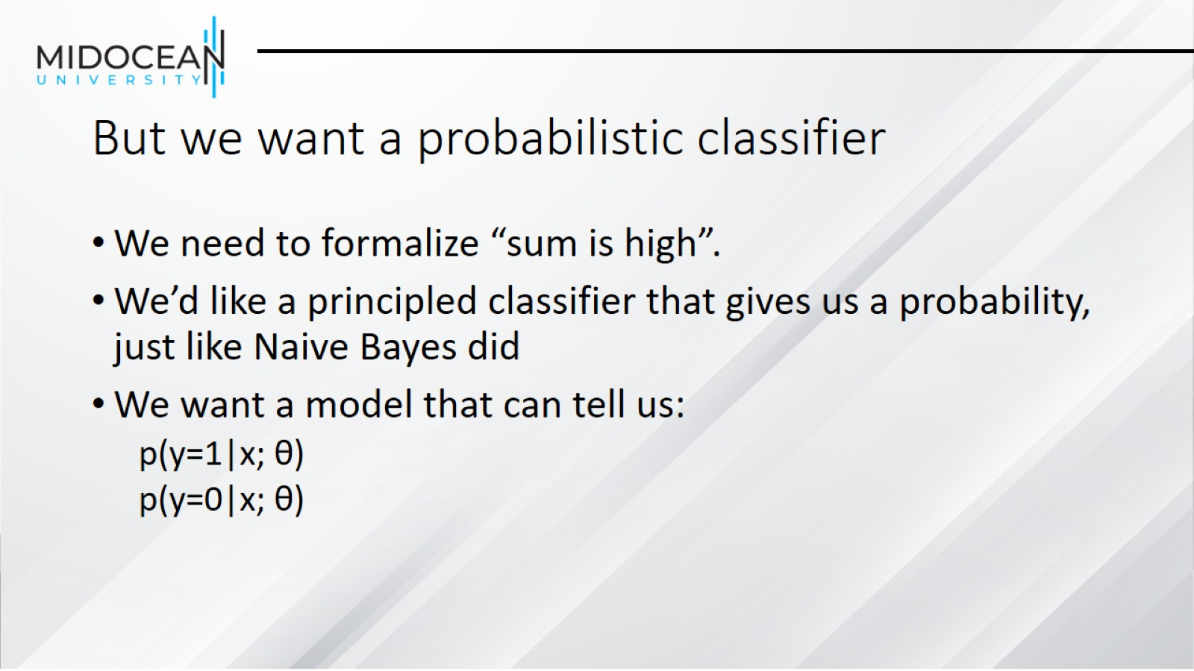
But we want a probabilistic classifier

Slide 15
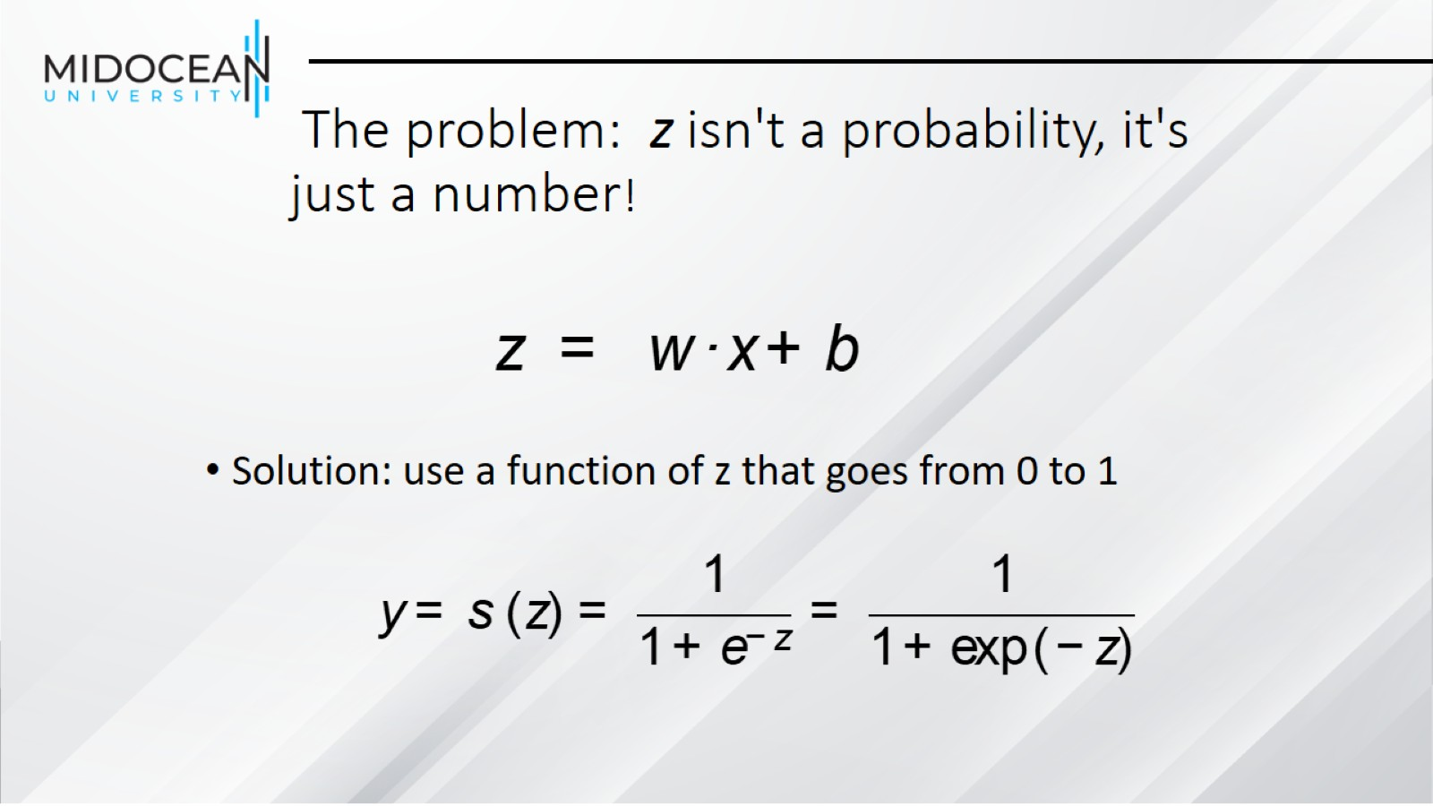
The problem: z isn't a probability, it's just a number!

Slide 16
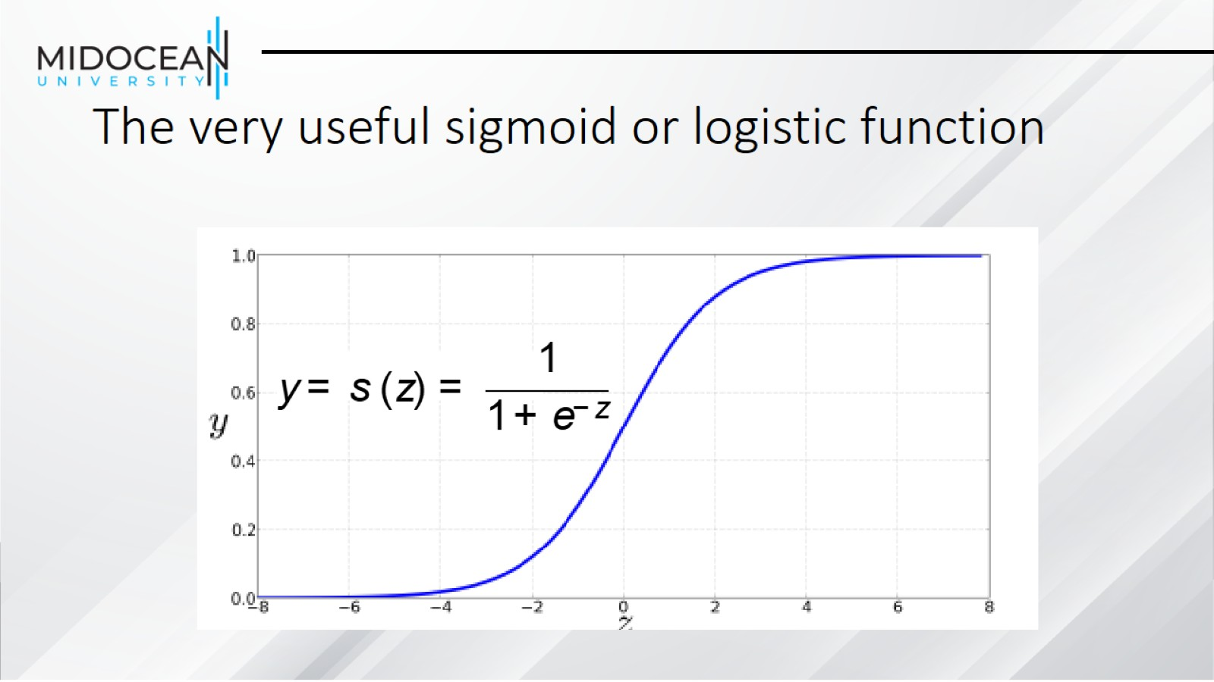
The very useful sigmoid or logistic function

Slide 17
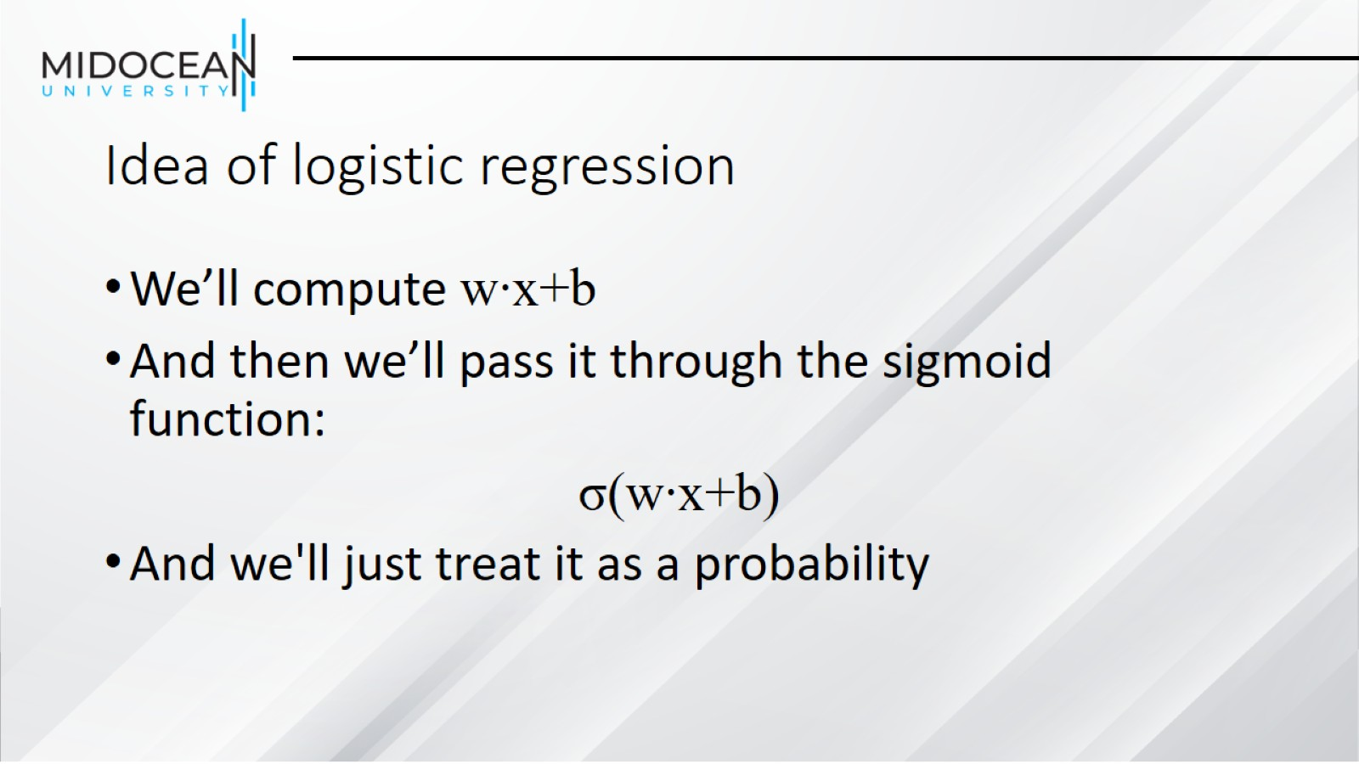
Idea of logistic regression

Slide 18
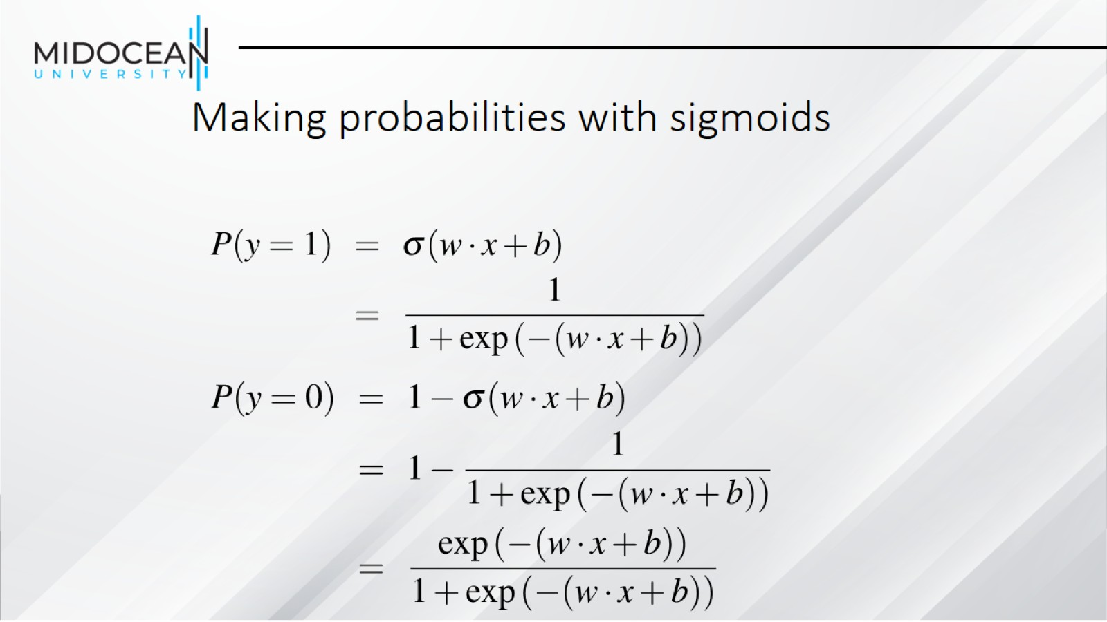
Making probabilities with sigmoids

Slide 19
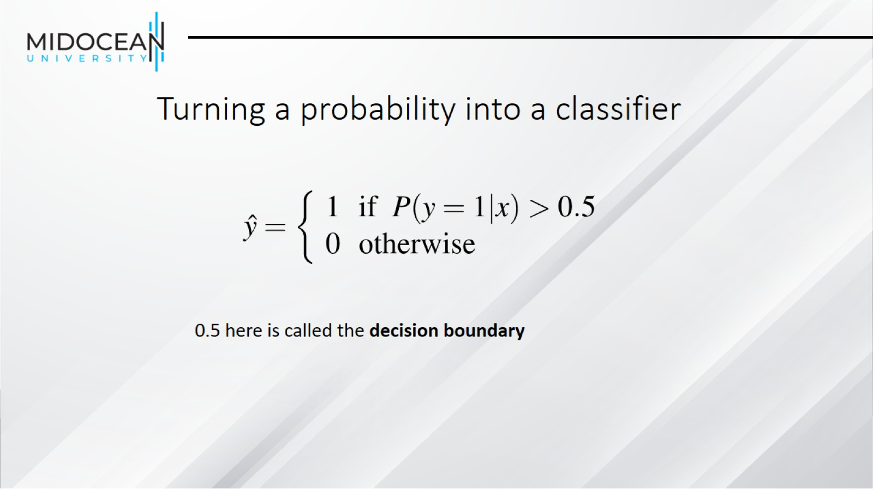
Turning a probability into a classifier

Slide 20
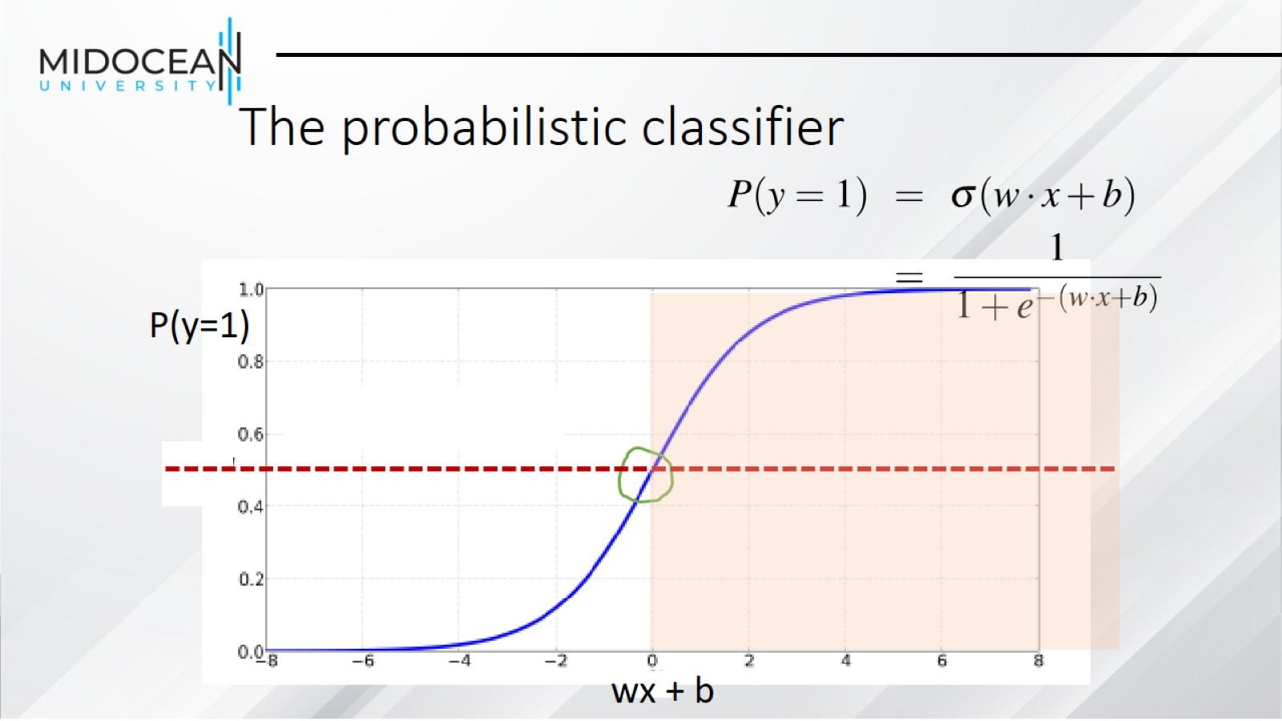
The probabilistic classifier

Slide 21
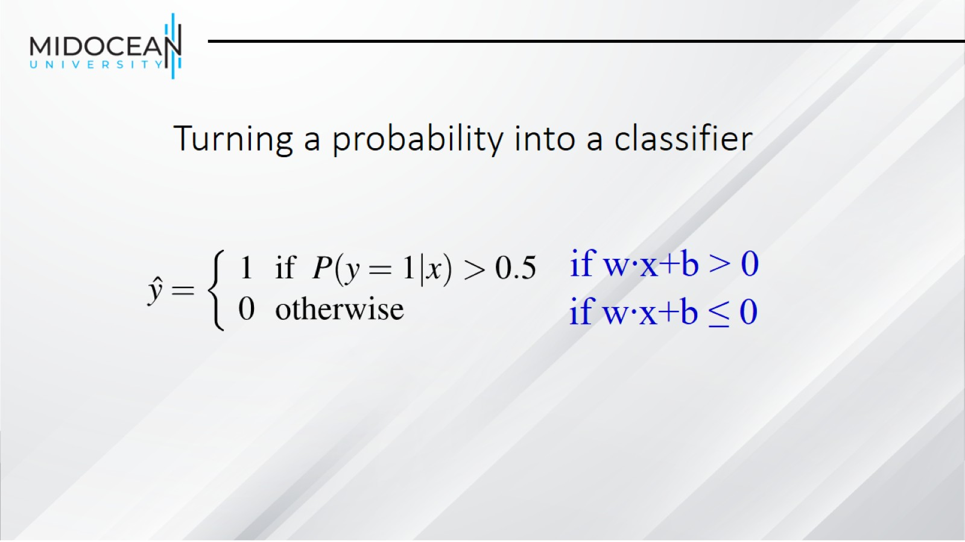
Turning a probability into a classifier

Slide 22
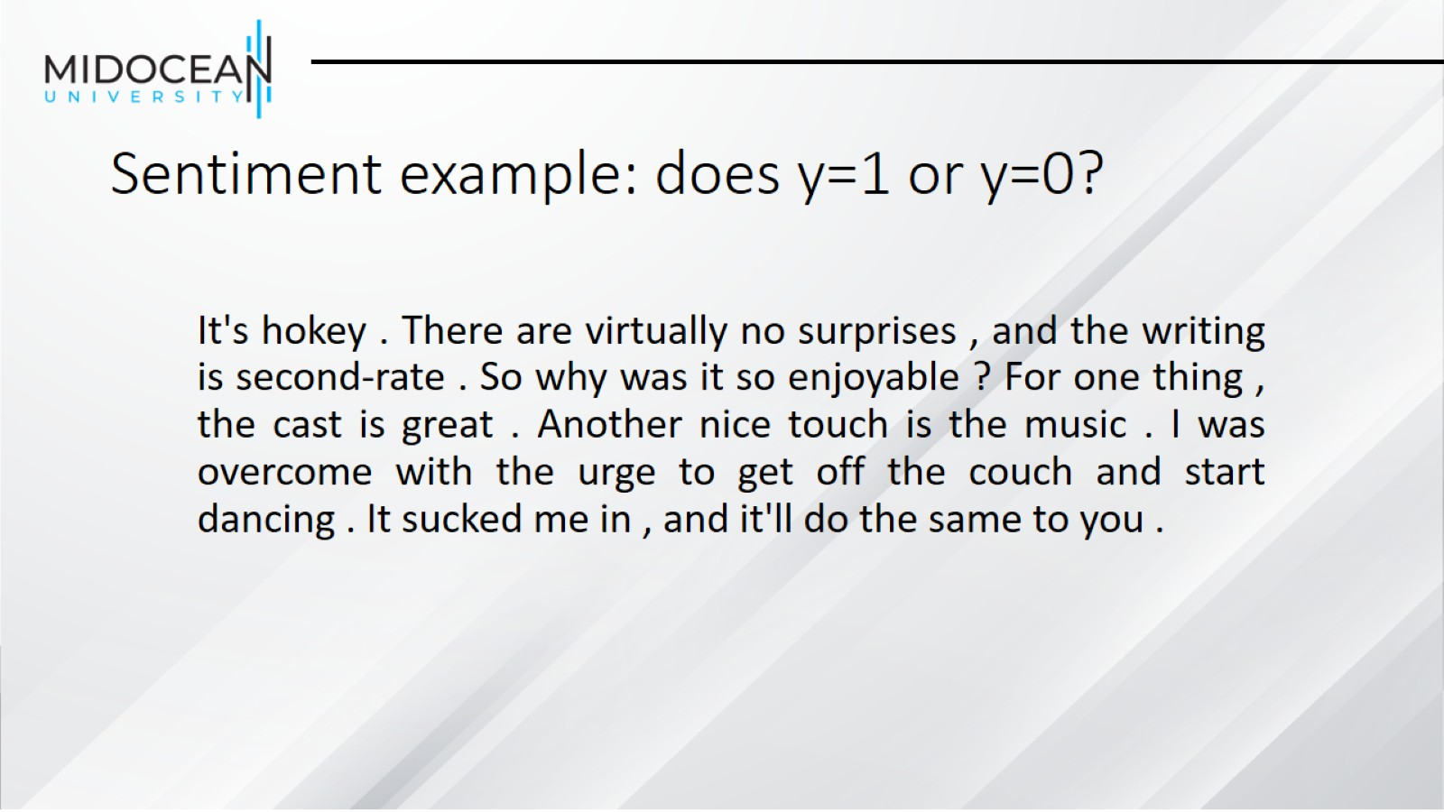
Sentiment example: does y=1 or y=0?

Slide 23
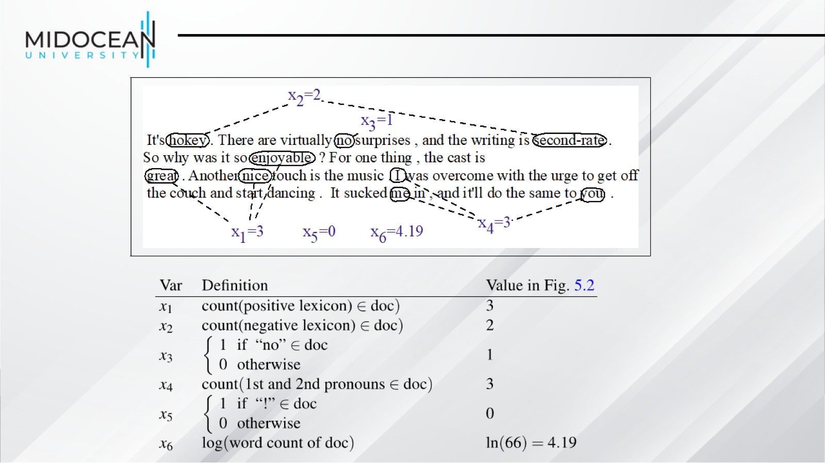

Slide 24
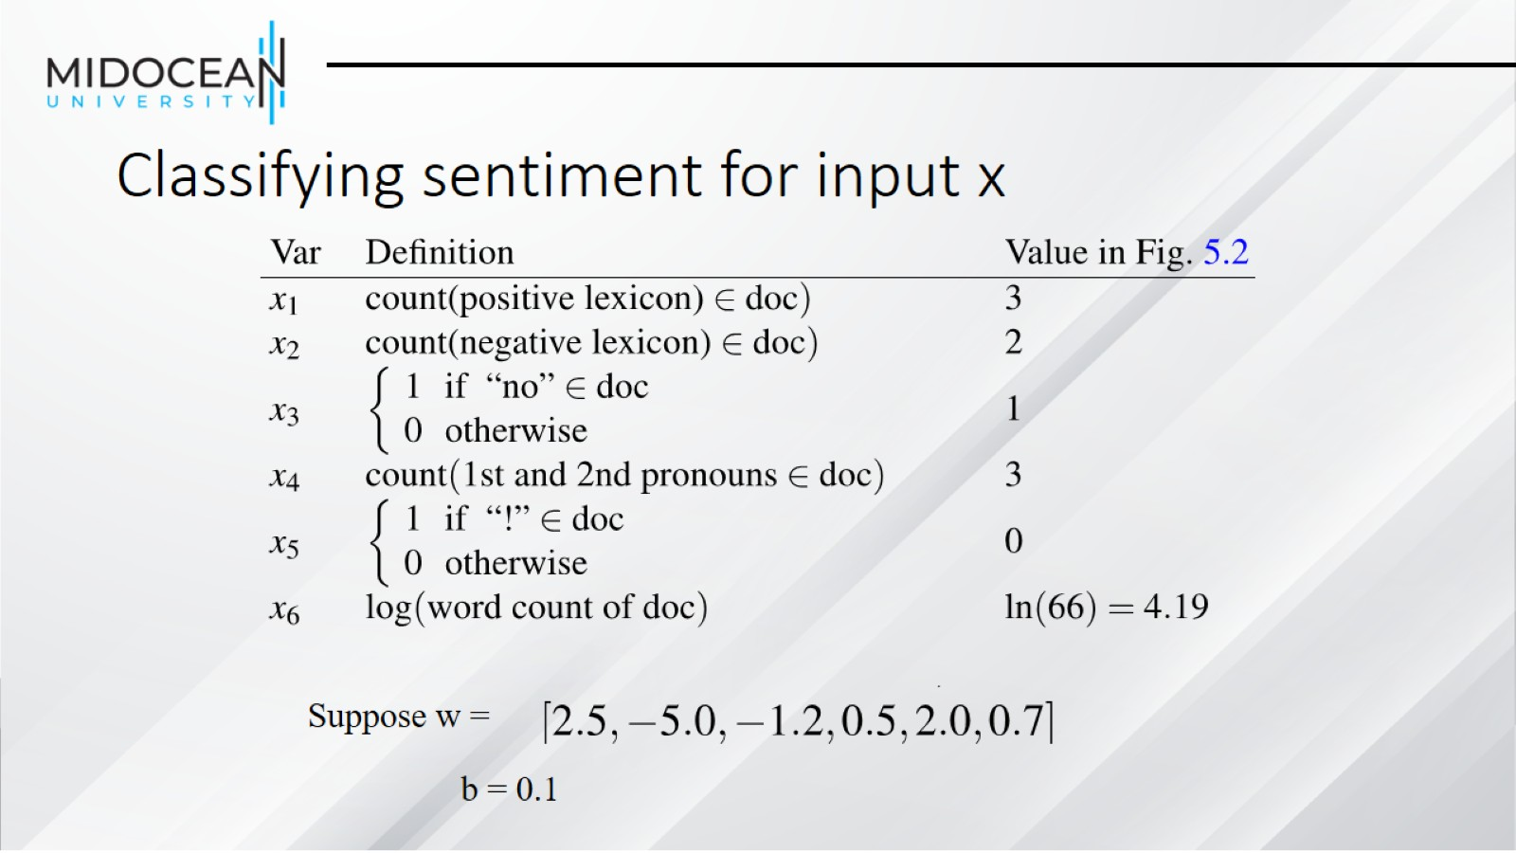
Classifying sentiment for input x

Slide 25
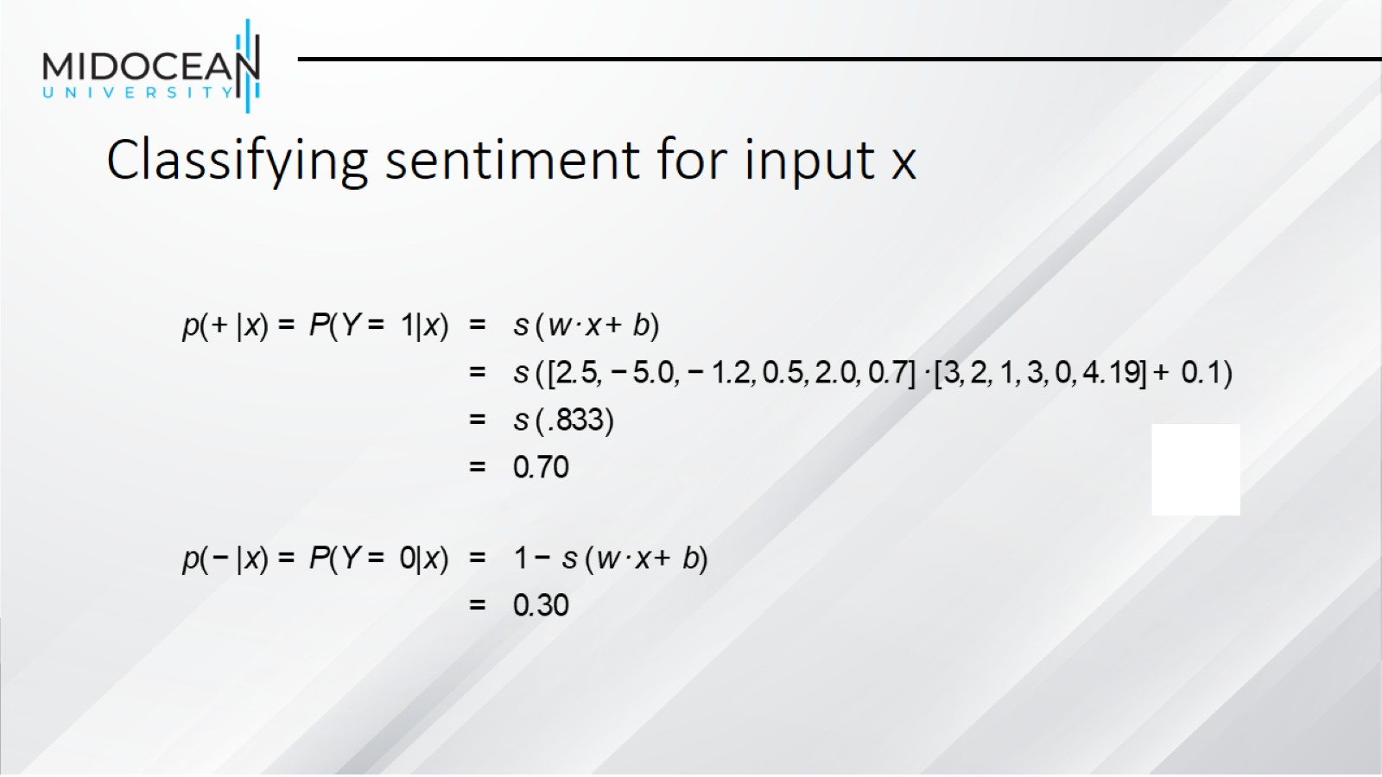
Classifying sentiment for input x

Slide 26
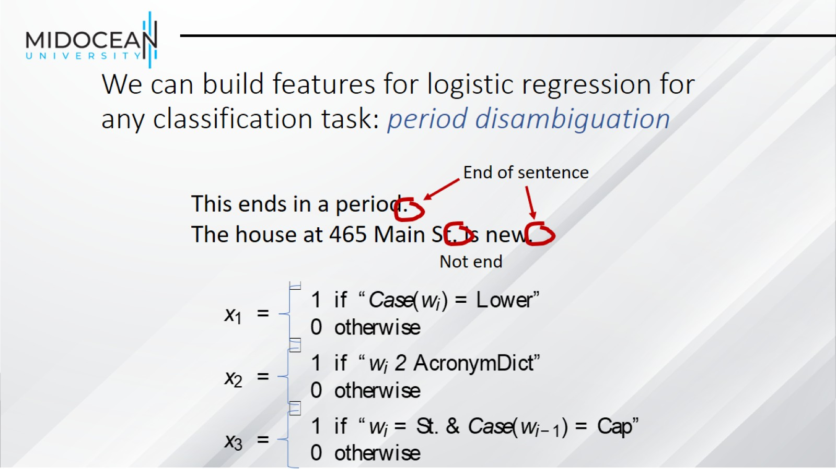
We can build features for logistic regression for any classification task: period disambiguation

Slide 27
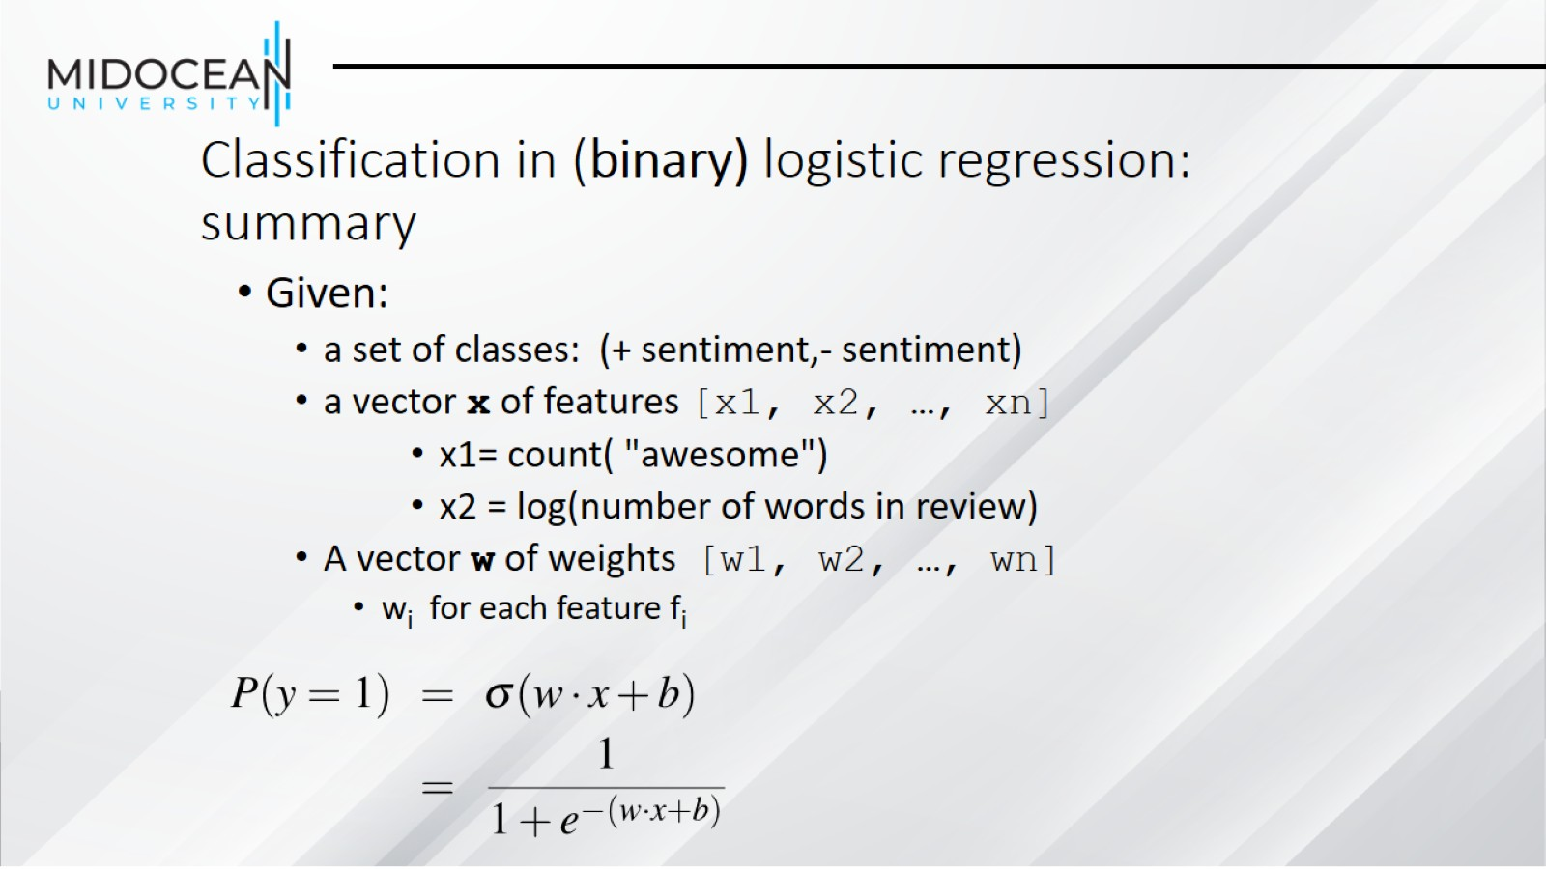
Classification in (binary) logistic regression: summary

Slide 28
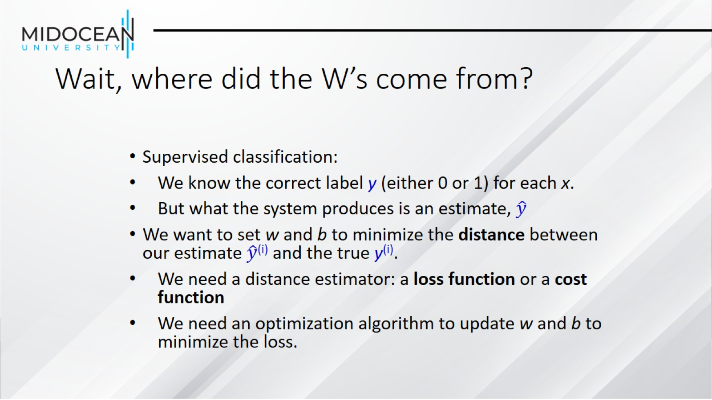
Wait, where did the W’s come from?

Slide 29
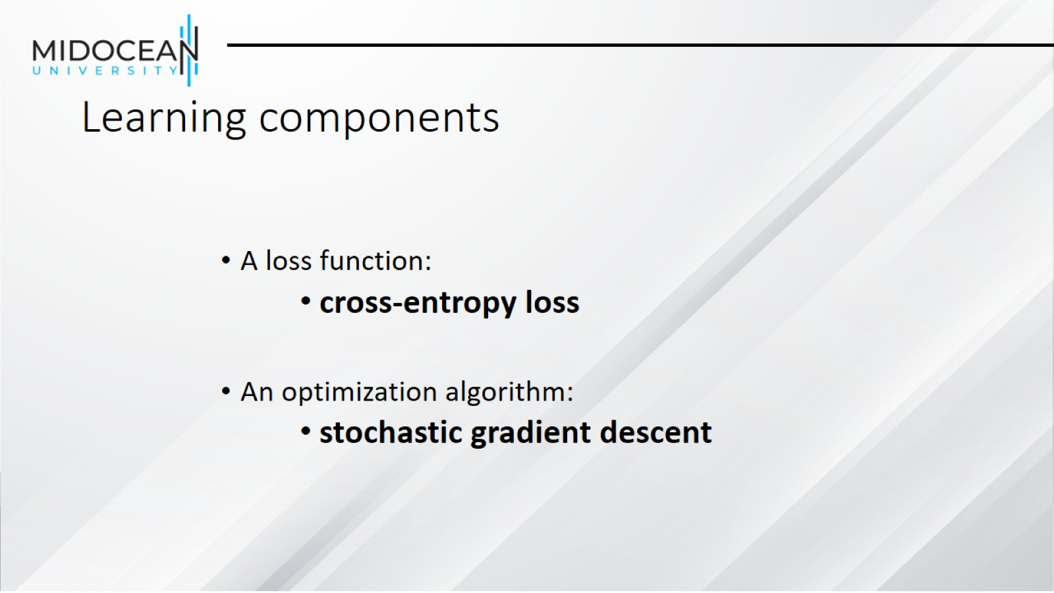
Learning components

Slide 30
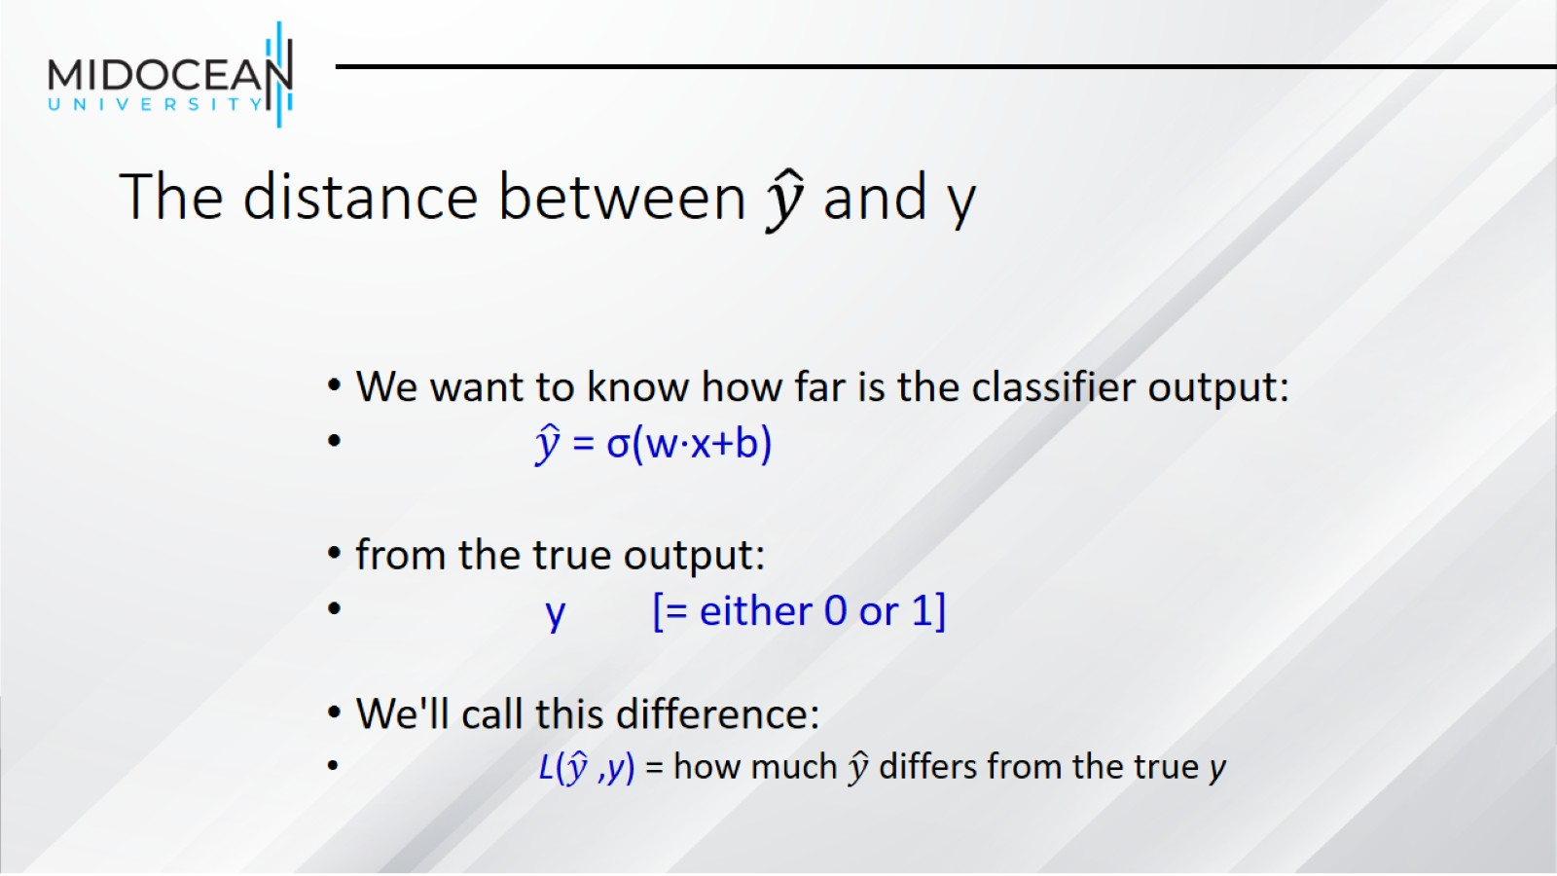

The distance between $\hat{y}$and y

Slide 31
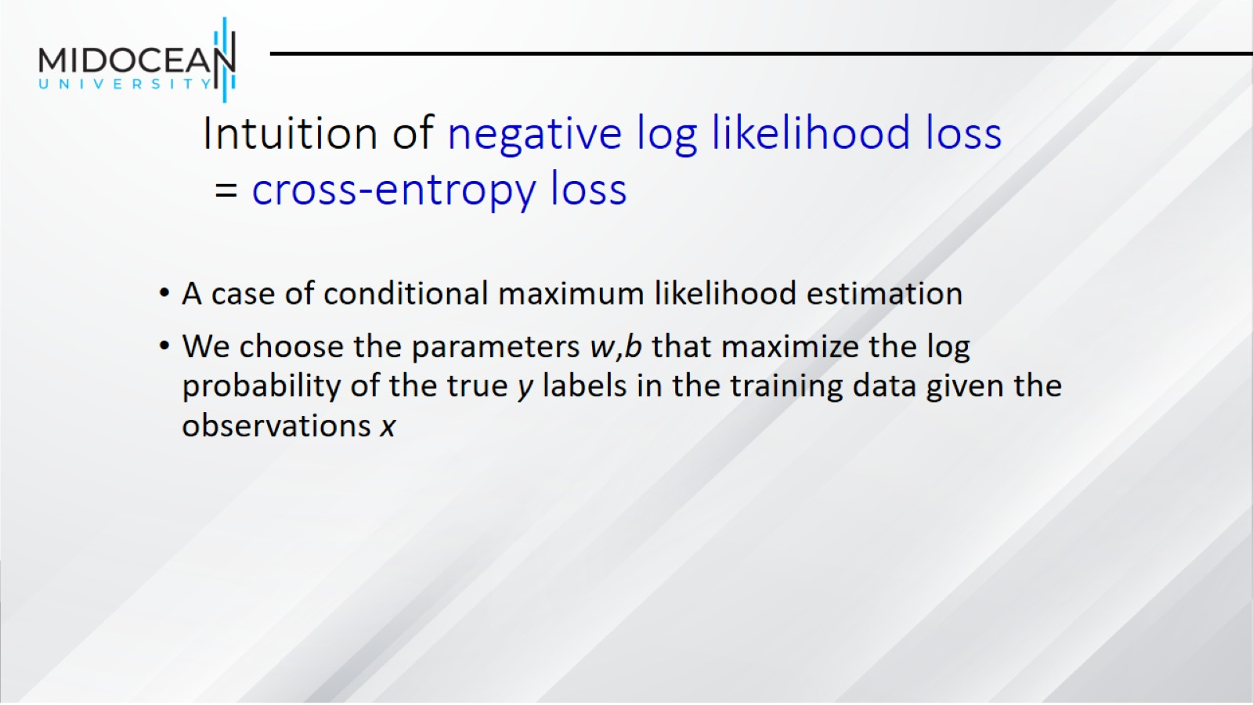
Intuition of negative log likelihood loss
= cross-entropy loss

Slide 32
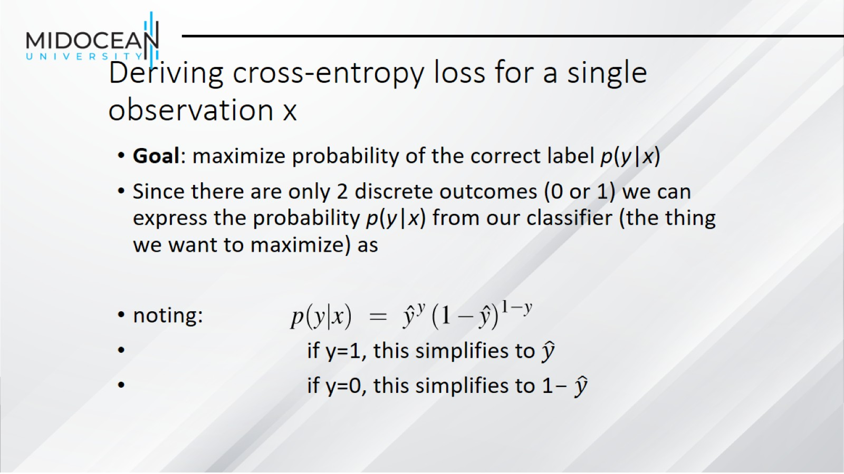
Deriving cross-entropy loss for a single observation x

Slide 33
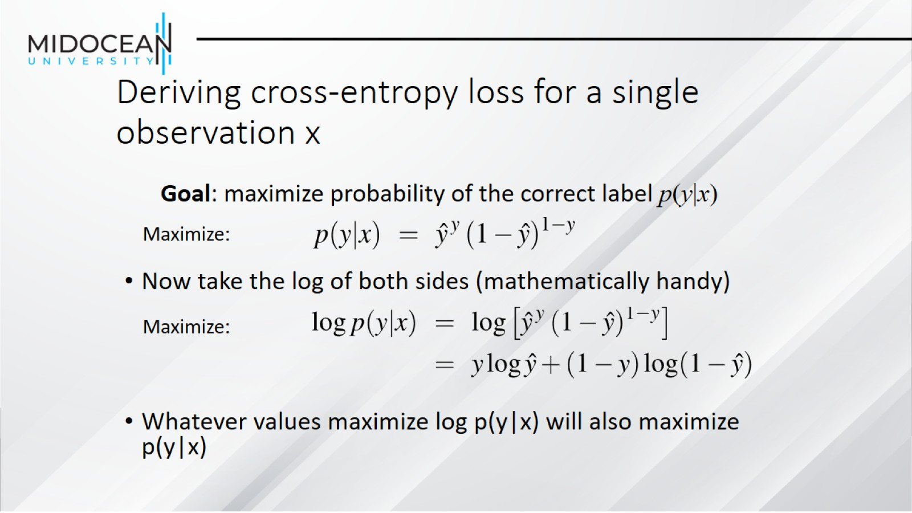
Deriving cross-entropy loss for a single observation x

Slide 34
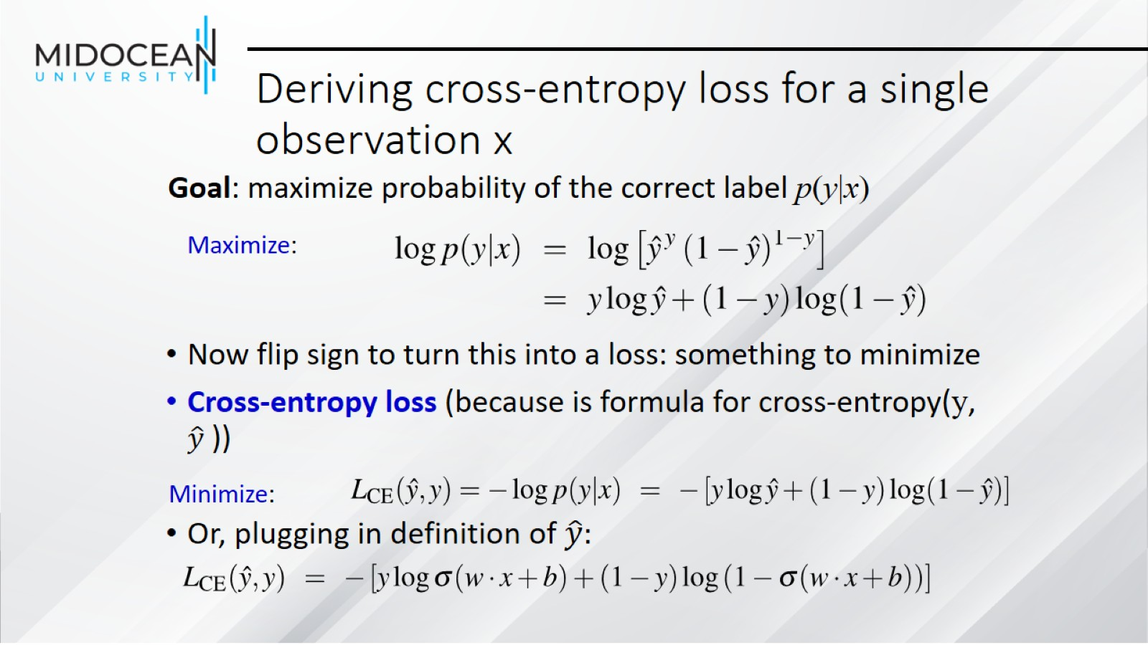
Deriving cross-entropy loss for a single observation x

Slide 35
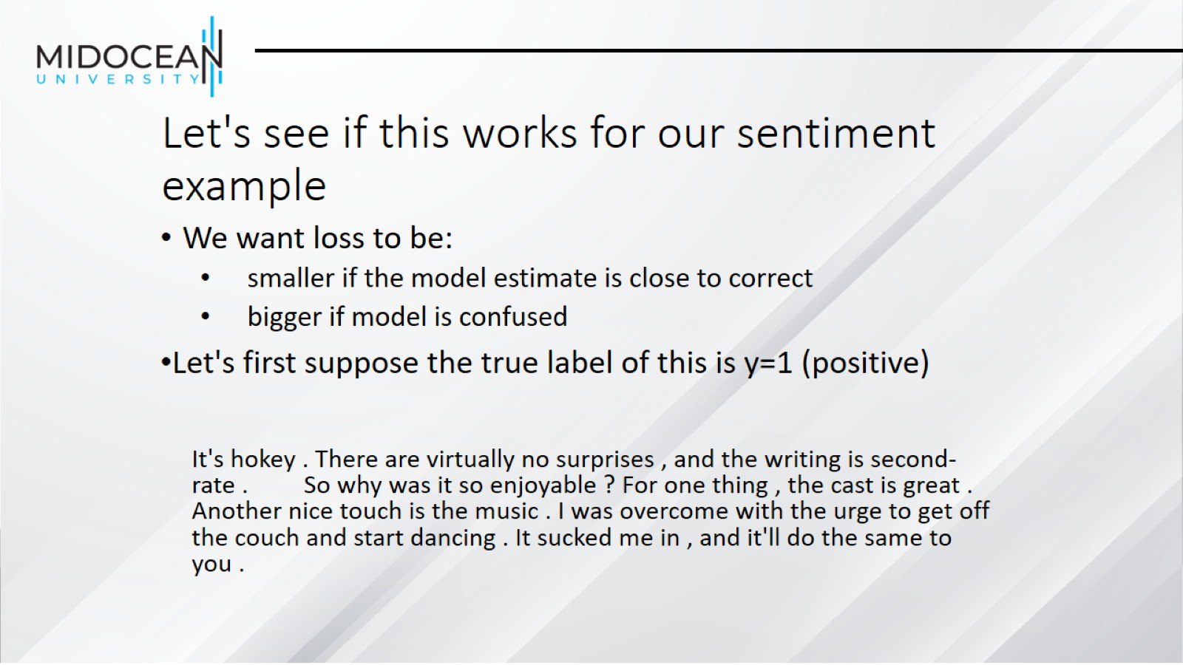
Let's see if this works for our sentiment example

Slide 36
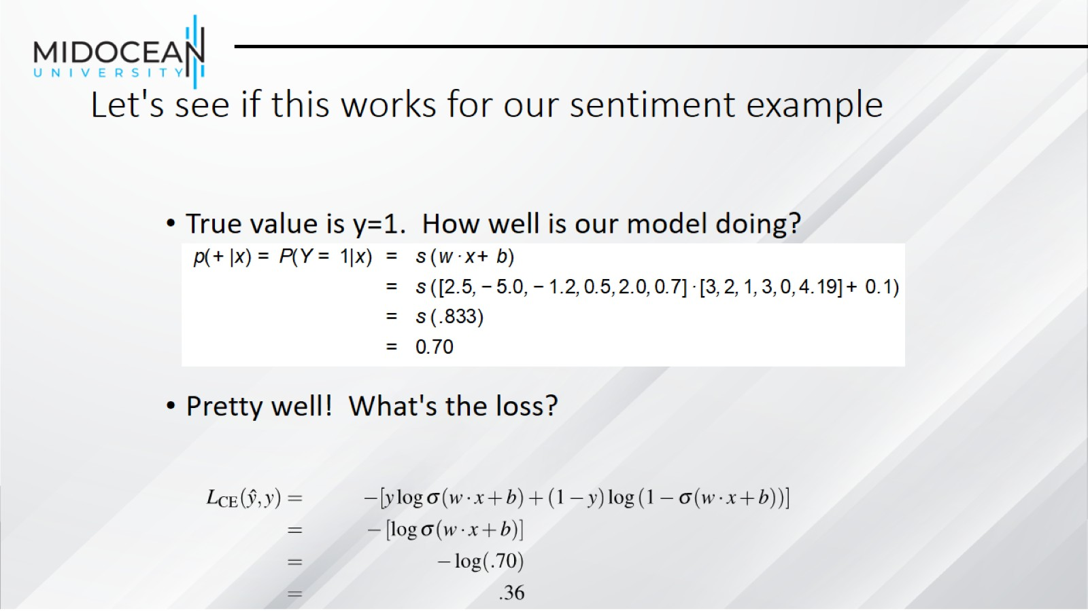
Let's see if this works for our sentiment example

Slide 37
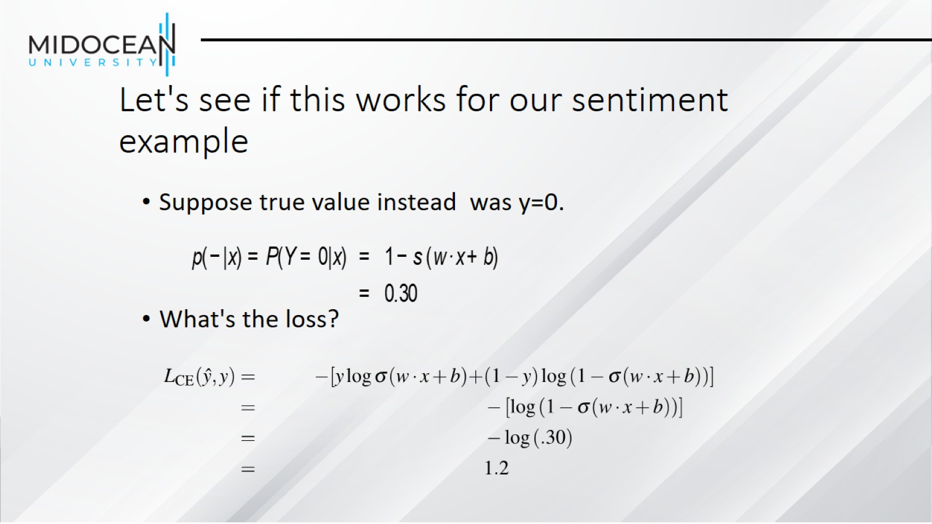
Let's see if this works for our sentiment example

Slide 38
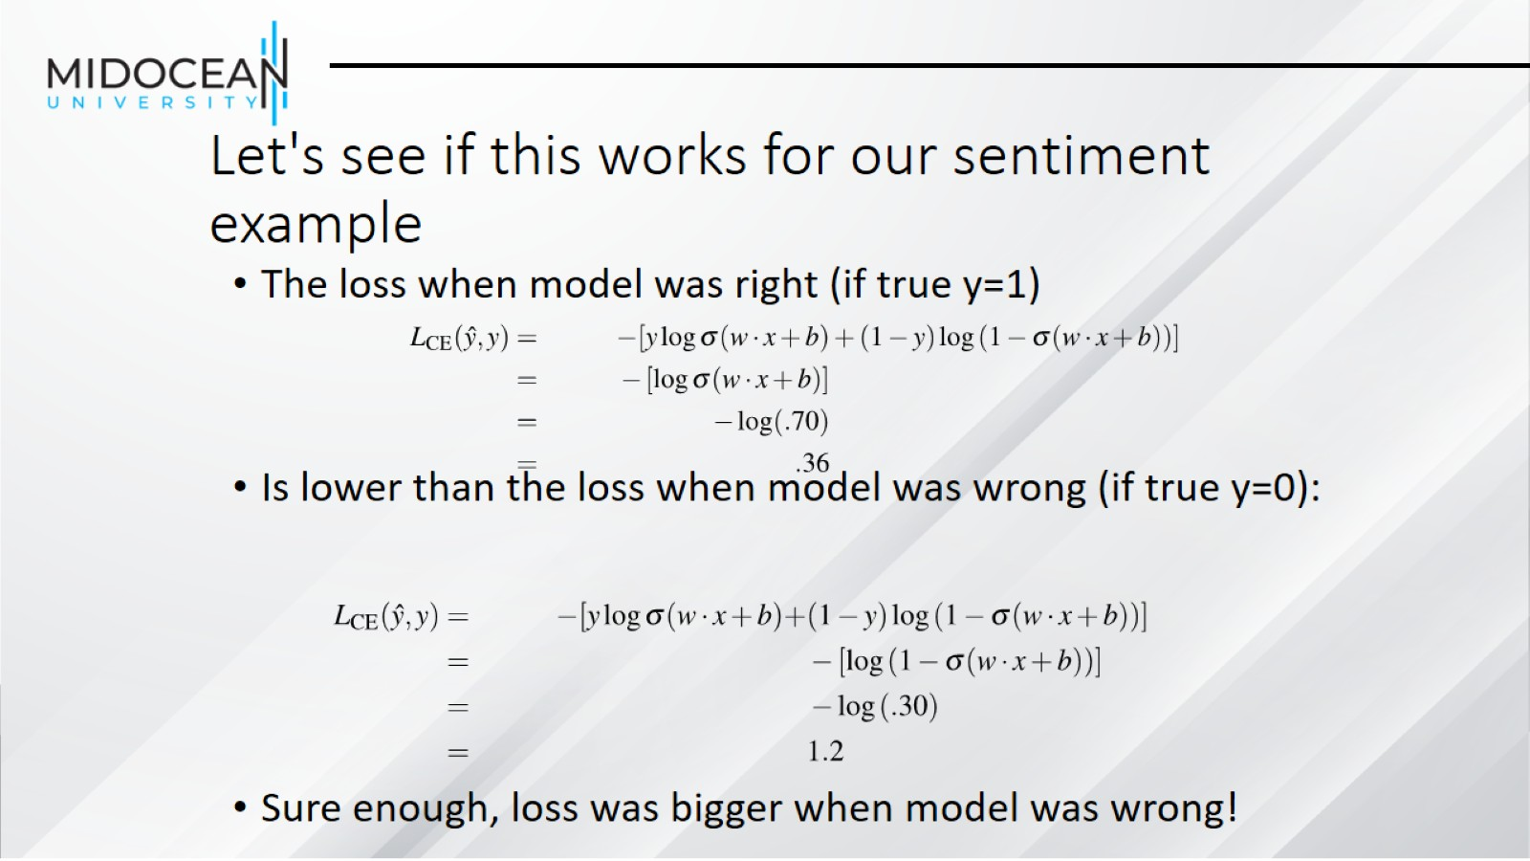
Let's see if this works for our sentiment example

Slide 39
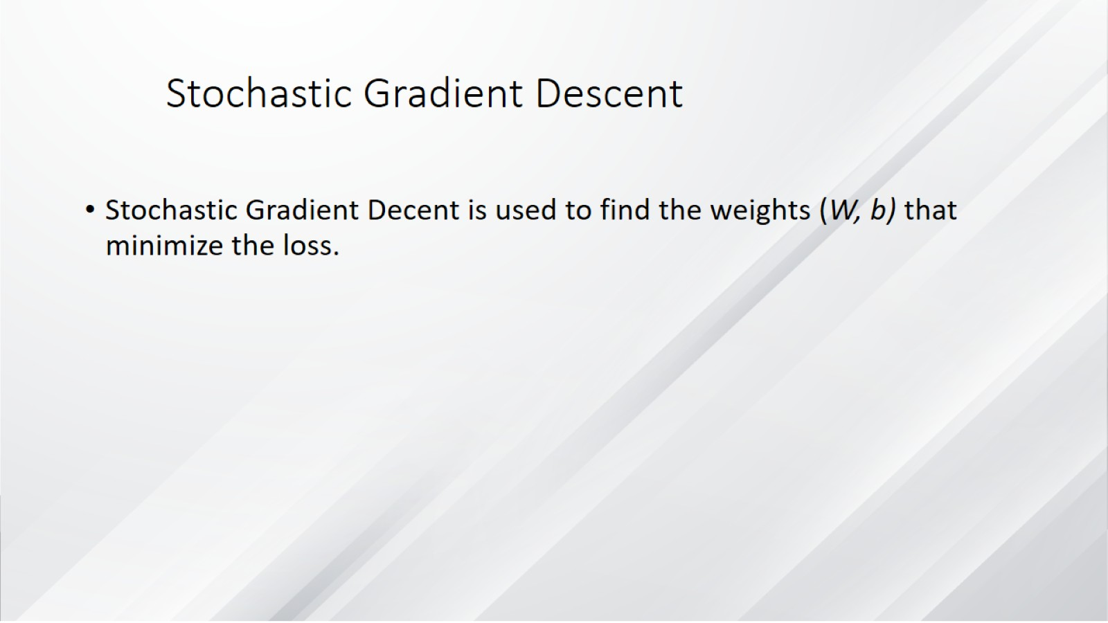
Stochastic Gradient Descent

Slide 40
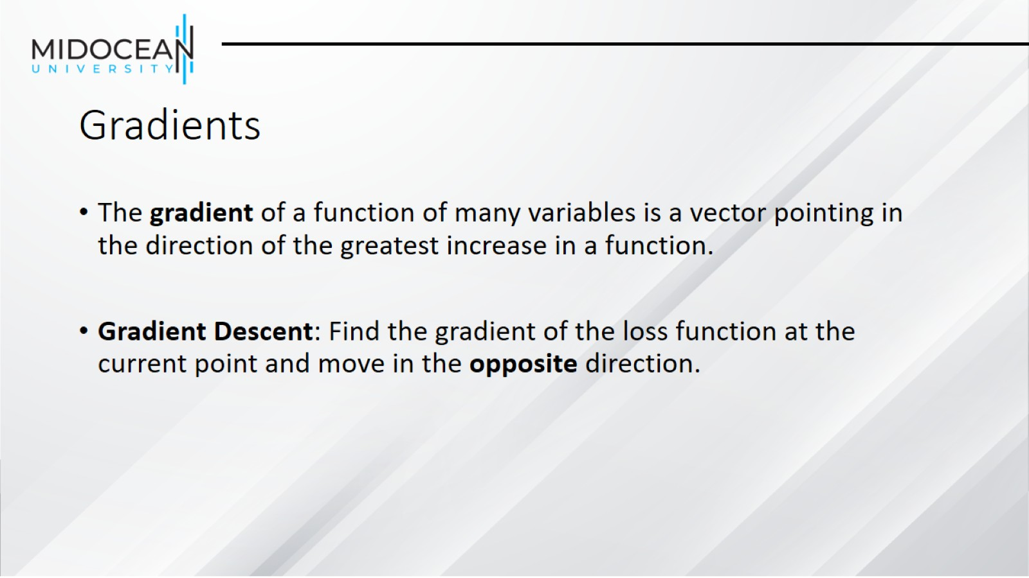
Gradients

Slide 41
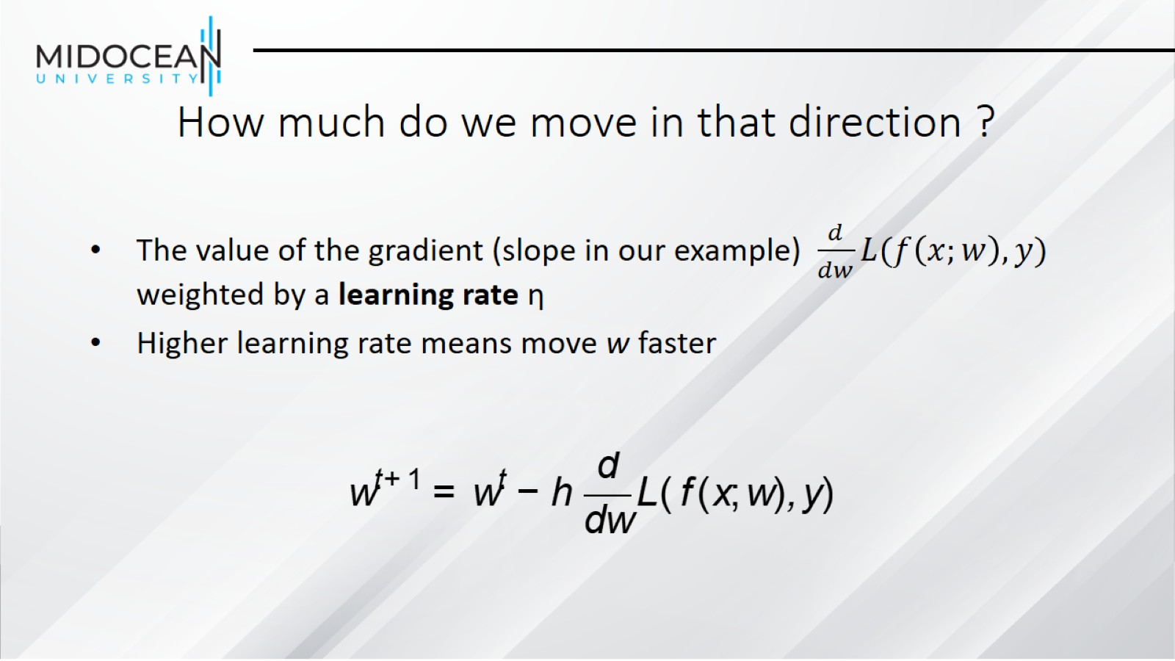
How much do we move in that direction ?

Slide 42
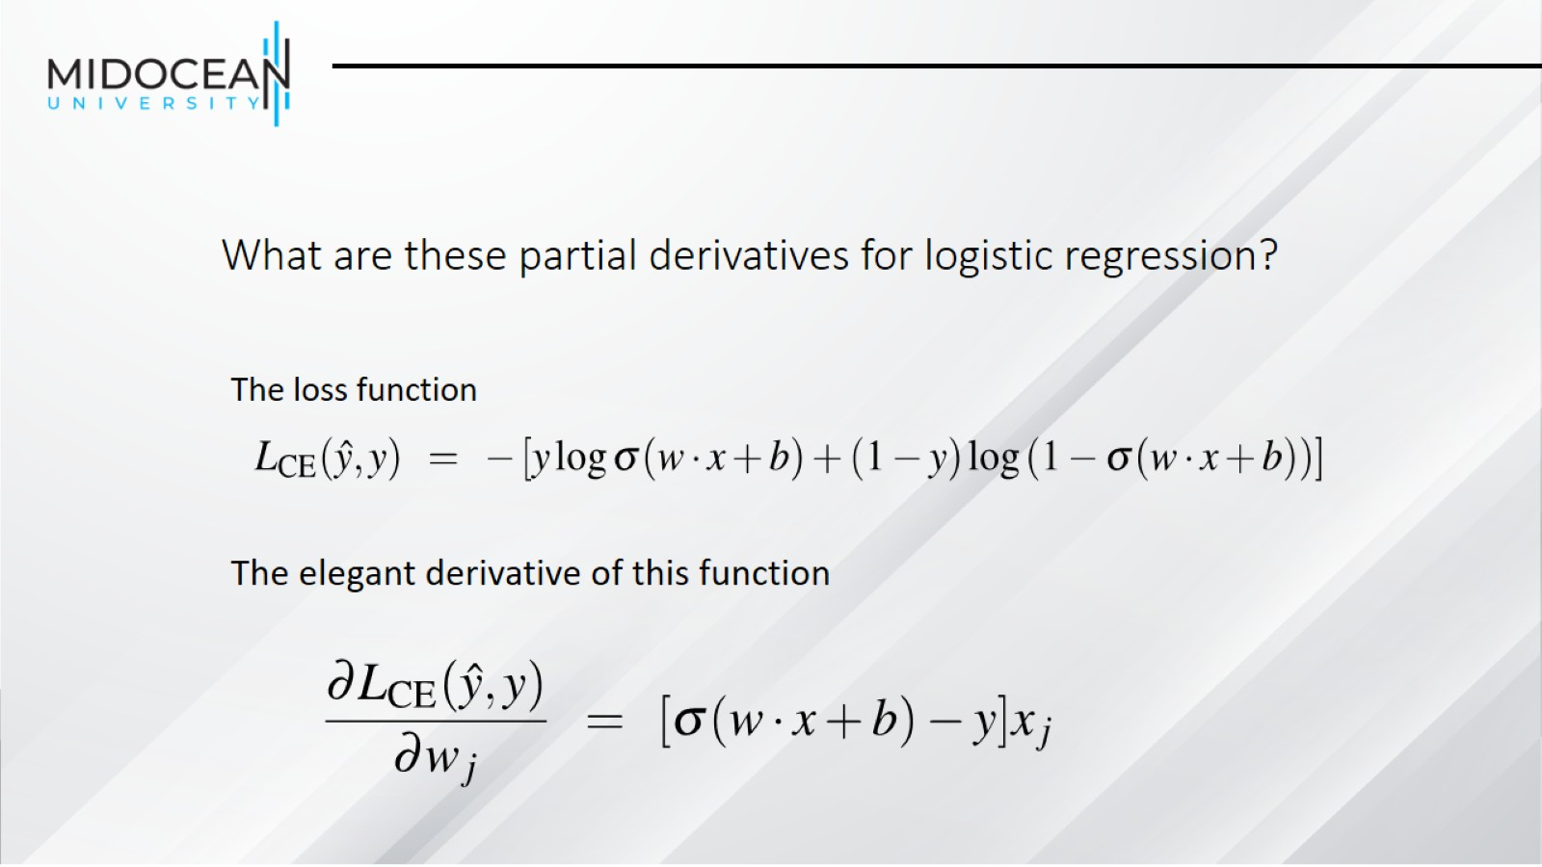
What are these partial derivatives for logistic regression?

Slide 43
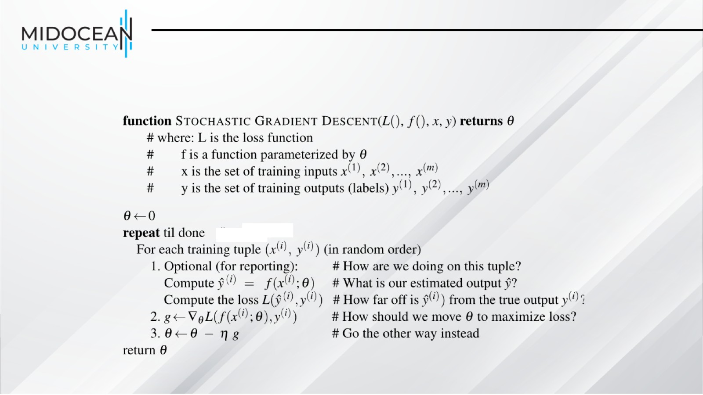

Slide 44
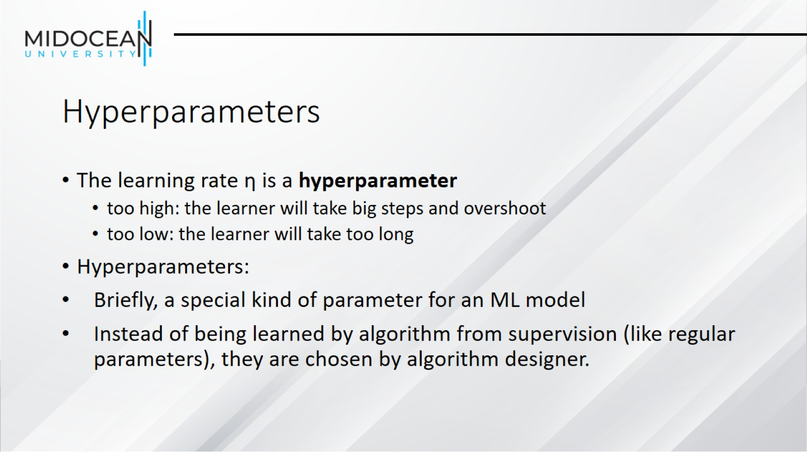
Hyperparameters

Slide 45
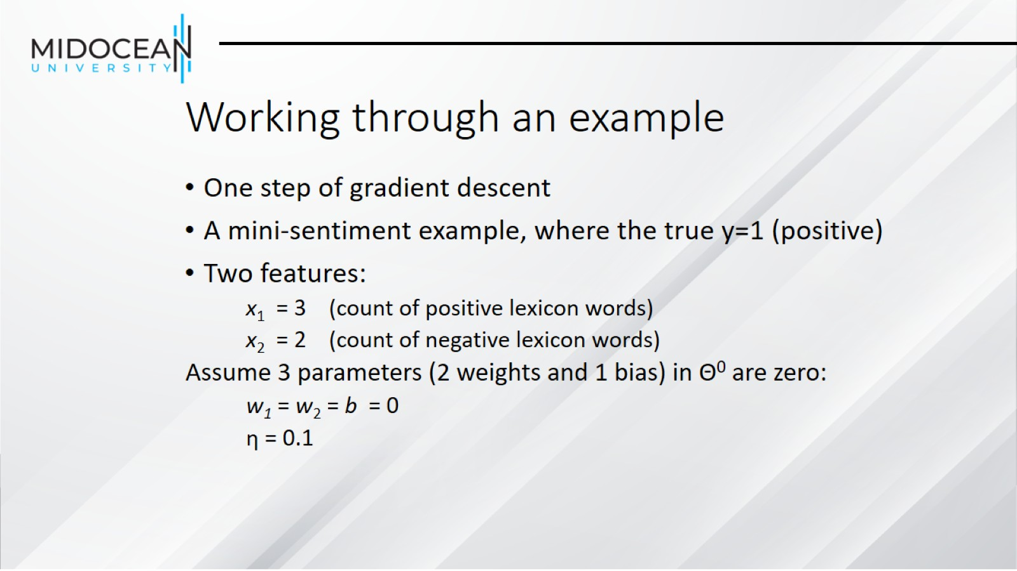
Working through an example

Slide 46
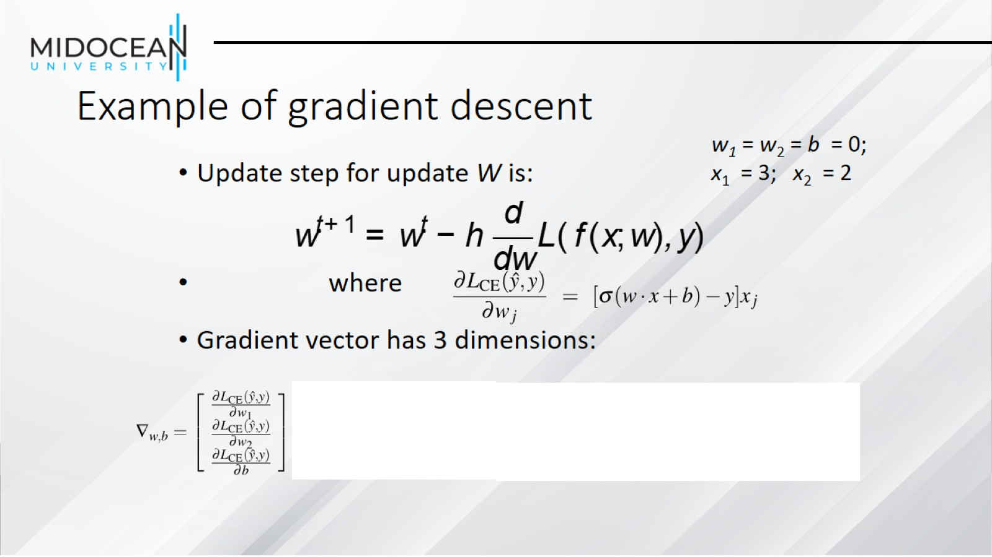
Example of gradient descent

Slide 47
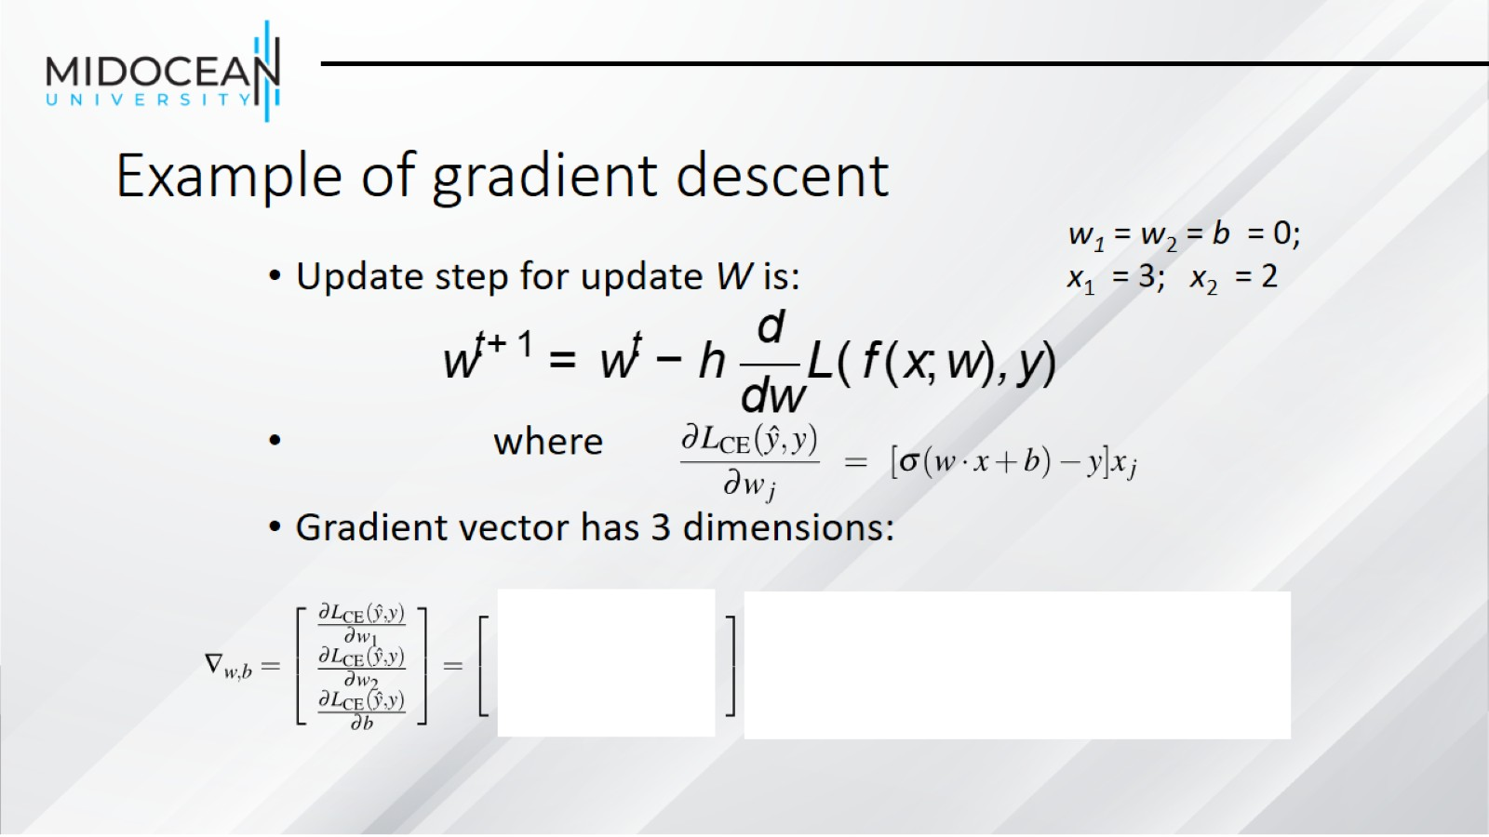
Example of gradient descent

Slide 48
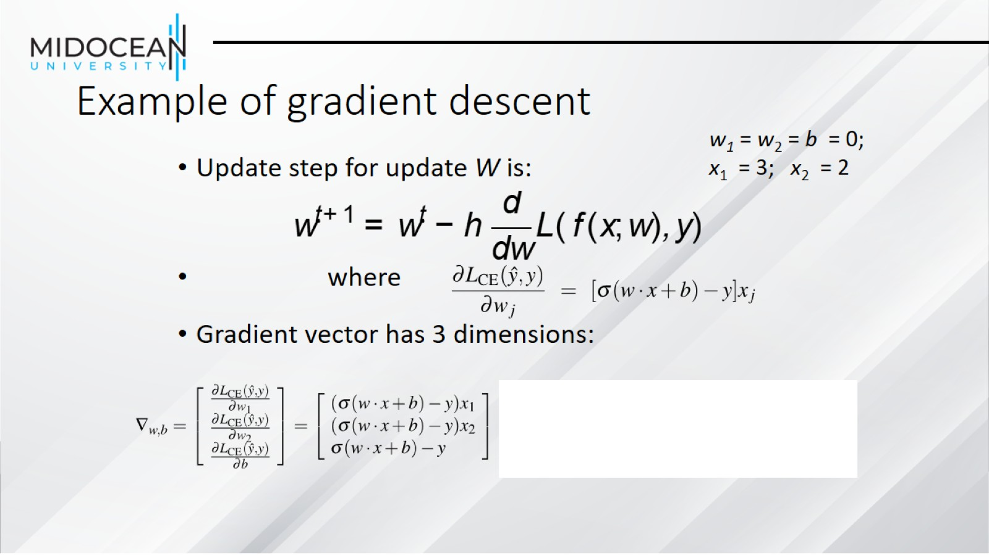
Example of gradient descent

Slide 49
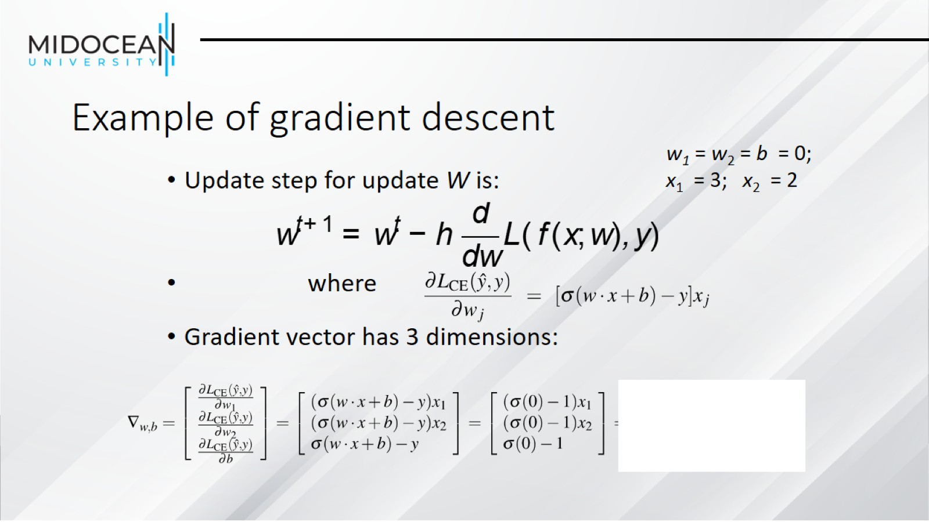
Example of gradient descent

Slide 50
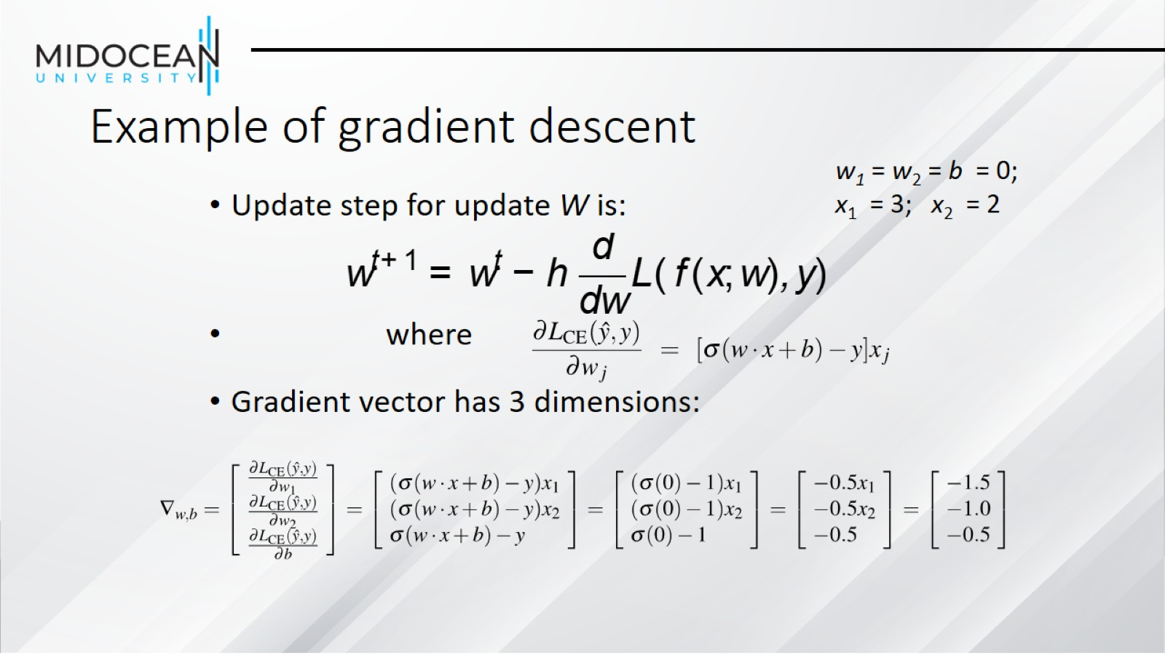
Example of gradient descent

Slide 51
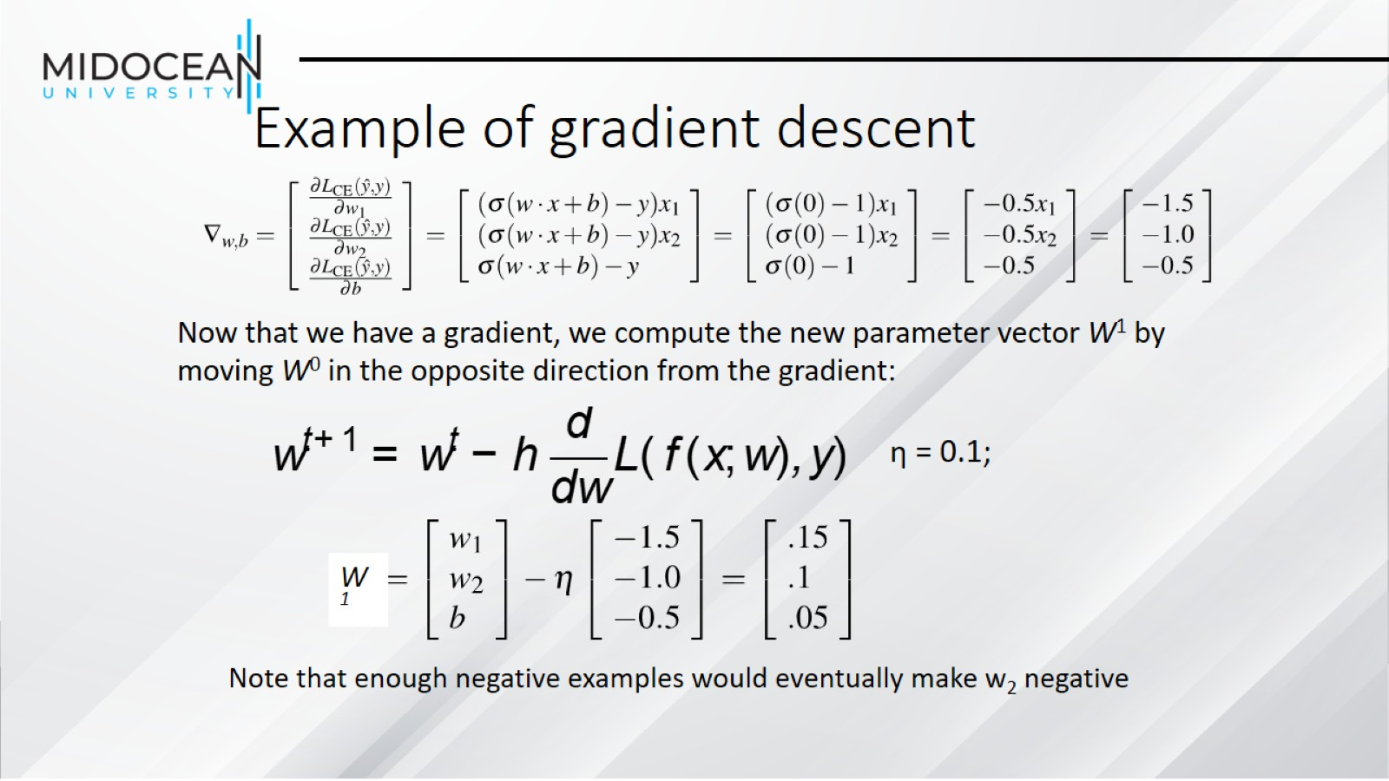
Example of gradient descent

Slide 52
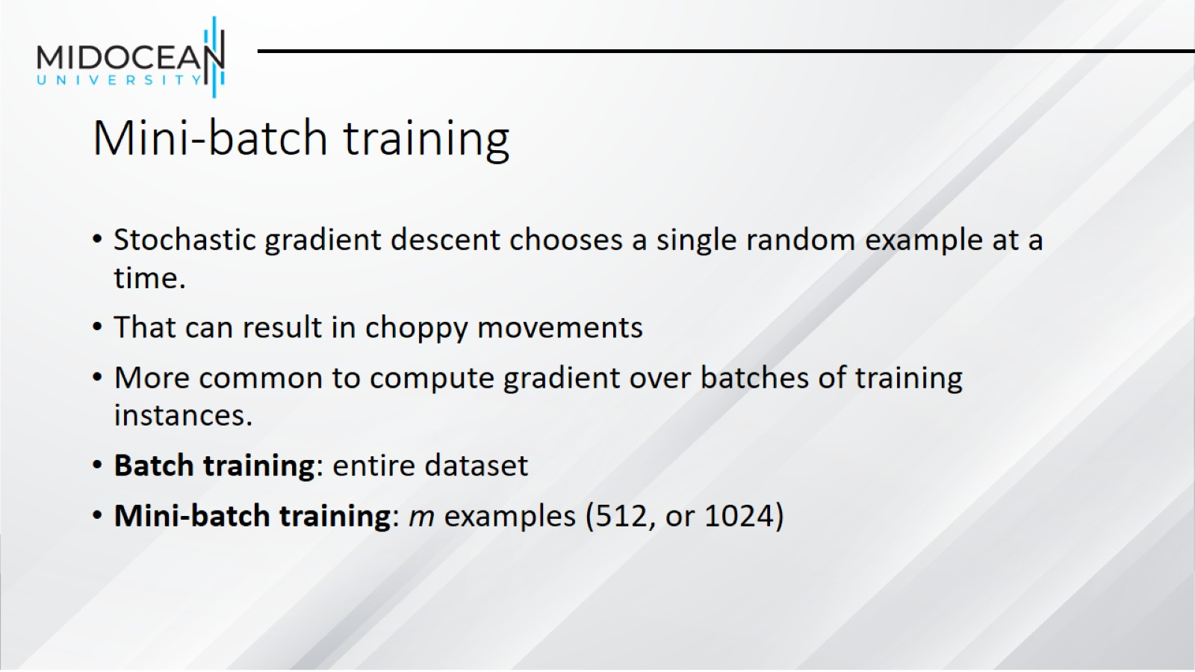
Mini-batch training

Slide 53

Multinomial Logistic Regression

Slide 54

Multinomial Logistic Regression

Slide 55

The softmax function

Slide 56

The softmax function

Slide 57

Softmax in multinomial logistic regression

Slide 58

Features in binary versus multinomial logistic regression

Slide 59


