Slide 1




Organizational Behavior and Projects
PMG421
Prepared by Mrs. Deena Ibrahim
Lecture 2
Evolution of Quality and Its Contemporary Application to Projects

Slide 2

Chapter 2 Includes the following Headlines
1.3 Scientific Management | 1.2 The Dark Ages | 1. Progressive History
1.6 Japanese Quality | 1.5 Inspection Reigns | 1.4 Understanding Variation
2. The Wheel of Quality | 1.8 Quality Then and Now | 1.7 Customers and Systems
2.3 Continuous Improvement | 2.2 Variation | 2.1 Customer Focus
2.6 Quality and Responsibility | 2.5 The Wheel of Quality Model | 2.4 Training and Leadership
3- Summary

Slide 3

1- Progressive History,
The concept of quality did not leap into existence fully formed. It evolved over time. It developed in progressive steps that responded to the needs and limitations of the times.
The historical development of quality concepts may be traced by examining major themes that held during various times. In some cases, these themes followed practice. In other cases, they made new practice possible and advanced the overall concept of quality

Slide 4

1.2 The Dark Ages,
The march of quality began during the age of craft production, the 1700s and before.
During this period, The craftsmen were totally responsible for the product from start to finish.
The need for more items, produced faster, put a fatal strain on craftsmen. Work began to move to central locations where many workers combined their efforts toward a common goal. Factories arose and the industrial revolution changed production.
- Workers were generally highly skilled because work was done by hand, but now the focus was on individual parts, not the whole. It was important that parts be very similar to each other so that they might be assembled into a final product without significant modification.

Slide 5
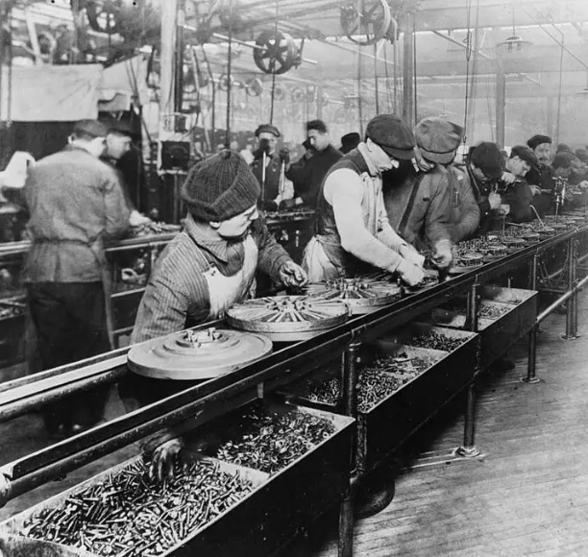
- Inspection became an important aspect of production to ensure that parts met some established design standard. Workers were the critical element in production; they were held responsible for the outcome. The quality philosophy at the time might best be stated as “If you want to make the boat go faster, whip the oarsmen harder.”

Slide 6
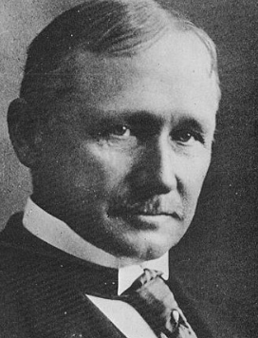
1.3 Scientific Management,
Frederick Winslow Taylor (was an American mechanical engineer. He was widely known for his methods to improve industrial efficiency and quality. He was one of the first management consultants).
In his view, if you want to make the boat go faster, you should examine and analyze those things that make the boat go and determine the best way to do it. In other words, it is not what you do, but how you do it that counts.
In 1911, he published The Principles of Scientific Management, which described his approach.

Slide 7

Taylor’s approach broke the mold of worker-focused quality, but failed to recognize two key aspects of quality.
The first is motivation. Taylor assumed that workers were principally motivated by money.
The other is his assumption that once an optimal procedure is defined, the results will be the same for every worker.
Taylor’s scientific management involves one way of doing something, one standard worker, no variation in performance, and no communication between workers and management.

Slide 8

1.4 Understanding Variation,
The next leap forward occurred when Walter Shewhart expanded the quality focus to include variation.
Variation meant potential waste. If a product varied too far from a target, it had to be redone or discarded.
Shewhart was assigned a project to develop a radio headset for the military.
When analyzing head breadth data provided by the military, Shewhart noticed an orderly distribution. Some people had wide heads, some had narrow heads, and a lot fell in between. The data seemed to follow a normal distribution pattern.
Over time, Shewhart developed methods for analyzing and understanding this variation. His work became a foundation for doing something about the variation, not just observing it. In 1931, he published Economic Control of Quality in Manufactured Products, which is a disciplined approach for improving quality by reducing variation in the process.

Slide 9

1.5 Inspection Reigns,
During World War II, the demand for manufactured products of many kinds increased dramatically. Military customers had urgent requirements that would not tolerate a lot of scrap and rework. At the same time, shortages of materials required efficient utilization of what was available.
Inspection departments flourished as the quality focus drifted back to conforming within an acceptable level of error.

Slide 10

1.6 Japanese Quality,
In Japan, members of the Japanese Union of Scientists and Engineers considered quality a key component in rebuilding the country’s industrial base in ways that would enhance international competition in the international market. They invited experts from other countries to come to Japan and share their methods.
As a result, Japan became a global economic superpower within twenty years. Because of Japanese quality achievements, it became a label of respect, denoting items that did what customers expected them to do, worked the first time, and did not fail during use.

Slide 11
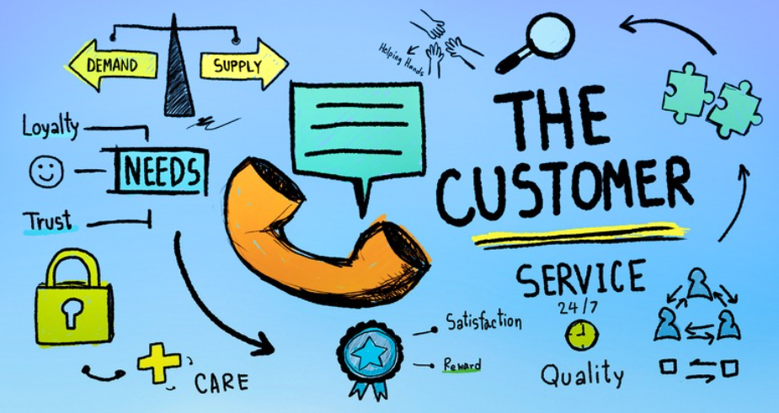
1.7 Customers and Systems,
In the contemporary view, customer requirements define quality, not products or processes. In other words, it is not what you do or how you do it, but who uses it that counts.
Elements of a quality system include external customers, internal customers, suppliers, materials, processes, policies, tools, skills, capabilities, and even society as a whole.

Slide 12
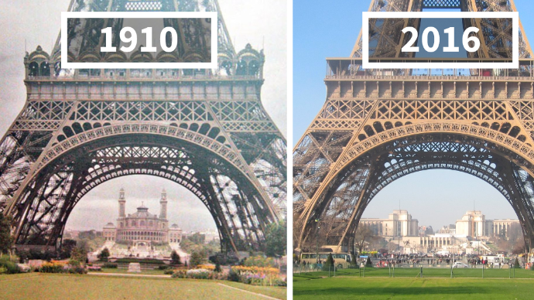
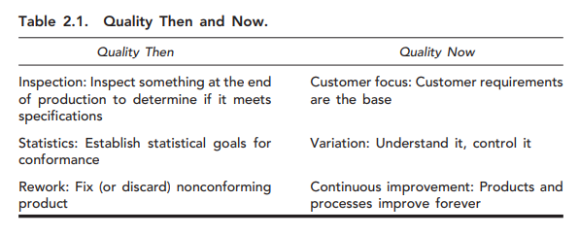
1.8 Quality Then and Now,
In recent times past, quality included three elements: inspection, statistics, and rework.
Contemporary quality included a significantly different set of elements: customer focus, variation, and continuous improvement.

Slide 13
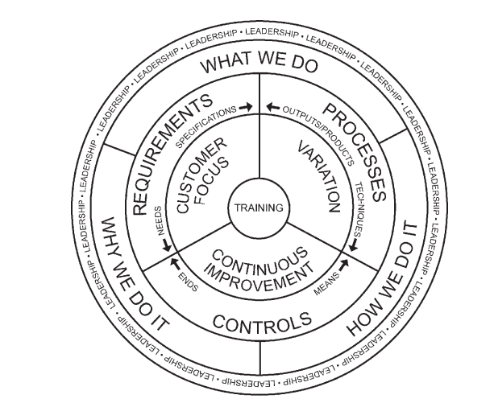
2. The Wheel of Quality
The Wheel of Quality. (Copyright ©2003 Kenneth H. Rose)

Slide 14

The concepts of contemporary quality are codified in a single graphic image. This graphic displays the three elements of customer focus, variation, and continuous improvement, showing the relationships and interactions among them. It also adds the essential elements of training and leadership.

Slide 15
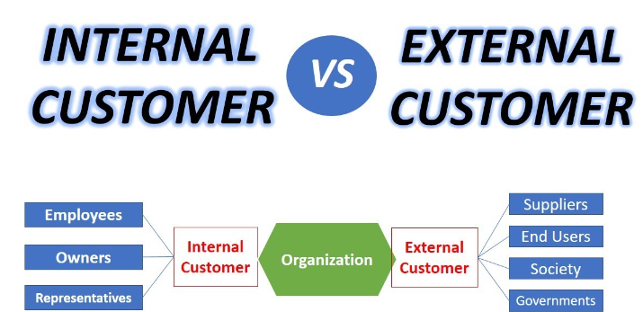
A- Customer Focus,
Projects have more than one customer.
External customer, Internal customer, and Hidden customer.

Slide 16

External customers,
Those outside the organization or the project team.
The client is the most obvious external customer.
Suppliers are also external customers.
The end user of the product is the one who either takes or rejects the product.

Slide 17
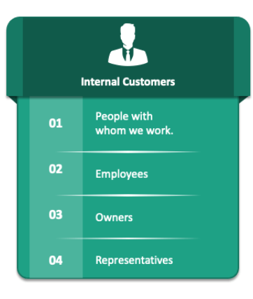
Internal customer,
Internal customers constitute another category.
A project is usually completed by a number of collaborating elements within an organization. Each element performs a piece of the work and passes its piece on to another element that will perform another piece and pass it along to another and another until the final product is delivered to the client.

Slide 18

Hidden customer,
Hidden customers can be the most difficult to identify and the most troublesome for project managers.
Hidden customers are stakeholders — people or organizations that do not participate directly in the project, but have an interest in or concern about the project to the degree that they may influence the outcome.
Some may be apparent; will pop up as a hidden customer.
Some are not apparent; these tend to be the dangerous ones as they can appear out of nowhere and put a project off track.

Slide 19

Customer role falls into four parts:
Provide needs and requirements — Customers are important because they are the source of requirements that are the foundation for the project.
Define standards — Beyond requirements, customers describe “how well” a product should perform. They provide measurable targets.
Evaluate products — Customers will accept or reject products based on the degree to which the products meet their expectations.
Provide feedback — Customers will comment, complain, recommend, or purchase a product again.

Slide 20
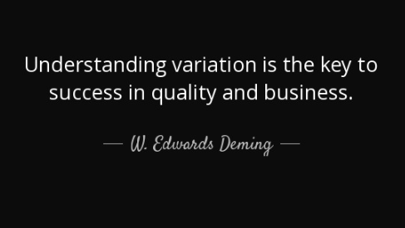
B- Variation,
Variation is a characteristic of any production process. Variation can and must be understood and controlled in order to influence results.
This is an important matter because variation can produce defects. After identifying sources of potential variation, project managers must seek to understand the variation, why it occurs, and what its effects are. Then they must control the variation so the process involved performs consistently, producing predictable results.

Slide 21
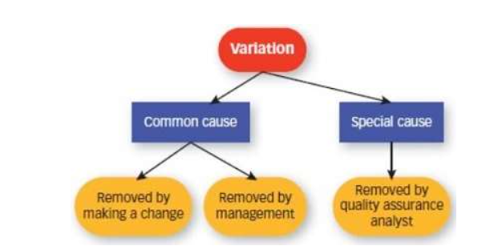
In 1924, Dr. Walter Shewhart identified two causes of variation,
- Common cause variation, also known as noise variation, is inherent in a process over time. It affects every outcome of the process and everyone working in the process. Managing common cause variation thus requires improvements to the process.
- Special cause variation, also known as signal cause variation, arises because of unusual circumstances and is not an inherent part of a process. Managing this kind of variation involves locating and removing the unusual or special cause.

Slide 22

C. Continuous Improvement,
Continuous improvement involves at least three specific actions.
1- Communication is essential. The project team must have effective communication within itself and with customers, suppliers, and stakeholders. Communication is the means of identifying problems and opportunities, resolving problems, and exploiting opportunities.

Slide 23

2- Corrective action is also essential. Fixing problems is necessary, but not sufficient. Project managers and team members must also identify the causes for any problems and eliminate them or reduce them to the greatest extent possible. It is good to fix a problem; it is better to prevent it from occurring again.
3- Identifying and acting on opportunities,
The plan-do- check-act (PDCA) cycle provides a disciplined approach for continuous improvement based on either identified problems or opportunities.

Slide 24

The benefits of continuous improvement,
◆ Meet dynamic needs and requirements, Customer needs are always changing. Give them what they ask for and they will ask for more.
◆ Stay competitive , Competitors are always improving. The global marketplace is not in a steady state; it is a race, and you cannot win a race by standing still.
◆ Reduce costs, increase profits , The global marketplace includes competitors with very low costs, particularly in labor. Reducing costs can increase competitive approach, which will increase sales and overall profit.
◆ Develop new technologies, processes, and products , Technology is always changing. Improving processes to take advantage of new technology or simply to employ a better way can reduce costs, provide a better product, or both.

Slide 25

Training and Leadership,
Training is the foundation of quality. Action should be based on trial and error.
Members of the project team, including the project manager, must be trained in all necessary skills. Members new to the team during implementation must be trained also.
.

Slide 26
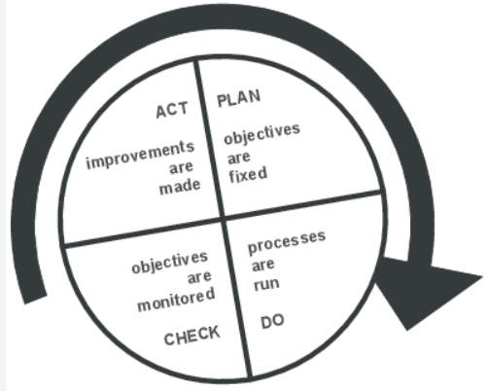
The Wheel of Quality Model ,
The graphic image of The Wheel of Quality discloses how all these elements interact. Customer focus, variation, and continuous improvement are the central issues in contemporary quality. Each is related to the others and shares a common boundary. As the foundation of quality, training is the hub of the wheel. Without training, project team members will be unable to employ the three elements effectively. Leadership holds it all together. Leadership encircles all elements, aspects, and considerations in a continuous outer loop that binds them in a unified whole.

Slide 27

Quality and Responsibility,
Given all this, a simple question remains: Who is responsible for quality? In times past, the quality department was responsible, but no more. Nowadays, everyone is responsible for quality. Organizational management is responsible for the quality system. Project managers are ultimately responsible for project and product quality. Project teams are responsible for the quality aspects of their part of the project, and individual team members are responsible for quality in everything they do to contribute to project completion. Everyone associated with a project is responsible in some way, with the project manager bearing the burden or obligation of ensuring quality in everything the project does.

Slide 28

3- Summary
◆ Contemporary quality arose through an evolution from craftsmen totally responsible for quality, to factories that distributed tasks and quality responsibility, to scientific management that focused on processes rather than individual workers. It further developed through an understanding of process variation and an understanding of the role of customers and systems
◆ The traditional quality approach involved inspection, statistics, and rework. The contemporary approach involves customer focus, variation, and continuous improvement.

Slide 29
◆ Training and leadership are essential to contemporary quality.
◆ The Wheel of Quality graphically displays the elements of contemporary quality and the interrelationships among them.
◆ Everyone is responsible for quality. The project manager is ultimately responsible for project and product quality.

Slide 30


Slide 31


