Slide 1


Slide 2


Slide 3

Software engineering ethics

Slide 4
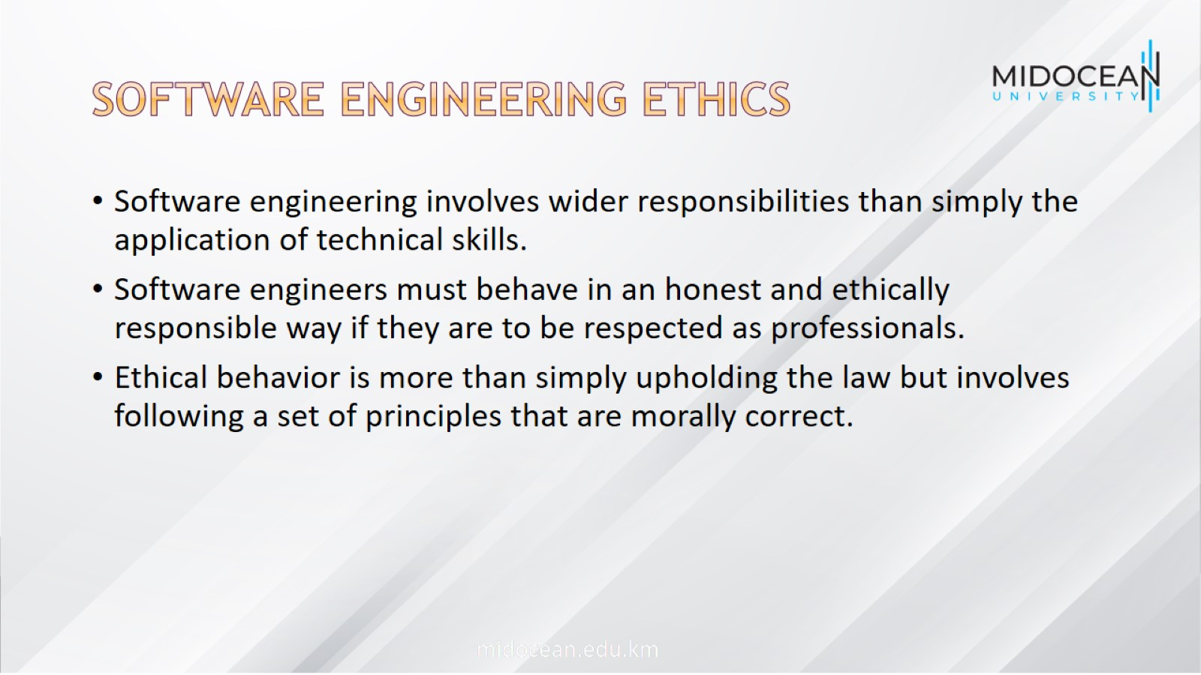
Software engineering ethics

Slide 5

Issues of professional responsibility

Slide 6
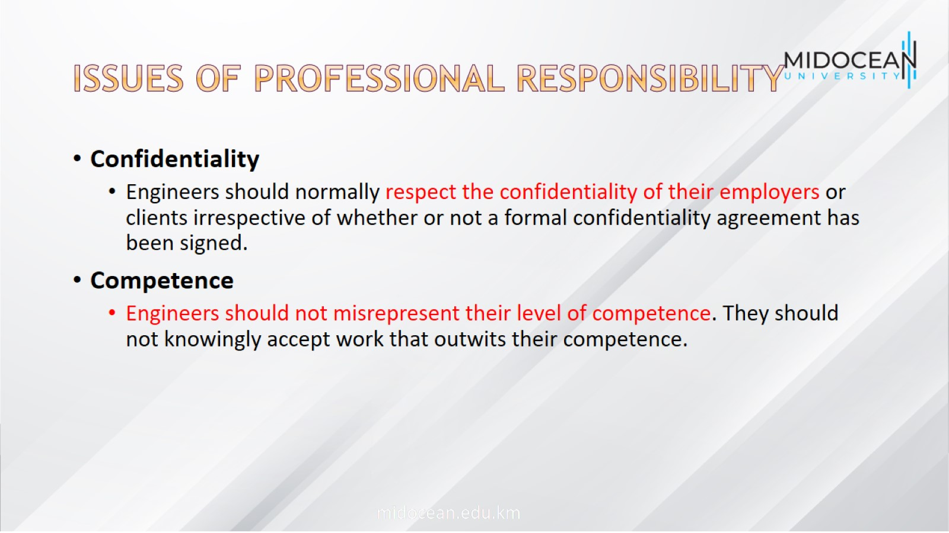
Issues of professional responsibility

Slide 7
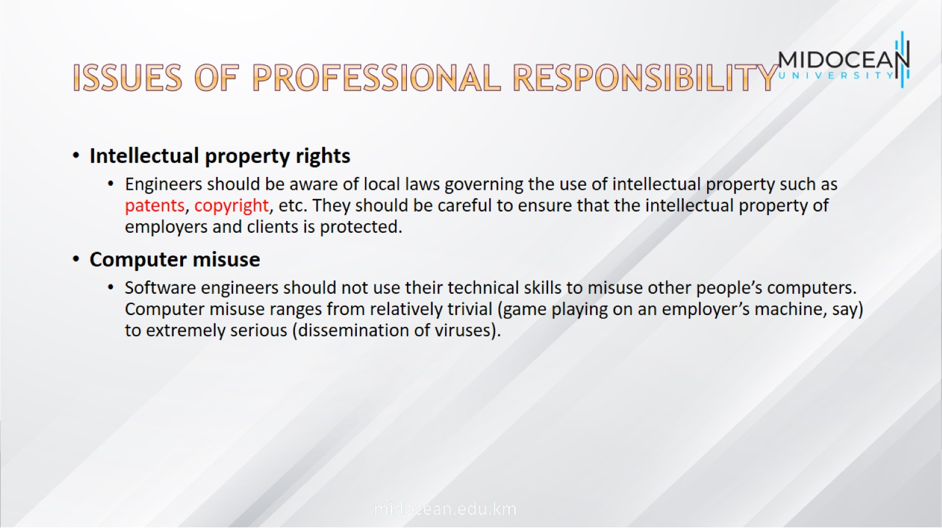
Issues of professional responsibility

Slide 8

ACM/IEEE Code of Ethics

Slide 9
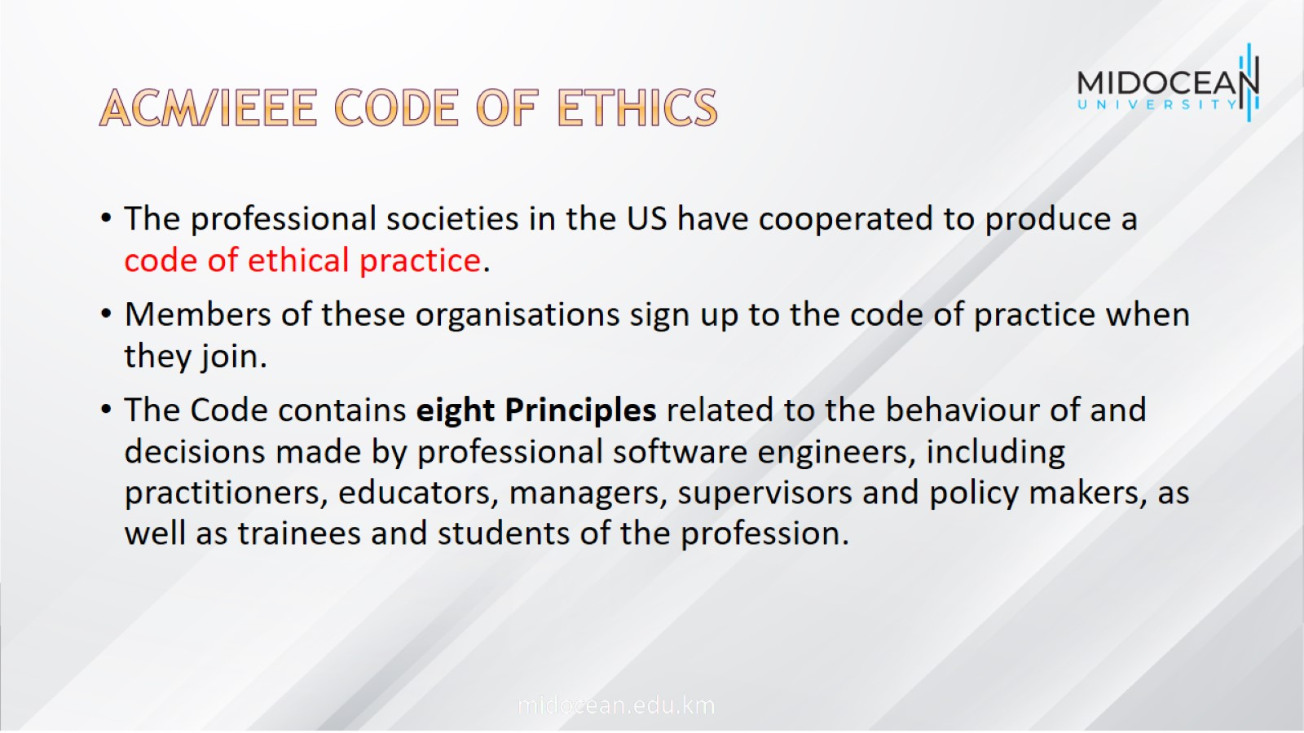
ACM/IEEE Code of Ethics

Slide 10
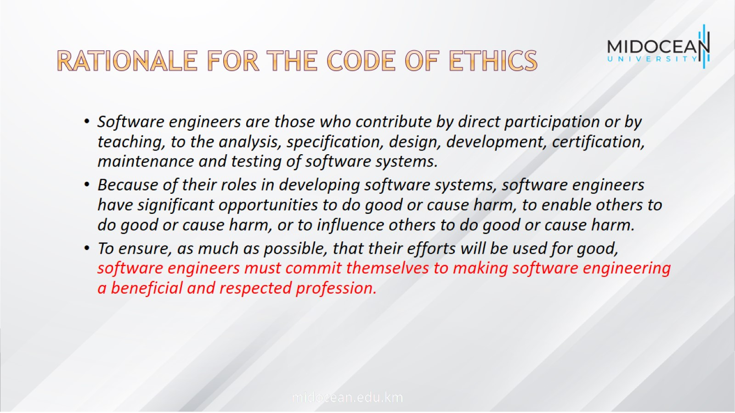
Rationale for the code of ethics

Slide 11

Software engineering
Code of Ethics

Slide 12
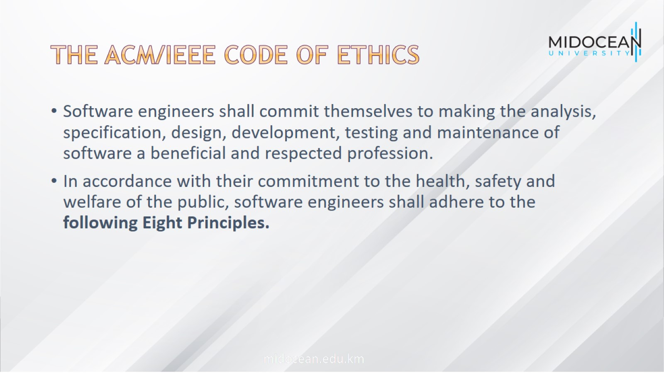
The ACM/IEEE Code of Ethics

Slide 13

PUBLIC

Slide 14

CLIENT AND EMPLOYER

Slide 15

PRODUCT

Slide 16

JUDGMENT

Slide 17

MANAGEMENT

Slide 18

PROFESSION

Slide 19

COLLEAGUES

Slide 20

SELF

Slide 21

Case studies

Slide 22
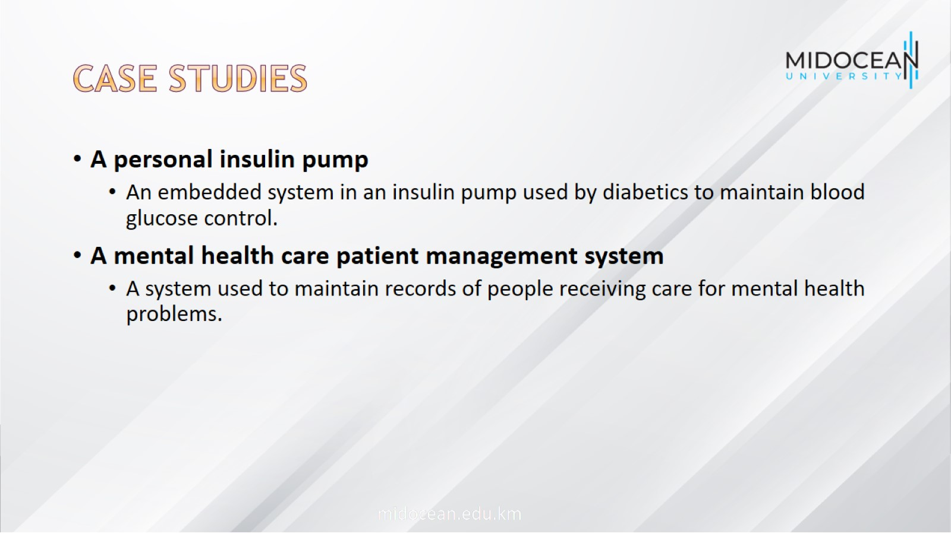
Case studies

Slide 23

Insulin pump control system

Slide 24
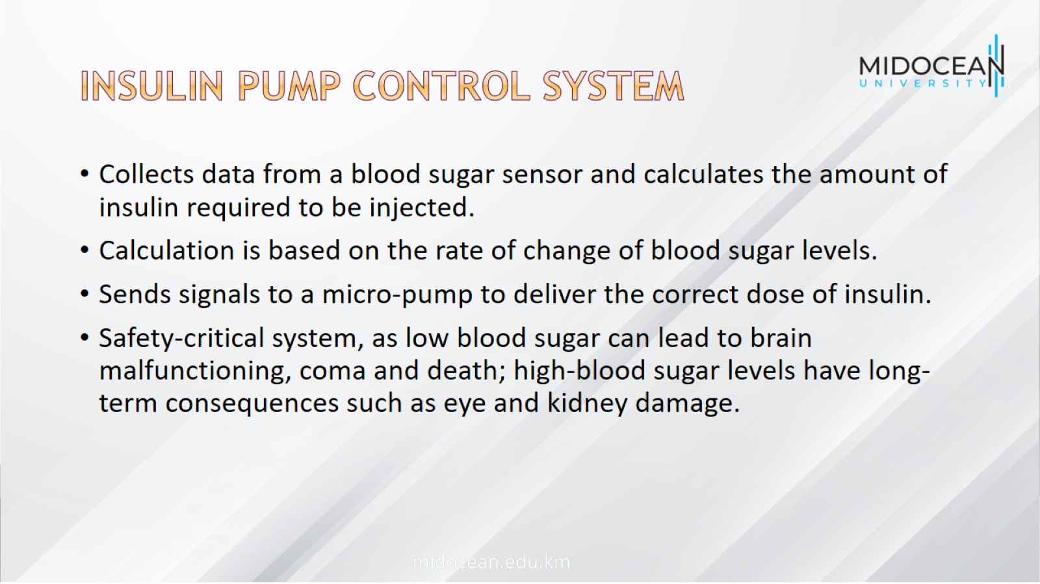
Insulin pump control system

Slide 25
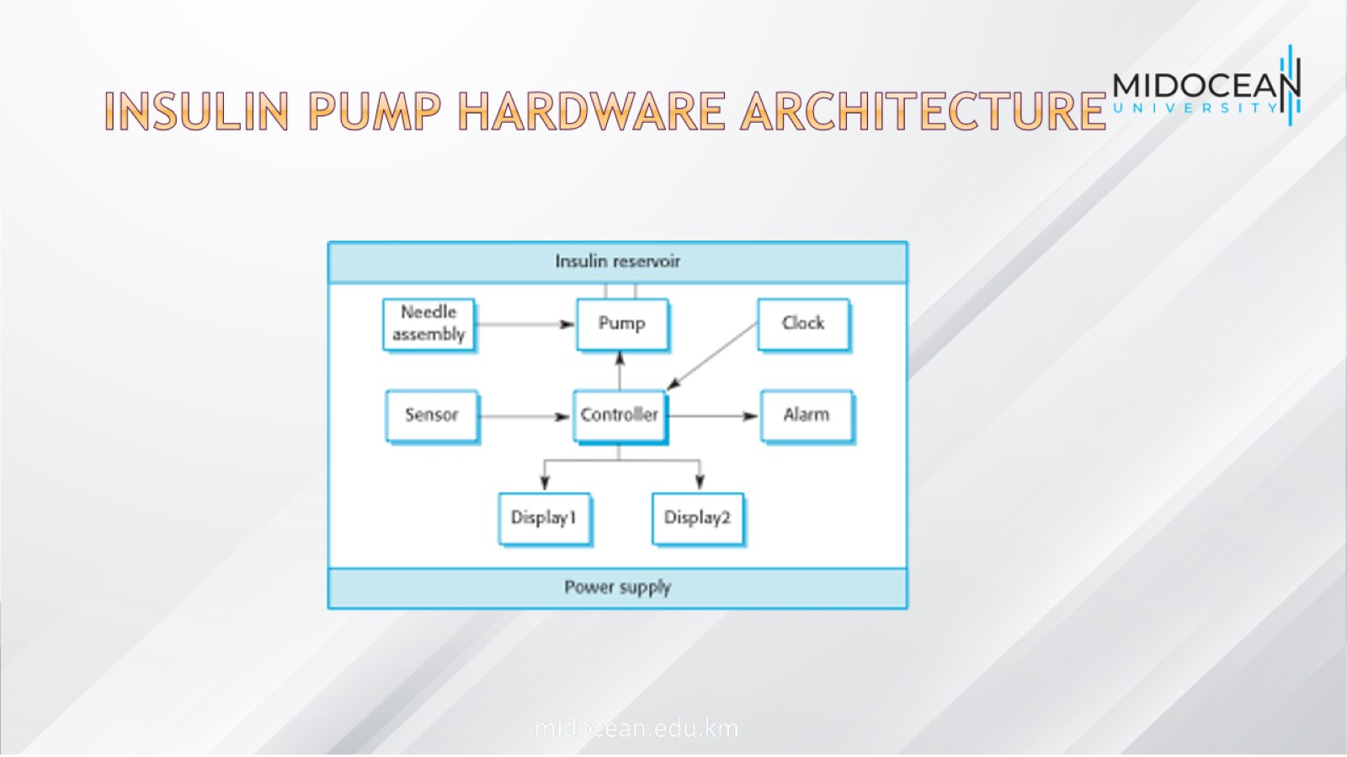
Insulin pump hardware architecture

Slide 26
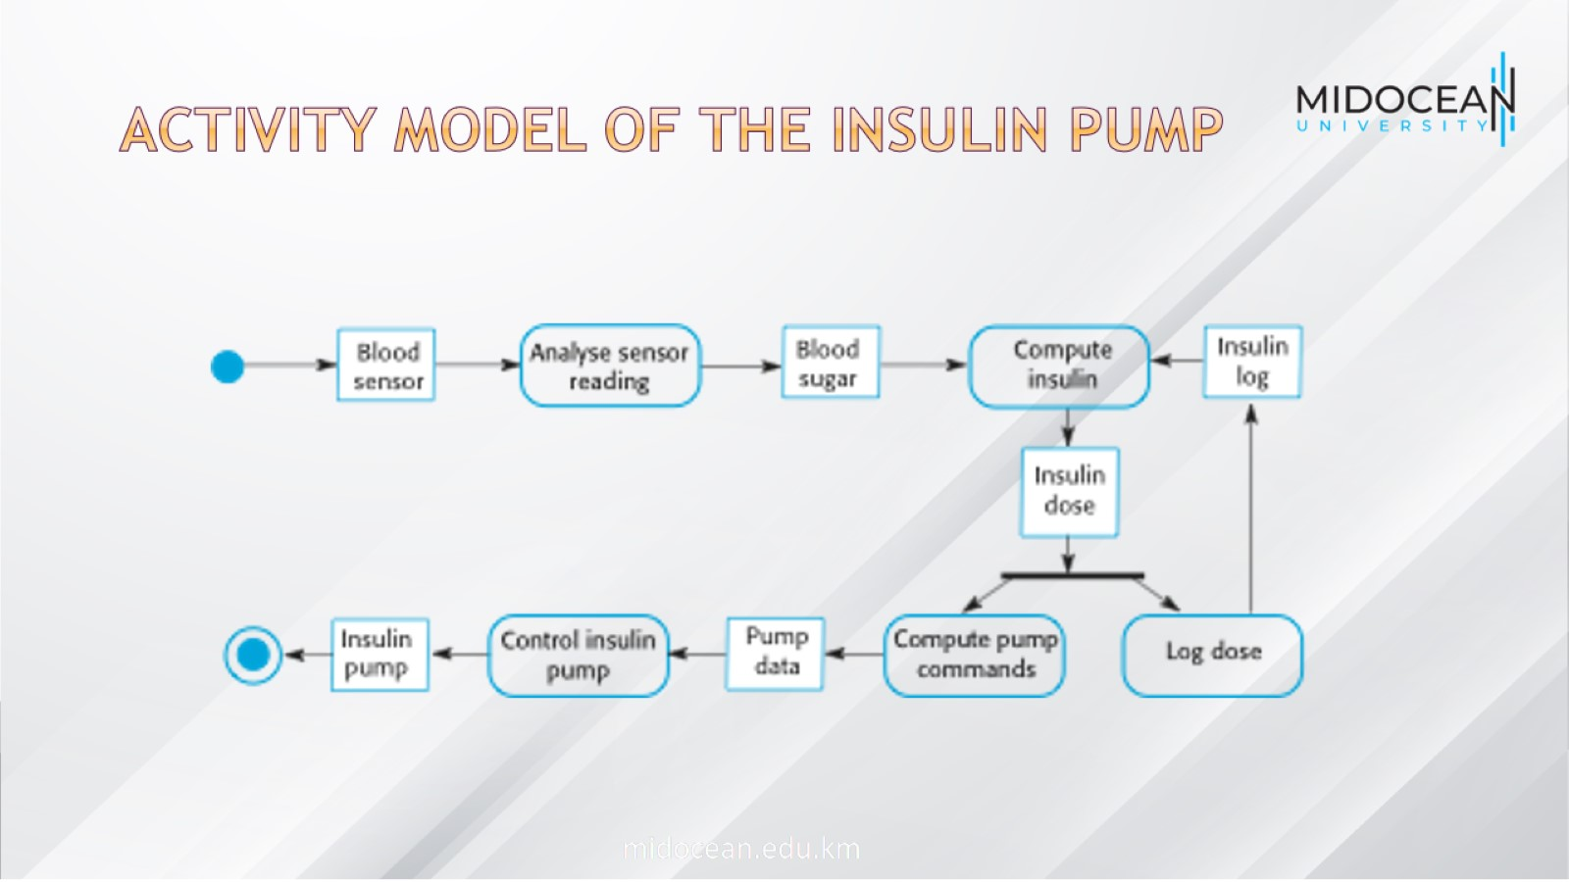
Activity model of the insulin pump

Slide 27
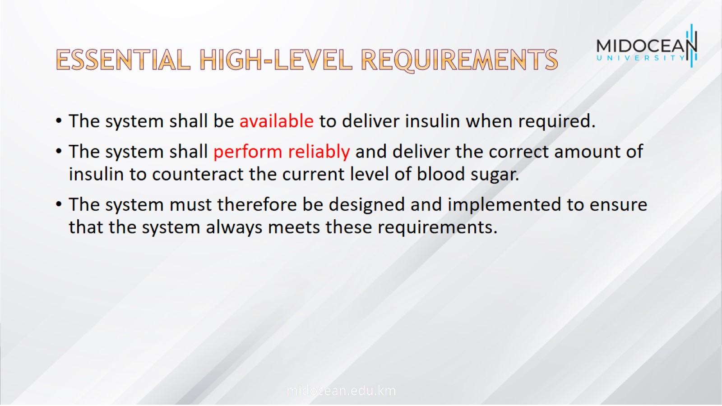
Essential high-level requirements

Slide 28

A patient information system for mental health care

Slide 29
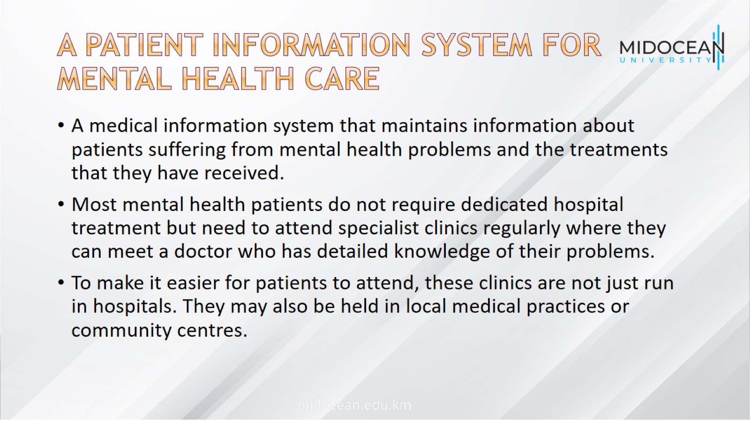
A patient information system for mental health care

Slide 30
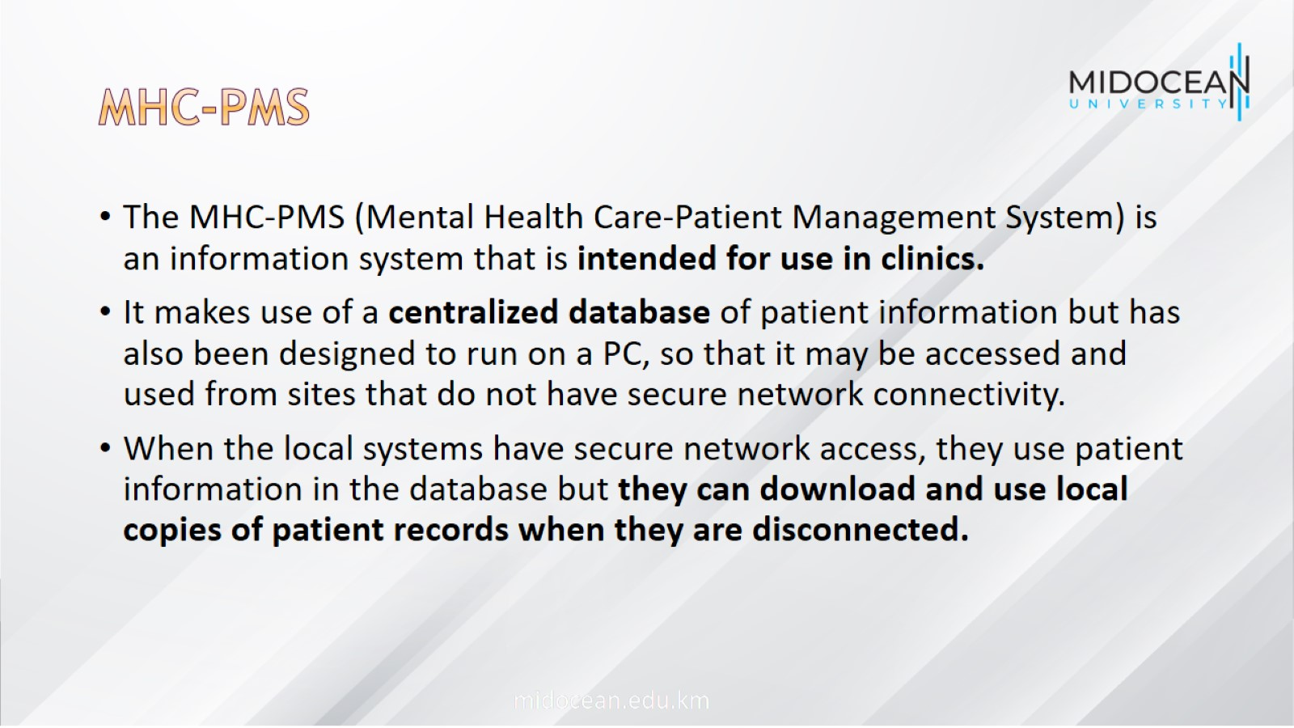
MHC-PMS

Slide 31

MHC-PMS goals

Slide 32
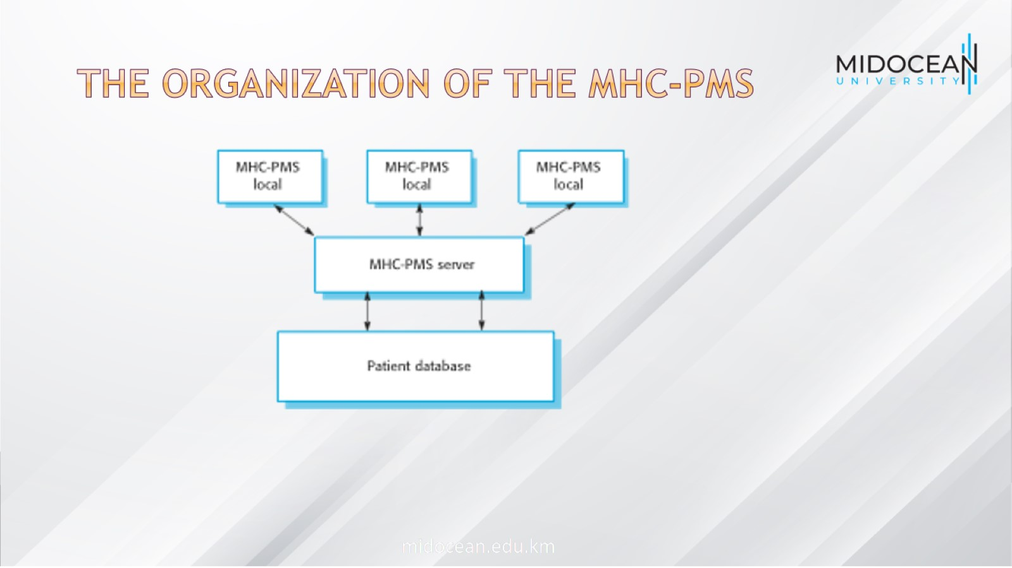
The organization of the MHC-PMS

Slide 33
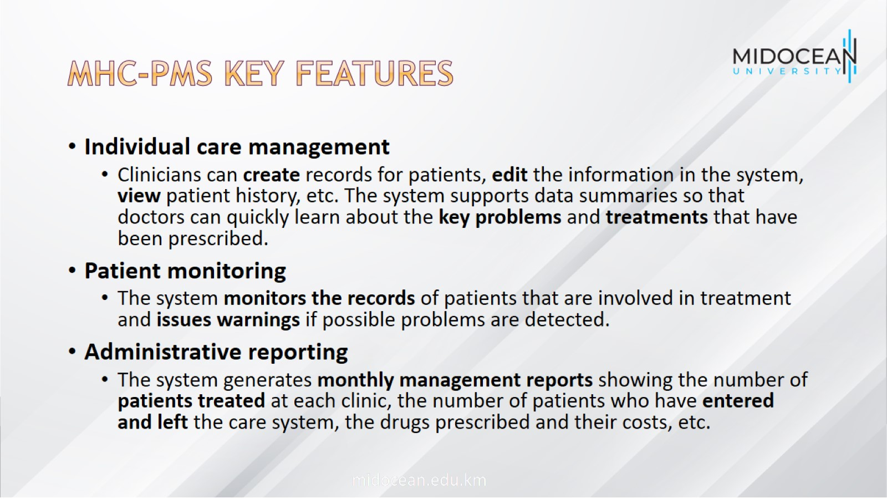
MHC-PMS key features

Slide 34
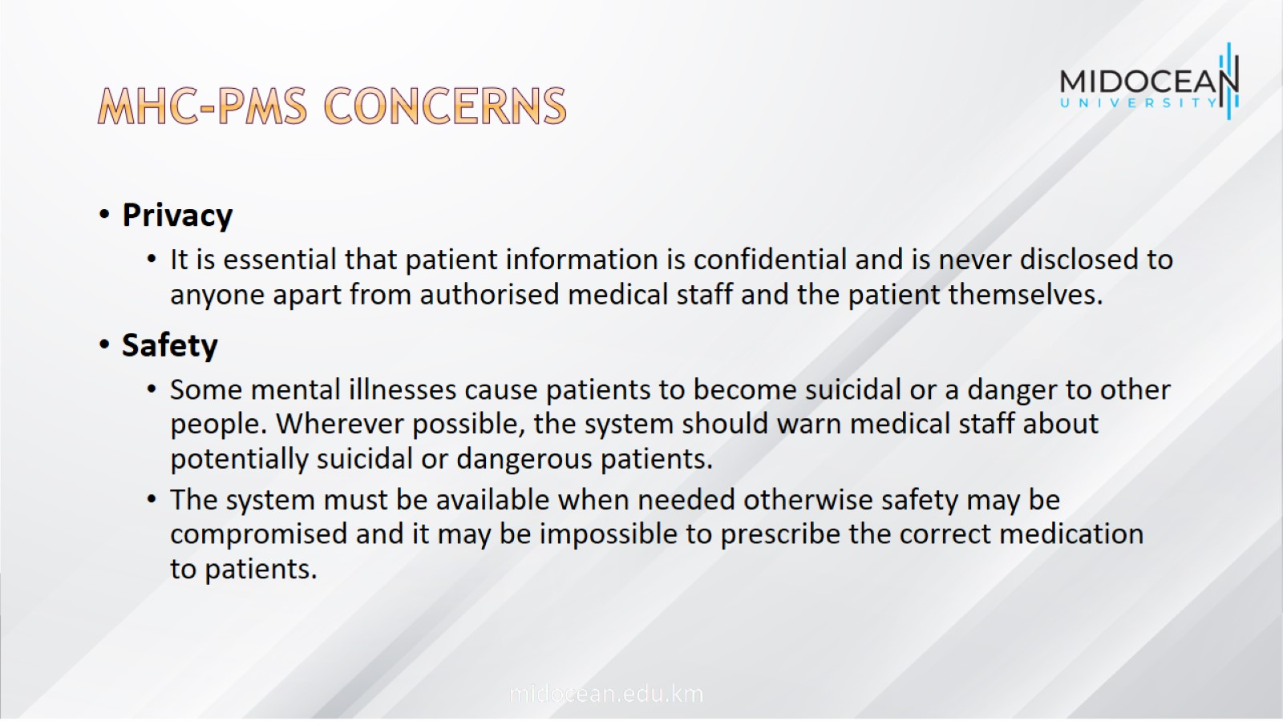
MHC-PMS concerns

Slide 35
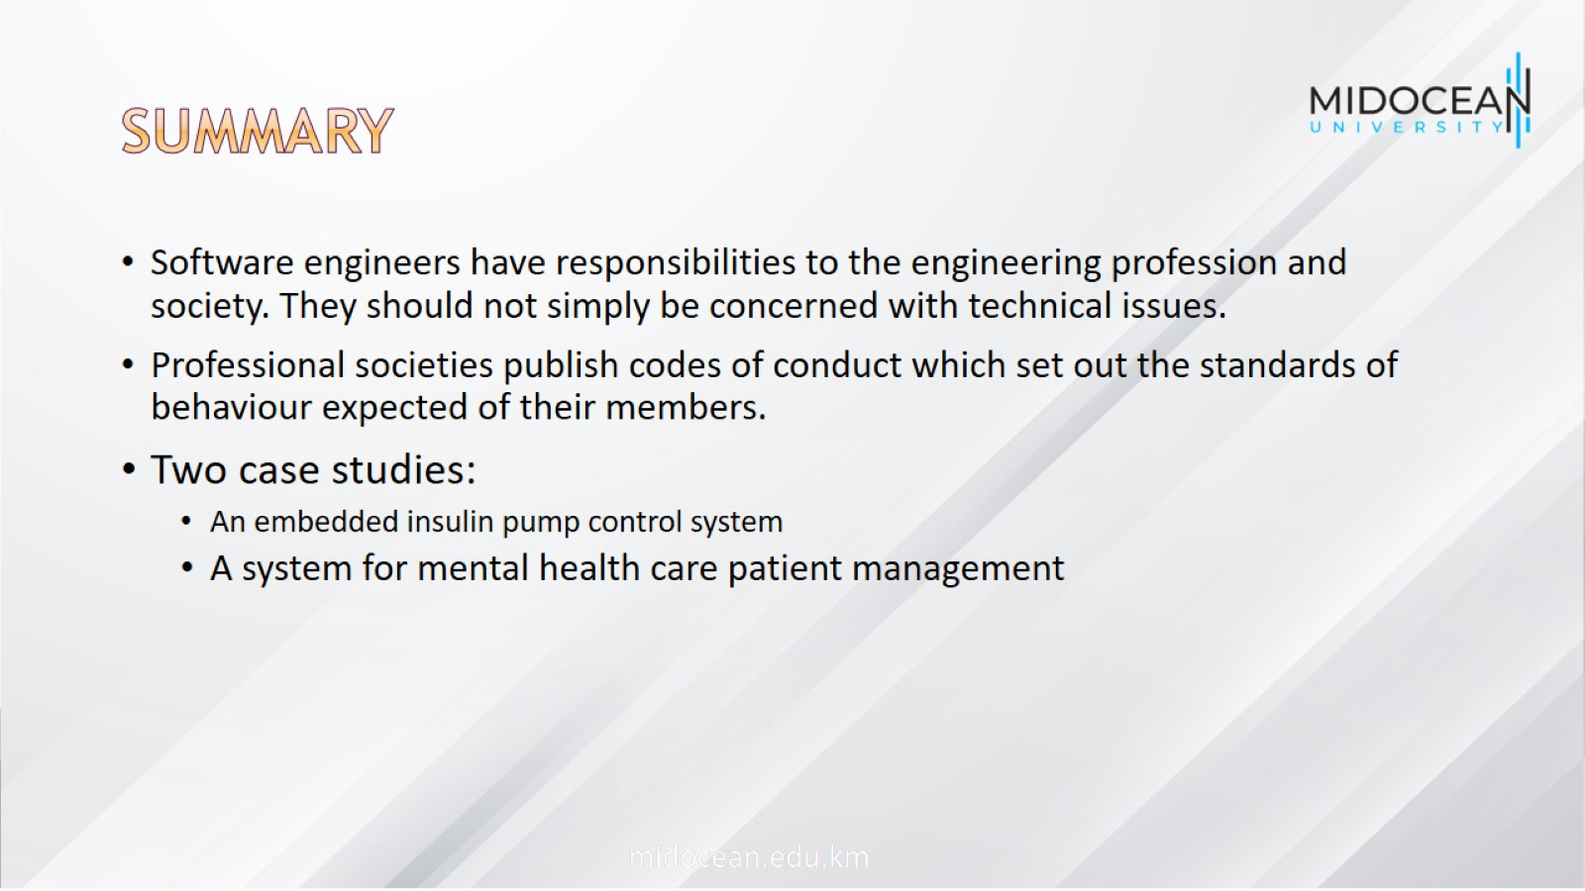
summary

Slide 36


