Slide 1



Deep Learning & Neural Networks
Dr. Shahira Ahmed
DS710
Lecture 10

Slide 2


Slide 3

Learning Outcomes
Understand the basic concepts and architecture of recurrent neural networks
Identify the different types of RNNs and their applications
Understanding the flow of information in an RNN
www.midocean.ae

Slide 4
Lecture Outline
Introduction to Recurrent Neural Networks
Architecture of Recurrent Neural Networks
Applications of Recurrent Neural Networks
Types of RNNs: Simple RNN, LSTM, and GRU
Lab 1
Lab2
www.midocean.ae

Slide 5
Sequences Data
A sequence refers to a collection of data points that are ordered based on their position or time.
Each element in the sequence has a specific position or index that determines its order relative to other elements in the sequence.

Slide 6
Sequences Data
Numeric Sequences: A sequence of numbers, such as [1, 3, 5, 7, 9],sensor reading.
Text Sequences: A sequence of characters or words, such as ["Hello", "world", "!"]. Text sequences are often used in natural language processing tasks, such as language modeling, sentiment analysis, or machine translation.
Time Series: A sequence of observations recorded over time, such as daily temperature readings or stock market prices. Time series analysis involves analyzing and forecasting patterns in these sequences.

Slide 7
Sequences Data
DNA Sequences: A sequence of nucleotides (A, C, G, T) representing genetic information. DNA sequences are used in genomics research to study genes, mutations, and evolutionary relationships.
Music Sequences: A sequence of musical notes or chords representing a piece of music. Music sequences can be analyzed and used for tasks such as music generation or recommendation.
Video Frames: A sequence of images or frames captured from a video. Video sequences can be processed for tasks like object recognition, action recognition, or video summarization

Slide 8
Recurrent Neural Networks (RNNs)
Recurrent Neural Networks (RNNs) are a type of neural network architecture specifically designed to model and process sequential data.
Unlike traditional feedforward neural networks, RNNs have connections that allow information to flow in cycles, enabling them to capture dependencies and patterns in sequential data.
RNN works on the principle of saving the output of a particular layer and feeding this back to the input in order to predict the output of the layer.

Slide 9
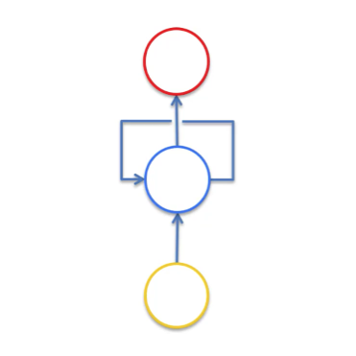
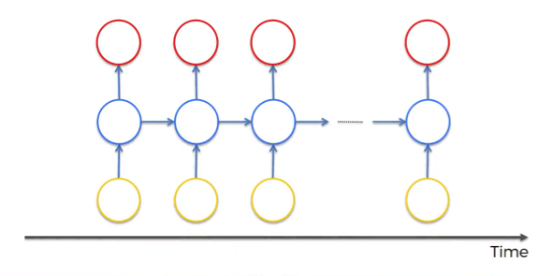
Recurrent Neural Networks (RNNs)
The Ultimate Guide to Recurrent Neural Networks (RNN) - Blogs SuperDataScience - Machine Learning | AI | Data Science Career | Analytics | Success

Slide 10
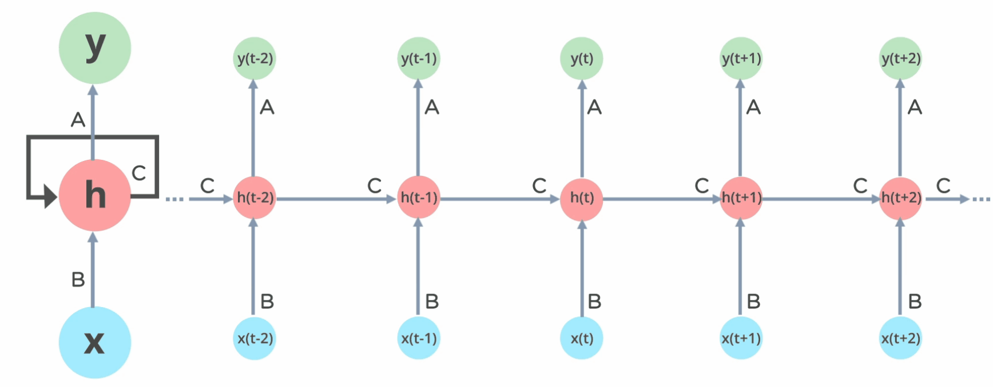
How Does Recurrent Neural Networks Work?
https://www.simplilearn.com/tutorials/deep-learning-tutorial/rnn

Slide 11
How Does Recurrent Neural Networks Work?
Recurrent Neural networks, the information cycles through a loop to the middle hidden layer.
Input and Hidden State:
  At each step of the sequence, an RNN receives an input vector or data point. For example, in natural language processing, the input vector can represent a word or a character.
  In addition to the input vector, the RNN also has a hidden state vector, which represents the network's memory and captures information from previous steps. Initially, the hidden state is initialized to a fixed value or learned from data

Slide 12
How Does Recurrent Neural Networks Work?
Information Flow and Recurrent Connections:
  The input vector and the hidden state are combined and passed through a set of learnable weights or parameters.
  The output of this computation is used to update the hidden state for the current step, which becomes the contextual information for the next step.
  Importantly, the hidden state is not only influenced by the current input but also influenced by the hidden state from the previous step. This feedback loop creates recurrent connections that allow information to flow across different steps in the sequence.

Slide 13
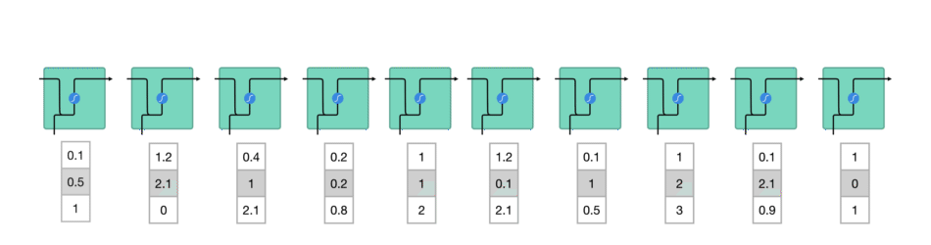
How Does Recurrent Neural Networks Work?
(1)- words get transformed into machine-readable vectors. Then the RNN processes the sequence of vectors one by one.
https://towardsdatascience.com/illustrated-guide-to-lstms-and-gru-s-a-step-by-step-explanation-44e9eb85bf21

Slide 14
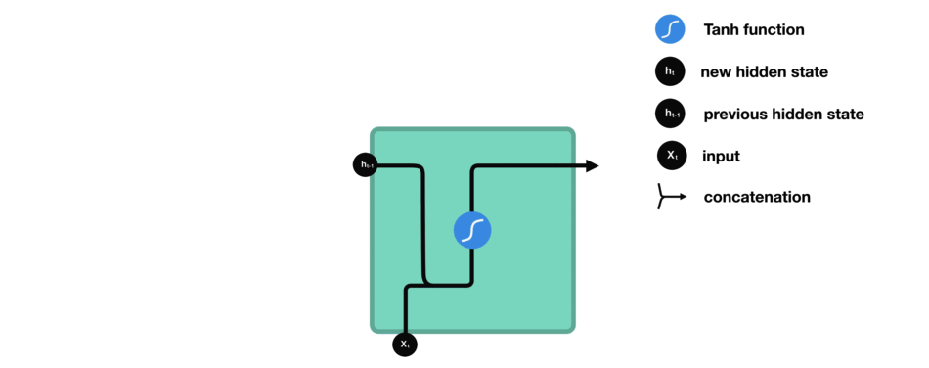
How Does Recurrent Neural Networks Work?
RNN Cell :the input and previous hidden state are combined to form a vector. That vector now has information on the current input and previous inputs. The vector goes through the tanh activation, and the output is the new hidden state, or the memory of the network.
https://towardsdatascience.com/illustrated-guide-to-lstms-and-gru-s-a-step-by-step-explanation-44e9eb85bf21

Slide 15
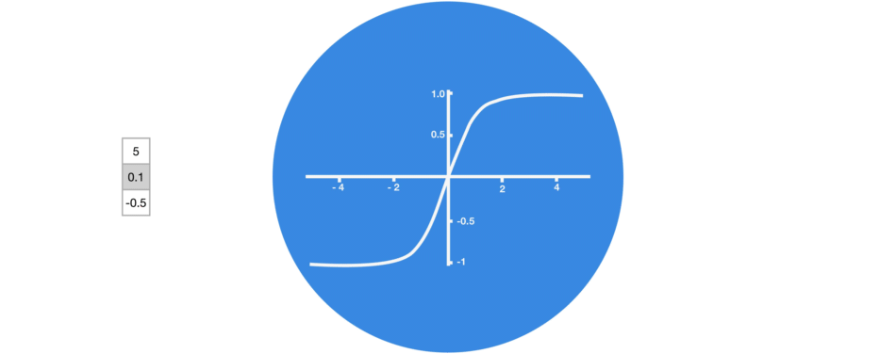
How Does Recurrent Neural Networks Work?
Tanh squishes values to be between -1 and 1
https://towardsdatascience.com/illustrated-guide-to-lstms-and-gru-s-a-step-by-step-explanation-44e9eb85bf21

Slide 16
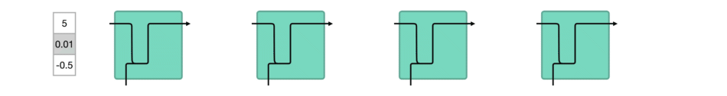
How Does Recurrent Neural Networks Work?
When vectors are flowing through a neural network, it undergoes many transformations due to various math operations.
https://towardsdatascience.com/illustrated-guide-to-lstms-and-gru-s-a-step-by-step-explanation-44e9eb85bf21

Slide 17
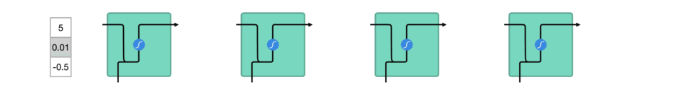
How Does Recurrent Neural Networks Work?
A tanh function ensures that the values stay between -1 and 1, thus regulating the output of the neural network. You can see how the same values from above remain between the boundaries allowed by the tanh function.
https://towardsdatascience.com/illustrated-guide-to-lstms-and-gru-s-a-step-by-step-explanation-44e9eb85bf21

Slide 18
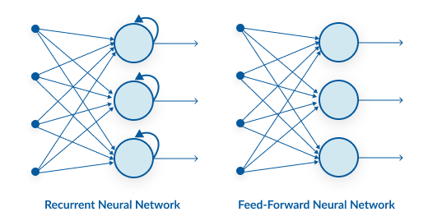
Recurrent Neural Networks vs Feed-forward neural networks
Source: Uditvani.com

Slide 19
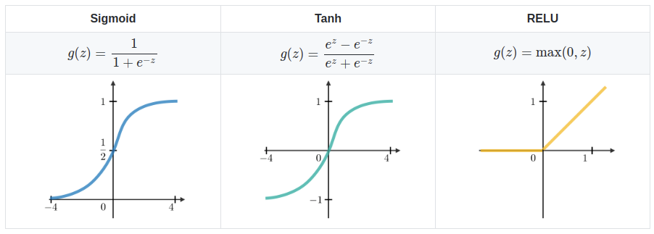
Common Activation Functions
MLtutorial.com

Slide 20
Recurrent Neural Networks vs Feed-forward neural networks
Feed-forward neural networks are poor predictions of sequences because they have no memory of the information they receive.
Feed-forward neural networks simply analyses the current input, a feed-forward network has no idea of temporal order. Apart from its training, it has no memory of what transpired in the past.

Slide 21
Recurrent Neural Networks vs Feed-forward neural networks
The information is in an RNN cycle via a loop. Before making a judgment, it evaluates the current input as well as what it has learned from past inputs.
https://www.analyticsvidhya.com/blog/2022/03/a-brief-overview-of-recurrent-neural-networks-rnn/#h-introduction-on-recurrent-neural-networks

Slide 22
Recurrent Neural Networks vs Feed-forward neural networks
RNNs are naturally suited for processing sequential data with varying lengths. They inherently have a memory component that allows them to maintain information from previous time steps.
RNNs can handle variable-length input sequences by processing them one time step at a time. The RNN's hidden state is updated at each time step, allowing it to capture dependencies and patterns in the sequence.

Slide 23
Variable length input
Padding is adding zeros or a special token to the end of shorter sequences to make them have the same length as the longest sequence in a batch.
Masking is telling the RNN to ignore the padded values and only process the actual inputs1. You can use a mask tensor that has ones where the inputs are valid and zeros where they are padded.
Single-sample batches are batches that contain only one sequence, so there is no need for padding or masking. However, this can be inefficient and slows

Slide 24
Recurrent Neural Networks vs Feed-forward neural networks
FFNs, on the other hand, are typically designed to handle fixed-length input vectors. They do not have an inherent memory component like RNNs, and their layers are fully connected, meaning each input element is treated independently.
you can also use techniques like padding or truncation to make the input vectors uniform in length

Slide 25
Why Recurrent Neural Networks?
RNN were created because there were a few issues in the feed-forward neural network:
  Cannot handle sequential data
  Cannot handle variable length input
  Considers only the current input
  Cannot memorize previous inputs

Slide 26
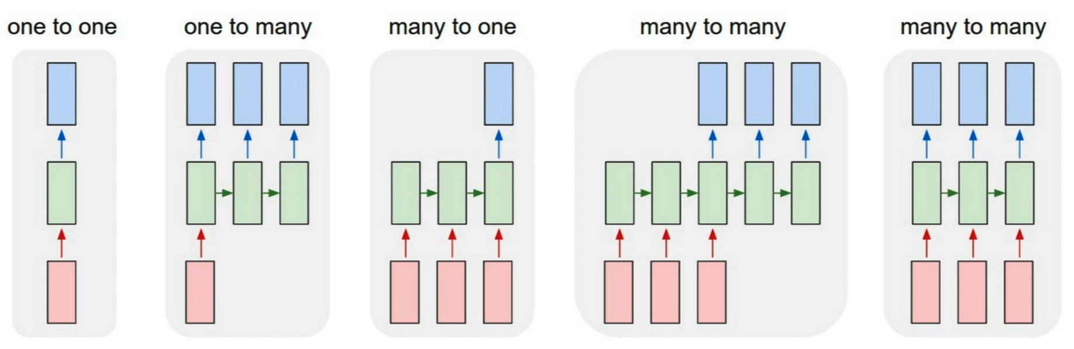
Main Types of RNN Architectures
https://calvinfeng.gitbook.io/machine-learning-notebook/supervised-learning/recurrent-neural-network/recurrent_neural_networks
Notes:
One-to-One (Feedforward): This is not technically an RNN architecture but a traditional feedforward neural network where there is no recurrence. It takes fixed-size input and produces a fixed-size output without considering any temporal dependencies.
One-to-Many: In this architecture, the RNN takes a single input and generates a sequence of outputs. For example, generating a sentence given an image caption.
Many-to-One: In this architecture, the RNN takes a sequence of inputs and produces a single output. For example, sentiment analysis where the input is a sentence and the output is the sentiment of that sentence.
Many-to-Many (Sequence-to-Sequence): This architecture takes a sequence of inputs and produces a sequence of outputs. Many-to-manyThis model is ideal for machine translation like the one we see on Google translate. The input could an English sentence which has variable length and the output will be the same sentence in a different language which also has variable length

Slide 27
Main Types of RNN Architectures
One-to-One (Feedforward): This is not technically an RNN architecture but a traditional feedforward neural network where there is no recurrence. It takes fixed-size input and produces a fixed-size output without considering any temporal dependencies.
One-to-Many: In this architecture, the RNN takes a single input and generates a sequence of outputs. For example, generating a sentence given an image caption.
Many-to-One: In this architecture, the RNN takes a sequence of inputs and produces a single output. For example, sentiment analysis where the input is a sentence and the output is the sentiment of that sentence.
Many-to-Many (Sequence-to-Sequence): This architecture takes a sequence of inputs and produces a sequence of outputs. Many-to-manyThis model is ideal for machine translation like the one we see on Google translate. The input could an English sentence which has variable length and the output will be the same sentence in a different language which also has variable length

Slide 28
Vanishing Gradient
The Problem: Short-term Memory
  Recurrent Neural Networks suffer from short-term memory. If a sequence is long enough, they’ll have a hard time carrying information from earlier time steps to later ones. So if you are trying to process a paragraph of text to do predictions, RNN’s may leave out important information from the beginning.
  During back propagation, recurrent neural networks suffer from the vanishing gradient problem. Gradients are values used to update a neural networks weights. The vanishing gradient problem is when the gradient shrinks as it back propagates through time. If a gradient value becomes extremely small, it doesn’t contribute too much learning.
https://towardsdatascience.com/illustrated-guide-to-lstms-and-gru-s-a-step-by-step-explanation-44e9eb85bf21

Slide 29
Exploding Gradient Problem
While training a neural network, if the slope tends to grow exponentially instead of decaying, this is called an Exploding Gradient. This problem arises when large error gradients accumulate, resulting in very large updates to the neural network model weights during the training process.

Slide 30
Solutions to Vanishing Gradient Problem
One popular variation is the Long Short-Term Memory (LSTM) network. LSTM networks introduce memory cells and gating mechanisms that allow for better preservation of information over longer sequences.
Another variation is the Gated Recurrent Unit (GRU), which simplifies the LSTM architecture by combining the forget and input gates into a single update gate. GRUs have similar capabilities to LSTMs but with a slightly more streamlined structure.

Slide 31
Advantages of Recurrent Neural Network
Recurrent Neural Networks (RNNs) have several advantages over other types of neural networks, including:
  Ability To Handle Variable-Length Sequences : RNNs are designed to handle input sequences of variable length, which makes them well-suited for tasks such as speech recognition, natural language processing, and time series analysis.
  Memory Of Past Inputs : RNNs have a memory of past inputs, which allows them to capture information about the context of the input sequence. This makes them useful for tasks such as language modeling, where the meaning of a word depends on the context in which it appears.
  Parameter Sharing : RNNs share the same set of parameters across all time steps, which reduces the number of parameters that need to be learned and can lead to better generalization.

Slide 32
Disadvantages of RNNs:
Vanishing/Exploding Gradient Problem: RNNs suffer from the vanishing or exploding gradient problem, which occurs when gradients either become too small or too large during backpropagation. This makes it difficult for the network to learn long-term dependencies or propagate information effectively over long sequences.
Difficulty in Capturing Long-Term Dependencies: Standard RNN architectures have difficulty capturing long-term dependencies in sequential data. As the time lag between relevant information increases, RNNs tend to forget or lose track of important information from earlier time steps.
Lack of Parallelism: RNNs process sequential data one time step at a time, which makes them inherently sequential in nature. This limits their ability to take advantage of parallel computing, resulting in slower training and inference times compared to other neural network architectures.

Slide 33
Disadvantages of RNNs:
Memory Limitations: RNNs have a fixed-size hidden state that is shared across all time steps. This fixed memory capacity can be a limitation when dealing with long sequences or complex tasks that require capturing extensive context or information.
Difficulty with Variable-Length Inputs: RNNs typically require fixed-length input sequences. Dealing with variable-length inputs, such as sentences of different lengths in natural language processing tasks, requires additional pre-processing or padding techniques, which can be inefficient.

Slide 34
Disadvantages of RNNs:
Computational Complexity: RNNs can be computationally expensive to train and require substantial computational resources due to their recurrent nature and sequential processing. Training large-scale RNN models on long sequences can be time-consuming and resource-intensive.

Slide 35

Applications of RNNs
Sunspring (movie, 2016) •
Directed By Oscar Sharp •
Written Benjamin
Sunspring - The short film written by an AI robot called 'Benjamin'. – Acumass
https://youtu.be/LY7x2Ihqjmc

Slide 36
Applications of RNNs
The following are some of the applications of RNNs:
  Natural Language Processing (NLP): RNNs are widely used in NLP tasks such as language modeling, machine translation, sentiment analysis, named entity recognition, and text generation. They can effectively capture the sequential nature of language and model dependencies between words or characters in a sentence.
  Speech Recognition: RNNs are used in automatic speech recognition systems to convert spoken language into written text. They can model the temporal dependencies in speech signals.
  Time Series Analysis: RNNs are well-suited for time series analysis tasks such as forecasting, anomaly detection, and signal processing. They can capture temporal dependencies and patterns in sequential data, making them effective for predicting future values or detecting abnormal behavior.

Slide 37
Applications of RNNs
The following are some of the applications of RNNs:
  Image Captioning: RNNs combined with Convolutional Neural Networks (CNNs) are used for generating captions for images. CNNs extract visual features from images, which are then fed into an RNN to generate a textual description of the image.
  Music Generation: RNNs can be used to generate music by learning from patterns in a sequence of musical notes or audio samples. They can capture musical structure and create new compositions based on the learned patterns.

Slide 38
Applications of RNNs
The following are some of the applications of RNNs:
  DNA Sequence Analysis: RNNs can be useful for analyzing DNA sequences and identifying patterns or motifs within the sequences.
  Health Monitoring and Disease Detection: RNNs can be used for health monitoring and disease detection by analyzing time series data from wearable devices or medical sensors. They can identify patterns or anomalies in physiological signals and assist in diagnosing diseases or monitoring patient health.
  Gesture Recognition: RNNs can analyze sequential data from sensors or motion capture devices to recognize and interpret human gestures. This has applications in fields such as sign language recognition, human-computer interaction, and virtual reality.

Slide 39
Variants of RNNs
RNN’s uses a lot less computational resources than it’s evolved variants, LSTM’s and GRU’s.
Long Short-Term Memory (LSTM): LSTM is an extension of the traditional RNN architecture that introduces a memory cell, which allows for better handling of long-term dependencies. LSTMs use gates to control the flow of information into and out of the memory cell, enabling them to selectively retain or forget information over long sequences.
Gated Recurrent Unit (GRU): GRU is another variant of the traditional RNN architecture that addresses the vanishing gradient problem. GRUs have a similar gating mechanism as LSTMs but with a simplified structure. They combine the forget and input gates into a single "update gate" and merge the hidden state and memory cell into a single "hidden state."

Slide 40
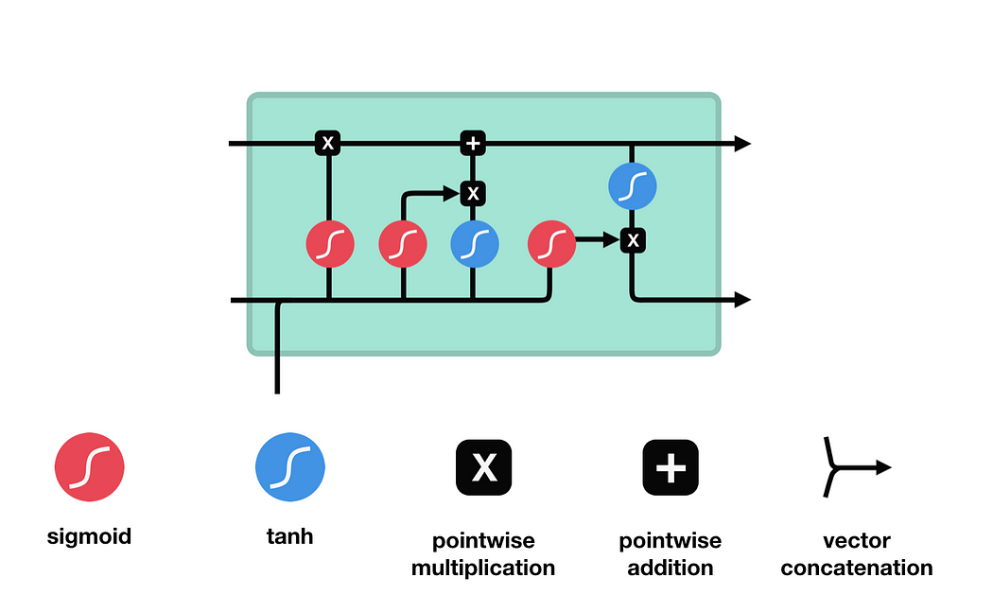
Long Short-Term Memory (LSTM)
An LSTM has a similar control flow as a recurrent neural network. It processes data passing on information as it propagates forward.
The differences are the operations within the LSTM’s cells.
https://towardsdatascience.com/illustrated-guide-to-lstms-and-gru-s-a-step-by-step-explanation-44e9eb85bf21

Slide 41
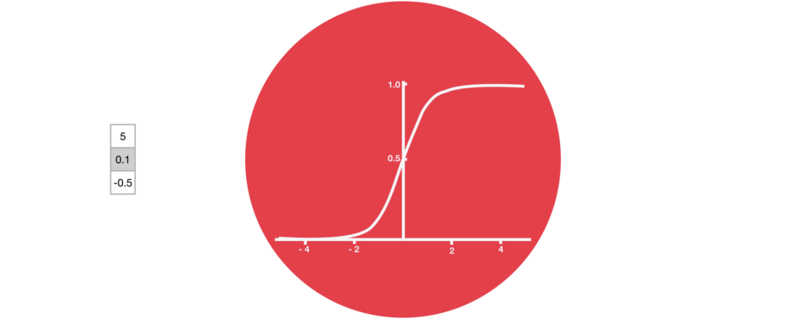
Long Short-Term Memory (LSTM)
Sigmoid
https://towardsdatascience.com/illustrated-guide-to-lstms-and-gru-s-a-step-by-step-explanation-44e9eb85bf21

Slide 42
Long Short-Term Memory (LSTM)
Sigmoid
A sigmoid activation is similar to the tanh activation. Instead of squishing values between -1 and 1, it squishes values between 0 and 1.
That is helpful to update or forget data because any number getting multiplied by 0 is 0, causing values to disappears or be “forgotten.”
Any number multiplied by 1 is the same value therefore that value stay’s the same or is “kept.” The network can learn which data is not important therefore can be forgotten or which data is important to keep.
https://towardsdatascience.com/illustrated-guide-to-lstms-and-gru-s-a-step-by-step-explanation-44e9eb85bf21

Slide 43
Long Short-Term Memory (LSTM)
Forget gate
This gate decides what information should be thrown away or kept. Information from the previous hidden state and information from the current input is passed through the sigmoid function. Values come out between 0 and 1. The closer to 0 means to forget, and the closer to 1 means to keep.
https://towardsdatascience.com/illustrated-guide-to-lstms-and-gru-s-a-step-by-step-explanation-44e9eb85bf21

Slide 44
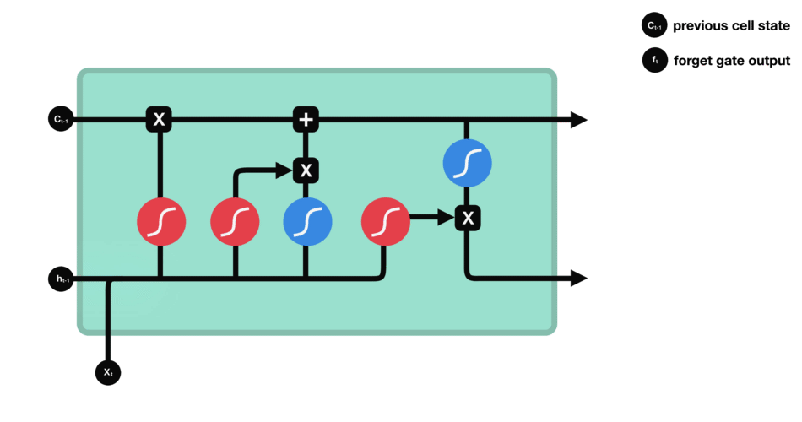
Long Short-Term Memory (LSTM)
https://towardsdatascience.com/illustrated-guide-to-lstms-and-gru-s-a-step-by-step-explanation-44e9eb85bf21

Slide 45
Long Short-Term Memory (LSTM)
Input Gate
we pass the previous hidden state and current input into a sigmoid function. That decides which values will be updated by transforming the values to be between 0 and 1. 0 means not important, and 1 means important.
You also pass the hidden state and current input into the tanh function to squish values between -1 and 1 to help regulate the network.
Then you multiply the tanh output with the sigmoid output. The sigmoid output will decide which information is important to keep from the tanh output.
https://towardsdatascience.com/illustrated-guide-to-lstms-and-gru-s-a-step-by-step-explanation-44e9eb85bf21

Slide 46
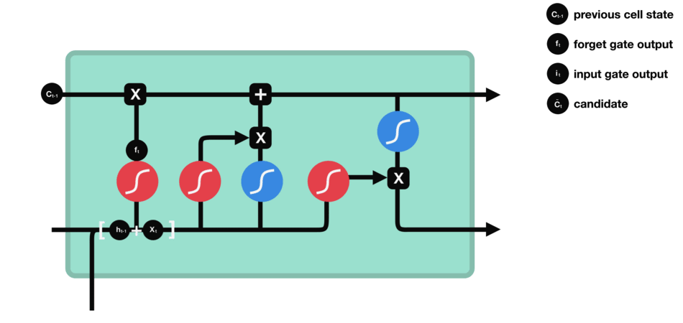
Long Short-Term Memory (LSTM)
https://towardsdatascience.com/illustrated-guide-to-lstms-and-gru-s-a-step-by-step-explanation-44e9eb85bf21

Slide 47
Long Short-Term Memory (LSTM)
Cell State
Now we should have enough information to calculate the cell state.
First, the cell state gets pointwise multiplied by the forget vector. This has a possibility of dropping values in the cell state if it gets multiplied by values near 0.
Then we take the output from the input gate and do a pointwise addition which updates the cell state to new values that the neural network finds relevant.
https://towardsdatascience.com/illustrated-guide-to-lstms-and-gru-s-a-step-by-step-explanation-44e9eb85bf21

Slide 48
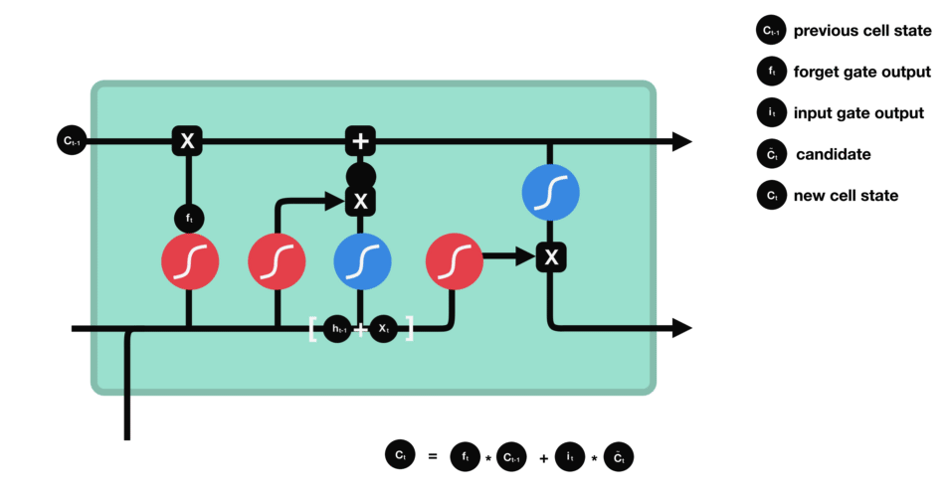
Long Short-Term Memory (LSTM)
https://towardsdatascience.com/illustrated-guide-to-lstms-and-gru-s-a-step-by-step-explanation-44e9eb85bf21

Slide 49
Long Short-Term Memory (LSTM)
Output Gate
The output gate decides what the next hidden state should be. Remember that the hidden state contains information on previous inputs. The hidden state is also used for predictions.
First, we pass the previous hidden state and the current input into a sigmoid function.
Then we pass the newly modified cell state to the tanh function.
We multiply the tanh output with the sigmoid output to decide what information the hidden state should carry. The output is the hidden state. The new cell state and the new hidden is then carried over to the next time step.
https://towardsdatascience.com/illustrated-guide-to-lstms-and-gru-s-a-step-by-step-explanation-44e9eb85bf21

Slide 50
Long Short-Term Memory (LSTM)
Output Gate
The output gate decides what the next hidden state should be. Remember that the hidden state contains information on previous inputs. The hidden state is also used for predictions.
First, we pass the previous hidden state and the current input into a sigmoid function.
Then we pass the newly modified cell state to the tanh function.
We multiply the tanh output with the sigmoid output to decide what information the hidden state should carry. The output is the hidden state. The new cell state and the new hidden is then carried over to the next time step.
https://towardsdatascience.com/illustrated-guide-to-lstms-and-gru-s-a-step-by-step-explanation-44e9eb85bf21

Slide 51
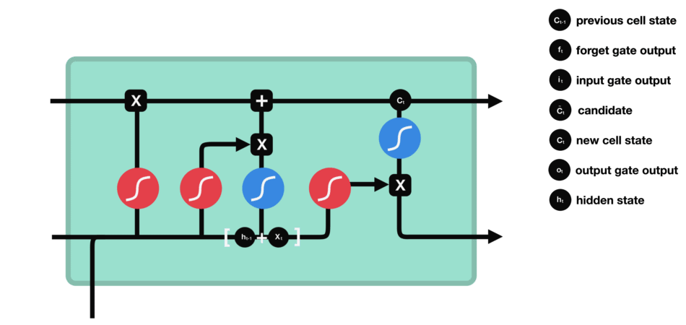
Long Short-Term Memory (LSTM)
https://towardsdatascience.com/illustrated-guide-to-lstms-and-gru-s-a-step-by-step-explanation-44e9eb85bf21

Slide 52
GRU and LSTM
LSTM and GRU introduce additional mechanisms to RNNs that allow them to selectively retain or update information over time. This enables them to capture long-term dependencies in sequences and make use of relevant information from the past.

Slide 53
LSTM
LSTM was introduced by Hochreiter and Schmidhuber in 1997.
It consists of memory cells that can store and access information over long periods of time.
The key components of an LSTM cell are the input gate, forget gate, output gate, and memory cell.
The input gate determines whether to update the memory cell with new information.
The forget gate decides which information to discard from the memory cell.
The output gate controls the information to be output from the memory cell.

Slide 54
GRU stands for Gated Recurrent Unit.(GRU)
GRU was introduced by Cho et al. in 2014 as a simplified version of LSTM.
It combines the forget and input gates of LSTM into a single update gate.
The reset gate determines the amount of information from the past to forget.
GRU has a more compact architecture compared to LSTM, which makes it easier to train and computationally more efficient.

Slide 55
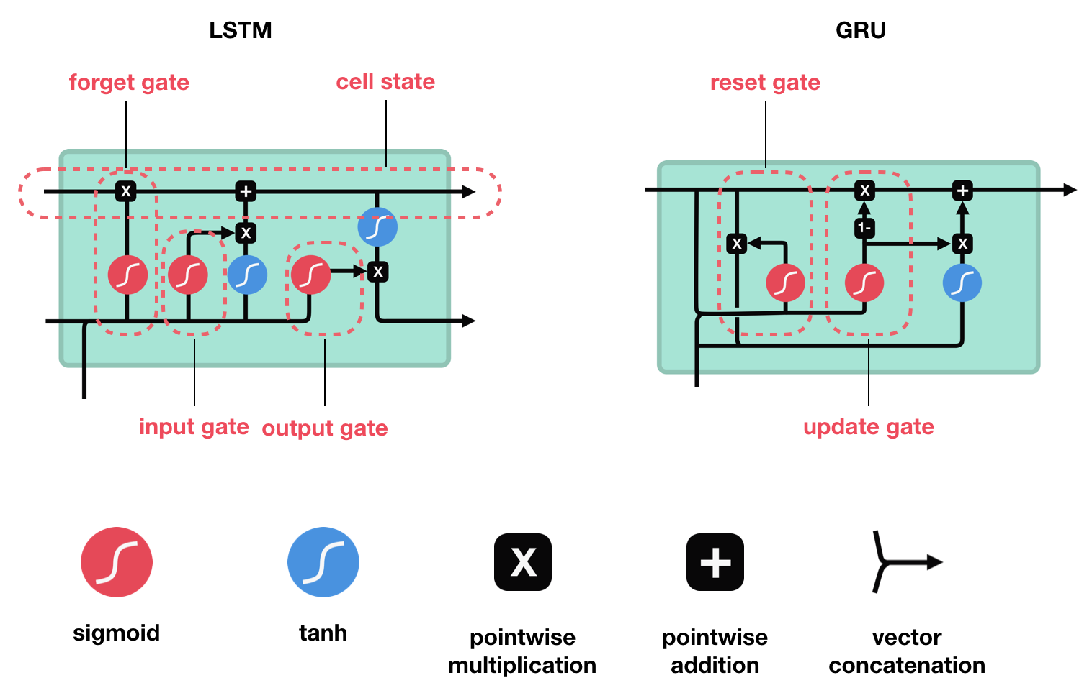
GRU vs LSTM
https://towardsdatascience.com/illustrated-guide-to-lstms-and-gru-s-a-step-by-step-explanation-44e9eb85bf21

Slide 56
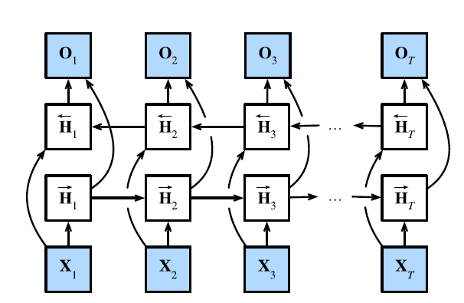
Bidirectional RNN (BiRNN)
BiRNN processes the input sequence in both forward and backward directions using two separate hidden layers.

Slide 57
Transformers
Transformers are a more recent architecture that have gained significant attention, particularly with the introduction of the Transformer model in the "Attention is All You Need" paper by Vaswani et al. in 2017.
Transformers are based on a self-attention mechanism that allows them to capture dependencies between elements in a sequence without the need for recurrent connections.
Instead of maintaining a recurrent hidden state, transformers process the entire sequence in parallel, attending to different parts of the sequence using attention mechanisms. This parallelization makes transformers highly efficient for training and inference.

Slide 58
Transformers
Compared to RNNs, transformers have several advantages. They can better handle long-range dependencies, capture global context, and parallelize computation, making them more efficient for training on modern hardware.
However, transformers may require more data to train effectively and can be computationally expensive due to the attention mechanism and the larger number of parameters compared to RNNs.

Slide 59
LAB 1

Slide 60
LAB 2

Slide 61
Lecture Summary
RNNs are well-suited for tasks that involve sequential data processing, such as natural language processing, speech recognition, and time series analysis.
RNNs suffer from the vanishing or exploding gradient problem, which can make it challenging to capture long-term dependencies in sequences.
www.midocean.ae

Slide 62
Lecture Summary
RNN variants like LSTM and GRU have been developed to address the vanishing gradient problem and improve the modeling capabilities of RNNs. LSTM introduces gating mechanisms to control the flow of information, while GRU simplifies the gating mechanism.
Transformers
www.midocean.ae

