Slide 1


Master Of Real Estate
Management
Prepared by
Dr. Al Montaser Abuhussein
Artificial Intelligence in Business
Lecture 7

Slide 2



Master Of Real Estate
Management
Lecture 7
Artificial Intelligence in Business
Prepared by
Dr. Al Montaser Abuhussein

Slide 3

Chapter
05
AI Integration in the Digital Transformation Strategy
3

Slide 4

Chapter
Learning Objectives
05
Explain the relationship between Artificial Intelligence and Digital Transformation Strategy.
Analyze how AI supports knowledge management and managerial decision-making in digitized organizations.
Understand the importance of business models, digital strategy, resource fit, and strategic alignment.
Describe the main phases of the Digital Transformation Strategy Framework.
Evaluate organizational AI readiness using the dimensions of technologies, activities, boundaries, and goals.
Apply AI integration concepts to real estate organizations, smart buildings, PropTech platforms, and customer experience.
Artificial Intelligence in Business | Chapter 5: AI Integration in the Digital Transformation Strategy
4

Slide 5
1. AI, Knowledge Management, and Managerial Decision-Making
AI becomes valuable when it converts data and knowledge into better decisions and organizational behavior.
Artificial Intelligence in Business | Chapter 5: AI Integration in the Digital Transformation Strategy
5

Slide 6
Why AI Adoption Varies Across Companies
• The chapter begins by emphasizing that AI adoption speed differs across companies and industries.
• AI requires complementary investment in data, skills, digitized workflows, infrastructure, and process redesign.
• Some organizations adopt AI quickly because they already have mature digital systems and strong data capabilities.
• Other organizations lag because they lack clear AI strategy, leadership commitment, technical talent, or organizational readiness.
• Therefore, AI adoption is not only a technology issue; it is a strategic, managerial, and organizational change issue.
Real estate application
A real estate firm with digitized property records, CRM, IoT sensors, and analytics teams can adopt AI faster than a firm relying on fragmented spreadsheets and paper-based workflows.
Artificial Intelligence in Business | Chapter 5: AI Integration in the Digital Transformation Strategy
6

Slide 7
AI Strategy and Clearly Defined Benefits
• Executives frequently cite weak strategy as one of the barriers to AI adoption.
• An AI strategy should define what business problems AI will solve and what benefits are expected.
• AI benefits may include cost reduction, faster decisions, improved customer experience, better forecasting, and process automation.
• Without clearly defined benefits, AI projects may become experimental technologies with little operational value.
• A strong AI strategy connects AI initiatives with business goals, customer value, and organizational priorities.
Artificial Intelligence in Business | Chapter 5: AI Integration in the Digital Transformation Strategy
7

Slide 8
Common Barriers to AI Adoption
• Companies may lack talent with the appropriate AI, data, and analytics skill sets.
• Functional silos may prevent end-to-end AI deployment across departments.
• Leadership may lack ownership, commitment, or understanding of AI opportunities.
• Organizations may not have robust data capture, data quality, or data governance processes.
• Legacy systems and non-digitized workflows may prevent AI from being integrated into real operational processes.
Real estate example
If marketing data, leasing data, maintenance data, and finance data are stored separately, AI cannot easily produce integrated portfolio insights.
Artificial Intelligence in Business | Chapter 5: AI Integration in the Digital Transformation Strategy
8

Slide 9
AI and Knowledge Delivery
• AI helps deliver knowledge to the right people at the right time.
• In a digitized organization, knowledge grows quickly and becomes difficult to manage manually.
• AI can personalize knowledge access according to user roles, tasks, and context.
• AI can map tacit and explicit knowledge so employees can find relevant information faster.
• Fast, contextual access to knowledge improves decision speed and organizational learning.
Real estate example
A property manager can receive AI-supported guidance based on maintenance history, tenant profile, lease terms, and building performance data.
Artificial Intelligence in Business | Chapter 5: AI Integration in the Digital Transformation Strategy
9

Slide 10
Tacit and Explicit Knowledge in Digital Organizations
• Explicit knowledge is documented and easy to share, such as reports, policies, and manuals.
• Tacit knowledge is experience-based and often difficult to capture, such as expert judgment or practical know-how.
• AI can help map both explicit and tacit knowledge by analyzing documents, decisions, workflows, and expert interactions.
• Knowledge mapping allows organizations to preserve expertise and make it accessible.
• In digital transformation, knowledge must be treated as a strategic asset, not merely as information storage.
Study focus
Students should connect this point to Chapter 2: Knowledge-Based Systems turn expert knowledge into reusable organizational capital.
Artificial Intelligence in Business | Chapter 5: AI Integration in the Digital Transformation Strategy
10

Slide 11
AI Ethics and Knowledge Management
• AI ethics is a core issue because AI affects how knowledge is collected, interpreted, and used.
• Poor data governance may produce inaccurate, biased, or unfair recommendations.
• Organizations must ensure transparency, accountability, privacy, and human oversight.
• Ethical AI is essential for trust in managerial decision-making.
• Knowledge management systems must protect sensitive knowledge while enabling access to useful insights.
Real estate risk
AI tenant screening systems may create discrimination risks if historical tenant data reflects biased practices.
Artificial Intelligence in Business | Chapter 5: AI Integration in the Digital Transformation Strategy
11

Slide 12
2. A Digital Strategic Framework
Digital transformation needs a structured strategic framework, not scattered technology adoption.
Artificial Intelligence in Business | Chapter 5: AI Integration in the Digital Transformation Strategy
12

Slide 13
Why Business Models Matter in the Digital Economy
• In the knowledge and digital economy, business models are central to strategic innovation.
• A business model explains how a firm creates value for customers and captures value through revenue, cost structure, and profit distribution.
• Digital technologies change how firms design operations, interact with customers, and compete.
• AI intensifies this shift because it allows organizations to automate, predict, personalize, and scale services.
• Digital transformation therefore requires managers to rethink the business model, not only upgrade technology.
Real estate application
PropTech platforms may shift real estate firms from traditional brokerage models toward data-driven advisory, platform-based leasing, or smart building service models.
Artificial Intelligence in Business | Chapter 5: AI Integration in the Digital Transformation Strategy
13

Slide 14
Digital Business Strategy
• Digital business strategy is an organizational strategy formulated and executed by leveraging digital resources to create differential value.
• The chapter emphasizes that digital business strategy is simultaneously strategic and technological.
• In digital transformation, business strategy overlaps with IT strategy because digital technologies affect nearly every business decision.
• Digital strategy should align technology, customers, processes, data, and organizational capabilities.
• AI becomes part of this strategy when it enables new value creation, improved decisions, and competitive differentiation.
Study focus
Digital strategy is not the responsibility of IT alone; it belongs to the whole organization.
Artificial Intelligence in Business | Chapter 5: AI Integration in the Digital Transformation Strategy
14

Slide 15
Main Elements of the DT Strategic Framework
• The framework identifies key elements that guide digital transformation strategy.
• The main elements include Strategy, Technology and Data, Client Experience 360°, and Operational Processes.
• Strategy defines direction, objectives, and competitive positioning.
• Technology and Data provide the infrastructure and analytical foundation.
• Client Experience and Operational Processes ensure that digital transformation creates value for customers and improves business execution.
Framework focus
Strategy
Technology & Data
Client Experience 360°
Operational Processes
Strategy
Tech/Data
Client 360
Processes
Artificial Intelligence in Business | Chapter 5: AI Integration in the Digital Transformation Strategy
15

Slide 16
Digital Transformation as a Continuous Journey
• Digital transformation is not a one-time project.
• Digital technology, customer expectations, and competitive conditions continue to evolve.
• Therefore, digital transformation requires a phase-based roadmap with flexibility and iteration.
• The final objectives may advance over time as new technologies and opportunities emerge.
• Managers must treat digital transformation as an ongoing strategic capability.
Real estate example
Smart building systems evolve from basic sensors to predictive maintenance, energy optimization, tenant analytics, and digital twins.
Artificial Intelligence in Business | Chapter 5: AI Integration in the Digital Transformation Strategy
16

Slide 17
Strategic DT Operational Framework
• The strategic framework is complemented by an operational framework.
• The operational framework translates strategic objectives into actions, tools, measures, and implementation activities.
• It helps organizations connect high-level digital strategy with practical projects and responsibilities.
• This prevents digital transformation from remaining abstract or disconnected from daily work.
• Operational frameworks also support accountability and progress monitoring.
Managerial lesson
A good strategy must become an executable plan with owners, budgets, timelines, KPIs, and governance.
Artificial Intelligence in Business | Chapter 5: AI Integration in the Digital Transformation Strategy
17

Slide 18
3. Digital Transformation Strategy Framework
The DT framework is organized into phases that help managers analyze, design, scope, execute, and govern digital transformation.
Artificial Intelligence in Business | Chapter 5: AI Integration in the Digital Transformation Strategy
18

Slide 19
Objective of the Digital Transformation Strategy
• The objective of the Digital Transformation Strategy is to create the capacities needed to take advantage of digital technologies.
• The strategy should help the organization act faster, better, and more innovatively in the future.
• It requires a phase-based approach and a clear roadmap.
• The roadmap must involve internal and external stakeholders beyond organizational silos.
• Digital transformation should extend the organization’s competitive advantage through digital opportunities.
Real estate application
A real estate company may use DT strategy to improve customer experience, automate operations, integrate data, and create smart property services.
Artificial Intelligence in Business | Chapter 5: AI Integration in the Digital Transformation Strategy
19

Slide 20
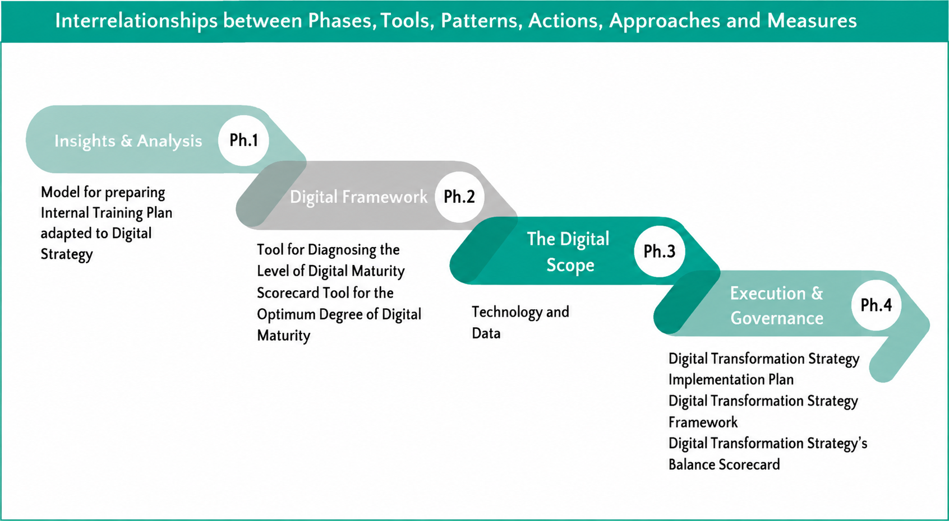
The Four Main Phases of the DT Framework
Phase 1: Insights and Analysis — understanding stakeholders, internal data, external threats, and value opportunities.
Phase 2: Digital Framework — creating a framework for digital goals, mission, vision, objectives, and value proposition.
Phase 3: Digital Scope — defining digital channels, initiatives, objectives, and challenges.
Phase 4: Execution and Governance — prioritizing projects, assigning teams, monitoring KPIs, and ensuring accountability.
Together, these phases form a structured roadmap for digital transformation.
Insights
Framework
Scope
Governance
Artificial Intelligence in Business | Chapter 5: AI Integration in the Digital Transformation Strategy
20

Slide 21
Phase 1: Insights and Analysis
• Phase 1 focuses on understanding the needs and priorities of customers, stakeholders, employees, and executives.
• It requires analysis of internal performance data and sales data to identify where the biggest value exists.
• External Digital Analysis identifies threats and opportunities from the digital environment.
• Customer Experience Mapping helps understand customer pain points and expectations.
• Digital Value Chain Analysis identifies where digital improvements can create operational and strategic value.
Real estate example
Analyze tenant complaints, occupancy rates, leasing inquiries, property maintenance data, and competitor platforms before choosing digital projects.
Artificial Intelligence in Business | Chapter 5: AI Integration in the Digital Transformation Strategy
21

Slide 22
External Digital Analysis: The Digital Way
• External analysis examines digital threats and opportunities outside the business.
• Managers should assess rivalry among existing firms and the threat of new digital entrants.
• They should also examine substitutes, supplier power, and buyer power in digital contexts.
• External digital analysis helps organizations identify where digital disruption may emerge.
Real estate example
Traditional agencies may face competition from online listing platforms, AI valuation tools, virtual tours, and direct owner-to-tenant platforms.
Artificial Intelligence in Business | Chapter 5: AI Integration in the Digital Transformation Strategy
22

Slide 23
Phase 2: Digital Framework
• Phase 2 creates a framework that allows the company to address digital goals and objectives.
• It defines the overall vision of what digital transformation will do for the organization.
• The phase includes the Iteration Model, Big Idea, Mission, Vision, Digital Objectives, and Unique Value Proposition.
• Digital transformation must be communicated clearly so employees and stakeholders understand the purpose.
• A strong digital framework provides focus and direction for later implementation.
Real estate example
Big Idea: 'Turning property management into a predictive, tenant-centered digital service.'
Artificial Intelligence in Business | Chapter 5: AI Integration in the Digital Transformation Strategy
23

Slide 24
The Iteration Model
• Digital transformation is an evolutionary process rather than a traditional long-range plan.
• Digital work should happen in short cycles or sprints focused on a specific short-term goal.
• Iteration allows organizations to test, learn, adapt, and improve quickly.
• This approach is useful because digital environments change rapidly.
• Iterative models reduce risk by avoiding large, rigid transformation plans that may become outdated.
Study focus
Digital transformation is closer to continuous learning than one fixed project.
Artificial Intelligence in Business | Chapter 5: AI Integration in the Digital Transformation Strategy
24

Slide 25
Big Idea, Mission, and Vision
• The Digital Strategy should be distilled into one big idea that people can remember and believe in.
• The big idea helps create commitment and shared understanding.
• Mission and vision link digital transformation to the organization’s purpose.
• Examples include turning visitors into customers or becoming customers’ favorite company.
• Clear vision is necessary because digital transformation depends on people adopting new ways of working.
Real estate example
Big Idea for a real estate firm: 'From property transactions to intelligent real estate experiences.'
Artificial Intelligence in Business | Chapter 5: AI Integration in the Digital Transformation Strategy
25

Slide 26
Digital Goals and Objectives
• Digital goals crystallize what stakeholders want most from digital transformation.
• Objectives identify the measurable actions needed to achieve the goal.
• Goals may focus on mobility, customer experience, digital sales, automation, or data visibility.
• Objectives may involve implementing CRM, mobile apps, data platforms, or AI analytics.
• Clear digital goals improve accountability and guide resource allocation.
Real estate example
Goal: increase visibility across property portfolio performance. Objective: implement an AI dashboard integrating rent, occupancy, maintenance, and tenant satisfaction.
Artificial Intelligence in Business | Chapter 5: AI Integration in the Digital Transformation Strategy
26

Slide 27
Unique Value Proposition (UVP)
• The Unique Value Proposition explains how digital transformation will create differentiated value.
• UVP connects digital tools with customer needs and business strategy.
• A strong UVP clarifies why customers should choose the organization in a digital marketplace.
• AI can strengthen UVP by enabling personalization, speed, predictive service, and better decision-making.
• Without UVP, digital transformation may become technology adoption without clear market meaning.
Real estate example
UVP: 'We provide data-driven property decisions with faster valuation, smarter recommendations, and proactive asset management.'
Artificial Intelligence in Business | Chapter 5: AI Integration in the Digital Transformation Strategy
27

Slide 28
Phase 3: The Digital Scope
• Phase 3 defines the company’s approach to key areas of digital activity.
• It outlines the purpose, objectives, key initiatives, and challenges of each digital channel.
• Common channels include websites, online content, digital advertising, SEM, SEO, CRM, social media, mobile, and ERP.
• This phase converts digital strategy into concrete digital workstreams.
• Digital scope helps avoid fragmented initiatives by clarifying what each digital channel should achieve.
Real estate application
A real estate firm may define scope for listing websites, virtual tours, CRM, mobile app, SEO, social media, property analytics, and ERP integration.
Artificial Intelligence in Business | Chapter 5: AI Integration in the Digital Transformation Strategy
28

Slide 29
Websites and Online Content
• A branded website strongly influences buyer decisions in digital markets.
• Websites must be credible, informative, visually educational, organized, and user-friendly.
• Online content should support customer learning and lead generation.
• Blogging and educational content can increase search traffic and customer trust.
• AI can personalize web content according to visitor behavior and property preferences.
Real estate example
Property pages can use AI to recommend similar properties, estimate financing options, and personalize neighborhood insights.
Artificial Intelligence in Business | Chapter 5: AI Integration in the Digital Transformation Strategy
29

Slide 30
Customer Relationship Management (CRM)
• CRM systems manage customer data, interactions, sales processes, and relationship history.
• The chapter emphasizes customizing CRM based on customer journey mapping.
• CRM should support the entire sales process rather than operate as a disconnected database.
• AI enhances CRM by predicting customer needs, scoring leads, and personalizing communication.
• A strong CRM system helps organizations turn digital interactions into long-term customer relationships.
Real estate application
AI-enabled CRM can identify which clients are ready to buy, which properties match their preferences, and when follow-up is most effective.
Artificial Intelligence in Business | Chapter 5: AI Integration in the Digital Transformation Strategy
30

Slide 31
Social, Mobile, and ERP
• Social channels should be integrated into other customer experiences, both online and offline.
• Mobile platforms increase accessibility, immediacy, and customer convenience.
• ERP systems integrate operational and administrative data across departments.
• Digital transformation requires alignment between customer-facing channels and internal systems.
• AI can analyze social behavior, mobile interactions, and ERP data to produce strategic insights.
Real estate example
A mobile tenant app connected to ERP and maintenance systems can improve service speed and operational transparency.
Artificial Intelligence in Business | Chapter 5: AI Integration in the Digital Transformation Strategy
31

Slide 32
Phase 4: Execution and Governance
• Phase 4 focuses on prioritizing the plan based on urgency, importance, resources, timelines, and budgets.
• Digital business models are agile; therefore, plans should be iterative.
• Unlike traditional planning, looking three to five years ahead may be unrealistic in fast-moving digital contexts.
• Execution requires clear project priorities, project teams, accountability, progress reporting, and KPIs.
• Governance ensures that digital transformation remains aligned with strategy and measurable outcomes.
Study focus
Good ideas fail without execution discipline. Governance turns digital vision into organizational reality.
Artificial Intelligence in Business | Chapter 5: AI Integration in the Digital Transformation Strategy
32

Slide 33
Project Prioritization
• Organizations should avoid trying to implement all digital projects at once.
• Projects should be prioritized based on their impact on bottom line, employee morale, productivity, brand equity, and customer experience.
• Prioritization prevents resource overload and increases the chance of successful implementation.
• Digital transformation should begin where value and feasibility are strongest.
Real estate example
Start with predictive maintenance if it reduces urgent repair costs, improves tenant satisfaction, and provides measurable ROI.
Artificial Intelligence in Business | Chapter 5: AI Integration in the Digital Transformation Strategy
33

Slide 34
Iterative Governance Models
• Digital project teams should be empowered to make critical decisions.
• Governance should avoid traditional silo thinking and support cross-functional collaboration.
• Iterative governance allows teams to adjust priorities as data and results emerge.
• Accountability is still necessary through clear KPIs and progress reporting.
• Governance should balance flexibility with control.
Real estate application
A smart building transformation team should include property managers, IT specialists, finance, tenant relations, facilities teams, and vendors.
Artificial Intelligence in Business | Chapter 5: AI Integration in the Digital Transformation Strategy
34

Slide 35
4. AI Integration in Digital Transformation Strategy
AI readiness helps organizations determine whether they can deploy AI in ways that create value.
Artificial Intelligence in Business | Chapter 5: AI Integration in the Digital Transformation Strategy
35

Slide 36
Why AI Readiness Matters
• AI technologies create new opportunities for digital transformation but also new managerial challenges.
• AI platforms vary in scope and complexity, making deployment difficult for organizations unfamiliar with them.
• The black box nature of some algorithms makes AI difficult to understand and govern.
• Organizations must assess their ability to deploy AI before expecting value from AI initiatives.
• AI readiness helps reduce transformation risks and increase the likelihood of successful adoption.
Real estate application
A firm should assess readiness before launching AI valuation, tenant screening, predictive maintenance, or customer recommendation systems.
Artificial Intelligence in Business | Chapter 5: AI Integration in the Digital Transformation Strategy
36

Slide 37
Definition of AI Readiness
• The AI readiness framework defines readiness as an organization’s ability to deploy and use AI in ways that add value.
• Readiness is not only technical; it includes organizational activities, boundaries, and goals.
• The framework supports assessment of current capabilities and future potential.
• It can be used in workshops where organizational members score readiness across dimensions.
• The purpose is to visualize strengths, weaknesses, risks, and opportunities.
Study focus
AI readiness answers: Are we prepared to use AI meaningfully, responsibly, and strategically?
Artificial Intelligence in Business | Chapter 5: AI Integration in the Digital Transformation Strategy
37

Slide 38
Four Dimensions of AI Readiness
• The framework uses four dimensions: technologies, activities, boundaries, and goals.
• Technologies examine the AI technology portfolio and its value contribution.
• Activities examine whether key organizational activities are supported by AI.
• Boundaries examine how AI stretches organizational boundaries and ecosystems.
• Goals examine whether AI supports organizational objectives and strategic value creation.
Framework
Technologies
Activities
Boundaries
Goals
Technologies
Activities
Boundaries
Goals
Artificial Intelligence in Business | Chapter 5: AI Integration in the Digital Transformation Strategy
38

Slide 39
Scoring AI Readiness
• AI readiness can be scored using levels such as None, Low, Moderate, High, and Excellent.
• The framework considers both present and future perspectives.
• The present perspective evaluates how AI currently adds value.
• The future perspective evaluates whether the organization has a strategy for future AI value creation.
• This dual perspective helps organizations move from current diagnosis to strategic planning.
Study focus
Students can use the scoring model as a practical classroom exercise for a real estate firm.
Artificial Intelligence in Business | Chapter 5: AI Integration in the Digital Transformation Strategy
39

Slide 40
Technologies Dimension
• The technologies dimension asks whether the current AI technology portfolio adds value to the organization.
• It also asks whether the organization has a future strategy for using AI technologies to add value.
• This includes AI platforms, data infrastructure, analytics tools, cloud services, automation systems, and integration capabilities.
• Technology readiness requires scalability, security, interoperability, and usability.
• Technology alone is not enough, but weak technology makes AI integration difficult.
Real estate example
Does the firm have integrated CRM, property database, market analytics, IoT building systems, and cloud infrastructure for AI?
Artificial Intelligence in Business | Chapter 5: AI Integration in the Digital Transformation Strategy
40

Slide 41
Activities Dimension
• The activities dimension evaluates whether key organizational activities are supported by AI in value-adding ways.
• It also evaluates whether the organization has a strategy for using AI to support key activities in the future.
• Activities include operations, marketing, customer service, finance, maintenance, sales, and strategic decision-making.
• AI should improve activities that matter to customers and performance.
• If AI is used only in minor tasks, its strategic value remains limited.
Real estate application
AI can support valuation, leasing, tenant communication, maintenance triage, investment analysis, and portfolio performance monitoring.
Artificial Intelligence in Business | Chapter 5: AI Integration in the Digital Transformation Strategy
41

Slide 42
Boundaries Dimension
• The boundaries dimension examines how AI stretches organizational boundaries.
• AI may connect organizations with customers, vendors, partners, platforms, ecosystems, and external data providers.
• AI-enabled digital transformation often blurs traditional boundaries between internal and external processes.
• Future AI strategy may involve changing how the organization collaborates with ecosystem actors.
• Boundary readiness is important because modern AI value often comes from connected digital ecosystems.
Real estate example
A smart property platform may connect tenants, maintenance contractors, facility managers, energy providers, and owners in one AI-enabled ecosystem.
Artificial Intelligence in Business | Chapter 5: AI Integration in the Digital Transformation Strategy
42

Slide 43
Goals Dimension
• The goals dimension examines whether current AI use supports organizational goals in ways that add value.
• It also evaluates whether the organization has a strategy for using AI to support future goals.
• AI goals should be linked to business outcomes such as growth, efficiency, customer experience, innovation, and sustainability.
• Misalignment between AI tools and business goals leads to wasted investment.
• Goal readiness ensures that AI is strategically purposeful.
Real estate application
If the goal is tenant retention, AI should support tenant satisfaction prediction, service responsiveness, and personalized communication.
Artificial Intelligence in Business | Chapter 5: AI Integration in the Digital Transformation Strategy
43

Slide 44
AI Readiness Workshop Exercise
• The AI readiness framework can be used in organizational workshops.
• Participants can score current and future readiness across technologies, activities, boundaries, and goals.
• Scores help visualize gaps between present capability and future ambition.
• Low scores indicate areas requiring investment, training, governance, or process change.
• The workshop approach encourages shared understanding across departments.
Classroom activity
Evaluate an imaginary real estate firm from 1 to 5 on the four AI readiness dimensions (See the table below).
Dimension
Now
Future
Tech
2
4
Act.
3
5
Bound.
2
4
Goals
3
5
Artificial Intelligence in Business | Chapter 5: AI Integration in the Digital Transformation Strategy
44

Slide 45
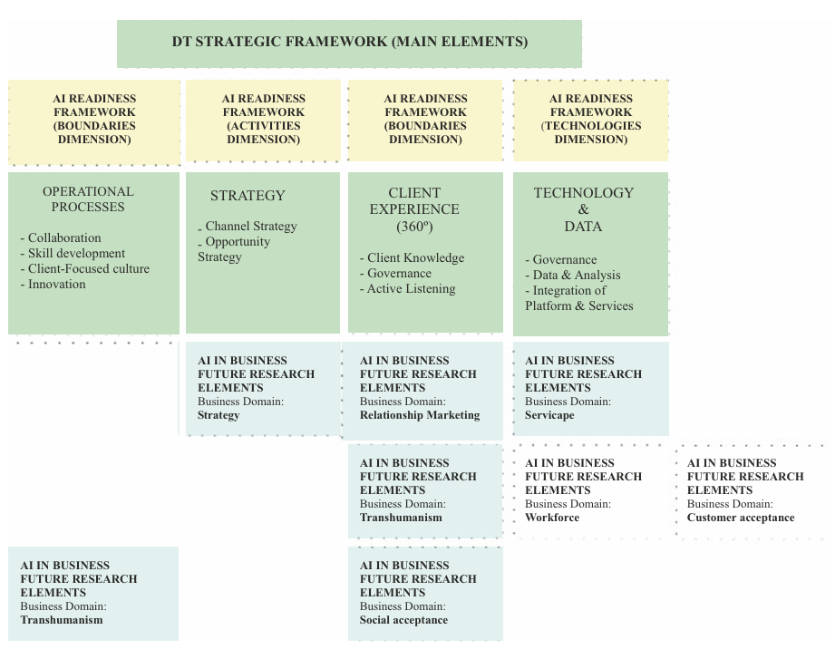
AI Integration in Digital Transformation Strategy Model
• The model integrates AI mechanisms and instruments into the broader digital business transformation strategy.
• AI should be rooted in the organization’s digital strategic framework rather than added as an isolated tool.
• The model helps managers connect AI technologies with goals, activities, boundaries, and digital maturity.
• Integration means AI becomes part of strategy, processes, governance, customer experience, and organizational learning.
Artificial Intelligence in Business | Chapter 5: AI Integration in the Digital Transformation Strategy
45

Slide 46
Framework Requirements for AI Integration
• A good framework should identify the phenomenon of interest, such as Digital Strategy and AI readiness.
• It should state key premises and assumptions clearly.
• It should describe relationships among framework elements.
• The chapter assumes that Digital Strategy and AI readiness are multidimensional.
• AI affects technologies, activities, boundaries, and goals simultaneously.
Managerial lesson
AI transformation should be designed as a system of connected dimensions, not as one independent technology purchase.
Artificial Intelligence in Business | Chapter 5: AI Integration in the Digital Transformation Strategy
46

Slide 47
AI in Real Estate Digital Transformation
• Real estate organizations can integrate AI into the full digital transformation strategy.
• AI can improve property valuation, predictive maintenance, tenant relationship management, and investment decision-making.
• Digital transformation enables smart buildings, smart cities, digital platforms, and customer-centered services.
• AI supports decision-making by reducing uncertainty and improving visibility across portfolios.
• Real estate firms must combine data governance, digital culture, and AI readiness to create value.
Real estate focus
AI is not only a tool for valuation. It can transform customer experience, building operations, strategy, and organizational knowledge.
Artificial Intelligence in Business | Chapter 5: AI Integration in the Digital Transformation Strategy
47

Slide 48
Case Study: AI-Enabled Smart Building Strategy
• A real estate company wants to transform a commercial building portfolio using AI and IoT.
• Phase 1 analyzes tenant needs, energy costs, maintenance data, and digital competitors.
• Phase 2 defines the big idea: predictive, sustainable, tenant-centered buildings.
• Phase 3 scopes technologies: sensors, mobile tenant app, energy analytics, CRM, and predictive maintenance.
• Phase 4 governs execution using KPIs such as energy savings, maintenance response time, tenant satisfaction, and operating cost reduction.
Artificial Intelligence in Business | Chapter 5: AI Integration in the Digital Transformation Strategy
48

Slide 49
Case Study: Digital Customer Experience in Real Estate
• A real estate agency wants to improve customer experience through digital transformation.
• It maps the customer journey from online search to property visit, financing, contract, and after-sale support.
• AI personalizes property recommendations and predicts customer readiness to buy.
• CRM integrates communication history, preferences, budget, and transaction status.
• The strategy improves customer engagement, sales conversion, and long-term relationship management.
Artificial Intelligence in Business | Chapter 5: AI Integration in the Digital Transformation Strategy
49

Slide 50
Case Study: AI Readiness Assessment for a Property Firm
• A medium-sized property management firm wants to adopt AI for maintenance, leasing, and portfolio analytics.
• Technology readiness is moderate because the firm uses digital records but lacks integrated data platforms.
• Activities readiness is low because AI is not yet embedded in operational processes.
• Boundary readiness is moderate because the firm already collaborates with contractors and tenants through digital channels.
• Goal readiness is high because leadership clearly wants cost reduction, tenant satisfaction, and data-driven decisions.
Learning point
Different dimensions may have different readiness scores. Strategy should target the weakest dimensions first.
Artificial Intelligence in Business | Chapter 5: AI Integration in the Digital Transformation Strategy
50

Slide 51
Challenges of AI Integration
• AI integration requires investment in data infrastructure, talent, governance, and organizational change.
• Legacy systems may prevent smooth data integration.
• Employees may resist AI if they fear replacement or do not understand the system.
• AI may create ethical, legal, and reputational risks if poorly governed.
• Successful integration requires leadership commitment, training, cross-functional collaboration, and measurable outcomes.
Real estate risk
An AI valuation tool may fail if historical property data is incomplete, biased, or not updated with market changes.
Artificial Intelligence in Business | Chapter 5: AI Integration in the Digital Transformation Strategy
51

Slide 52
Strategic-Operational Suggestions for Managers
• Start with a clear business problem and measurable digital objective.
• Assess digital maturity and AI readiness before large AI investment.
• Develop strong data governance and ensure data quality.
• Prioritize projects with high strategic value and feasible implementation.
• Create cross-functional teams including business managers, IT specialists, data experts, and users.
• Monitor KPIs and adjust initiatives through iterative governance.
Study focus
Managers must connect strategy, technology, people, data, and governance.
Artificial Intelligence in Business | Chapter 5: AI Integration in the Digital Transformation Strategy
52

Slide 53
Key Takeaways from Chapter 5
• AI integration requires more than technology adoption; it requires digital transformation strategy.
• Knowledge management is central because AI helps deliver contextual knowledge to decision-makers.
• Digital transformation requires business model thinking, resource fit, maturity assessment, and structured phases.
• The Digital Transformation Strategy Framework includes Insights and Analysis, Digital Framework, Digital Scope, and Execution and Governance.
• AI readiness is assessed through technologies, activities, boundaries, and goals.
• Real estate firms can use AI integration to improve valuation, smart building management, customer experience, and strategic decision-making.
Final message
AI becomes strategically valuable when it is embedded into a coherent digital transformation journey.
Artificial Intelligence in Business | Chapter 5: AI Integration in the Digital Transformation Strategy
53

Slide 54

Discussion Questions
• Why do some organizations lag in AI adoption despite the availability of advanced technologies?
• How can AI improve knowledge management and managerial decision-making?
• What is the difference between digital transformation and simple technology adoption?
• How can real estate firms use customer experience mapping to design better digital services?
• Which AI readiness dimension is most important for real estate firms: technologies, activities, boundaries, or goals?
• What risks may appear if AI is integrated without strong governance?
Artificial Intelligence in Business | Chapter 5: AI Integration in the Digital Transformation Strategy
54

Slide 55


Thank You

