Slide 1

AI-Based Predictive Maintenance
Prepared by
-Ali Alzunaydi
-Abdulaziz Mari
Supervisor Name:
-Dr Hager Saleh
Notes:
[Sources]
- Visual and university logo inherited from the user-provided source deck, slide 1.
[/Sources]

Slide 2
Problem Statement
Unexpected failures: disrupt production and increase downtime and maintenance cost.
Time-based maintenance: may be performed too early or too late because actual component health is unknown.
Prediction need: estimate Remaining Useful Life (RUL) from sensor data to schedule maintenance before failure.
Notes:
[Sources]
- Problem statement synthesized from the project scope in the user-provided source deck, slides 3-8.
[/Sources]

Slide 3
Related Works
Three studies on remaining useful life prediction.
Study | Model | Application | Main contribution
Deng & Zhou (2024) | CNN–LSTM–Attention | Aero-engine RUL | Combines spatial and temporal feature learning with attention for remaining-life prediction.
Fan, Li & Chang (2024) | Two-stage attention hierarchical Transformer | Turbofan-engine RUL | Uses hierarchical attention to model degradation patterns across multiple temporal scales.
Elsherif et al. (2025) | Deep-learning prognostic approach | Turbofan degradation and RUL | Links degradation diagnosis with RUL estimation in one prognostic framework.
Notes:
[Sources]
- Deng, S., & Zhou, J. (2024). Prediction of Remaining Useful Life of Aero-engines Based on CNN–LSTM–Attention. International Journal of Computational Intelligence Systems.
- Fan, Z., Li, W., & Chang, K. C. (2024). A Two-Stage Attention-Based Hierarchical Transformer for Turbofan Engine Remaining Useful Life Prediction. Sensors.
- Elsherif, S. M., Hafiz, B., Makhlouf, M. A., & Farouk, O. (2025). A Deep Learning-Based Prognostic Approach for Predicting Turbofan Engine Degradation and Remaining Useful Life. Scientific Reports.
- Citations transcribed from the user-provided source deck, slide 13, references 1–3.
[/Sources]

Slide 4
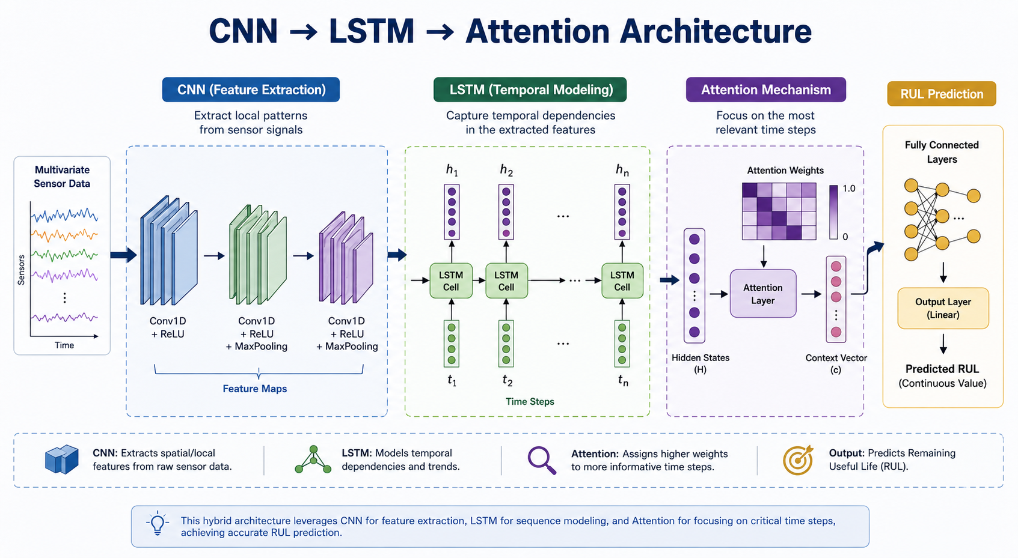
Methods
Preprocessing → CNN features → LSTM temporal modeling → attention → RUL prediction
Notes:
[Sources]
- Method architecture inherited from the user-provided source deck, slide 8.
[/Sources]

Slide 5
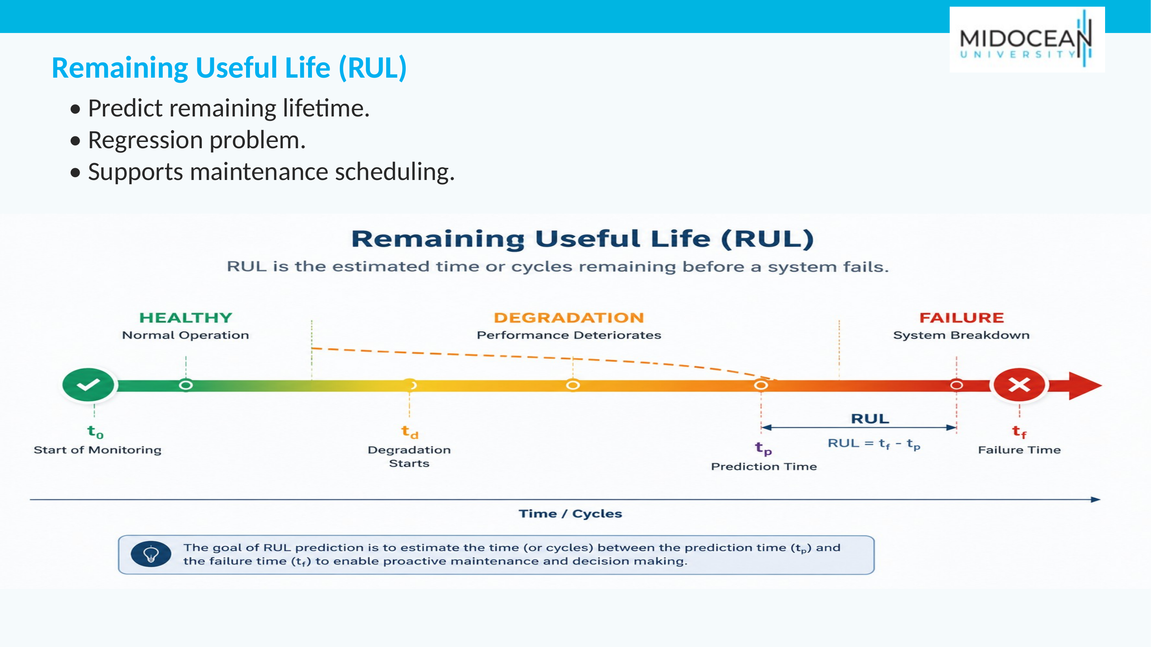

Slide 6
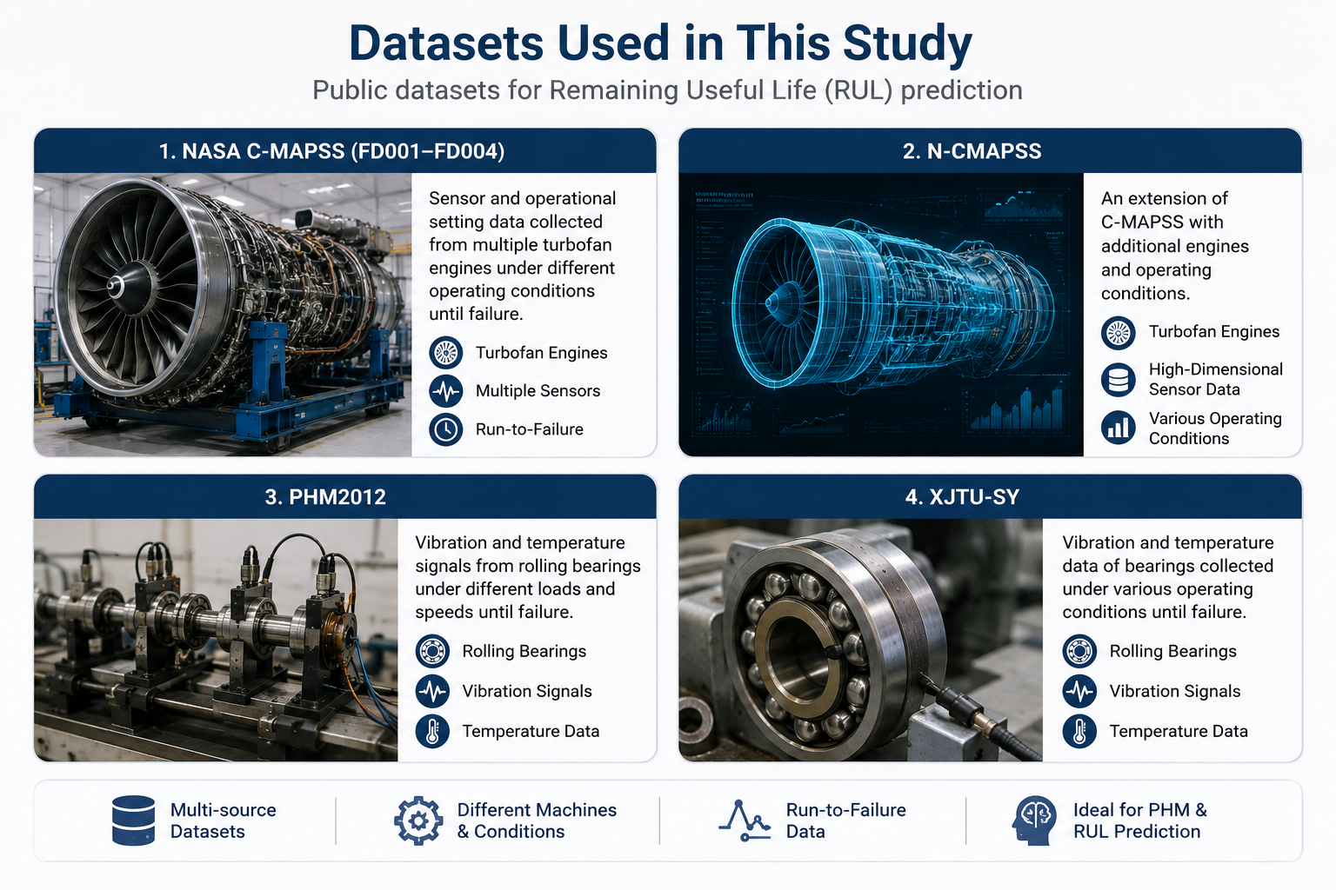
Data Collection
• NASA C-MAPSS (FD001–FD004) • NASA N-CMAPSS • PHM2012 • XJTU-SY
Notes:
[Sources]
- Dataset list and visual inherited from the user-provided source deck, slides 6 and 13.
[/Sources]

Slide 7
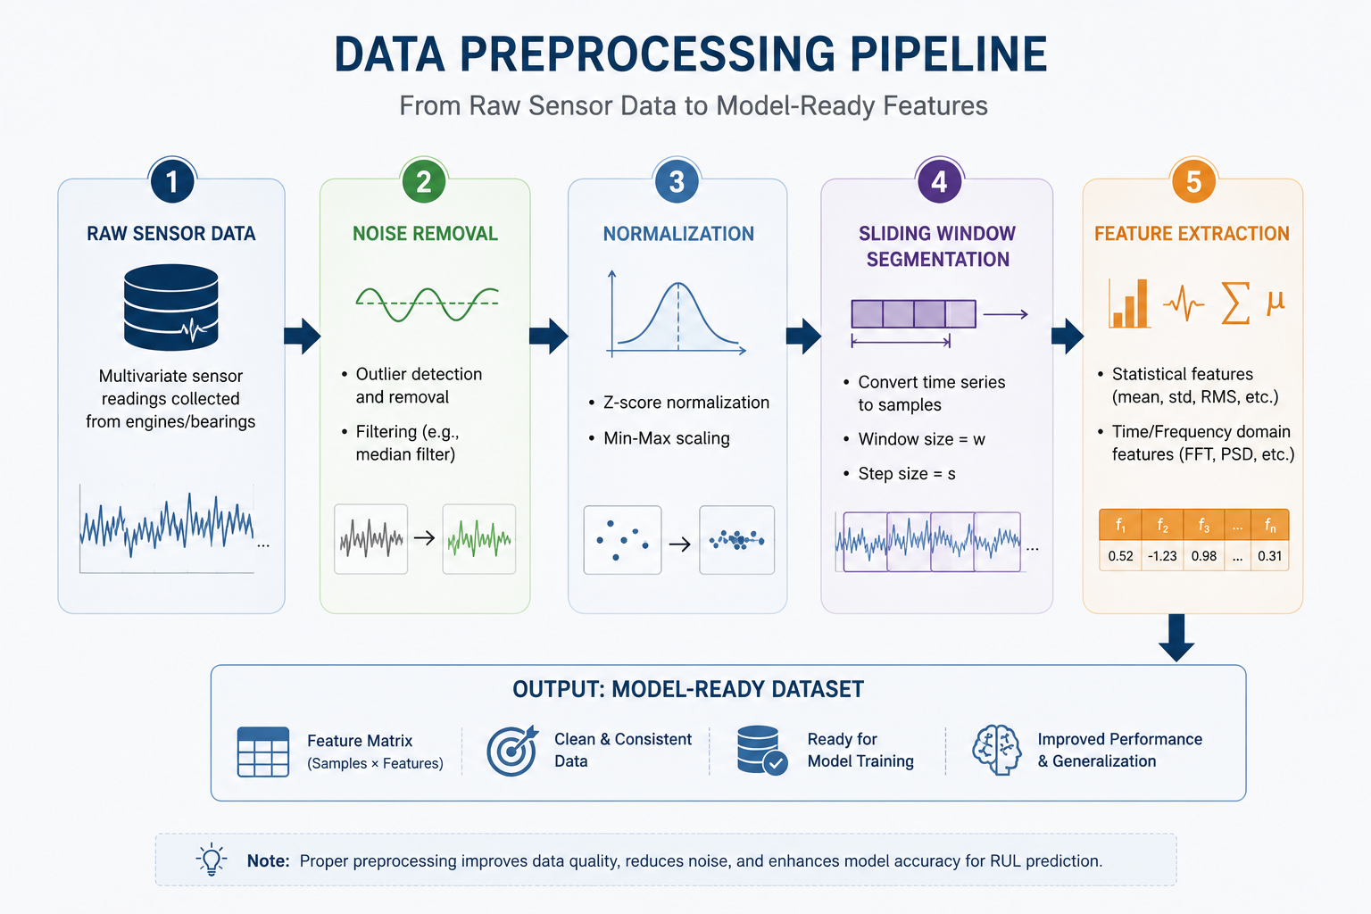
Data Preparation
• Noise removal • Normalization • Sliding windows • Feature extraction
Notes:
[Sources]
- Data-preparation pipeline inherited from the user-provided source deck, slide 7.
[/Sources]

Slide 8
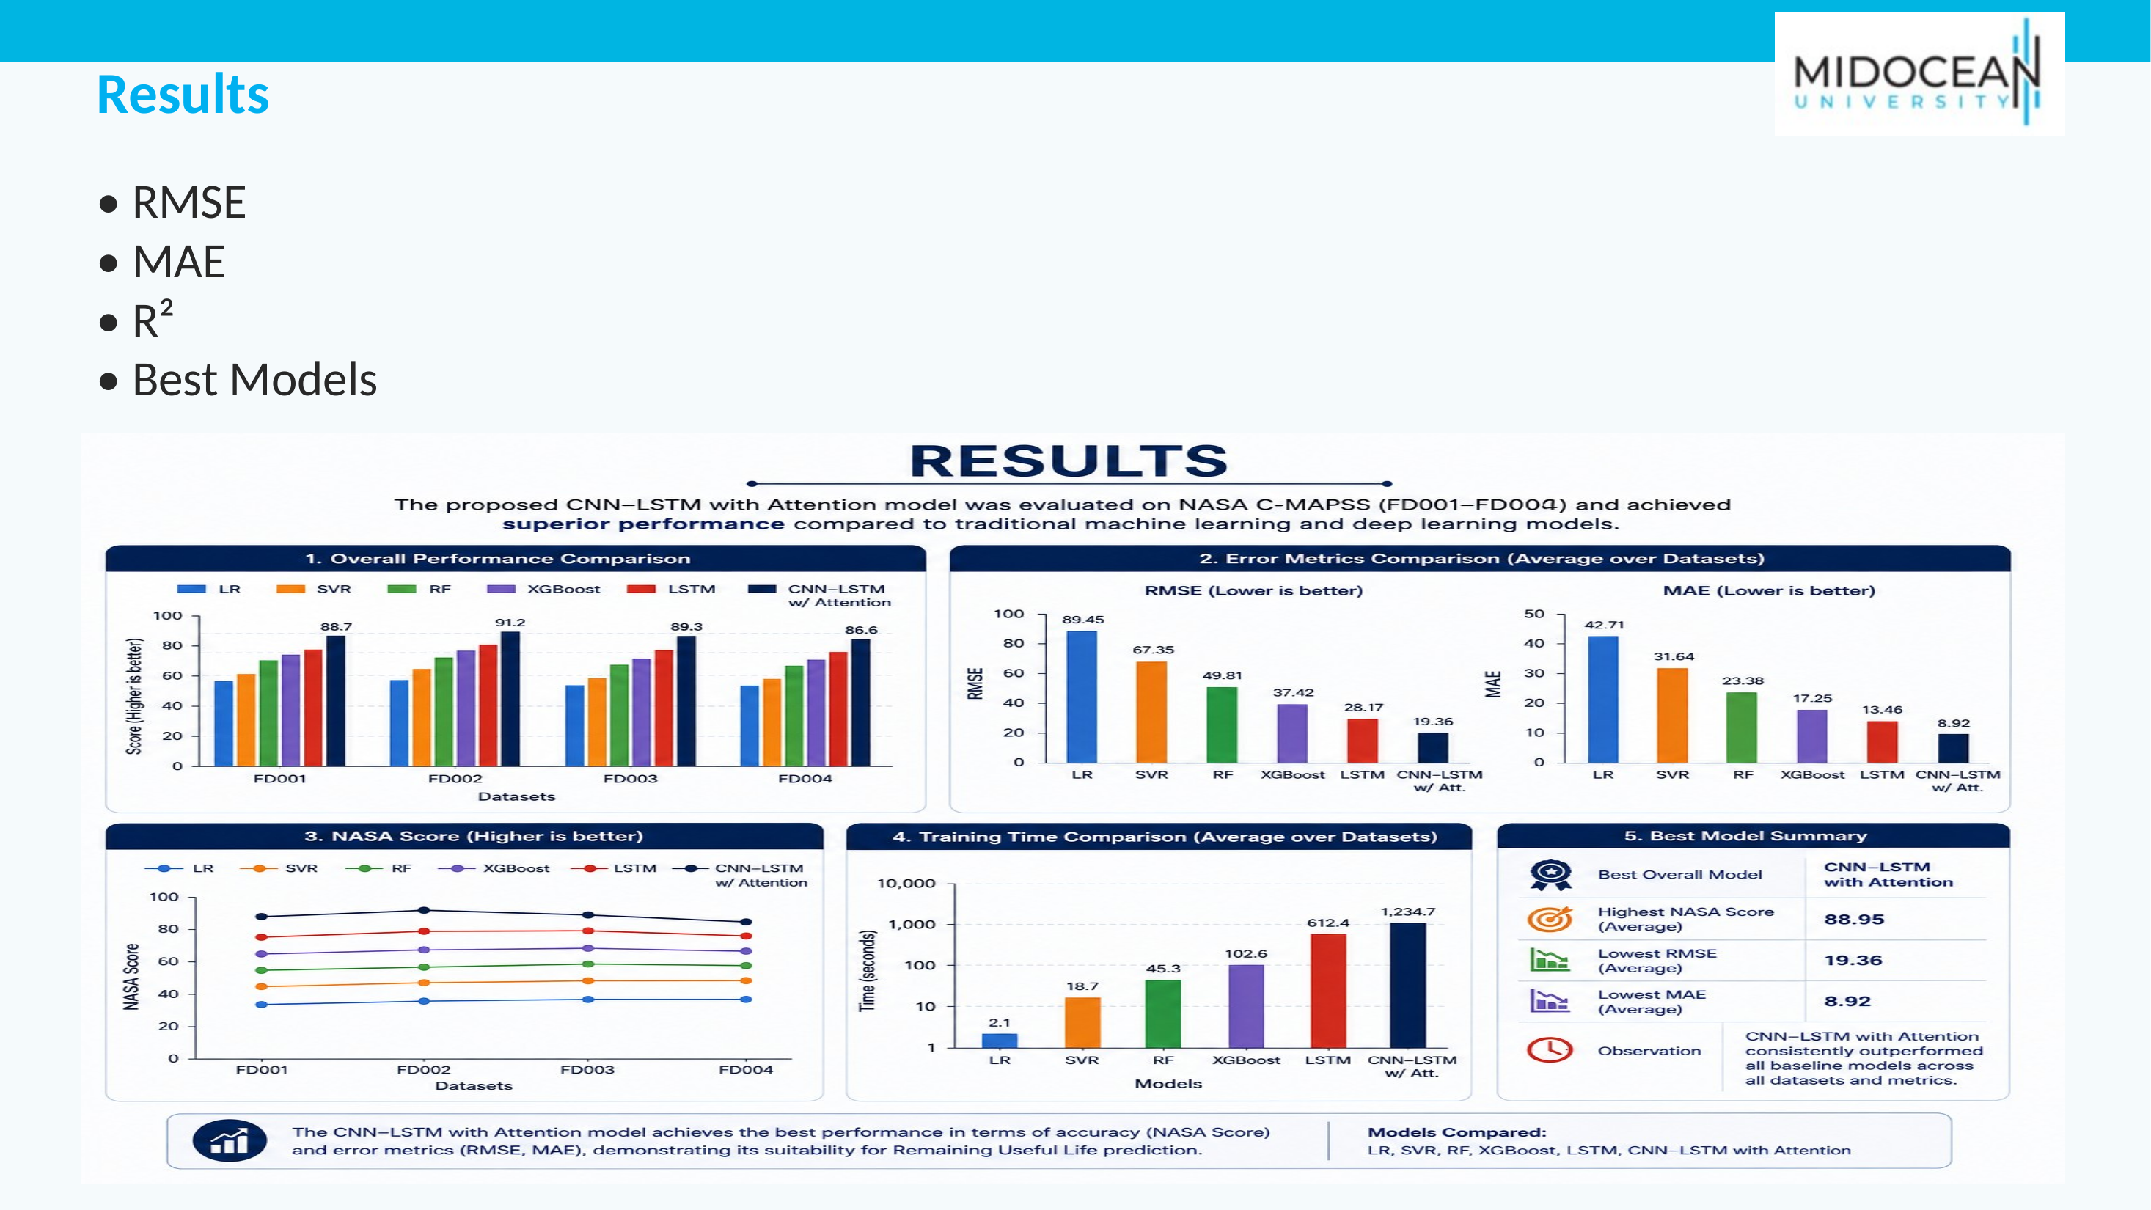

Slide 9
Thank You
Questions?

