Slide 1


Organizational Structure & Its Impact on Project Management
Lecture 3
PMG 101
Foundations of Project Management
www.midocean.ae

Slide 2
Learning Objectives
Components of any organization.
Define organizational structure and its importance.
Understand different types of organizational structure and its impact on project management.
Comparison between different types of organizational structures.
- Choosing the appropriate structure for project Management.
www.midocean.ae

Slide 3
Components of any organization
Within any organization, successful project management is contextual. What that means is that the organization itself matters:
its structure;
its culture; and its strategy.
Each play an integral part and together they create the environment in which a project will flourish or founder.
Issues that affect a project can vary widely from company to company.
Contextual issues provide the backdrop around which project activities must operate, so understanding what is beneath these issues truly contributes to understanding how to manage projects.
www.midocean.ae

Slide 4
Organization Structure
Organization is a social entity that has a collective goal and is linked to an external environment.
The purpose of an organization to coordinate the efforts of many to accomplish goals.
An organizational structure defines how activities such as tasks allocation, coordination, and supervision are directed toward the achievement of organizational aims. Organizational structure affects organizational action and provides the foundation on which standard operating procedures and routines rest.
www.midocean.ae

Slide 5
Organization Structure
Represents the management hierarchy:
  - Reporting relationships who report to whom.
  - The official chain of control or authority, which deals of official activities, such firing, hiring, and promotion.
Organization can be grouped into major subdivisions on the basis of a number of frameworks.
Responsibilities & type of work for each subdivision.
Official lines of authority & communication.
Informal organization also important and can exist in parallel to the official organization, communication of the informal is socially motivated.
www.midocean.ae

Slide 6
Organization Structure
There are several forms of organizational structures. The best structure form depends on goals, type of work it supposed to do, and the environment within which it operates.
Organization structure consists of three key elements:
Designates formal reporting relationships:
  number of levels in the hierarchy
  span of control
Groupings of:
  individuals into departments
  departments into the total organization
www.midocean.ae

Slide 7
Organization Structure
3. Design of systems for
  effective communication
  coordination
  integration across departments
Basic forms of organization structures are:
  1- Functional organization
  2- Project organization
  3- Matrix organization
www.midocean.ae

Slide 8
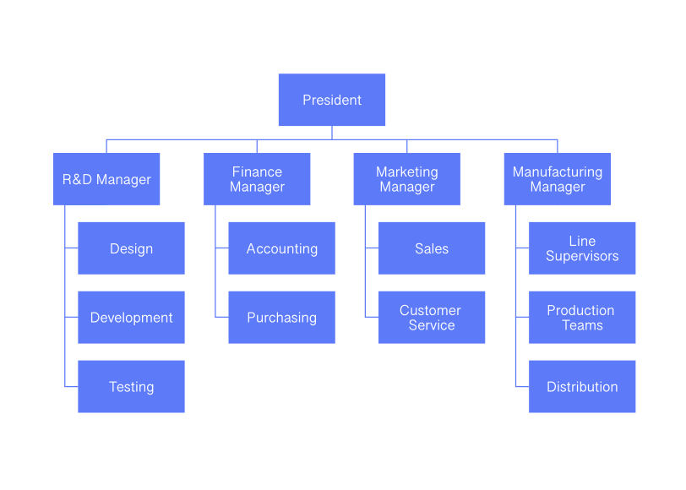
1. Functional organization structure
www.midocean.ae

Slide 9
1. Functional organization structure
The functional structure is based on an organization being divided up into smaller groups with specific tasks or roles. For example, a company could have a group working in information technology, another in marketing and another in finance. It is the most common of the three organizational structures adopted by most companies.
Each department has a manager or director who answers to an executive a level up in the hierarchy who may oversee multiple departments. One such example is a director of marketing who supervises the marketing department and answers to a vice president who is in charge of the marketing, finance and IT divisions.
www.midocean.ae

Slide 10
1. Functional organization structure
It works best in small organizations in which the different sections are geographically close together and which provide only a small number of goods and/or services.
In a functional structure, the organization is broken into different sections based upon specialty. For example, there may be one area for sales, one for customer service and one for the supervisors who deal with escalated problems.
The project manager's role is to ensure smooth execution of processes and projects; however, the functional manager has the most power and makes the final decision.
www.midocean.ae

Slide 11
Advantages of Functional Organization
An advantage to the functional structure is the role of the functional manager, which means there is only one boss. This reduces or prevents conflicts of interest and makes it easier to manage specialists. This will lead to:
1. Clear line of authority
2. Career development
3. Comfortable and easy
4. Technical expertise
5. Flexible resource assignment
6. Firm’s design maintained
7. Project team members remain connected with their functional group
www.midocean.ae

Slide 12
disadvantages of Functional Organization
1- The project manager has limited authority and power.
2- No accountability over complete project
3- No project emphasis
4- Projects may take longer time
5- Low coordination across functions
6- Lack of customer focus
7- Low delegation of authority
8- Work delays due to red tape
9- Lack of a big picture view
10- Functional siloing (isolating from others)
11- Projects may be suboptimal due to varying interest or commitment across functional boundaries
www.midocean.ae

Slide 13
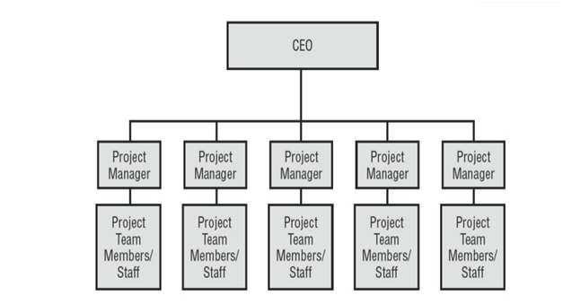
2. Projectized organizational structure
www.midocean.ae

Slide 14
2. Projectized organizational structure
- Projectized organization is a project focused organizational structure where project manager has the final authority over the project to make project decisions, priorities, acquire and assign resources.
- A projectized organization refers specifically to an organizational structure that has been set up in a way the project manager leads the group and in which the project manager has the ultimate authority to make all decisions involving the organization.
- In a projectized structure, all the work is looked at as a project. The project manager has complete control, unlike in the functional structure, and all team members report directly to the project manager.
www.midocean.ae

Slide 15
Advantages of projectized organizational structure
Team members are loyal to the project goal.
Team members report directly to project managers; the line of authority is clear. This reduces conflict and decision making is faster and more flexible.
Communication is fast because of a single authority and single reporting system. This helps solve stakeholders’ concerns quickly.
Being the only authority, project managers can make quick decisions and complete the project faster.
Team members become more versatile and flexible due to working on different projects.
Projectized culture is adaptive. Team members are encouraged to learn from others’ experiences and share their own.
www.midocean.ae

Slide 16
Disadvantages of projectized organizational structure
Absolute authority can make project manager arrogant.
Projects always have deadlines and tight schedules, which can make the work environment stressful.
Poor communication can cause resource duplication if there are multiple projects.
There is a sense of insecurity among the team members. They know they may lose their jobs once the project is finished. They tend to be less loyal to the organization.
www.midocean.ae

Slide 17
Disadvantages of projectized organizational structure
The cost of employees and equipment can be higher because they are being hired for a shorter period.
The employees may not be highly skilled in a particular area because they work on so many different projects. This may affect the quality of the deliverable.
www.midocean.ae

Slide 18
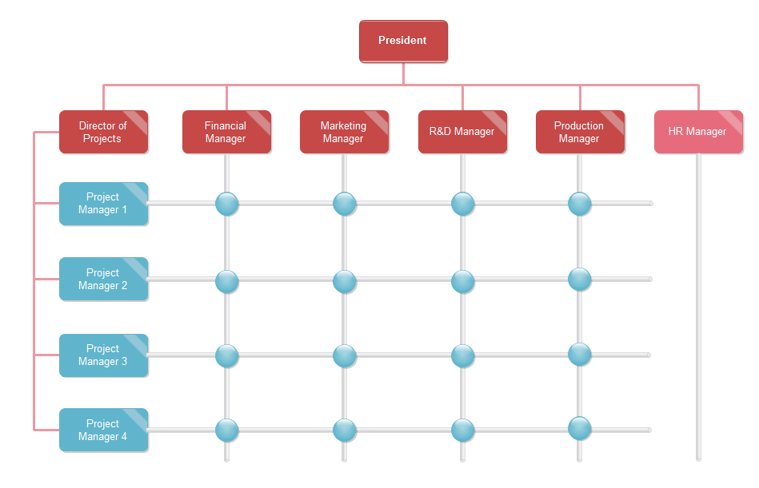
  3. Matrix organizational structure (Hybrid)
www.midocean.ae

Slide 19
  3. Matrix organizational structure (Hybrid)
  Matrix organizational structure is a blend of the functional organizational structure and the projectized organizational structure.
    Two chains of command (functional and projectized):
    -Project participants report simultaneously to both functional and project managers.
    Matrix structure optimizes the use of resources:
    -Allows for participation on multiple projects while performing normal functional duties and achieves a greater integration of expertise and project requirements.
www.midocean.ae

Slide 20
  Advantages of matrix organizational structure (Hybrid)
- One of the most important benefits of the matrix structure is that it allows cross-collaboration between staff and departments that may not always have opportunities to work together:
A matrix structure brings together highly skilled team members from different departments, allowing the organization to capitalize on the resources it already has rather than seeking expertise and recruiting project team members from outside of the organization.
-Employees can develop new skill sets.
-Project team members can keep their functional roles.
www.midocean.ae

Slide 21
Disadvantages of Matrix organizational structure (Hybrid)
1.Team members might have misconceptions about how they are expected to divide their time between their functional duties and their project responsibilities.
2. A conflict may occur between line managers and project managers over the allocation of resources.
3. The decision-making process can be slowed down.
4. Too much work can cause overload.
5. Measuring employee performance might become difficult.
6. The matrix structure is complex, which can be difficult to manage.
7. Unclear lines of authority, Two bosses, dual reporting, causing confusion to project team members.
www.midocean.ae

Slide 22
Types of Matrix organizational structure (Hybrid)
The strong matrix organizational structure has some similarities with that of a projectized organizational structure in the sense that the project manager is responsible for a project.
If the organization is running a weak matrix structure, then the project authority would fall to the hands of a functional manager as it is in a functional organization.
In a balanced matrix structure, both the project manager and the functional manager shares equal authority for the project.
www.midocean.ae

Slide 23
Table 1 Organizational Structures comparison
 | Functional | Weak Matrix | Balanced Matrix | Strong Matrix | Projectized
Description | Traditional organization with a direct supervisor. | The PM and FM share responsibility, with the FM having more authority. | The PM and FM share responsibility, with each having equal authority. | The PM and FM share responsibility, with the PM having more authority. | Projects do not exist under functional departments. The PM has sole management authority.
Authority of project manager | Very low. | Low. | Low to medium. | Medium to high. | High.
Resource availability | Very low. | Low. | Low to medium. | Medium to high. | High.
Project manager involvement | Part-time. | Part-time. | Full-time. | Full-time. | Full-time.
Staff involvement | Part-time. | Part-time. | Part-time. | Full-time. | Full-time.
Advantages | The FM holds accountability for the project. | The PM gets some authority to manage the project. | The PM and FM share the responsibility of the project. | The PM gets more authority to assign resources and manage the project. | The PM has full authority to staff and manage the project.
Disadvantages | The PM holds little or no authority. | The FM can see the PM as a threat and cause conflict. | The PM and FM can be confused about who manages what. | The FM may feel out of the loop. | The PM holds accountability for the project.
www.midocean.ae

Slide 24
Choosing the Appropriate Project Management Structure
Depending on the autonomy the project needs to complete successfully, the project considerations include the following:
1. Size of the project
2. Strategic importance
3. Novelty and need for innovation.
4. Need for integration (number of departments involved)
5. Environmental complexity.
www.midocean.ae

Slide 25
Choosing the Appropriate Project Management Structure
6. Budget and time constraints.
7. Stability of resource requirements.
Higher the levels of these seven factors, the more autonomy and authority the project manager and project team need to be successful. This would lead to using of either projectized structure or a matrix structure.
www.midocean.ae

