Slide 1


Reinforcement Learning
(AI644)
Prepared by Dr. Ashraf Elsayed
Lecture 2

Slide 2


Reinforcement Learning
Lecture 2
Prepared by
Dr. Ashraf Elsayed

Slide 3
Exploration and Exploitation

Slide 4
The objectives of this lecture is to:
Understand Exploration and Exploitation
Define and explain the trade off between Exploration and Exploitation.
Understand The Multi-Armed Bandit.

Slide 5
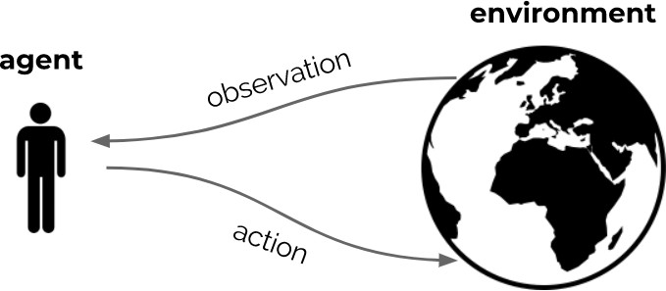
Recap
Reinforcement learning is the science of learning to make decisions
Agents can learn a policy, value function and/or a model
The general problem involves taking into account time and consequences
Decisions affect the reward, the agent state, and environment state
The most important feature distinguishing reinforcement learning from other types of learning is that it uses training information that evaluates the actions taken rather than instructs by giving correct actions

Slide 6
Exploration vs. Exploitation
In this lecture we study the evaluative aspect of reinforcement learning in a simplified setting, one that does not involve learning to act in more than one situation
Learning agents need to trade off two things
  Exploitation: Maximize performance based on current knowledge
  Exploration: Increase knowledge
We need to gather information to make the best overall decisions
The best long-term strategy may involve short-term sacrifices

Slide 7
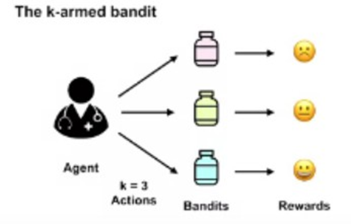
The Multi-Armed Bandit
(Clinical Trial)
Sequential Decision Making with Evaluative Feedback
  Assume the problem where the doctor has to give medicine to a patient and based on which one he chooses, he will receive a reward (cure the patient).
  For the doctor to decide which action is best, we must define the value of taking each action.
  We call these values the action values or the action value function.

Slide 8
Action-Values
The action value for action a is the expected reward
The goal is to maximize the expected reward (optimal value)

Slide 9
Calculating Action-Values

Slide 10
Learning Action Values
The value of an action is the expected reward when the action is taken
q* (a) is not known, so we estimate it.
The estimated value for action A is the sum of rewards observed when taking action A divided by the total number of times action A has been taken.

Slide 11
Sample-Average Method
The estimate of q*(a) is denoted as Q_{t}(a) and can be written as

Slide 12
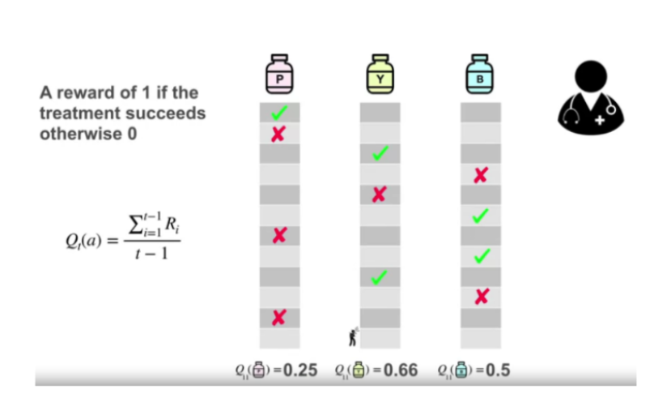
Example of Sample-Average Method
(Clinical Trial)
Assume different attempts are made during the trial.
As the experiment advances, the estimates of the Action Values became more accurate.

Slide 13
The greedy action
In reality, our doctor would not randomly assign treatments to their patients.
They would probably assign the treatment that they currently think is the best.
We call this method of choosing actions greedy. The greedy action is the action that currently has the largest estimated value.
Selecting the greedy action means the agent is exploiting its current knowledge.
It is trying to get the most reward it can right now.
Instead of behaving greedily most of the time, but every once in a while, say with small probability ε, instead select randomly from among all the actions with equal probability, independently of the action-value estimates.
We call this method using this near-greedy action selection rule ε -greedy methods.

Slide 14
The exploration-exploitation dilemma
We can compute the greedy action by taking the argmax_{a} of our estimated values.
The agent cannot choose to both explore and exploit at the same time.
This is one of the fundamental problems in reinforced learning.
The exploration-exploitation dilemma.

Slide 15
Estimating Action Values Incrementally
The action-value method we have discussed so far estimates action values as sample averages of observed rewards.
These averages can be computed in a computationally efficient manner.
The incremental update rule is derived as follows:
The obvious implementation would be to maintain a record of all the rewards and then
perform this computation whenever the estimated value was needed
Target

Slide 16
Incremental update rule
The error in the estimate is the difference between the old estimate Q_{n} and the new target R_{n} (The new reward is our target).
Taking a step towards that new target will create a new estimate that reduces our error.
The size of the step is determined by our step size parameter and the error of our old estimate.
The step size α can be a function of n that produces a number from zero to one.
In the special case of the sample average, the step size is equal to one over n

Slide 17
Bandit Algorithm Pseudocode
In this Pseudocode for a complete bandit algorithm using incrementally computed sample averages and ε -greedy action selection is shown in the box below.
The function bandit(a) is assumed to take an action and return a corresponding reward.
α will be replaced by

Slide 18
Non-Stationary Bandit Problem
These problems are like the bandit problems except the distribution of rewards changes with time.
The doctor is unaware of this change but would like to adapt to it.
One option is to use a fixed step size.
If α_{n} is constant like 0.1, then the most recent rewards affect the estimate more than older rewards

Slide 19
Decaying past rewards
The prove of the effectiveness of decaying the past rewards is shown as follows.
  The first term tells us that the contribution of Q1 decreases exponentially with time.
  The second term tells us the rewards further back in time contribute exponentially less to the sum.
  Taken all together, we see that the influence of our initialization of Q goes to zero with more and more data.
  The most recent rewards contribute most to our current estimate.
The initial Action-Value

Slide 20
What is the trade-off? (Example: Picking A Meal)
q(a) is the estimated value for picking a meal.
N(a) is the number of times you have picked that meal,
q*(a) is the true value of each meal
Exploration improves the knowledge for the long-term benefit.

Slide 21
What is the trade-off? (Example: Picking A Meal)
Exploitation exploits the agent's current estimated values. It chooses the greedy action to try to get the most reward.
But by being greedy with respect to estimated values, may not actually get the most reward.

Slide 22
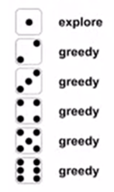
Epsilon-Greedy Action Selection
The ε-greedy selection process is given as follows
In this case ε = 1/6

Slide 23
Counter Example
Exploration and Exploitation
A visiting professor will stay at a city 300 days
A city has 3 restaurants
Restaurant 1 has average reward 10 with standard deviation 5
  Min 5 Average 10 Max 15
Restaurant 2 has average reward 8 with standard deviation 4
  Min 4 Average 8 Max 12
Restaurant 3 has average reward 5 with standard deviation 2.5
  Min 2.5 Average 5 Max 7.5

Slide 24
Counter Example
Exploration and Exploitation
Exploration
  Try Restaurant 1 100 days, Try Restaurant 2 100 days, Try Restaurant 3 100 days,
  Total rewards: 100*10 + 100*8 +100*5 = 2300
Exploitation
  Try 3 different restaurants for 3 days
  Get rewards as follows: R1= 7, R2=8 , R3=5
  Total rewards: (7+8+5) + 297*8 = 2396

Slide 25
Counter Example
Exploration and Exploitation
ε - Greedy
  let ε = 10% 30 explore and then 270 exploit
  Total rewards: 2907

Slide 26
The 10-armed Testbed
In order to understand how to assess the relative effectiveness of the greedy and ε-greedy selection process methods, they were compared numerically on a set of 2000 randomly generated k-armed bandit problems with k = 10 .
For each bandit problem, the action values, q*(a), a = 1, . . . , 10, were selected according to a normal (Gaussian) distribution with mean 0 and variance 1. Then, when a learning method applied to that problem selected action A_{t} at time step t, the actual reward, R_{t}, was selected from a normal distribution with mean q*(a) and variance 1.

Slide 27
The 10-armed Testbed
Read section 2.3 in the book (The 10-armed Testbed)

Slide 28
Optimistic Initial Values (Example: Clinical Trial)
Previously the initial estimated values were assumed to be 0, which is not necessarily optimistic.
Let’s say that our doctor optimistically assumes that each treatment is highly effective before running the trial.
To make sure we're definitely overestimating, let's make the initial value for each action 2.
Let's assume the doctor always chooses the greedy action.

Slide 29
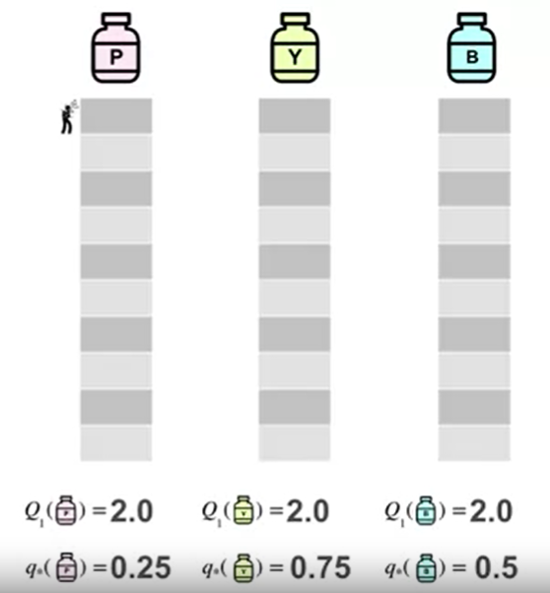
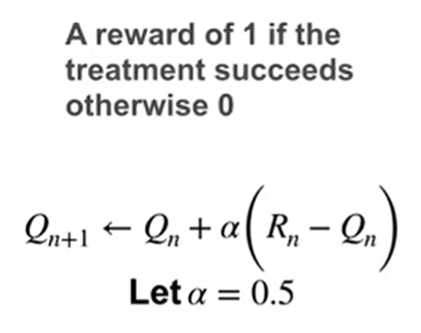
Optimistic Initial Values

Slide 30
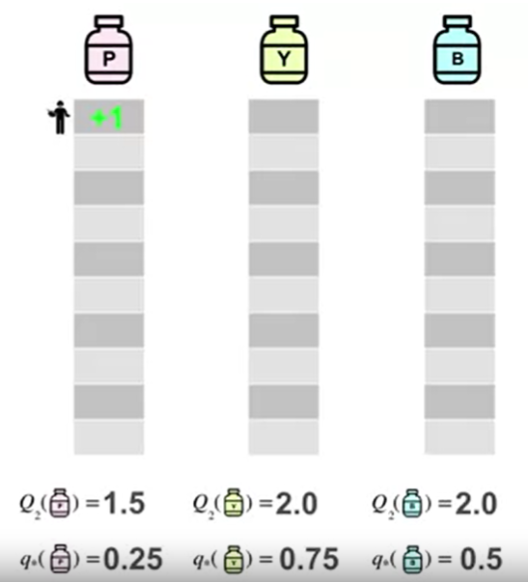
Optimistic Initial Values

Slide 31
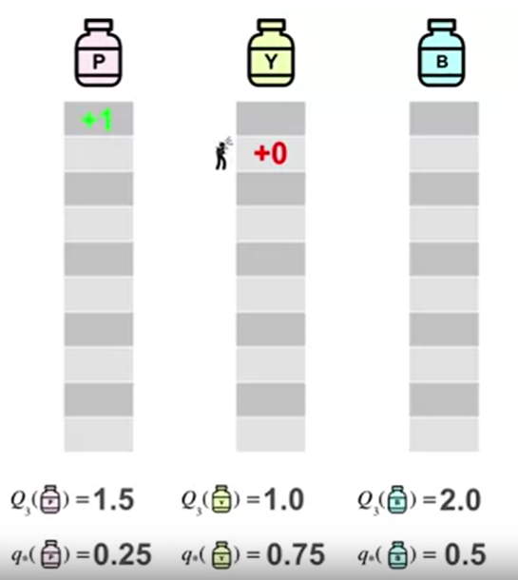
Optimistic Initial Values

Slide 32
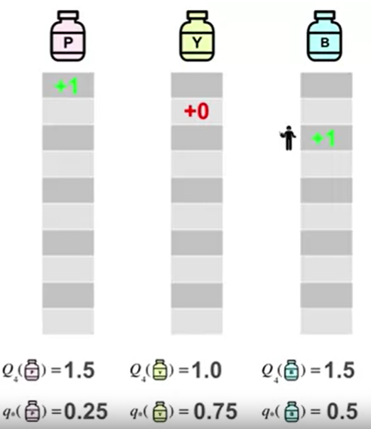
Optimistic Initial Values

Slide 33
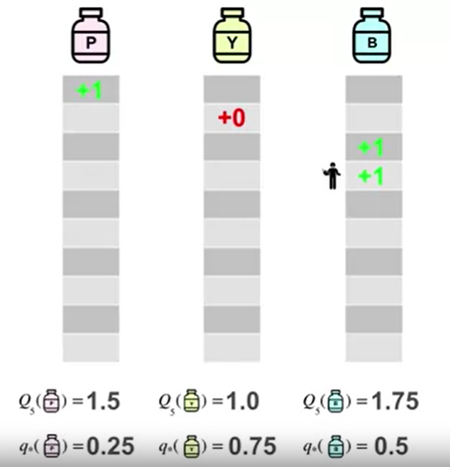
Optimistic Initial Values

Slide 34
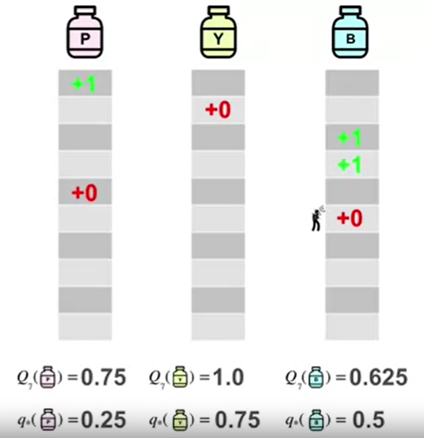
Optimistic Initial Values

Slide 35
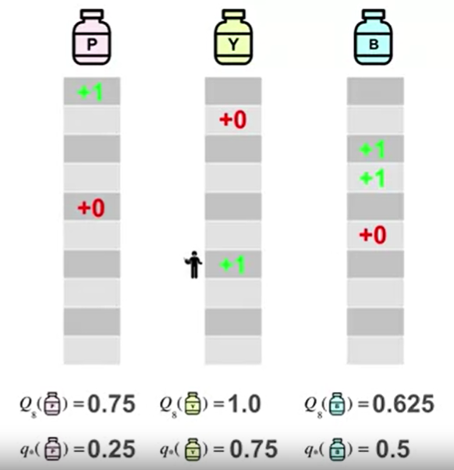
Optimistic Initial Values

Slide 36
Optimistic Initial Values
We can see how this optimistic values incentive exploration during the initial steps of the experiment, making Q closer to q*

Slide 37
Optimistic Initial Values
The effect of optimistic initial action-value estimates on the 10-armed testbed.
Both methods used a constant step-size parameter, α = 0.1.

Slide 38
Limitations of Optimistic Initial Values
Some of the limitations of optimistic initial values are
  Optimistic initial values only drive early exploration
  They are not well-suited for non-stationary problems
  We may not know what the optimistic initial value should be

Slide 39
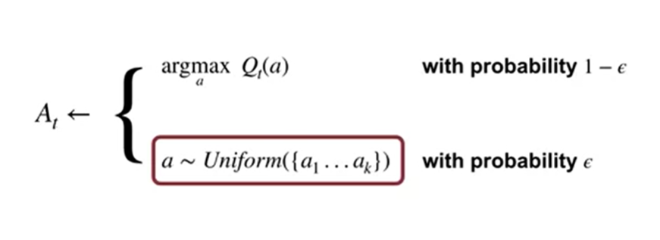
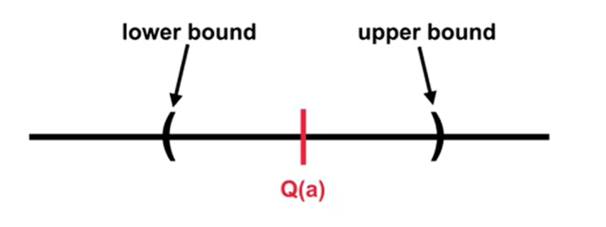
Upper-Confidence Bound (UCB) Action Selection
Remember the Epsilon-Greedy selection method
If we had a notion of uncertainty in our value estimates, we could potentially select actions in a more intelligent way.
These brackets represent a confidence interval (uncertainty) around q*(a).

Slide 40
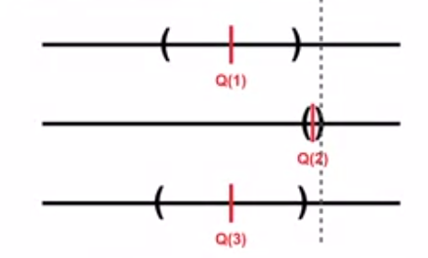
Optimism in the Face of Uncertainty
Optimistically picks the action that has the highest upper bound.
This makes sense because either it does have the highest value and we get good reward, or by taking it we get to learn about an action we know least about.

Slide 41
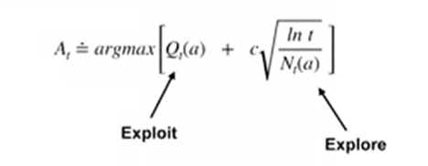
Upper-Confidence Bound (UCB)
Action Selection
The following equation defines the action selection process based on the Upper-Confidence Bound (UCB).
The c parameter is a user-specified parameter that controls the amount of exploration.

Slide 42
Upper-Confidence Bound (UCB) Action Selection
To see the effects of this action selection criteria in
The use of the natural logarithm means that the increases get smaller over time
All actions will eventually be selected, but actions with lower value estimates, or that have already been selected frequently, will be selected with decreasing frequency over time.

Slide 43
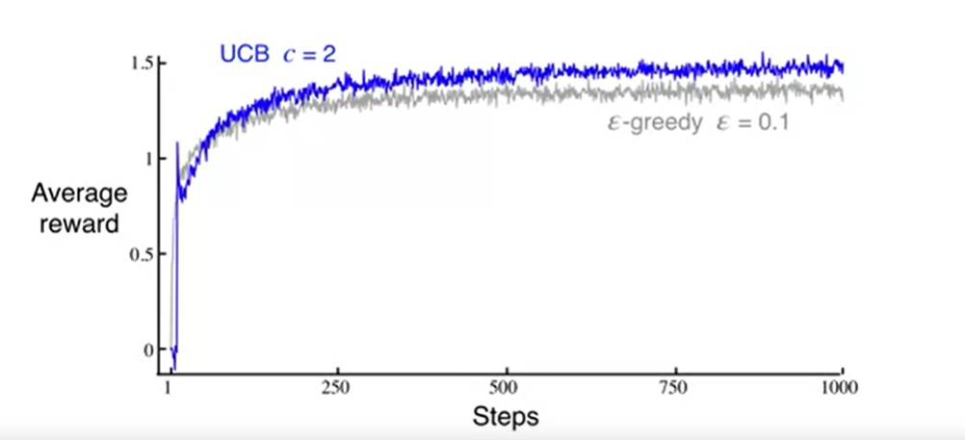
Upper-Confidence Bound (UCB)
Action Selection
The effect of the UCB on the 10-arms TestBed

Slide 44


Thank You

