Slide 1

Theories of Leadership
Chapter 4
Everyone’s Smart
University
PMG511
Project Leadership
Dr.Sara Adel

Slide 2

Learning Outcomes:
4.1 Understand different leadership theories.
4.2 Types of leadership power (Influence).
4.3 Motivators.
4.4 Culture.
4.5 Professional Discipline and Ethics.
4.6 Summary and Conclusions.
4.7 Self Assessment.
Dr.Sara Adel
Notes:
Corresponds to chapter 2, pages 25-77 of the Project Team Leadership and Communication book. ISBN: 9781732378902 (Softcover), 9781732378919 (Hardcover). These slides may only be posted or used in conjunction with the book in a training or classroom environment. Key terms (pages 74-75) are often italicized on the slides.
Outline:
What is a Project
Project Phases
Project Functions
Projects can Vary in Size and Scale
Organizational Structures
Functional
Project-Focused
Matrix
Organizational Values and Needs
Process
Plan-focused model
Cyclical model
Change-focused model
Quality
Project Quality
Product and Process Quality
Quality as a Balancing Act
The Project Triangle
Project Outcomes (The Layered Approach)
Goals, Scope Statements, Requirements/Specifications
Project Kickoff Meeting
Project Plan
Summary and Conclusion
Learning Objectives
2.1 What is a Project?
Define 'project,' identifying 2 defining features
List 4 project phases and 1 additional element
Recognize the interactions between projects/phases and the product lifecycle
2.2 The Project Environment
Identify 3 types of organizations in the context of how projects are organized
Recognize strengths and weaknesses of each of the 3 organizational types
2.3 Values, Needs, and Process
Recall factors influencing the values and needs of a project, team, or organization
List 3 fundamental process models and summarize the strengths and weaknesses of each
Recognize varying levels of detail/abstraction in documented processes
2.4 Quality and The Project Triangle
Define 'quality,' identifying 4 main aspects/concerns
Give examples of elements that are 'cost of quality' and 'cost of poor quality' in a project
Label the project triangle's 4 components
Relate examples of each project triangle component and the relationships between them
2.5 Defining Project Outcomes: A Layered Approach
Relate the concept of project goals, including examples of such
Relate the concept of project scope statements, including examples of such
Relate the concept of project requirements/specifications, including examples of such
Describe ‘the layered approach’ to project outcome definition
2.6 The Project’s Early Stages
Identify the primary objectives of a project kickoff meeting
List the essential elements of a basic project plan
2.7 Chapter Tool: Planning Project Quality
Relate basic steps for determining a project’s quality objectives
Associated Class Activities: (Separate Slides)
One Product, Multiple Projects (10 minutes, section 2.1)
Propose multiple projects within a single product’s life cycle
Organizational Culture and Structure (10 minutes, sections 1.5 and 2.2)
Analyze the cultural norms and organizational structures of multiple industries
‘Rolling Your Own’ Process (10-15 minutes, section 2.3)
Analyze a scenario and construct a basic process
Understanding Quality (10-15 minutes, section 2.4)
Develop scenario-specific quality-related elements of consideration
Layering Project Outcomes (10-15 minutes, section 2.5)
Construct scenario-specific goals, scope statements, and specifications/requirements
Outlining the Project Plan (10-15 minutes, section 2.6)
Design a project plan outline

Slide 3
Theories of Leadership
Dr.Sara Adel

Slide 4

The interest in leadership increased during the early part of the 1900’s .
Dr.Sara Adel

Slide 5
“Great Man” Theory
(1900’s)
Dr.Sara Adel

Slide 6

“Great Man” Theory
Great Man theories assume that the capacity for leadership is inherent – that great leaders are born, not made.
These theories often reveals a great leaders as hero, myth, and fated to end by leadership when needed.
The term “Great Man” was used because, at that time, leadership was believed on a male quality, especially in terms of military leadership.
Dr.Sara Adel

Slide 7
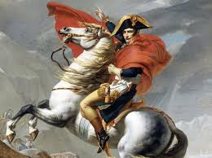

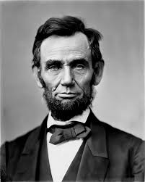
“Great Man” Theory Cont..
Great Man approach actually emphasis “charismatic leadership”.
(Gandhi, Lincoln, Napoleon) .
Dr.Sara Adel

Slide 8
Trait Theory
(1940’s – 1950’s)
Dr.Sara Adel

Slide 9
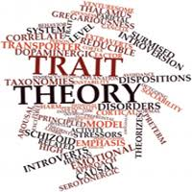
Trait Theory
Similar in some ways to “Great Man” theories, trait theory assumes that people inherit certain qualities and traits that make them better matched to leadership.
Trait theories often identify certain personality or behavioral characteristics shared by leaders.
Dr.Sara Adel

Slide 10
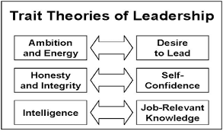
The Trait Theories Of Leadership is a social, physical traits that differentiate leaders from non leaders
Trait theories of leadership deal with personality, Trait view has little analytical or predictive value, Technical, and human skills.
all leaders would have to possess those unique and consistent characteristics, making it easy to find leaders in organizations.
Dr.Sara Adel

Slide 11
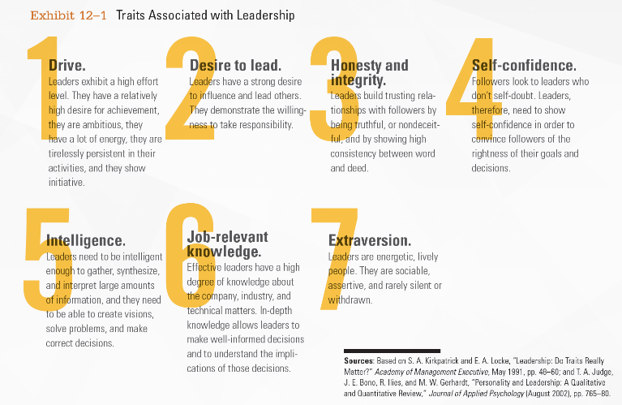
What Traits associated with Leadership ?
Dr.Sara Adel
Notes:
Attempts to identify traits consistently associated with the process of leadership (the process, not the person) have been more successful. The seven traits associated with leadership are described in Exhibit 12-1.
The seven traits associated with effective leadership are: drive, desire to lead, honesty and integrity, self-confidence, intelligence, job-relevant knowledge, and extraversion.
Next, researchers recognized that the identification of effective leaders needed to include interactions of leaders with their group members, as well as situational factors. Possessing the appropriate traits only made it more likely that an individual would be an effective leader.
Therefore, leadership research from the late 1940s to the mid-1960s turned to finding the preferred behavioral styles that leaders demonstrated. Researchers wondered whether there was something unique in the behavior of effective leaders.

Slide 12
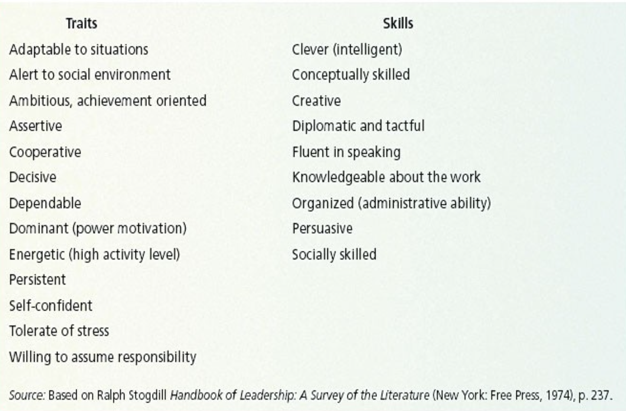
TRAITS AND SKILLS FOR LEADER
Dr.Sara Adel
Notes:
Attempts to identify traits consistently associated with the process of leadership (the process, not the person) have been more successful. The seven traits associated with leadership are described in Exhibit 12-1.
The seven traits associated with effective leadership are: drive, desire to lead, honesty and integrity, self-confidence, intelligence, job-relevant knowledge, and extraversion.
Next, researchers recognized that the identification of effective leaders needed to include interactions of leaders with their group members, as well as situational factors. Possessing the appropriate traits only made it more likely that an individual would be an effective leader.
Therefore, leadership research from the late 1940s to the mid-1960s turned to finding the preferred behavioral styles that leaders demonstrated. Researchers wondered whether there was something unique in the behavior of effective leaders.

Slide 13
Behavioral Theories
(1950’s – 1960’s)
Dr.Sara Adel

Slide 14
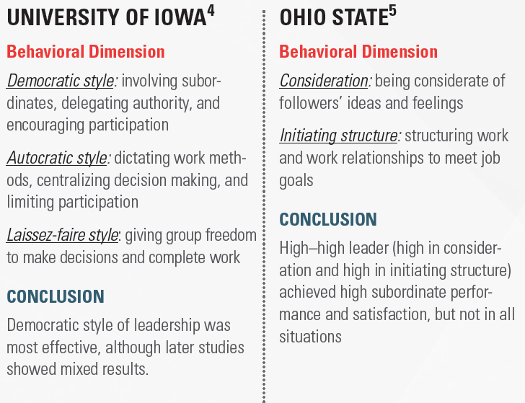
University of Iowa and Ohio State Studies
Dr.Sara Adel
Notes:
The University of Iowa study identified three leadership styles: democratic, which means involving subordinates, delegating authority, and encouraging participation; autocratic, which means dictating work methods, centralizing decision making, and limiting participation; and laissez-faire, which means giving a group freedom to make decisions and to complete work. This study concluded that the democratic style of leadership was most effective, although later studies showed mixed results.
The Ohio State study identified two factors, consideration, which involves being considerate of followers’ ideas and feelings; and initiating structure, which involves structuring work and work relationships to meet job goals. The study concluded that a high–high leader (high in consideration and high in initiating structure) achieved high subordinate performance and satisfaction, but not in all situations.

Slide 15
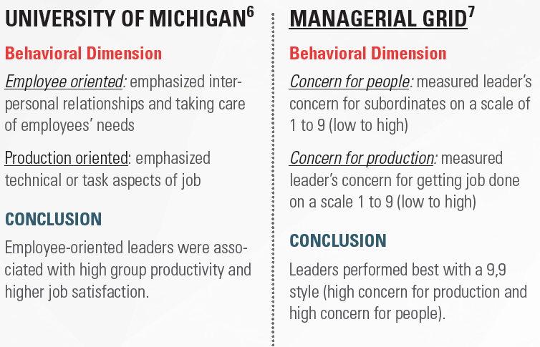
University of Michigan Study and Managerial Grid
Dr.Sara Adel
Notes:
The University of Michigan study identified two styles, employee oriented, which emphasizes interpersonal relationships and taking care of employees’ needs; and production oriented, which emphasizes technical or task aspects of a job. The study concluded that employee-oriented leaders were associated with high group productivity and higher job satisfaction.
The Managerial Grid uses two behavioral dimensions, concern for people, which measures a leader’s concern for subordinates on a scale of 1 to 9 (low to high); and concern for production, which measures a leader’s concern for getting a job done on a scale 1 to 9 (low to high). The conclusion is that leaders performed best with a 9,9 style (high concern for production and high concern for people).

Slide 16
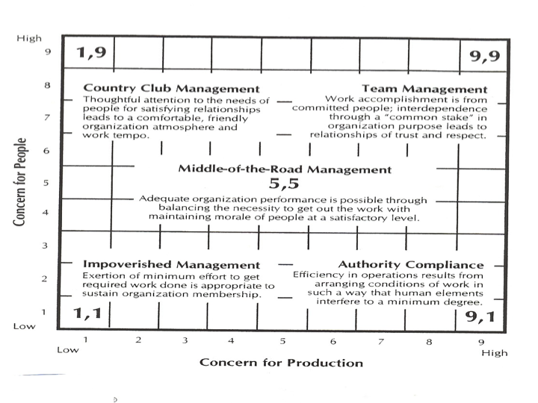
The Managerial Grid
Dr.Sara Adel
Notes:
The University of Michigan study identified two styles, employee oriented, which emphasizes interpersonal relationships and taking care of employees’ needs; and production oriented, which emphasizes technical or task aspects of a job. The study concluded that employee-oriented leaders were associated with high group productivity and higher job satisfaction.
The Managerial Grid uses two behavioral dimensions, concern for people, which measures a leader’s concern for subordinates on a scale of 1 to 9 (low to high); and concern for production, which measures a leader’s concern for getting a job done on a scale 1 to 9 (low to high). The conclusion is that leaders performed best with a 9,9 style (high concern for production and high concern for people).

Slide 17
Contingency Theories
(1960’s– 1970’s)
Dr.Sara Adel

Slide 18
Describe the four major contingency leadership theories?
The Fiedler Model.
Situational Leadership Theory.
Leader-Participation Model.
Path-Goal Theory.
Dr.Sara Adel

Slide 19
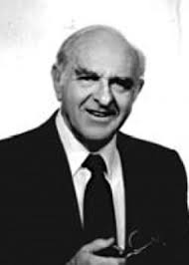
1) The Fiedler Model
The Fiedler Contingency Model was created in the mid-1960s by Fred Fiedler.
The model states that there is no one best style of leadership. Instead, a leader's effectiveness is based on the situation.
Fiedler believes a key factor in leadership success is the individual’s basic leadership style which could be categorized as either task oriented or relationship oriented.
Dr.Sara Adel
Notes:
After an individual’s leadership style had been assessed through the LPC, the leader was matched with the situation. Fiedler’s research uncovered three contingency dimensions that defined the key situational factors in leader effectiveness as:
Leader-member relations: The degree of confidence, trust, and respect employees had for their leader; rated as either good or poor;
Task structure: The degree to which job assignments were formalized and structured; rated as either high or low; and
Position power: The degree of influence a leader had over activities such as hiring, firing, discipline, promotions, and salary increases; rated as either strong or weak.
Each leadership situation was evaluated in terms of these three contingency variables, which, when combined, produced eight possible situations that were either favorable or unfavorable for the leader. (See the bottom of the chart in Exhibit 12-2.) Situations I, II, and III were classified as highly favorable for the leader. Situations IV, V, and VI were moderately favorable for the leader. Situations VII and VIII were described as highly unfavorable for the leader.
Once Fiedler had described the leader variables and the situational variables, he could define the specific contingencies for leadership effectiveness. To do so, he studied 1,200 groups to compare relationship-oriented versus task-oriented leadership styles in each of the eight situational categories. He concluded that task-oriented leaders performed better in very favorable and in very unfavorable situations. (See the top of Exhibit 12-2 where performance is shown on the vertical axis and situation favorableness is shown on the horizontal axis.) On the other hand, relationship-oriented leaders performed better in moderately favorable situations.
Research testing the overall validity of Fiedler’s model has shown considerable evidence to support it. However, its major criticisms include:
It’s unrealistic to assume that a person can’t change his or her leadership style to fit the situation;
The LPC wasn’t very practical; and
The situation variables were difficult to assess.
Despite its shortcomings, the Fiedler model showed that effective leadership style needed to reflect situational factors.

Slide 20
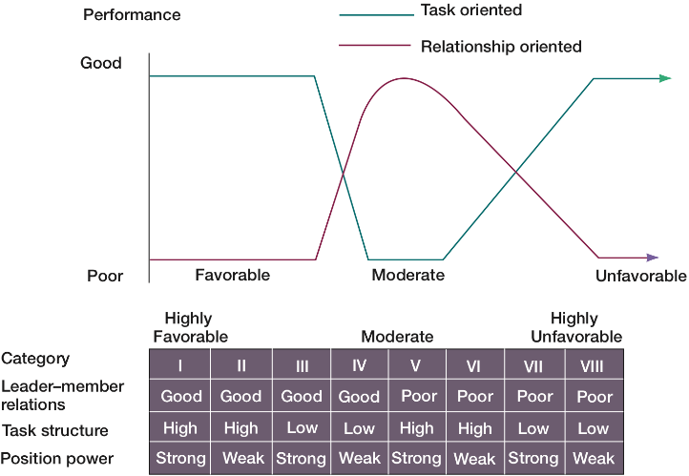
The Fiedler Model - Least-Preferred Coworker Questionnaire
LPC: An instrument that tells to measure whether a person is task or relationship oriented .
Dr.Sara Adel
Notes:
After an individual’s leadership style had been assessed through the LPC, the leader was matched with the situation. Fiedler’s research uncovered three contingency dimensions that defined the key situational factors in leader effectiveness as:
Leader-member relations: The degree of confidence, trust, and respect employees had for their leader; rated as either good or poor;
Task structure: The degree to which job assignments were formalized and structured; rated as either high or low; and
Position power: The degree of influence a leader had over activities such as hiring, firing, discipline, promotions, and salary increases; rated as either strong or weak.
Each leadership situation was evaluated in terms of these three contingency variables, which, when combined, produced eight possible situations that were either favorable or unfavorable for the leader. (See the bottom of the chart in Exhibit 12-2.) Situations I, II, and III were classified as highly favorable for the leader. Situations IV, V, and VI were moderately favorable for the leader. Situations VII and VIII were described as highly unfavorable for the leader.
Once Fiedler had described the leader variables and the situational variables, he could define the specific contingencies for leadership effectiveness. To do so, he studied 1,200 groups to compare relationship-oriented versus task-oriented leadership styles in each of the eight situational categories. He concluded that task-oriented leaders performed better in very favorable and in very unfavorable situations. (See the top of Exhibit 12-2 where performance is shown on the vertical axis and situation favorableness is shown on the horizontal axis.) On the other hand, relationship-oriented leaders performed better in moderately favorable situations.
Research testing the overall validity of Fiedler’s model has shown considerable evidence to support it. However, its major criticisms include:
It’s unrealistic to assume that a person can’t change his or her leadership style to fit the situation;
The LPC wasn’t very practical; and
The situation variables were difficult to assess.
Despite its shortcomings, the Fiedler model showed that effective leadership style needed to reflect situational factors.

Slide 21
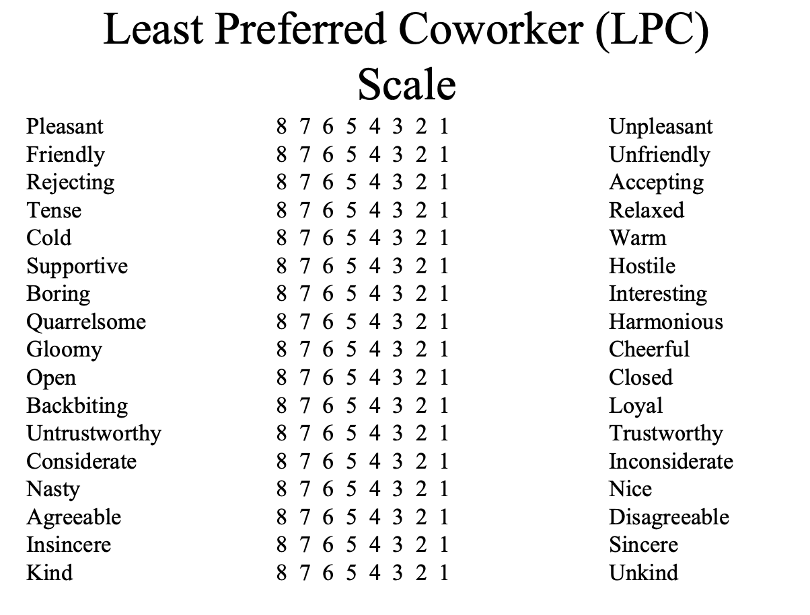
Least-Preferred Coworker Questionnaire
If the low LPC score then the person is task oriented.
If the high LPC score then the person is relationship oriented.
Dr.Sara Adel
Notes:
Now let’s examine four contingency theories—Fiedler, Hersey-Blanchard, leader-participation, and path-goal—which each look at defining leadership style and the situation and attempt to answer the contingency: If this is the context (or situation), then this is the best leadership style to use.
The first comprehensive contingency model for leadership was developed by Fred Fiedler and was based on the premise that a certain leadership style would be most effective across all different types of situations.
Fiedler proposed that a key factor in leadership success was an individual’s basic leadership style, which could be categorized as either task oriented or relationship oriented. To measure a leader’s style, Fiedler developed the least-preferred coworker (LPC) questionnaire. This questionnaire contained 18 pairs of contrasting adjectives—such as pleasant–unpleasant and boring–interesting. Respondents were asked to think of all the coworkers they had ever had and to describe that one person with whom they least enjoyed working by rating him or her on a scale of 1 to 8 for each of the sets of adjectives.
If the leader described the least preferred coworker in relatively positive terms, then the leader was primarily interested in good personal relations with coworkers and the style would be described as relationship oriented. In contrast, if the leader saw the least preferred coworker in relatively unfavorable terms, then that leader was primarily interested in productivity and his or her style would be labeled as task oriented.
Fiedler did acknowledge that a small number of people might fall between these two extremes, but he also assumed a person’s leadership style was fixed regardless of the situation.
Richard Branson, founder and CEO of Virgin Group, is a relationship-oriented leader. Pictured here with an in-flight teammate while showing the interior of a new Virgin airplane, Branson is fun loving, takes a personal interest in the needs of employees, emphasizes interpersonal relations, and accepts individual differences among workers.

Slide 22


2) Situational Leadership Theory (SLT)
Which leadership styles might be suitable in different situations, and what are those different situations?
Dr.Sara Adel
Notes:
The dual nature of leader behaviors—that is, focusing on the work to be done and focusing on the employees—is an important characteristic of each of these studies.
Leadership researchers were discovering that predicting leadership success involved something more complex than isolating a few leader traits or preferable behaviors. They began looking at situational influences. Specifically, which leadership styles might be suitable in different situations and what were these different situations?

Slide 23
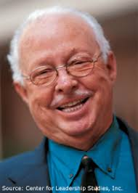
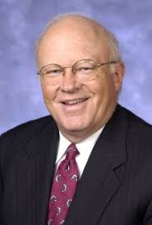
Situational Leadership Theory (cont.)
It was developed by Paul Hersey and Ken Blanchard.
It is a contingency theory that focuses on followers’ readiness.
It refers to those leaders who adopt different leadership styles according to the situation and the development level of their team members. It is an effective way of leadership because it adapts to the team’s needs and sets a beneficial balance for the whole organization.
Dr.Sara Adel
Notes:
The Situational Leadership Theory (SLT) is a contingency theory that focuses on followers’ readiness. It was developed by Paul Hersey and Ken Blanchard and enjoys a strong following among management development specialists.
Let’s stop here to clarify two points: (1) why a leadership theory focuses on the followers, and (2) what is meant by the term readiness. The emphasis on the followers reflects the reality that it is the followers who accept or reject the leader, regardless of what the leader does, so the group’s effectiveness depends on the actions of the followers. Readiness, as defined by Hersey and Blanchard, refers to the extent to which people have the ability and willingness to accomplish a specific task.
SLT uses the same two leadership dimensions that Fiedler identified—task and relationship behaviors—but takes it a step further by considering each as either high or low and then combining them into four specific leadership styles.

Slide 24



Situational Leadership Theory (cont.)
Dr.Sara Adel
Notes:
Telling (high task–low relationship), in which the leader defines roles and tells people what, how, when, and where to do various tasks;
Selling (high task–high relationship), in which the leader provides both directive and supportive behavior;
Participating (low task–high relationship), in which the leader and followers share in decision making and the main role of the leader is facilitating and communicating;
Delegating (low task–low relationship), in which the leader provides little direction or support.
The final component in the model is the four stages of follower readiness:
R1: People are both unable and unwilling to take responsibility for doing something. Followers aren’t competent or confident.
R2: People are unable but willing to do the necessary job tasks. Followers are motivated but lack the appropriate skills.
R3: People are able but unwilling to do what the leader wants. Followers are competent but don’t want to do something.
R4: People are both able and willing to do what is asked of them.
SLT essentially views the leader-follower relationship like that of a parent and a child, in which a parent needs to relinquish control when a child becomes more mature and responsible. As followers reach higher levels of readiness, the leader responds not only by decreasing control over their activities but also by decreasing relationship behaviors.

Slide 25
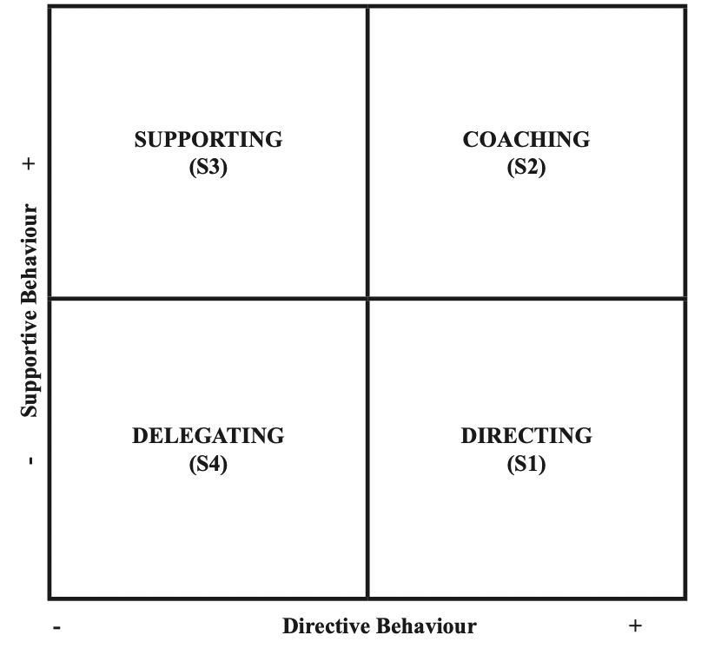
Situational Leadership Theory (cont.)
Situational theories propose that leaders choose the best course of action based upon situational variable.
Different styles of leadership may be more appropriate for certain types of decision- making.
Dr.Sara Adel
Notes:
The dual nature of leader behaviors—that is, focusing on the work to be done and focusing on the employees—is an important characteristic of each of these studies.
Leadership researchers were discovering that predicting leadership success involved something more complex than isolating a few leader traits or preferable behaviors. They began looking at situational influences. Specifically, which leadership styles might be suitable in different situations and what were these different situations?

Slide 26
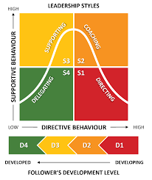
Situational Leadership Theory (cont.)
Hersey and Blanchard suggested that there are four primary leadership styles:
Telling (S1): In this leadership style, the leader tells people what to do and how to do it.
Selling (S2): This style involves more back-and-forth between leaders and followers. Leaders "sell" their ideas and message to get group members to buy into the process.
Participating (S3): In this approach, the leader offers less direction and allows members of the group to take a more active role in coming up with ideas and making decisions.
Delegating (S4): This style is characterized by a less involved, hands-off approach to leadership. Group members tend to make most of the decisions and take most of the responsibility for what happens.
Dr.Sara Adel
Notes:
Telling (high task–low relationship), in which the leader defines roles and tells people what, how, when, and where to do various tasks;
Selling (high task–high relationship), in which the leader provides both directive and supportive behavior;
Participating (low task–high relationship), in which the leader and followers share in decision making and the main role of the leader is facilitating and communicating;
Delegating (low task–low relationship), in which the leader provides little direction or support.
The final component in the model is the four stages of follower readiness:
R1: People are both unable and unwilling to take responsibility for doing something. Followers aren’t competent or confident.
R2: People are unable but willing to do the necessary job tasks. Followers are motivated but lack the appropriate skills.
R3: People are able but unwilling to do what the leader wants. Followers are competent but don’t want to do something.
R4: People are both able and willing to do what is asked of them.
SLT essentially views the leader-follower relationship like that of a parent and a child, in which a parent needs to relinquish control when a child becomes more mature and responsible. As followers reach higher levels of readiness, the leader responds not only by decreasing control over their activities but also by decreasing relationship behaviors.

Slide 27

3) Participative Theories
Leader-Participation Model (Yroom & Yetton’s Leader-Participation Model )
A leadership theory that provides a set of rules to determine the form and amount of participative decision making in different situations.
Participative leadership theories suggest that the ideal leadership style is one that takes the input of others into account.
These leaders encourage participation and contributions from group members and help group members feel more relevant and committed to the decision-making process.
Dr.Sara Adel
Notes:
In 1973, Victor Vroom and Phillip Yetton developed a leader-participation model that related leadership behavior and participation to decision making. Recognizing that task structures have varying demands for routine and nonroutine activities, these researchers argued that leader behavior must adjust to reflect the task structure.
Vroom and Yetton’s model was normative; that is, it provided a sequential set of rules to be followed in determining the form and amount of participation in decision making in different types of situations. The model was a decision tree incorporating seven contingencies (the relevance of which could be identified by making yes or no choices) and five alternative leadership styles. More recent work by Vroom and Arthur Jago has expanded the contingency variables to twelve, as listed in Exhibit 12-3.
The original leader-participation model provided some solid, empirically supported insights into key contingency variables related to leadership effectiveness. It confirmed that leadership research should be directed at the situation rather than at the person—that is, it should talk about autocratic and participative situations rather than autocratic and participative leaders.

Slide 28
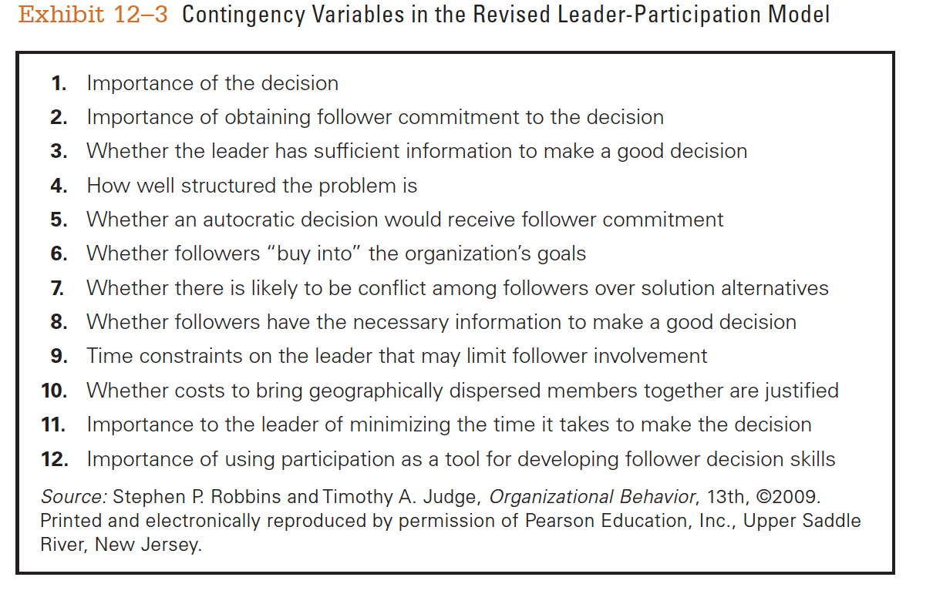
Leader-Participation Model ( contingency variables)
Dr.Sara Adel
Notes:
In 1973, Victor Vroom and Phillip Yetton developed a leader-participation model that related leadership behavior and participation to decision making. Recognizing that task structures have varying demands for routine and nonroutine activities, these researchers argued that leader behavior must adjust to reflect the task structure.
Vroom and Yetton’s model was normative; that is, it provided a sequential set of rules to be followed in determining the form and amount of participation in decision making in different types of situations. The model was a decision tree incorporating seven contingencies (the relevance of which could be identified by making yes or no choices) and five alternative leadership styles. More recent work by Vroom and Arthur Jago has expanded the contingency variables to twelve, as listed in Exhibit 12-3.
The original leader-participation model provided some solid, empirically supported insights into key contingency variables related to leadership effectiveness. It confirmed that leadership research should be directed at the situation rather than at the person—that is, it should talk about autocratic and participative situations rather than autocratic and participative leaders.

Slide 29

4) Path-Goal Theory
  Four leadership behaviors:
A directive leader lets subordinates know what’s expected of them, schedules work to be done, and gives specific guidance on how to accomplish tasks.
A supportive leader shows concern for the needs of followers and is friendly.
A participative leader consults with group members and uses their suggestions before making a decision.
An achievement-oriented leader sets challenging goals and expects followers to perform at their highest level.
Dr.Sara Adel
Notes:
Another approach to understanding leadership is path-goal theory, which states that the leader’s job is to assist followers in attaining their goals and to provide direction or support needed to ensure that their goals are compatible with the goals of the group or organization.
Developed by Robert House, path-goal theory takes key elements from the expectancy theory of motivation. The term path-goal derives from the belief that effective leaders clarify the path to help their followers get from where they are to the achievement of their work goals and to make the journey along the path easier by reducing roadblocks and pitfalls.
House identified four leadership behaviors:
A directive leader lets subordinates know what’s expected of them, schedules work to be done, and gives specific guidance on how to accomplish tasks.
A supportive leader shows concern for the needs of followers and is friendly.
A participative leader consults with group members and uses their suggestions before making a decision.
An achievement-oriented leader sets challenging goals and expects followers to perform at their highest level.

Slide 30
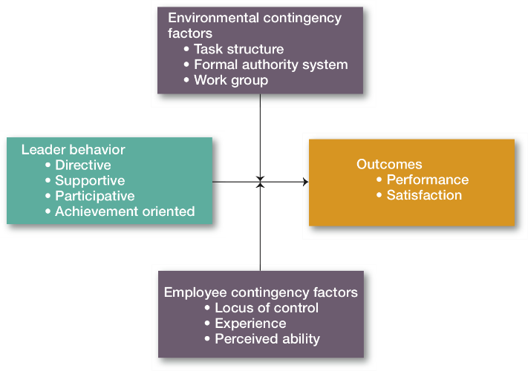
Path-Goal Model
Dr.Sara Adel
Notes:
In contrast to Fiedler’s view that a leader couldn’t change his or her behavior, House assumed that leaders are flexible and can display any or all of these leadership styles depending on the situation.
As Exhibit 12-4 illustrates, path-goal theory proposes two situational (or contingency) variables that moderate the leadership behavior-outcome relationship:
Those in the environment that are outside the control of the follower (such as task structure, formal authority system, and the work group); and
Those that are part of the personal characteristics of the follower (which include locus of control, experience, and perceived ability).
Environmental factors determine the type of leadership behavior required to maximize subordinate outcomes. Personal characteristics of the follower determine how to interpret the environment and leadership behavior. For example, some predictions from path-goal theory are that:
Directive leadership leads to greater satisfaction when tasks are ambiguous or stressful and followers aren’t sure what to do.
Supportive leadership results in high employee performance and satisfaction when subordinates are performing structured tasks; and
Subordinates with an internal locus of control will be more satisfied with a participative style of leadership.
Research findings on the path-goal model have been mixed due to the number of variables to examine. However, evidence does show that an employee’s performance and satisfaction are likely to be positively influenced when the leader chooses a leadership style that compensates for shortcomings in either the employee or the work setting.

Slide 31
Modern Views Of Leadership
Dr.Sara Adel

Slide 32
Modern Views Of Leadership
Leader-member exchange (LMX).
Transformational-transactional leadership.
Charismatic-visionary leadership.
Team leadership.
Dr.Sara Adel
Notes:
Contemporary views of leadership include:
Leader-member exchange (LMX);
Transformational-transactional leadership;
Charismatic-visionary leadership; and
Team leadership.
These views of leadership have a common theme: leaders who interact with, inspire, and support followers.
Leader-member exchange (LMX) theory says that leaders create in-groups and out-groups and that those in the in-group will have higher performance ratings, less turnover, and greater job satisfaction than those in the out-group. Leaders encourage LMX by rewarding employees with whom they want a closer linkage and punishing those with whom they do not. How a leader chooses who falls into each category isn’t definitive, but evidence indicates that in-group members have demographic, attitude, personality, and even gender similarities with the leader, or they have a higher level of competence than out-group members.
Research on LMX supports the idea that leaders do differentiate among followers who report greater satisfaction with their boss, which is consistent with leaders choosing to invest time and resources in those whom they expect to perform best.

Slide 33
1)- Leader-Member Exchange Theory (LMX).
A leadership theory that says leaders create in-groups and out-groups and those in the in-group will have higher performance ratings, less turnover, and greater job satisfaction.
Dr.Sara Adel
Notes:
Contemporary views of leadership include:
Leader-member exchange (LMX);
Transformational-transactional leadership;
Charismatic-visionary leadership; and
Team leadership.
These views of leadership have a common theme: leaders who interact with, inspire, and support followers.
Leader-member exchange (LMX) theory says that leaders create in-groups and out-groups and that those in the in-group will have higher performance ratings, less turnover, and greater job satisfaction than those in the out-group. Leaders encourage LMX by rewarding employees with whom they want a closer linkage and punishing those with whom they do not. How a leader chooses who falls into each category isn’t definitive, but evidence indicates that in-group members have demographic, attitude, personality, and even gender similarities with the leader, or they have a higher level of competence than out-group members.
Research on LMX supports the idea that leaders do differentiate among followers who report greater satisfaction with their boss, which is consistent with leaders choosing to invest time and resources in those whom they expect to perform best.

Slide 34
2)- Transactional vs. Transformational Leaders
Transformational Leaders
leaders who stimulate and inspire (transform) followers to achieve extraordinary outcomes.
Transactional Leaders
Leaders who lead primarily by using social exchanges (or transactions).
Dr.Sara Adel
Notes:
Many early leadership theories viewed leaders as transactional figures who lead primarily by using social exchanges (or transactions) and guide or motivate followers to work toward established goals by exchanging rewards for their productivity.
But another type of leader—a transformational leader—stimulates and inspires (transforms) followers to achieve extraordinary outcomes. Transformational leadership produces levels of employee effort and performance that go beyond what would occur with a transactional approach and instills in followers the ability to question established views, including those held by the leader.
There is a great deal of evidence that shows transformational leadership is superior to transactional leadership. Studies that looked at managers in different settings found that transformational leaders were evaluated as more effective, higher performers, and more promotable than their transactional counterparts, and also more interpersonally sensitive. Additionally, transformational leadership is strongly correlated with lower turnover rates and higher levels of productivity, work engagement, employee satisfaction, creativity, goal attainment, and follower well-being.

Slide 35

3)- Charismatic vs. Visionary Leaders
Dr.Sara Adel
Notes:
Amazon.com founder and CEO Jeff Bezos is a charismatic leader. Shown here introducing Amazon’s new Kindle Fire tablets, he is described as energetic, enthusiastic,
optimistic, and self-confident. Bezos has the drive to set and pursue goals for risky new ventures and uses his charisma to inspire his employees to work hard to achieve them.
A charismatic leader is an enthusiastic, self-confident leader whose personality and actions influence people to behave in certain ways. The most comprehensive analysis of charismatic leaders identified the following five personal characteristics they share:
They have a vision;
The have the ability to articulate that vision
They are willing to take risks to achieve that vision;
They are sensitive to both environmental constraints and follower needs; and
They demonstrate behaviors that are out of the ordinary.
An increasing body of evidence shows impressive correlations between charismatic leadership and high performance and satisfaction among followers. Although a small number of experts still think that charisma can’t be learned, most believe that individuals can be trained to exhibit charismatic behaviors.
Although the term “vision” is often linked with charismatic leadership, visionary leadership is the ability to create and articulate a realistic, credible, and attractive vision of the future that improves upon the present situation. This vision effectively “jump-starts” the future by calling forth the skills, talents, and resources to make it happen.
An organization’s vision should offer clear and compelling imagery that taps into members’ emotions and inspires enthusiasm to pursue the organization’s goals. It should generate possibilities that are inspirational and unique and offer new ways of doing things that are clearly better for the organization and its members.

Slide 36

4)- Leaders and Teams
The role of team leader is different from the traditional leadership role and many leaders are not equipped to handle the shift to employee teams.
A good way to describe the team leader’s job is to focus on two priorities:
Managing the team’s external boundary; and
Facilitating the team process.
Dr.Sara Adel
Notes:
Because leadership is increasingly taking place within a team context, the role of the leader in guiding team members has become increasingly important. The role of team leader is different from the traditional leadership role and many leaders are not equipped to handle the shift to employee teams.
Managers have to learn skills such as patiently sharing information, being able to trust others and to give up authority, and understanding when to intervene and when not to. One study looking at organizations that had reorganized themselves around employee teams found certain common responsibilities of all leaders, including:
Coaching
Facilitating
Handling disciplinary problems
Reviewing team and individual performance
Training, and
Communication.
A good way to describe the team leader’s job is to focus on two priorities:
Managing the team’s external boundary; and
Facilitating the team process.
These priorities entail the four specific leadership roles we see in Exhibit 12-5.

Slide 37
Influence
Types of leadership power
Dr.Sara Adel

Slide 38
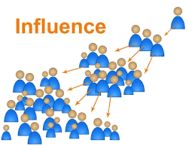
Influence
Not just the leader; All team members have influence on their peers.
Can be positive or negative
Choose appropriate combinations for each peer or team member.
Is being the ‘boss’ isn’t enough?
Dr.Sara Adel
Notes:
Corresponds to section 1.3, pages 5-7 of the Project Team Leadership and Communication book.
The next slide is the types of influence

Slide 39
Influence Types:
Formal / Legitimate
  Classic title-based position of authority.
  Ex: CEO.
Penalty / Coercive
  The ability or fear of punishment such as demotion.
  Ex: Sales manager who tells underperforming team members that they will be replaced if goals are not met.
Reward
  The ability to reward.
  Ex: Employee reward and recognition as being the best achiever.
Expert
  A superior level of skill, experience, or knowledge.
  Ex: statistician who helps team interpret data for a project.
Referent
  Based on trust and respect, similar to the influence of trusted family members
  Ex: A coach who is known for preventing team member from bulling one anther.
Dr.Sara Adel
Notes:
Corresponds to page 6 of the Project Team Leadership and Communication book.

Slide 40
Influence Types activity.
Leadership Styles
Affiliative
Authoritarian/Commanding/Autocratic
Coaching
Democratic
Laissez-faire
Pacesetting
Transformational / Visionary
- For each leadership style, which types of influence are:
  Most likely or expected to be used
  Most likely to be effective
  Least likely to be effective
Types of Influence
Formal/Legitimate
Penalty/Coercive
Reward
Expert
Referent
- Decide which type of influence is appropriate / inappropriate for multiple leadership styles?
Dr.Sara Adel
Malachowsky, Samuel. Project Team Leadership and Communication. Lintwood Press. 2018. p. 2-7.
Notes:
Corresponds to page 6 of the Project Team Leadership and Communication book.

Slide 41
Motivators
Dr.Sara Adel

Slide 42

Motivators
It is what makes us want to come to work.
Norms often established by industry, organization, or previous leaders.
What motivates you may or may not motivate others?
Motivators are highly personal; the leader must consider each team member individually.
Divided into Extrinsic and Intrinsic motivators.
Dr.Sara Adel
Notes:
Corresponds to section 1.4, pages 7-10 of the Project Team Leadership and Communication book.
The next 2 slide are the types of motivators

Slide 43
Extrinsic Motivators
Money / Power
  Want to ‘move up’ in the organization or earn higher wages.
  Ex: Salespeople, CEO’s, Politicians
Recognition
  Often motivated most by acknowledgement of those in power.
  Ex: Entertainment, Lawyers, Interns
Interpersonal Relationships
  Relationships with co-workers and a cooperative atmosphere are valued.
  Ex: Religious Leaders, Social Workers
Dr.Sara Adel
Notes:
Corresponds to pages 7-8 of the Project Team Leadership and Communication book.

Slide 44
Intrinsic Motivators
Autonomy / Interesting Work
  Prefer the excitement of new and innovative endeavors.
  Ex: Architects, Engineers
Purpose
  Need to feel that their work is beneficial to the causes they care about.
  Ex: Doctors, Teachers, Military
Mastery / Exploration
  Personal achievement, problem solving opportunities, and creative endeavors are sought.
  Ex: Artists, Scientists
Dr.Sara Adel
Notes:
Corresponds to page 8 of the Project Team Leadership and Communication book.

Slide 45
Your Motivators activity
- Rank the following motivators from most important to you to least important to you:
  Autonomy / Interesting Work
  Interpersonal Relationships
  Mastery / Exploration
  Money / Power
  Purpose
  Recognition
- Are the majority of your group members intrinsically or extrinsically motivate?
Dr.Sara Adel

Slide 46
Leaders Professional Ethics
Dr.Sara Adel

Slide 47

Leaders Professional Ethics
Ethics (self-discipline) are key to professionalism
Ethics influence and are influenced by organizational culture
Examples:
  Honesty regarding qualifications
  Protecting proprietary information
  Confronting conflict directly
  Disclosing conflicts of interest
  Focusing on mutual cooperation
  Advocating for team members and stakeholders
Dr.Sara Adel
Includes elements from the Project Management Institute’s 2006 Code of Ethics and Professional Conduct
Notes:
Corresponds to pages 15-16 of the Project Team Leadership and Communication book.

Slide 48
National Culture
Dr.Sara Adel

Slide 49
National Culture
The set of behaviors or beliefs that determine how an organization or team interacts or carries out work
Awareness of culture and different circumstances/attitudes is key
Influenced by:
  The industry, environment, customers, organizational practices
  Personalities, values, principles, etc. of the organization, leader, and team
Influences:
  Decision making, risk tolerance, decisiveness, orderliness, competitiveness
  Level of attention to detail, amount of process, emphasis on achievement
  Supportiveness, reward/punishment, team vs. individual contribution
Dr.Sara Adel
Notes:
Leadership research shows that effective leaders do not use a single style—rather, they adjust their style to the situation—and national culture is an important situational variable in determining which leadership style will be most effective. National culture affects leadership style because it influences how followers will respond. Managers are therefore constrained by the cultural conditions their followers have come to expect.
Exhibit 12-6 shows findings from selected examples of cross-cultural leadership studies. Because most leadership theories were developed in the United States, they have an American bias.
However, the GLOBE research program, which is the most extensive and comprehensive cross-cultural study of leadership ever undertaken, has found that there are some universal aspects to leadership. Specifically, a number of elements of transformational leadership appear to be associated with effective leadership regardless of what country the leader is in. These elements include vision, foresight, providing encouragement, trustworthiness, dynamism, positiveness, and proactiveness.
Some people suggest that the universal appeal of these characteristics is due to the pressures toward common technologies and management practices that are a result of global competitiveness and multinational influences. What do you think?

Slide 50

National Culture
Cross-Cultural Leadership
Korean leaders are expected to be paternalistic toward employees.
• Arab leaders who show kindness or generosity without being asked to do so are seen by other Arabs as weak.
• Japanese leaders are expected to be humble and speak frequently.
• Scandinavian and Dutch leaders who single out individuals with public praise are likely to embarrass, not energize, those individuals.
Dr.Sara Adel
Notes:
Leadership research shows that effective leaders do not use a single style—rather, they adjust their style to the situation—and national culture is an important situational variable in determining which leadership style will be most effective. National culture affects leadership style because it influences how followers will respond. Managers are therefore constrained by the cultural conditions their followers have come to expect.
Exhibit 12-6 shows findings from selected examples of cross-cultural leadership studies. Because most leadership theories were developed in the United States, they have an American bias.
However, the GLOBE research program, which is the most extensive and comprehensive cross-cultural study of leadership ever undertaken, has found that there are some universal aspects to leadership. Specifically, a number of elements of transformational leadership appear to be associated with effective leadership regardless of what country the leader is in. These elements include vision, foresight, providing encouragement, trustworthiness, dynamism, positiveness, and proactiveness.
Some people suggest that the universal appeal of these characteristics is due to the pressures toward common technologies and management practices that are a result of global competitiveness and multinational influences. What do you think?

Slide 51
Emotional Intelligence (EI)
Dr.Sara Adel

Slide 52
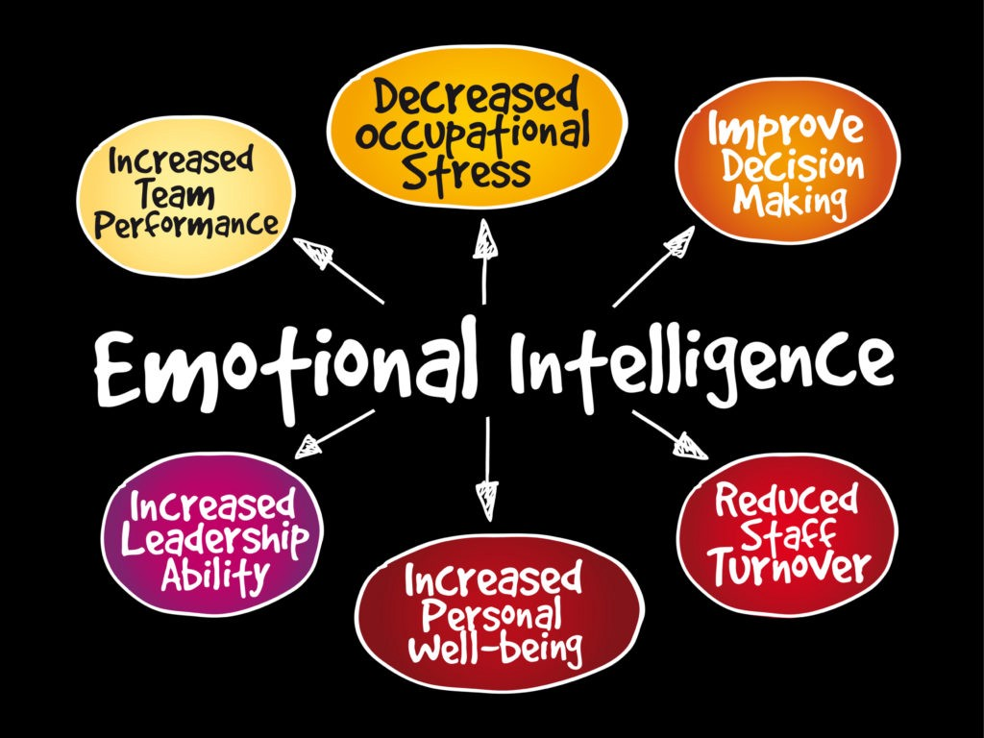
Emotional Intelligence (EI)
EI, more than any other single factor, is the best predictor of who will emerge as a leader.
EI is an essential element in leadership effectiveness.
Dr.Sara Adel
Notes:
Some recent studies indicate that emotional intelligence (EI)—more than IQ, expertise, or any other single factor—is the best predictor of who will emerge as a leader. While technical skills are necessary, they are not sufficient for leadership. Possession of the five components of emotional intelligence—self-awareness, self-management, self-motivation, empathy, and social skills—allows an individual to become a star performer.
EI has been shown to be positively related to job performance at all levels, but it appears to be especially relevant in jobs that demand a high degree of social interaction—which is what leadership is all about. Most research concludes that EI is an essential element in leadership effectiveness and that it could be added to the list of traits associated with leadership that were described at the beginning of this chapter.

Slide 53
Summary and Conclusions
Dr.Sara Adel

Slide 54
Summary and Conclusions
There are different leadership theories.
We must be intentional in how we influence and motivate others
  Awareness of various types and techniques is the key.
Project Management is an important discipline which requires diverse skills and a commitment to ethics
Culture influences every aspect of the organization and team.
EI is an essential element in leadership effectiveness.
Dr.Sara Adel
Notes:
Corresponds to section 1.9, page 20 of the Project Team Leadership and Communication book. Summarizes chapter 1 and these slides.

Slide 55
Self Assessment.
Dr.Sara Adel

Slide 56

Self Assessment
1) - Compare and contrast the different leadership
Theories?
2)- In 3 words or less, what cultural value is commonly held by the average organization in the industry?
3) What is the outcomes from the self discipline for the leader?
Dr.Sara Adel

Slide 57
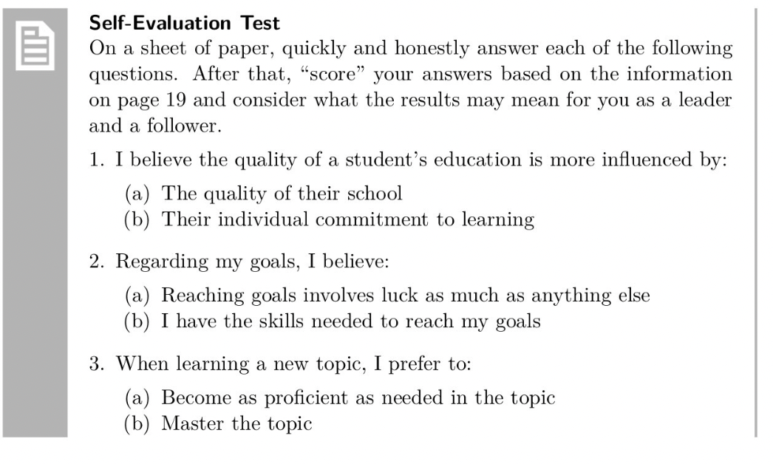
Dr.Sara Adel

Slide 58
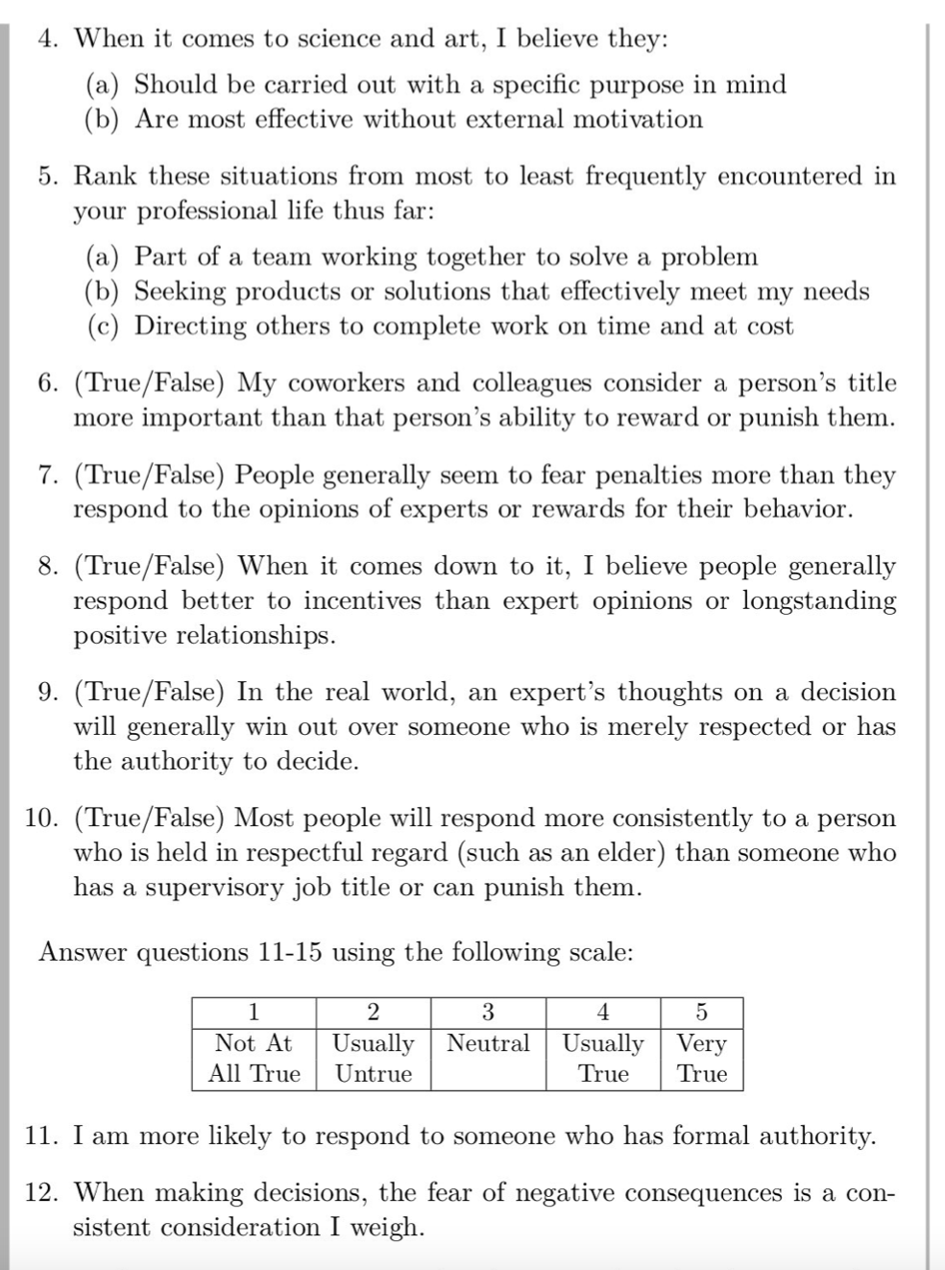
Dr.Sara Adel

Slide 59
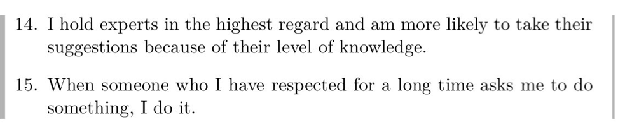
Dr.Sara Adel

Slide 60
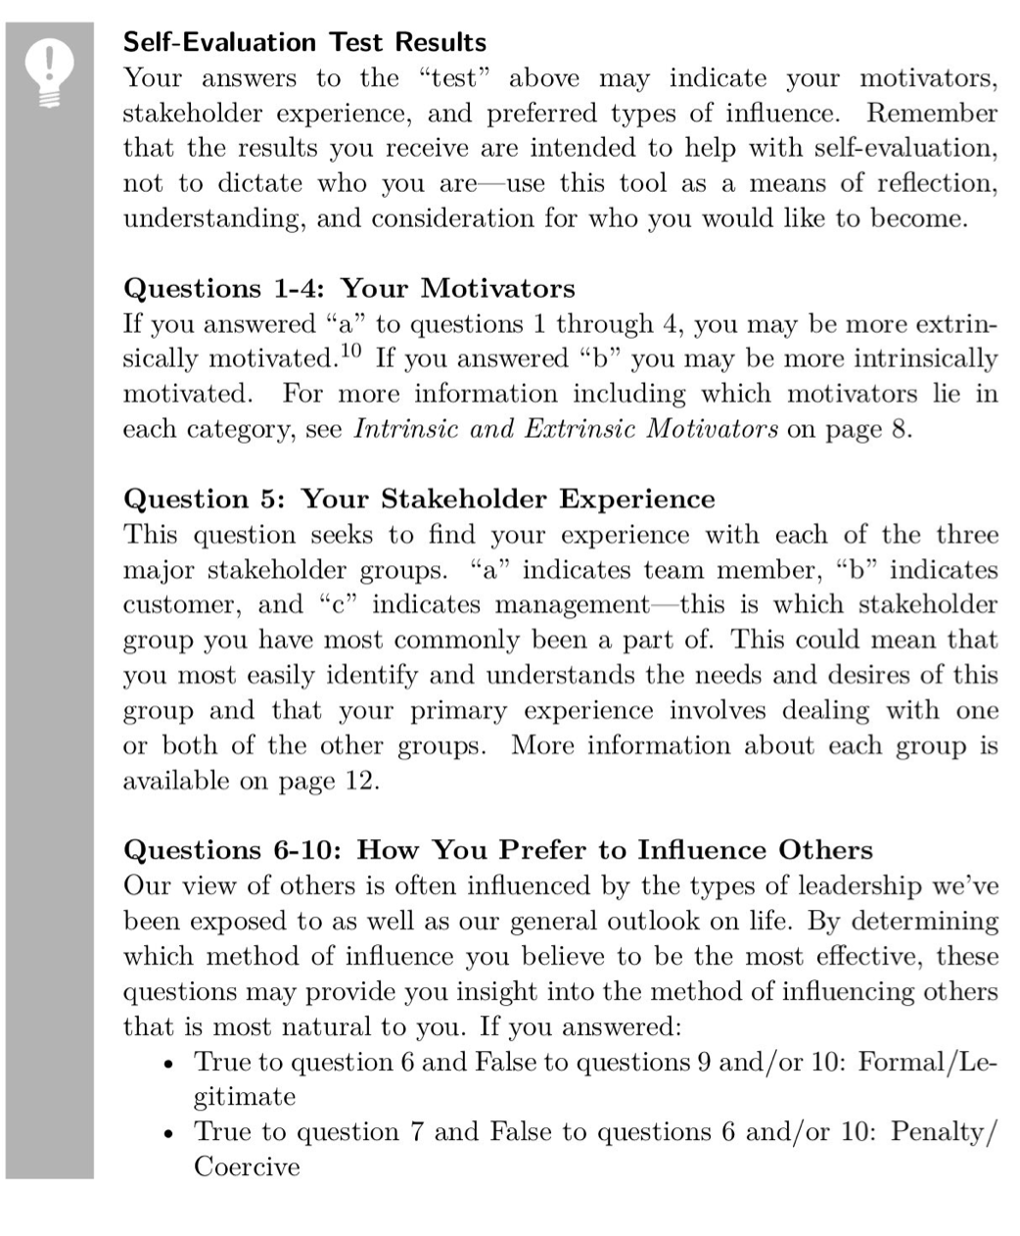
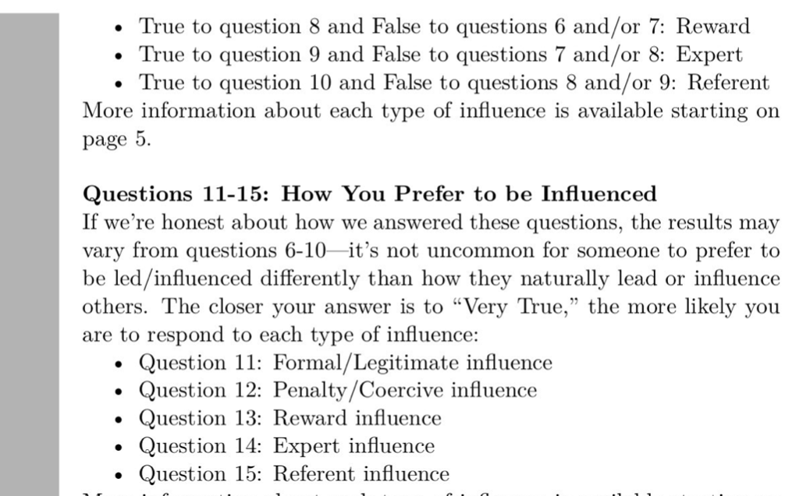
Dr.Sara Adel

Slide 61

Resources:
Project Team Leadership and Communication by Samuel Malachowsky, 2018.
Leadership: Theory and Practice, 7th Edition.
Dr.Sara Adel

Slide 62
THANKS!
Dr.Sara Adel

