Slide 1



Operational & Strategic Risk Management
PMG630
Lecture 5
Prepared by
Dr. Nael Zabel
www.midocean.ae

Slide 2
FMEA FORMAT
A tabular form or worksheet is used to collect information and document failure analysis in FMEA. Figure 3.6 shows an of an FMEA worksheet. Similar to HAZOP studies, the FMEA worksheet is often done in reference to a larger system analysis.

Slide 3
FMEA FORMAT
Correspondingly, each FMEA worksheet typically refers to one of the parts or components depicted in a system diagram such as PFD or P&ID used in the application of HAZOP. An item analysis for simple systems may also be used, as illustrated in Figure 3.5. An item analysis is a listing of a system’s basic components.

Slide 4
FMEA FORMAT
The FMEA worksheet generally follows the key questions of the risk management process. Very notably, the precursory question What should go right? Is posed first. It is similar to the notion of design intention HAZOP.

Slide 5
FMEA FORMAT
However, in FMEA, the design intent is explicitly documented and captured in the worksheet itself, unlike in HAZOP where it is primarily implied. The following are the descriptions of columns that correspond to the FMEA worksheet shown in Figure 3.6.

Slide 6
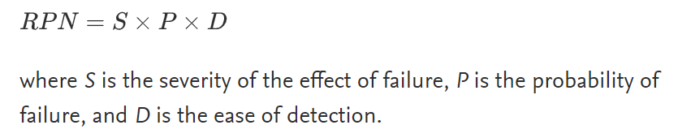
Risk Priority Number
Risk priority number (RPN) is a function of the three parameters such as: the severity of the effect of failure, the probability of occurrence, and the ease of detection for each failure mode. RPN is calculated by multiplying these three numbers as per the formula below,

Slide 7
FMEA FORMAT
• What should go right?
{ Column 1: Functional objectives of the subsystem or component
• What can go wrong?
{ Column 2: Failure modes that prevent the achievement of
objectives
• What are the causes and consequences?
The failure modes are described as risk events in terms of

Slide 8
FMEA FORMAT
{ Column 3: Consequences of failure (labeled effects in the
FMEA worksheet)
{ Column 4: Severity (S) of the consequences
{ Column 5: Potential causes of failure

Slide 9
FMEA FORMAT
• What are the likelihood or chances of occurrence?
{ Column 6: Likelihood (L) of each causes or failure (labeled
occurrencesin the FMEA worksheet)
• What can be done to detect,control,and manage them?
{ Column 7: Existing detection, prevention, and control measures
{ Column 8: Rating for existing detection (D), prevention, and
control measures

Slide 10
FMEA FORMAT
{ Column 9: The risk score determined by the likelihood, severity, and effectiveness of existing detection, prevention, and
control measures to address failure, evaluated as L ×S ×D
{ Column 10: Recommendations for additional prevention and
control measures to address the failures, their causes, and
consequences

Slide 11
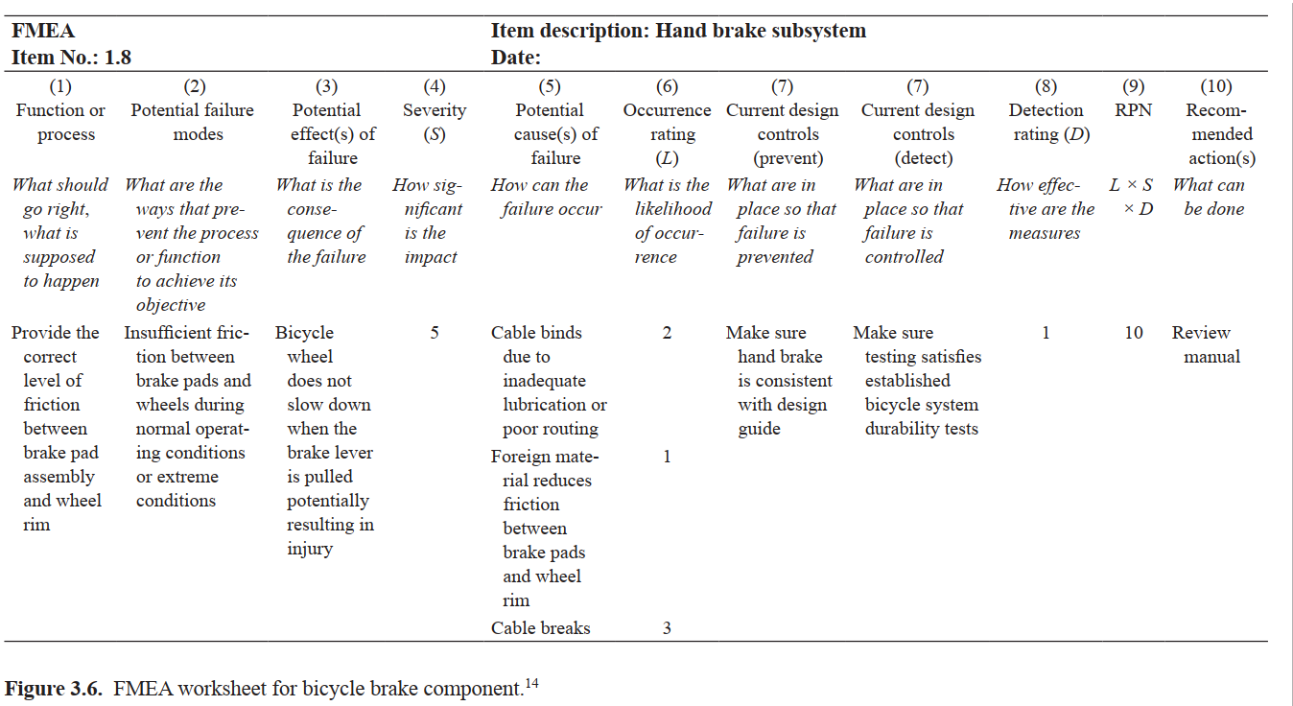
FMEA FORMAT

Slide 12
GENERALIZED STEPS FOR FMEA
1. Define the system and the scope of the study.
2. Identify the key functional objectives.
3. For each objective, identify the ways failure can occur (the failure modes).

Slide 13
GENERALIZED STEPS FOR FMEA
4. For each failure mode, identify the consequences (effects) if failure occurs.
5. Rate the consequences in terms of severity.
6. Identify the root causes for each failure mode.

Slide 14
GENERALIZED STEPS FOR FMEA
7. Rate each root cause in terms of chance of occurrence.
8. Identify current preventive and control measures for each root cause.
9. For each root cause and failure, rate how well or early they can be detected and addressed.

Slide 15
GENERALIZED STEPS FOR FMEA
10. Calculate the risk priority number (RPN) based on the consequences, occurrence, and detection.
11. Identify the failures that are considered critical.
12. Determine additional preventive or control measures as needed.

Slide 16
GENERALIZED STEPS FOR FMEA
Step 1 identifies the system and the scope of the study. FMEA can be a comprehensive look at the total system as a whole, or it may focus on certain subsystems, elements, or components. As an example, consider the bicycles a system of interest. An item analysis of the bicycle system is shown in Figure 3.5.

Slide 17
GENERALIZED STEPS FOR FMEA
The FMEA worksheet in Figure 3.6 focuses on a particular subsystem, the hand brake subsystem, and refers to Item 1.8 (shaded in gray) in the item analysis of the bicycle in Figure 3.5.

Slide 18
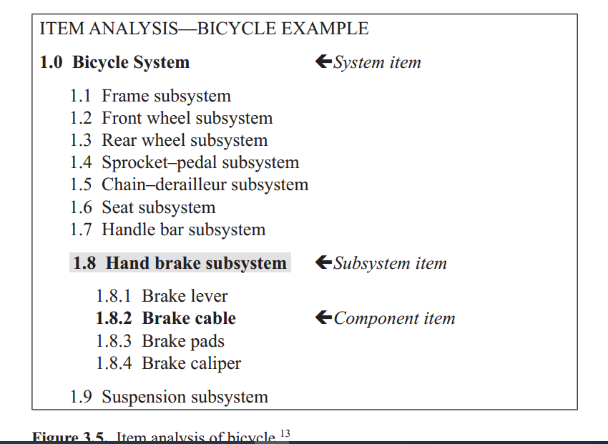
GENERALIZED STEPS FOR FMEA

Slide 19
GENERALIZED STEPS FOR FMEA
Step 2 identifies the key functional objectives of the system, subsystem, or component of interest. It describes what the component is supposed to do to achieve the functional objective—description of what needs to go right. Thus for the bicycle, one of its critical functions is the ability to stop safely within a required distance under all operating conditions.

Slide 20
GENERALIZED STEPS FOR FMEA
This function is achieved through the hand brake by providing the correct level of friction between the brake pad assembly and the wheel rim when the brake lever is pulled. This information is entered in Column 1 of the FMEA worksheet. It describes what the hand brake subsystem is supposed to do to achieve the function of stopping or braking (What should go right?).

Slide 21
GENERALIZED STEPS FOR FMEA
Step 3 identifies the failure modes. As Column 1 defines what the component is supposed to do, Column 2 describes what can happen (What can fail?) that will prevent the component from doing what it is supposed to do. In other words, the failure modes are the different ways the component can fail to accomplish its functional objective.

Slide 22
GENERALIZED STEPS FOR FMEA
For the bicycle, one potential failure mode is having insufficient friction between the brake pad and wheel rim during normal or extreme conditions such as heavy rains. This information is entered in Column 2 of the FMEA worksheet. Note that it is important to describe in detail the conditions in which the failure mode can occur.

Slide 23
GENERALIZED STEPS FOR FMEA
Step 4 identifies the consequences (effects) on the system as a whole, its elements, and the environment for each failure mode.
It helps to ask What happens when this failure occurs?

Slide 24
GENERALIZED STEPS FOR FMEA
What does the user experience because of this failure? For the bicycle, insufficient friction means the bicycle wheel does not slow down when the brake lever is pulled, potentially resulting in collision, loss of control, and eventual injury.
This information is entered in Column 3 of the FMEA worksheet.

Slide 25
GENERALIZED STEPS FOR FMEA
Step 5 provides a severity rating for each effect. Rating scales such as those used in Lecture 2 can be used. For the bicycle, the worse potential result of the identified failure mode is safety failure; the severity is evaluated as catastrophic (see Table 2.2).
A level 5 is entered in Column 4.

Slide 26
GENERALIZED STEPS FOR FMEA
Step 6 identifies all potential root causes for each failure mode. What specifically causes this failure mode to occur? Here it is important to establish the causal chain of events to identify root causes. For the bicycle example, there are three potential causes for having insufficient friction between the brake pads and wheel rim

Slide 27
GENERALIZED STEPS FOR FMEA
1) failure of cable binds due to inadequate lubrication or poor routing, (2) foreign material on brake pad or wheel rim that reduces friction, (3) cable itself breaks, and (4) brake lever misalignment. This information is entered in Column 5 in the FMEA worksheet.

Slide 28
GENERALIZED STEPS FOR FMEA
Step 7 rates the root causes according to their likelihood of occurrence. This rating evaluates the chance of failure because of a particular root cause. It follows that if a particular root cause is more likely to occur, then failure from this root cause is also more likely.

Slide 29
GENERALIZED STEPS FOR FMEA
For the bicycle, the cable breaking is the most likely cause of insufficient friction among the causes. Using Table 2.3, its likelihood of occurrence is moderately possible and given a rating of 3. This information is entered in Column 6 in the FMEA worksheet.

Slide 30
GENERALIZED STEPS FOR FMEA
Steps 8 and 9 describe and rate the effectiveness of preventive and control measures that currently exist. Each measure is evaluated according to how well or early the failure mode or its cause can be detected and addressed before the effects occur. Detection is rated on a scale from 1 to 5, where 1 means the control is absolutely certain to detect the cause or failure and 5 means the inability for detection.

Slide 31
GENERALIZED STEPS FOR FMEA
For the bicycle example, detection of the cable binding due to inadequate lubrication or poor routing is given a rating of 2. This is due to the quality and testing process in the manufacturing of bicycles. Table 3.2 can be used to determine a detection rating. The information for steps 8 and 9 are entered in Column 7 and Column 8 of the FMEA worksheet, respectively.

Slide 32
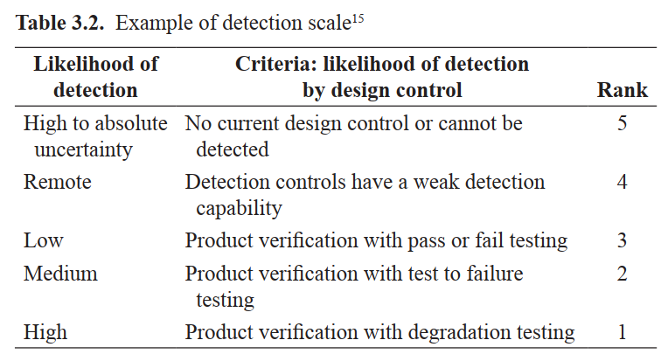
GENERALIZED STEPS FOR FMEA

Slide 33
GENERALIZED STEPS FOR FMEA
One can also evaluate reactive measures. Specifically, how the system is able to detect failure after the cause has already happened; and how the system is able to address the failure before the impact of the effects occurs. For example, if the bicycle had an indicator or an alarm that the hand brake subsystem has failed. This measure can inform the user to use alternative means for stopping or breaking.

Slide 34
GENERALIZED STEPS FOR FMEA
In step 10, upon identifying the likelihood (L), consequences (S) of failure modes, and the current system’s ability to address (D) the causes of failure, failure modes are then evaluated for criticality using a risk score similar to PHA. For FMEA, the risk score is known as the RPN and can be derived by multiplying L ×S ×D, corresponding to Columns 4, 6, and 8 respectively. The RPN score entered in Column 9 can provide guidance for ranking potential failures in the order they should be addressed.

Slide 35
GENERALIZED STEPS FOR FMEA
Step 11 describes recommendations and proposed additional preventive control measures if necessary. Particular attention is given to proposals that will decrease the likelihood of occurrence, lower the severity of the consequences, or increase the capability or effectiveness to detect early and mitigate the causes of failure. Part of the recommendation should include the organizational functions responsible for these actions and target completion dates. This information is entered in Column 10 of the FMEA worksheet.

Slide 36
References
Resources:
Operational Risk Management
C. Ariel Pinto
Luna Mylene Magpili
Raed M. Jaradat

