Slide 1

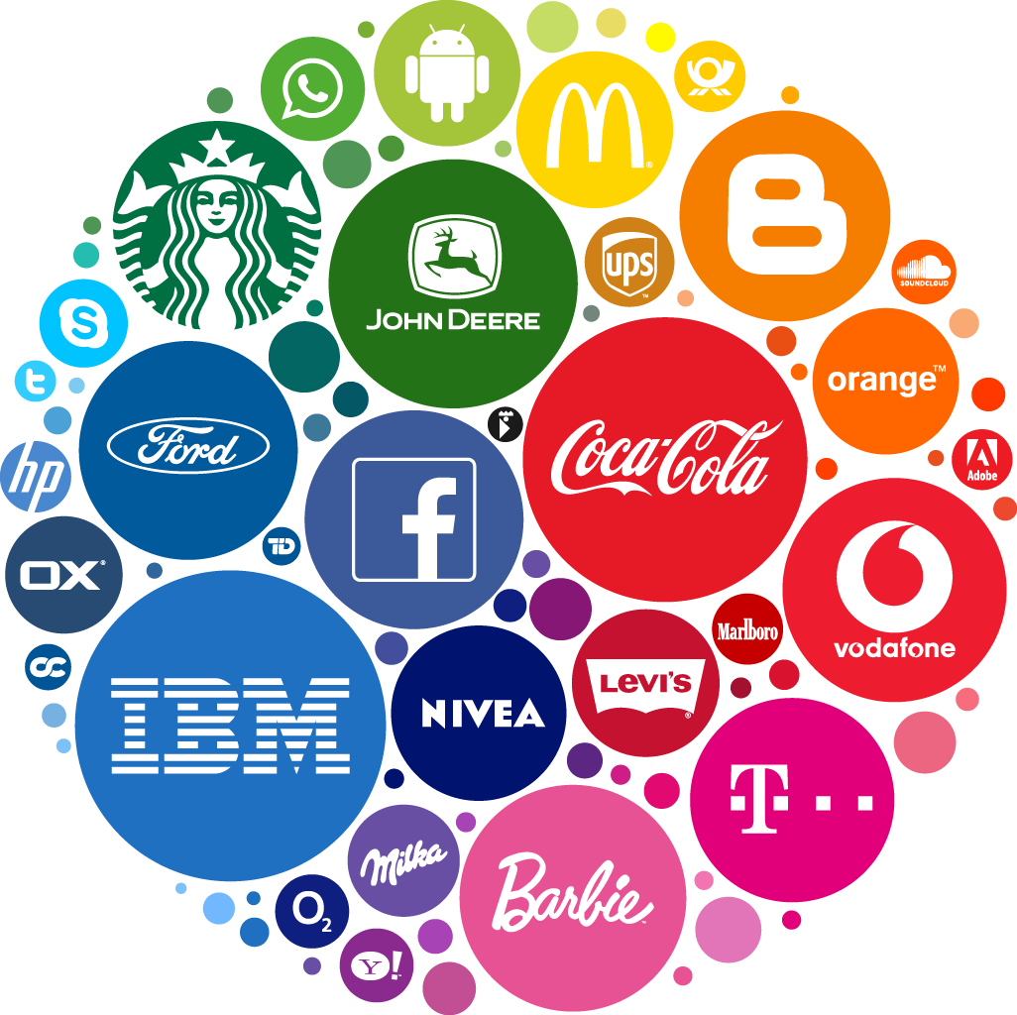
Products, Services & Brands
Prepared by Thana Ahmed
MGM204
PRINCIPLE OF MARKETING
Lecture 05

Slide 2
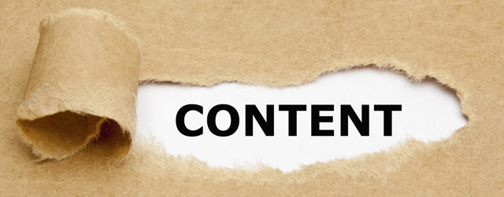
Defining Product & Services
Product and service classifications
Product and service Decisions
Nature and Characteristics of Services
Product Life Cycle

Slide 3
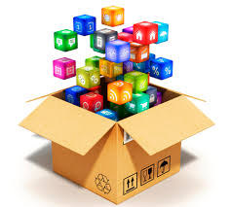
WHAT IS A PRODUCT?
PRODUCT= Anything that can be offered to a market for attention, acquisition, use, or consumption that might satisfy a want or need.
SERVICE = An activity , benefits, or satisfaction offered for sale that is essentially intangible and does not result in the ownership of anything.
Broadly defined, products include tangible products, services, event, persons, places, organization, an idea, or a mixture of these.

Slide 4
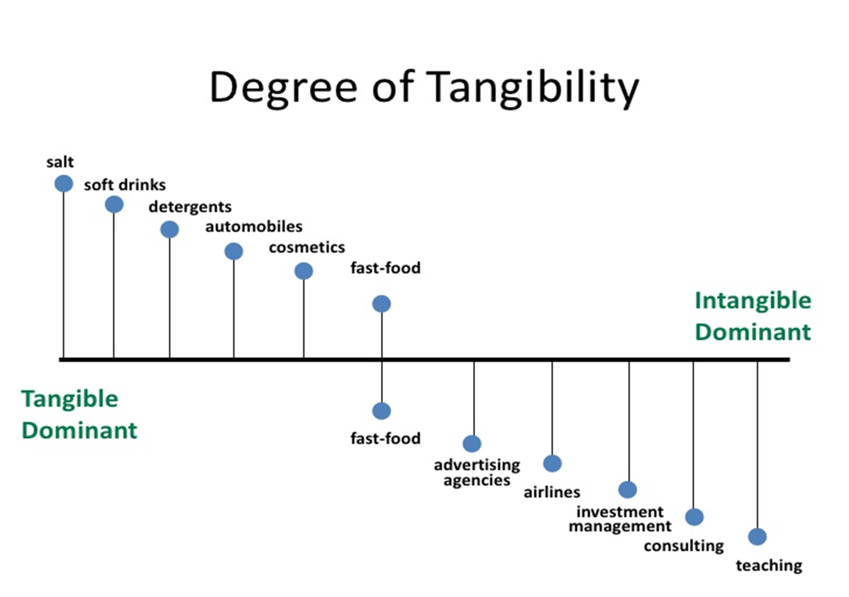
Product & Services

Slide 5
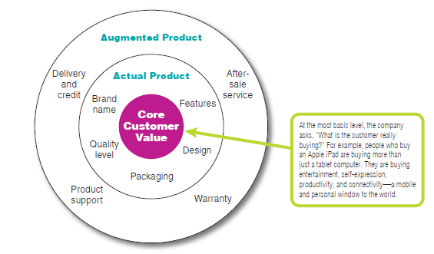
Level of Product & Services
Each level adds more customer value
three levels of Product

Slide 6
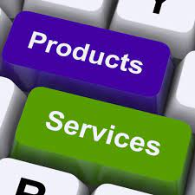
Level of Product & Services
Consumers see products as complex bundles of benefits that satisfy their needs. When developing products, marketers first must identify the core customer value that consumers seek from the product.

Slide 7
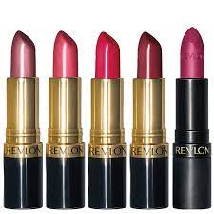

WHAT ARE CUSTOMERS REALLY BUYING?
They are buying entertainment, self-expression, productivity, and connectivity with friends and family—a mobile and personal window to the world
Charles Revson of Revlon saw this early: “In the factory, we make cosmetics; in the store, we sell hope.”

Slide 8
Product and service classifications
Consumer Products: are products and services bought by final consumers for personal consumption (Convenience, shopping, specialty, and unsought products).
Industrial product: A product bought by individuals and organizations for further processing or for use in conducting a business. ( materials and parts, capital items, supplies & services).

Slide 9
Consumer Products Classification
Type of Consumer Products | Definition | Example
Convenience product | A consumer product that customers usually buy frequently, immediately, and with minimal comparison and buying effort. | Laundry Detergent Fast-food...
Shopping product | A consumer product that the customer, in the process of selecting and purchasing, usually compares on such attributes as suitability, quality, price, and style. | furniture, clothing, major appliances, hotel services…
Specialty product | A consumer product with unique characteristics or brand identification for which a significant group of buyers is willing to make a special purchase effort. | specific brands of cars (Ferrari), high-priced photography equipment, designer clothes…
Unsought product | A consumer product that the consumer either does not know about or knows about but does not normally consider buying. | New innovations, life insurance, blood donations to the Red Cross.

Slide 10
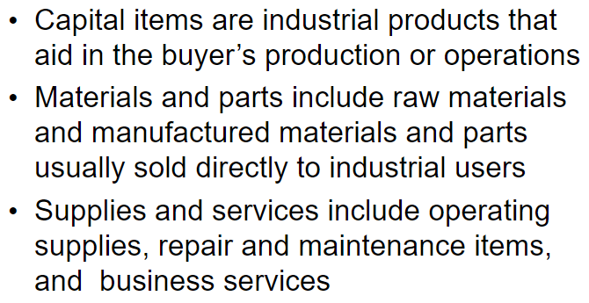
Industrial Products Classification

Slide 11
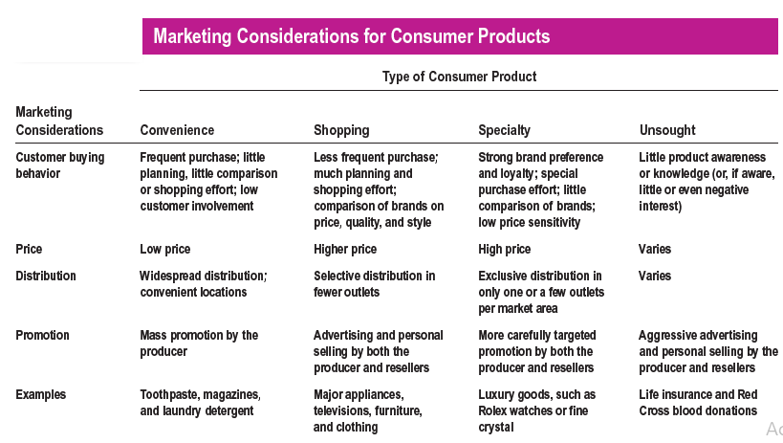

Slide 12
Product and service Decisions
Product & service decisions
Individual product decisions
Product line decisions
Product mix decisions

Slide 13
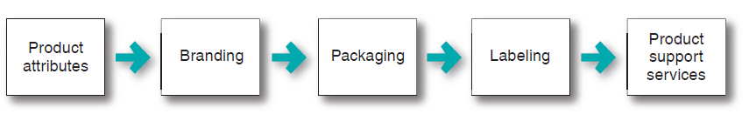
INDIVIDUAL PRODUCT DECISIONS

Slide 14
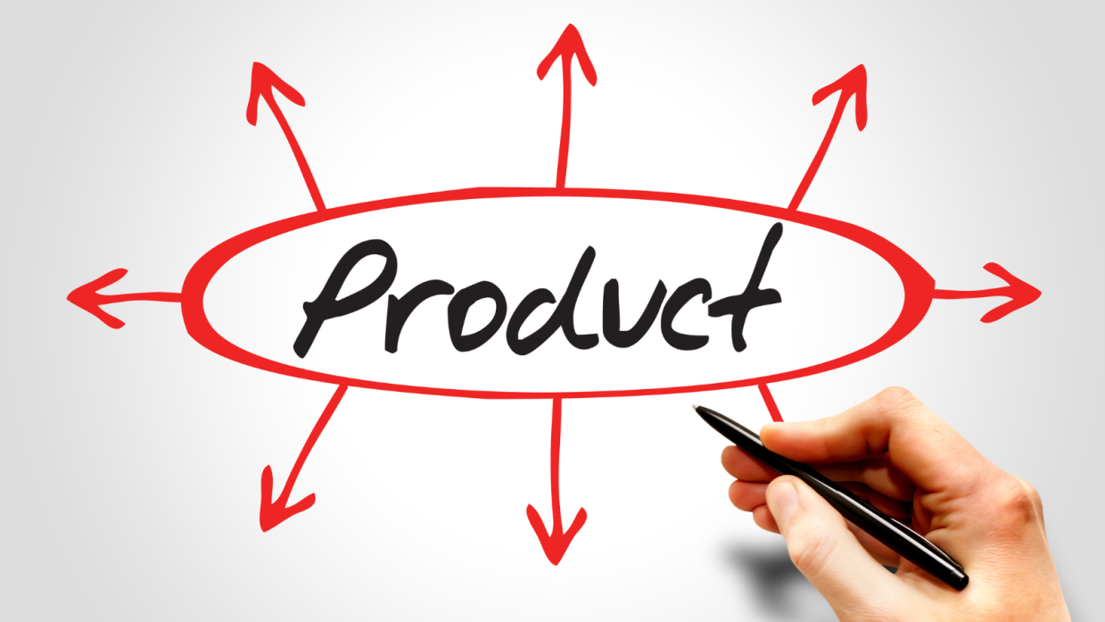
Product Attributes
Developing a product or service involves defining the benefits that it will offer. These benefits are communicated and delivered by product attributes such as
    Quality
    Features
    Style
    Design.

Slide 15

Product Attributes
Product Quality:
  It is “the characteristics of a product or service that bear on its ability to satisfy stated or implied customer needs”
  Siemens defines quality this way: “Quality is when our customers come back, and our products don’t.”
  Product quality has 2 dimensions: Performance & Conformance.
    Performance quality—the product’s ability to perform its functions.
    Conformance quality- freedom from defects and consistency in delivering a targeted level of performance.

Slide 16
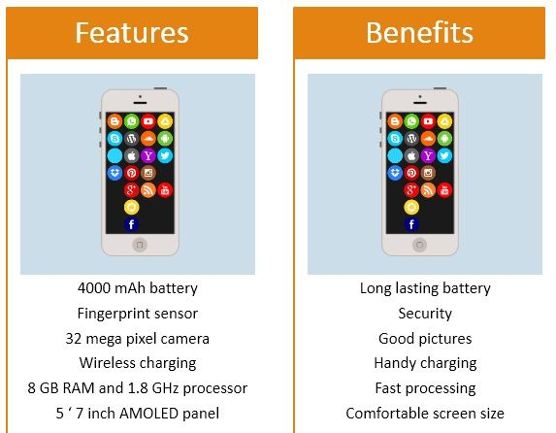
Product Attributes
Product Features:
  A product can be offered with varying features. A stripped-down model, one without any extras, is the starting point.
  The company can then create higher-level models by adding more features

Slide 17
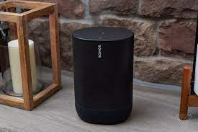
Product Attributes
Product style and Design:
  Style simply describes the appearance of a product.
  Design contributes to a product’s usefulness as well as to its looks.
a wireless speaker system that’s not just stylish but also easy to set up, easy to use, and easy to move to meet changing needs. ( No need for routing wires through walls, complex installation…)

Slide 18

BRANDING
Brand: “A name, term, sign, symbol, or design or a combination of these that identifies the products or services of one seller or group of sellers and differentiates them from those of competitors”.
Brands represent consumers’ perceptions and feelings about a product and its performance—everything that the product or the service means to consumers.

Slide 19
BRANDING
Brands exist in the heads of consumers: “Products are created in the factory, but brands are created in the mind.”
A powerful brand has high brand equity.
Brand equity is the differential effect that knowing the brand name has on customer response to the product and its marketing. It’s a measure of the brand’s ability to capture consumer preference and loyalty. A brand has positive brand equity when consumers react more favorably to it than to a generic or unbranded version of the same product. It has negative brand equity if consumers react less favorably than to an unbranded version.

Slide 20
BRANDING
Brand Positioning:
At the lowest level, they can position the brand on product attributes. however, attributes are the least desirable level for brand positioning. Competitors can easily copy attributes. More important, customers are not interested in attributes as such—they are interested in what the attributes will do for them.
A brand can be better positioned by associating its name with a desirable benefit. Exp: Nike (performance), and Instagram (capturing and sharing moments).
The strongest brands go beyond attribute or benefit positioning. They are positioned on strong beliefs and values, engaging customers on a deep, emotional level.

Slide 21
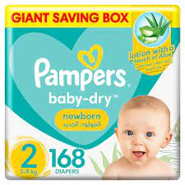
BRANDING POSITIONING EXAMPLE
Product attributes: fluid absorption, fit, and disposability
Desirable benefit: baby skin-health benefits from staying dry
Strong beliefs and values: love, sleep, and play

Slide 22
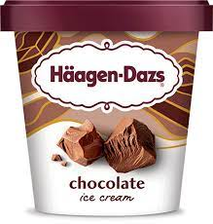
BRAND NAME SELECTION
It should suggest something about the product’s benefits and qualities: Slimfast, Snapchat.
It should be easy to pronounce, recognize, and remember: iphone
The brand name should be distinctive: Pepsi
It should be extendable—Amazon.com
The name should translate easily into foreign languages. Bing
It should be capable of registration and legal protection.
WHAT ABOUT THIS ICE-CREAM BRAND?
WHAT DO YOU THINK ABOUT THE NAME?

Slide 23
BRANDING
Branding Advantages for buyers:
Brand names help consumers identify products that might benefit them.
Brands give consumers clues about product quality and consistency.
Branding Advantages for sellers:
The seller’s brand name and trademark provide legal protection.
Branding helps the seller to segment markets

Slide 24
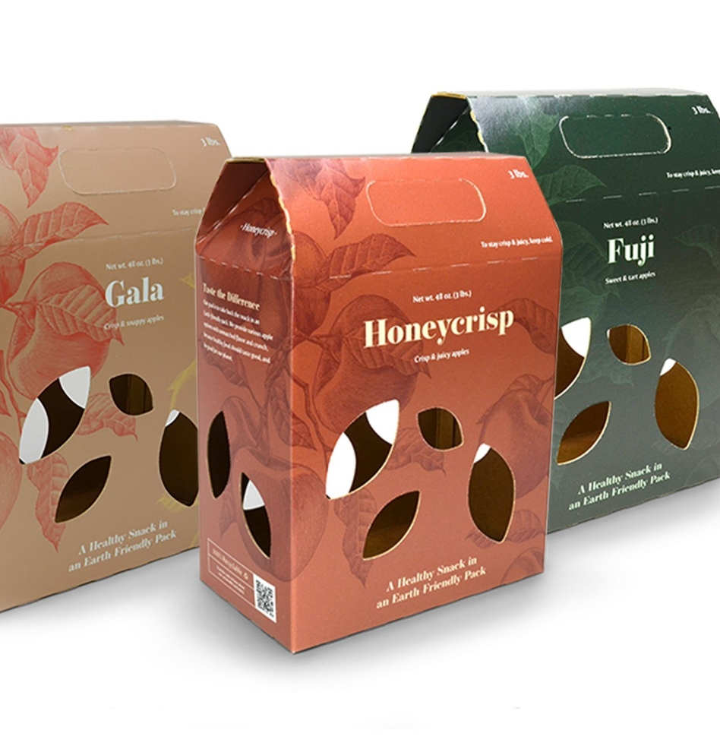
PACKAGING
Packaging:
The activities of designing and producing the container or wrapper for a product.
Companies are realizing the power of good packaging to create immediate consumer recognition of a brand.
Poorly designed packages can cause frustration for consumers and lost sales for the company.
Distinctive packaging may even become an important part of a brand’s identity.

Slide 25

Packaging main functions
1. Protect product contents and features

Slide 26
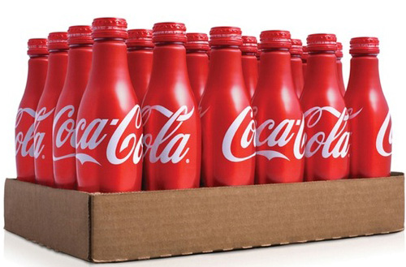
2. Facilitate the process of trading and storage

Slide 27
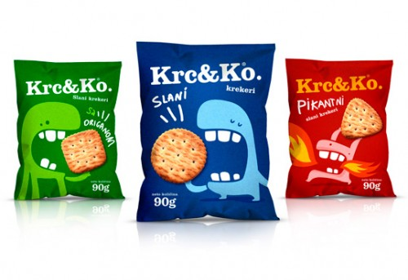
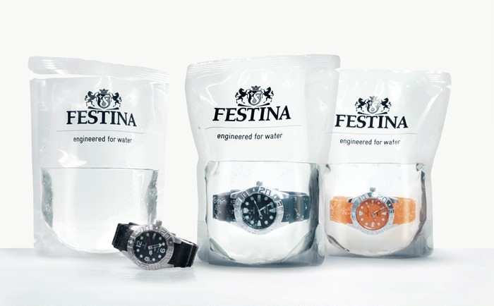
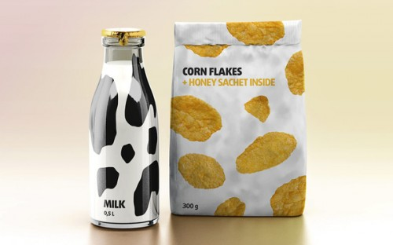
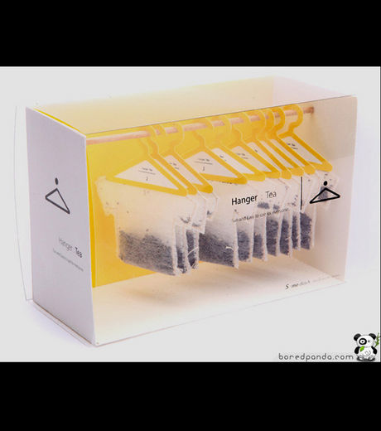
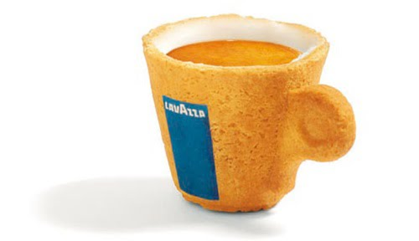
3. Attract customer attention (“ the silent seller”)

Slide 28
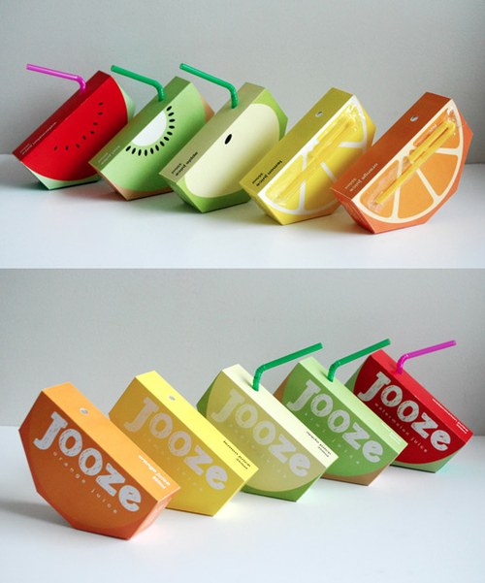

4. Facilitating the consumption

Slide 29
LABELING
Label: range from simple tags attached to products to complex graphics that are part of the packaging.
They perform several functions.
  label identifies the product or brand
  The label might also describe several things about the product (who made it, where it was made, when it was made, its contents, how it is to be used, and how to use it safely).
  The label might help to promote the brand and engage customers.

Slide 30
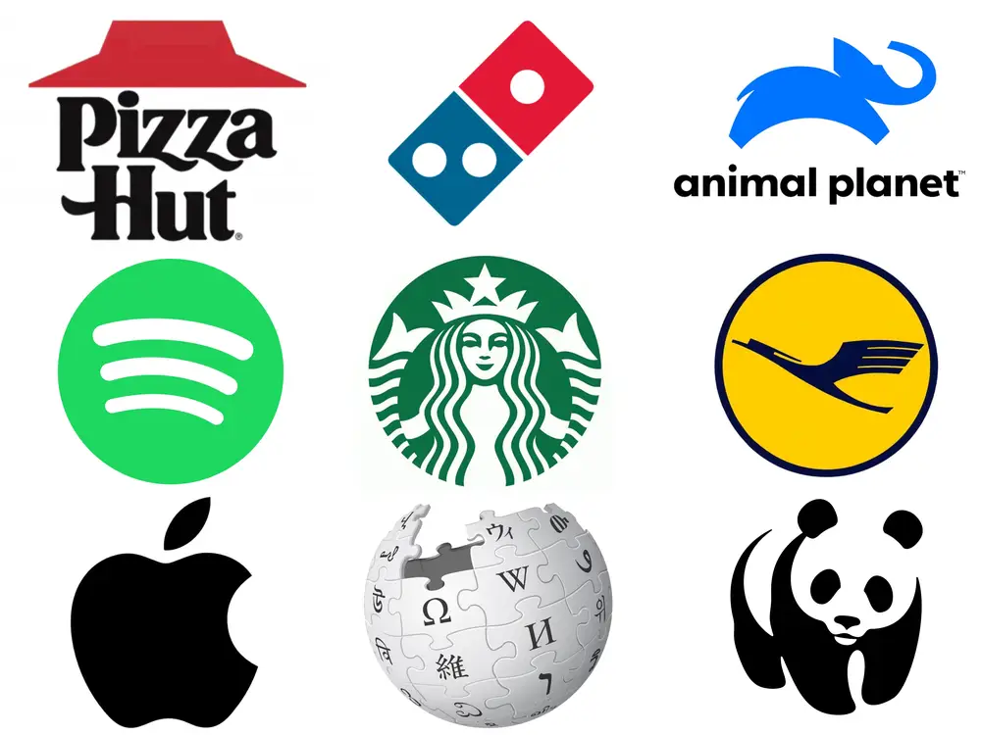
LABELING
Label
Labels and brand logos can support the brand’s positioning and add personality to the brand.
Customers often become strongly attached to logos as symbols of the brands they represent. Consider the feelings evoked by the logos of companies such as Coca- Cola, Google, Twitter, Apple, and Nike.

Slide 31

Product support services
Keeping customers happy after the sale is the key to building lasting relationships.
Support services may include:
  Warranties
  Deliveries
  Repair and maintenance
  Installation
  Other services

Slide 32
Product and service Decisions
Product & service decisions
Individual product decisions
Product line decisions
Product mix decisions

Slide 33
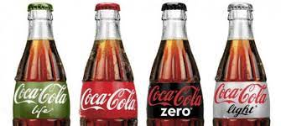
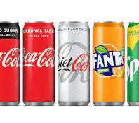
Product Line Decisions
Product line: A group of products that are closely related because they function in a similar manner, are sold to the same customer groups, are marketed through the same types of outlets, or fall within given price ranges.

Slide 34
Product line decisions
The major product line decision involves product line length—the number of items in the product line.
A company can expand its product line in two ways: by line filling or line stretching
  Product line filling involves adding more items within the present range of the line
  Product line stretching occurs when a company lengthens its product line beyond its current range

Slide 35
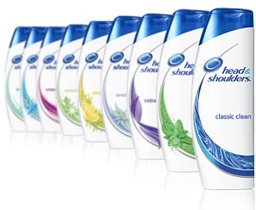
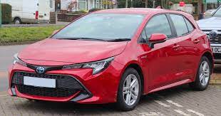
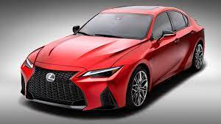
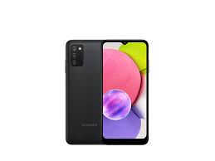
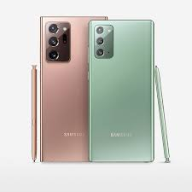
Product line decisions
  Product line filling
  Product line stretching

Slide 36
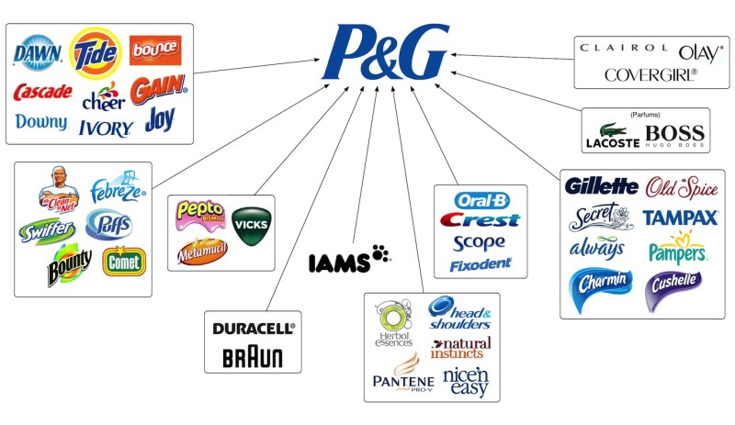
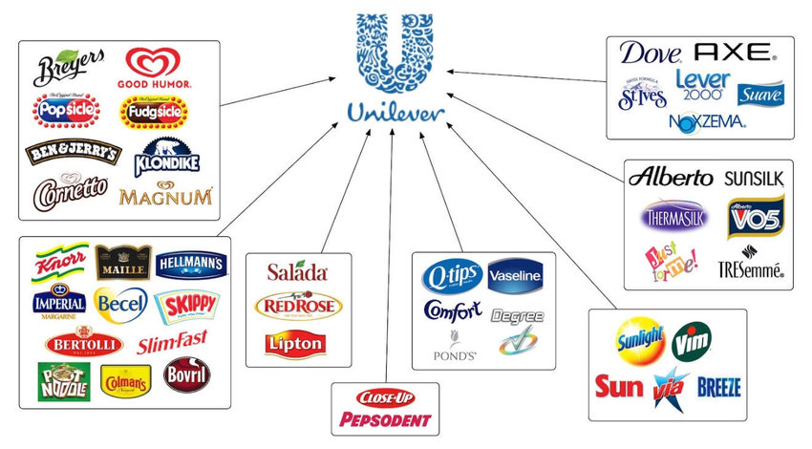
Product Mix decisions
The set of all product lines and items that a particular seller offers for sale.

Slide 37
Product mix decisions
A company’s product mix has four important dimensions: width, length, depth, and consistency.
Product mix dimensions | Definition
Product mix width | The number of different product lines the company carries.
Product mix length | The total number of items a company carries within its product lines.
Product mix depth | The number of versions offered for each product in the line.
Product mix Consistency | How closely related the various product lines are in end use, production requirements, distribution channels, or some other aspect.

Slide 38

Product Mix Example
Width = 7 Lines of products
Length= The ice cream line, for example, has 8 different brands.
Depth= The Breyers line has various flavours
Consistency= Home & Personal care + Food

Slide 39
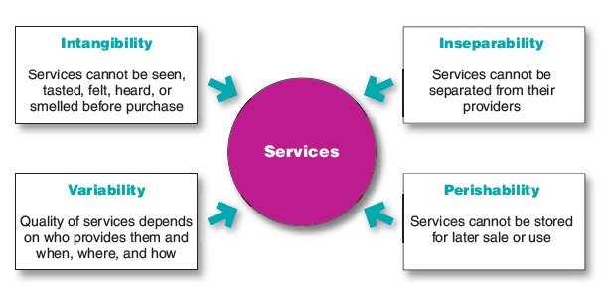
Nature and Characteristics of Services
A company must consider four special service characteristics when designing marketing programs: intangibility, inseparability, variability, and perishability

Slide 40

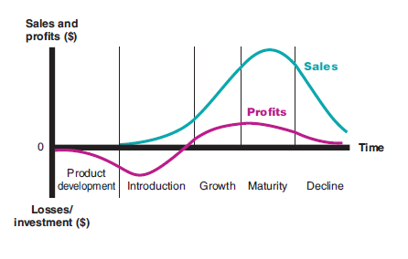
Product Life Cycle Definition
All products have a particular life span, which is called the product life cycle. The length of time a product is on the market is largely contingent upon its competition, technology and even the savvy of a company's marketing department. One of the best ways of extending a product's life cycle is to continuously garner feedback from consumers, finding out what they need and want from a particular product.
Product life cycle (Plc): The course of a product’s sales and profits over its lifetime.

Slide 41
THE PRODUCT LIFE CYCLE
The PLC has five distinct stages:
Product development: begins when the company finds and develops a new product idea. During product development, sales are zero, and the company’s investment costs mount.
Introduction: is a period of slow sales growth as the product is introduced in the market. Profits are nonexistent in this stage because of the heavy expenses of product introduction.
Growth: is a period of rapid market acceptance and increasing profits.
Maturity : is a period of slowdown in sales growth because the product has achieved acceptance by most potential buyers. Profits level off or decline because of increased marketing outlays to defend the product against competition.
Decline: is the period when sales fall off and profits drop.

Slide 42
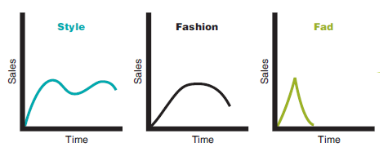
THE PRODUCT LIFE CYCLE
Not all products follow all five stages of the PLC. Some products are introduced and die quickly; others stay in the mature stage for a long, long time. Some enter the decline stage and are then cycled back into the growth stage through strong promotion or repositioning.

Slide 43
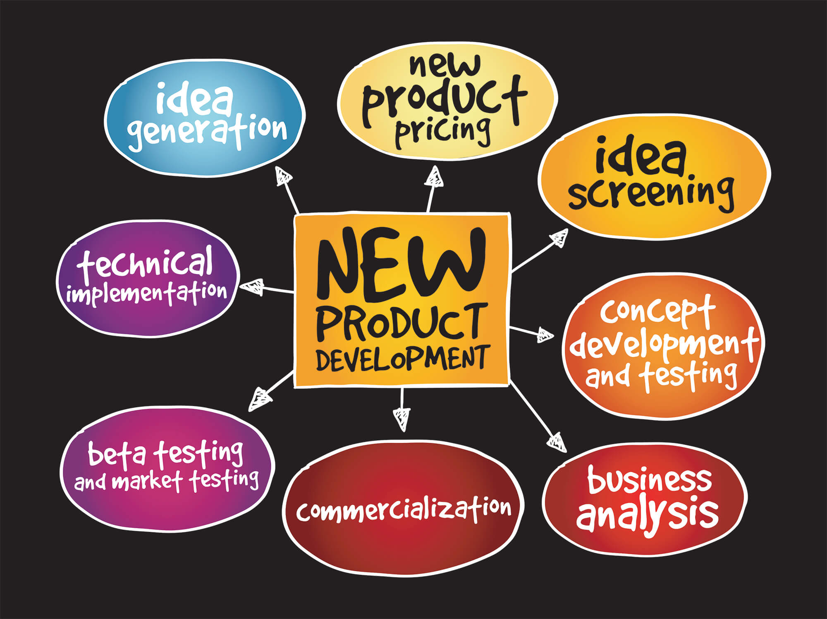
THE PRODUCT LIFE CYCLE
The Development Stage:
Initial Ideas – possibly large number
May come from any of the following –
  Market research – identifies gaps in the market
  Monitoring competitors
  Planned research and development (R&D)
  Luck or intuition
  Creative thinking – inventions, feeling
  Futures thinking – what will people be
  using/wanting/needing 5,10,20 years hence?

Slide 44

THE PRODUCT LIFE CYCLE
Introduction Stage:
It’s the PLC stage in which a new product is first distributed and made available for purchase.
Profits are negative or low because of the low sales and high distribution and promotion expenses.
This stage requires an increase in advertising and personal selling efforts and marketing efforts should be directed towards creating brand awareness, positioning the products in the consumers' minds and demonstrate its benefits and superiority.
Marketers should follow up and make any necessary modification as defects may appear as a result of the actual consumption of the products.

Slide 45

THE PRODUCT LIFE CYCLE
Growth Stage:
It’s the PLC stage in which a product’s sales start climbing quickly.
The product captures larger segments of the market
Sales increase significantly at this stage.
Attracted by the opportunities for profit, new competitors will enter the market.
Company improves product quality and adds new product features and models. It enters new market segments and new distribution channels.
Companies keep their promotion spending at the same or a slightly higher level. It shifts some advertising from building product awareness to building product conviction and purchase,
It keeps prices at the same level or lowers prices at the right time to attract more buyers.

Slide 46
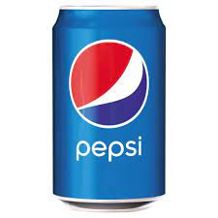
THE PRODUCT LIFE CYCLE
Maturity Stage:
It’s the PLC stage in which a product’s sales growth slows or levels off.
This maturity stage normally lasts longer than the previous stages, and it poses strong challenges to marketing management.
Competitors begin marking down prices, increasing their advertising and sales promotions, and upping their product development budgets to find better versions of the product. These steps lead to a drop in profit.
In modifying the market,
  the company tries to increase consumption by finding new users and new market segments for its brands.
  The company may also look for ways to increase usage among present customers

Slide 47
THE PRODUCT LIFE CYCLE
The company might also try modifying the product
  changing characteristics such as quality, features, style, packaging, or technology platforms to retain current users or attract new ones.
The company can try modifying the marketing mix—improving sales
  Changing one or more marketing mix elements. The company can offer new or improved services to buyers.
  It can cut prices to attract new users and competitors’ customers.
  It can launch a better advertising campaign or use aggressive sales promotions—trade deals, cents-off, premiums, and contests.
  The company can also move into new marketing channels to help serve new users.

Slide 48
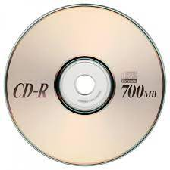
THE PRODUCT LIFE CYCLE
Decline Stage:
The PLC stage in which a product’s sales fade away. Sales may plunge to zero, or they may drop to a low level where they continue for many years.
Sales decline for many reasons, including technological advances, shifts in consumer tastes, and increased competition.
Some firms withdraw from the market. Those remaining may prune their product offerings. In addition, they may drop smaller market segments and marginal trade channels, or they may cut the promotion budget and reduce their prices further.

Slide 49
THE PRODUCT LIFE CYCLE
Companies must identify products in the decline stage and decide whether to maintain, harvest, or drop them.
Management may decide to maintain its brand, repositioning or reinvigorating it in hopes of moving it back into the growth stage of the product life cycle
Management may decide to harvest the product, which means reducing various costs (plant and equipment, maintenance, R&D, advertising, sales force), hoping that sales hold up. If successful, harvesting will increase the company’s profits in the short run.
Management may decide to drop the product from its line. The company can sell the product to another firm or simply liquidate it at salvage value.

Slide 50
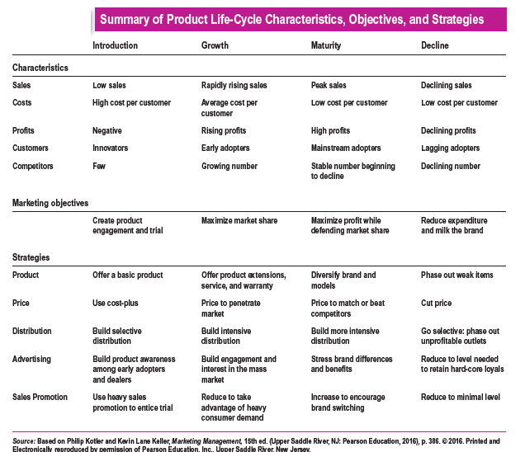

Slide 51


Slide 52



Thank You

